Slide 1
Department Scheduling App
Sprint 2
Jared Burns, David Dillard, Brandon Nguyen, Peter Shim

Slide 2
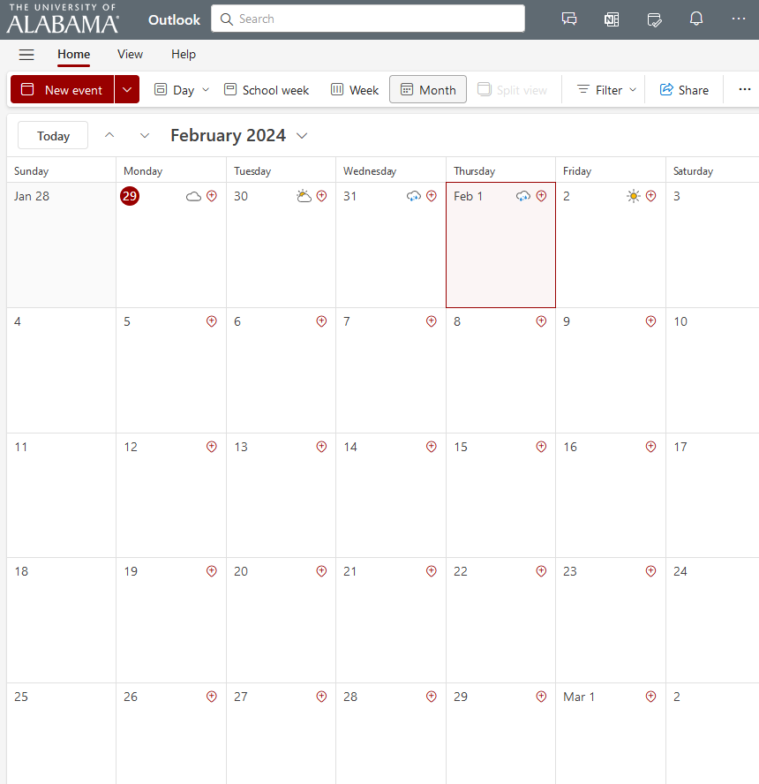
General Motivation
Organize visits to the CS department and maintain them
Simplify the process of arranging meetings between faculties and high school students
Designed for the use of the CS department
Notes:
The purpose of this app is to facilitate the organization of visits within the CS department. It ensures the coordination of these visits to be manageable.
The app is used for the of CS department faculty members who would handle these visits.

Slide 3

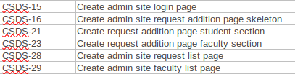
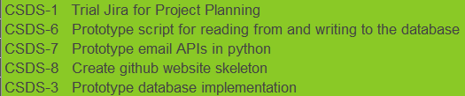
Sprint Goals
Sprint 2
Sprint 1

Slide 4

Major Sprint Achievements
Built the frontend for the:
Login Page
Request Creation Page
Faculty Page
Request List Page
Implemented the backend for the:
Login Page

Slide 5

What was not completed and Lessons Learned
Learn how to work on the frontside of the application learning React, HTML framework, and CSS styling
Not enough time put into the backend like the display of the database
Next sprint goal is to solely work on the backend of the application while touching up some of the frontend

Slide 6
Deliverable

