Slide 1
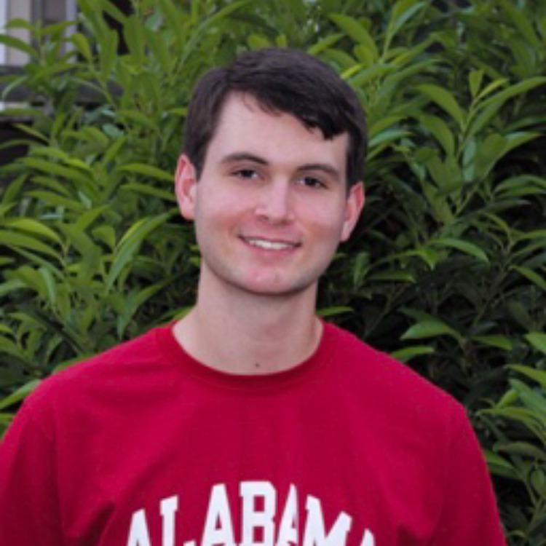
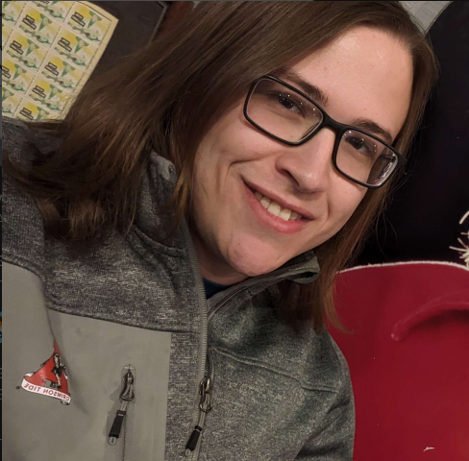
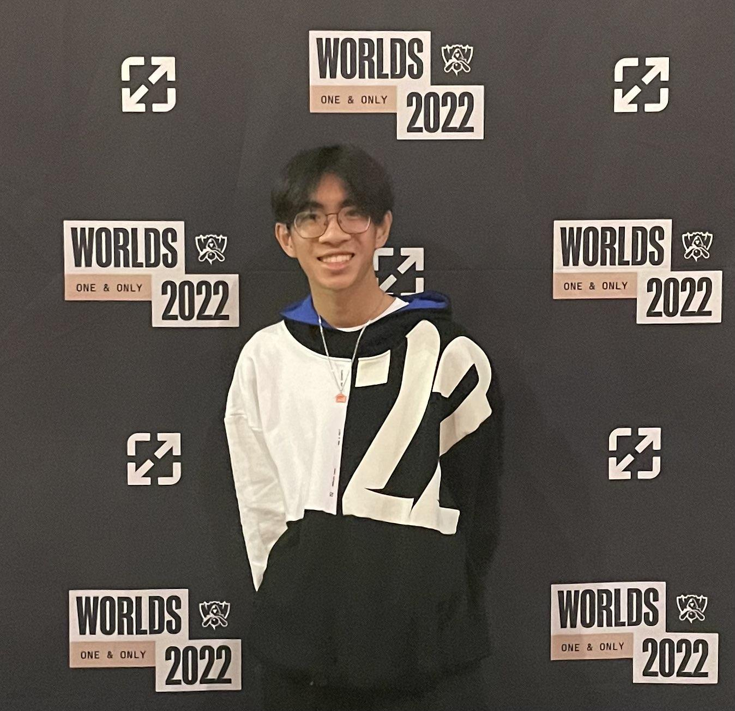
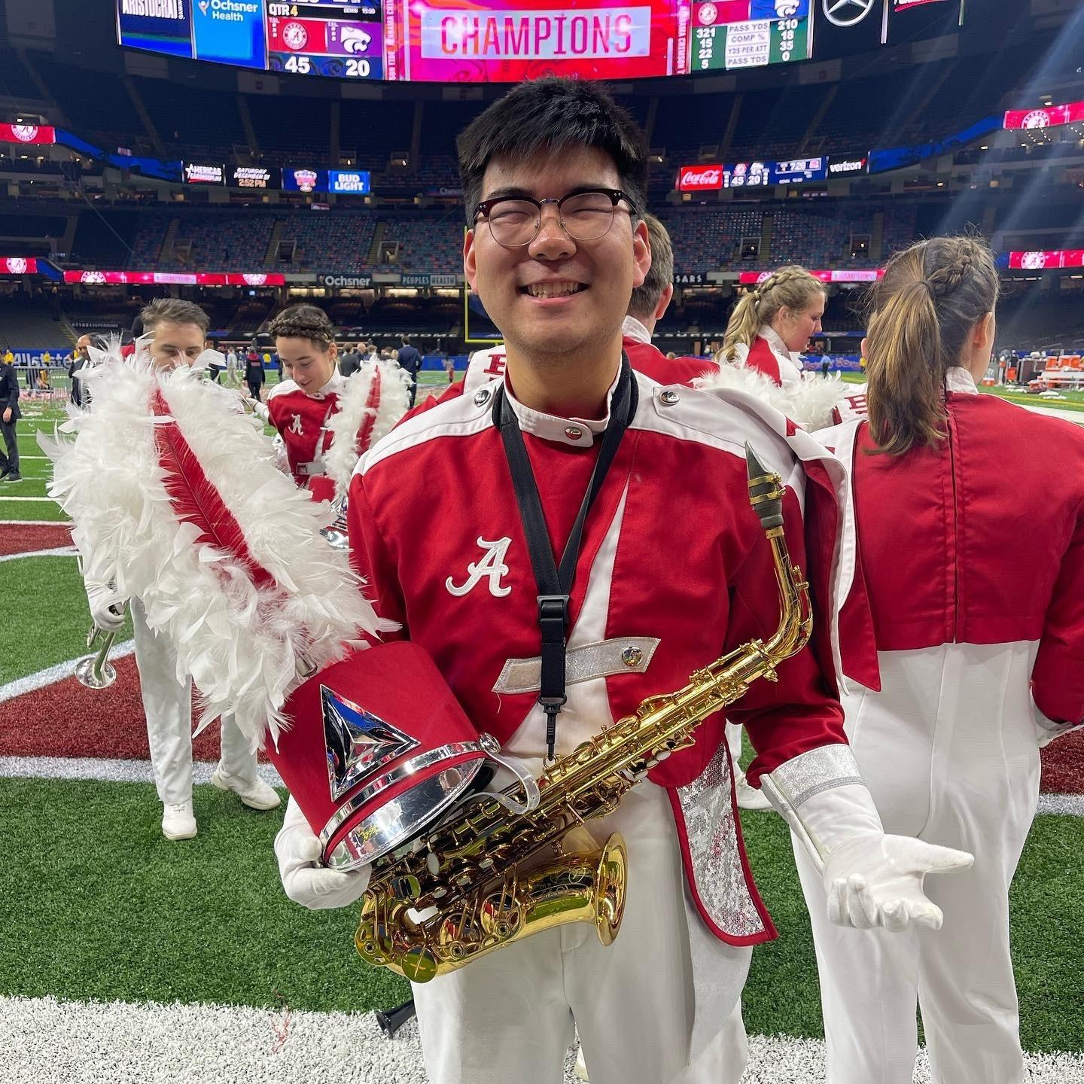
Department Scheduling App
Sprint 3
Jared Burns David Dillard Brandon Nguyen Peter Shim
Github link: https://github.com/FakeShim/CS_Sked

Slide 2
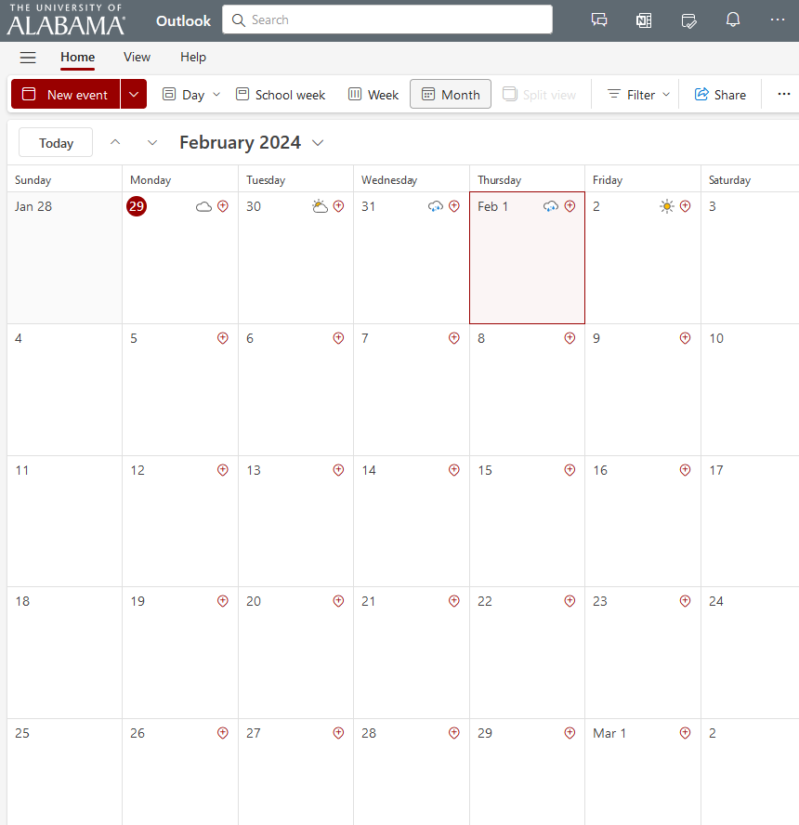
Project Focus
Organize visits to the CS department and maintain them
Simplify the process of arranging meetings between faculty and high school students
Designed for the use of the CS department
Notes:
The purpose of this app is to facilitate the organization of visits within the CS department. It ensures the coordination of these visits to be manageable.
The app is used for the of CS department faculty members who would handle these visits.

Slide 3

High-Level Project Functionality Implemented
Login page with encryption
API development for Sending Emails
CRUD operations for MongoDB Atlas as utilized in API functions

Slide 4
Significant Backlog Items
CSS styling
Reminder Logic
Email cleanup
Template
Fix sending to spam folder
Migrating to preferred email account
Hosting
Currently backend is on Heroku, should be migrated to personal host
Student input overhaul
Tracking total requests completed

Slide 5
Individual Reflections
Jared:
I learned a lot about the need for communication with sponsors.
The hardest part was deciding on the platforms to use because of my limited experience.
I felt my contributions were sufficient.
David: - I had very little experience with networking, javascript, react, or node and as such made poor planning decisions - I learned that I should have kept up with other team members’ progress more closely, as when they needed help it was very on the wire - Regardless, I am happy with my contributions and was happy to learn new skills
Brandon:
I learned a lot about the effort and requirements needed to work on a project like this
The hardest part was making enough time and learning the skills meant for this project
I feel like I should have contributed more. There were times that I felt that I didn’t put in enough effort into my part of the project that caused us to get behind.
Peter:
- I learned a lot about planning and about communicating on a consistent basis.
-The hardest part of the project was the need to learn new tools and languages that I had no prior knowledge to.
-My contribution definitely could have been better as I missed many days, but I still think I made valuable contributions to the team

Slide 6
Live Demo

