Slide 1
Department Scheduling App
Sprint 1
Jared Burns, David Dillard, Brandon Nguyen, Peter Shim

Slide 2
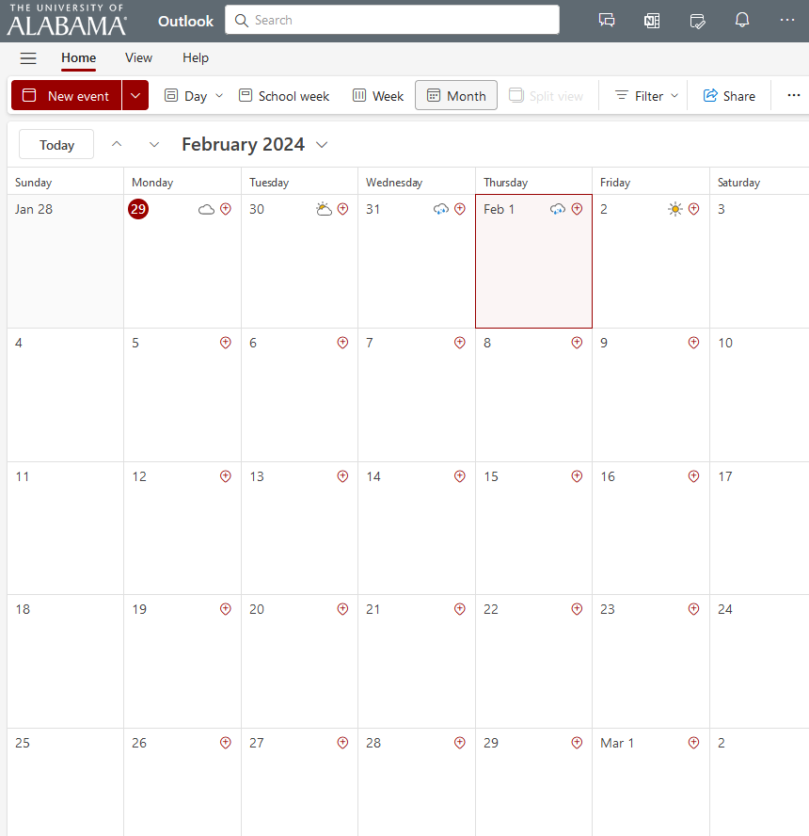
General Motivation
Organize visits to the CS department and maintain them
Simplify the process of arranging meetings between faculties and high school students
Designed for the use of the CS department
Notes:
The purpose of this app is to facilitate the organization of visits within the CS department. It ensures the coordination of these visits to be manageable.
The app is used for the of CS department faculty members who would handle these visits.

Slide 3



Sprint Goals
Setting up a website
Reading from Outlook Emails through a Python Script
Create a Database in MongoDB
Ability to write/update into the database
Combine scripts to read and write email body to the database

Slide 4

Major Sprint Achievements
Set up the website
Read in outlook emails through a python script
Created a database in MongoDB atlas
Created a python script to write/update to the database

Slide 5
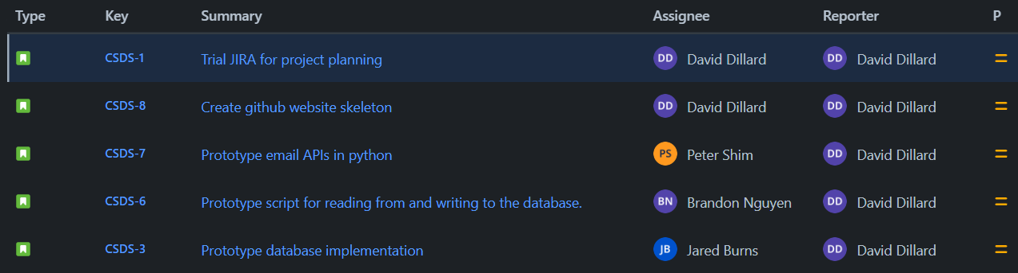
Sprint backlog

Slide 6
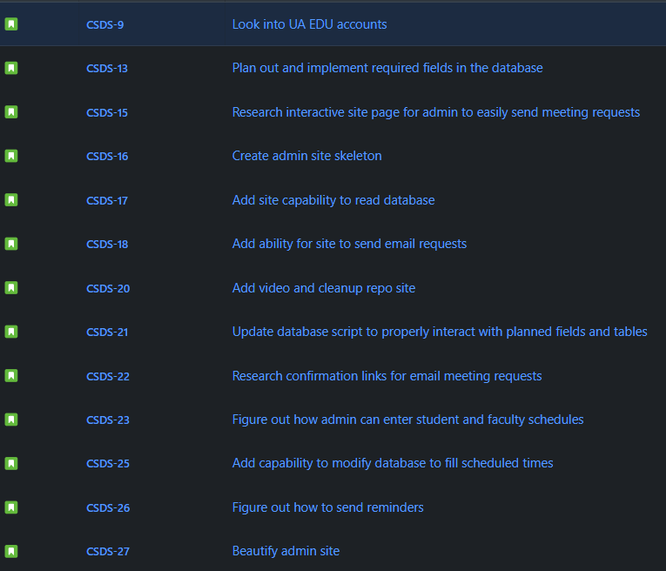
Project backlog
Not set in stone
Pivoted mid-sprint

Slide 7
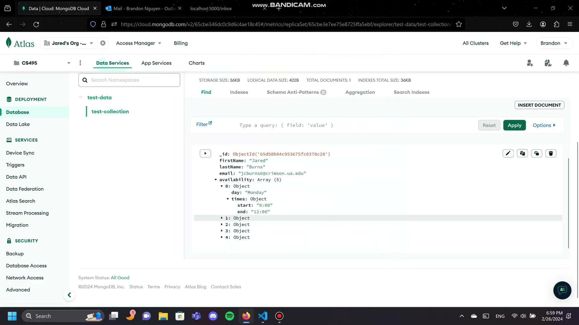
Deliverable

Slide 8

What was not completed and Lessons Learned
We were able to read from the emails and were able to input to the database using python but were unable to use values received from the email
Meet in a more structured format every week
Communicate with our sponsor in a more productive manner

