Slide 1
Vanishing point detection result summary

Slide 2
Other projects
Sebastian Zanlongo - https://github.com/SZanlongo/vanishing-point-detection
Xiaohu Lu - https://github.com/rayryeng/XiaohuLuVPDetection
Symen Yang - https://github.com/SymenYang/Vanish-Point-Detection

Slide 3
Sebastian Zanlongo
First the algorithm uses Canny edge detection to extract the edges of the image
Hough transformation for line extraction
RANSAC method to find intersections
Split image into cells, cell with most intersections is determined to contain vanishing point

Slide 4
Xiaohu Lu
LSD to extract lines
Custom built RANSAC grouping
2-line method to estimate vanishing points

Slide 5
Symen Yang
Filters to reduce noise
Canny Edge detection
Probabilistic Hough transformation to extract line segments
Line segment grouping
Hierarchical Clustering
Vanishing point extraction from clusters

Slide 6
Datasets
Each of these projects have been run using the York Urban database and the Eurasian Urban cities dataset.
Name | Number of images | Description
Eurasian Cities dataset | 103 | Images are differing in sizes. Each image satisfies the Manhattan assumption. Includes images, line segment end points with associated vanishing points, estimated vanishing point locations and estimated horizon.
York Urban database | 102 (45 indoor + 57 outdoor) | Each image is 640 x 480 in size and satisfies the Manhattan assumption. Includes images, camera calibration settings and ground truth line segments and vanishing points.

Slide 7
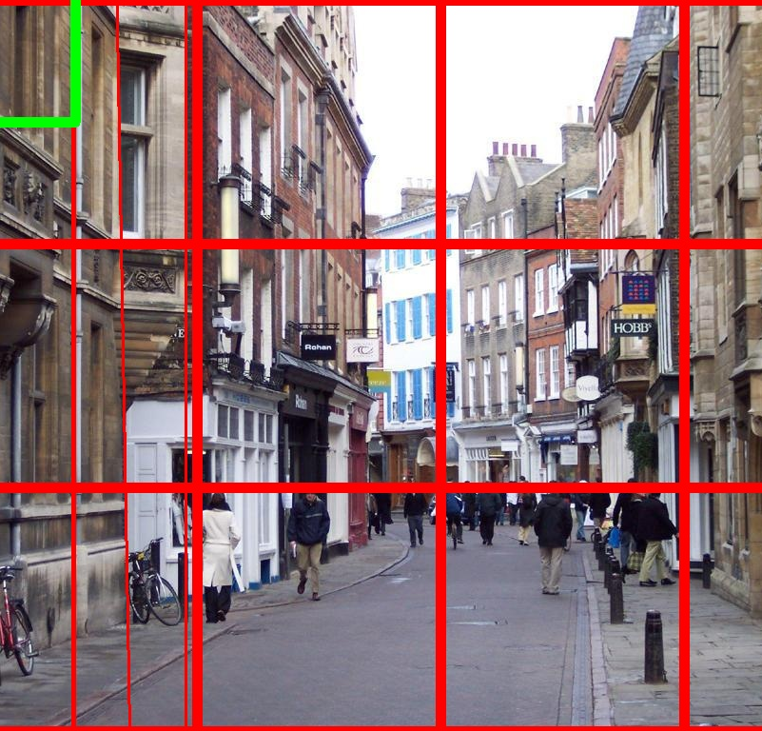
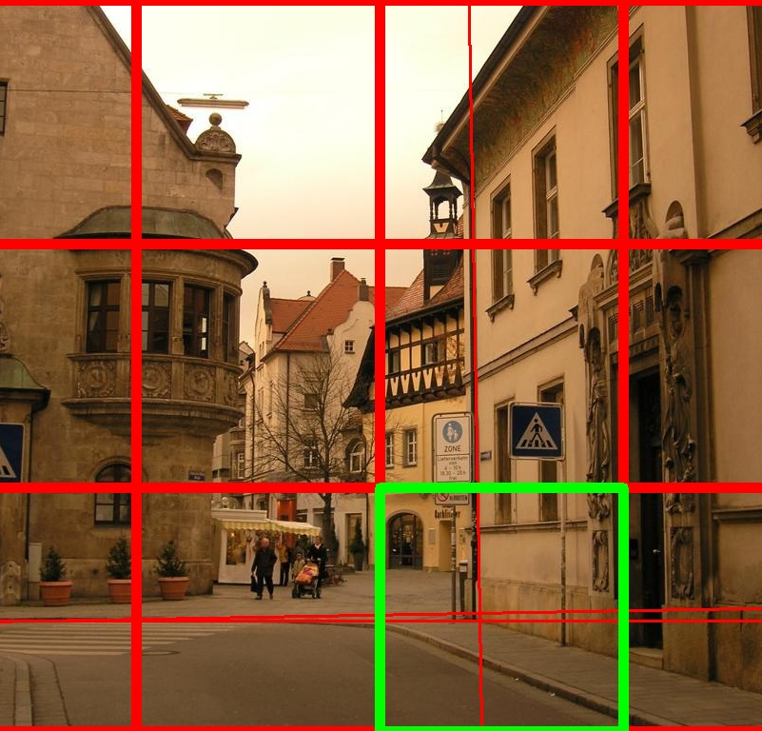
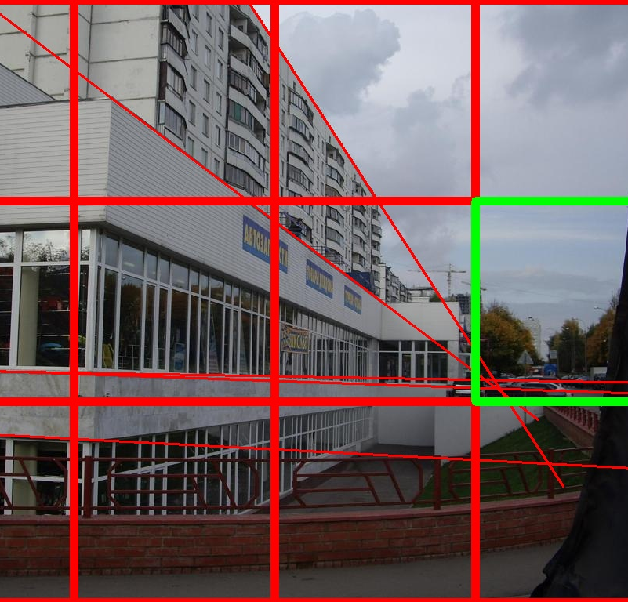
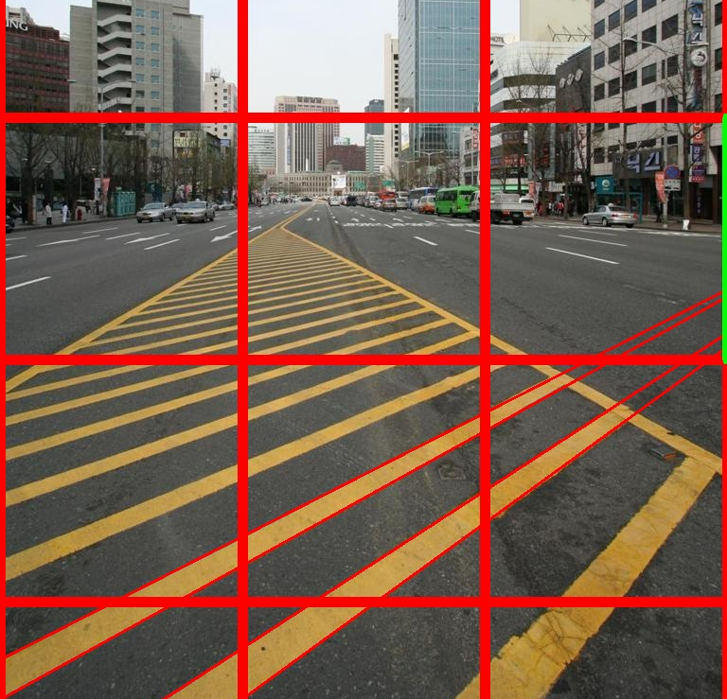
Accuracy
Sebastian Zanlongo’s result set was very poor. The algorithm he used was unable to find line segments in the image and as a result there was not enough data to extract a vanishing point. This issue is persistent across the Eurasian cities data base and the York Urban data base.

Slide 8
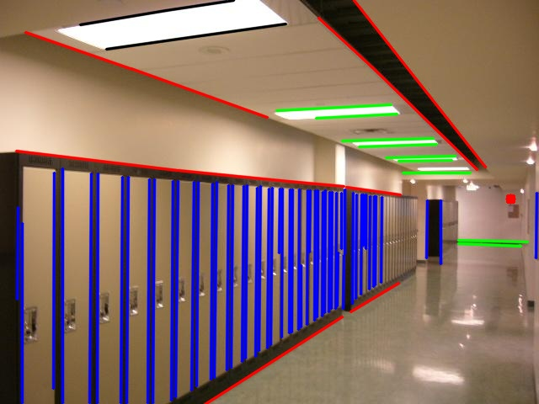
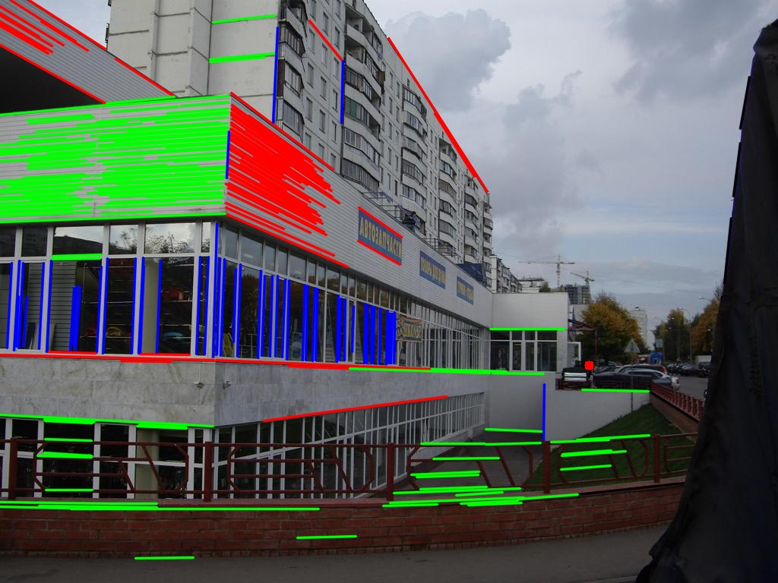
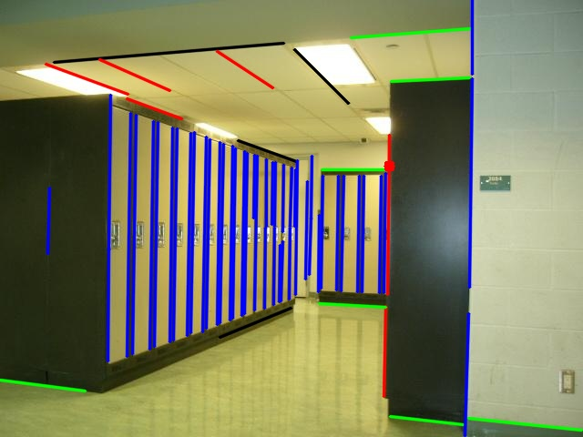
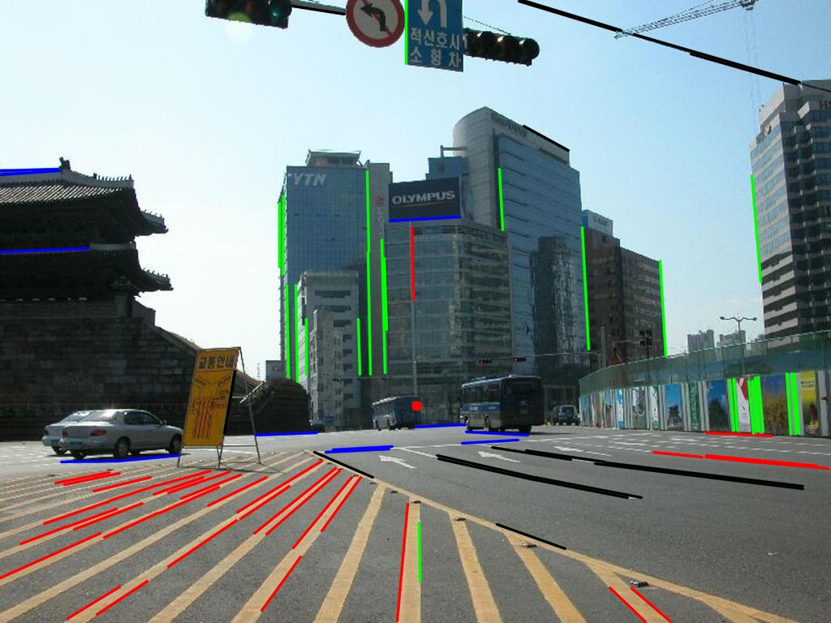
Accuracy
Xiaohu Lu’s results were promising, however his algorithm would sometimes incorrectly cluster lines together. Examples of this can be seen in image 2, 3 and 4, however when the algorithm clustered values together correctly the results are accurate.

Slide 9
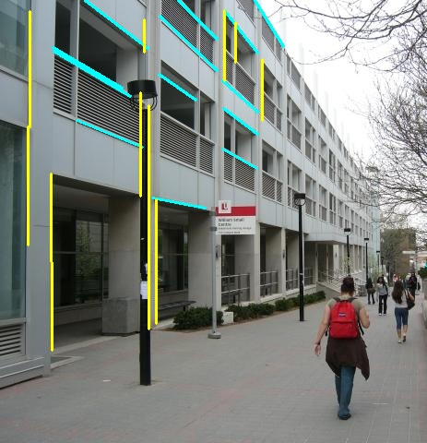
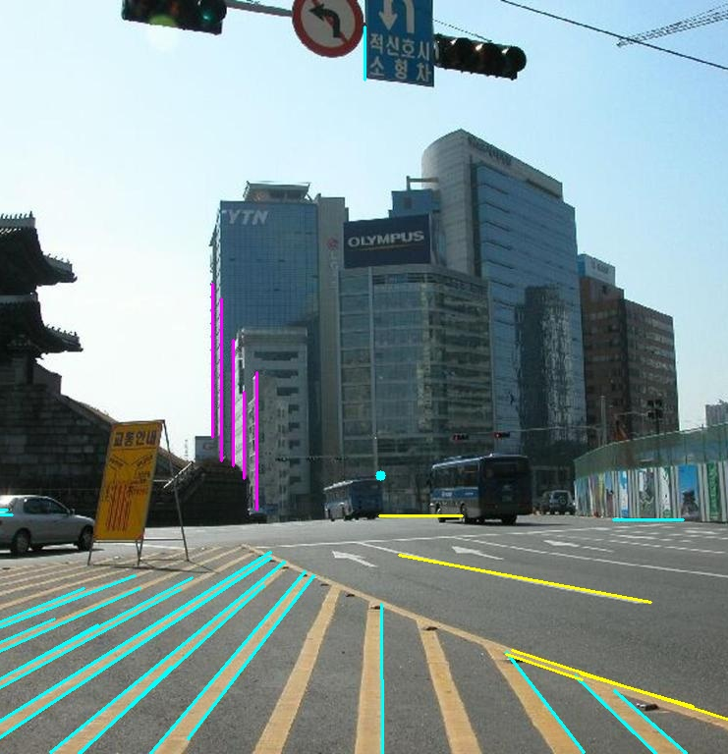
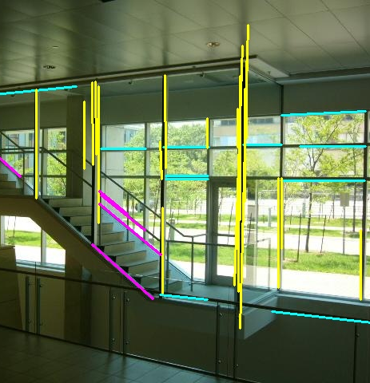
Accuracy
Symen Yang’s results also struggled to cluster lines together, but when they were clustered correctly it resulted in relatively accurate and quick results.

Slide 10
Sebastian Zanlongo
Sebastian Zanlongo’s results were very poor for multiple reasons.
Canny Edge detection failed to extract edges efficiently
Hough Transformation fails to find line segments from edge maps
Image divided into cells and cell with most intersections determined to contain vanishing point, causing inaccurate results

Slide 11
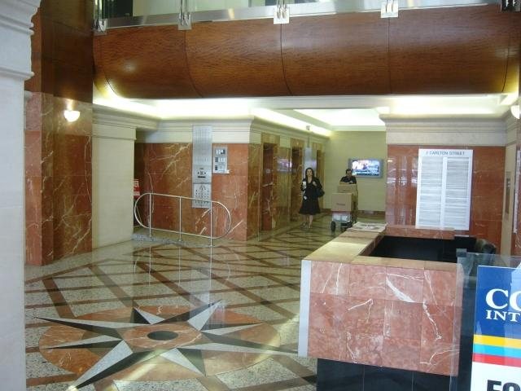
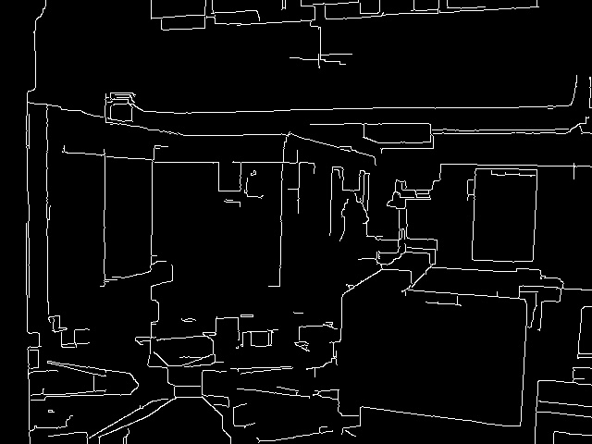
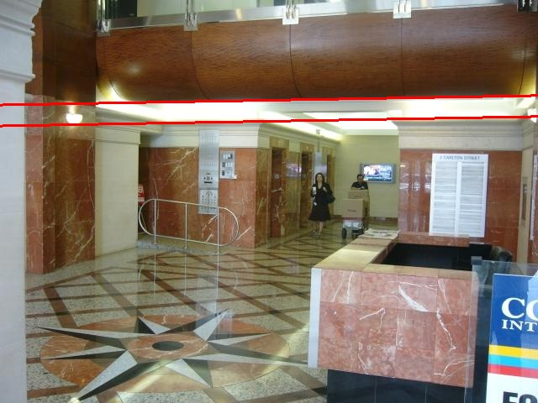
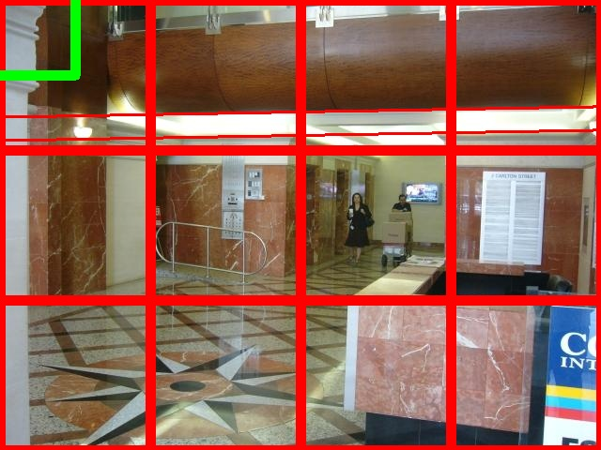
Sebastian Zanlongo
As these results are poor this method will not be discussed further

Slide 12
Xiaohu Lu
Xiaohu Lu’s results are very promising, although it has issues.
Line segment extraction was very effective
Line grouping had issues, but when the lines were grouped correctly the results are accurate

Slide 13
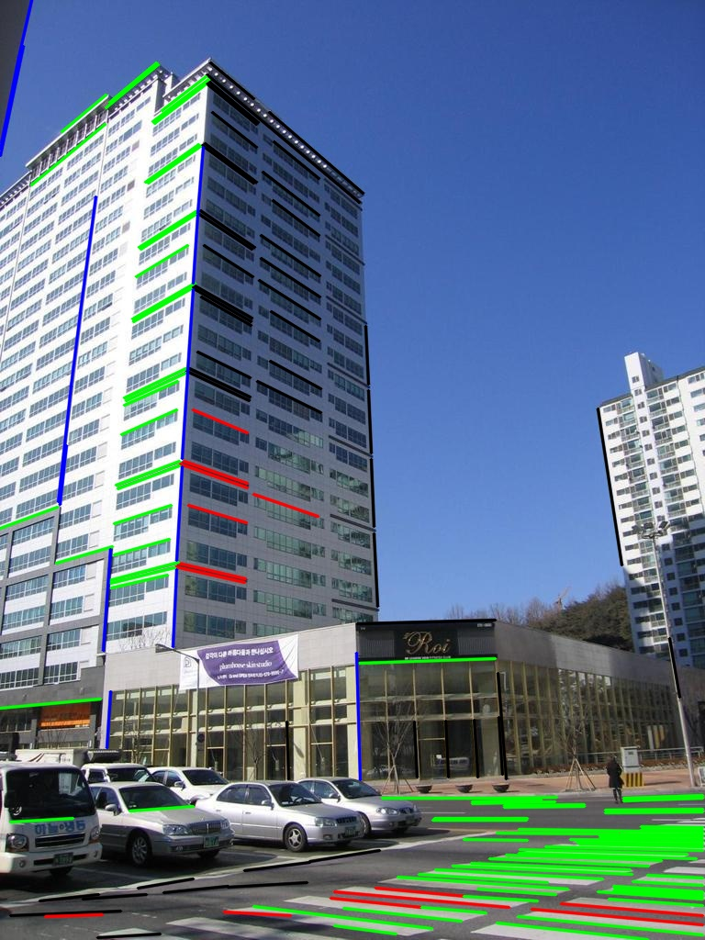
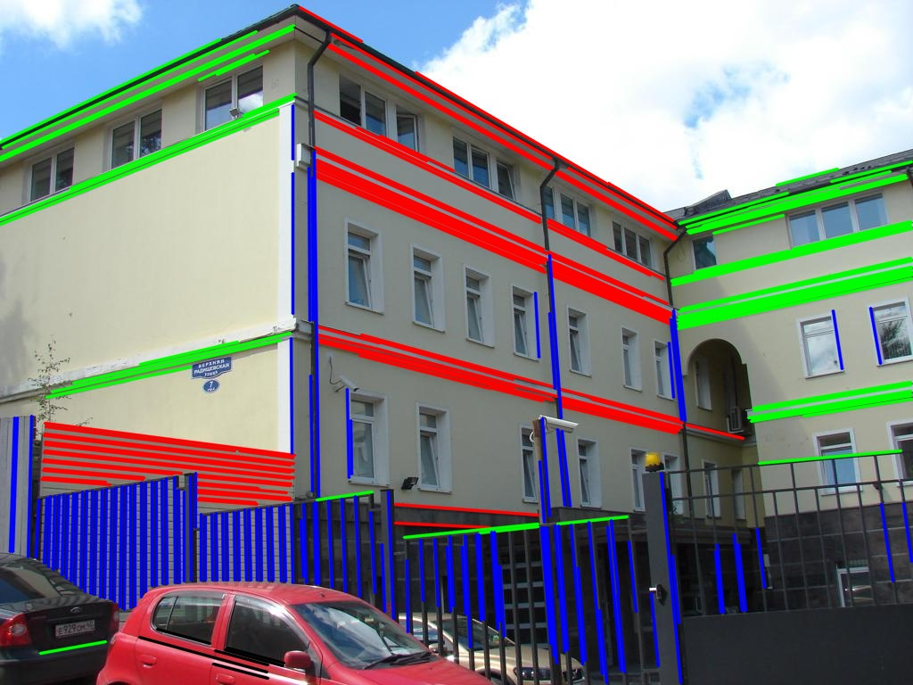
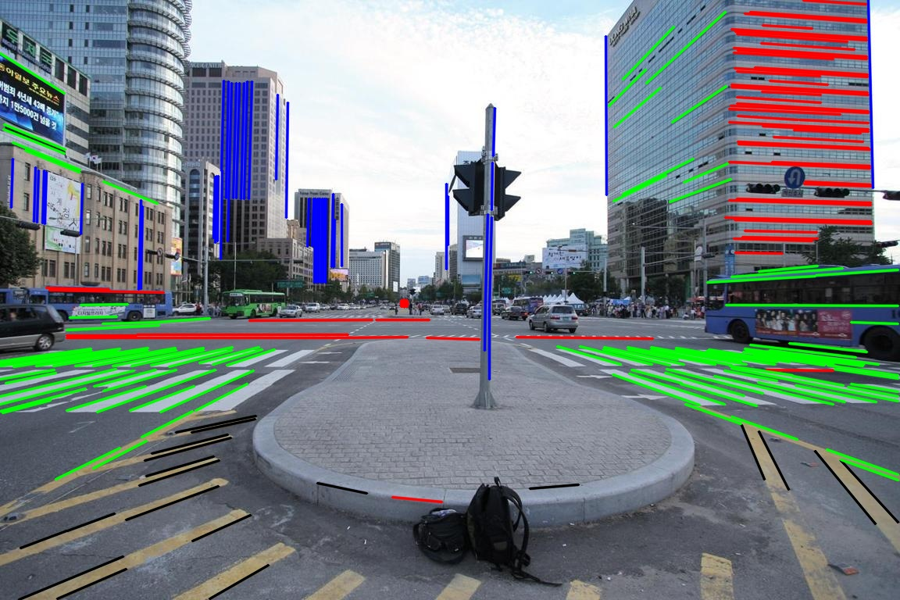
Xiaohu Lu
Image 1 and image 2 have accurately extracted and grouped line segments and predicted vanishing points which seem accurate, image 3 has failed to cluster lines together properly, as a result skewing the vanishing point location.

Slide 14
Symen Yang
Symen Yang’s implementation also has promising results, but they do not appear to be as accurate as Lu’s
Yang’s implementation is not able to detect lines as effectively as Lu’s
Yang’s implementation also appears to struggle to group lines

Slide 15

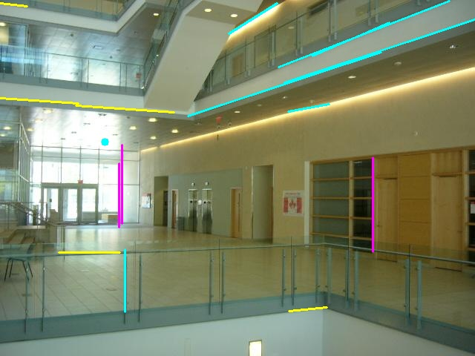
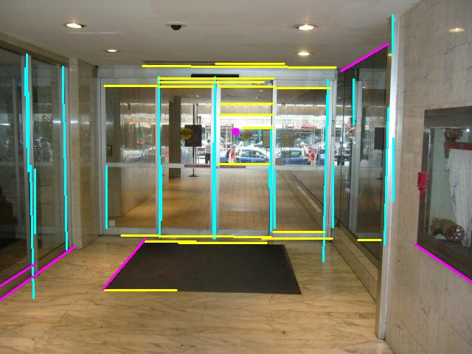
Symen Yang
As we can see in image 1 and image 3 the solutions, when grouping properly, is able to accurately predict the
vanishing points of the images. In image 2 we can see that the vanishing point is accurately predicted by height, but is
skewed by an incorrect line grouping.

Slide 16
Eurasian Cities Quantitative results
File | Actual Vanishing Point | Xiaohu Lu results | Symen Yang results
001 | 518.85, 392.00 | 517.42, 388.67 (Distance 3.62) | 413.64, 377.39 (Distance 106.22)
007 | 605.74, 511.36 | 513.12, 500.49 (Distance 93.26) | 516.58, 484.94 (Distance 92.99)
018 | 1220.90, 508.38 | 1240.00, 510.50 (Distance 19.22) | 1194.61, 480.62 (Distance 38.23)
028 | 1440.73, 648.54 | 1479.48, 667.85 (Distance 43.29) | 1423.83, 630.69 (Distance 24.58)
030 | -248.89, 593.12 | -250.89, 589.23 (Distance 4.37) | -239.32, 601.54 (Distance 12.75)
040 | -225.05, 536.90 | -230.80, 528.39 (Distance 10.27) | -161.98, 500.47 (Distance 72.84)
057 | -343.37, 874.74 | -390.74, 897.03 (Distance 52.35) | -374.56, 901.63 (Distance 41.18)
071 | 1074.85, 414.45 | 1084.67, 424.04 (Distance 13.73) | 1036.24, 389.22 (Distance 46.12)
081 | -230.31, 722.52 | -258.15, 720.65 (Distance 27.90) | -198.81, 699.63 (Distance 38.94)
092 | 967.49, 531.45 | 974.39, 539.04 (Distance 10.26) | 836.87, 434.56 (Distance 162.63)
Mean Average accuracy |  | 27.827 | 63.648
Only the quantitative results of the Eurasian Cities dataset are being analyzed as the York Urban database represents
vanishing points in a world coordinates system.

Slide 17
Live Demo

