Slide 1
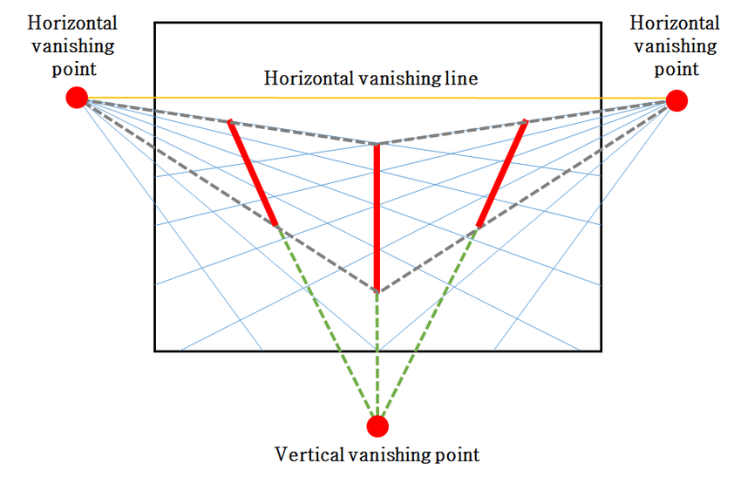
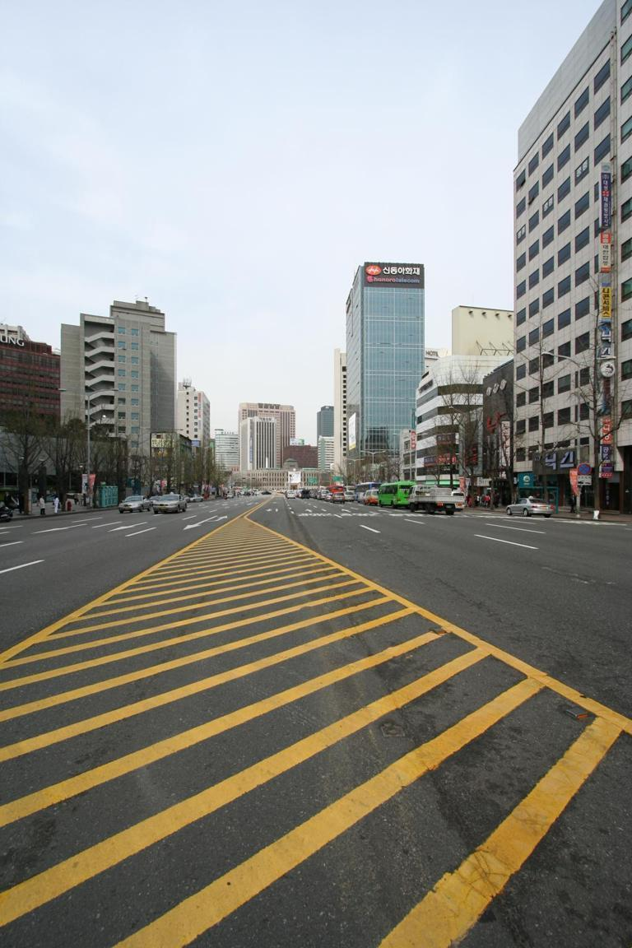
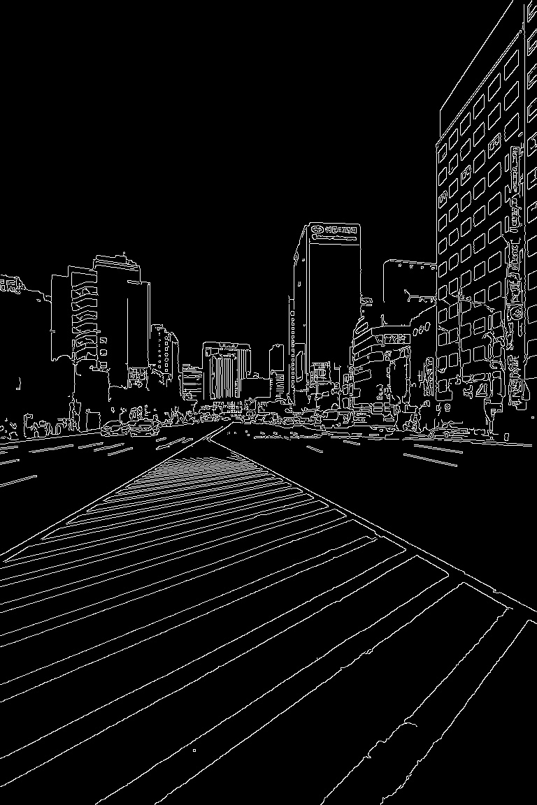
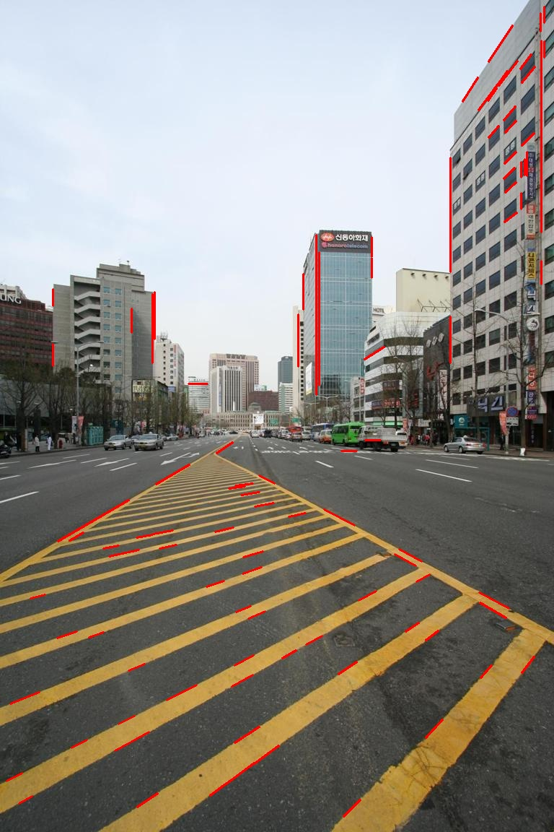
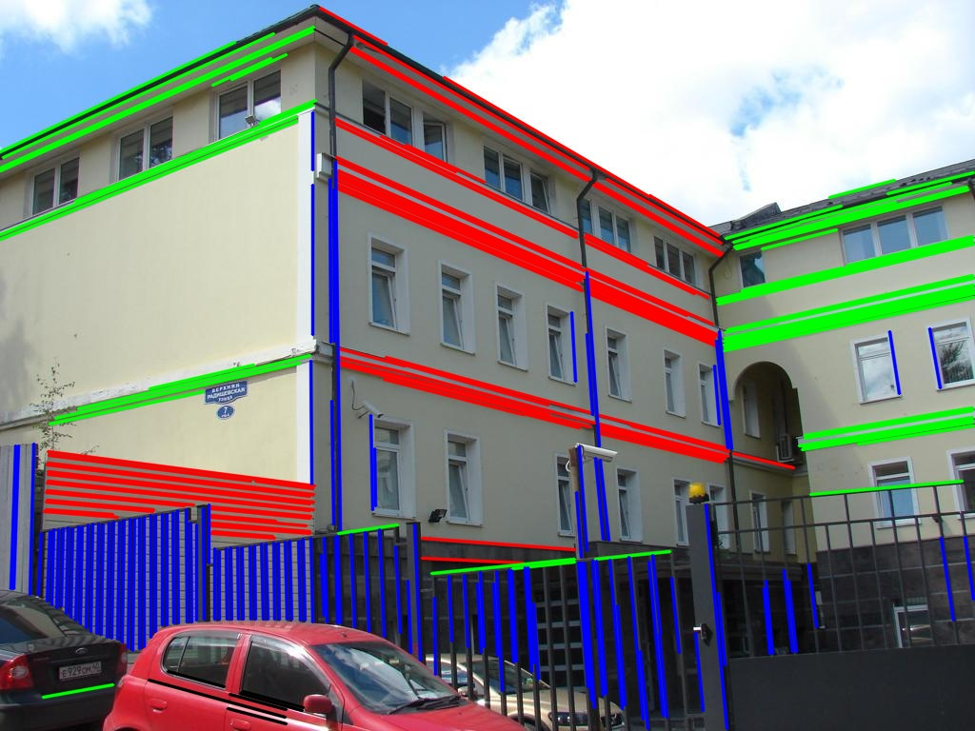
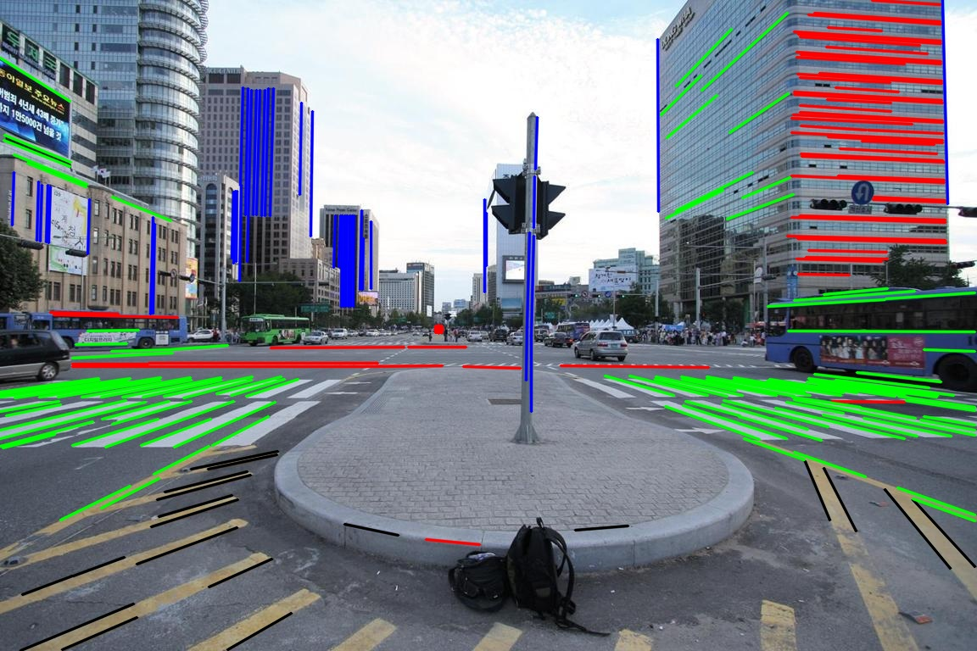
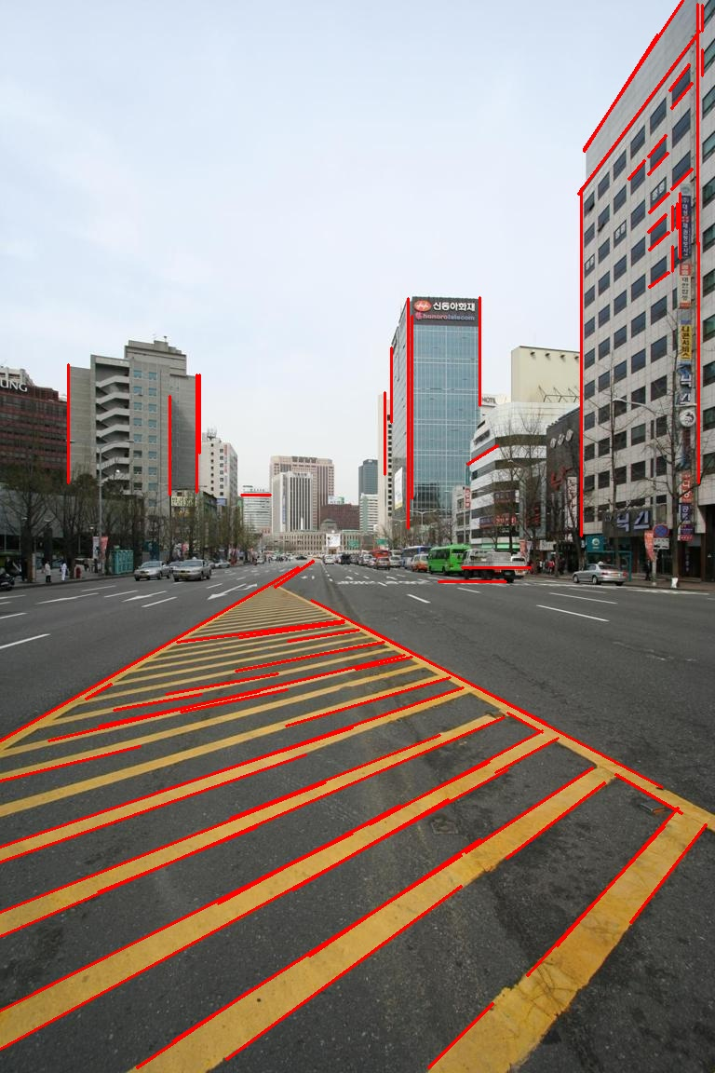
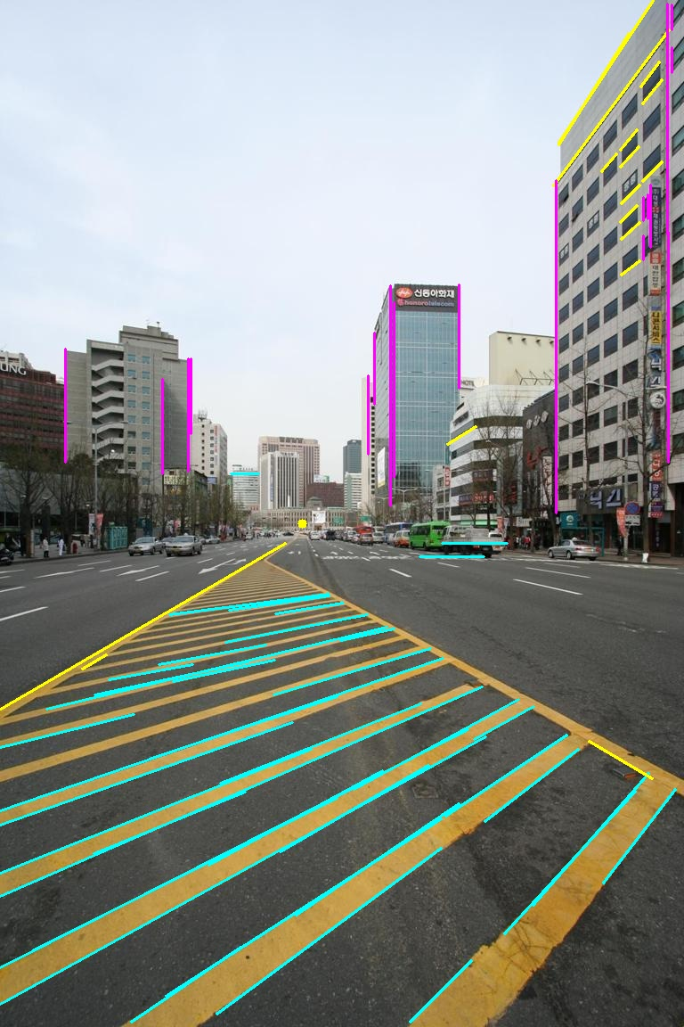
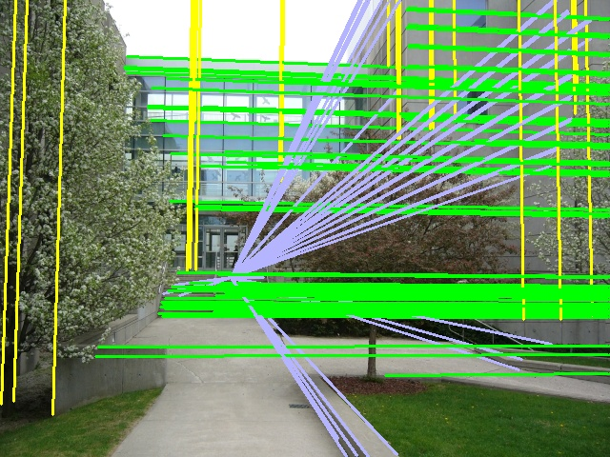

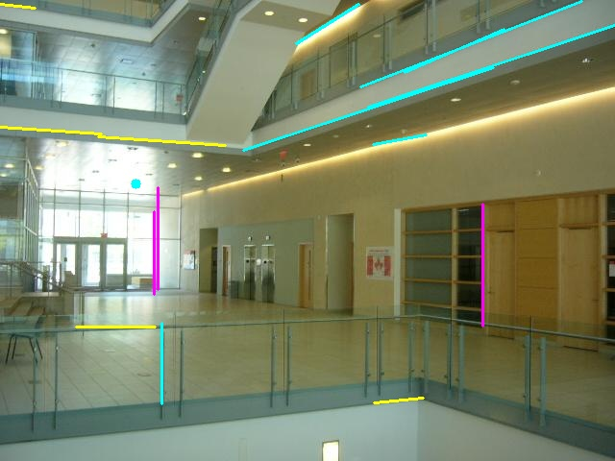

Vanishing Point Detection
Harry Beggs
BSc Hons Applied Computing
Problem definition
Framework
Edge Detection
Xiao Hu Lu: LSD Symen Yang: Canny
Results
There are a few existing projects that also carry out edge based vanishing point detection. Two of these projects by Xiao Hu Lu and Symen Yang have returned very accurate results.
Symen Yang examples
Xiao Hu Lu examples
Horizontal Vanishing Point
Horizontal Vanishing Point
Edge Detection
Datasets | Methods | Error (avg) | Time (avg)
Eurasian (103) | Xiao | 27.827 | 0.356
 | Symen | 63.648 | 0.531
Toulouse (114) | Xiao | 95.849 | 1.748
 | Symen | 238.359 | 1.917
Vertical Vanishing Point
Vanishing point calculation through extraction of straight lines in an image.
Vanishing points in an image is where all the straight lines converge, creating the illusion of perspective.
As real world coordinate systems contain 3 dimensions our VP detection will detect three vanishing points, this is called the Manhattan Assumption.
Line Grouping
Line Extraction
Line Clustering and VP Estimation
Detected Vanishing Point
stir.ac.uk
For further information contact: Harry Beggs
hab00079@students.stir.ac.uk

