Slide 1

Diabetes Prediction Model using Machine Learning
This presentation outlines the development of a machine learning model for predicting diabetes risk. The model is trained on a dataset containing a variety of factors related to diabetes. The model can be used to identify individuals at risk and enable early intervention and management.
Muhammad Fakhar ul Islam

Slide 2
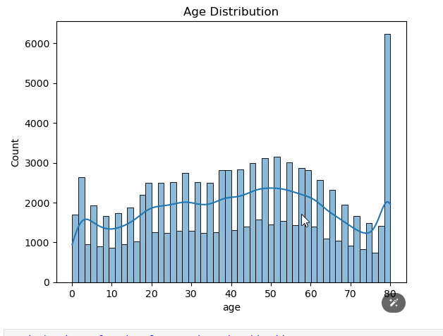
Introduction
1
Objective
The objective is to develop a robust and accurate machine learning model capable of predicting diabetes risk based on a set of relevant features.
2
Purpose
The purpose of this model is to facilitate early diabetes detection and enable timely intervention, improving health outcomes and potentially reducing complications.
Notes:
Objective: Create a model to predict diabetes risk
.Purpose: Help detect diabetes early and improve health.

Slide 3
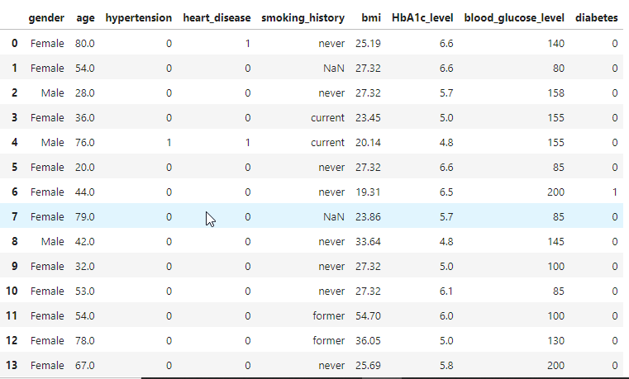
Dataset
The dataset contains the following features:
Gender
Age
Hypertension
Heart Disease
Smoking History
BMI
HbA1c Level
Blood Glucose Level
The target variable is Diabetes.
Source of the Dataset: Kaggle

Slide 4
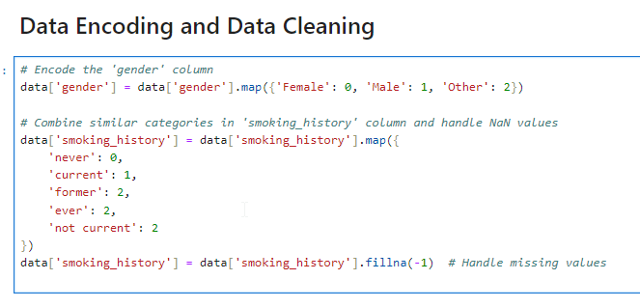
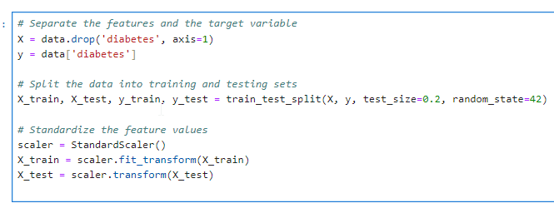
Data Preprocessing
1
Missing Values
In this dataset there is only missing values in the column smoking_history. They are denoted by -1 to signify their absence. This approach ensures that all data points are accounted for, albeit with a designated placeholder value.
2
Encoding
Categorical features, such as Gender and Smoking History, are encoded into numerical values. One-hot encoding or label encoding is commonly used. This allows the machine learning model to understand and process these features.
3
Normalization
The features are normalized using StandardScaler to ensure all features are on a similar scale. This can improve model performance and reduce bias towards features with larger values.
Notes:
In your diabetes prediction model, normalization ensures that features like age, BMI, and glucose levels, which may have different scales and units, are transformed to a standard scale. This standardization helps your chosen machine learning algorithms perform optimally, leading to more accurate predictions and robust model performance.

Slide 5
Model Selection and Training
Logistic Regression
Random Forest
Support Vector Machine
Logistic Regression is a linear model that predicts the probability of a binary outcome (diabetes or no diabetes) based on the input features. It is a simple and interpretable model suitable for understanding the relationship between features and the outcome.
Random Forest is an ensemble learning method that combines multiple decision trees to make predictions. It is known for its robustness and ability to handle high-dimensional data, making it suitable for complex diabetes prediction.
Support Vector Machine (SVM) is a powerful model that finds the optimal hyperplane to separate data points into different classes. It is known for its accuracy and ability to handle non-linear relationships between features and the outcome.

Slide 6
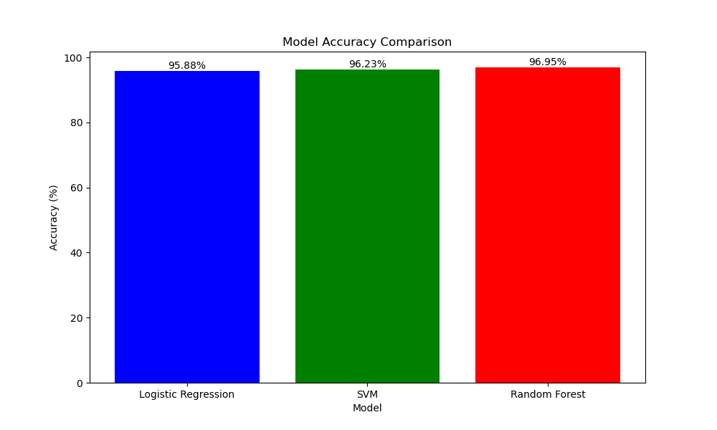
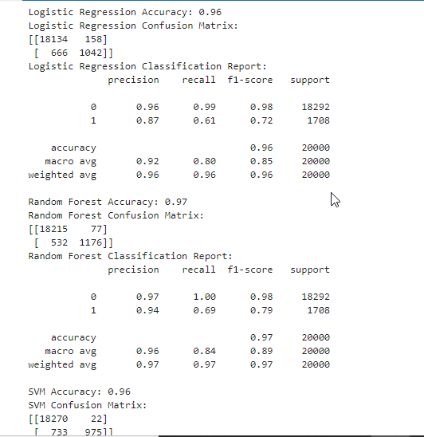
Model Evaluation
Model
Accuracy
Logistic Regression
96%
Random Forest
97%
SVM
96%

Slide 7
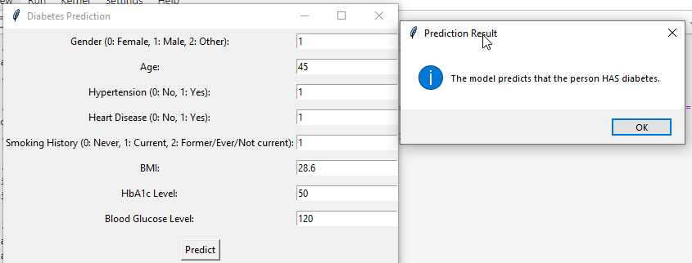



GUI for Prediction
User Input
Model Prediction
Results Display
The user interface allows users to input their relevant information, such as age, gender, blood pressure, and other health parameters.
The model utilizes the user-provided data to predict the probability of diabetes risk, offering personalized insights.
The results are displayed to the user in a clear and understandable manner, highlighting their risk level and providing information on potential next steps.

Slide 8


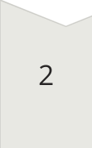
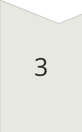
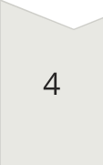
Contribution to Society
Early Detection
Early detection enables timely intervention and management, potentially preventing complications and improving overall health outcomes.
Healthcare Outcomes
Personalized treatment plans can be developed based on individual risk factors, leading to more effective care and better health outcomes.
Cost Savings
Early intervention can help prevent costly hospitalizations and complications, leading to overall cost savings for healthcare systems.
Empowerment
This model empowers individuals to take proactive steps to manage their health and potentially reduce their risk of developing diabetes.

