Slide 1
Real-time Segmentation and Recognition of On-line Handwritten Arabic Script
By George KouR
Under the supervision of
Prof. Dana Ron
Dr. Raid Saabne
Masters Thesis Defense
12 November, 2014

Slide 2
Outline
Conventional approaches usually wait until the entire curve is traced out before starting the analysis, inevitably causing delays in the recognition process.
However, Delaying the analysis launch until the completion of the handwritten word scribing:
Restricts highly responsiveness demands.
Prevents implementing advanced features of input typing, such as Automatic word completion & Real-time automatic spelling.
We propose a real-time recognition-based segmentation technique of on-line Arabic script. It demonstrates the feasibility of carrying out the most time consuming tasks, required for the segmentation process, during the course of writing.
The real-time segmentation and classification information can be used to significantly reduce the potential dictionary size and accelerate a later holistic recognition process.

Slide 3
Agenda
The Arabic Language
Handwriting Recognition
Recent work
Fast script classification
Real-time segmentation
Future work

Slide 4
The Arabic Language - Facts
The Arabic script is a descendant of its Aramaic ancestor.
The earliest document known dates from 512 AD.
It is spoken by 350 million people around the world.
All Muslims, around 25% of the world population can read Arabic script as it is the language of the Holy Qur’an.
Although spoken Arabic is different from country to country, written Arabic is a standard system used all over the Arab world.
Arabic HWR research came to the attention of researches very recently compared to Latin and Chinese.
First work on Arabic character recognition published in 1975, while the earliest work in Latin may be traced to the 1940’s.

Slide 5
Characteristics of the Arabic Language
Consists of 28 letters
Written right to left in a cursive manner in both printed and handwritten forms. (examples)
Most letters are written in four shapes depending on position in the word. (examples of the letter 3 and h)
Rasm and I’jam – show letters that have the same I’jam
Get from: “Online Arabic Handwriting Recognition Using Hidden Markov Models”

Slide 6
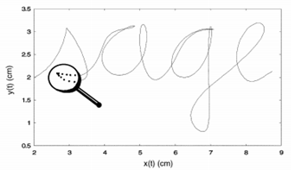
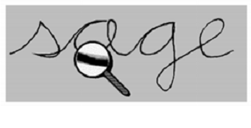
Introduction to the field
Online vs. Offline Handwriting recognition (1)
Open vs. Closed Dictionary
Holistic vs. Analytic Approach
Notes:
Analytic - Involves segmentation and classification of each part of the text.
Holistic - considers the global properties of the written text and recognizes the input word shape as a whole.

Slide 7
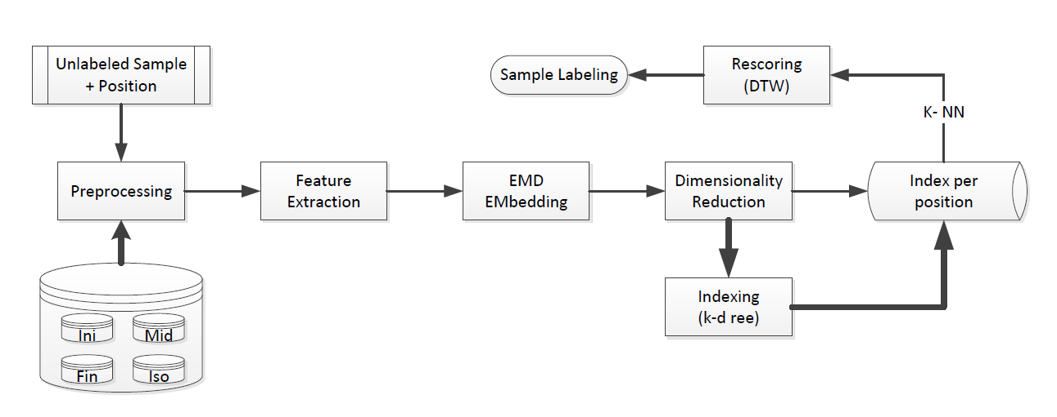
Letters Classification flow

Slide 8
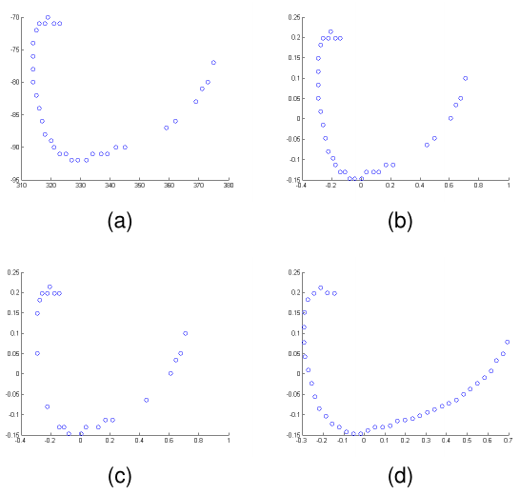
Preprocessing
A sample of the character ب
before preprocessing (a);
after normalization (b);
after noise elimination (c);
after re-sampling (d).
Notes:
Propose:
Avoid the jagged and non-uniform sampling of the digitizer.
Avoid imperfections caused by hand vibration from hesitate wrting
Give uniform structure to the data

Slide 9

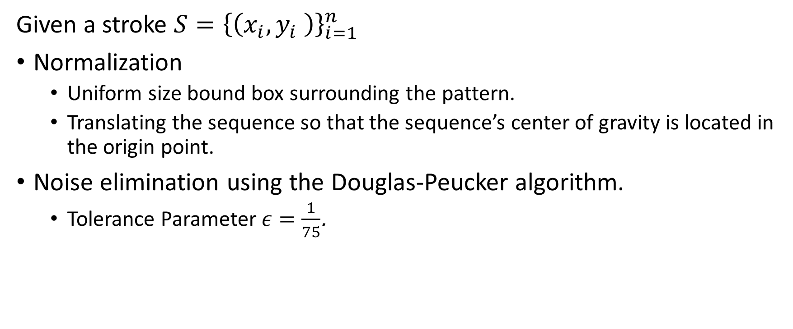
Preprocessing
Given a stroke $S={\left\{\left(x_{i},y_{i} \right)\right\}}_{i=1}^{n}$
Normalization
Uniform size bound box surrounding the pattern.
Translating the sequence so that the sequence’s center of gravity is located in the origin point.
Noise elimination using the Douglas-Peucker algorithm.
Tolerance Parameter $ε=\frac{1}{75}$.
Notes:
"Douglas-Peucker animated" by Mysid - Own work; self-made in Inkscape and Gimp. Based on File:Douglas Peucker.png by de:User:Leupold.. Licensed under Creative Commons Attribution-Share Alike 3.0 via Wikimedia Commons - http://commons.wikimedia.org/wiki/File:Douglas-Peucker_animated.gif#mediaviewer/File:Douglas-Peucker_animated.gif

Slide 10
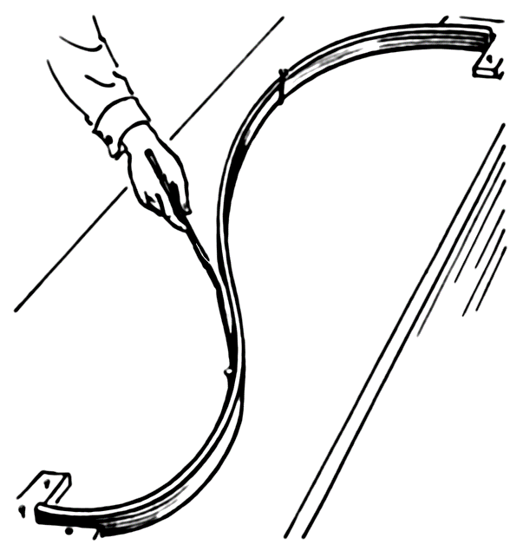
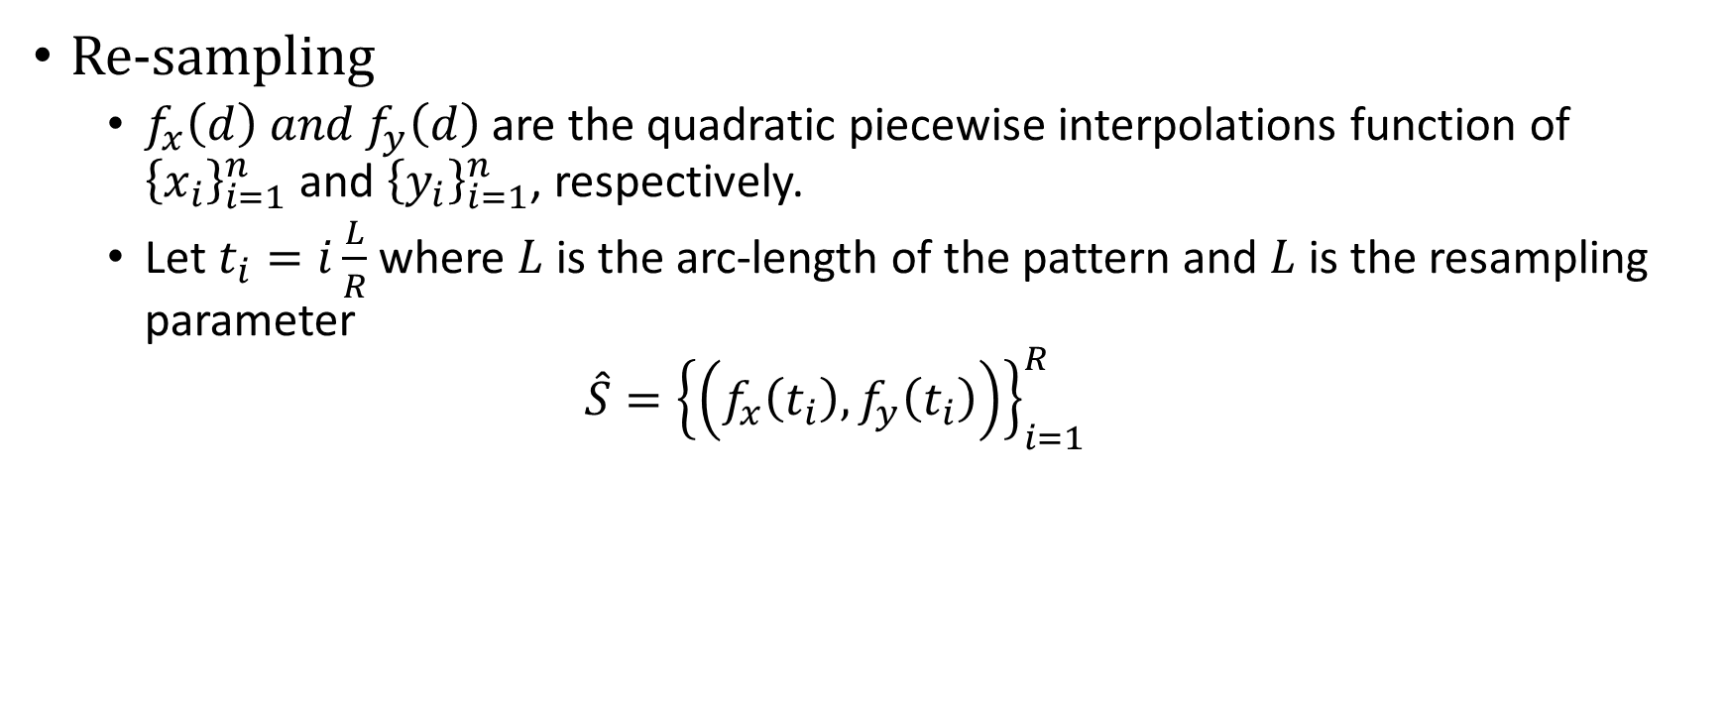
Preprocessing (2)
Re-sampling
$f_{x}\left(d\right) and f_{y}\left(d\right)$ are the quadratic piecewise interpolations function of ${\left\{x_{i}\right\}}_{i=1}^{n}$ and ${\left\{y_{i}\right\}}_{i=1}^{n}$, respectively.
Let $t_{i}=i\frac{L}{R}$ where $L$ is the arc-length of the pattern and $L$ is the resampling parameter
$$\hat{S}={\left\{\left(f_{x}\left(t_{i}\right),f_{y}\left(t_{i}\right)\right)\right\}}_{i=1}^{R}$$

Slide 11
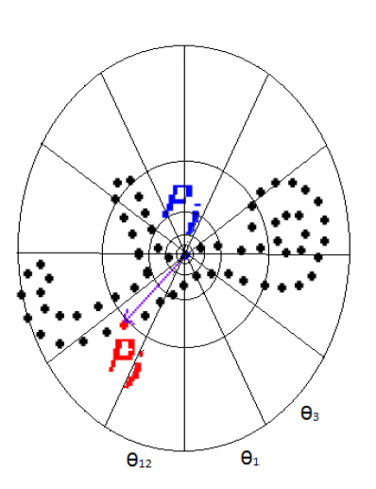
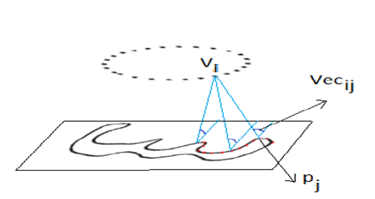
Feature Extraction
(a) (b)
Multi Angular Descriptor (MAD)
Shape Context Descriptor (SC)
Notes:
Feature extraction is the process of extracting informative parameters for learning and recognition of patterns.
Poor feature extraction and selection will, in most cases, result in a poor system performance, regardless of the sophistication of the classification algorithm.

Slide 12
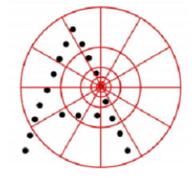
The shape context
Key idea: represent an image in terms of descriptors at certain locations that describe the image relative to those locations
Shape context of a point is the histogram of the relative positions of all other points in the image.
Use bins that are uniform in log-polar space to emphasize close-by, local structure.
Notes:
Feature extraction is the process of extracting informative parameters for learning and recognition of patterns.
Poor feature extraction and selection will, in most cases, result in a poor system performance, regardless of the sophistication of the classification algorithm

Slide 13
Similarity measure
Given two objects. What is the perceptual similarity between them?
Depends on the representation.
Histograms: Earth Mover’s Distance (EMD)
Time sequences: Data Time Warping (DTW)

Slide 14
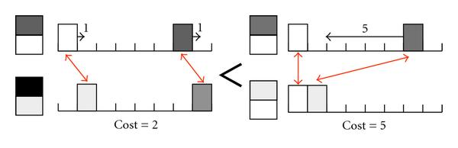
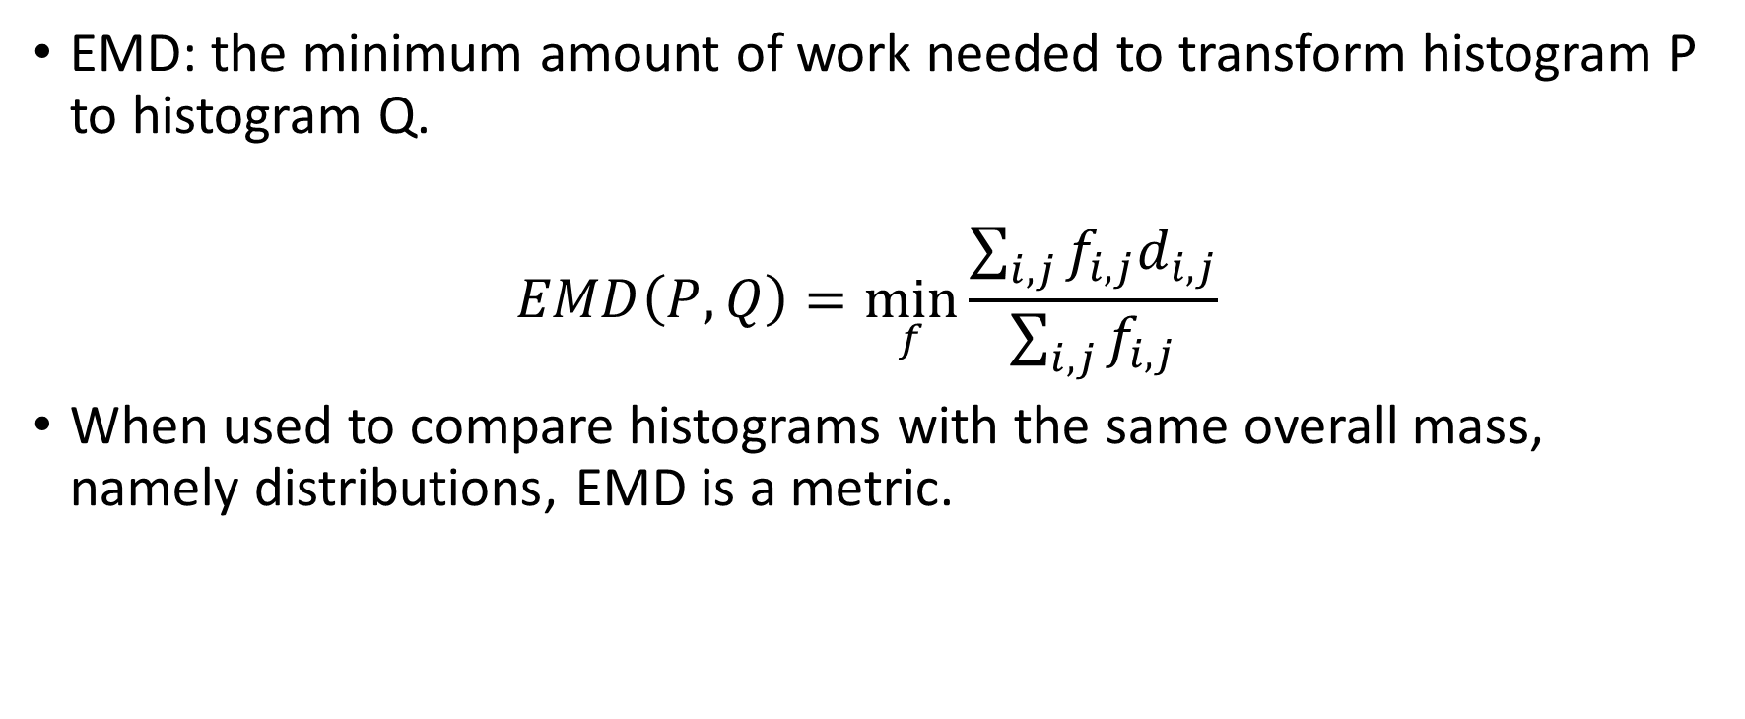
Earth movers distance
EMD: the minimum amount of work needed to transform histogram P to histogram Q.
$$EMD\left(P,Q\right)=\min_{f}{\frac{\sum_{i,j}{f_{i,j}d_{i,j}}}{\sum_{i,j}{f_{i,j}}}}$$
When used to compare histograms with the same overall mass, namely distributions, EMD is a metric.

Slide 15
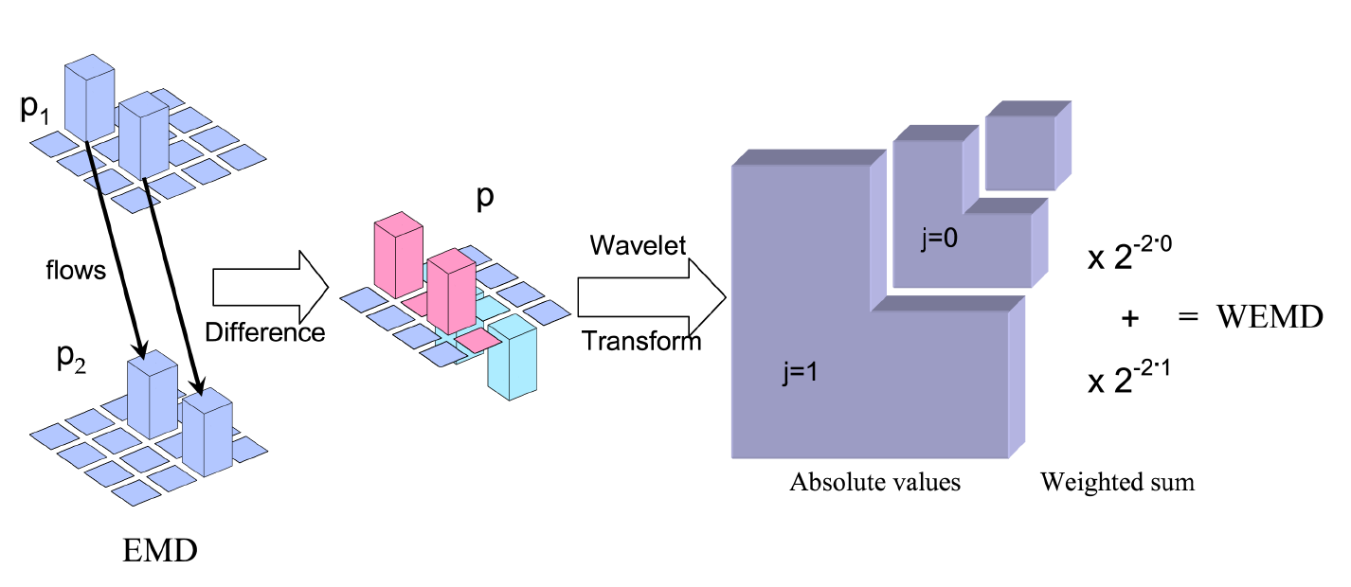

Fast EMD Approximation using wavelets
Shirdhonkar and Jacobs’ embedding.
the Manhattan distance in the wavelets coefficients domain approximate the EMD distance between histograms.
The Haar wavelet achieved the best classification results.
$${d(p)}_{wemd}=\sum_{λ}{2^{−j(1+n/2)}\left|p_{λ}\right|}$$
Notes:
EMD computation complexity is its $O(N^{3}logN)$ for an $N$-bin histogram. Greatly reducing the EMD calculation time can be achieved using metric approximation techniques.
The embedding of the sample set into a normed space facilitates the usage of metric indexing methods to solve the problem of searching k-NN in a large set and avoid linear scan of the entire dataset.

Slide 16
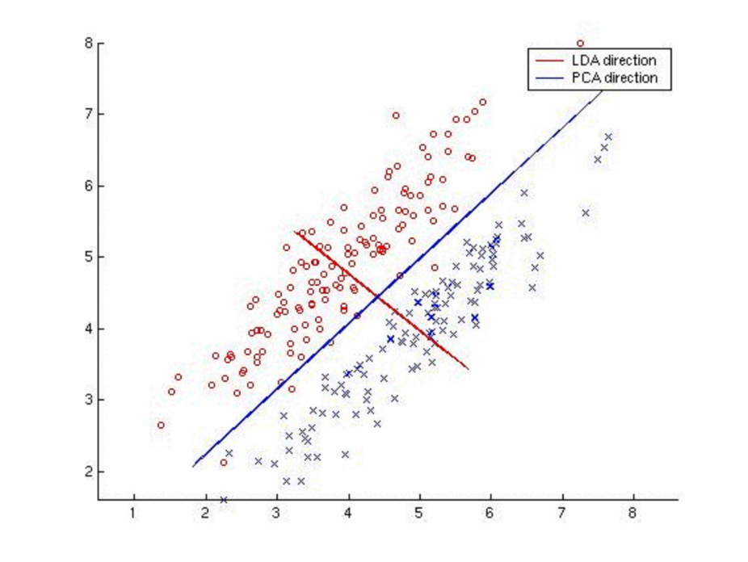
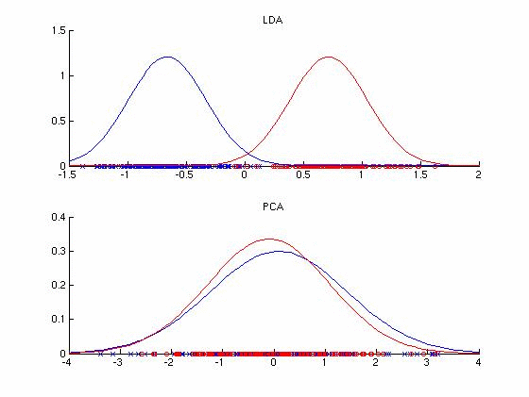

Dimensionality Reduction
Solve the curse of dimensionality.
Embedding the SC feature vectors has produces sparse vectors in $ℝ^{2422}$.
PCA: Unsupervised but efficiently computed
LDA: Supervised but costly
Notes:
Nearest neighbors retrieval methods such as k-d tree are ineffective when the dimensionality of the data is high.

Slide 17
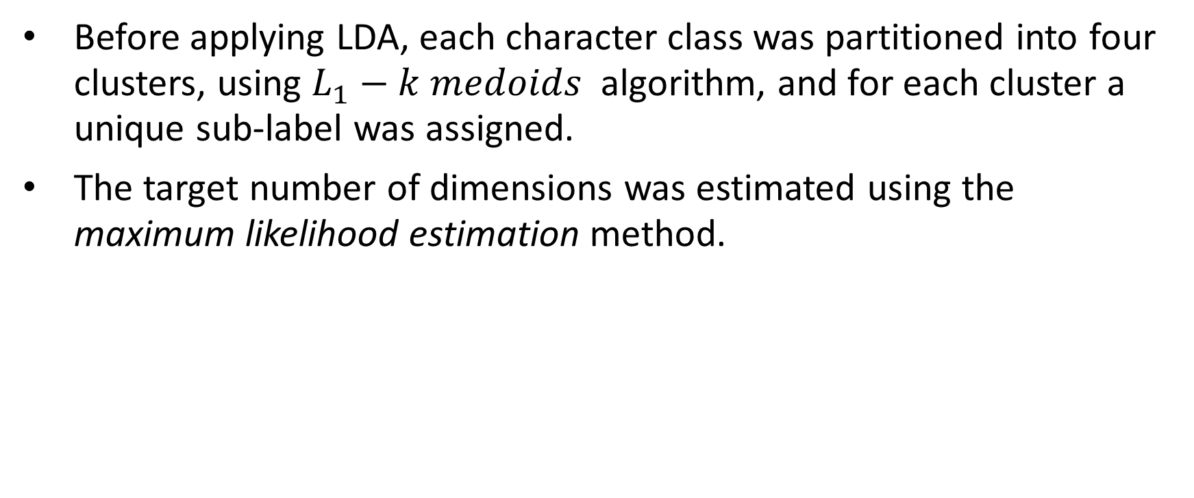
Dimensionality Reduction (2)
Before applying LDA, each character class was partitioned into four clusters, using $L_{1}−k medoids$ algorithm, and for each cluster a unique sub-label was assigned.
The target number of dimensions was estimated using the maximum likelihood estimation method.
PCA+LDA | PCA | Letter Position
9 | 48 | Ini
10 | 52 | Mid
9 | 44 | Fin
8 | 39 | Iso

Slide 18
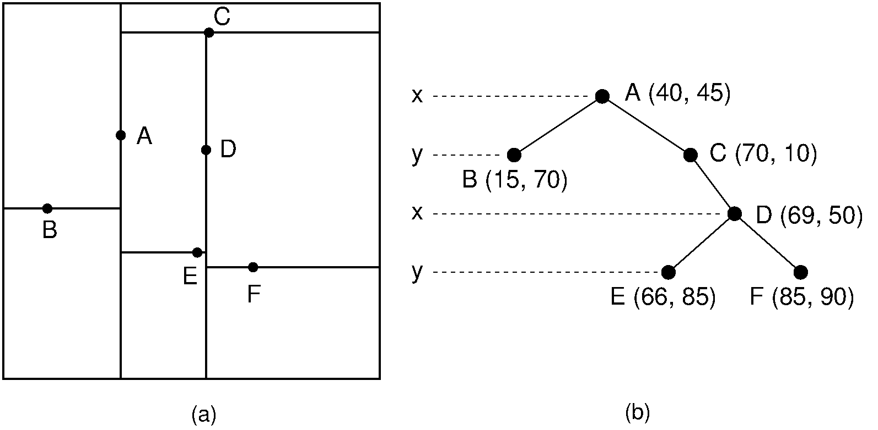
Metric Indexing
Distance function approximation techniques alone cannot avoid linear scan of the entire dataset when searching for the k-NN of a query object.
The k-d tree is an efficient data structure for storing a finite set of points from a k-dimensional space, proposed by Bentley.
Notes:
Indexing techniques partition the dataset into equivalence classes such that each equivalence class contains objects that are sufficiently close to each other.

Slide 19
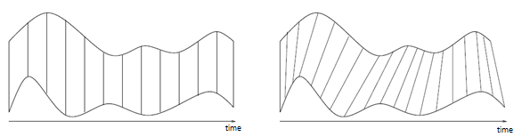
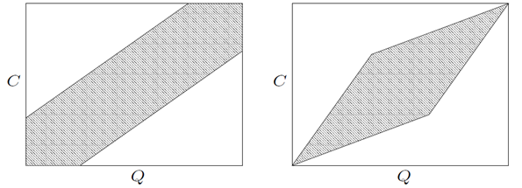
Candidates Rescoring
Given an unlabeled sequence q, the k-NN classifier, using the Manhattan distance, returns a set of $k$ potential letter candidates from the sample set and their scoring, i.e., the perceptual distance between the candidate and q.
re-scoring of the candidates is done by calculating the DTW distance between the preprocessed version of the query sequence and the candidates.

Slide 20
Results
The system was trained and tested on characters and word parts extracted from the ADAB database.
# of Samples | Letter Position
1405 | Ini
1196 | Mid
1629 | Fin
1372 | Iso
Shape Descriptor | Accuracy [Top 1] | Accuracy [Top 3]
SC | 91% | 96%
MAD | 88% | 94%
None | 87% | 93%
Sample set size and distribution
Letters Classification results

Slide 21
Results comparison

Slide 22
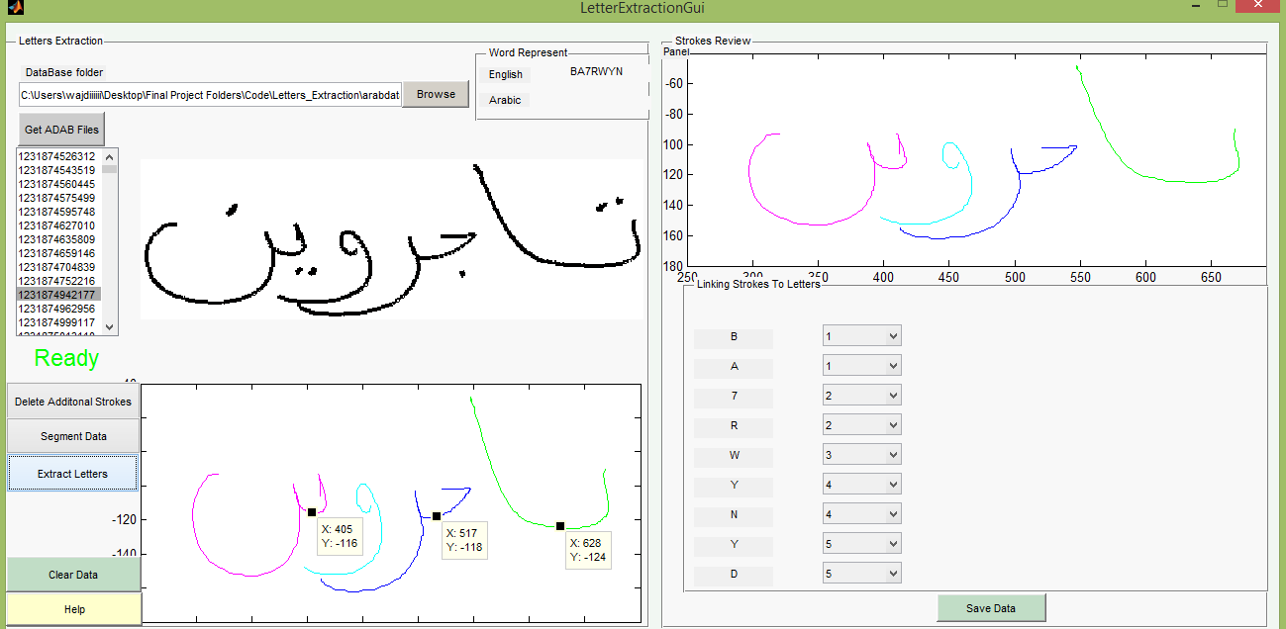
Sample set
We are planning to standardize and publish the characters database extracted from the ADAB database and make available for other researches in the field.
Manual Segmentation

Slide 23
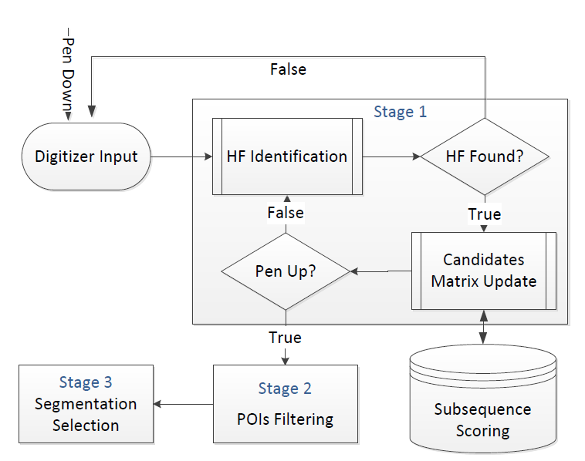
Real time segmentation
Notes:
The segmentation is performed in the stroke level.

Slide 24
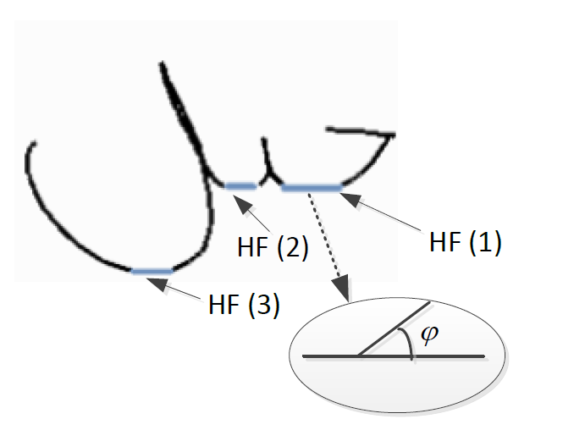
Stage 1 - HF identification
Points of interest (POIs), i.e., potential segmentation points (SPs), are continuously nominated using morphological features while the stroke is being scribed.
Horizontal Fragments (HFs) are ligatures that join pairs of connected letters in the Arabic script are usually horizontal, directed right to left and located near the baseline. POIs are the mid-points of HFs.

Slide 25
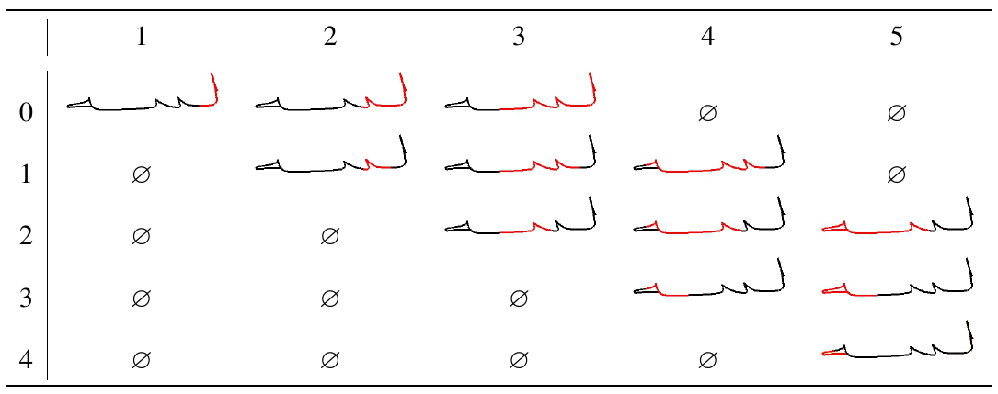
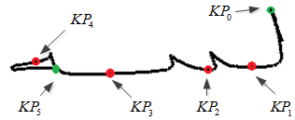
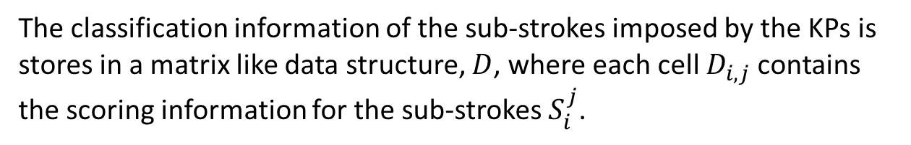
Stage 1 (Cont.) – Sub-strokes Scoring
The KPs (Key-Points) set is the ordered set of POIs, in addition to the first and the last points of the stroke positioned as the first and the last items in the set
The classification information of the sub-strokes imposed by the KPs is stores in a matrix like data structure, $D$, where each cell $D_{i,j}$contains the scoring information for the sub-strokes $S_{i}^{j}$.

Slide 26

Stage 2
Once the entire stroke is available, a rules-based process is used to refine the set of POIs and re-score the sub-strokes based on the following rules:
SPs should lie close to the baseline.
do not reside in loops.
sub-stroke length should be proportional to the length of the containing stroke.

Slide 27
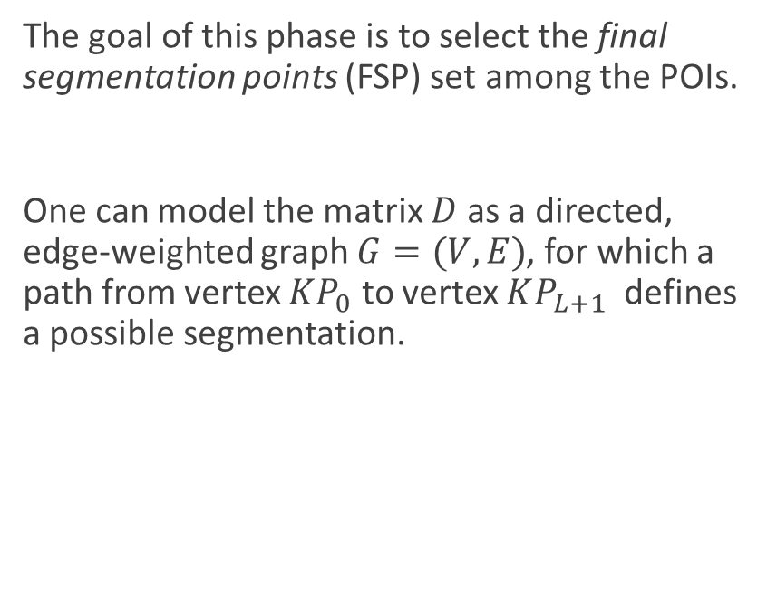
Stage 3 – Segmentation Selection
The goal of this phase is to select the final segmentation points (FSP) set among the POIs.
One can model the matrix $D$ as a directed, edge-weighted graph $G=(V,E)$, for which a path from vertex $KP_{0}$ to vertex $KP_{L+1}$ defines a possible segmentation.

Slide 28
Real-time segmentation Results
Over-segmentation:
A horizontal region in initial form which does not accommodate a SP.
A letter spanned over several strokes.
Under-segmentation:
Letter pairs that are not separated by HFs (e.g., لم and لح).
Not selecting a POI in the third stage.
Strokes SR | 83% | Missing SPs | 14%
Stroke RR | 78% | Invalid SPs | 11%
# true SPs | 1081 | SPs Precision | 88.6%
Valid SPs | 86% | SPs Recall | 85.3%

Slide 29
Segmentation Validation

Slide 30
Main Contributions

Slide 31
Publications

Slide 32
Future Work

