Slide 1
SALIENT VENTURES
Q4 2025 Sales Analysis
Prepared by: 10Alytics Data Analytics Team
Pod Group: Pod Astra
Period: October 1 – December 31, 2025
CONFIDENTIAL — BOARD PRESENTATION

Slide 2
Business Introduction — Who is Salient Ventures?
Pod Astra
🏢
📍
🛍️
Who They Are
Where They Operate
What They Sell
Salient Ventures is a fast-growing e-commerce company specialising in the sales and distribution of high-quality household and lifestyle products, operating exclusively through digital channels.
Headquartered in California, the company uses the state's commercial infrastructure as its primary logistics hub while expanding aggressively into several other US states.
Products span multiple categories including Gym Accessories, Sports, Clothing, Accessories, Electronics, and Toys — diversified to capture the festive Q4 market.
Salient Ventures | Q4 2025 Sales Analysis | 10Alytics — Pod Astra
2

Slide 3
Problem Statement — The Challenge Facing Salient Ventures
Pod Astra
Root Causes
20%
1. Poor inventory management leading to stockouts and overstock
2. Low customer retention — limited repeat purchase behaviour
QoQ Revenue Decline
Q1 – Q3 2025
3. Lack of regional market penetration beyond California
4. Flat salary structure — no sales performance incentives
CORE PROBLEM
Despite a surge in Q4 transaction volume following the strategic pivot, management cannot validate the true impact of the recovery plan due to limited data visibility — making it impossible to approve the 2026 budget with confidence. Salient Ventures must distinguish between vanity metrics and sustainable business growth.
Salient Ventures | Q4 2025 Sales Analysis | 10Alytics — Pod Astra
3

Slide 4
Aim of the Project — Strategic Objectives for Q4 Analysis
Pod Astra
01
Assess Sales Performance
02
Validate the Turnaround Strategy
Calculate and evaluate key metrics — total revenue, expenses, profit, margin, and product mix — for the Q4 2025 period.
Determine whether the surge in Q4 transaction volume represents genuine, sustainable growth or short-term, low-value activity.
03
Uncover Product & Customer Insights
04
Aid Board Decision-Making
Identify top-performing products, categories, customer segments, and regional contributors to profit.
Provide a dynamic, data-driven dashboard to support evidence-based decisions for the 2026 budget and strategy.
Salient Ventures | Q4 2025 Sales Analysis | 10Alytics — Pod Astra
4

Slide 5
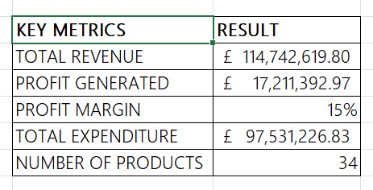
Sales Performance: Key Metrics Overview
Pod Astra
💡 KEY INSIGHT
✅ RECOMMENDATION
Q4 generated £114.7M in revenue with a 15% profit margin — a strong recovery from the Q1–Q3 decline. Total profit reached £17.2M across 34 products.
Prioritise high-margin products and reduce the cost base to push the profit margin beyond 15% in 2026. Monitor expenditure closely against the £97.5M Q4 spend.
Salient Ventures | Q4 2025 Sales Analysis | 10Alytics — Pod Astra
5

Slide 6
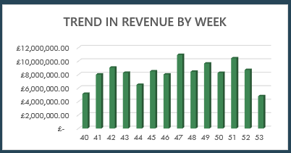
Sales Performance: Weekly Revenue & Profit in Q4
Pod Astra
💡 KEY INSIGHT
✅ RECOMMENDATION
Revenue was strongest in weeks 47–50 (mid-to-late November), peaking at £11M, driven by Black Friday and festive season demand. Week 53 dipped sharply.
Plan targeted promotions around weeks 46–50 for 2026 to capitalise on the proven festive surge. Use week 53 dip to schedule restocking and operational resets.
Salient Ventures | Q4 2025 Sales Analysis | 10Alytics — Pod Astra
6

Slide 7
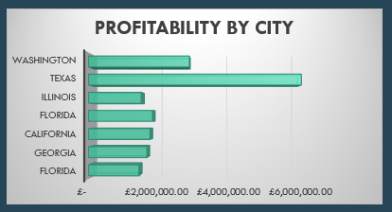
Sales Performance: Cities with the Most Profit
Pod Astra
💡 KEY INSIGHT
Texas and Washington are the top two profit-generating states, significantly outperforming California, the company's home base. Georgia and Florida show lower contribution.
✅ RECOMMENDATION
Increase marketing and inventory allocation in Texas and Washington. Investigate why California underperforms relative to its logistical advantage and close that gap.
Salient Ventures | Q4 2025 Sales Analysis | 10Alytics — Pod Astra
7

Slide 8
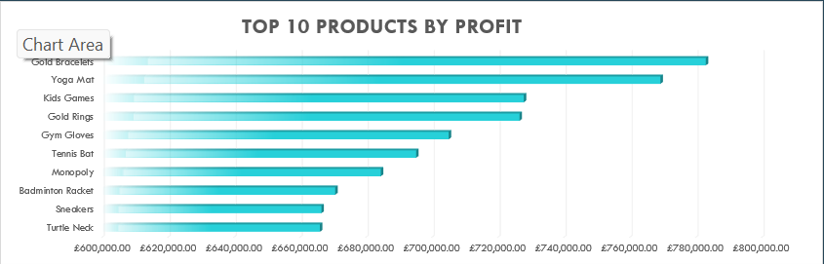
Product Performance: Top 10 Products by Profit
Pod Astra
💡 KEY INSIGHT
✅ RECOMMENDATION
Gold Bracelets lead profit by a wide margin, followed by Yoga Mat and Kids Games. Accessories and Gym products dominate the top 10, validating the Q3 diversification strategy.
Increase stock levels and marketing spend on Gold Bracelets, Yoga Mats, and Kids Games. Bundle lower-ranking products with top performers to lift their contribution.
Salient Ventures | Q4 2025 Sales Analysis | 10Alytics — Pod Astra
8

Slide 9
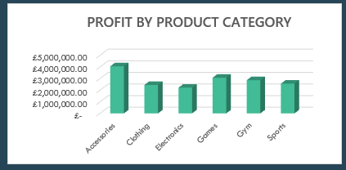
Product Performance: Most Profitable Categories
Pod Astra
💡 KEY INSIGHT
Accessories is the most profitable category, followed closely by Clothing. Gym and Sports — newly introduced categories — already show competitive profit levels, confirming the pivot paid off.
✅ RECOMMENDATION
Continue expanding the Accessories and Clothing range. Scale Gym and Sports inventory to meet growing demand and consider launching seasonal bundles across these categories.
Salient Ventures | Q4 2025 Sales Analysis | 10Alytics — Pod Astra
9

Slide 10
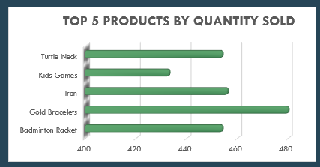
Product Performance: Top 5 Best-Selling Products by Quantity
Pod Astra
💡 KEY INSIGHT
Gold Bracelets leads unit sales, with Turtle neck and Iron also ranking highly. Notably, Gold Bracelets appear in both the top profit AND top quantity lists, a standout product.
✅ RECOMMENDATION
Ensure consistent stock availability for Turtle Neck and Gold Bracelets. Use their popularity to cross-sell complementary items and increase average order value.
Salient Ventures | Q4 2025 Sales Analysis | 10Alytics — Pod Astra
10

Slide 11
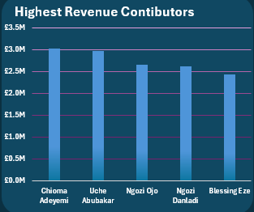
Customer Insights: Top 5 Customers by Revenue
Pod Astra
💡 KEY INSIGHT
Chioma Adeyemi and Uche Abubakar are the top revenue contributors. The revenue gap between top and bottom customers in this group is relatively narrow.
✅ RECOMMENDATION
Introduce a VIP loyalty programme targeting the top 10 customers. Personalised offers and early access to new products can increase retention and boost their lifetime value.
Salient Ventures | Q4 2025 Sales Analysis | 10Alytics — Pod Astra
11

Slide 12
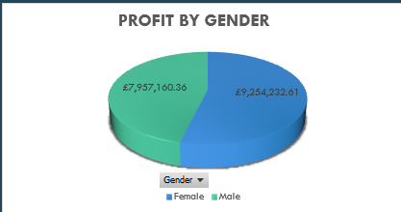
Customer Insights: Purchasing Behavior by Gender
Pod Astra
💡 KEY INSIGHT
Male customers generated slightly higher profit (£9.25M) compared to female customers (£7.96M). The split is relatively balanced at approximately 54% male vs 46% female.
✅ RECOMMENDATION
Avoid a single-gender focus — both segments are valuable. Tailor marketing creatives by gender preference: promote Gym/Sports to male customers and Accessories/Clothing to female customers.
Salient Ventures | Q4 2025 Sales Analysis | 10Alytics — Pod Astra
12

Slide 13
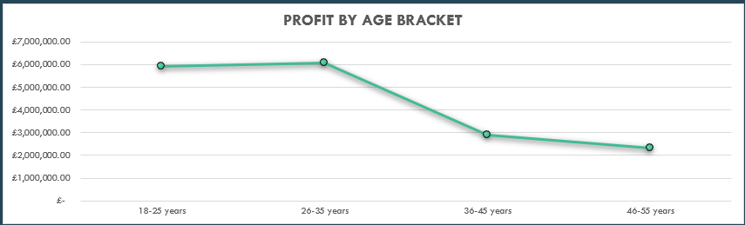
Customer Insights: Revenue by Age Group
Pod Astra
💡 KEY INSIGHT
✅ RECOMMENDATION
The 18–35 age bracket (combined) generates the highest profit, peaking at the 26–35 group. Profit declines steadily after 35, dropping sharply in the 46–55 bracket.
Focus acquisition and retention campaigns on the 18–35 demographic. Introduce youth-oriented products and social-media-driven promotions. Consider incentives to re-engage the 36–45 segment.
Salient Ventures | Q4 2025 Sales Analysis | 10Alytics — Pod Astra
13

Slide 14
Turnaround Strategy Validation
Pod Astra
✅ VERDICT: YES — THE STRATEGY WORKED
💰
📦
📍
Performance-Based Incentives
Inventory Diversification
Aggressive Regional Marketing
BEFORE
BEFORE
BEFORE
Flat salaries → low staff motivation
Narrow product range
California-centric operations
AFTER
AFTER
AFTER
£114.7M revenue & £17.2M profit in Q4
Accessories & Gym lead profitability; 34 active products
Texas & Washington now top profit cities
✅ DELIVERED
✅ DELIVERED
✅ DELIVERED
Q4 revenue of £114.7M marks a 31% rebound vs Q3's £87.6M — sustainable growth confirmed across revenue, profit margin, regional expansion, and product diversification.
Salient Ventures | Q4 2025 Sales Analysis | 10Alytics — Pod Astra

Slide 15
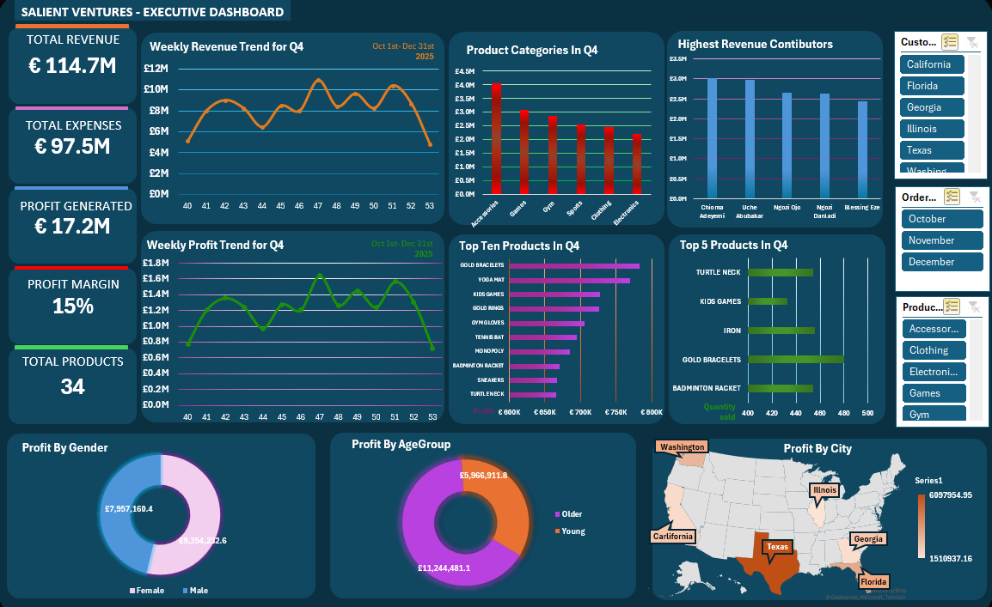
Interactive Excel Dashboard — Salient Ventures Q4 2025 Full Overview
Pod Astra
🖥️
Dashboard Screenshot
(Insert your Excel Dashboard screenshot here)
Dashboard includes slicers: Location | Category | Month
Salient Ventures | Q4 2025 Sales Analysis | 10Alytics — Pod Astra
14

Slide 16
Thank You
Salient Ventures Q4 2025 Sales Analysis
Prepared by 10Alytics — Pod Astra
Questions & Feedback Welcome
#ShowYourWorkings | @10Alytics
SALIENT VENTURES | Q4 2025

