Slide 1
Employee Salary Prediction using Machine Learning
CAPSTONE PROJECT
Presented By:
Name: FAKRUDDIN
College/Institute: REVA UNIVERSITY
Program: MCA

Slide 2
OUTLINE
Problem Statement
System Development Approach
Algorithm & Deployment
Result
Conclusion
Future Scope
References

Slide 3
Problem Statement
The project aims to build a machine learning model to predict employee salaries based on various features like job title, experience, company, location, and employment status.
Many job seekers and companies struggle to estimate fair and competitive salaries. Traditional methods lack accuracy and adaptability to changing market trends.
This system is designed to help both employers and job seekers make data-driven salary decisions.
The model attempts to reach an R² accuracy of 80–85% by using proper feature engineering, encoding, and model tuning.
This project can serve as a decision support tool in HR analytics and recruitment.

Slide 4
System Approach
System Requirements:
Jupyter Notebook, Python 3.x
RAM: Min 4GB, Internet for API access
Libraries Used:
pandas, numpy
matplotlib, seaborn
scikit-learn
xgboost, catboost
Joblib

Slide 5
System Approach
Dataset:
Contains columns like experience, company name, job title, employment status, location, and salary.

Slide 6
Algorithm & Deployment
Step-by-Step Procedure:
1. Data Cleaning:
Removed nulls and duplicates
Converted salary to numeric values
2. Feature Engineering:
Label/Ordinal encoding for categorical data
Created custom salary buckets (optional)
3. Model Selection:
Tried Random Forest, XGBoost, CatBoost
CatBoost performed the best

Slide 7
Algorithm & Deployment
4. Model Evaluation:
Used R² Score and MAE
Tuned hyperparameters using GridSearchCV
5. Deployment:
Saved the model using joblib
Prepared for Streamlit UI and web-based deployment

Slide 8
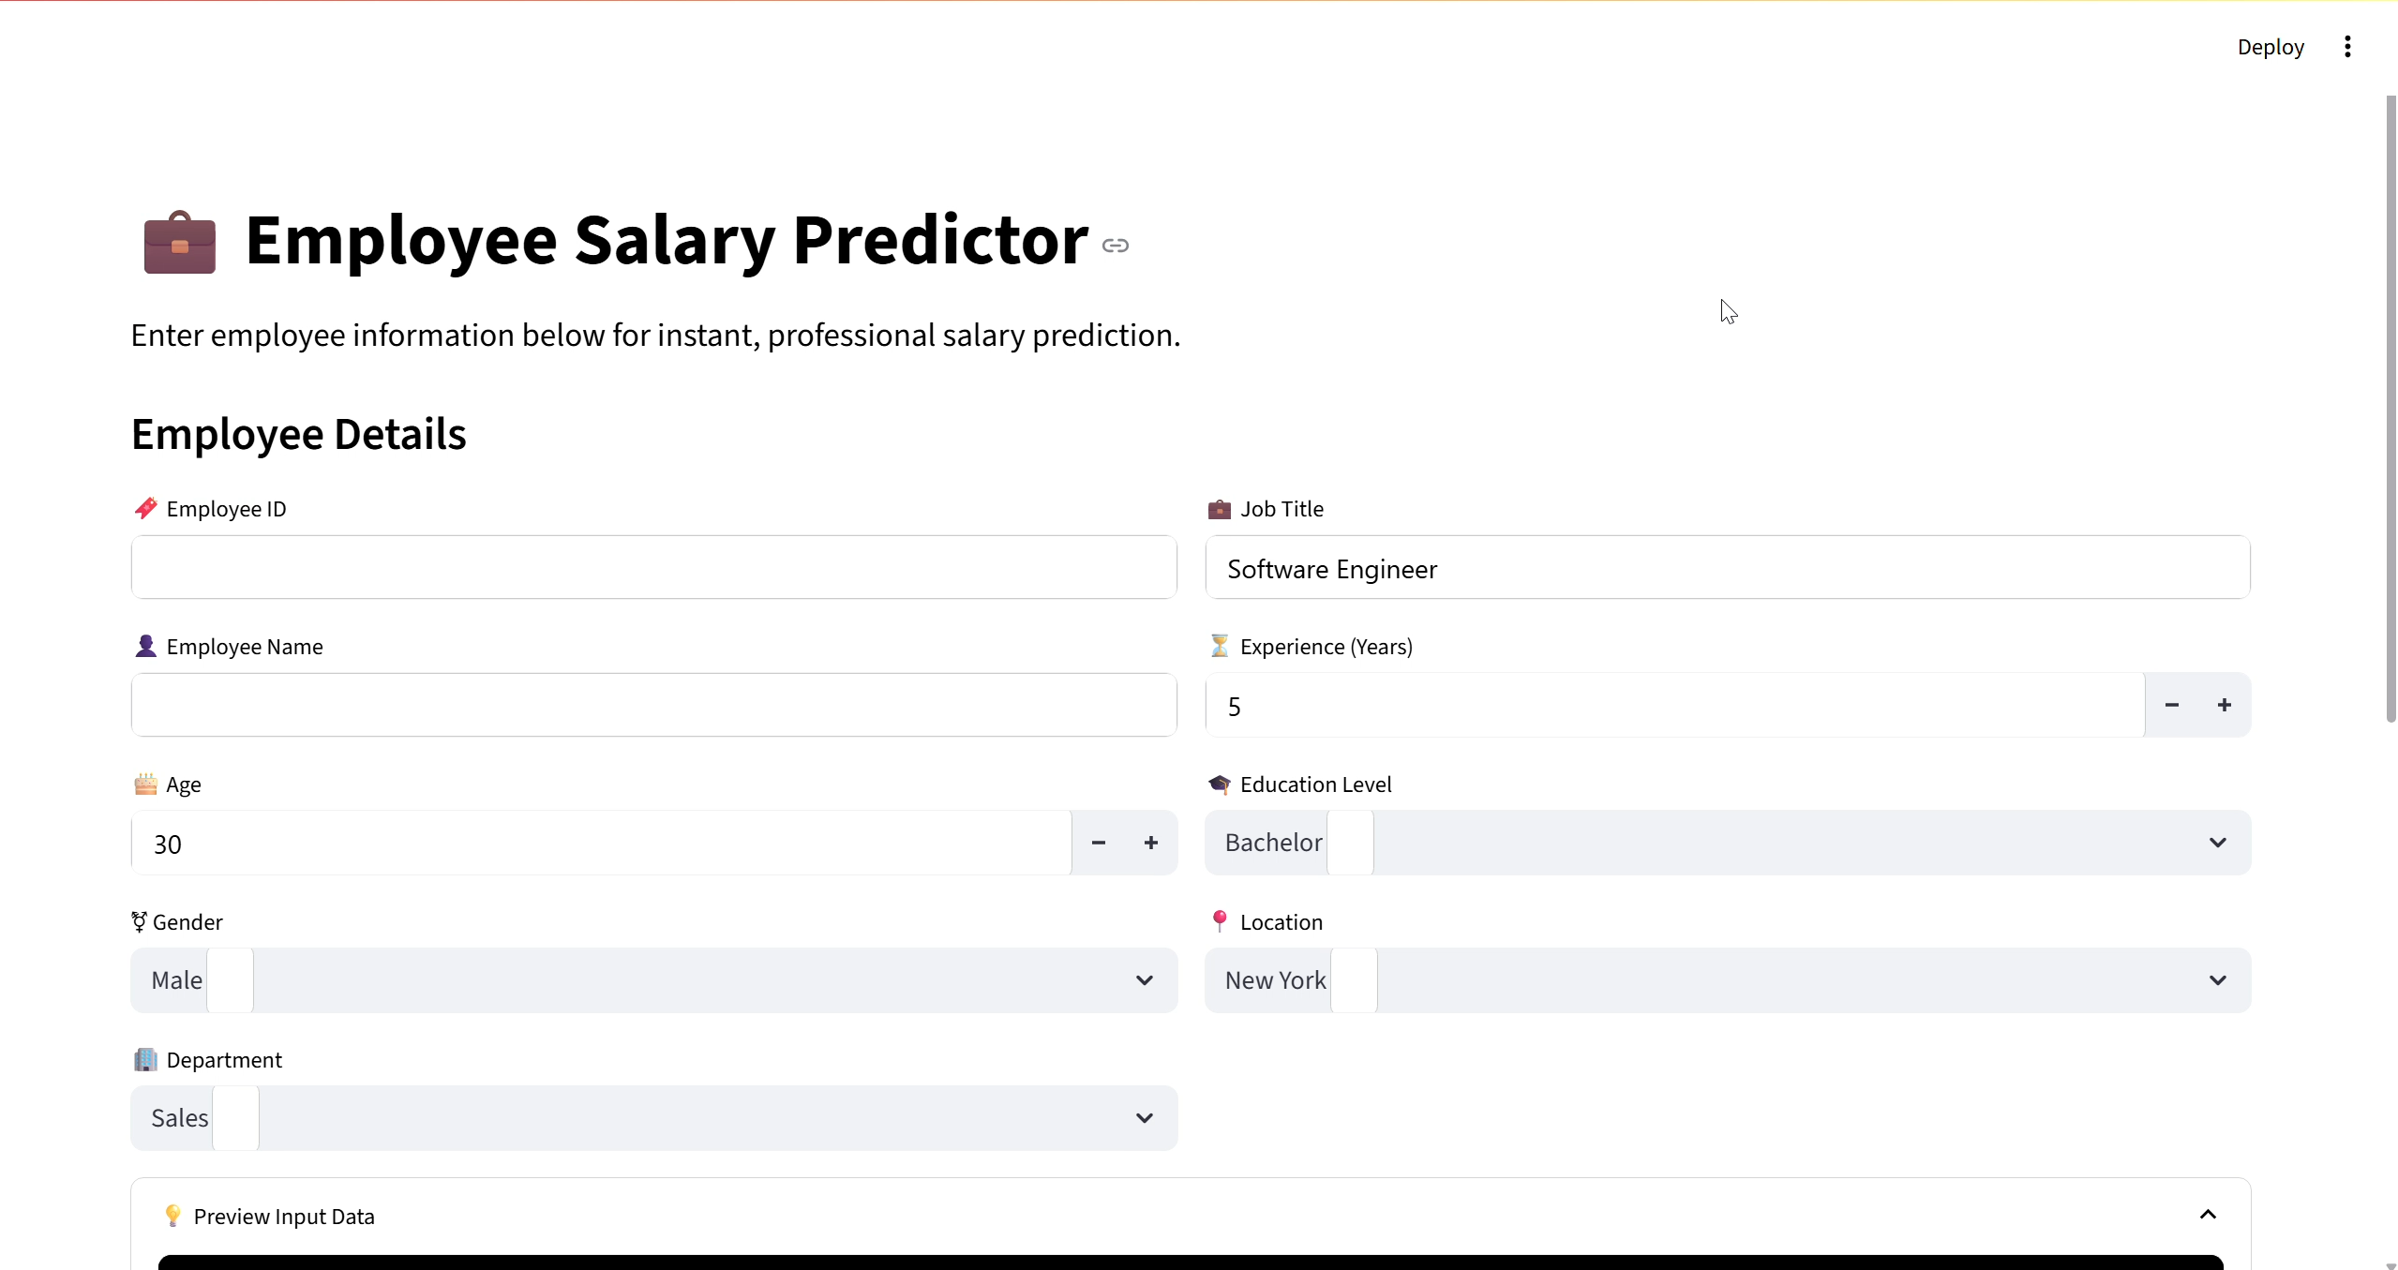
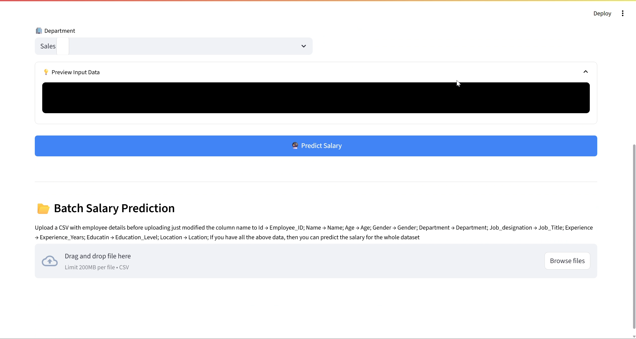
Result

Slide 9
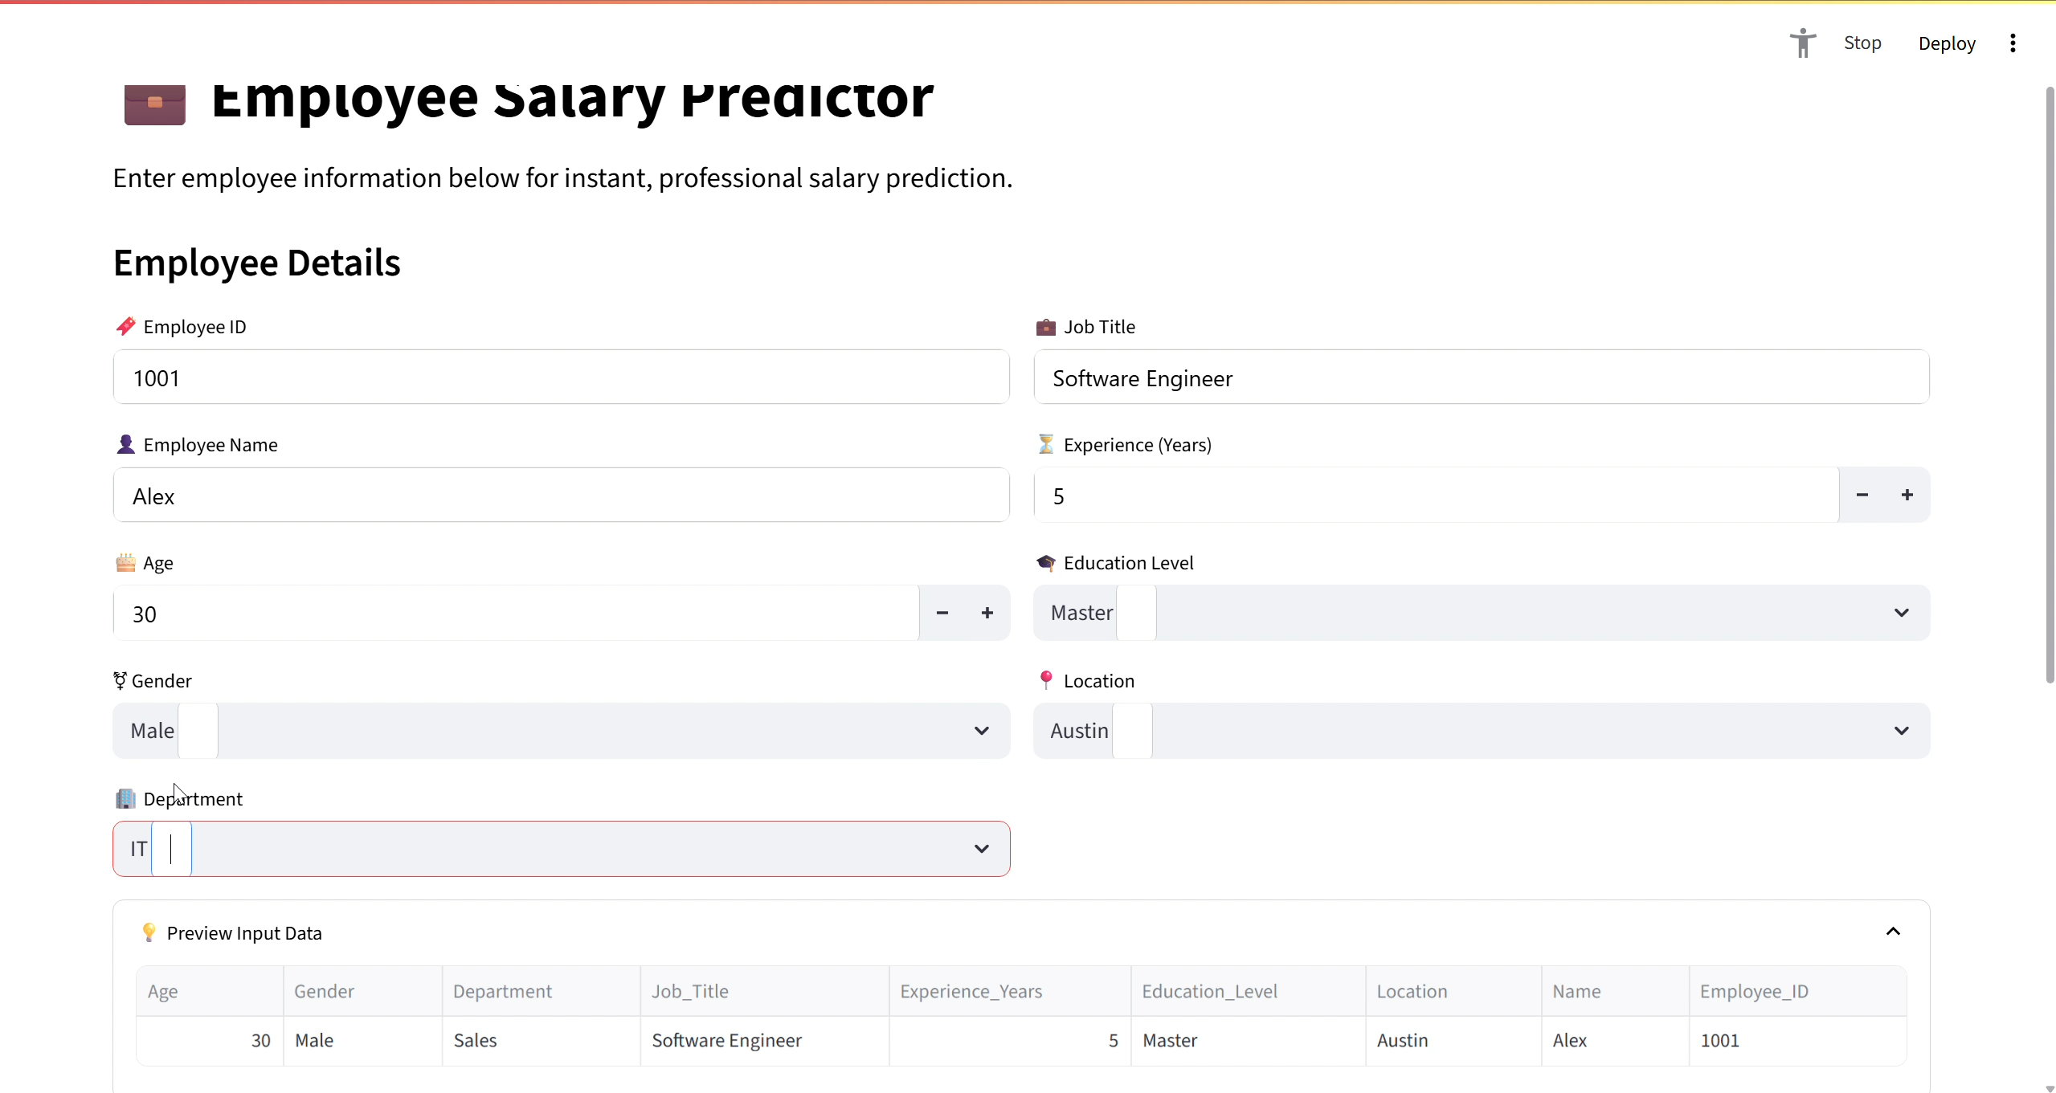
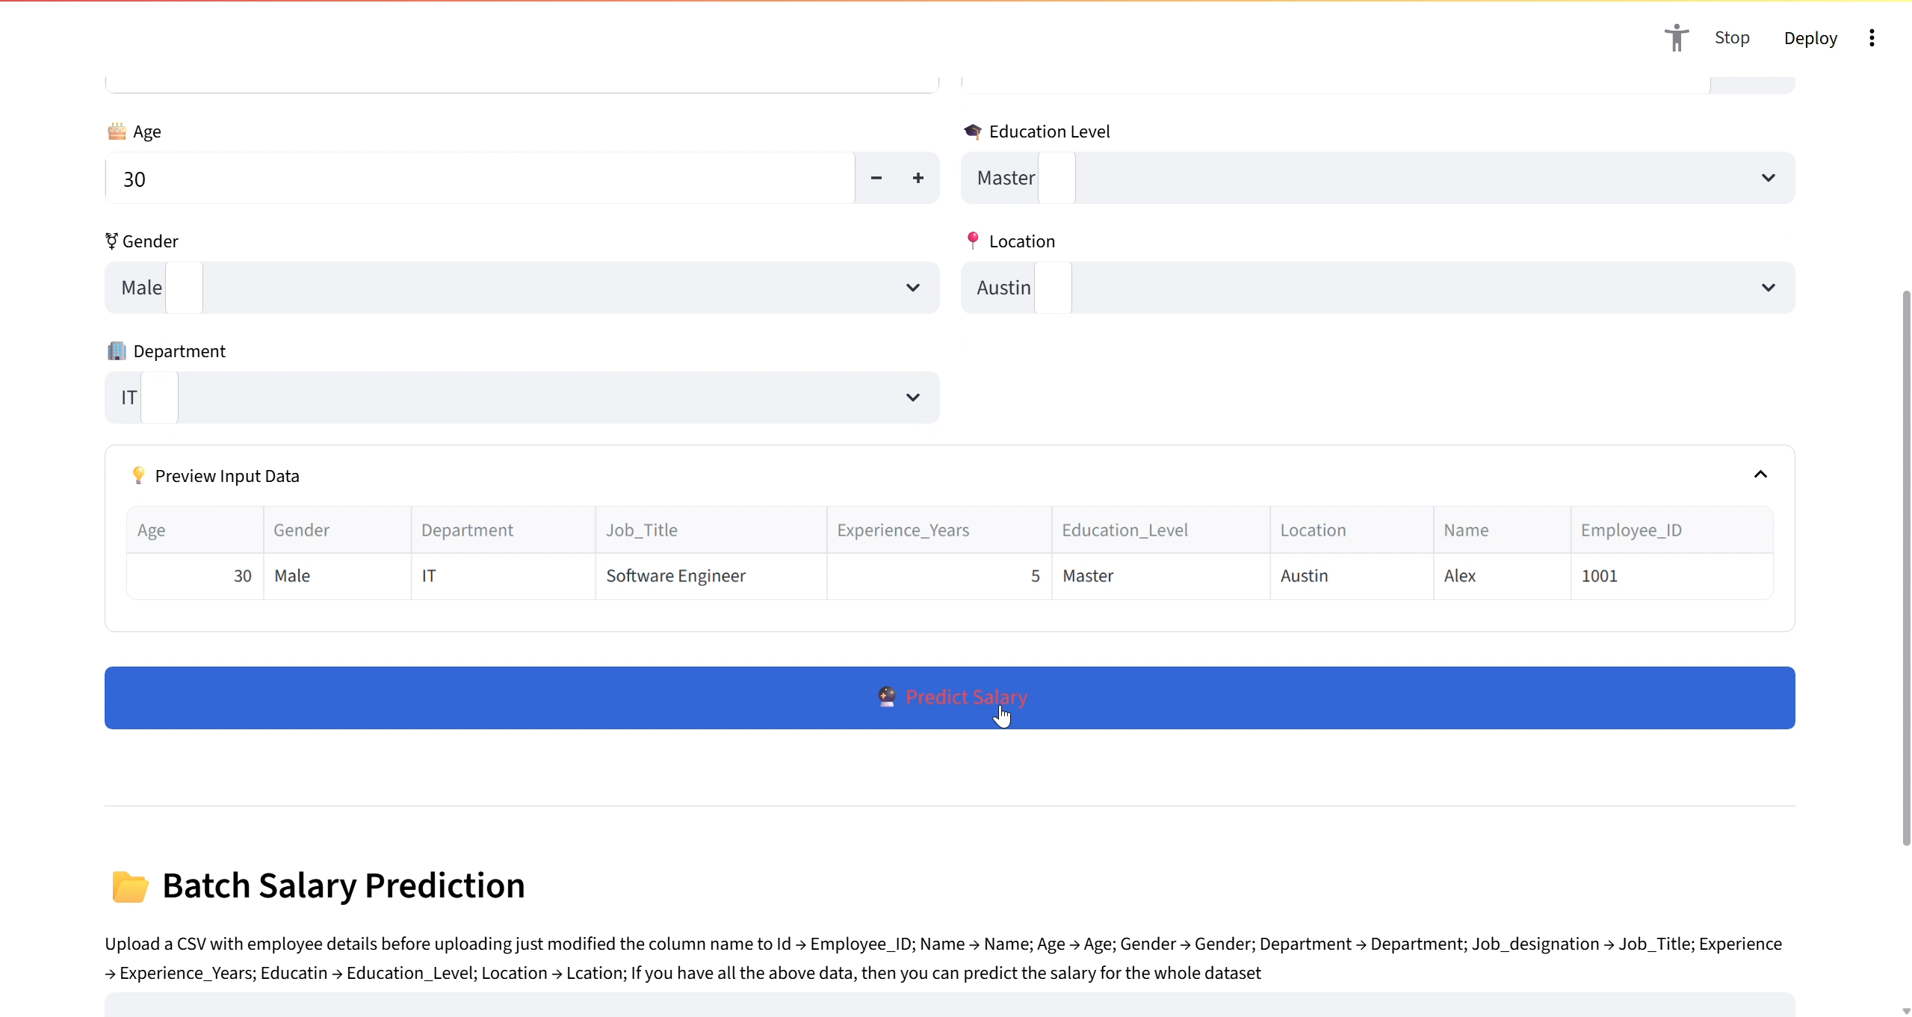
Result

Slide 10
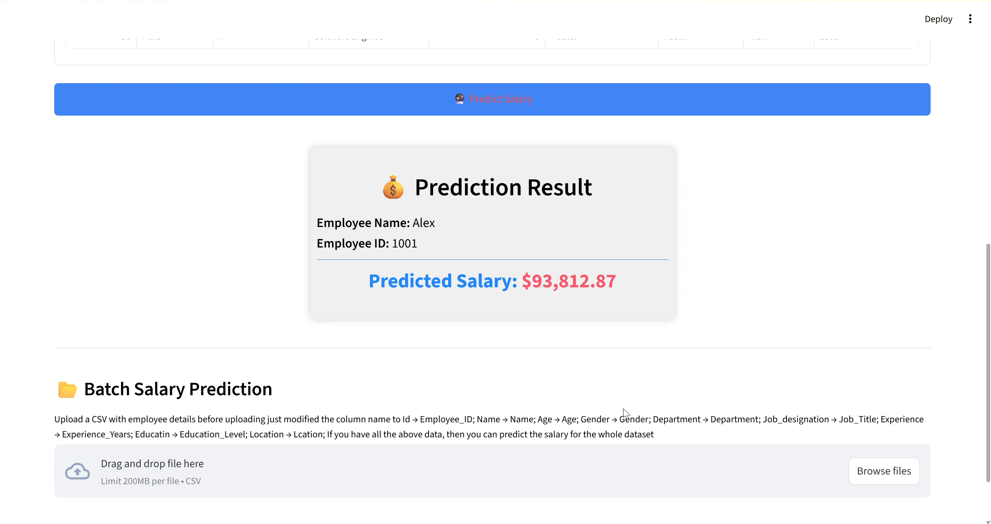
Result

Slide 11
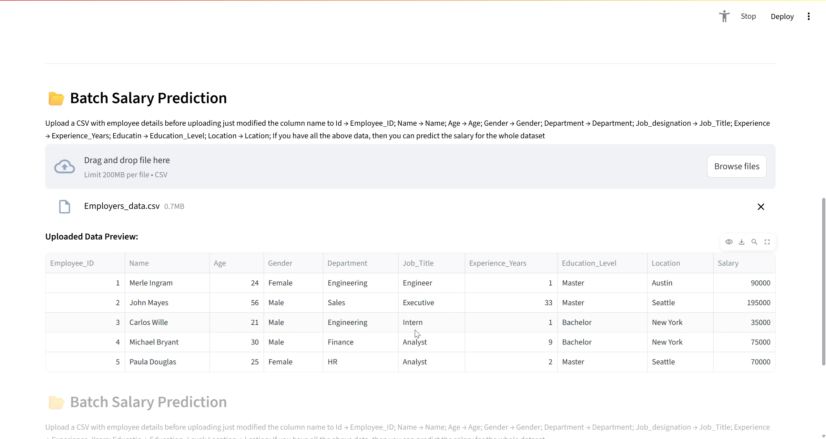
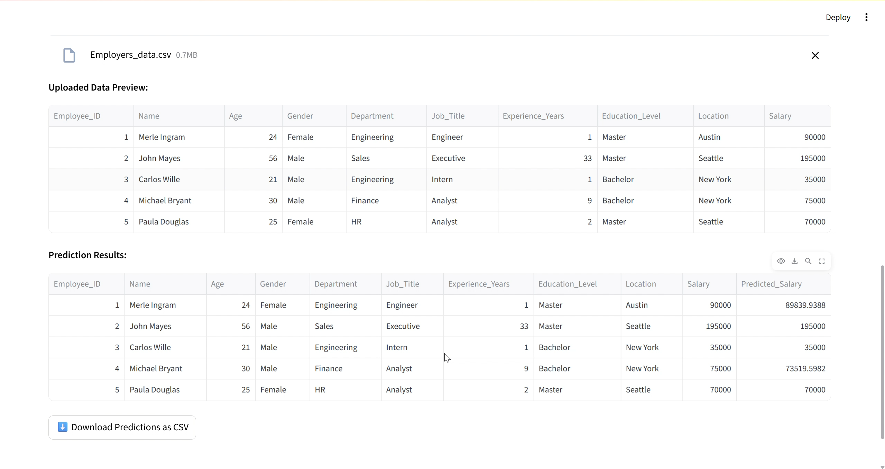
Result

Slide 12
LINKS
GitHub:
Attach your Github link:
https://github.com/Fakruddin002/Employee-Salary-Prediction.git
Deployed Link:
Project Deployed Live link:
https://machine-learning-employee-salary-prediction.streamlit.app/

Slide 13
Conclusion
The project successfully predicts employee salaries with decent accuracy using CatBoost.
It demonstrates how machine learning can assist in real-world HR analytics.
Challenges:
Handling outliers in salary
Encoding diverse job titles
Small sample size for some job roles
The model can be expanded by including more features like education, industry type, or city tier.

Slide 14
Future scope
Deploy the model as a web app (Streamlit or Flask)
Add NLP to parse job descriptions automatically
Integrate with LinkedIn or Naukri job listings
Continuous model retraining using real-time salary data

Slide 15
References
Scikit-learn Documentation 🔗 https://scikit-learn.org/stable/documentation.html
CatBoost Documentation 🔗 https://catboost.ai/en/docs/
Kaggle - Salary Prediction Discussions 🔗 https://www.kaggle.com/discussions
Feature Engineering Guide – Towards Data Science (Medium) 🔗 https://towardsdatascience.com/feature-engineering-for-machine-learning-3a5e293a5114
GitHub – Salary Prediction Projects 🔗 https://github.com/search?q=salary+prediction
XGBoost Documentation 🔗 https://xgboost.readthedocs.io/en/stable/
Seaborn Visualization Docs 🔗 https://seaborn.pydata.org/introduction.html

Slide 16
THANK YOU

