Slide 1


NEXT GEN EMPLOYABILITY PROGRAM
CREATING A FUTURE-READY WORKFORCE
Student Name :
FAKRUDDIN
Student ID :
College Name :
STU6763031ae16ef1734542106
REVA UNIVERSITY

Slide 2
CAPSTONE PROJECT SHOWCASE
Project Title
Crowdfunding Platform with React and ExpressJS Framework
Abstract | Problem Statement | Project Overview | Proposed Solution | Technology Used | Modelling & Results | Conclusion

Slide 3
Abstract
1
Purpose: The project aims to develop a web-based Crowdfunding Platform using React.js and Express.js to facilitate fundraising for startups, social causes, and creative projects.
2
Challenges Addressed: Traditional fundraising methods suffer from limited reach, slow processing, and lack of transparency. This platform provides a digital, efficient, and secure alternative.
3
Solution Approach: The platform enables users to create, manage, and contribute to campaigns, with features like real-time progress tracking, secure payments, and user authentication.
4
Expected Outcome: A scalable, user-friendly, and transparent crowdfunding system that empowers individuals and organizations to raise funds effectively.

Slide 4


Problem Statement
Traditional fundraising methods face several challenges, including limited reach, slow processing, and lack of transparency. Many startups, social initiatives, and creative projects struggle to secure funds due to inefficient financial channels and trust issues.
❌ Limited Accessibility: Fundraising is often restricted to local networks, reducing potential contributions. ❌ Lack of Transparency: Donors are unsure how their funds are used, leading to distrust. ❌ Slow and Complex Transactions: Traditional methods involve manual verification and delayed fund transfers. ❌ High Processing Fees: Many platforms charge high fees, reducing the funds received by campaign creators.
💡 Solution: A digital Crowdfunding Platform that provides a secure, transparent, and efficient way to raise and manage funds using React.js and Express.js.

Slide 5

Project Overview
The Crowdfunding Platform is a web-based solution designed to help individuals, startups, and NGOs raise funds efficiently. Built using React.js for the frontend and Express.js for the backend, the platform ensures a secure, user-friendly, and scalable fundraising experience.
🔹 Key Features:
✔️ Create and manage campaigns with funding goals and deadlines. ✔️ Secure payment integration for seamless transactions. ✔️ Real-time funding progress tracking for transparency. ✔️ User authentication and fraud prevention to ensure security. ✔️ Admin dashboard for monitoring campaigns and user activity.
This platform bridges the gap between fundraisers and contributors, making fundraising accessible, transparent, and efficient.

Slide 6
Proposed Solution
To address the challenges of traditional fundraising, we propose a web-based Crowdfunding Platform built using React.js and Express.js, ensuring a secure, efficient, and transparent fundraising process.
🔹 Key Components of the Solution:
✔️ User-Friendly Campaign Creation – Fundraisers can easily create and manage campaigns with images, descriptions, and funding goals. ✔️ Secure Payment Processing – Integration with Razorpay for seamless and fraud-free transactions. ✔️ Real-Time Fund Tracking – Users can monitor campaign progress and receive updates. ✔️ Admin Dashboard – Ensures security, prevents fraud, and manages platform activities. ✔️ Authentication & Authorization – Secure login with JWT/Firebase Auth to protect user data.
🔹 Outcome: A fast, scalable, and transparent platform that connects fundraisers with potential backers, ensuring trust and efficiency.

Slide 7
Technology used
Frontend: React.js (UI components, state management)
Backend: Express.js (REST API, business logic)
Database: MongoDB (storing campaigns and transactions)
Authentication: Firebase Auth / JWT (user login and security)
Payment Gateway: Razorpay (secure transactions)

Slide 8
Modelling & Result
🔹 User Journey Flowchart
User Registers/Login → Creates Campaign → Shares Campaign → Receives Contributions → Funds Withdrawal
Backer Browses Campaigns → Makes Secure Payment → Receives Updates
🔹 System Architecture Diagram
Frontend (React.js) – User Interface
Backend (Express.js, Node.js) – Handles API and business logic
Database (MongoDB) – Stores campaigns and transactions
Payment Gateway (Razorpay) – Processes secure payments

Slide 9
Modelling & Result
Key Features Working as Expected:
✔️ Users can register/login securely. ✔️ Campaign creators can launch fundraising campaigns with images, goals, and deadlines. ✔️ Contributors can donate securely through an integrated payment gateway. ✔️ Users can track funding progress in real-time. ✔️ Admins can moderate campaigns and prevent fraud.

Slide 10
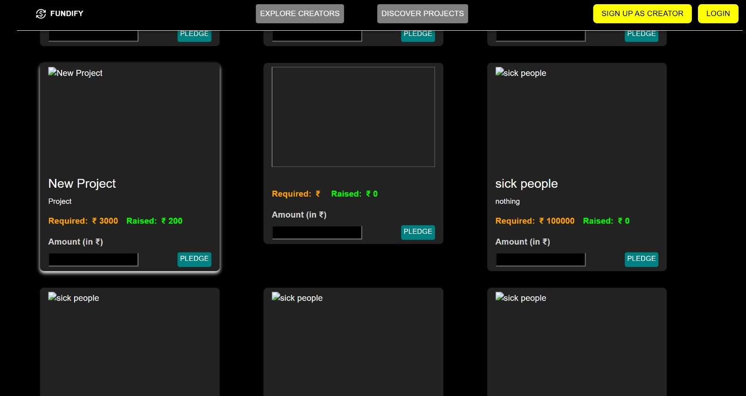
Modelling & Result

Slide 11
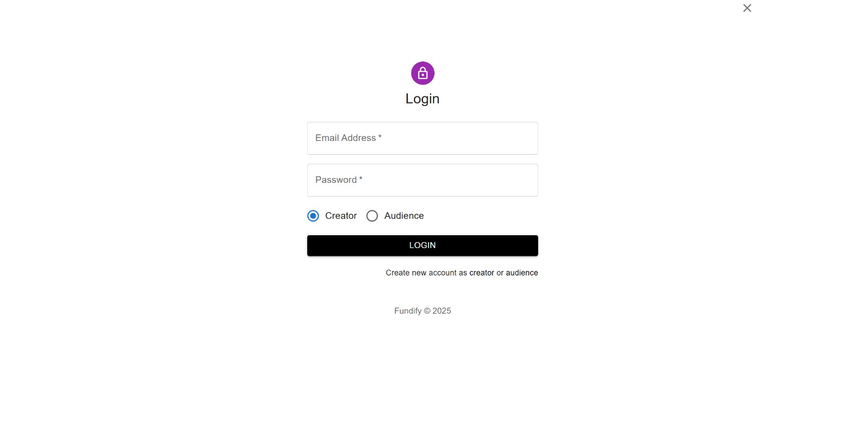
Modelling & Result

Slide 12
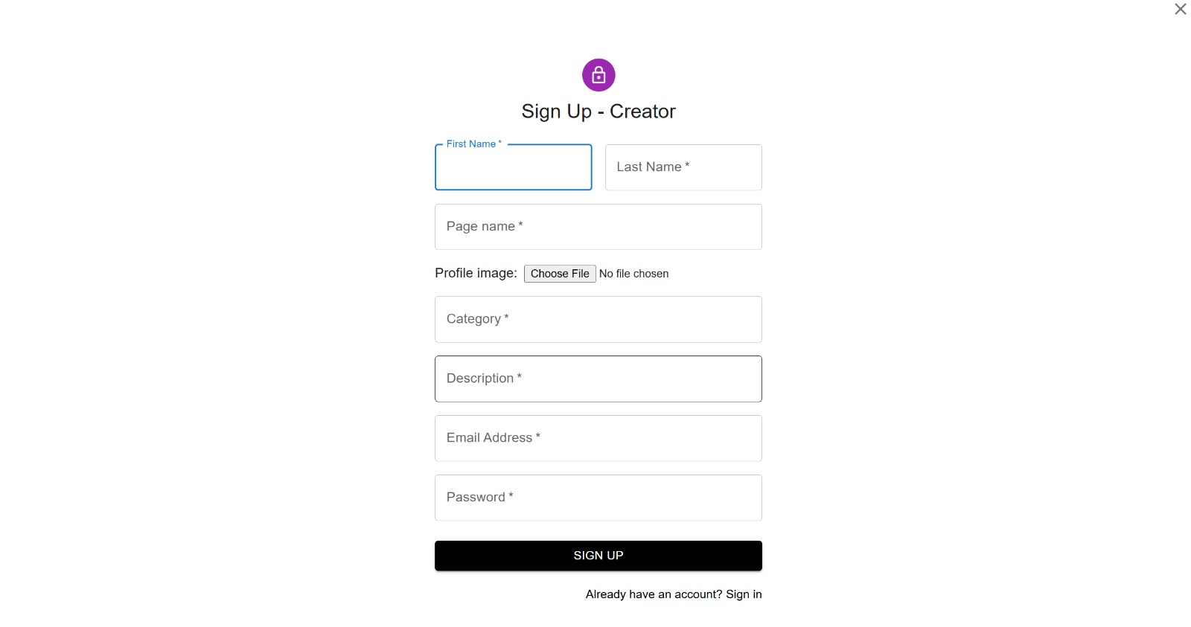
Modelling & Result

Slide 13
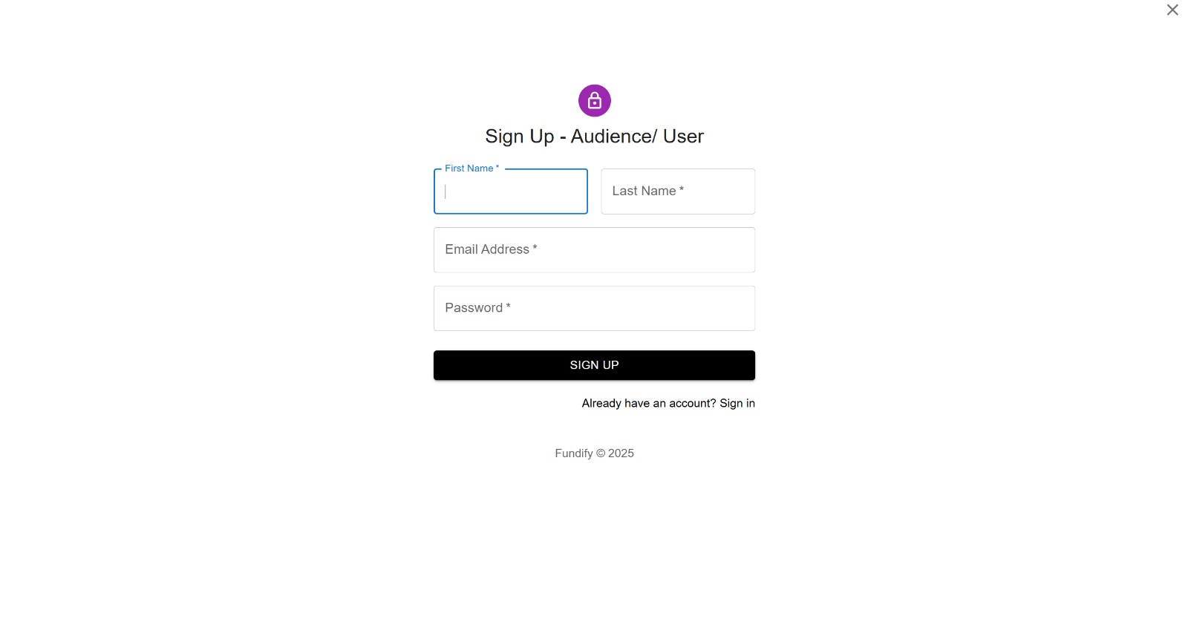
Modelling & Result

Slide 14
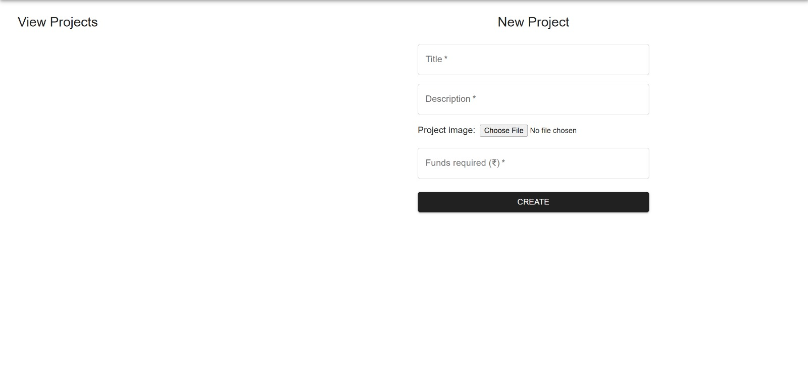
Modelling & Result

Slide 15
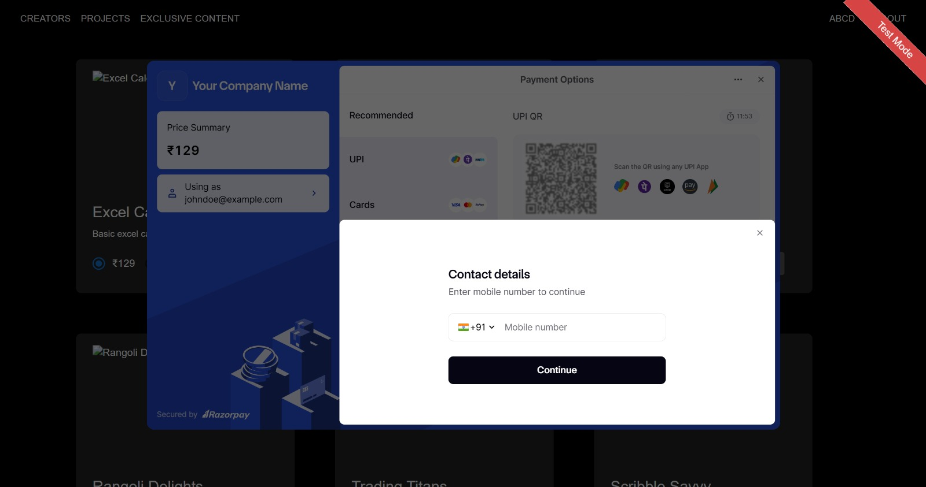
Modelling & Result

Slide 16

Conclusion
The Crowdfunding Platform built with React.js and Express.js provides an efficient, transparent, and secure way for individuals, startups, and NGOs to raise funds. By leveraging modern web technologies, the platform ensures:
✔️ User-Friendly Interface – Easy campaign creation and fund tracking. ✔️ Secure Transactions – Safe payment processing with fraud prevention. ✔️ Transparency & Trust – Real-time updates and progress tracking. ✔️ Scalability – Can accommodate growing user demand and fundraising campaigns.
🔹 Final Impact: This project empowers innovators, entrepreneurs, and social causes by bridging the gap between fundraisers and backers, making fundraising more accessible and efficient.

Slide 17


Notes:
Thank You !!

