Slide 1

PRESENTATION ON:
INSURANCE COST PREDICTION USING MULTIPLE LINEAR REGRESSOR RANDOM FOREST REGRESSOR
BY
FALAK KHAN

Slide 2
CONTENTS:
ABSTRACT
INTRODUCTION
TABLE OF CONTENTS
GRAPHS/FIGURES
DATAFLOW OF MULTIPLE LINEAR REGRESSION MODEL
EXPLANATION OF MULTIPLE LINEAR REGRESSION MODEL
EXPLANATION OF RANDOM FOREST REGRESSION MODEL
CONCLUSION
REFERENCES

Slide 3
ABSTRACT:
Insurance is a policy that eliminates or decreases loss costs occurred by various risks. Various factors influence the cost of insurance. These considerations contribute to the insurance policy formulation. Machine learning (ML) for the insurance industry sector can make the working of insurance policies more efficient. This study demonstrates how different models of regression can forecast insurance costs. And we will compare the results of models, for example, Multiple Linear Regression, Random Forest Regressor, CART, XGBoost,
Insurance fees are based on different variables. As a result, insurance fees are continuous values. Regression is the best choice available to fulfil our needs. We use multiple linear regression in this analysis since there are many independent variables used to calculate the dependent(target-y) variable. for this study, the dataset for cost of health insurance is used

Slide 4
INTRODUCTION
Insurance is a policy that eliminates or decreases loss costs occurred by various risks. Various factors influence the cost of insurance. These considerations contribute to the insurance policy formulation.
Machine learning (ML) for the insurance industry sector can make the wording of insurance policies more efficient.
This study demonstrates how different models of regression can forecast insurance costs.
And we can compare the results of models, for example, Multiple Linear Regression, Generalized Additive Model, Support Vector Machine, Random Forest Regressor, CART, XGBoost, k-Nearest Neighbors, etc.
For this project We have used multiple linear regressor and Random Forest Regressor for predicting Insurance Costs.
Linear regression is one of the easiest and most popular Machine Learning algorithms which belongs to the supervised learning. It is a statistical method that is used for predictive analysis.
RANDOM FOREST REGRESSOR is a popular machine learning algorithm that belongs to the supervised learning technique. It can be used for both classification and regression.

Slide 5
TABLE OF CONTENTS:
Age: | age of primary beneficiary
sex: | insurance contractor gender, female, male
bmi: | Body mass index, providing an understanding of body, weights that are relatively high or low relative to height, objective index of body weight (kg / m ^ 2) using the ratio of height to weight, ideally 18.5 to 24.9
children: | Number of children covered by health insurance / Number of dependents
smoker: | Smoking
region: | The beneficiary's residential area in the US, northeast, southeast, southwest, northwest.
charges: | Individual medical costs billed by health insurance (target – y)

Slide 6
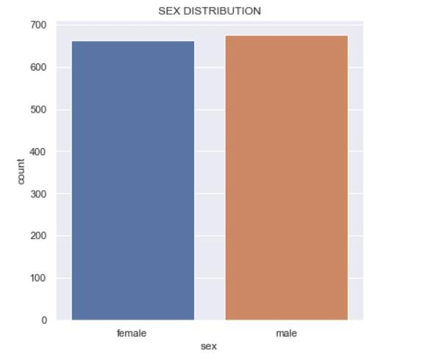
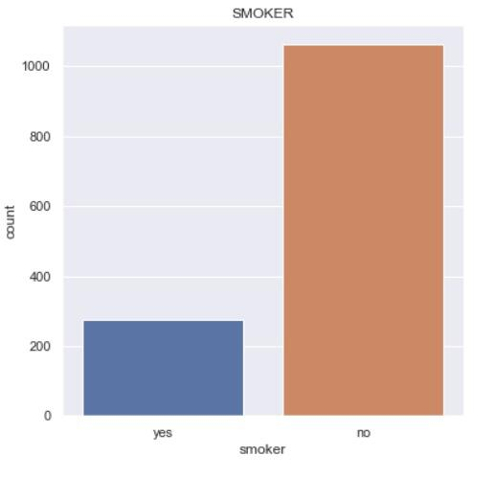
TABLE OF FIGURES/GRAPHS:

Slide 7
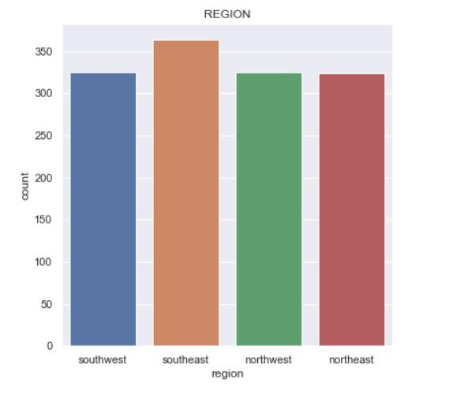
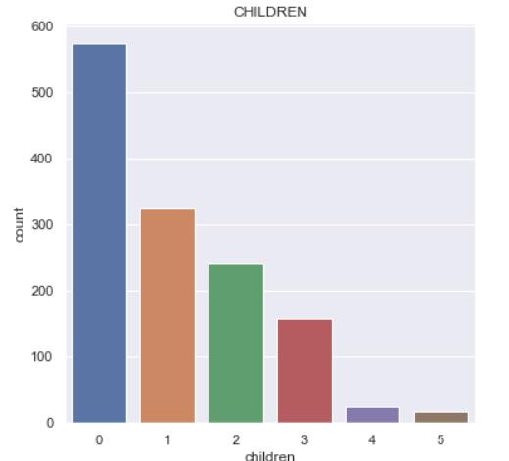
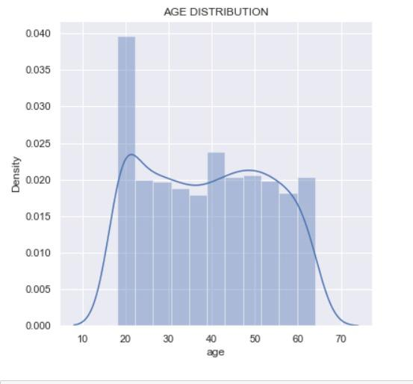
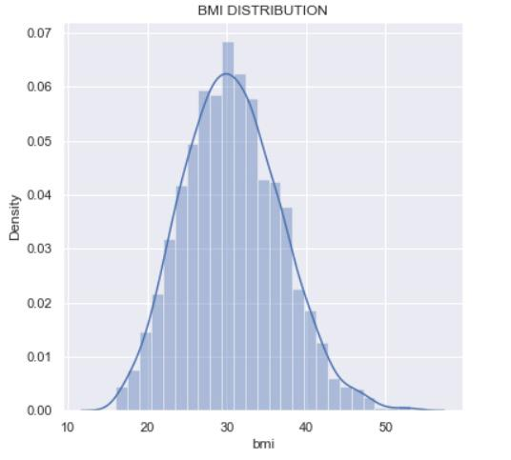

Slide 8
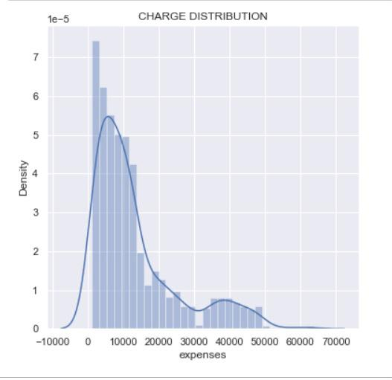
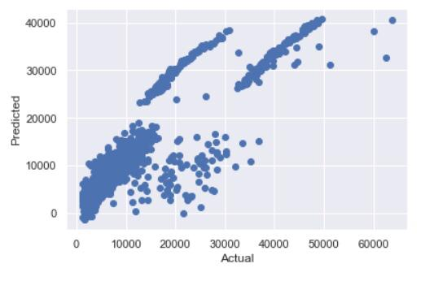

Slide 9
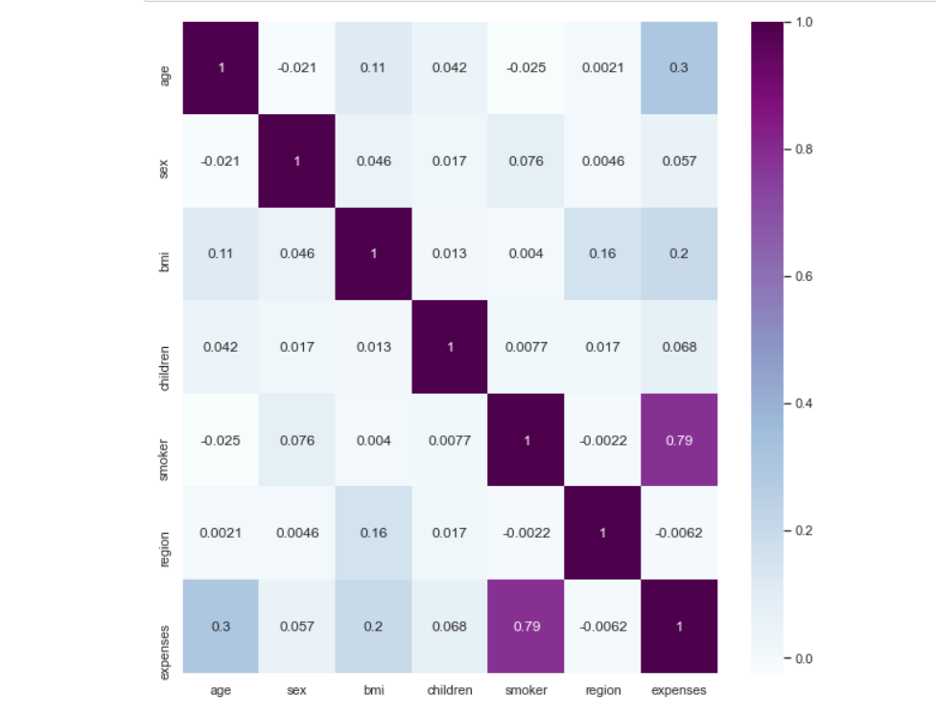
Correlation Matrix using Heatmap

Slide 10
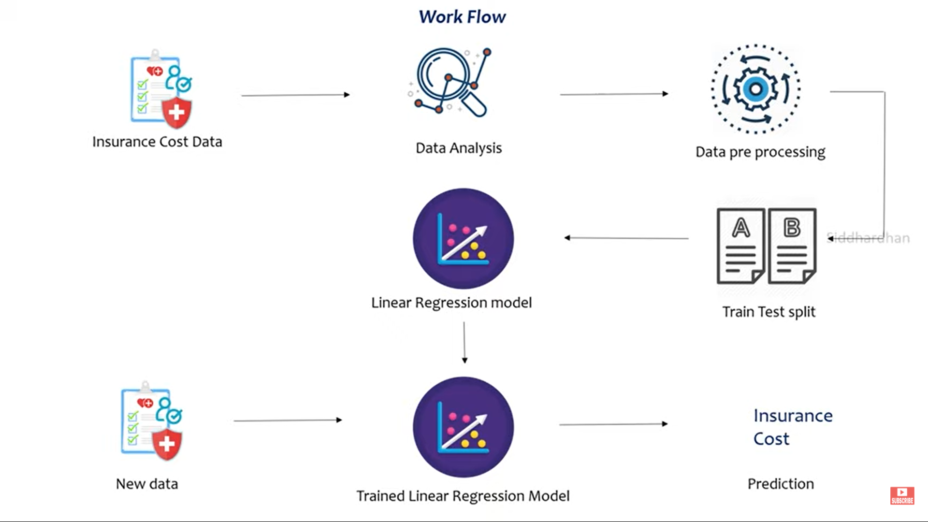
WORK FLOW OF MULTIPLE LINEAR REGRESSION MODEL:

Slide 11
STEPS IN MULTIPLE LINEAR REGRESSION:
Insurance cost data is fed into the system
Data analysis is done on the input data
Data Pre-processing
Split the data into training and testing set
Introduce it to the linear regression model
When the model is trained we finally pass new data to the trained regression model and the prediction of insurance cost is obtained

Slide 12
Algorithmic Model MULTIPLE LINEAR REGRESSION :
Multiple Linear Regression: is a machine learning algorithm based on supervised learning. It performs a regression task.
Linear regression is one of the easiest and most popular Machine Learning algorithms.
It is a statistical method that is used for predictive analysis.
We are going to use the sklearn library in python to implement Linear Regression.
Linear regression makes predictions for continuous/real or numeric variables such as sales, salary, age, product price, etc.

Slide 13
Working:
We are going to split our dataset into test and training data and fit the regression model with the training data and evaluate the model based on its RMSE and R-square scores over the test data.
The detailed code implementation and statistical models are displayed in the further screenshots.
From the data,
RMSE: 0.44201345567
R squared value: 0.7999053396503137
It means that our model has explained 80% of the variance of the target function using independent variables.

Slide 14
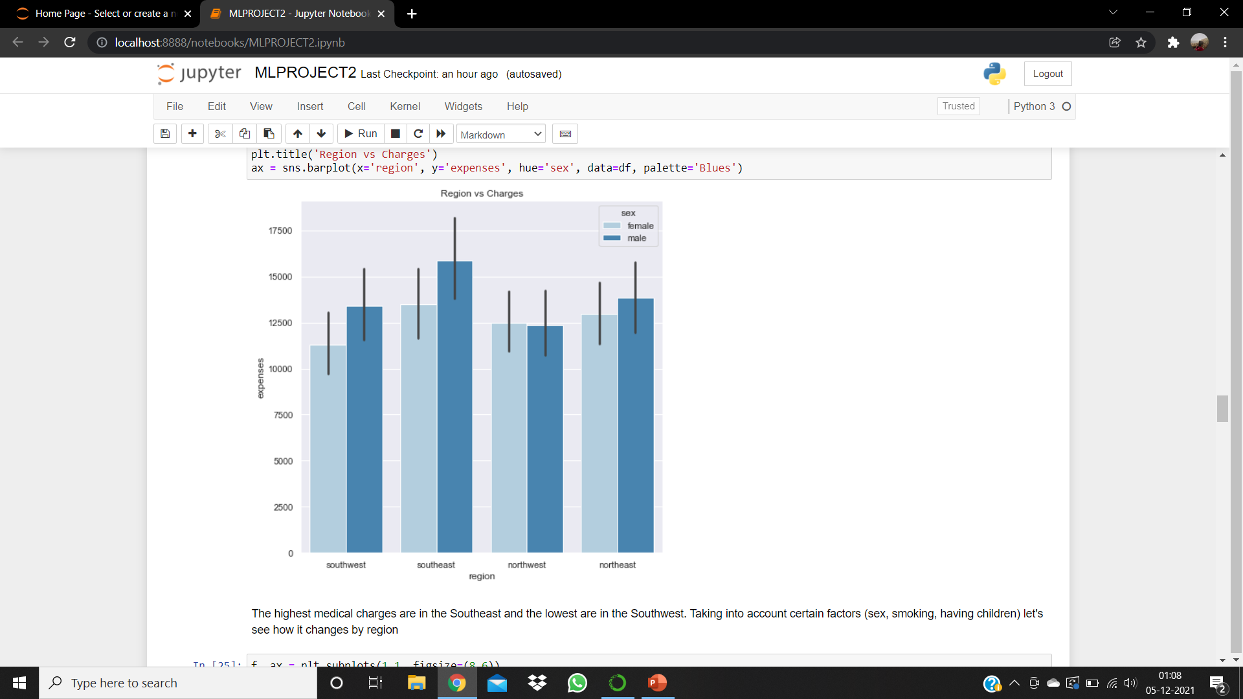

Slide 15
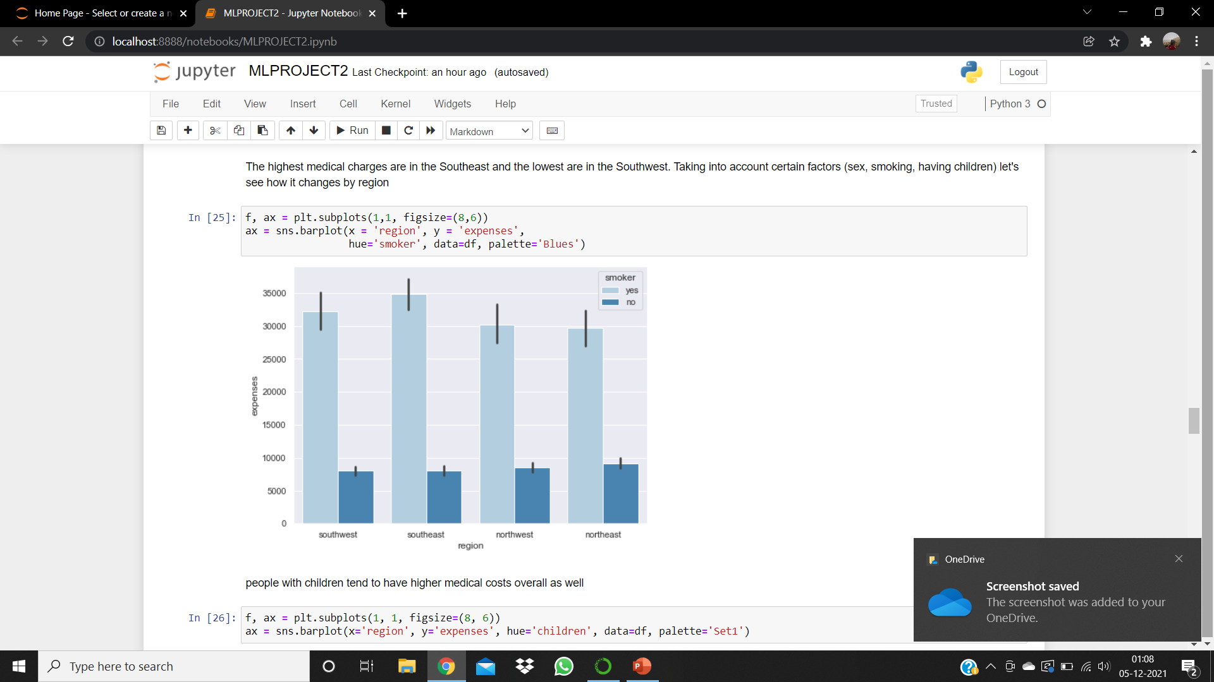

Slide 16
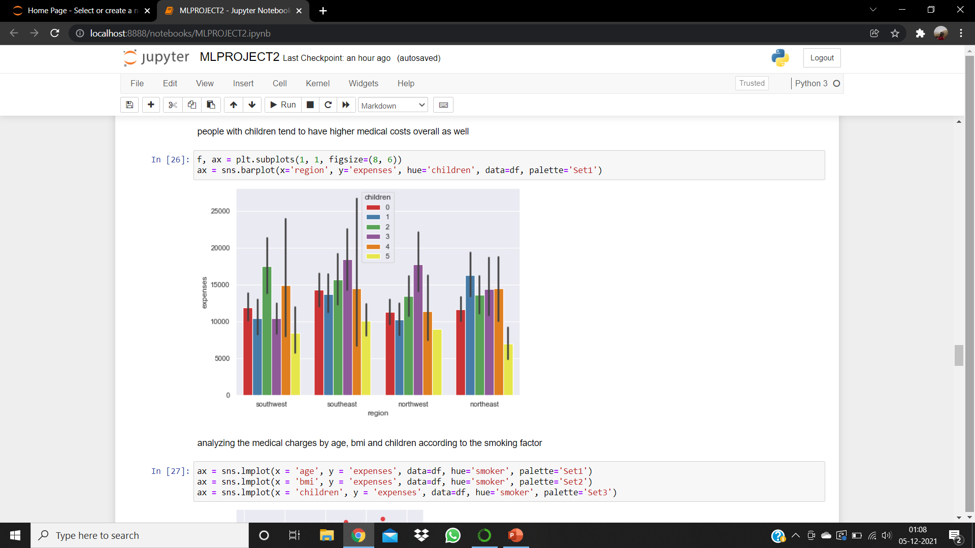

Slide 17
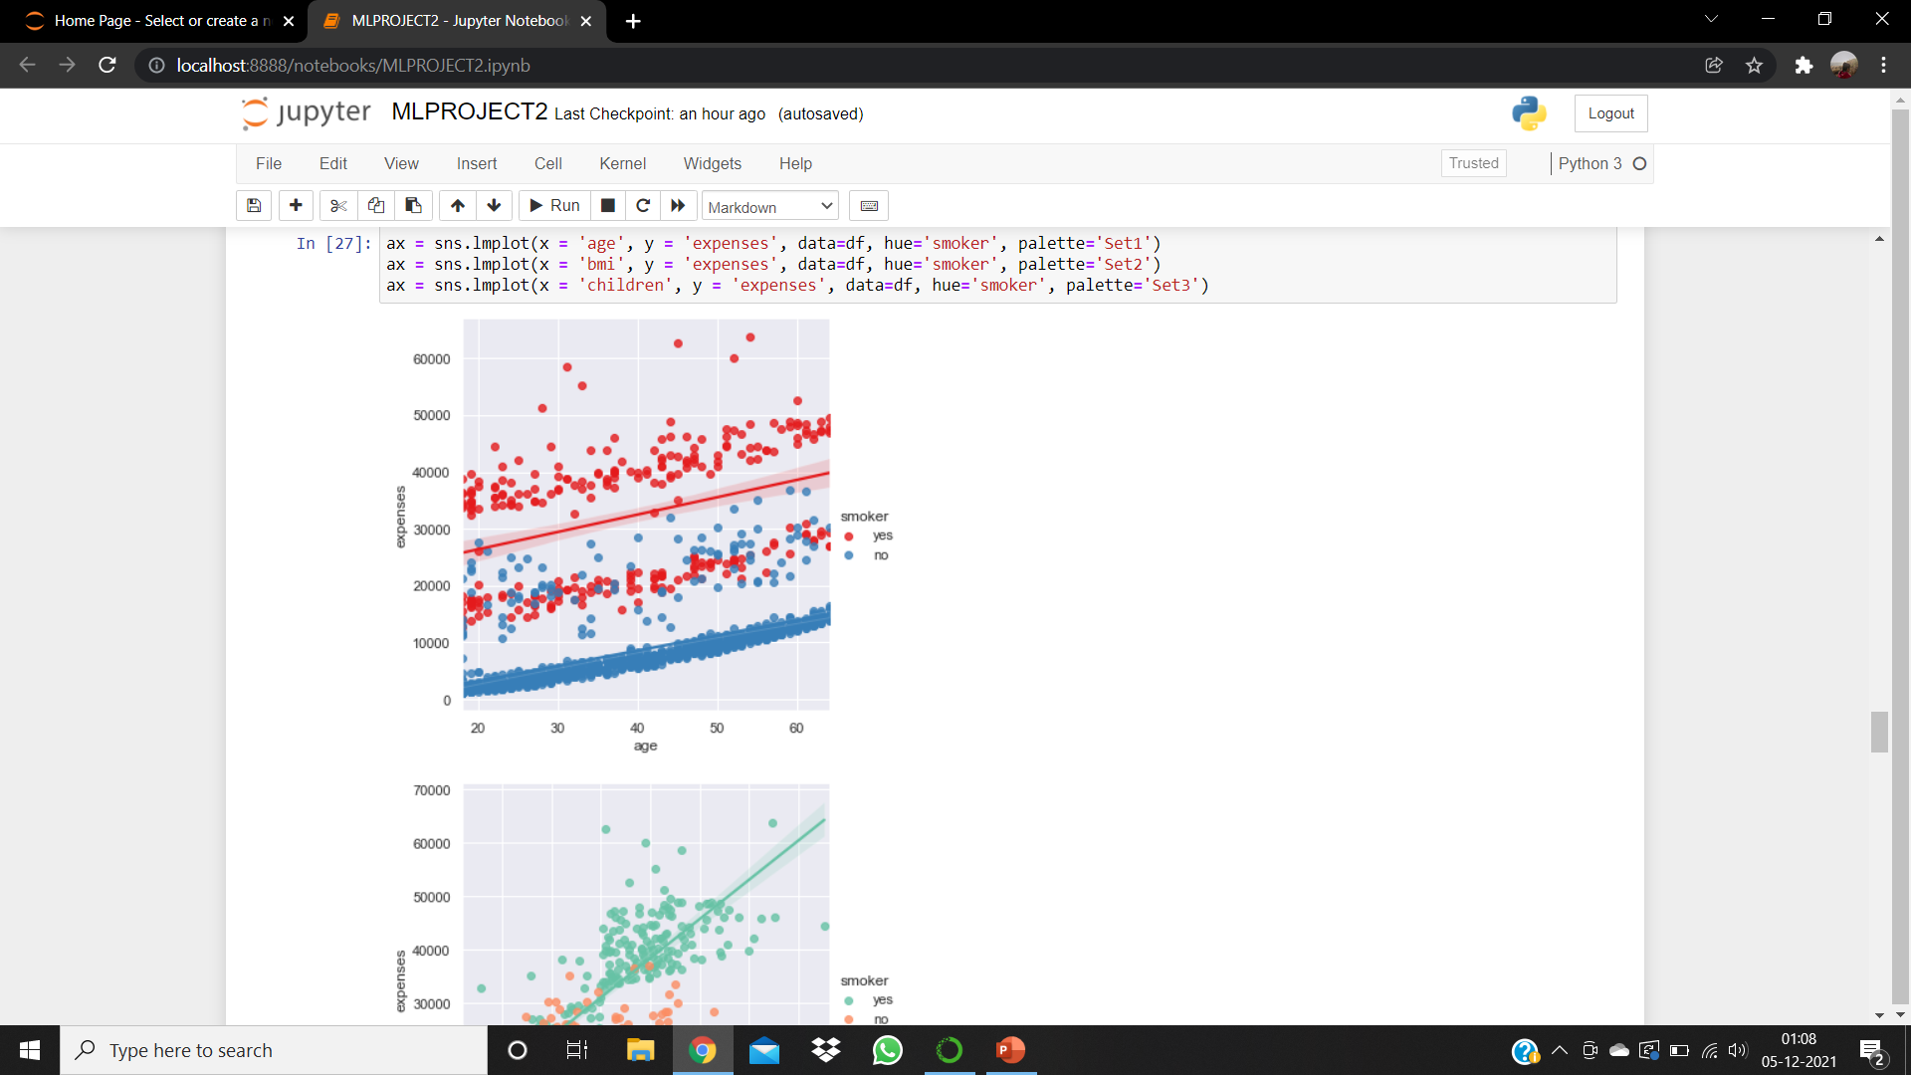

Slide 18
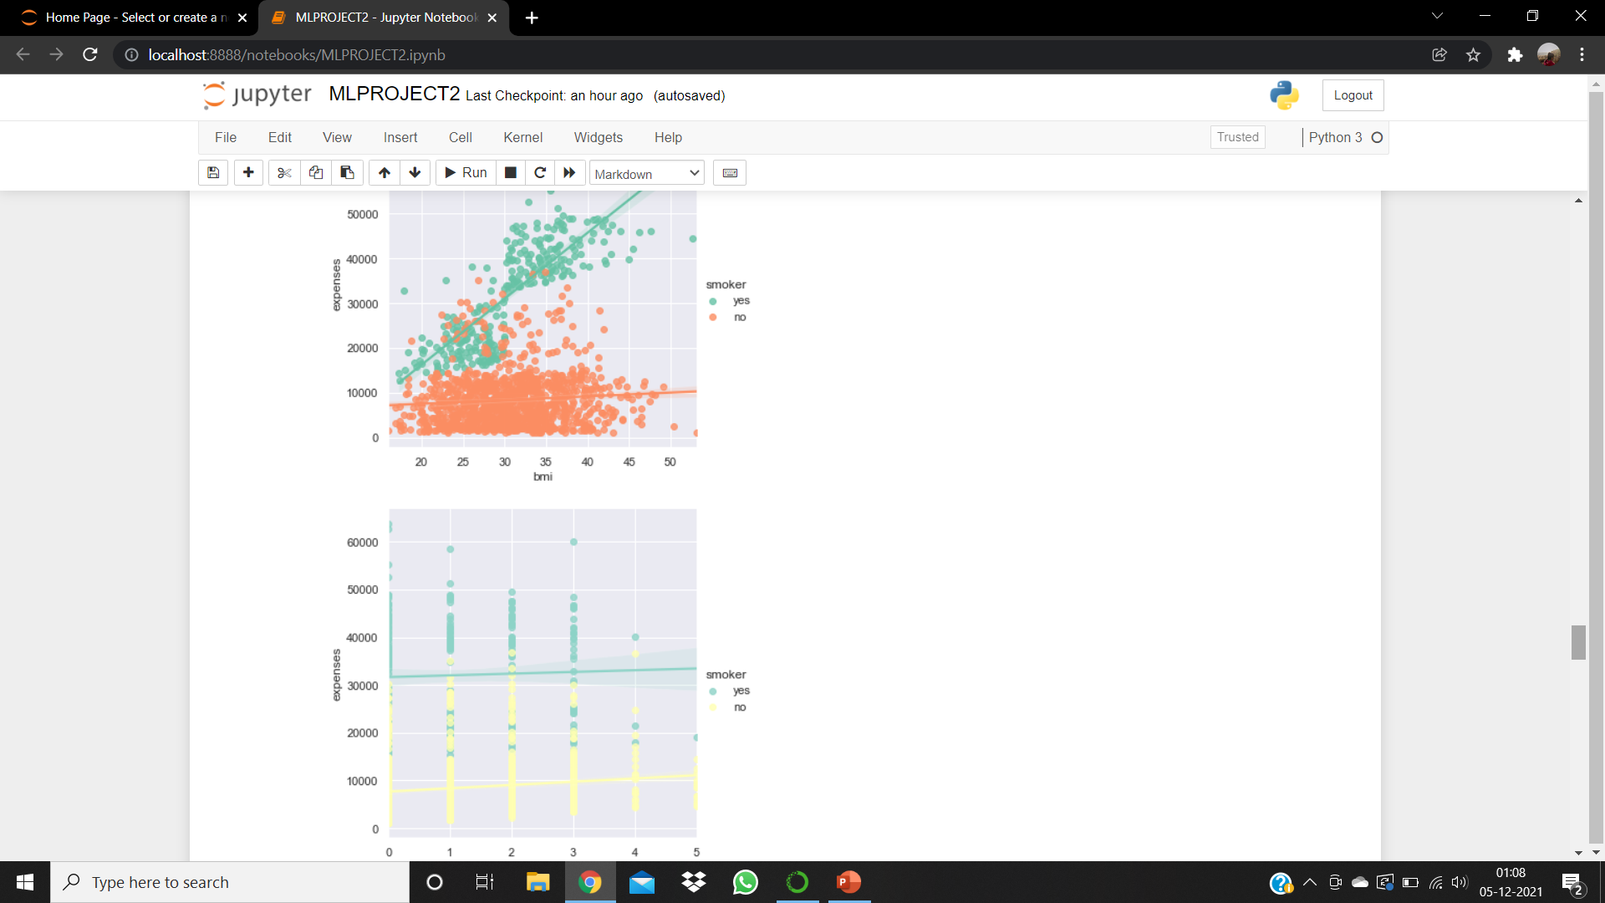
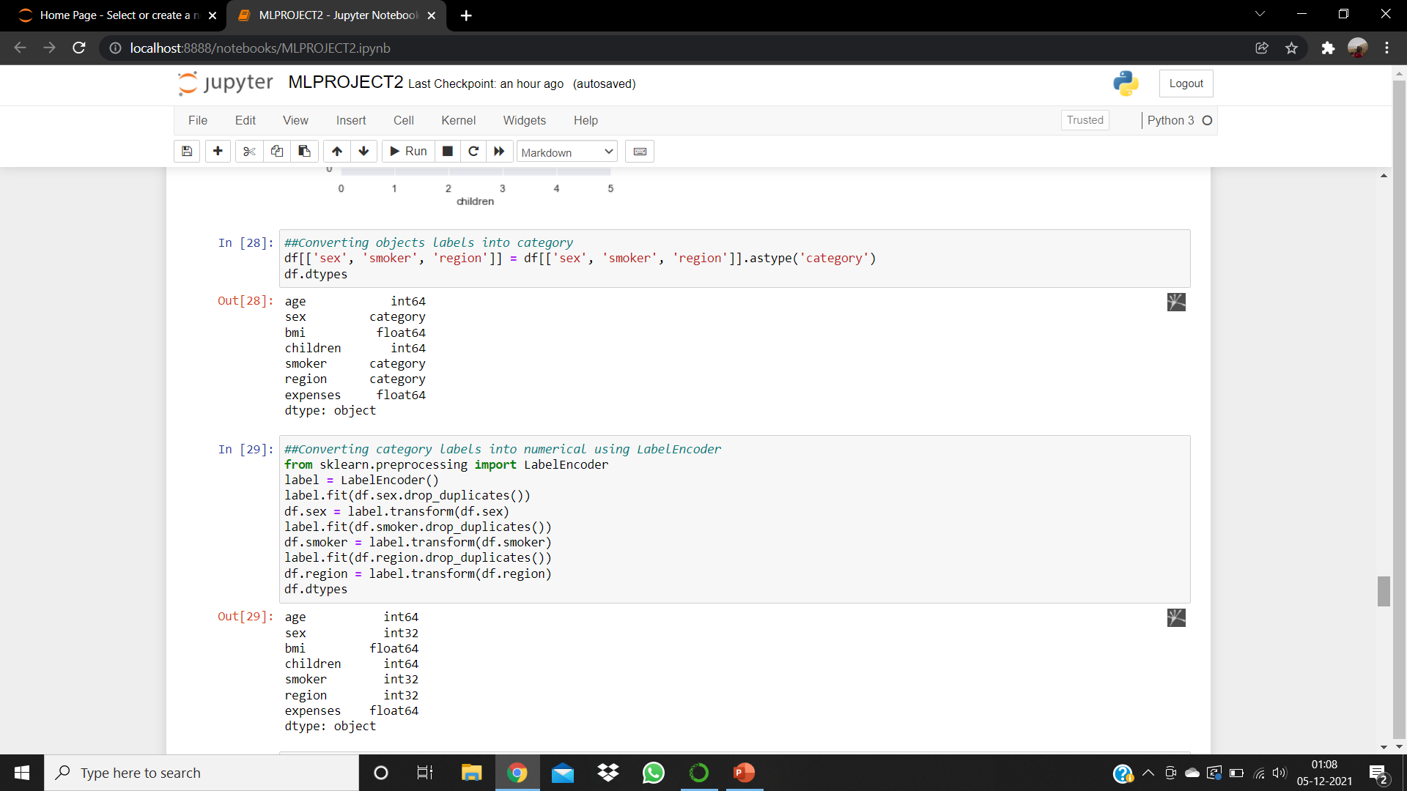
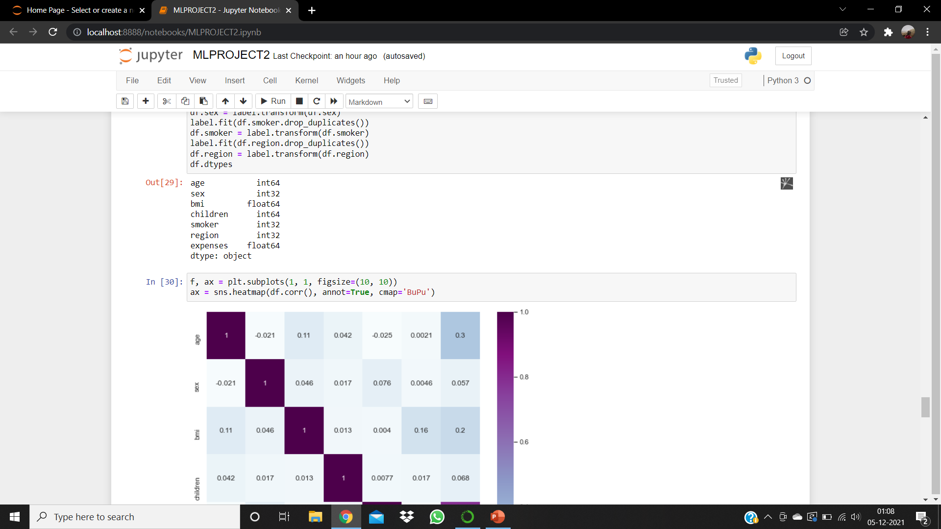
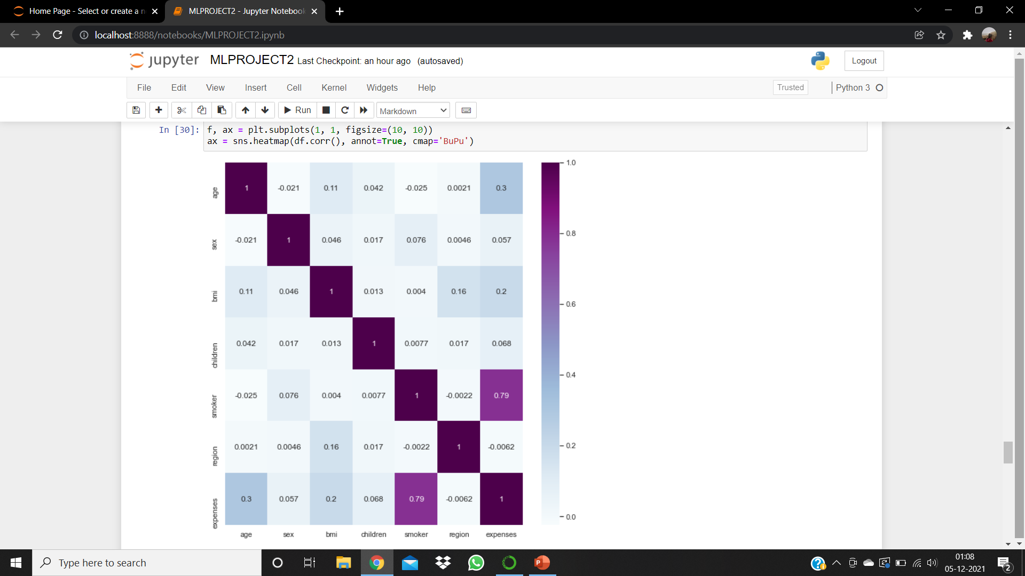

Slide 19
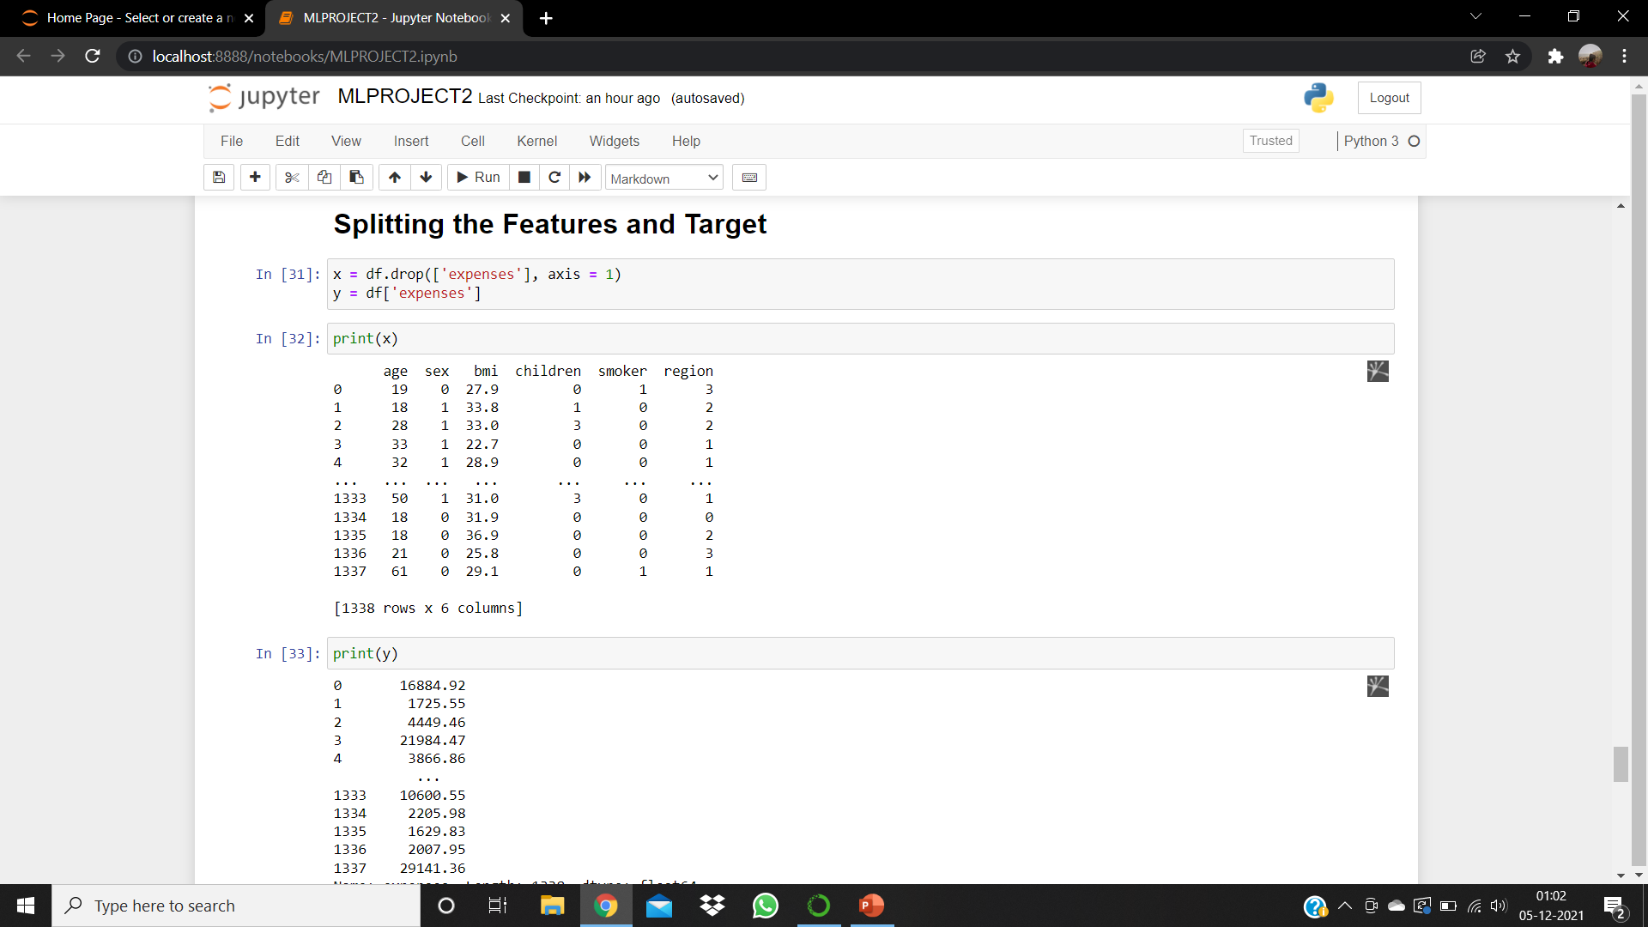

Slide 20
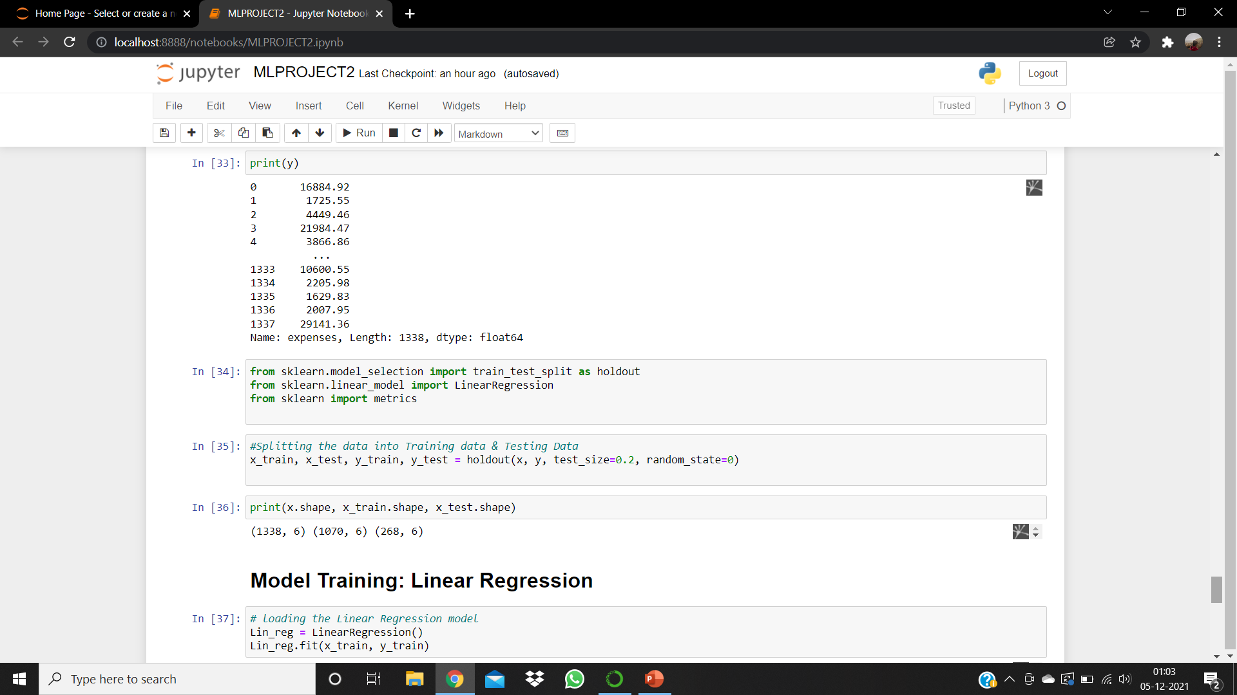

Slide 21
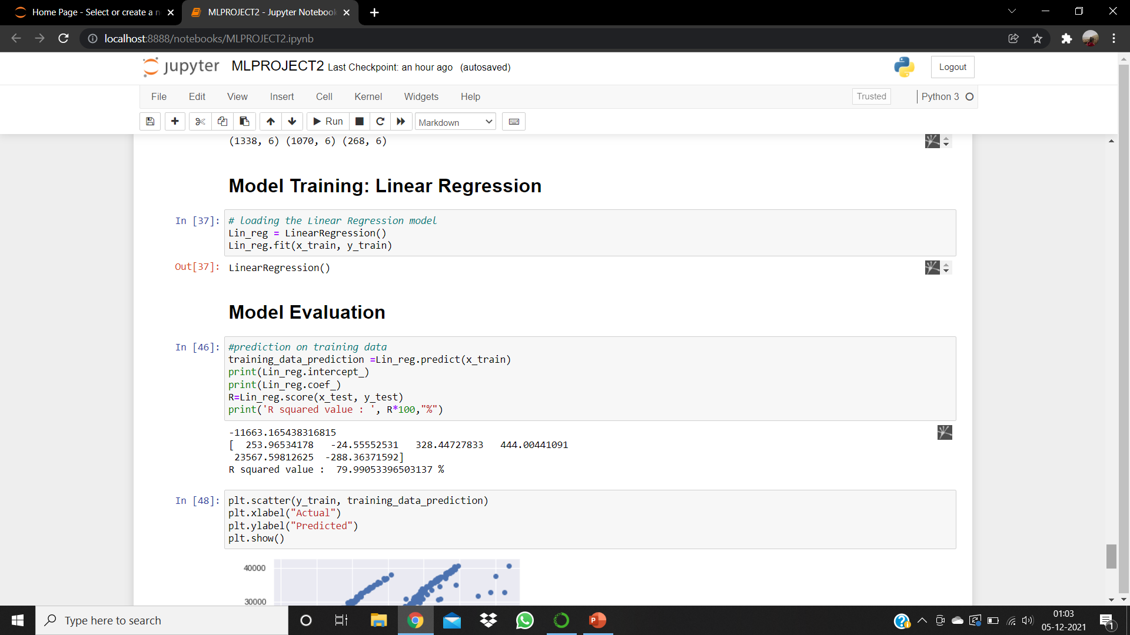

Slide 22
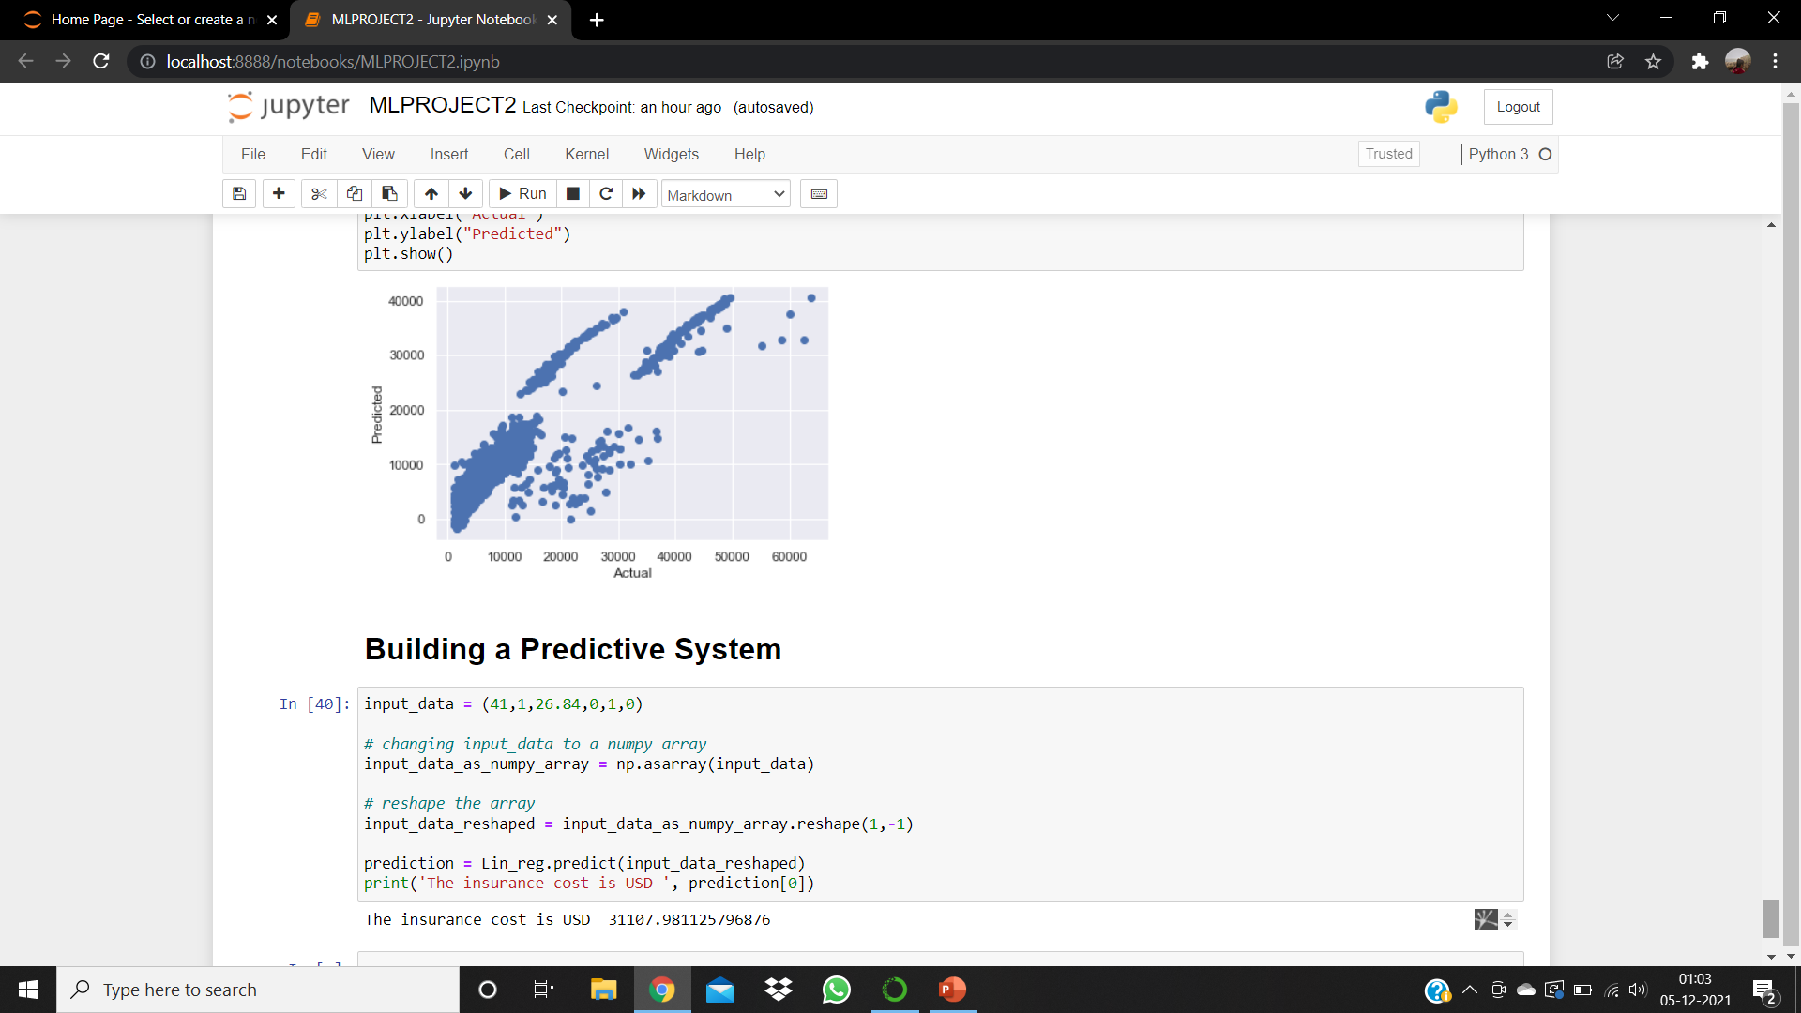

Slide 23
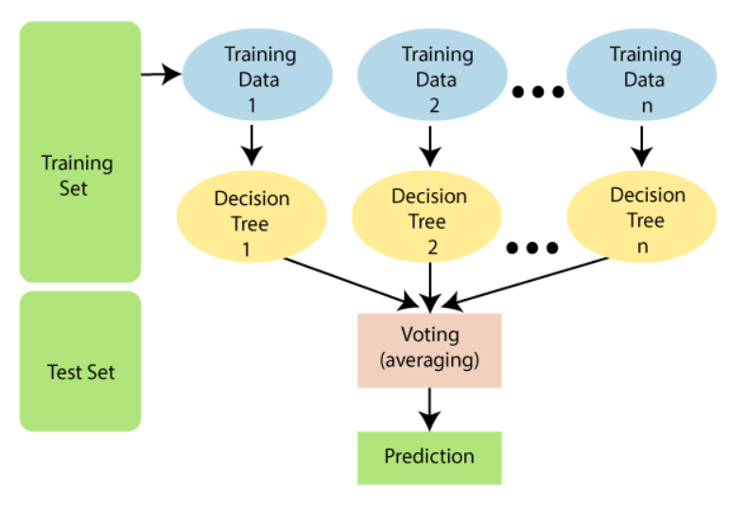
Random Forest Regression
RFR uses ensemble learning method which is a process of combining multiple classifiers to solve a complex problem and to improve the performance of the model.

Slide 24
Basic steps in RFR
1. Pick at random k data points from the training set.
2. Build a decision tree associated to these k data points.
3. Choose the number N of trees you want to build and repeat steps 1 and 2.
4. For a new data point, make each one of your N-tree trees predict the value of y for the data point in question and assign the new data point to the average across all of the predicted y values.

Slide 25
How does RFR works?
Importing the libraries, importing the dataset, addressing null values and dropping any necessary (least significant) columns, then the following steps are taken to create the model
Step 1: Identify your dependent (y) and independent variables (x)
Step 2: Split the dataset into the Training set and Test set
Step 3: Training the Random Forest Regression model on the whole dataset
From the sklearn package containing ensemble learning, we import the class RandomForestRegressor, create an instance of it, and assign it to a variable. The parameter n_estimators creates n number of trees in your random forest, where n is the number you pass in. The .fit() function allows us to train the model, adjusting weights according to the data values in order to achieve better accuracy. After training, our model is ready to make predictions, which is called by the .predict() method.
Step 4: Predicting the Test set results.

Slide 26
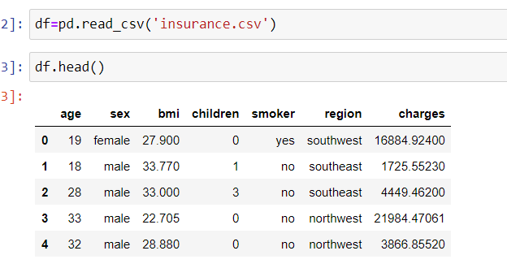
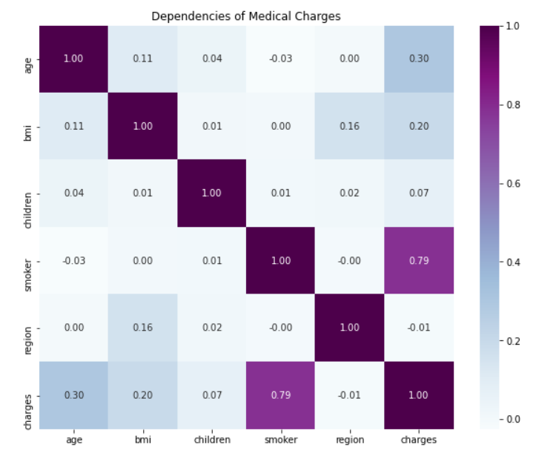
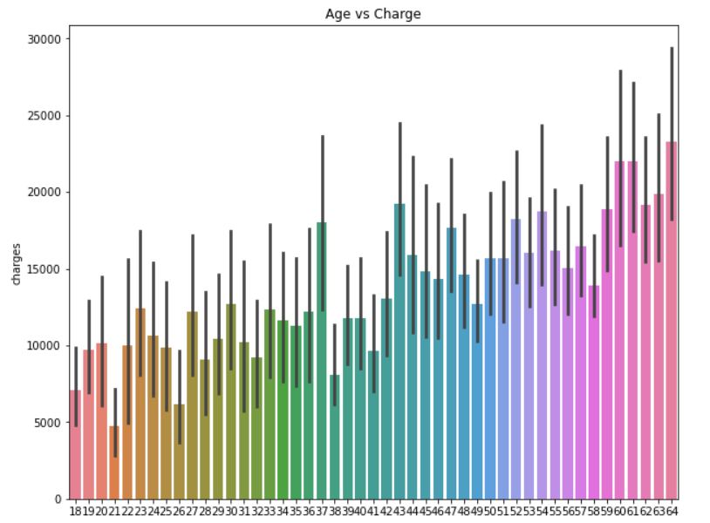
GRAPHS/FIGURES

Slide 27
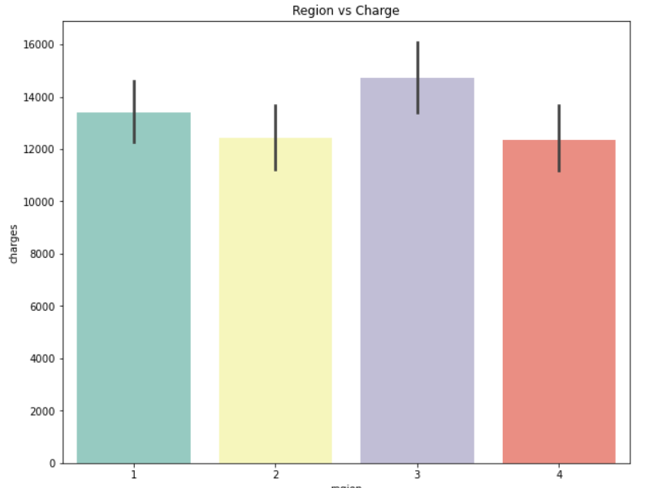
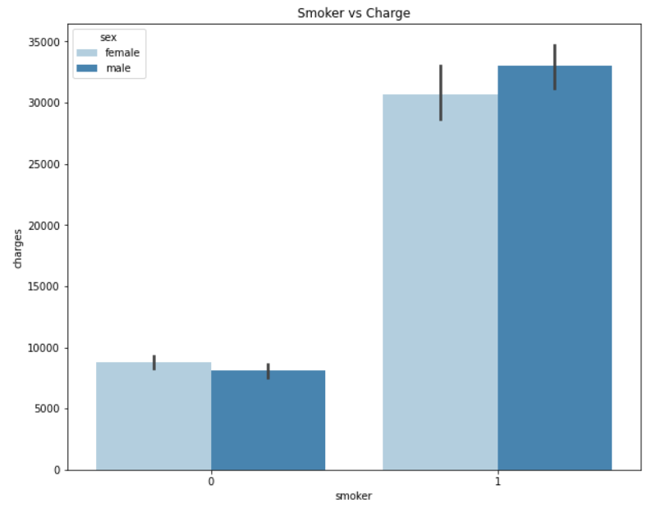
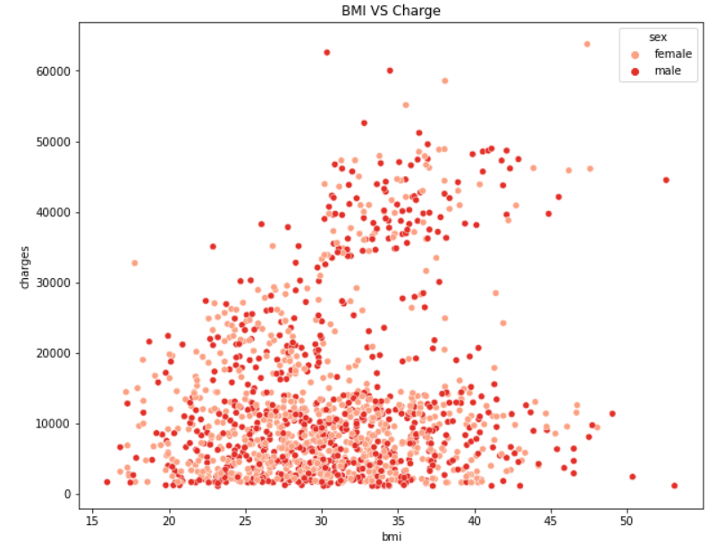
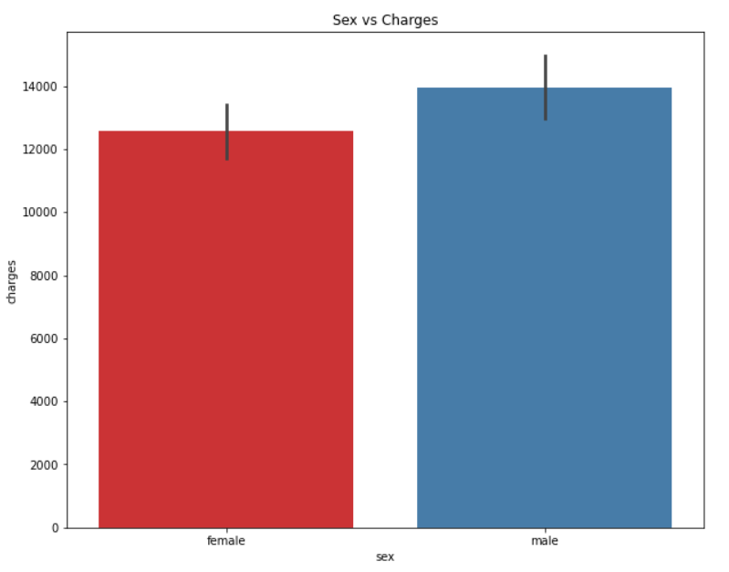

Slide 28
CONCLUSION
Forecasting insurance costs based on certain factors help insurance policy providers to attract consumers and save time in formulating plans for every individual.
Machine learning can significantly minimize these individual efforts in policymaking, as ML models can do cost calculation in a short time, while a human being would be taking a long time to perform the same task. This will help businesses improve their profitability.
The ML models can also manage enormous amounts of data.
The conclusion which we found is that machine learning algorithms performed better in this analysis.
And Random Forest Regression model performs the best among the regression models.

Slide 29
THANK YOU

