Slide 1


GILT-EDGE “A PENNY INVESTED. DOUBLE EARNED”
Participants:
Yash Bhanushali
yashbhanushali7107@gmail.com
Phone: 9008875696
College: Jain college of B.Com
Address: Hindwadi, Belgaum
Sahim Sanadi
sahimsanadi456@gmail.com
Phone: 7204413234
College: Gogte Institute of technology
Address: TV centre, Belgaum
Falak Khan
khanfalak799@gmail.com
Phone: 8951984808
College: S.G.Balekundri Institute of technology
Address: Camp, Belgaum

Slide 2
Source of passive income in the ever-changing economy
To achieve financial discipline in the long run
To beat Inflation
Why Investing?
Achieving financial goals
Making money grow
Channelizing savings into income

Slide 3
Introduction to our application
As we all know Improvements and Innovations have no boundaries.
In this presentation, we are focusing on building an application that will help us to invest in the Indian stock market and mitigate some drawbacks of the existing system of online trading applications.
Also adding some improvements and our ideas. Our application can provide some improvised services and holds scope to be enhanced in the future to cope up with the new technological advancements.

Slide 4
Few product services of the existing systems:
Different types of orders like the cover, bracket, stop-loss, etc.
Watchlists to view multiple stocks on your device.
Chart listing.
Order summary.
Console consisting of Profit/loss, trade book, IPO, etc.
Profile and application settings

Slide 5
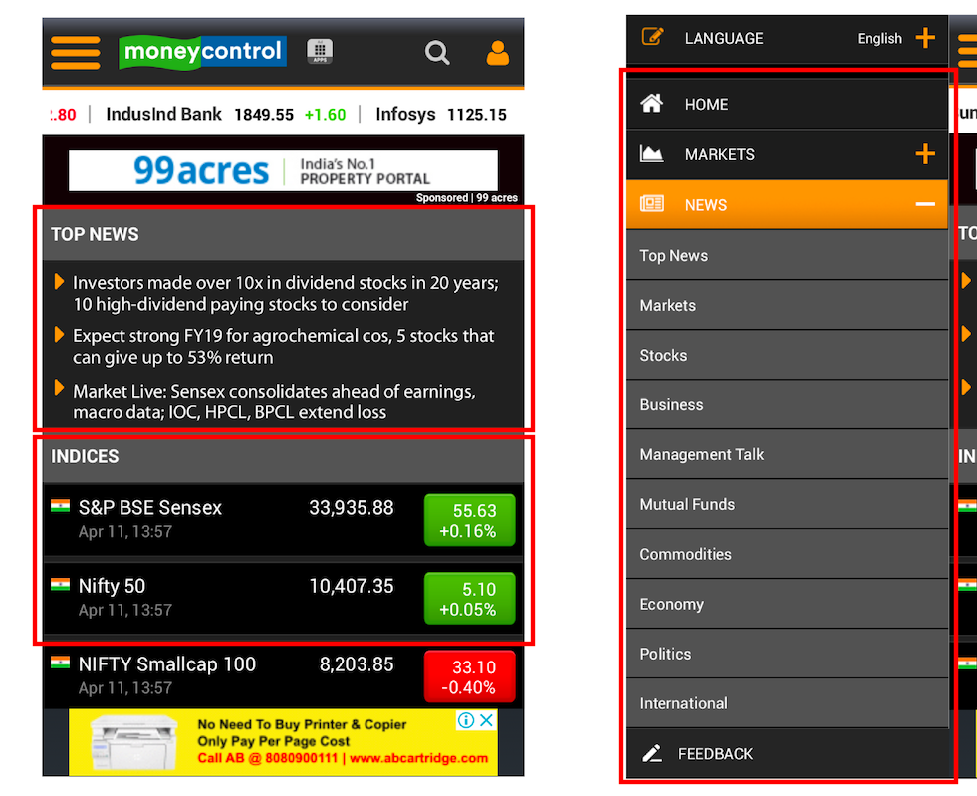
SOME KEY IMPROVISATIONS PROVIDED BY OUR APPLICATION:
ADDITION OF A TAB FOR NEWS AND STOCK INFORMATION:
REDUCTION OF WITHDRAWAL AMOUNT SETTLEMENT TIME.

Slide 6

NEW SERVICES PROVIDED BY OUR APPLICATION:
Agents(SEBI REGISTERED):
Introduction to Joint Demat accounts:

Slide 7
NEED FOR THE SERVICES PROVIDED BY OUR APPLICATION:
Agents(SEBI REGISTERED): These are individual financial advisors or associations which give stock calls or recommendations for educational purposes which helps us to receive a few additional stock-related information for better understanding.
Introduction to Joint Demat accounts: This feature is introduced for the safety and security of individuals who are minors and wish to invest in the Indian stock market.

Slide 8
Marketing Strategy Penetration Pricing
Penetration Pricing in the Long Run
Penetrative Strategy is adopted by Gilt-Edge
It is a method of pricing where the company enters the market with low prices when compared to its competitors to attract the target market and gradually increases the prices.
The reason for following this pricing strategy is that, India being a price sensitive economy, will adopt the new product/service

Slide 9
Government Aid for Startups:
Tax benefits for start-ups in India:
Tax exemptions on investments above the fair market value.
3 year tax holiday in a block of seven years.
Exemption from tax on LTCG.
Other Aids:
1. Single point registration facility on the
www.startupindia.gov.in
2. Venture Capital Scheme providing interest free loans to upcoming entrepreneurs.
3. Seed Fund Scheme (SISFS).

Slide 10
Summary
Gilt-Edge is an application that provides assistance to users in their financial journey.
As far as business development is concerned, the planning stage is highlighted in the presentation.
This application holds the ability to be enhanced in the future to cope up with the upcoming technological advancements in the trading community.
Government of India, provides various aid to upcoming and growing start-ups, by giving interest free loans and various tax benefits.
Hence, we strive at being the best trading app in India and thus assisting in the project of Digital India.

