Slide 1


﻿Fast Arts
PRESENTATION

Slide 2



﻿TEAM MEMBERS
﻿Ridhi Anand
﻿Falak Bhati
Faizan Khan
Hosting of Website
Backend of Gmail
Gmail Logo
PPT design
QR PAYMENT
LCD FUNCTION
CUP DISPENSER
COIN ACCEPTING LOGIC, ASSEMBLY
SENSOR
FRONT END OF EMAIL
Temperature Sensor
Cost cutting
﻿Ideas
Design
Logo

Slide 3
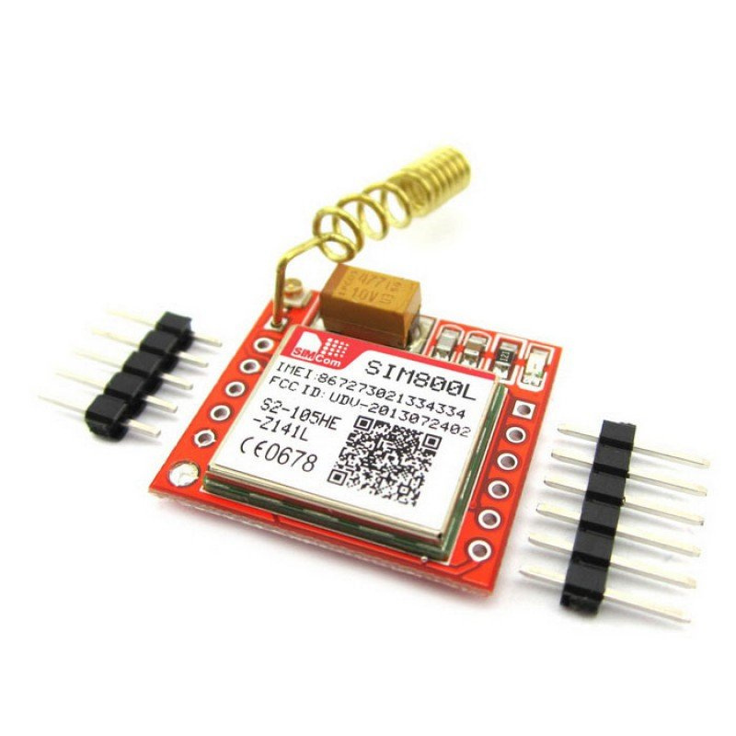
﻿SIM 800L
The SIM800L module is used to enable remote monitoring and control of the soda dispenser.
It allows you to send and receive data (e.g., status updates, maintenance alerts) using SMS or GPRS.
~FAIZAN

Slide 4
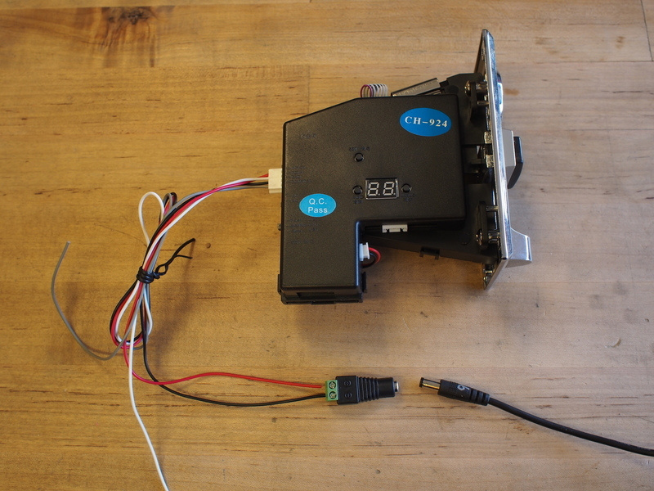
CH-926
CH-926 is a coin acceptor which can accept upto 6 kinds of different coins at the same time. It sets and records the value of a particular coin along with the shape and size.
~FAIZAN

Slide 5
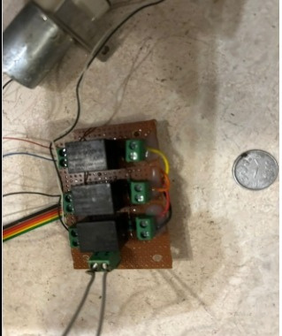
Relay module
In the soda dispenser, the relay module is used to control the dispensing mechanism.
It acts as a switch, allowing the microcontroller to control the flow of soda by activating the pump or valve.
~FAIZAN

Slide 6
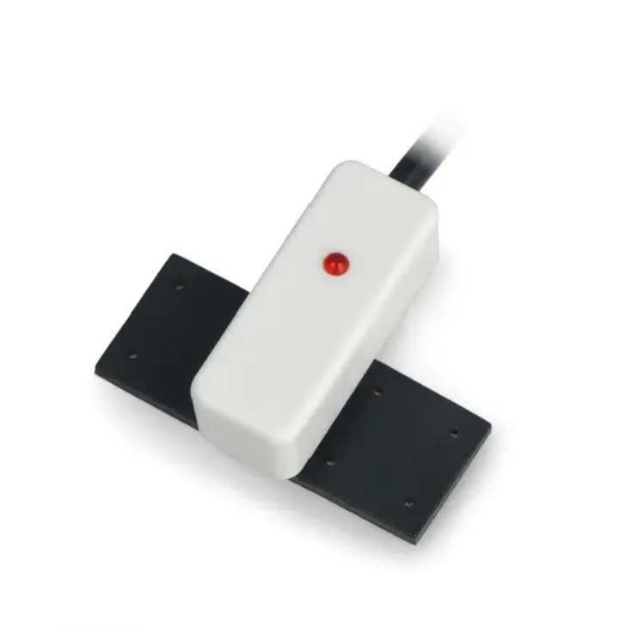
Non-Contact water sensor
Senses the beverage level through the dispenser wall, which stops contamination or sensor
damage from direct contact with liquid and indicates with a red light turning off when the beverage level is low.
~SARAH & FALAK

Slide 7
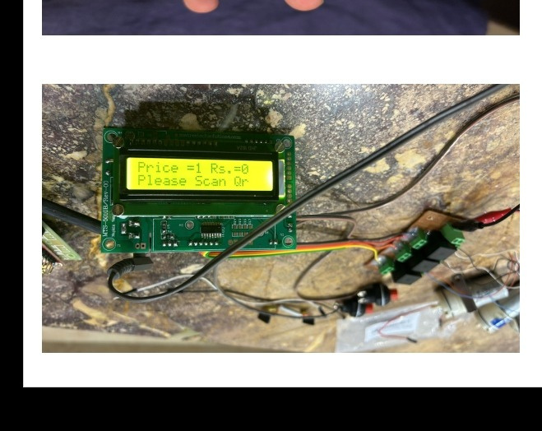
LCD
The LCD displays the price and tells the customer to scan the QR code. After the payment is done, it displays a “THANKYOU” message.
﻿Displays "OUT OF SERVICE" when the dispenser is out of beverage.
~FAIZAN

Slide 8
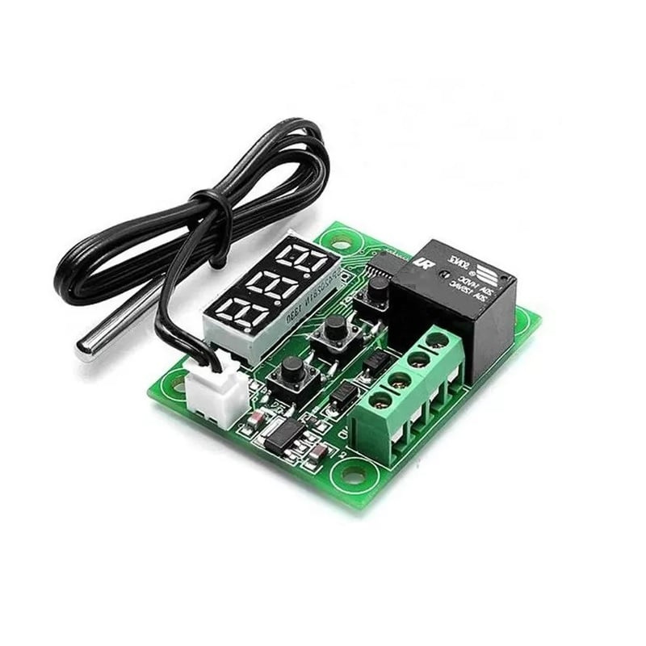
W1209 temperature sensor
This device keeps a constant eye on the temperature within the
dispenser. It sends a signal that the power supply is to be disconnected if the temperature is
above the set level.
~RIDHI

Slide 9
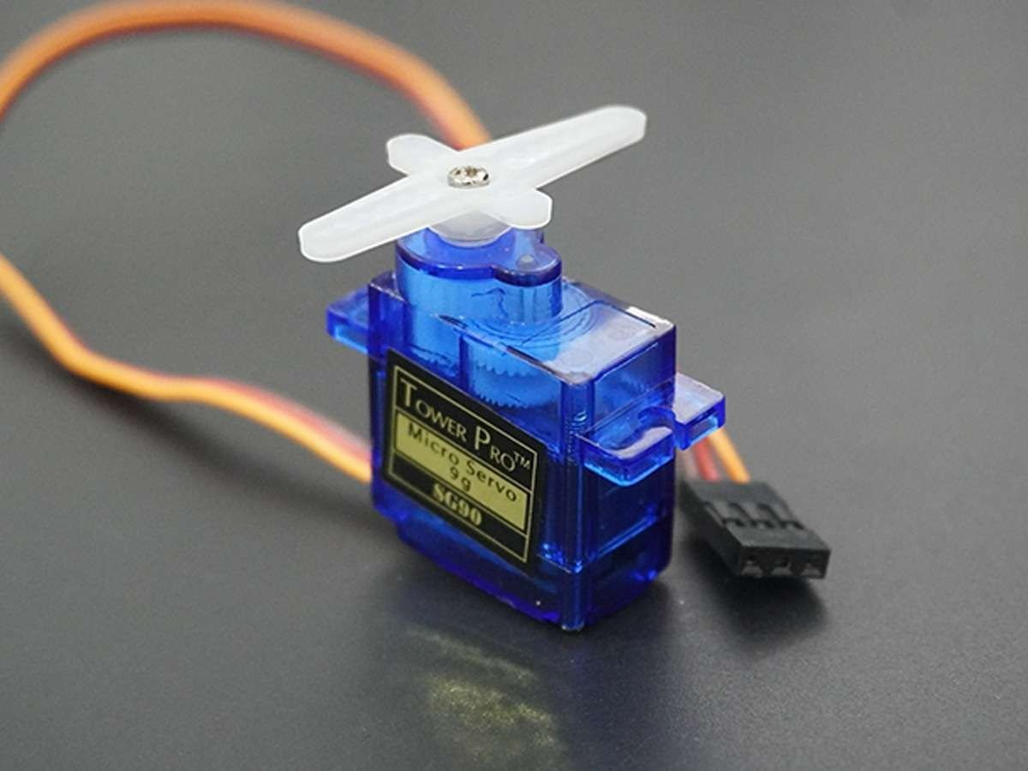
﻿FLAP SENSOR
Flap sensor detects the motion of the cup being placed or removed.Once the cup is removed, the flap sensor detects the motion and signals the microcontroller to
stop the beverage flow.This prevents further dispensing until another cup is placed under the
dispenser
~SIMRAN

Slide 10
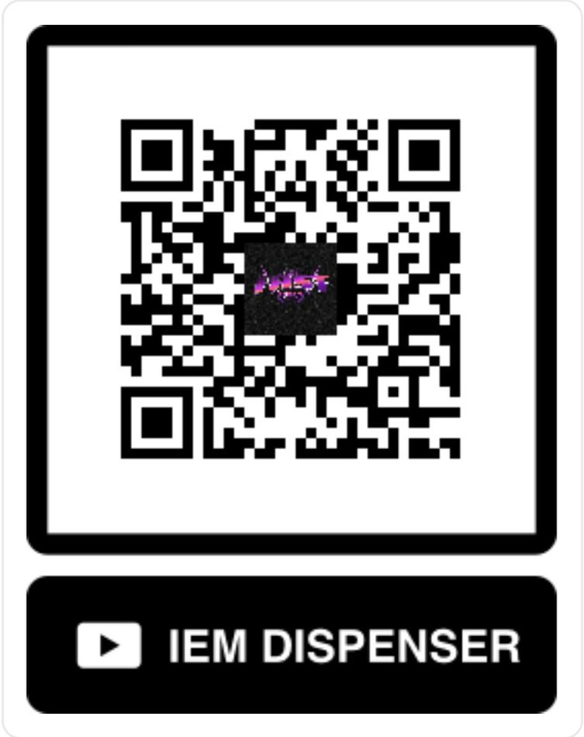
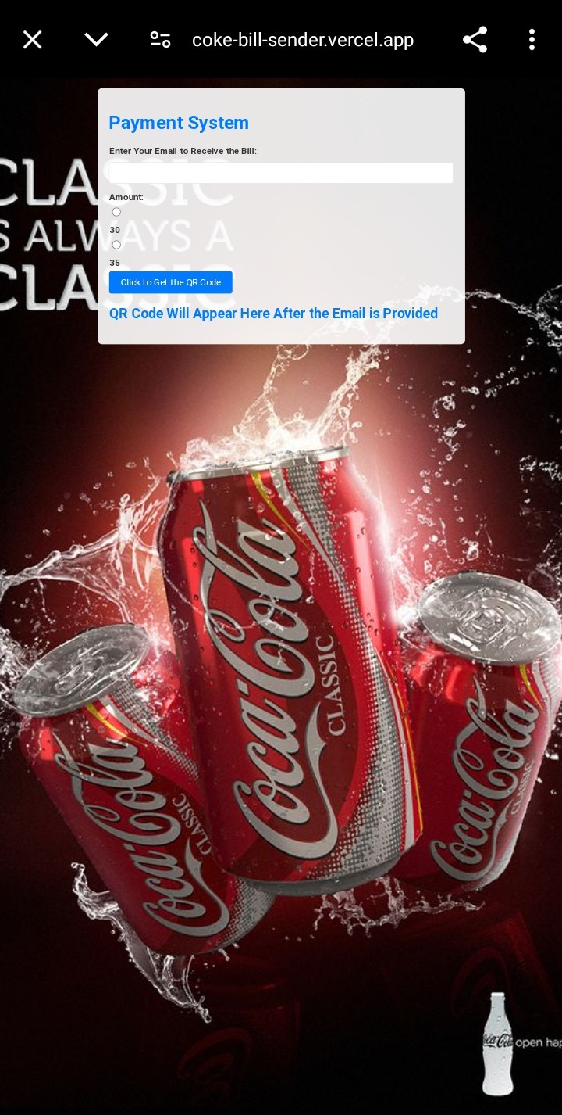
WORKING
No.02
﻿Enter your email, select price and click on 'click to get QR'
how the website works
Scan the QR
No.01

Slide 11
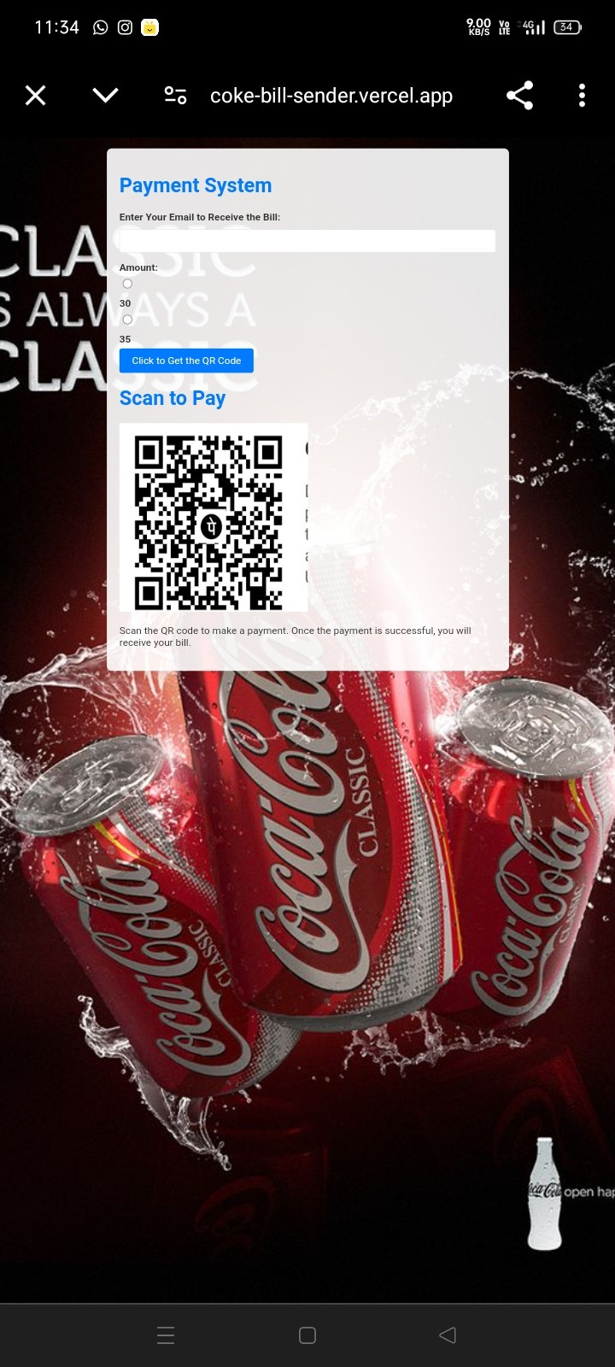
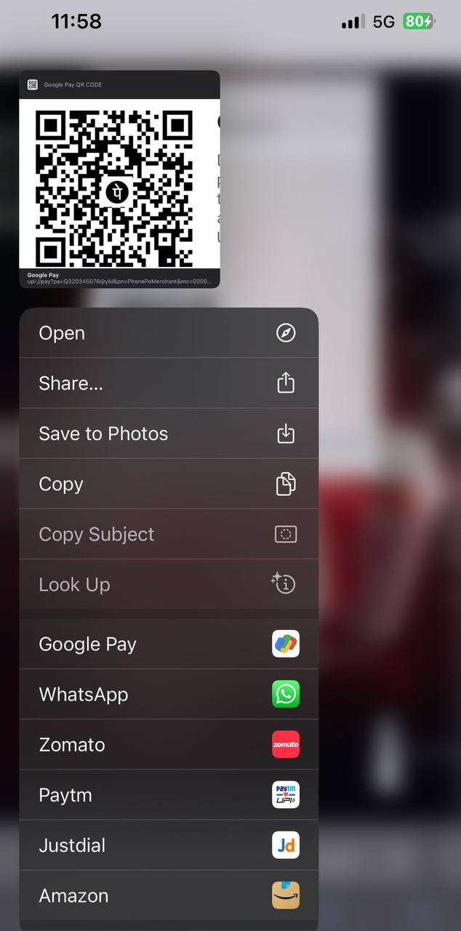
WORKING
how the website works
Scan the QR to proceed with the payment
In case of IOS, long press on the payment QR to proceed with the payment directly
No.03
No.04

Slide 12
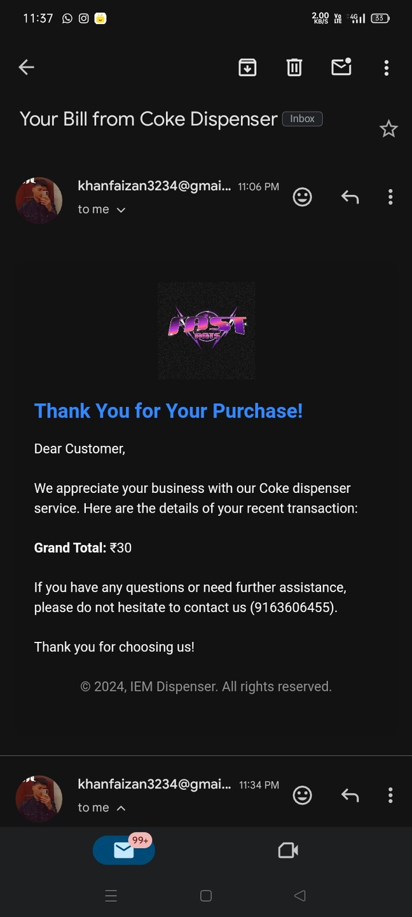
WORKING
No.05
Receive a mail after the payment is successful
how the website works
No.06
If not received mail of the bill, check the spam folder

Slide 13

﻿Overall Working
01
After scanning the QR and proceeding with the payment, a cup is to be put under the dispenser.
02
03
After pressing the button for your desired drink, the drink falls down into the cup until the cup is filled.
In case of excess beverage, it flows down to the fluid catch tray and then goes back to the bin

Slide 14
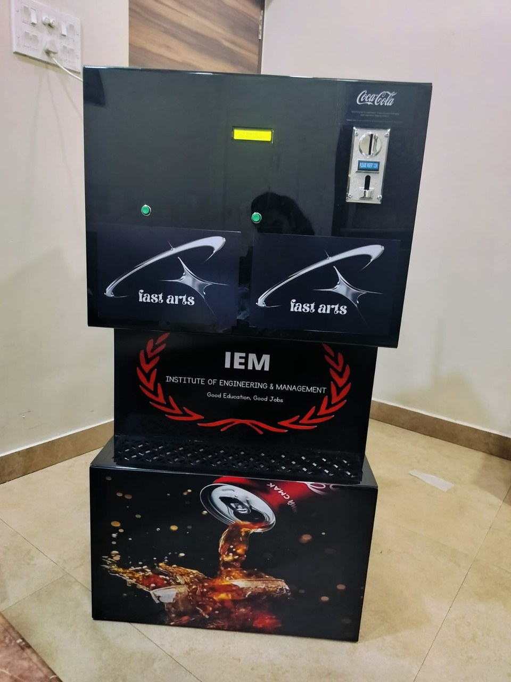
The IEM Coke Dispenser is an automated system designed to dispense Coke efficiently. It uses moisture sensors to monitor liquid levels (full and low) and a relay module to control a pump for dispensing. A buzzer alerts users when the stock is empty. The system is powered by a microcontroller (like ESP32), which manages sensor input and pump operation. When the level sensor detects no liquid, a notification system can send alerts to refill the dispenser. It’s a reliable and simple solution for automated drink dispensingd a subheading

Slide 15


Thank You.
﻿FAST ARTS
PRESENTATION

