Slide 1
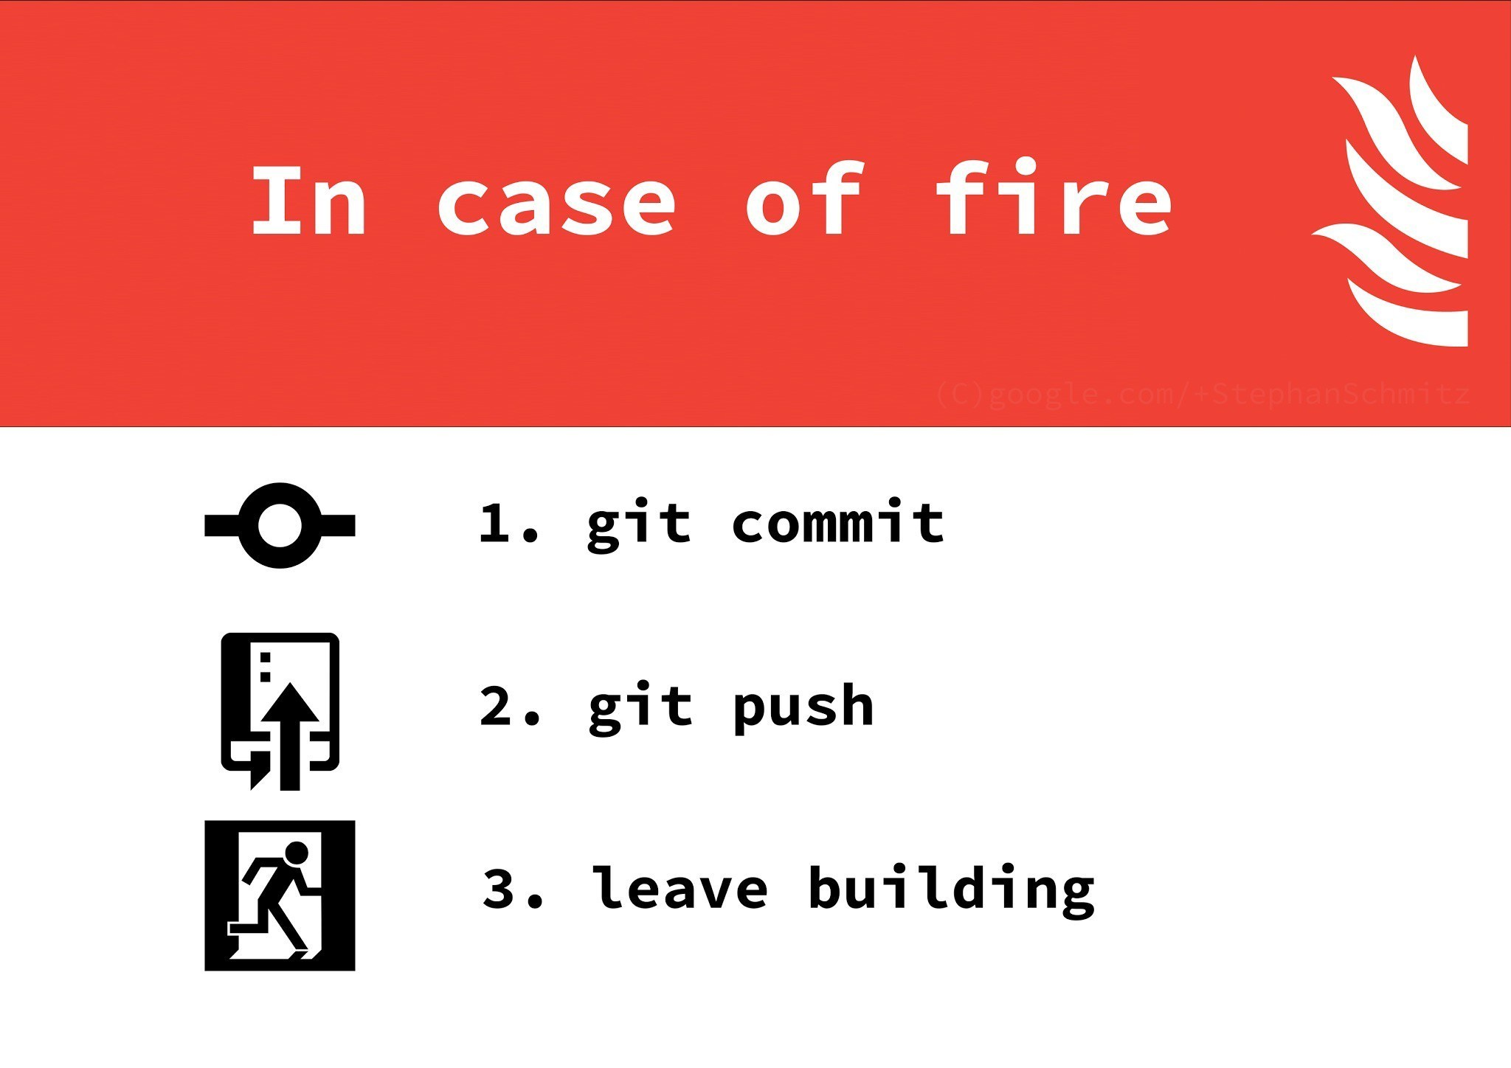
Git & Github

Slide 2
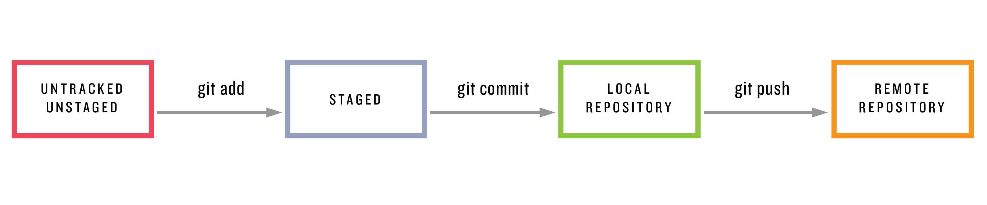

Slide 3
First Demo

Slide 4
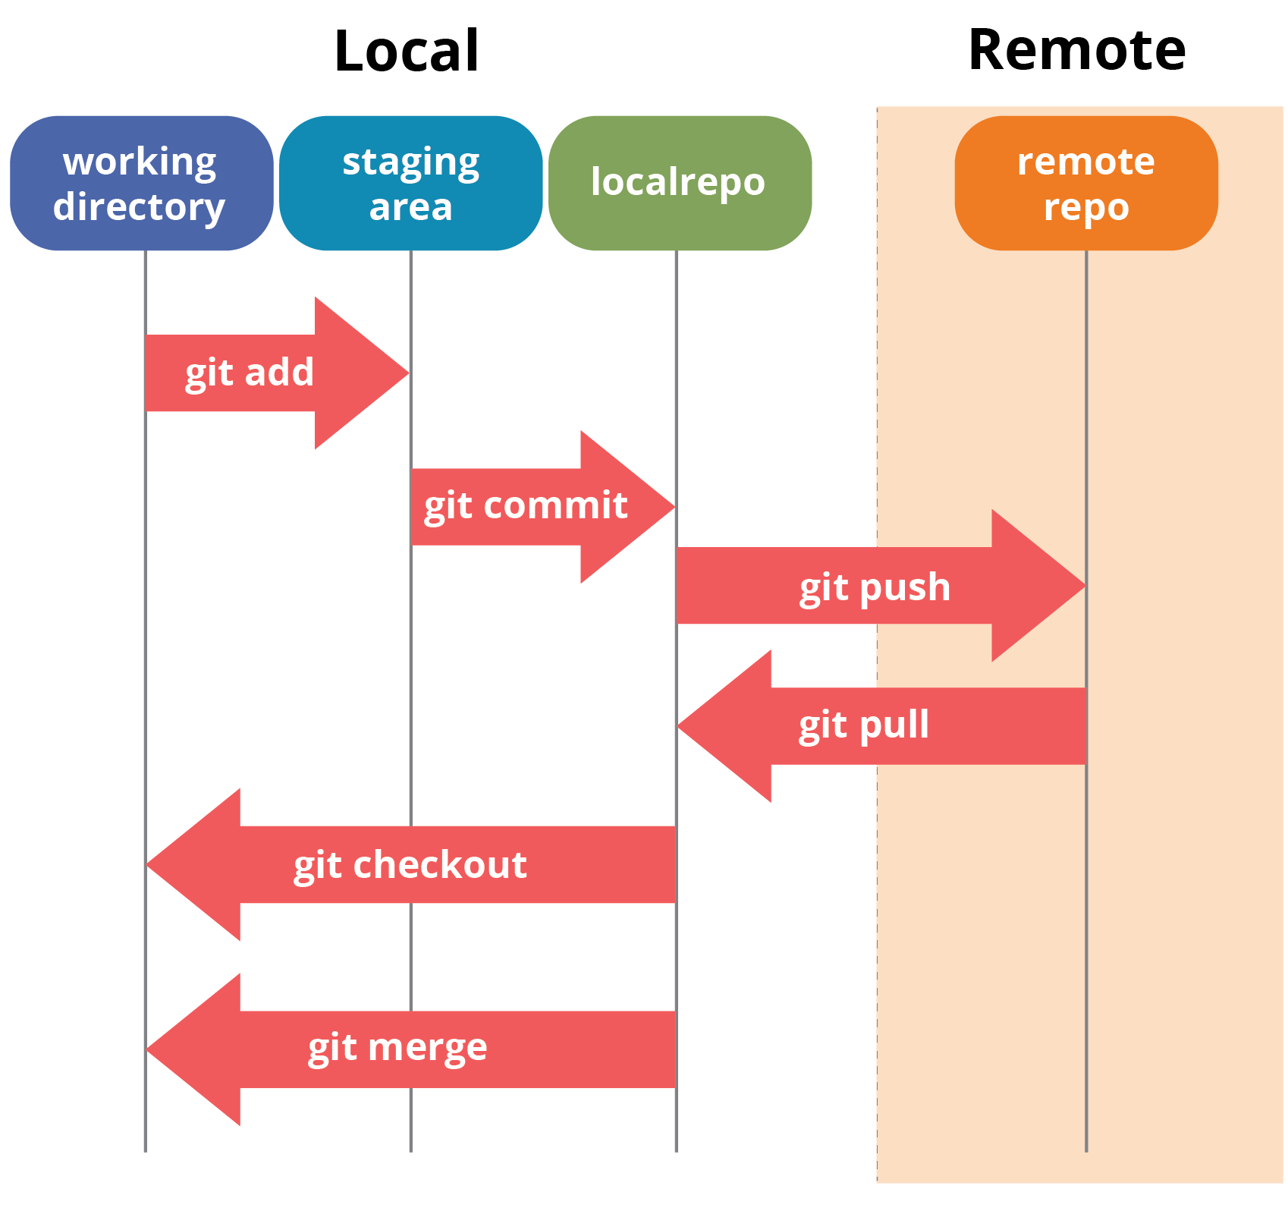

Slide 5
Second Demo

Slide 6
How to undo stuff in general
1) Accidentally edited a file without committing or “git add-ing” it?
“git checkout -- (file)” (this is in the “git status” message)
2) 1 AND git add-ed it?
“git reset HEAD (file); git checkout -- (file)”
3) 2 AND committed it?
“Git reset HEAD~1; git add the proper files, git commit a new one”
4) 3 AND pushed it?
2 and “git push -f” (to rewrite history), or
“git revert HEAD; git push” to make an undo commit

Slide 7
Great tools online
https://try.github.io/
https://stackoverflow.com/questions/52704/how-do-i-discard-unstaged-changes-in-git?rq=1
https://github.com/ColinChartier/207MiniLecturesF2018

