Slide 1
POINTERS
A pointer is defined as a derived data type that can store the address of other C variables or a memory location. We can access and manipulate the data stored in that memory location using pointers.
The syntax of pointers is similar to the variable declaration in C, but we use the ( * ) dereferencing operator in the pointer declaration.
datatype * ptr;
where
ptr is the name of the pointer.
datatype is the type of data it is pointing to.

Slide 2
Pointer Declaration
Pointer Initialization
Pointer Dereferencing
1. Pointer Declaration
In pointer declaration, we only declare the pointer but do not initialize it. To declare a pointer, we use the ( * ) dereference operator before its name.
Example -int *ptr;
The pointer declared here will point to some random memory address as it is not initialized. Such pointers are called wild pointers.

Slide 3
2. Pointer Initialization
Pointer initialization is the process where we assign some initial value to the pointer variable. We generally use the ( & ) addressof operator to get the memory address of a variable and then store it in the pointer variable.
Example-
int var = 10; int * ptr; ptr = &var;
We can also declare and initialize the pointer in a single step. This method is called pointer definition as the pointer is declared and initialized at the same time.
Example
int *ptr = &var;

Slide 4
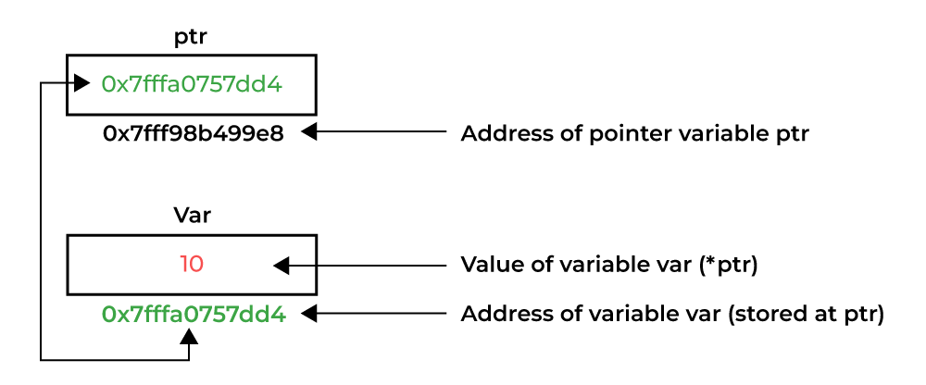
Pointer Dereferencing
Dereferencing a pointer is the process of accessing the value stored in the memory address specified in the pointer. We use the same ( * ) dereferencing operator that we used in the pointer declaration.

Slide 5
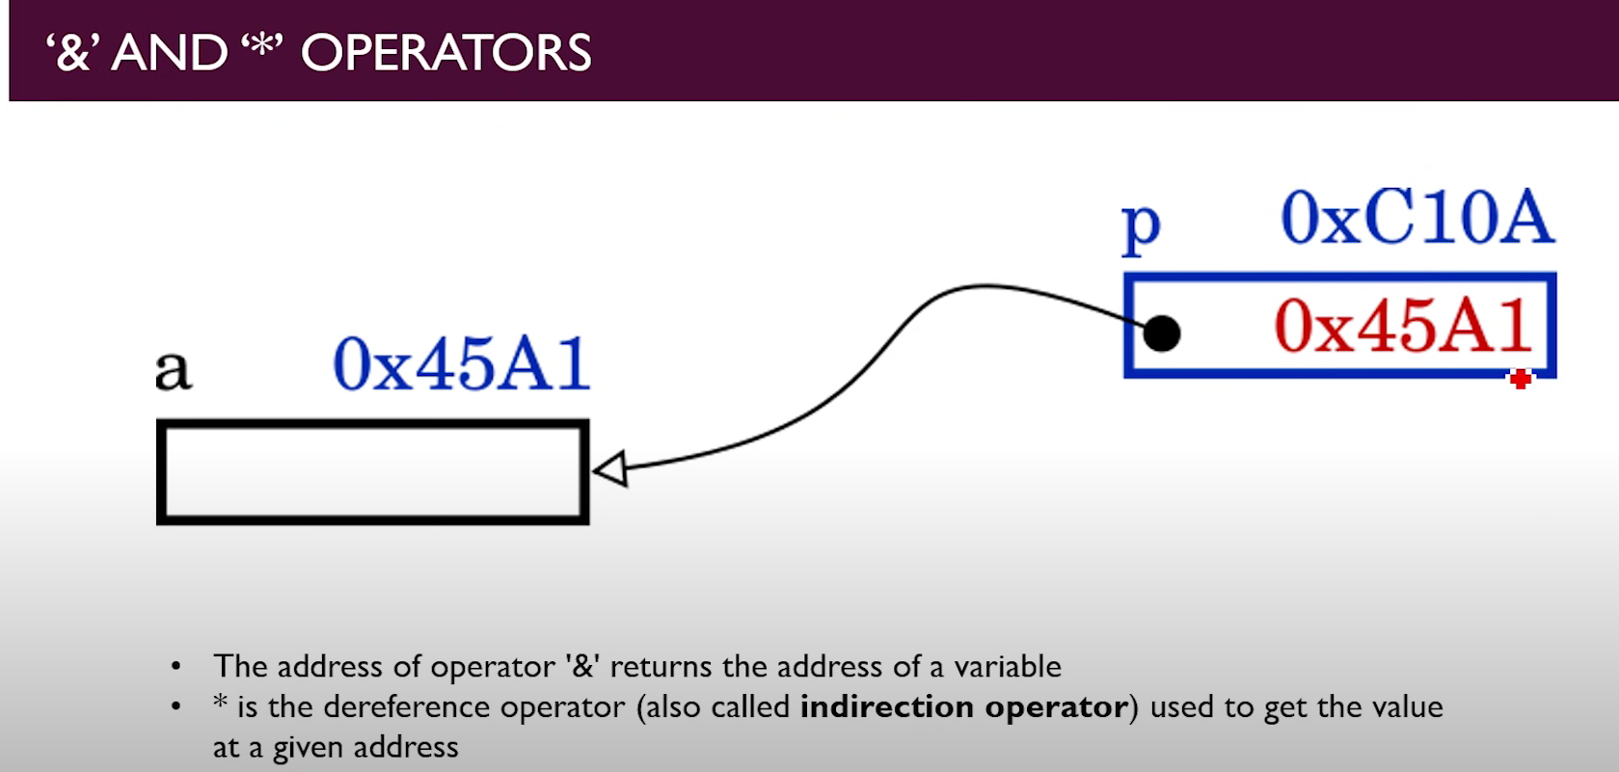

Slide 6
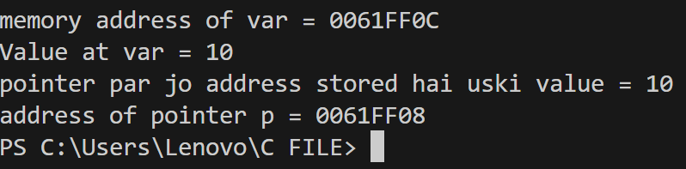
EXAMPLE:
/
#include <stdio.h>
void pointer()
{
int var = 10;
// declare pointer variable
int* ptr;
ptr = &var;
printf("memory address of var at ptr = %p \n",ptr);
printf("Value at var = %d \n", var);
printf("pointer par jo address stored hai uski value(value at *ptr) = %d \n", *ptr);
printf("address of pointer p = %p \n", &ptr);
}
int main()
{
pointer();
return 0;
}

Slide 7
USES OF POINTERS
Dynamic Memory Allocation:
Pointers allow dynamic memory allocation using functions like malloc, calloc, realloc, and free. This is particularly useful when you need to allocate memory at runtime and release it when it is no longer needed.
Efficient Parameter Passing:
Passing a pointer to a function instead of passing the actual data can be more efficient, especially for large data structures. This avoids the overhead of copying the entire data and allows functions to modify the original data directly.
Arrays and Strings:
Pointers are extensively used with arrays and strings in C. An array name itself is a constant pointer to the first element of the array. Pointers facilitate easy traversal and manipulation of array elements.
Dynamic Data Structures:
Pointers are essential for implementing dynamic data structures such as linked lists, trees, and graphs. These data structures can grow or shrink at runtime, and pointers are crucial for managing the connections between elements.
Function Pointers:
C supports function pointers, which allow you to create arrays of functions, pass functions as arguments to other functions, and implement callback mechanisms.

Slide 8
Pointer Arithmetic:
Pointers support arithmetic operations like addition and subtraction. This allows for efficient traversal of arrays and data structures, as well as performing complex manipulations with memory addresses.
Accessing Hardware and Memory-Mapped Devices:
Pointers are often used in low-level programming, such as accessing hardware registers or interacting with memory-mapped devices, where direct memory manipulation is required.
Efficient String Manipulation:
Pointers are commonly used for efficient string manipulation. Functions from the standard library, such as strcpy, strcat, and strlen, often take pointers as arguments.
Reducing Code Redundancy:
Pointers can be used to create generic functions that operate on different data types. This helps reduce code redundancy by writing functions that can work with various types using pointers.
Memory Optimization:
Pointers allow for more efficient use of memory by enabling direct access and manipulation of memory locations. This can lead to more compact and faster code in certain situations.

Slide 9
TYPES OF POINTER:
Integer Pointers
As the name suggests, these are the pointers that point to the integer values.
Syntax: int *ptr;
These pointers are pronounced as Pointer to Integer.
2. Array Pointer
Syntax: char *ptr = &array_name;
Pointers and Array are closely related to each other. Even the array name is the pointer to its first element.
int main()
{
int arr[5] = { 1, 2, 3, 4, 5 };
int *ptr = arr;
printf("%p\n", ptr);
return 0;
}

Slide 10
NULL POINTER
The Null Pointers are those pointers that do not point to any memory location. They can be created by assigning a NULL value to the pointer. A pointer of any type can be assigned the NULL value.
Syntax:
data_type *pointer_name = NULL;
or
pointer_name = NULL

Slide 11
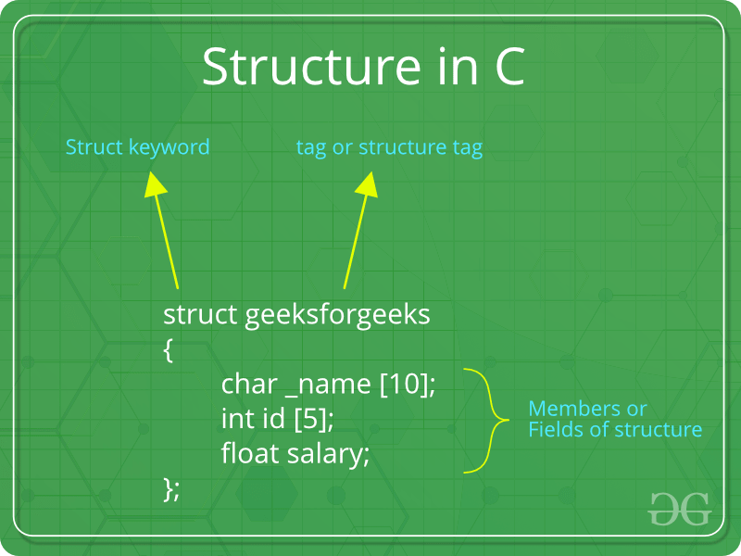
STRUCTURE POINTER
The structure in C is a user-defined data type that can be used to group items of possibly different types into a single type. The struct keyword is used to define the structure in the C programming language.
The items in the structure are called its member and they can be of any valid data type.
A structure pointer is defined as the pointer which points to the address of the memory block that stores a structure known as the structure pointer.

Slide 12
VOID POINTER
A “void pointer “in C is a special type of pointer that is used to represent a generic memory address without specifying the type of data stored at that address. The void pointer is declared using the void keyword, and it can be used to point to objects of any type. They are also called generic pointers as they can point to any type and can be typecasted to any type.
Syntax- void * pointer_name;
WILD POINTER
The WILD POINTER are pointers that have not been initialized with something yet. These types of C-pointers can cause problems in our programs and can eventually cause them to crash.
Syntax-int *ptr; char *str;

Slide 13
Example of pointer
#include <stdio.h>
int main()
{
int* pc, c;
c = 22;
printf("Address of c: %p\n", &c);
printf("Value of c: %d\n\n", c); // 22
pc = &c;
printf("Address of pointer pc: %p\n", pc);
printf("Content of pointer pc: %d\n\n", *pc); // 22
c = 11;
printf("Address of pointer pc: %p\n", pc);
printf("Content of pointer pc: %d\n\n", *pc); // 11
*pc = 2;
printf("Address of c: %p\n", &c);
printf("Value of c: %d\n\n", c); // 2
return 0;
}
Output:
Address of c: 2686784
Value of c: 22
Address of pointer pc: 2686784
Content of pointer pc: 22
Address of pointer pc: 2686784
Content of pointer pc: 11
Address of c: 2686784
Value of c: 2

Slide 14
Size of Pointer As in C
The size of the pointers in C is equal for every pointer type. The size of the pointer does not depend on the type it is pointing to. It only depends on the operating system and CPU architecture. The size of pointers in C is
8 bytes for a 64-bit System
4 bytes for a 32-bit System
The reason for the same size is that the pointers store the memory addresses, no matter what type they are. As the space required to store the addresses of the different memory locations is the same, the memory required by one pointer type will be equal to the memory required by other pointer types.

Slide 15
C pointer arithmetic
The pointer arithmetic refers to the legal or valid arithmetic operations that can be performed on a pointer.
These operations include:
Increment in a Pointer
Decrement in a Pointer
Addition of integer to a pointer
Subtraction of integer to a pointer
Subtracting two pointers of the same type
Comparison of pointers of the same type.
Assignment of pointers of the same type.

Slide 16
// C program to illustrate Pointer Arithmetic
#include <stdio.h>
int main()
{
int v[3] = { 10, 100, 200 }; // Declare an array
int* ptr; // Declare pointer variable
ptr = v; // Assign the address of v[0] to ptr
for (int i = 0; i < 3; i++)
{
printf("Value of *ptr = %d\n", *ptr); // print value at address which is stored in ptr
printf("Value of ptr = %p\n\n", ptr); // print value of ptr
ptr++; // Increment pointer ptr by 1
}
return 0;
}
Output:
Value of *ptr = 10
Value of ptr = 0x7ffe8ba7ec50
Value of *ptr = 100
Value of ptr = 0x7ffe8ba7ec54
Value of *ptr = 200
Value of ptr = 0x7ffe8ba7ec58

Slide 17
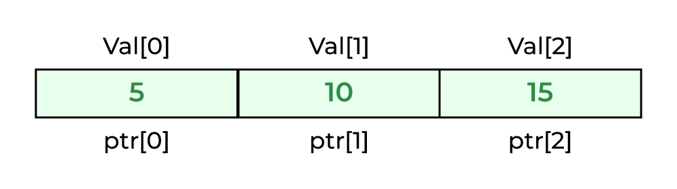
C pointers and array
An array name acts like a pointer constant. The value of this pointer constant is the address of the first element. For example, if we have an array named val then val and &val[0] can be used interchangeably.
Example 1: Accessing Array Elements using Pointer with Array Subscript

Slide 18
C Program to access array elements using pointer
#include <stdio.h>
void geeks()
{
int val[3] = { 5, 10, 15 }; // Declare an array
int* ptr; // Declare pointer variable
ptr = val; // Assign address of val[0] to ptr.
// We can use ptr=&val[0];(both are same)
printf("Elements of the array are: ");
printf("%d, %d, %d", ptr[0], ptr[1], ptr[2]);
return;
}
int main()
{
geeks();
return 0;
}
Output:
Elements of the array are: 5 10 15

Slide 19
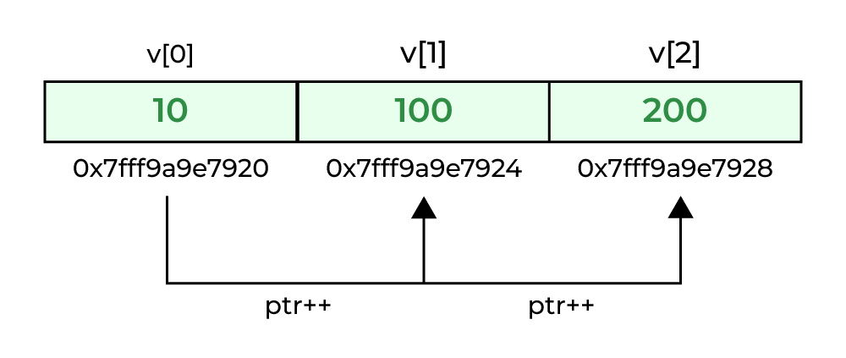
Example 2: Accessing Array Elements using Pointer Arithmetic
#include <stdio.h>
int main()
{
int arr[5] = { 1, 2, 3, 4, 5 };
int* ptr_arr = arr; // defining the pointer to array
// traversing array using pointer arithmetic
for (int i = 0; i < 5; i++) {
printf("%d ", *ptr_arr++);
}
return 0;
}

Slide 20
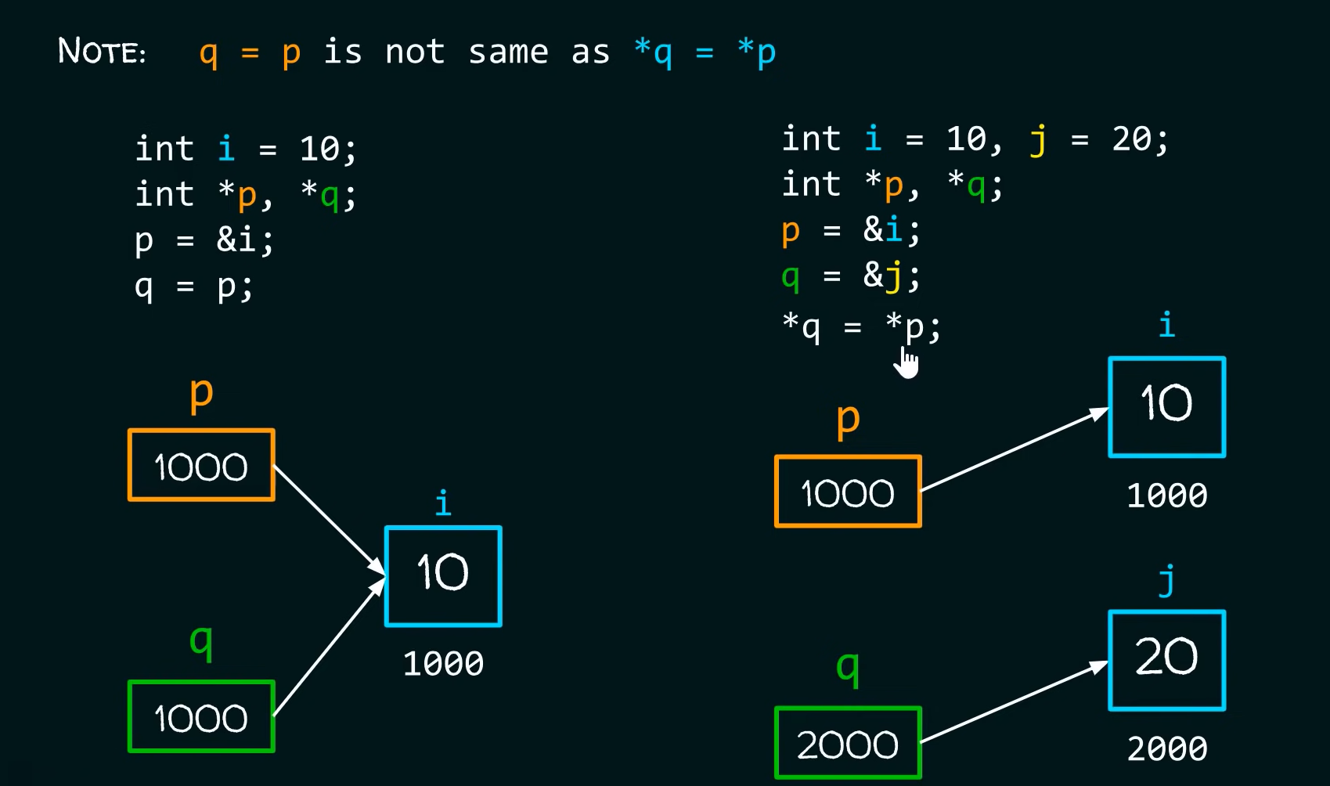
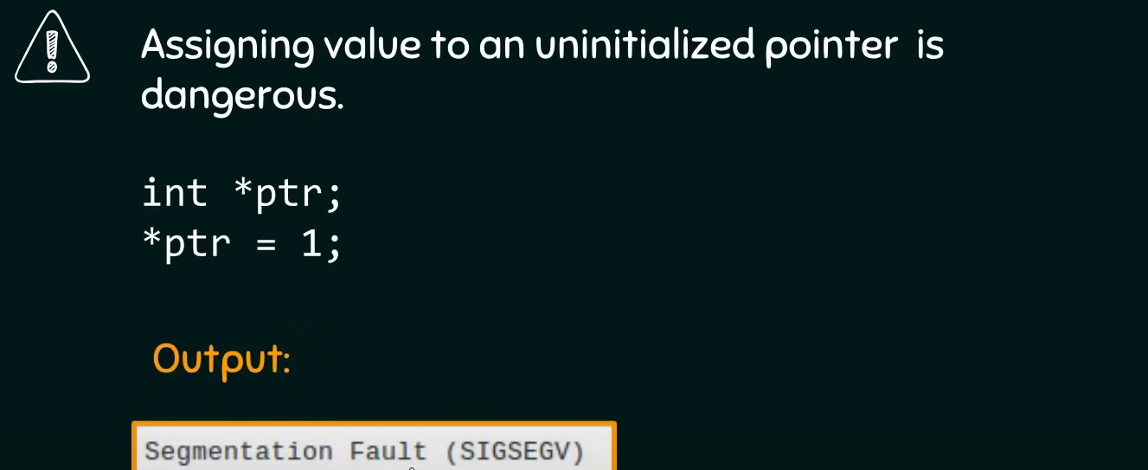

Slide 21
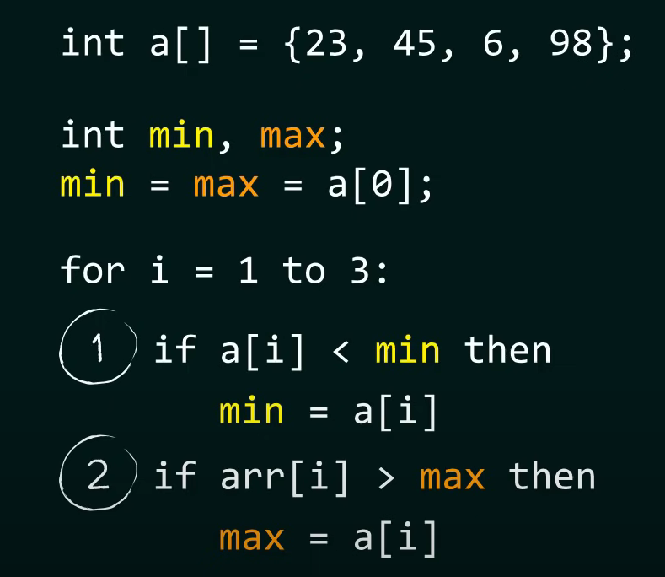
IDEA

Slide 22
PROGRAM TO FIND MAX. AND MIN. IN ARRAY USING POINTER
#include<stdio.h>
void minmax(int a[],int len,int *max,int *min)
{
*min=*max=a[0];
int i;
for(i=1;i<len;i++)
{
if(a[i]>*max)
*max=a[i];
if(a[i]<*min)
*min=a[i];
}
}
int main()
{
int a[]={23,4,21,98,987,45,32,10,123,986,50,3,4,5};
int len=sizeof(a)/sizeof(a[0]);
int min, max;
minmax(a,len,&max,&min);
printf("maximum value of array is:%d\n, minimum value of array is:%d",max,min);
return 0;
}

Slide 23
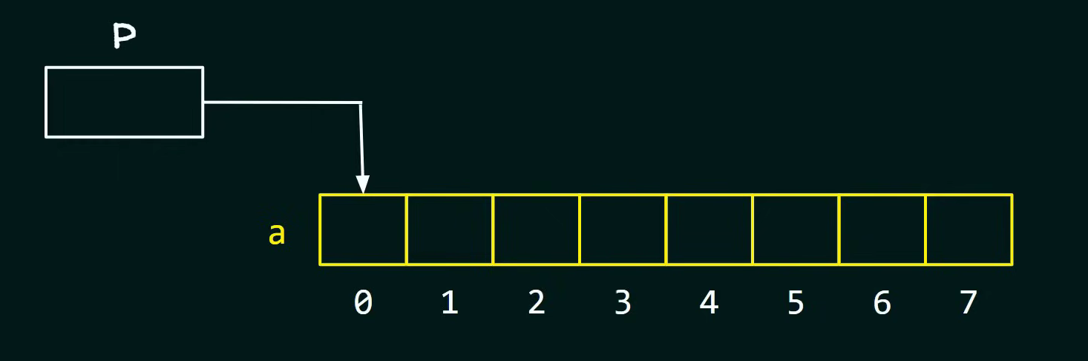
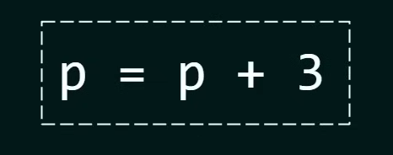
Pointer addition arithmetic
How will you point pointer p to first element of array
Adding an integer to pointer

Slide 24
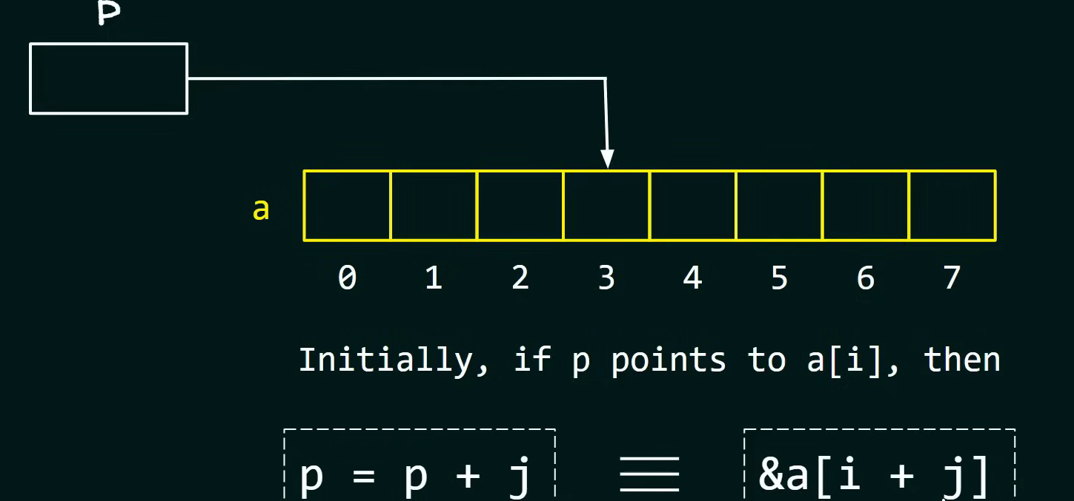
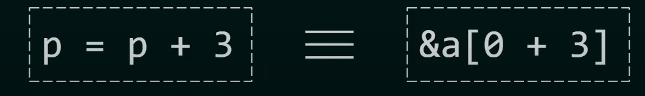
Cont..

Slide 25
C Pointer Addition
new_address= current_address + (number * size_of(data type))
32-bit
For 32-bit int variable, it will add 2 * number.
64-bit
For 64-bit int variable, it will add 4 * number.
#include<stdio.h>
int main(){
int number=50;
int *p;//pointer to int
p=&number;//stores the address of number variable
printf("Address of p variable is %u \n",p);
p=p+3; //adding 3 to pointer variable
printf("After adding 3: Address of p variable is %u \n",p);
return 0;
}
OUTPUT:
Address of p variable is 3214864300
After adding 3: Address of p variable is 3214864312

Slide 26
C Pointer Subtraction
Like pointer addition, we can subtract a value from the pointer variable. Subtracting any number from a pointer will give an address. The formula of subtracting value from the pointer variable is given below:
new_address= current_address - (number * size_of(data type))
The subtraction of two pointers is possible only when they have the same data type. The result is generated by calculating the difference between the addresses of the two pointers and calculating how many bits of data it is according to the pointer data type. The subtraction of two pointers gives the increments between the two pointers.

Slide 27
Program for subtraction
#include<stdio.h>
int main(){
int number=50;
int *p;//pointer to int
p=&number;//stores the address of number variable
printf("Address of p variable is %u \n",p);
p=p-3; //subtracting 3 from pointer variable
printf("After subtracting 3: Address of p variable is %u \n",p);
return 0;
}

Slide 28
You can see after subtracting 3 from the pointer variable, it is 12 (4*3) less than the previous address value.
However, instead of subtracting a number, we can also subtract an address from another address (pointer). This will result in a number. It will not be a simple arithmetic operation, but it will follow the following rule.
If two pointers are of the same type,
Address2 - Address1 = (Subtraction of two addresses)/size of data type which pointer points
Consider the following example to subtract one pointer from an another.
#include<stdio.h>
void main ()
{
int i = 100;
int *p = &i;
int *temp;
temp = p;
p = p + 3;
printf("Pointer Subtraction: %d - %d = %d",p, temp, p-temp);
}

Slide 29
Program for subtraction
#include <stdio.h>
int main()
{
int x = 6; // Integer variable declaration
int N = 4;
int *ptr1, *ptr2;
ptr1 = &N; // stores address of N
ptr2 = &x; // stores address of x
printf(" ptr1 = %u, ptr2 = %u\n", ptr1, ptr2); // %p gives an hexa-decimal value,
// We convert it into an unsigned int value by using %u
x = ptr1 - ptr2;
printf("Subtraction of ptr1 ""& ptr2 is %d\n",x);
return 0;
}
Output:
ptr1 = 2715594428, ptr2 = 2715594424
Subtraction of ptr1 & ptr2 is 1

Slide 30
Increment
#include<stdio.h>
int main(){
int number=50;
int *p;//pointer to int
p=&number;//stores the address of number variable
printf("Address of p variable is %u \n",p);
p=p+1;
printf("After increment: Address of p variable is %u \n",p); // in our case, p will get incremented by 4 bytes.
return 0;
}
OUTPUT
Address of p variable is 3214864300
After increment: Address of p variable is 3214864304

Slide 31
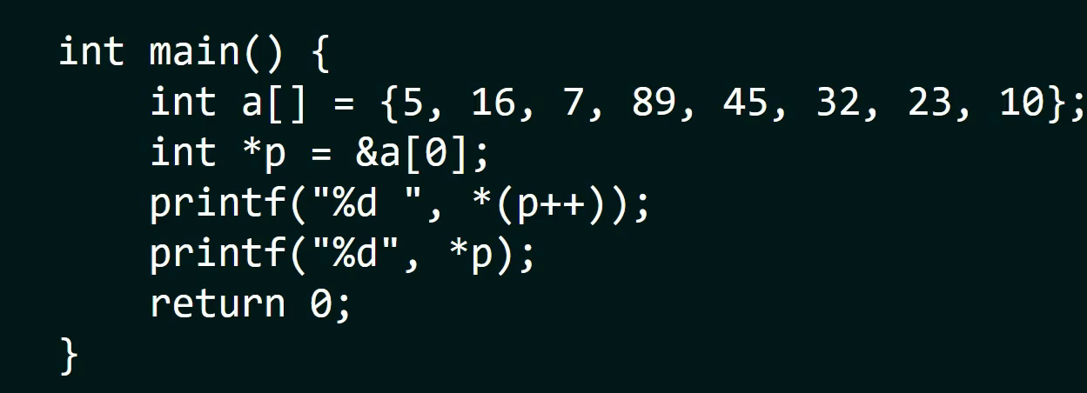

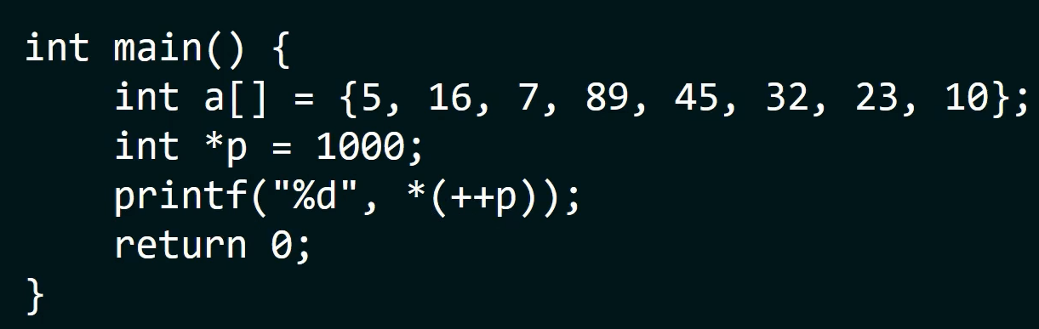

Post Increment
Pre Increment

Slide 32
Decrementing Pointer in C
Like increment, we can decrement a pointer variable. If we decrement a pointer, it will start pointing to the previous location. The formula of decrementing the pointer is given below:
new_address= current_address - i * size_of(data type)
32-bit
For 32-bit int variable, it will be decremented by 2 bytes.
64-bit
For 64-bit int variable, it will be decremented by 4 bytes.
#include <stdio.h>
void main(){
int number=50;
int *p;//pointer to int
p=&number;//stores the address of number variable
printf("Address of p variable is %u \n",p);
p=p-1;
printf("After decrement: Address of p variable is %u \n",p); // P will now point to the immediate previous location.
}
OUTPUT:
Address of p variable is 3214864300
After decrement: Address of p variable is 3214864296

Slide 33
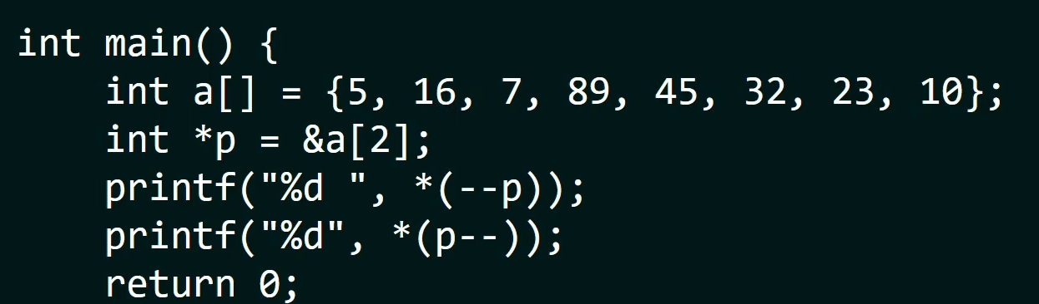
Post and pre decrement

Slide 34
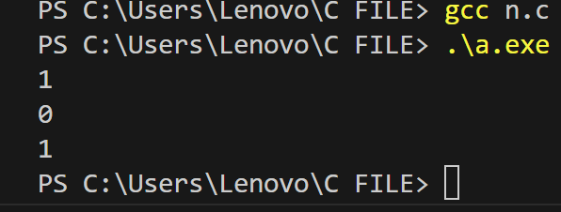
Comparison of Pointers
All operators in C >, >=, <, <=, ==, !=. It returns true for the valid condition and returns false for the unsatisfied condition.
#include<stdio.h>
int main(){
int a[]={1,2,3,4,5,6};
int *p=&a[3];
int *q=&a[5];
printf("%d\n",p<=q);
printf("%d\n",p>=q);
q=&a[3];
printf("%d",p==q);
return 0;
}

Slide 35
Dynamic Memory Allocation
C Dynamic Memory Allocation can be defined as a procedure in which the size of a data structure (like Array) is changed during the runtime.
C provides some functions to achieve these tasks. There are 4 library functions provided by C defined under <stdlib.h> header file to facilitate dynamic memory allocation in C programming. They are:
malloc()
calloc()
free()
realloc()

Slide 36
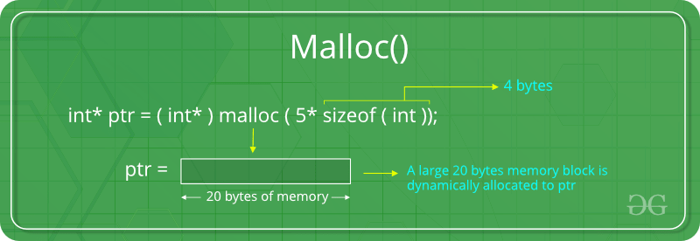
C malloc() method
The “malloc” or “memory allocation” method in C is used to dynamically allocate a single large block of memory with the specified size. It returns a pointer of type void which can be cast into a pointer of any form.
Syntax of malloc() in C
ptr = (cast-type*) malloc(byte-size)
For Example:
ptr = (int*) malloc(100 * sizeof(int)); Since the size of int is 4 bytes, this statement will allocate 400 bytes of memory. And, the pointer ptr holds the address of the first byte in the allocated memory.

Slide 37
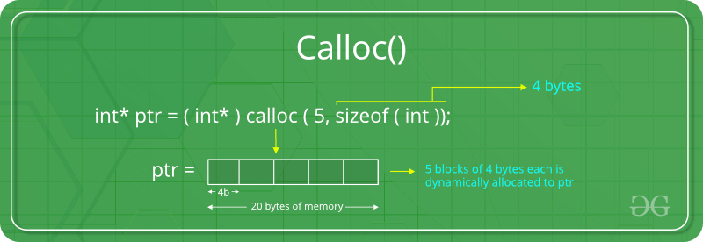
C calloc() method
“calloc” or “contiguous allocation” method in C is used to dynamically allocate the specified number of blocks of memory of the specified type. it is very much similar to malloc() but has two different points and these are:
1.It initializes each block with a default value ‘0’.
2.It has two parameters or arguments as compare to malloc().
Syntax of calloc() in C
ptr = (cast-type*)calloc(n, element-size);
here, n is the no. of elements and element-size is the size of each element.
For Example:
ptr = (float*) calloc(25, sizeof(float));
This statement allocates contiguous space in memory for 25 elements each with the size of the float.

Slide 38
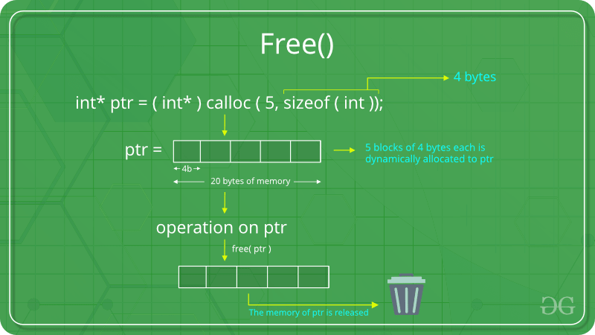
C free() method
“free” method in C is used to dynamically de-allocate the memory. The memory allocated using functions malloc() and calloc() is not de-allocated on their own. Hence the free() method is used, whenever the dynamic memory allocation takes place. It helps to reduce wastage of memory by freeing it
Syntax of free() in C: free(ptr);

Slide 39
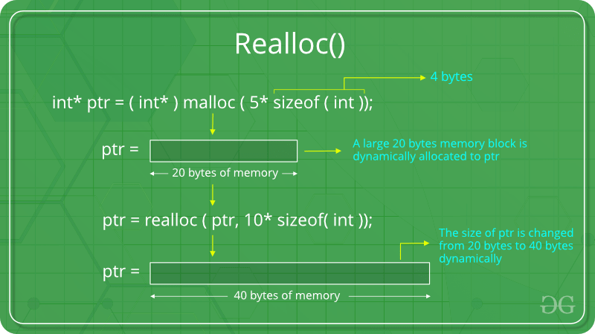
C realloc() method
“realloc” or “re-allocation” method in C is used to dynamically change the memory allocation of a previously allocated memory. In other words, if the memory previously allocated with the help of malloc or calloc is insufficient, realloc can be used to dynamically re-allocate memory.
Syntax of realloc() in C : ptr = realloc(ptr, newSize);
where ptr is reallocated with new size 'newSize'

Slide 40
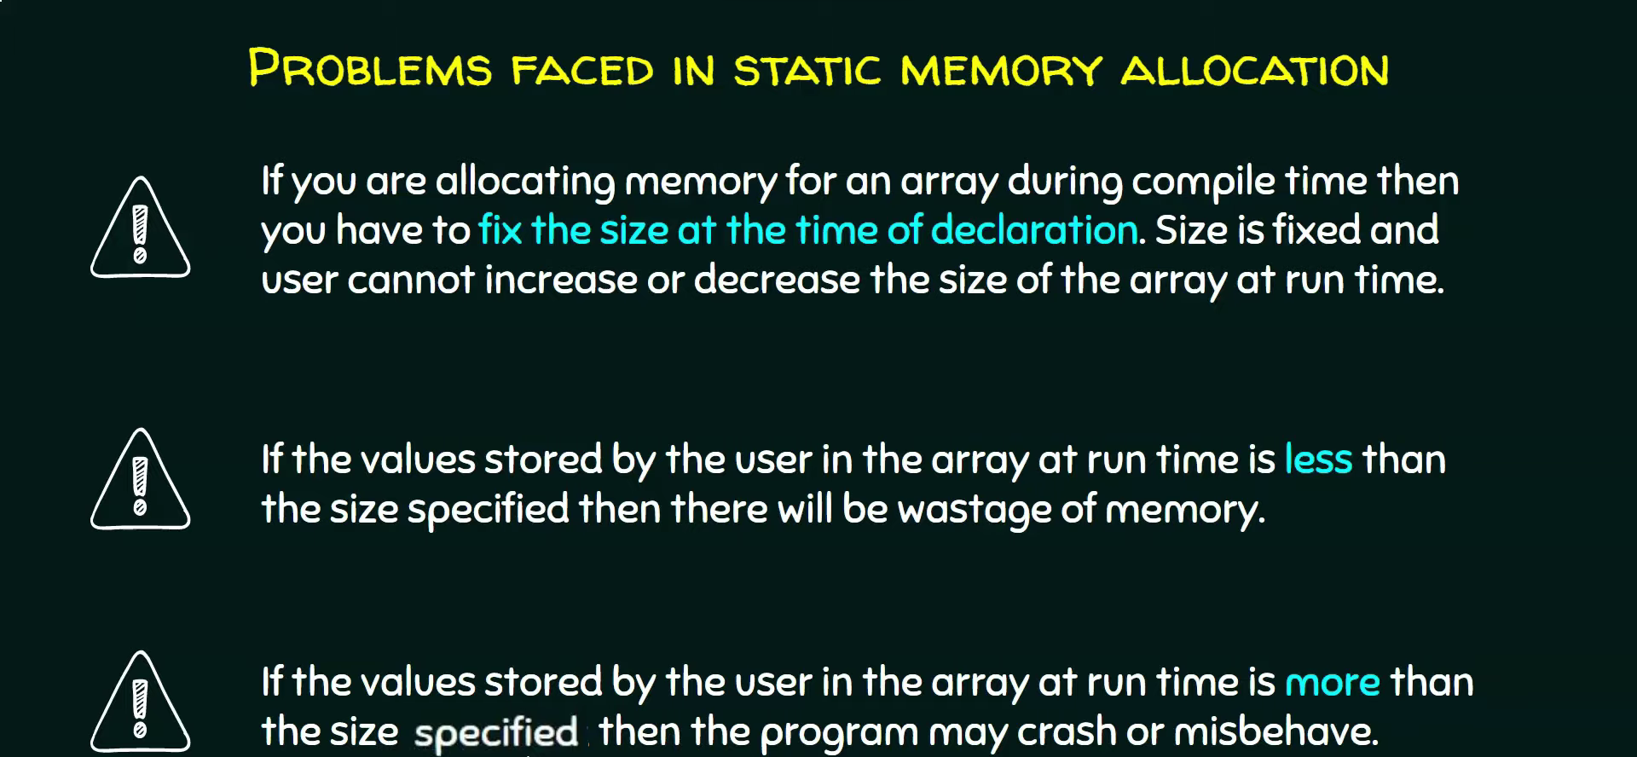
STATIC MEMORY ALLOCATION

Slide 41
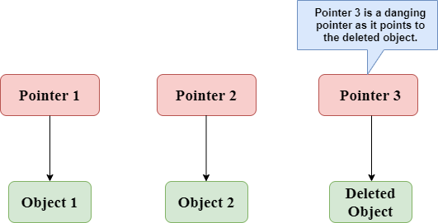
Dangling pointer
Dangling pointer occurs at the time of the object destruction when the object is deleted or de-allocated from memory without modifying the value of the pointer. In this case, the pointer is pointing to the memory, which is de-allocated. The dangling pointer can point to the memory, which contains either the program code or the code of the operating system. If we assign the value to this pointer, then it overwrites the value of the program code or operating system instructions; in such cases, the program will show the undesirable result or may even crash. If the memory is re-allocated to some other process, then we dereference the dangling pointer will cause the segmentation faults.

Slide 42

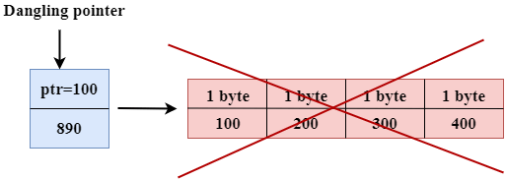
EXAMPLE OF 1 of Dangling pointer
#include <stdio.h>
int main()
{
int *ptr=(int *)malloc(sizeof(int));
int a=560;
ptr=&a;
free(ptr);
return 0;
}
In the above code, we have created two variables, i.e., *ptr and a where 'ptr' is a pointer and 'a' is a integer variable. The *ptr is a pointer variable which is created with the help of malloc() function. As we know that malloc() function returns void, so we use int * to convert void pointer into int pointer.
The statement int *ptr=(int *)malloc(sizeof(int)); will allocate the memory with 4 bytes shown in the below image:
The statement free(ptr) de-allocates the memory as shown in the below image with a cross sign, and 'ptr' pointer becomes dangling as it is pointing to the de-allocated memory

Slide 43
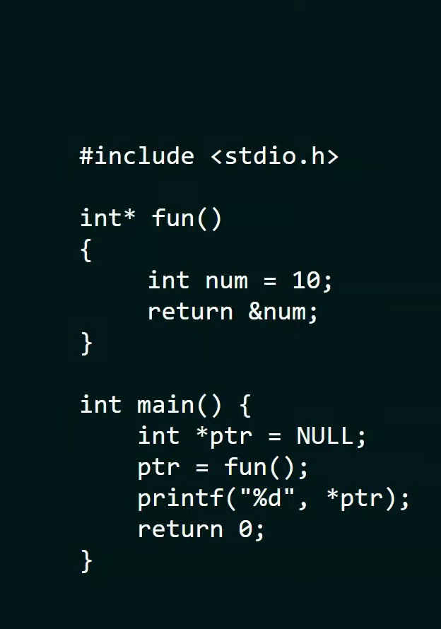

EXAMPLE 2

Slide 44
#include <stdio.h>
#include <stdlib.h>
int main()
{
int* ptr; // This pointer will hold the // base address of the block created
int n, i;
printf("Enter number of elements:"); // Get the number of elements for the array
scanf("%d",&n);
printf("Entered number of elements: %d\n", n);
ptr = (int*)malloc(n * sizeof(int)); // Dynamically allocate memory using malloc()
// Check if the memory has been successfully // allocated by malloc or not
if (ptr == NULL) {
printf("Memory not allocated.\n");
exit(0);
}
Example of malloc() in C

Slide 45
Continue….
else {
// Memory has been successfully allocated
printf("Memory successfully allocated using malloc.\n");
// Get the elements of the array
for (i = 0; i < n; ++i) {
ptr[i] = i + 1;
}
// Print the elements of the array
printf("The elements of the array are: ");
for (i = 0; i < n; ++i) {
printf("%d, ", ptr[i]);
}
}
return 0;
}

