Slide 1

HIDE MESSAGES IN IMAGE
Created by –
Madhur Narang

Slide 2
Introduction
Agenda
How It Works
Operations on Image
RGB Layer
Values
Why LSB ?
Technology Stack
Future Scope

Slide 3
PROBLEM STATEMENT
Hide messages in image using python with using Tkinter library and onetimepad module for The purpose of steganography to conceal and deceive.

Slide 4
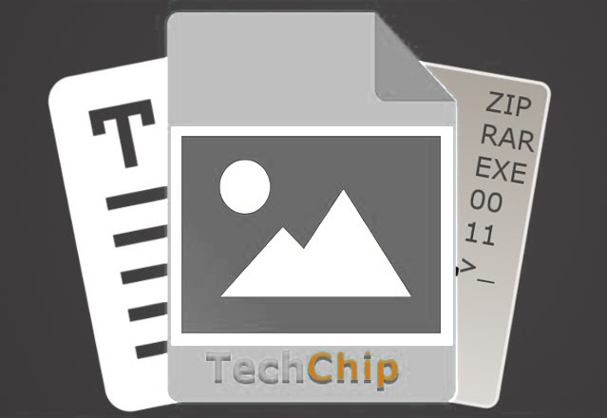
STEGANOGRAPHY
Steganography is a method of hiding secret data, by embedding it into an audio, video, image, or text file.
It is one of the methods employed to protect secret or sensitive data from malicious attacks.

Slide 5




BLOCK DIAGRAM
COVER IMAGE
EXTRACTING FUNCTION
EMBEDDING FUNCTION
COVER IMAGE
110010100011
101100011101
100001011011
100110101000
111001000111
100001101011
STEGO
110010100011
101100011101
100001011011
100110101000
111001000111
100001101011
SECRET MESSAGE
EXTRACTED MESSAGE

Slide 6
HOW IT WORKS
STEP 1: extract each character from message
E.g. message =“ play a song”
Characters=( ‘p’ , ‘l’ , ‘a’ , ‘y’ , …)
STEP 2: add it with key and generate cyphertext
STEP 3: convert each character from cyphertext into ascii value
and then binary number
E.g. ascii value of Y = 89
in binary 89 = 01011001

Slide 7
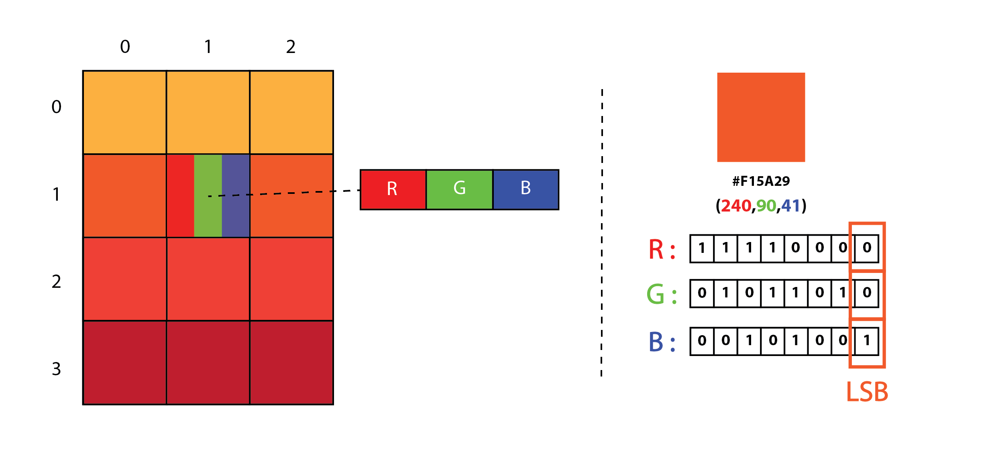
Operations on Image
Step 4: extract pixels from cover image
Step 5: each pixels into binary
three pixels are required to store one character

Slide 8
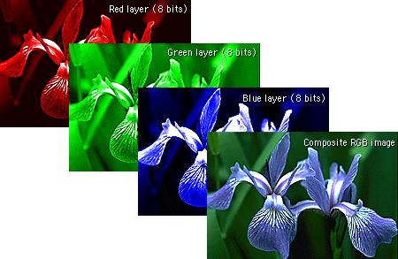
RGB layer
Each layer is of 8 bit means value ranges between 0-255

Slide 9
Values
Step 5: storing each bit of character in pixel’s bit
Pixels:
pixel 1 : (00100111 11101001 11001000)
pixel 2 : (00100111 11001000 11101001)
pixel 3 : (11001000 00100111 11101001)
Y (89) : 01011001
Result:
(00100110 11101001 11001000)
(00100111 11001001 11101000)
(11001000 00100111 11101001)

Slide 10
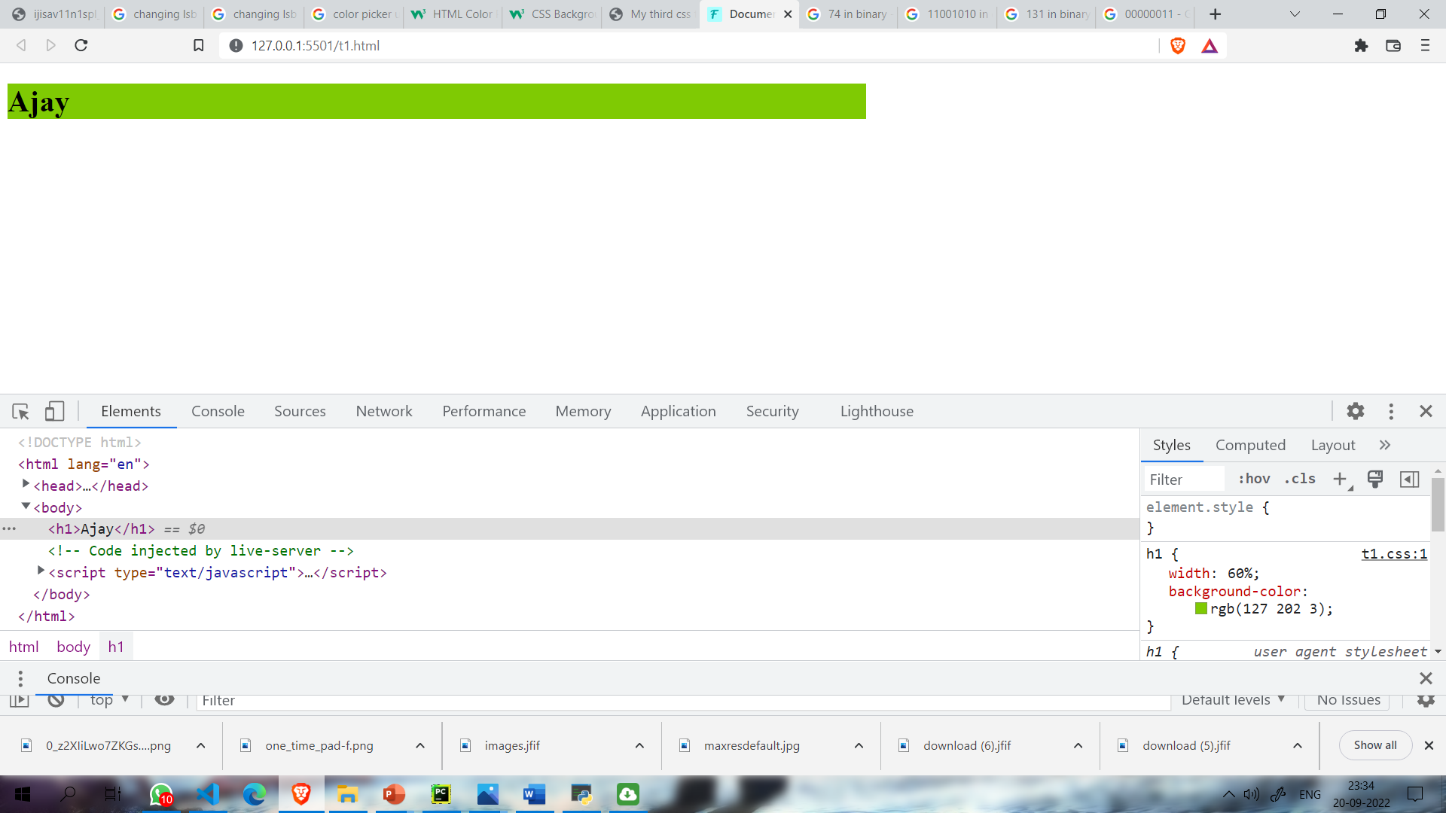
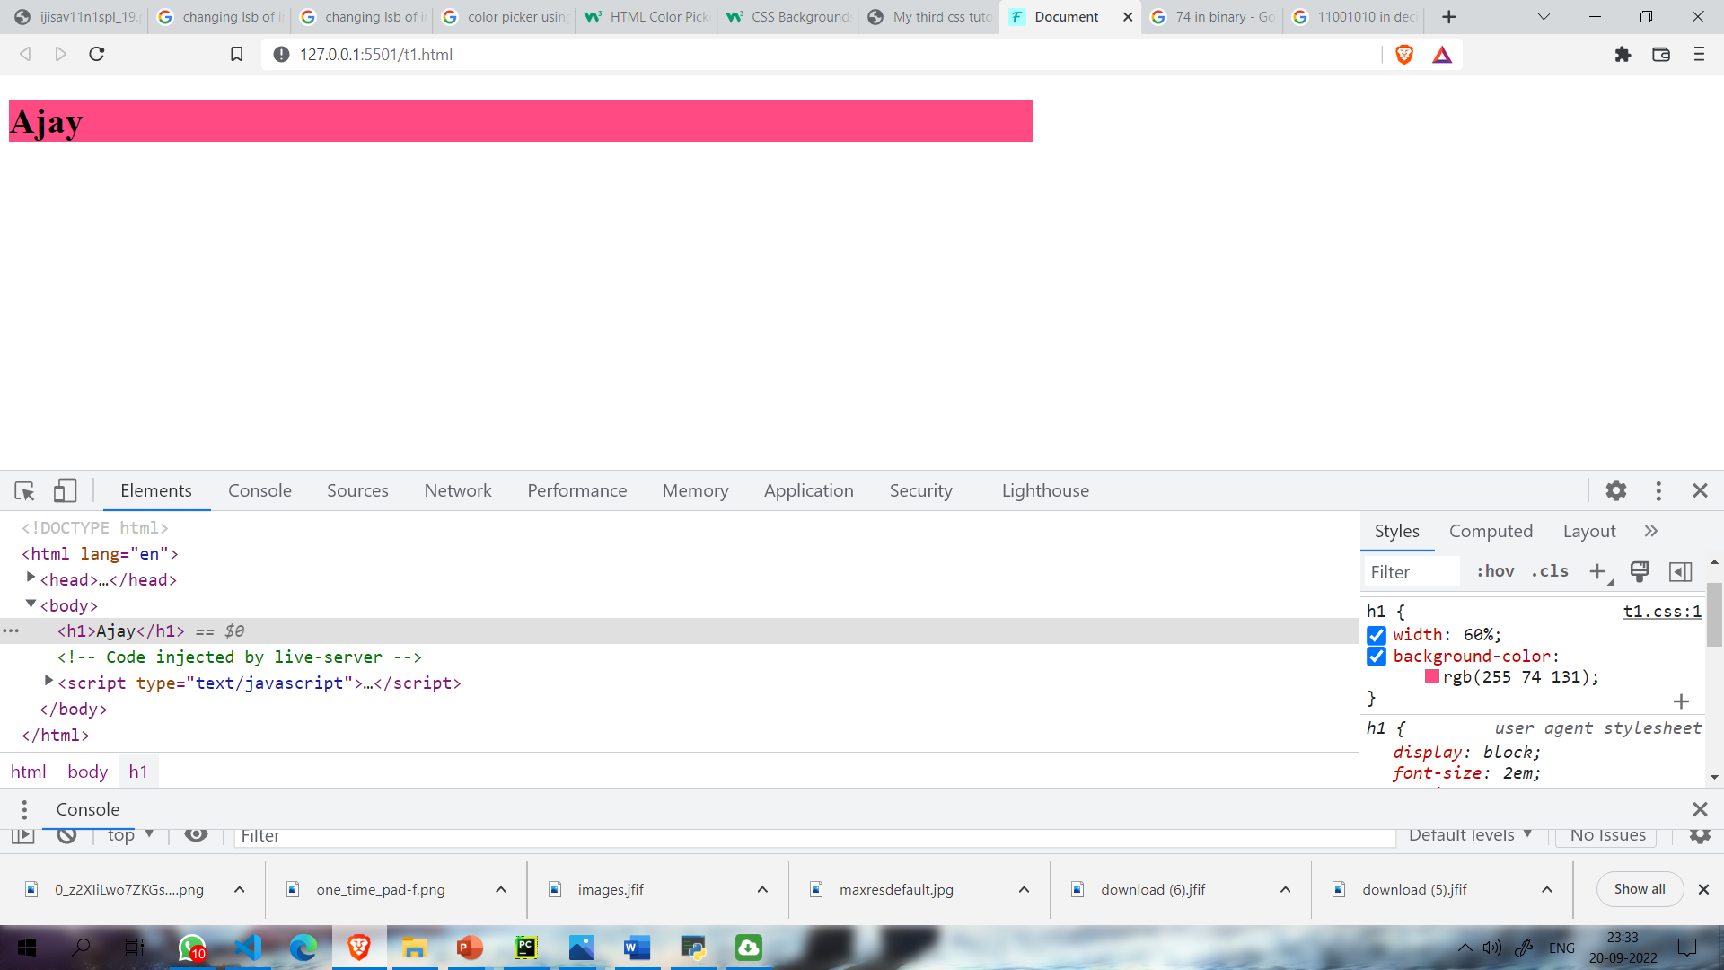
WHY LSB ?
Value : 255
1 | 1 | 1 | 1 | 1 | 1 | 1 | 1
Most Significant Bit (MSB)
Least Significant Bit (LSB)
255
1 | 1 | 1 | 1 | 1 | 1 | 1 | 1
1 | 1 | 1 | 1 | 1 | 1 | 1 | 1
255
127
0 | 1 | 1 | 1 | 1 | 1 | 1 | 1
0 | 1 | 1 | 1 | 1 | 1 | 1 | 0
254
Change in color is 99.99%
Change in color is 0.000002%
127 = 01111111
202 = 11001010
003 = 00000011
255 = 11111111
074= 01001010
131 = 10000011

Slide 11
Step 01
Step 03
Text – “test”
Key – “FVEB”
Cypher text translate in character and number.
Generated number –” 12131616”
Step 02
Step 04
Cypher Text – “YZWU”
Generated Number from cypher text convert into binary number and store in pixels of image

Slide 12
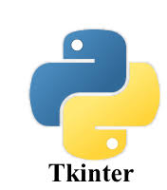
TECHNOLOGY STACK
Programming Language- Python
Operating System- Windows
.
RAM- 256MB or more
Library- TKinter

Slide 13
ADVANTAGES
• In steganography, cryptography secures the contents of a message, steganography can be said to secure both messages and connecting parties.
• This approach featured security, capacity, and robustness, the three needed element of steganography that creates it beneficial in hidden exchange of data through text files and creating secret communication.
• There are some important files carrying confidential data can be in the server in and encrypted form and No intruder can receive some beneficial information from the initial file during transmit.
• With the need of Steganography Corporation government and law enforcement agencies can connect privately.

Slide 14
DISADVANTAGES
• There are large number of information, huge file size, therefore someone can suspect about it.
• If this approach is gone in the wrong hands such as hackers, terrorist, criminals then this can be very much critical.
• Steganography is not without its disadvantages. However, these can be rectified and once it is performed and it can strengthen the element of steganography.
• Most data hiding approach take advantage of human perceptual deficiency, but they have deficiency of their own. However, these can be independently rectified.

Slide 15
APPLICATIONS
Confidential communication and secret data storing
Protection of data alteration We take advantage of the fragility of the embedded data in this application area.
Access control system for digital contents distribution In this area embedded data is ”hidden” but is ”explained” to publicize the content. Today, digital contents are getting more and more commonly distributed over Internet than before.

Slide 16


Audio steganography
02
Audio steganography
Video steganography
02
Better gui
03
Future Scope
05
More Features
06
And Many More

Slide 17
About Me
Name – Madhur Narang
Email - falconjourney1@gmail.com
STU ID – STU6273e9a70ed971651763623
Github Link - https://github.com/Falcon-Journey
Programming Language- Python
RAM- 256MB or more

Slide 18

Thank You..!

