Slide 1

Software Quality Assurance Test Report
Analysis of System and Feature Test Execution
Report Date
Prepared By
November 15, 2025
Mohamed Wageeh
Notes:
Good morning. This presentation delivers a comprehensive, data-driven analysis of our recent Quality Assurance testing cycle, providing the necessary insights to guide our immediate remediation and development priorities. We executed a focused test cycle to validate the stability and functional correctness of key system modules before the next release. The data we present today is crucial for understanding where the system is stable and, more importantly, where critical risks reside. We will move quickly through the overall results and then focus our attention on the specific areas that demand immediate action. Our goal is to present clear findings and propose actionable recommendations that allow us to move forward with confidence. Let's begin by reviewing the scope and objectives of this test cycle.

Slide 2

Test Cycle Overview and Objectives
Objective
The objective of this testing cycle was to verify the functionality, stability, and accuracy of ParaBank’s Profile Management, Loan Management, and System modules, ensuring that all operations — including profile updates, loan validation, and system navigation — work correctly under valid, invalid, and edge-case scenarios.
Scope
▸
26 Test Cases
executed across three primary modules
▸
System (SYS): 6 tests covering core functionality and session management
▸
Loan (LOAN): 15 tests validating loan application logic and data validation
▸
Profile (PROF): 5 tests for user profile management and security features
Goal of This Presentation
▸
Communicate test execution results with clear data visualization
▸
Highlight
critical defects
requiring immediate attention
▸
Propose actionable recommendations for remediation and process improvement
▸
Enable informed decision-making for the next development cycle
Notes:
The primary objective of this test cycle was to assess the stability and functional correctness of three core modules: System, Loan, and Profile. We executed a total of 26 test cases across these areas, with the majority focused on the Loan application logic and data validation. The Profile module, which covers user management and security features, was also a key focus. The goal of this presentation is not just to report numbers, but to translate those execution results into clear, actionable recommendations. We need to highlight critical defects and enable informed decision-making for the next development sprint. Understanding this scope sets the context for the overall execution results we are about to review.

Slide 3

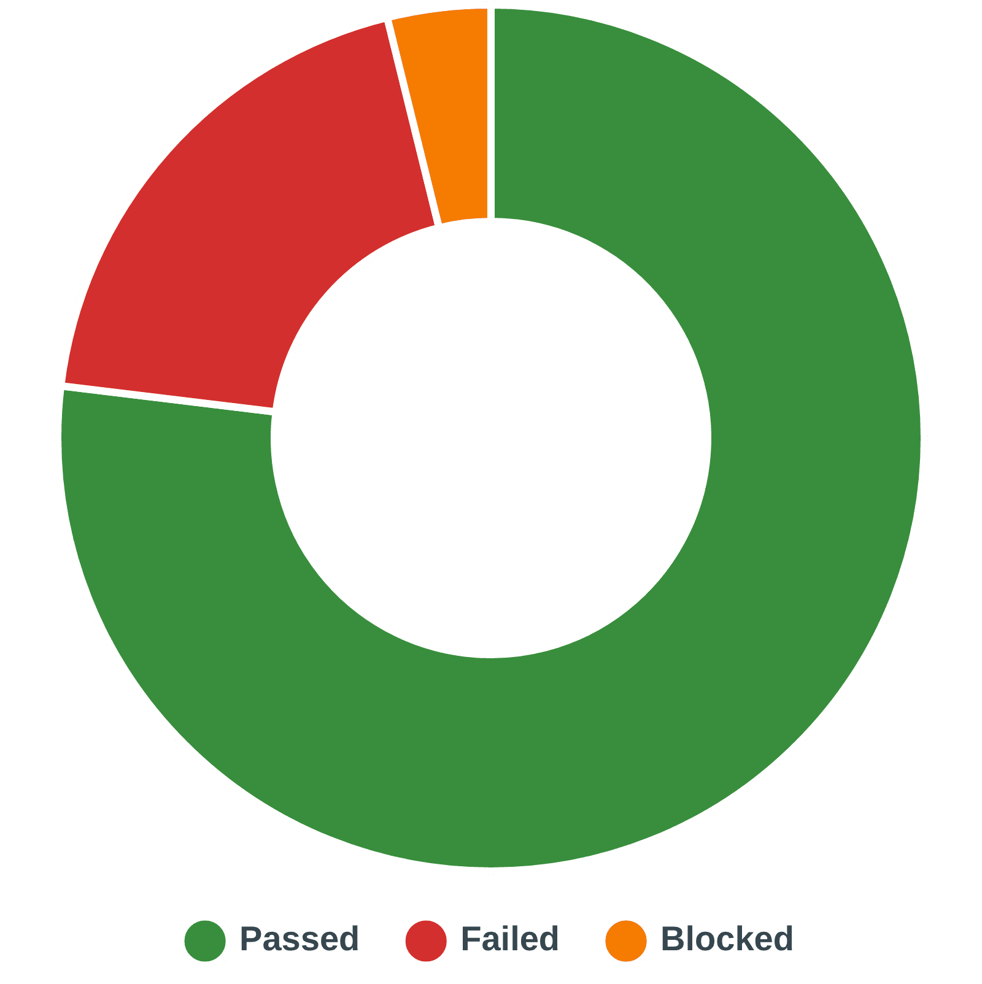
Overall Test Execution Results
Passed
✓
20
76.92%
Failed
✕
5
19.23%
Blocked
⊘
1
3.85%
Key Insight
The overall pass rate is 76.92%, indicating moderate stability. However, the 19.23% failure rate requires immediate investigation and remediation.
Notes:
Moving from the scope, let's look at the overall execution results for the 26 test cases. We achieved a passing rate of 76.92%, which provides a solid foundation of stability across the system. However, the 19.23% failure rate, representing five failed tests, is significant and requires immediate investigation. We cannot overlook this level of failure. Additionally, one test case was blocked, meaning we could not fully assess a system-level feature due to a dependency issue. While the overall pass rate is moderate, the concentration of failures indicates a potential problem area that we must isolate and address quickly. Now, let's break down these results by module to pinpoint exactly where these failures are occurring.

Slide 4

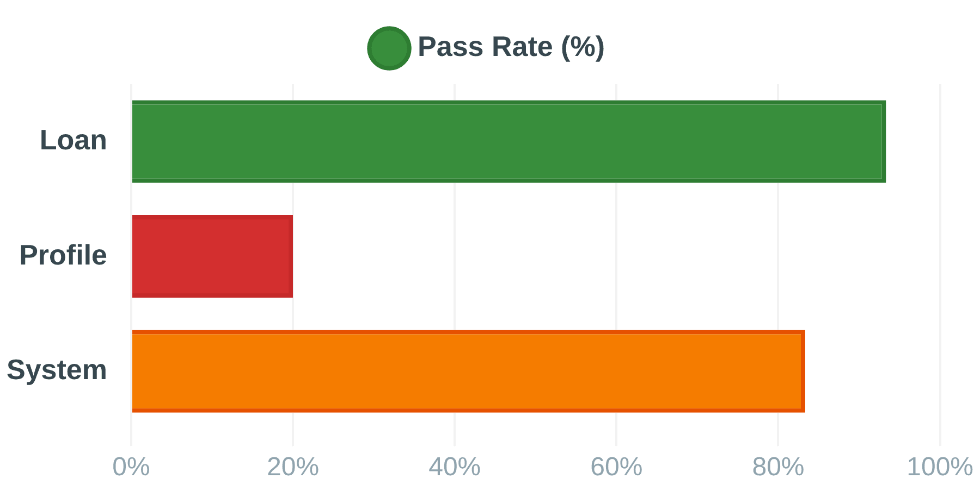
Test Coverage and Pass Rate by Module
Loan Module
Total Tests:
15
Passed:
14
Failed:
1
Blocked:
0
Pass Rate: 93.33%
Profile Module
Total Tests:
5
Passed:
1
Failed:
4
Blocked:
0
Pass Rate: 20.00%
System Module
Total Tests:
6
Passed:
5
Failed:
0
Blocked:
1
Pass Rate: 83.33%
Critical Finding
The Profile (PROF) module has a critically low pass rate of 20%, indicating major issues in user profile management and security-related features.
Notes:
The breakdown by module clearly isolates our primary area of concern, which is the Profile module. The Loan module is highly stable, with 14 out of 15 tests passing, resulting in an excellent 93.33% pass rate. The System module is also performing well at 83.33%, though we must resolve that single blocked test to ensure full coverage. Critically, the Profile module failed four out of its five tests, yielding a critically low pass rate of only 20%. This is a major finding. These tests cover sensitive areas like user profile updates and security features, meaning this low pass rate indicates severe issues in a high-risk area. We must now analyze the nature of these failures to understand the impact.

Slide 5

Analysis of Findings: High-Impact Defects
5
Total Bugs
4
Critical Severity
Identified
80% of All Bugs
Critical Issues Requiring Immediate Attention
Bug ID
Related TC
Severity
Issue Scenario
BG_003
TC_PROF_24
Critical
Email Update fails to enforce OTP verification. System displays error instead of sending OTP to old email address.
BG_004
TC_PROF_25
Critical
Password Change fails to enforce OTP verification. System displays error instead of verifying user ownership via OTP.
BG_005
TC_PROF_26
Critical
Phone Number Update fails to enforce OTP verification. System displays error instead of sending OTP to old phone number.
BG_001
TC_LOAN_10
Critical
Loan application incorrectly approved when Down Payment exceeds Loan Amount. Data validation logic failure.
BG_002 TC_PROF_23 Major System displays an error message instead of success confirmation, and data is not saved.
Notes:
We just saw that the Profile module failed 80% of its tests. This slide reveals why that failure rate is so critical. The most alarming finding is the concentration of Critical severity bugs. Four out of the five total bugs we identified are classified as Critical, representing 80% of all defects found. Three of these Critical bugs directly compromise user security by failing to implement One-Time Password verification for sensitive profile updates. Specifically, updating email, password, and phone number all bypass the necessary OTP security checks. This is a severe vulnerability that leaves user accounts exposed to unauthorized changes. The fourth critical bug is a serious data validation failure in the Loan module, where a loan application is incorrectly approved when the down payment exceeds the loan amount. This failure has direct financial and compliance implications. These four issues are not minor functional glitches; they are high-impact defects that threaten data integrity and user trust. We must address these immediately. Let's move to the proposed action plan.

Slide 6

Recommendations and Proposed Next Steps
1
Immediate Fix & Retest
Critical
Prioritize the 4 Critical bugs (BG_001, BG_003, BG_004, BG_005) for immediate hotfix and re-testing.
Target: Complete fixes and retest within 24-48 hours
2
Security Review of Profile Module
Critical
Conduct an urgent code review of the Profile (PROF) module's update logic to ensure all security controls, especially OTP and input validation, are correctly implemented.
Focus: Email, Password, and Phone Number update endpoints
3
Resolve Blocked Test
High
Investigate and resolve the dependency issue blocking the 'Language Switch' test (TC_SYS_06) to ensure full system coverage.
Impact: Enables complete assessment of system-level functionality
4
Continuous Improvement
Medium
Integrate test execution status into the CI/CD pipeline to prevent regressions and catch defects earlier in the development cycle.
Benefit: Shift-left testing approach for faster feedback
Notes:
Based on the analysis of those high-impact defects, our recommendations are clear and urgent. The absolute top priority is the Immediate Fix and Retest of the four Critical bugs we just reviewed. We need the development team to target completion of these fixes and retesting within the next 24 to 48 hours. Secondly, we must conduct an urgent Security Review of the entire Profile module's update logic. The repeated failure of OTP enforcement suggests a systemic issue, not just isolated bugs. We need to ensure all security controls and input validation are correctly implemented across those sensitive endpoints. Beyond the critical fixes, we need to Resolve the Blocked Test case in the System module. This is necessary to ensure we have full coverage and assessment of system-level functionality. Finally, we recommend integrating test execution status into the CI/CD pipeline. This Continuous Improvement step will help us catch defects much earlier and prevent regressions of this magnitude in the future.

Slide 7

Summary and Q&A
Key Takeaway
The system shows good stability in the Loan module, but the Profile module has critical security and validation defects that require immediate attention before the next release.
Next Action
Development team to confirm hotfix plan for Critical bugs by end of day. All four Critical severity defects must be prioritized for immediate remediation and re-testing.
Questions?
QA Team
Notes:
In summary, the test cycle showed a split result. We have good stability in the core Loan module, which passed over 93% of its tests. However, this stability is overshadowed by the critical security and validation defects concentrated in the Profile module. The key takeaway is that we cannot proceed with a release until these four Critical severity defects are fully remediated and re-tested. Our Next Action requires the development team to confirm a hotfix plan for these four bugs by the end of the day. This is a non-negotiable priority for the immediate future. We have provided the data, the analysis, and a clear path forward. We believe this focused approach will quickly stabilize the system's most vulnerable areas. I'm now open to any questions you may have regarding the data, the analysis, or the proposed next steps.

