Slide 1

Authentication Module Quality Assurance Report
Analysis of Functional Testing Results
Identifying Critical Defects and Recommending Corrective Actions for Executive Review
Prepered by :Kerolos George Attia
November 28, 2025
Notes:
Good morning. We are presenting the findings from the functional testing of the Authentication Module, a core component of our platform. This analysis is critical because the module's stability directly impacts user access, data integrity, and our overall security posture. We have identified significant quality deficiencies that require immediate executive attention and resource allocation. The goal today is to move quickly through the data, highlight the most severe risks, and propose an actionable path forward. We must treat this report not as a routine update, but as an urgent security and stability briefing. The data we present will make it clear that the module is not ready for deployment. We will begin with a high-level summary of the findings and the objectives for this review.

Slide 2

Executive Summary & Presentation Objectives
Objective The objective of testing the Authentication module is to ensure that all login and password recovery functionalities operate securely, accurately, and according to business requirements. This includes validating correct handling of registered and unregistered credentials, verifying system responses to blank or invalid inputs, ensuring secure session management, and confirming that password reset flows generate a valid temporary password within the required timeframe. The goal is to validate functional correctness, error handling, usability flows, and compliance with authentication standards.
The functional testing of the Authentication Module (Login and Forgot Login Info) revealed a critical quality deficit. The module exhibits an overall test case failure rate of 61.04%, with a total of 42 defects identified. All defects are classified as Major or Minor severity, with 92.86% being Major.
Notes:
The headline finding is that the Authentication Module is currently in a state of critical quality deficit. We executed 77 test cases and observed a staggering 61.04% failure rate. This is unacceptable for a module handling user credentials. We identified 42 defects, and the severity distribution is highly concerning. Over 92% of these bugs are classified as Major, meaning they represent core functional failures. The most alarming finding is a systemic failure in input validation, where invalid data is often processed as a successful login or account creation. This bypasses security checks and creates a critical vulnerability. Our objectives are to present the data, detail the severity of these systemic defects, and provide clear, prioritized recommendations for immediate remediation. Let's look at the overall execution results to quantify this risk.

Slide 3
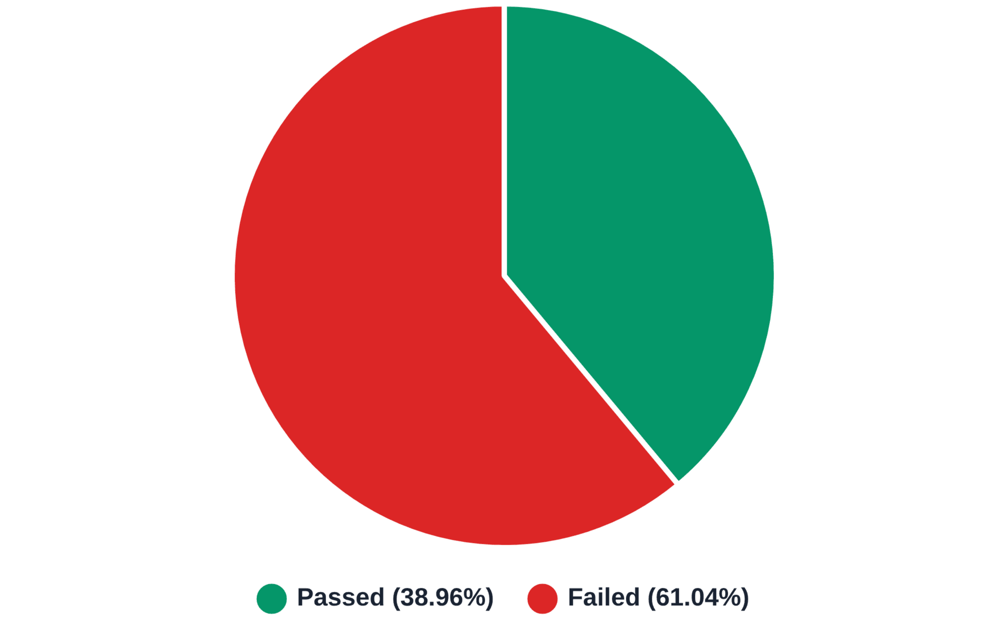
Overall Functional Test Execution Results
Total Test Cases
Total Defects
77
42
Passed Test Cases
Failed Test Cases
30
47
Pass Rate
Fail Rate
38.96%
61.04%
Notes:
Following the executive summary, this slide provides the hard metrics that underscore the severity of the problem. Out of 77 total test cases executed, only 30 passed, resulting in a 38.96% pass rate. This translates to a 61.04% failure rate, which is a clear indicator that the module is fundamentally unstable. We cannot move forward with a core component failing three out of every five tests. The high failure count of 47 test cases confirms that the module is not meeting its basic functional requirements. This level of instability introduces significant operational risk and potential security exposure. We need to understand where this instability is concentrated, so let's break down the performance by the two core functionalities.

Slide 4
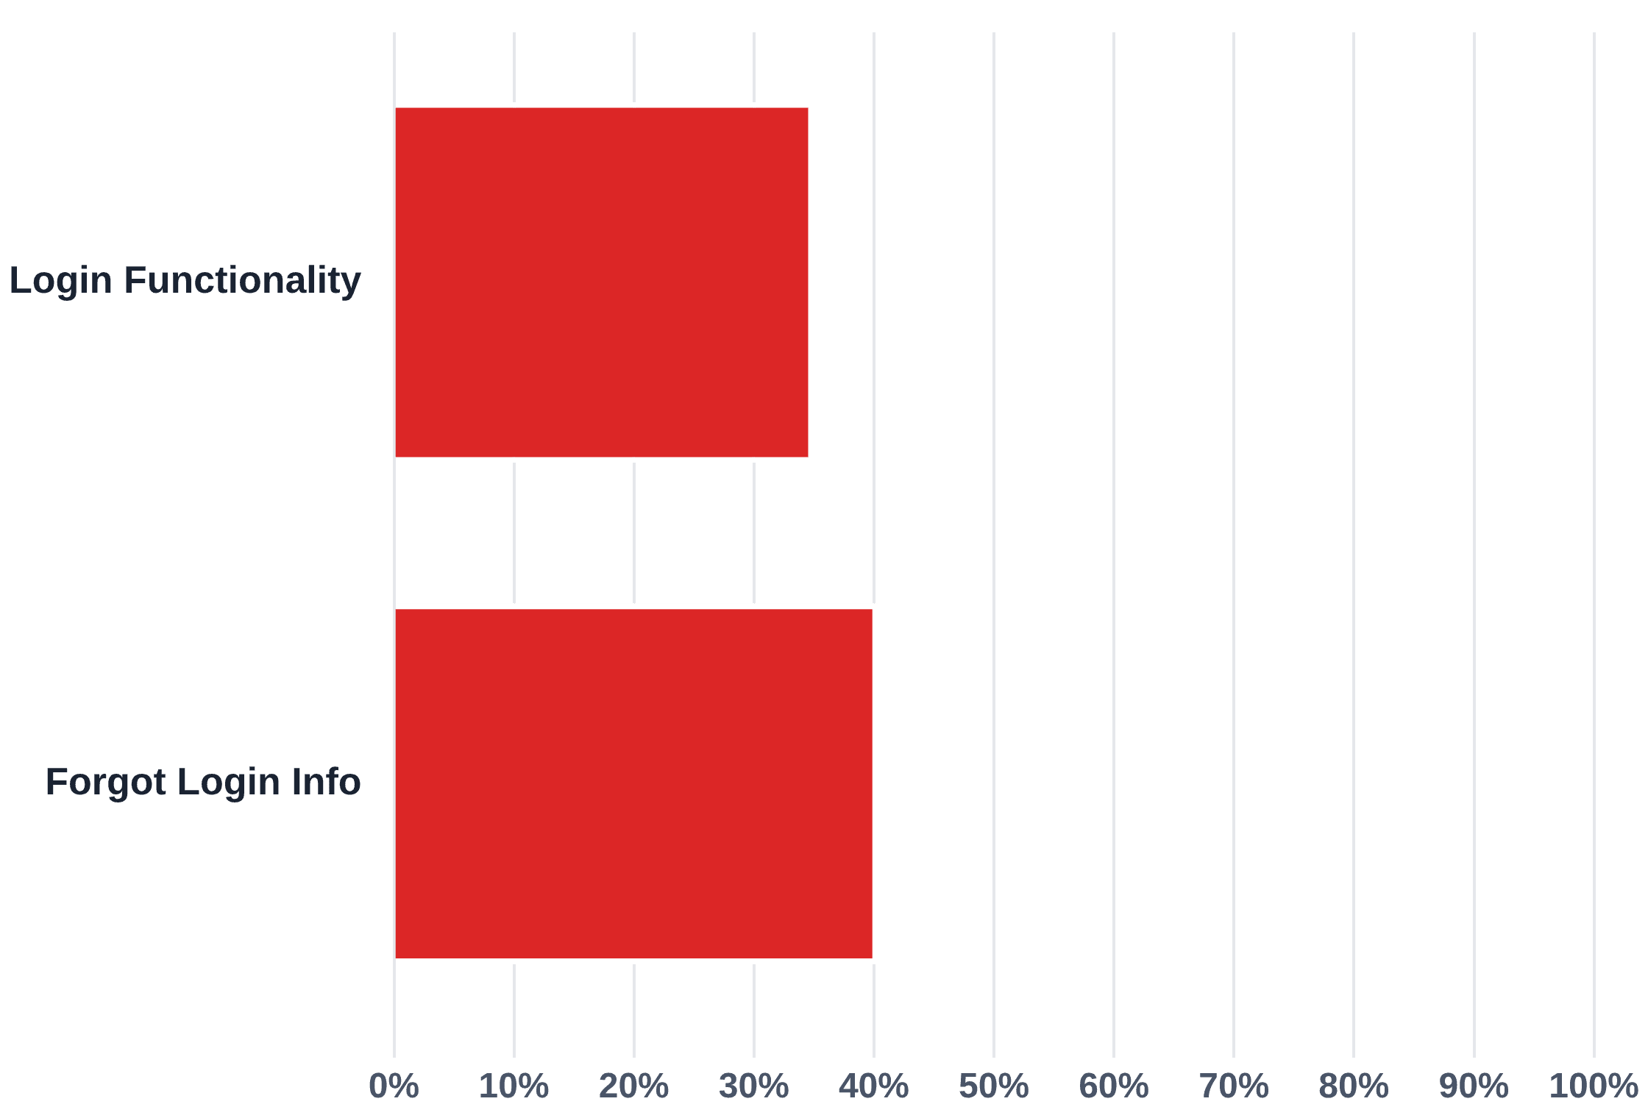
Test Case Pass Rate by Module
Login Functionality
Total Test Cases
Pass Rate
20
35.0%
Failed Test Cases
Passed Test Cases
13
7
Forgot Login Info
Total Test Cases
Pass Rate
57
40.35%
Failed Test Cases
Passed Test Cases
34
23
Notes:
The overall failure rate is driven by poor performance in both core components, as this breakdown clearly shows. The Login Functionality, which is the gateway to the system, has the lowest pass rate at only 35.0%. This means two-thirds of our login scenarios are failing. The Forgot Login Info functionality is only marginally better, with a 40.35% pass rate. Neither component is close to a deployable state. The fact that the Login module is the most unstable component is particularly concerning, as it is the first line of defense. The low pass rates in both areas suggest a common underlying issue, likely related to how input is handled across the module. To fully grasp the impact of these failures, we must examine the severity of the defects we found.

Slide 5
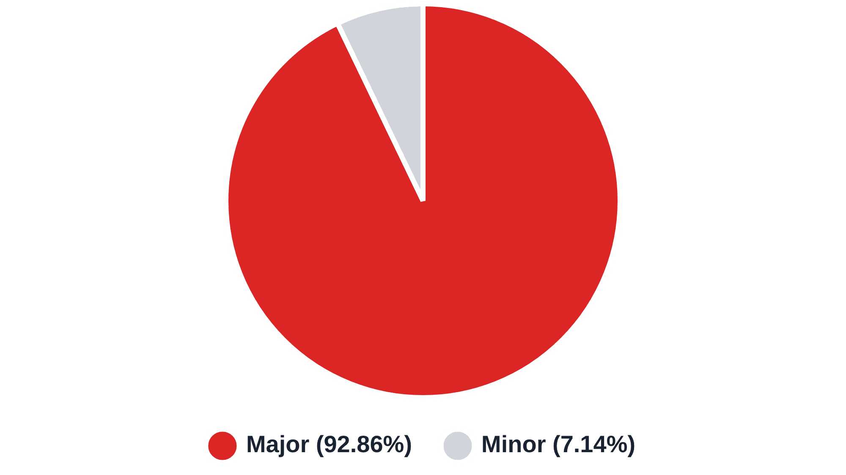
Defect Severity Distribution (Total Bugs: 42)
Major Severity
Minor Severity
39
3
92.86%
7.14%
The overwhelming majority of identified defects are classified as Major, signifying critical functional failures that severely impact the user experience and system integrity.
Notes:
The severity distribution of the 42 identified defects is perhaps the most critical data point in this report. An overwhelming 92.86% of the bugs, or 39 out of 42, are classified as Major severity. This is not a collection of cosmetic or minor usability issues. These are critical functional failures that severely impact system integrity and user experience. Only three defects were classified as Minor. The high concentration of Major defects means that the failures we are seeing are not isolated incidents but rather systemic flaws in the module's architecture or implementation. This confirms that the module is not just unstable, but critically flawed. We need to focus our resources on fixing these Major defects immediately, starting with the most critical systemic issue we uncovered.

Slide 6
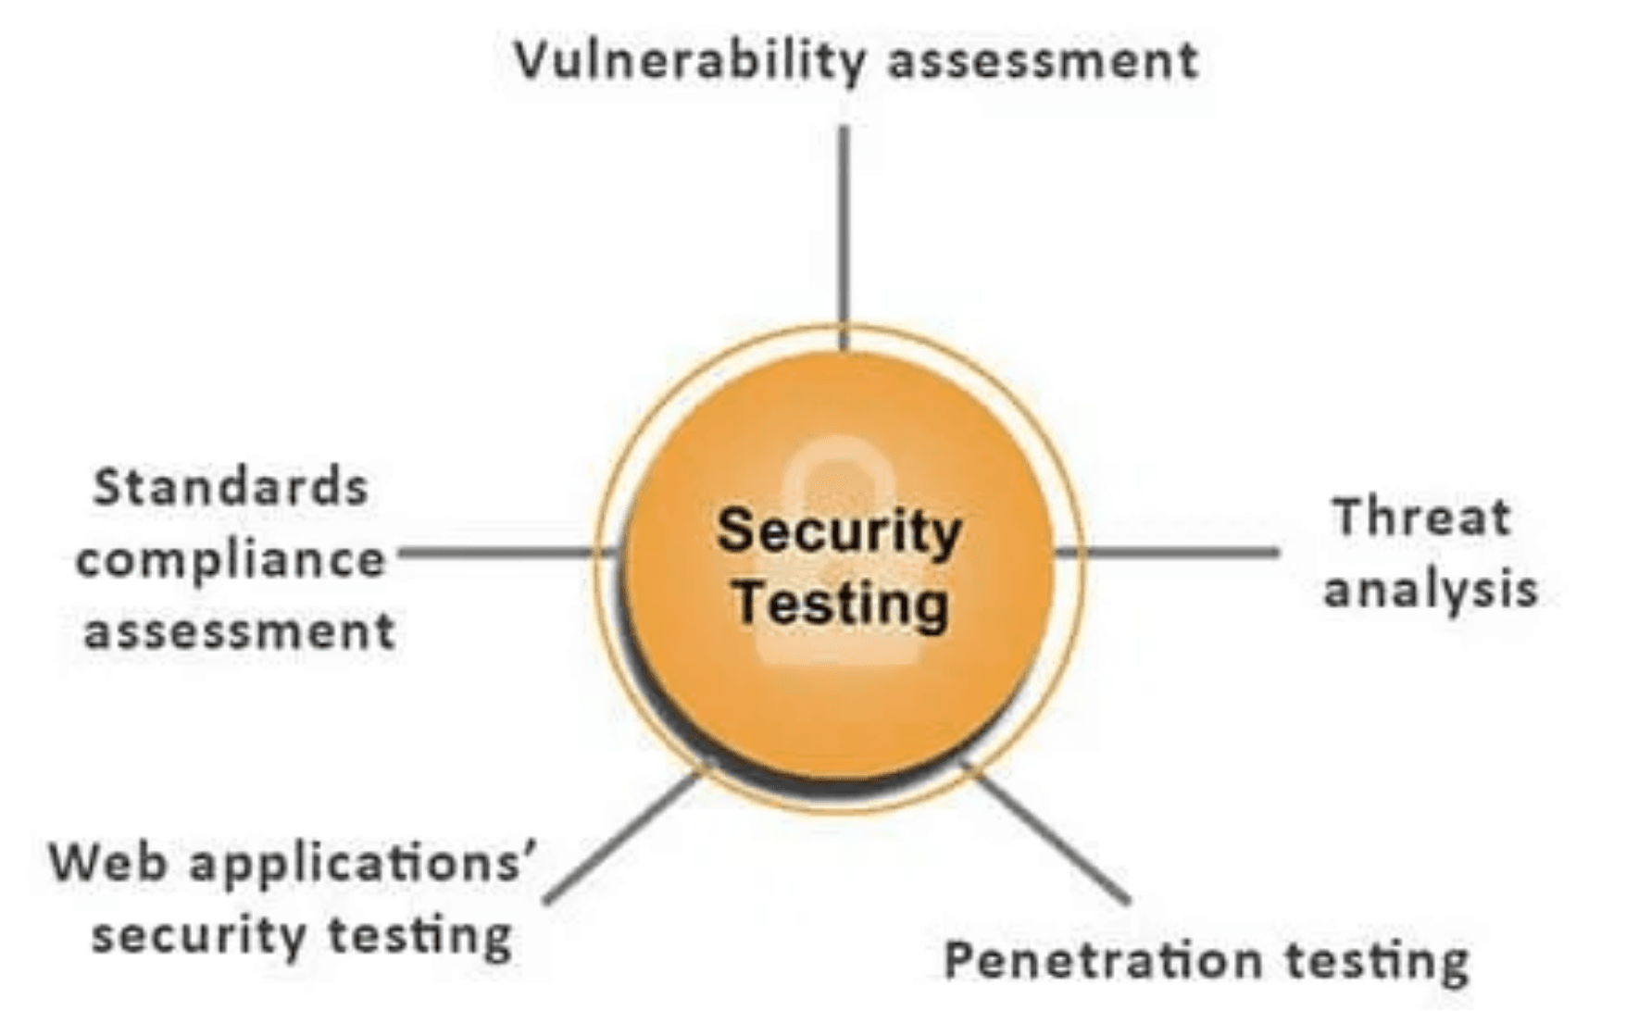
Test Approach
& Test Techniques
• Manual functional testing will be performed for all login and password recovery requirements.
• Each requirement (AUTH-001 to AUTH-011) will be validated individually with positive and negative test scenarios.
• Field-level validation will be tested for blank entries, invalid formats, and valid registered credentials.
• Error messages will be checked for accuracy, correctness, and alignment with requirements.
• Redirection behavior will be validated after successful login.
• Password recovery flow will be tested using valid and invalid user information.
• Session management tests will verify that user sessions persist during normal navigation and end properly after logout.
• Test results will be documented, and defects will be reported with request/response logs and screenshots.
Equivalence Partitioning (EP):
Categorizing inputs into valid and invalid partitions for username, password, and recovery fields.
Boundary Value Analysis (BVA):
Applying limits on username/password length (min/max characters if applicable).
Positive & Negative Testing:
Validating correct login with valid inputs and proper rejection of invalid ones.
Error Guessing:
Predicting common issues such as spaces-only input, expired temporary passwords, incorrect capitalization.
Use Case Testing:
Validating real-world flows such as "Login → Navigate → Logout".
State Transition Testing:
Ensuring session states change correctly (Logged Out → Logged In → Logged Out).
Notes:
We now shift our focus to the most critical finding of this entire review: a systemic defect in input validation. This is not just a functional bug; it is a critical security and data integrity flaw that compromises the entire authentication process. The evidence is alarming: in 45 out of 57 test cases for the Forgot Login Info module, the system failed to return the expected error message for invalid data. Instead, it returned a success message, often stating, "Your account was created successfully. You are now logged in." This means that when we submit malformed data—like numbers in a name field or special characters in an address—the system bypasses all validation checks and treats the submission as a successful account creation or login event. This is a fundamental failure of security architecture. It allows unauthorized or malformed credentials to gain access or trigger incorrect system responses, posing an unacceptable risk to our user data and system integrity. We must treat this systemic failure as the highest priority for immediate resolution. Now, let's look at the specific defects found within the Login functionality.

Slide 7
Key Defects in Login Functionality
Pass Rate
35.0%
Boundary Condition Failure
Character Validation Bypass
System fails to enforce minimum/maximum length for Username (1 char accepted) and Password (7 or 13 chars accepted).
Invalid characters (e.g., spaces, special chars) in Username are accepted, leading to unexpected success.
BUG_001, BUG_005, BUG_006
BUG_002
Incorrect Error Message
Password Complexity Bypass
Invalid usernames incorrectly return "This username already exists" error instead of "The username and password could not be verified."
System accepts passwords that fail complexity rules (missing uppercase, special characters, or numbers).
BUG_003, BUG_004
BUG_007, BUG_008, BUG_009, BUG_010
Critical Finding: The Login module's input validation is fundamentally broken, allowing unauthorized or malformed credentials to gain access or trigger incorrect system responses. All 10 identified defects are classified as Major severity, indicating critical functional failures that severely impact security and system integrity.
Notes:
Following the systemic failure we just discussed, let's examine the specific defects found within the Login functionality, which currently has a pass rate of only 35.0%. We identified 10 Major bugs here, all pointing to a fundamentally broken input validation process. For example, the system fails to enforce basic boundary conditions, accepting usernames as short as one character and passwords with incorrect length boundaries. We also found that invalid characters, such as spaces and special characters, are accepted in the Username field, which can lead to unexpected success or system instability. Furthermore, the system incorrectly handles invalid usernames, returning an error that suggests the username already exists instead of correctly stating that the credentials could not be verified. This lack of robust validation means the module is highly susceptible to unauthorized access and data corruption. This poor performance is mirrored in the password recovery mechanism, which we'll review next.

Slide 8
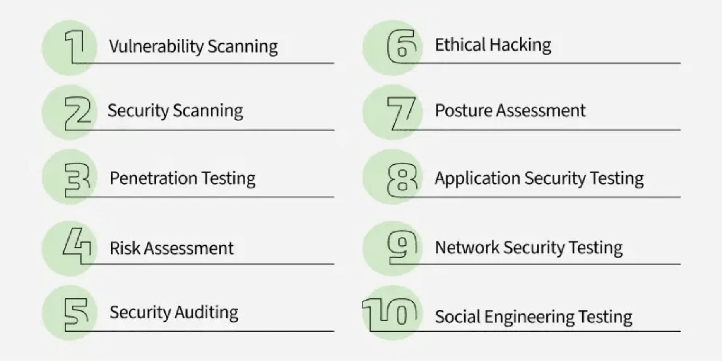
Key Defects in Forgot Login Info
Defect Summary (32 Bugs, 90.6% Major): The Password Recovery mechanism exhibits a systemic failure where invalid input consistently leads to "Your account was created successfully. You are now logged in." instead of displaying the required error message.
Name Field Validation Failures
Accepting numbers in First/Last names (BUG_01, BUG_02)
•
Accepting special characters in First/Last names (BUG_03, BUG_04)
•
Accepting names with leading spaces (BUG_05, BUG_06)
•
Failing boundary validation for 1-character names (BUG_09)
•
Address & Location Field Failures
Address field accepting special characters (BUG_12)
•
Address field failing length boundaries (BUG_13, BUG_14)
•
City field accepting numbers and special characters (BUG_15, BUG_16)
•
City field accepting leading spaces and exceeding max length (BUG_17, BUG_19)
•
State, ZIP & SSN Validation Failures
State field accepting numbers and special characters (BUG_20, BUG_21)
•
ZIP Code failing boundary and format validation (BUG_26, BUG_27)
•
SSN accepting incorrect formats and digit counts (BUG_28, BUG_29, BUG_30, BUG_31, BUG_32)
•
Critical Implication: The Password Recovery mechanism is completely non-functional from a validation perspective, posing a significant risk to data quality and security. Invalid submissions are treated as successful account creation events.
Notes:
The poor performance we saw in the Login module is unfortunately mirrored, and amplified, in the Forgot Login Info functionality, which has a pass rate of only 40.35%. This module contains 32 bugs, with over 90% classified as Major severity. The core issue is the systemic success-on-failure problem we highlighted earlier. Invalid data in fields like Name, Address, and SSN consistently results in a success message instead of the required error. Specifically, we found that name fields accept numbers and special characters, and address fields fail to enforce length boundaries. Even critical fields like ZIP Code and SSN fail to enforce correct format and length validation. This means the password recovery mechanism is completely non-functional from a validation perspective. It poses a significant risk to data quality and security by treating invalid submissions as successful account creation events. We must move quickly to define the path forward to remediate these critical issues.

