Slide 1
Using Neural Networks to generate test cases using BDD specifications
By N. p. s. c. Nugawela (189337j)

Slide 2
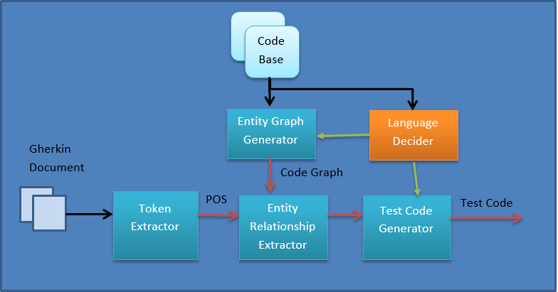
Modular Design

Slide 3
A Brief Overview
Started as a way to generate test cases using BDD and neural networks, specifically Generative Adversarial Networks. (GANs)
After refinement, it became a much more complex and a different system than initially thought.
Takes a document written in Gherkin.
Has the basic structure of GIVEN, WHEN and THEN.
We exploit the inherent structure within the document and the data contained within the natural language statements within the BDD statements.
The Language Decider looks at the code base and decides what the target language is for the test case generation.
Then, it loads the corresponding language modules in the Entity Graph Generator and Test Case Generator modules.

Slide 4
Token Extractor
This module is capable of reading Gherkin ﬁles. The target of this module will be to extract the necessary tags from the ﬁle.
Does not depend on the programming language selection.
The types of data that can be extracted from each of the Gherkin keywords
Feature
Example/Scenario
Steps
Background
Scenario Outline
Doc Strings
Notes:
Feature: It is the topic under which the test cases are organized. Following the feature, there are lines describing the overall feature, which is usually used as comments.
Example/Scenario: This is the speciﬁcation of a scenario, i.e. a BDD test case.
Steps: These contain the keywords, Given, When, Then, And, But. Given provides the initial setup conditions. The initial step should describe how the initial setup is done with enough clarity to unambiguously decide the classes and methods to call.
Background: Background is similar to a given statement that spans throughout multiple test cases. So we can treat it similar to the way we would treat a ”Given” statement.
Scenario Outline: The Scenario Outline keyword can be used to run the same Scenario multiple times, with different combinations of values. 30 demonstrates an instance where a scenario outline is used.
Doc Strings: The doc string is passed as the last argument of a step deﬁnition when it is speciﬁed. We have to treat the string as an immutable value and pass it forward through the system.

Slide 5
Entity Graph Generator
This module is responsible for parsing the available code base and 3rd party sources, and generating a relationship graphs which includes all of the available classes, their methods, inheritance and association relationships.
This is created for the use in the Entity Relationship Extractor. Entity Relationship Extractor module uses the output of the Entity Graph Generator to match the tokens against the code base.
We will have modules supporting all target languages. Currently, these are Java and Python.

Slide 6
Entity Relationship Extractor
This section takes in the outputs of the previous two sections and tries to map the test case’s entities to the entities from the code base graph.
We need a similarity measure to decide if there is a match between the BDD entity and the source code entities. Such measures can be,
A string matcher: A simple string matcher that matches the class, method names using basic string operations.
An NLP matcher: A matcher that considers the similarity between the two strings by considering the real life language meanings.
A context based matcher: A matcher that attempts to match the entities based on descriptions and other relationships contained in the test case.
The ideal option is the last option as it provides the best opportunities for matching.

Slide 7
User Interface
User Interface in our system has a several responsibilities.
At the initial run, specify the code base root directory. Therefore, the code base must be contained within a single master directory.
The UI must allow the user to specify the source directories of 3rd party libraries.
When generating the test, if there are multiple possible entities matching an entity in the Gherkin test case, the interface must ask the user to disambiguate.
If there are no matching entities for an entity in the test case, the user interface must ask the user to browse to the entity’s path if it exists and give path to save a stub generated by our system.
Refresh functionality must be available for the user to refresh the entity graph and other related data structures. Otherwise, the graphs will be update them at startup.
When generating the test glue code, the UI must prompt the user to inspect the generated code test case, the interface must ask the user to disambiguate.

Slide 8
Test Code Generator
The Test Code Generator will generate the test case based on the output of the Entity Relationship Extractor.
The Entity Relationship Extractor feeds all the necessary code elements to the generator and the generator simply arranges them according to the target programming language’s linguistics.
To achieve this, we plan to use a Recurrent Neural Networks, as it has been demonstrated it is feasible to generate code using RNNs. This will be our generative network.
The generative network is responsible for the generation of the BDD style test cases based on the client requirements.
The discriminative network will decide whether the output of the code generation module is valid. This can be done in two ways.
Code consistency checking : Checking whether the generated code is consistent with the rules of the target programming language.
Consistency with client requirement : This is checking whether the generated code is consistent with the client requirement. It involves NLP.
For the current project, we shall only be focusing on having a code consistency checking network.

Slide 9
Training the Networks
For training the networks will be trained using available open source code bases and their tests. We need both BDD test cases as well as the code. But if there are tests, we can easily create them given a code base and tests.
Research papers such as “Learning to Generate Pseudo-code from Source Code using Statistical Machine Translation” by Yusuke Oda et al. describe how to generate NL specifications based on code.

