Slide 1
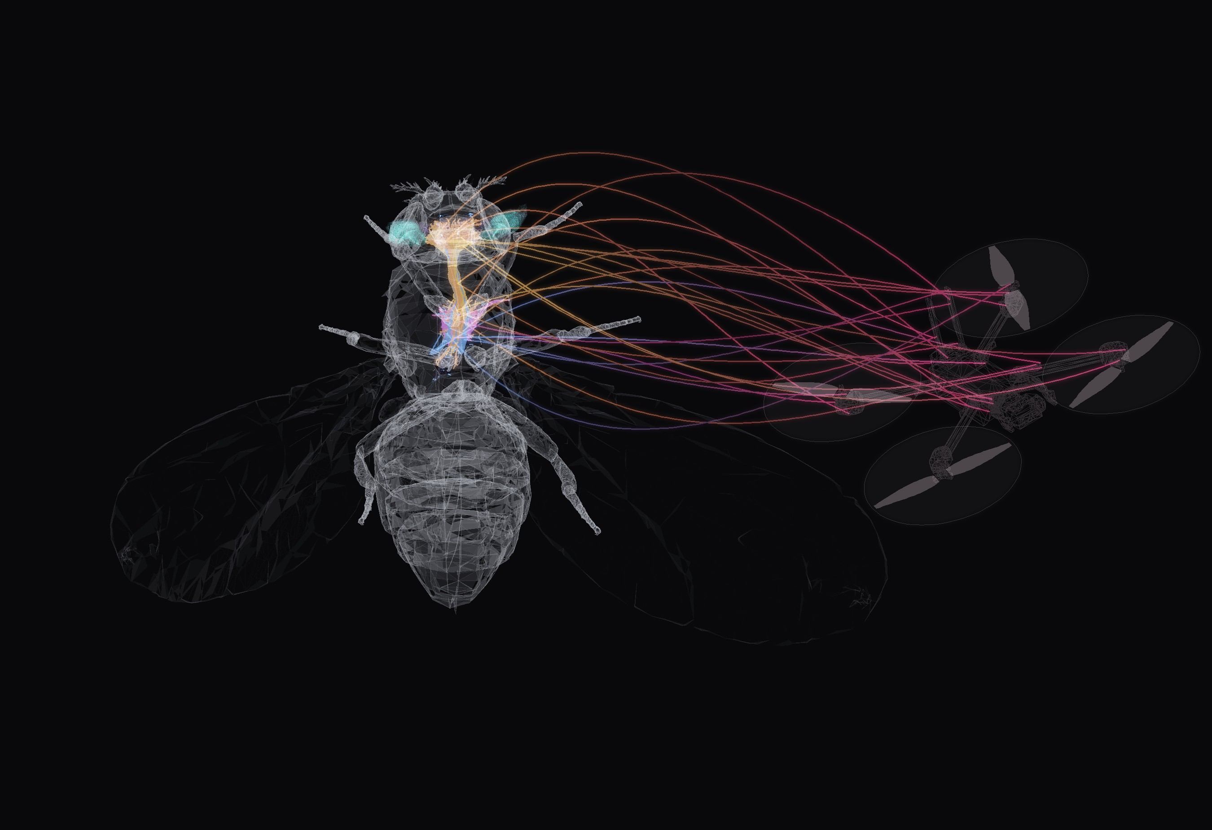

BANC V888 CONNECTOME
NEUROFLY
The brain of a fruit fly which
pilots a drone
FULL BANC V888 CONNECTOME 175,401 NEURONS CLOSED LOOP IN MUJOCO
NO IMAGE OR 3D OBJECT ON THE PRESENTATION IS AI GENERATED
Notes:
NeuroFly: the drone camera image goes through a model of the fly eye (FlyVis), then through the real Drosophila connectome (BANC v888, brain + ventral nerve cord), and flight-neuron activity steers the drone in simulation. Render: semi-transparent NeuroMechFly body (FlyGym) with the BANC connectome inside — body alignment is illustrative — next to the X2 drone from MuJoCo. The threads from flight neurons to the drone are an illustration of the loop, not data.

Slide 2
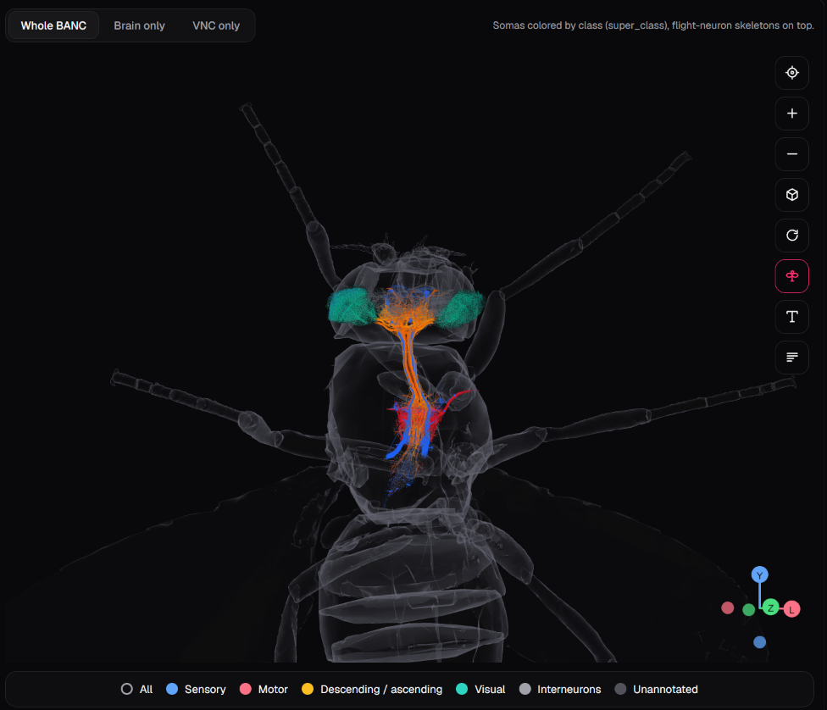
WHY A FLY BRAIN?
IDEA
A fruit fly can detect motion, avoid obstacles and move towards a target using a very small brain.
Its visual system quickly turns what it sees into movement decisions. This can help build drone navigation that reacts to the environment without needing a large model or constant connection to powerful hardware.
OUR QUESTION
Can the real wiring of an insect brain pilot effectively an autonomous drone?
175,401
2.6 ms
neurons, mapped synapse by synapse
to run all of them once on a laptop GPU
Notes:
NeuroFly is not another chatbot connected to a drone. It is an experiment in biologically grounded visual intelligence: the controller is the published connectome of a fruit fly (BANC), run as a neural network.

Slide 3
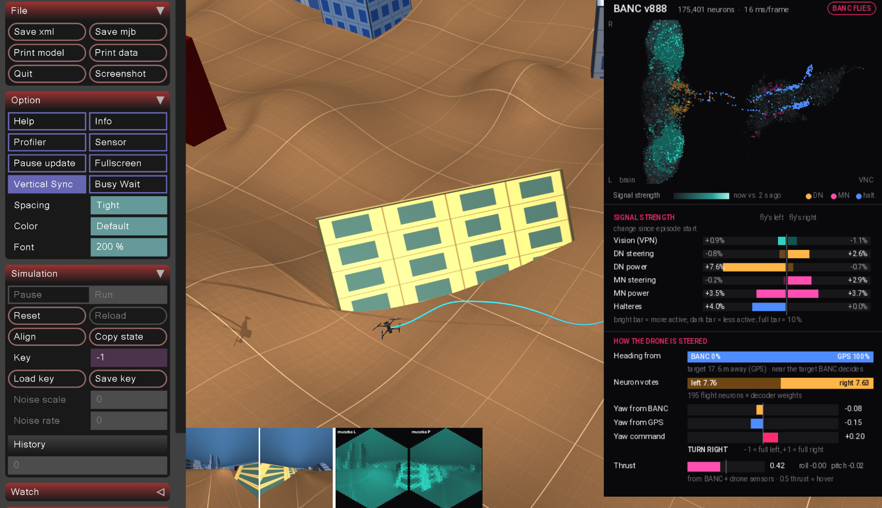
THE PROBLEM
IDEA
An autonomous drone decides from imperfect pictures, many times a second.
Where is the target?
a mast somewhere ahead, GPS off by metres
Is something in the way?
buildings,walls and trees on the route
Which way to turn?
left, right, how hard
How to stay in the air?
height, tilt, wind gusts
Live run: world, drone eyes (bottom), BANC panel (right)
Our experimental path is a small, inspectable circuit that evolution already tuned instead of big datasets, long training, a black box
Notes:
Classic systems need large datasets, expensive training and opaque networks. We explore a different path: the measured wiring of a fly, where every neuron has a name and a function label.

Slide 4
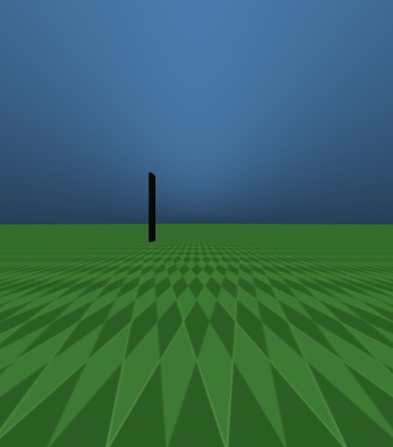

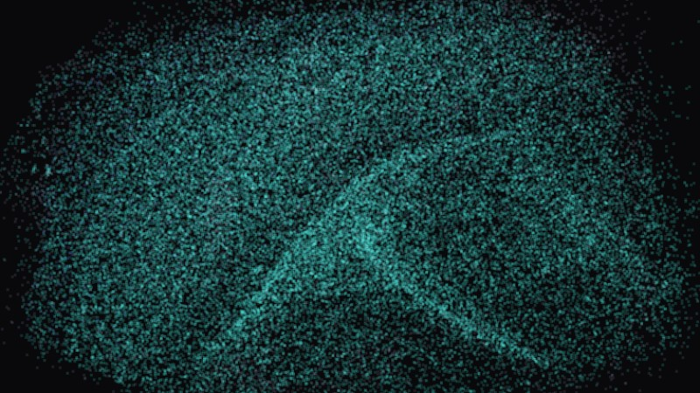
FROM A CAMERA FRAME TO A FLY'S VIEW
HOW IT WORKS
1 Camera
2 Compound eye
3 Motion vision
two eyes on the drone's nose, 157° each from 3d simulation
721 ommatidia per eye, one brightness value each
FlyVis photoreceptors turns it into fly visual neuron activity
Each ommatidium (one facet of the compound eye) sees only a small patch of the scene. No full image ever reaches the brain.
Notes:
The camera image is resampled into the hexagonal lattice of a fly eye (FlyGym retina, 721 ommatidia per eye). FlyVis (Lappalainen et al.) computes the activity of fly visual neuron types, including motion detectors T4 and T5. Those activities are mapped by cell type onto 22,462 BANC neurons.

Slide 5
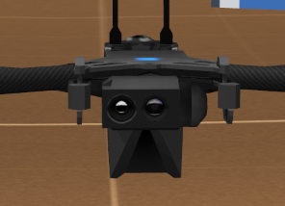
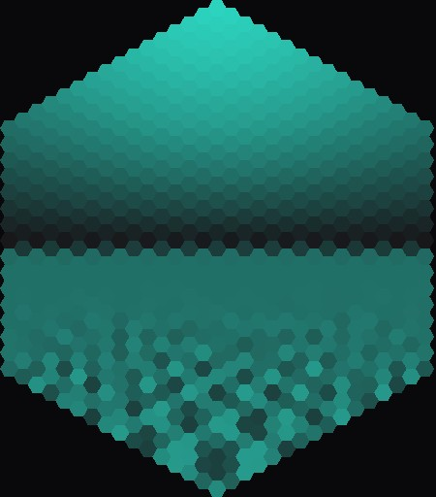
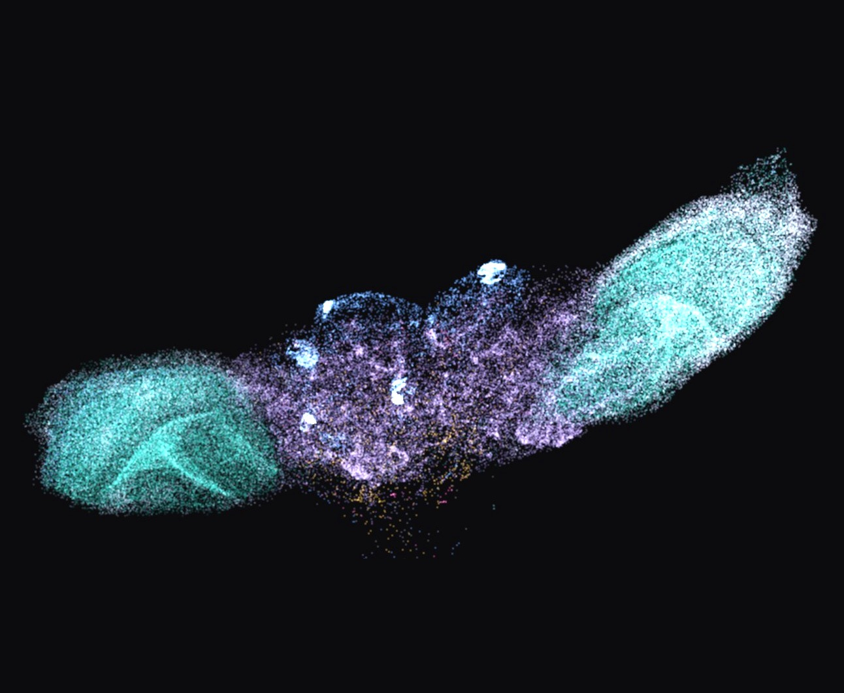
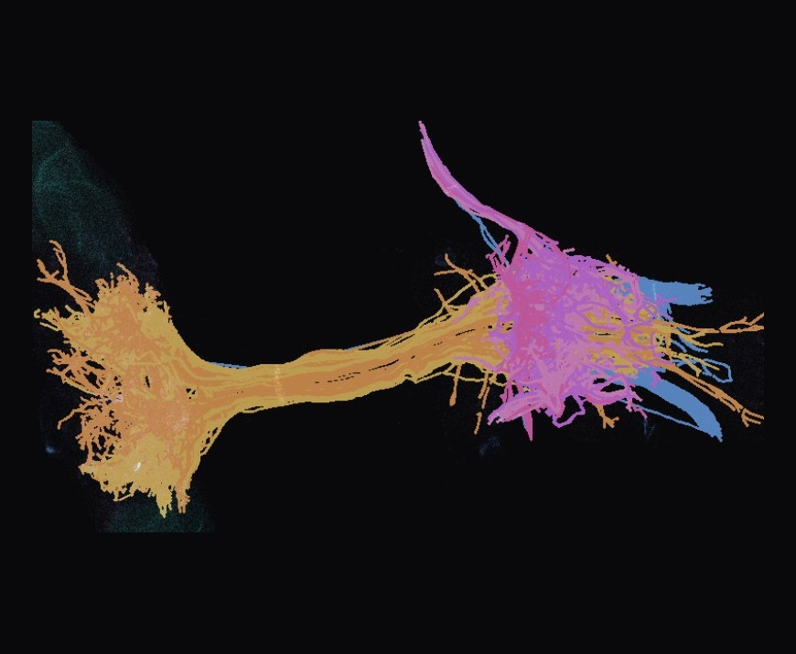
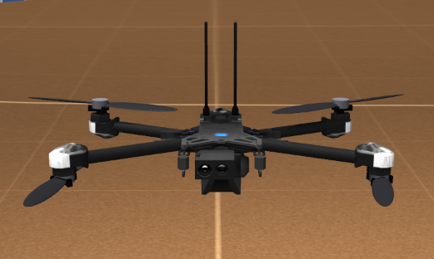
HOW NEUROFLY WORKS IN SIMPLE TERMS
HOW IT WORKS
TRAINED NET
REAL CONNECTOME
LEARNED
1 Camera
2 Fly eye
3 Fly brain
4 Decoder
5 Drone
Two cameras on the drone's nose film the world 30 times a second.
721 facets per eye. FlyVis turns them into the signals of real fly visual neurons.
The signals spread through 175,401 real neurons and 1.5 M connections, on the GPU.
Reads 375 flight neurons and turns them into commands. Learned from a teacher pilot.
Thrust, roll, pitch and yaw spin the 4 rotors. The drone moves and sees a new frame.
Every frame goes once around: seeing, processing, deciding, moving, then a new picture.
Red tag: where AI works in the loop
Simulator: MuJoCo physics with a Skydio X2 drone model
Speed: 30 camera frames per second
Notes:
Three AI parts: FlyVis (trained network of the fly visual system), the BANC connectome (biological network, rate model on the GPU, never trained) and the decoder that reads flight neurons, learned by imitation (DAgger) on two laptop GPUs at once.

Slide 6
WHAT KIND OF AI THIS IS
AI AND CONTROL
WHAT IT IS
A network copied neuron by neuron from a real fruit fly brain. Every connection keeps the strength nature gave it. We only learn how to read it.
COPIED
the brain is not trained
its connections come from electron microscope scans of a real fly
READ
only the readout learns
a small decoder learns which flight neurons mean left or right
VISIBLE
every turn can be explained
named neurons vote left or right, shown live in flight
TESTED
new worlds, no teacher
How often fly neurons tell where the target is (50% = guessing)
it reaches targets in random worlds it has never seen
Flight neurons: 375 descending neurons that carry flight commands from brain to body
Notes:
Connectome-constrained recurrent rate model: 175,401 BANC v888 neurons, 1.5 M connections, weights fixed by synapse counts and predicted transmitter sign; nothing inside the brain is trained. The only learned part is a linear ridge readout (DAgger from a teacher pilot) of 375 descending flight neurons plus 6 wing-motor group means, about 380 weights for yaw. Chart: target side is readable from single flight neurons in 99% of scenes, averaging motor neurons loses it (68%), cross-validated, scripts/check_side_decoding.py. 138 of the last 150 training flights reached the target with the teacher off, clear corridor. Our assumptions: rate dynamics, tau, gain, transmitter signs and the linear readout.

Slide 7
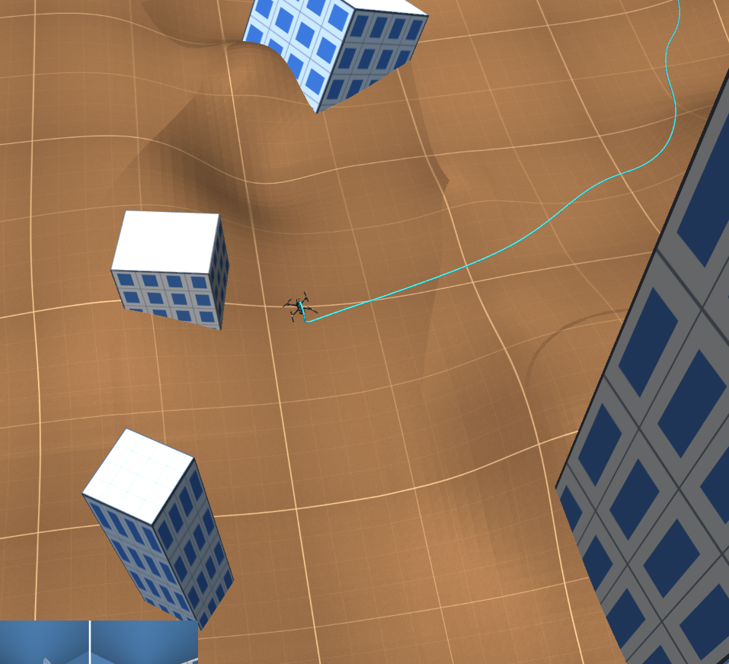
USE CASE: REACH A TARGET SAFELY
HOW IT WORKS
No route is pre-written. Every frame the eyes see the scene, the fly brain reacts, and the decoder reads its flight neurons like a pilot's stick.
far: rough GPS signal
avoiding objects: fly brain
WHO CONTROLS WHAT
Turning left and right
fly brain only: 375 flight neurons, no drone sensors
Height and speed
fly eyes and brain plus height and speed sensors
Holding the tilt
the simulator's autopilot keeps the tilt the brain asks for
Notes:
Concrete use case: the final approach, where GPS drifts by metres, e.g. homing on a marked landing zone. Far away a GPS heading is used; inside 4 m the turn comes only from BANC flight neurons. 138 of the last 150 training flights reached the target with the teacher fully off (clear corridor). Obstacle avoidance is being trained.

Slide 8
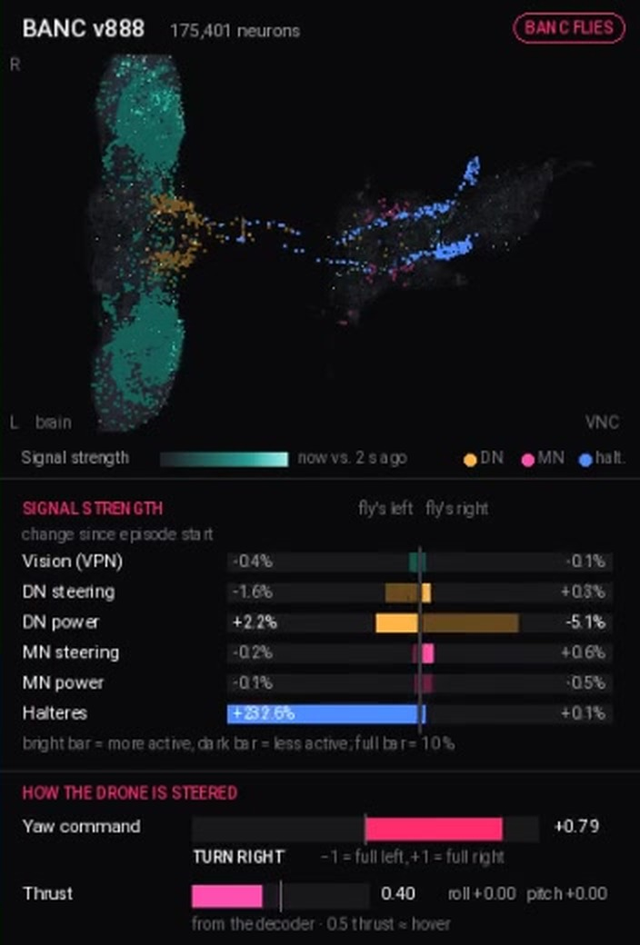
LIVE NEURON PANEL DURING AI FLIGHT
AI AND CONTROL
1
What it sees
the camera view and both fly eyes, live next to the drone
2
Who steers
live share of the heading from the fly brain vs GPS, and the final command
3
Why it turns
each flight neuron's vote for left or right, from the real decoder weights
4
Take over any time
fly by keyboard while the brain only watches; 3D explorer shows every neuron
Left: live BANC panel in flight
Notes:
The live panel (sim/brain_panel.py) shows signal strength in vision, flight, muscle and haltere groups, who decides the heading (BANC vs GPS) and the votes of individual neurons. python -m sim.viewer --brain lets a person fly while the network only observes. The Next.js explorer shows every neuron with its real synaptic partners.

Slide 9
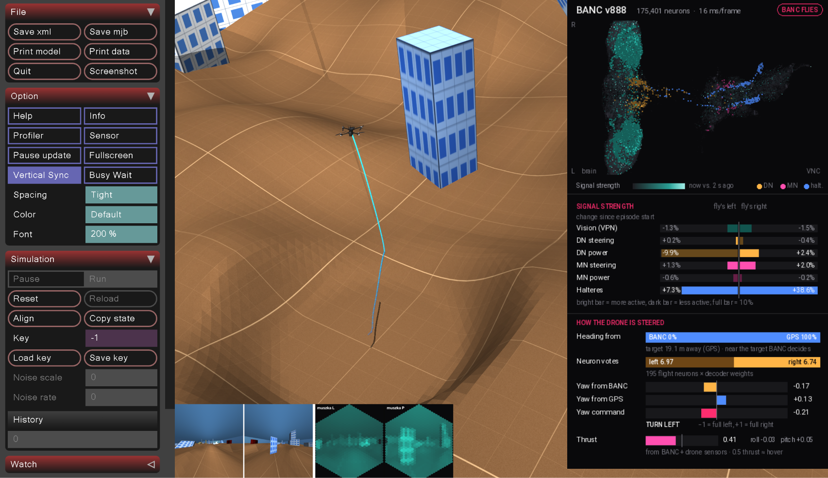
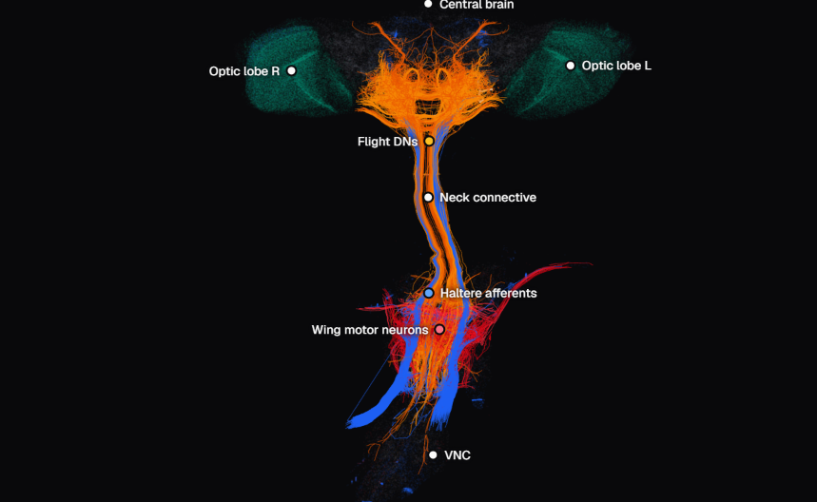
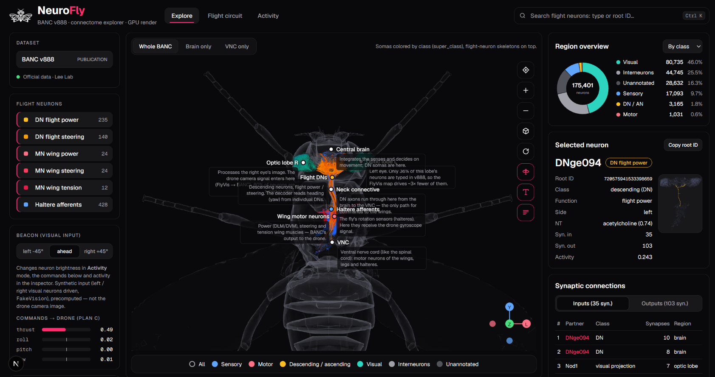
WHAT WE BUILT DURING HACKYEAH
RESULTS
1 3D simulation and drone
2 Complete neural pipeline
3 Connectome explorer in browser
MuJoCo world with hills, blocks and wind, and an X2 drone that sees through two fly eyes
camera, fly eye, FlyVis, all 175,401 BANC neurons, decoder and drone in one closed loop
a web page to explore the connectome and sort out the neuron types we needed
4 Three models, more autonomy each time
Each model took over more of the flight than the one before, all trained on two GPUs in parallel (RTX 4060 + RTX 3070 Ti).
hangs in the air and turns its nose toward the target
flies through a new random world to the target, guided by GPS from afar
height and speed from the fly brain alone, no drone sensors, blocks on the way
Project based on open-source repos: BANC v888 (Bates et al. 2026), FlyVis, FlyGym, MuJoCo with the Skydio X2 model, PyTorch, Next.js, three.js.
Notes:
Newest run (world_nostab): thrust, roll and pitch only from BANC, drone sensors weighted 0. Evaluation on 6 fixed worlds with 2 blocks on the path: 0, 0, 1, 4, 5 reached after 0, 40, 80, 120, 160 flights; mean closest approach 9.8 m to 1.8 m. Only 6 test worlds, so treat it as promising, not final. The attitude controller of the simulator still holds the commanded tilt and GPS sets the heading beyond 4 m.

Slide 10
FROM A FLY'S VISUAL WORLD
TO AUTONOMOUS NAVIGATION
THE EYES
THE BRAIN
THE BODY
Dawid Wypych
Mateusz Nowaczek
Krzysztof Mazur
camera, fly eye, FlyVis
BANC on the GPU, decoders, training
drone, 3D world, sensors
Team the Roook
GITHUB.COM/FALCONDEVX/NEUROFLY
Notes:
Disclosure: BANC data, FlyVis, FlyGym, MuJoCo and the X2 model are open resources; PyTorch, Next.js and three.js are libraries; Claude Code was used as an AI coding assistant. We did not use Godot or FlyWire data. Everything else was built during HackYeah.

