Slide 1
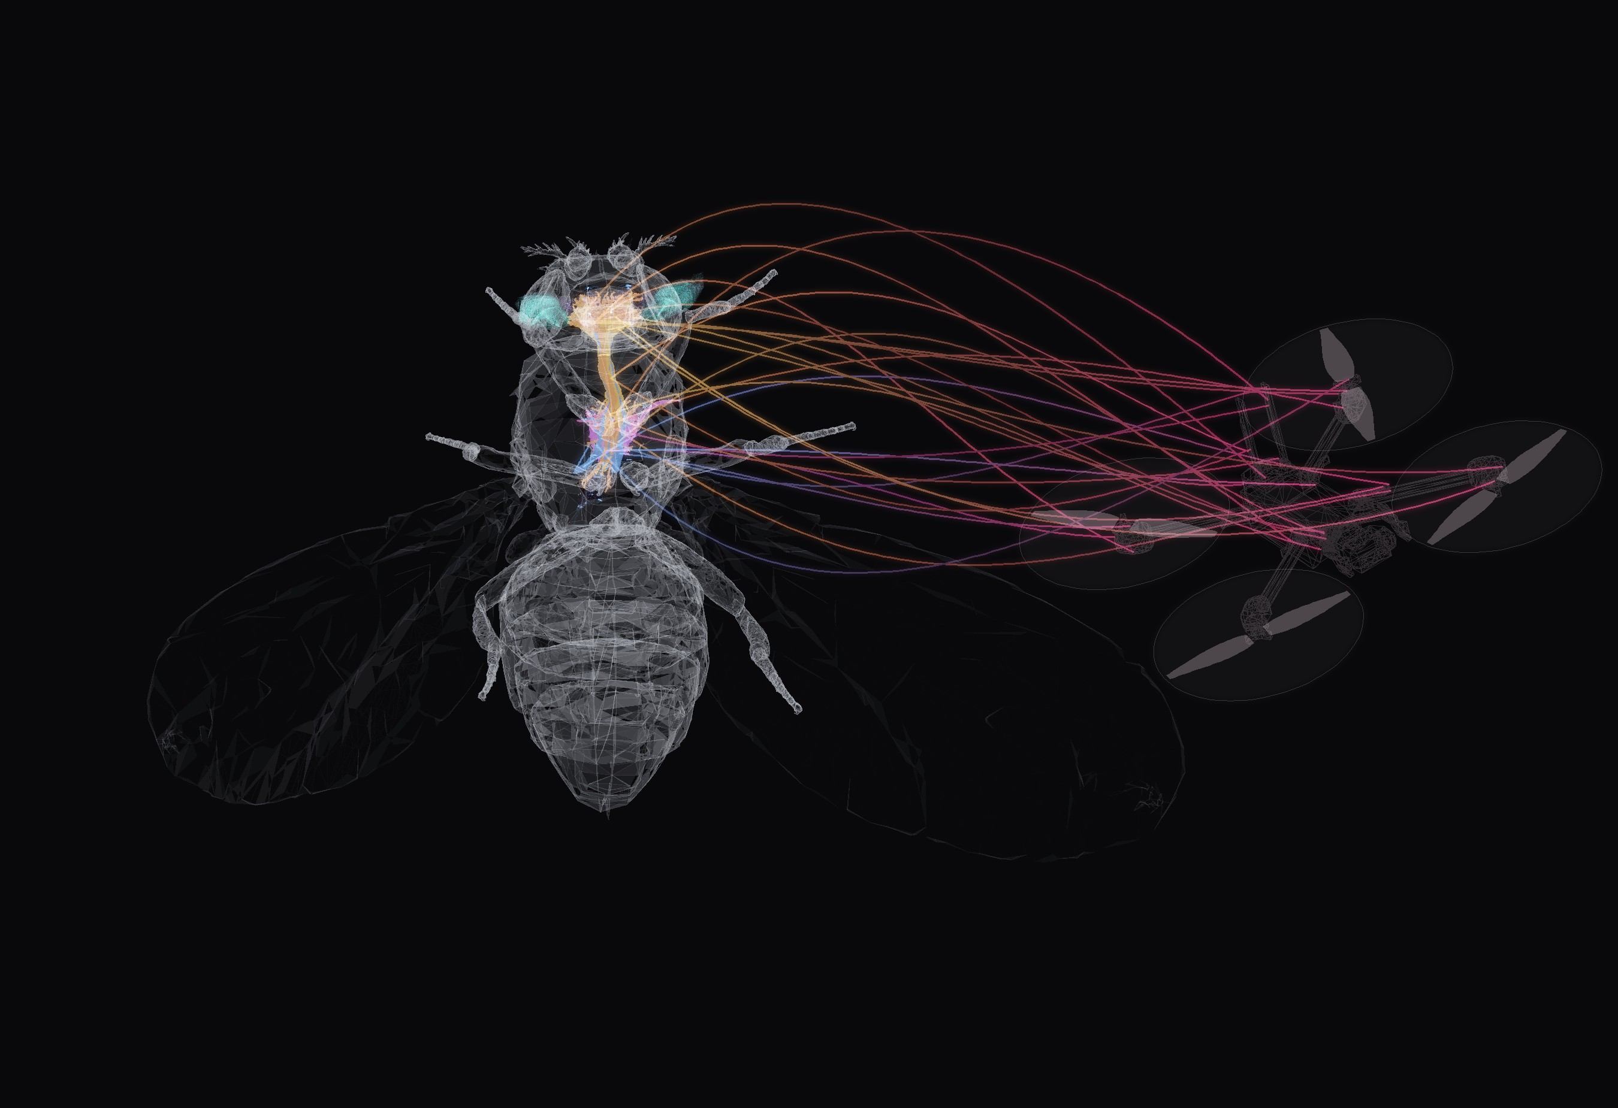

BANC V888 CONNECTOME
NEUROFLY
A fruit-fly brain
flies a drone
FULL BANC V888 CONNECTOME 175,401 NEURONS CLOSED LOOP IN MUJOCO
Notes:
NeuroFly: the drone camera image goes through a model of the fly eye (FlyVis), then through the real Drosophila connectome (BANC v888, brain + ventral nerve cord), and flight-neuron activity steers the drone in simulation. Render: semi-transparent NeuroMechFly body (FlyGym) with the BANC connectome inside — body alignment is illustrative — next to the X2 drone from MuJoCo. The threads from flight neurons to the drone are an illustration of the loop, not data.

Slide 2
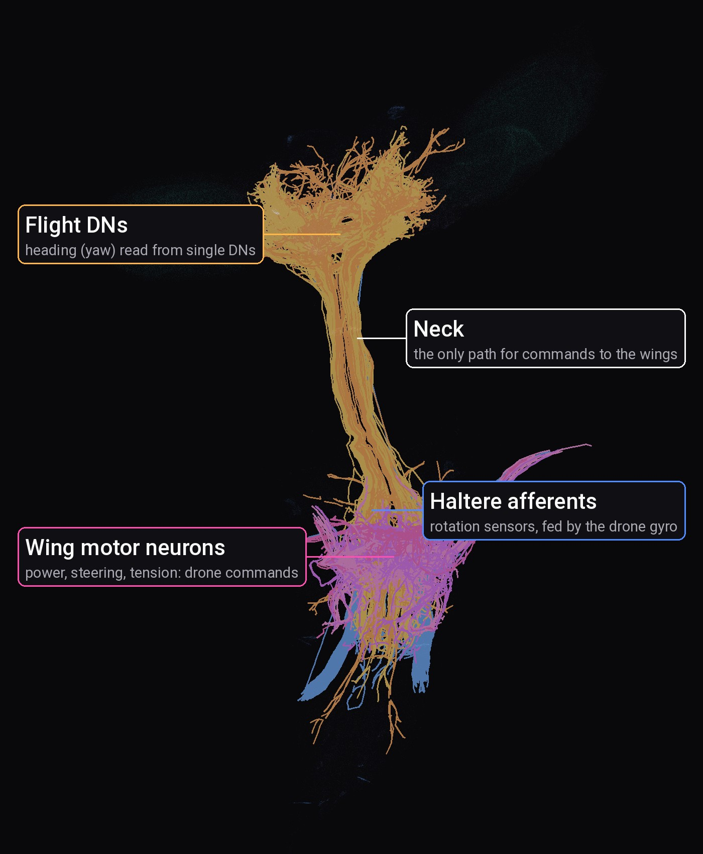
THE IDEA
IDEA
What if a real brain wiring diagram — not an artificial network — decided where a drone flies?
Real wiring
175,401 neurons and their synapses from the BANC v888 fly connectome. We invent no connections and no weights.
Real loop
Camera, fly eye, brain, wing neurons, drone, new image: frame after frame.
Real test
The connectome is judged by behaviour: does the drone turn to the target and reach it?
BANC: Brain And Nerve Cord, the first connectome of a whole fly brain plus nerve cord (Bates et al. 2026)
v888: the public data release we use
Notes:
This is the one sentence to remember. We take the actual wiring of a fruit fly — mapped synapse by synapse in the BANC connectome — and put it in the loop. The only thing we train is a small linear readout from flight neurons to drone commands. Render: 863 flight neurons from BANC skeletons.

Slide 3
WHAT MAKES NEUROFLY DIFFERENT
IDEA
Connectome: the complete wiring diagram of a nervous system, every neuron and synapse
PID: the classic hand-tuned controller used in most drones
TYPICAL APPROACH
NEUROFLY
OUR RULE NO. 1
Brain
artificial network, trained end-to-end
the real fly wiring diagram, kept frozen
The connectome makes the key decision
Scale
a small, hand-picked circuit
whole brain and nerve cord: 175,401 neurons
100%
Heading
decided by the trained net or a PID loop
decided by the fly's own flight neurons
of the heading near the target comes from BANC neurons
Learned
everything
only a simple readout of flight neurons
We dropped an early synthetic network the moment it stopped looking like BANC.
Eyes
a standard image network
a fly-eye model: 721 facets per eye
Notes:
Hundreds of projects call themselves brain-inspired. Almost all use an artificial network that borrows only the word 'neuron', or a tiny hand-built circuit. We use the real, complete wiring of a fruit fly, we never train it, and we built the system so that the most important decision — where to turn — is made by the fly's own descending neurons. Drone sensors get zero weight on heading by construction. When an early prototype used a made-up network, we threw it away.

Slide 4
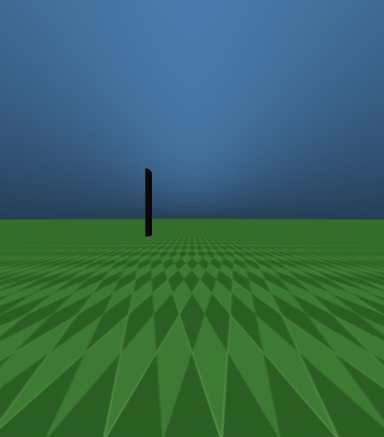

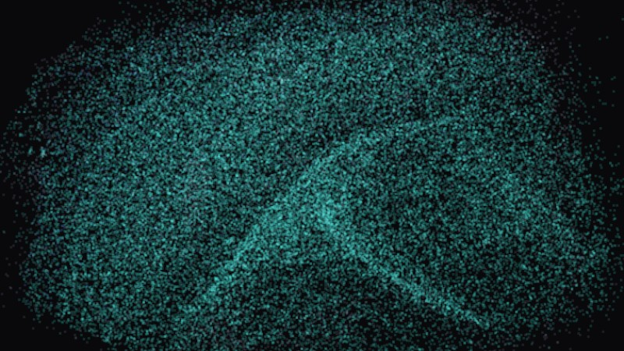
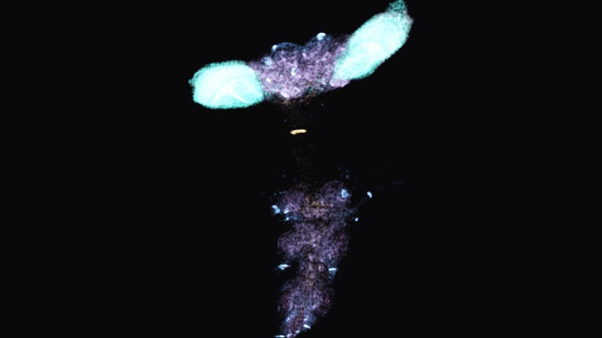
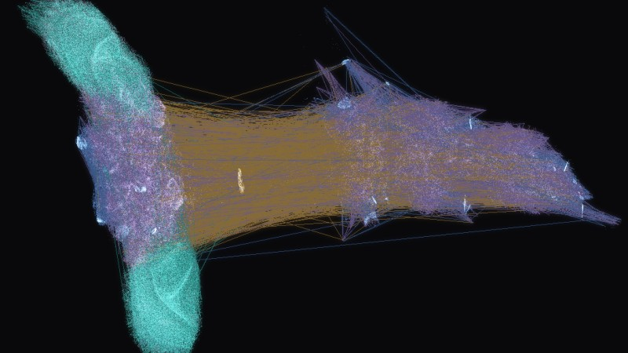
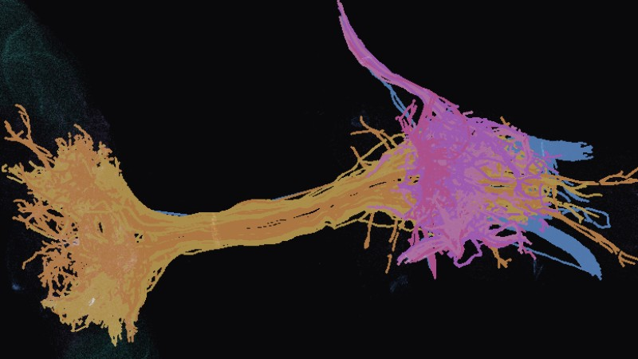
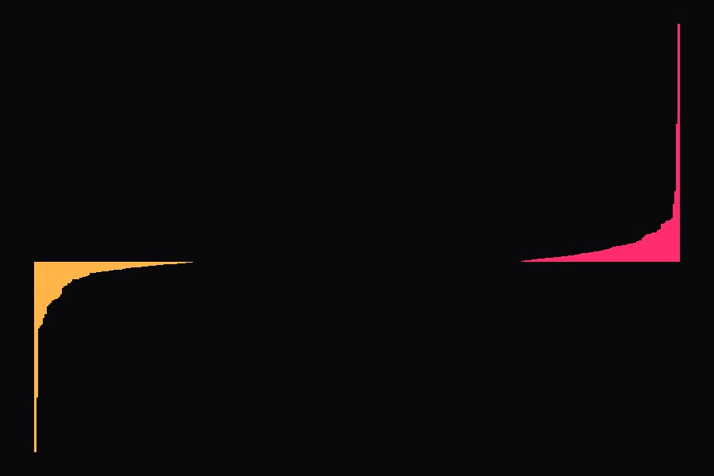
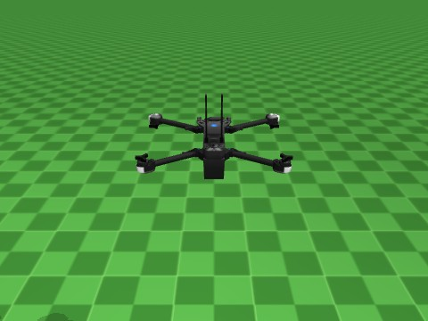
HOW IT WORKS: ONE LOOP, 8 STEPS
IDEA
1 Camera
2 Retina
3 FlyVis
4 Into the brain
2 eyes, 157° view each
721 facets per eye
fly vision model
22,462 neurons get input
5 Fly brain
6 Flight neurons
7 Decoder
8 Drone
175,401 neurons
the brain's flight commands
turns them into 4 numbers
moves, then back to 1
FlyVis: a published model of how the fly eye and visual brain process an image
Flight neurons: neurons that carry flight commands from the brain to the wings
Thrust, roll, pitch, yaw: total power, tilt sideways, nose up or down, turn
Notes:
Every camera frame goes once around this loop, steps 1 to 8. Steps 1–4 happen before the connectome; 5–8 are the connectome, the flight-neuron readout, the decoder and the drone. One frame (FlyVis + 4 BANC substeps on the GPU) takes ~15–20 ms. There is no hand-coded heading controller near the target: the direction is read out from descending-neuron (DN) activity in BANC. Decoder thumbnail: the real yaw weights of the best world decoder, sorted.

Slide 5

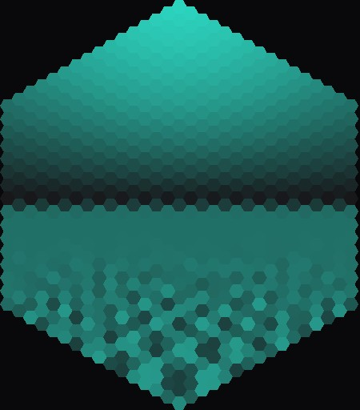
STEPS 1–3: SEEING LIKE A FLY
HOW IT WORKS
Left camera
Left retina
Right camera
Right retina
Each drone camera sees as wide as a fly eye. The picture is cut into 721 small hexagons, like the lenses of a fly eye, then FlyVis works out how the fly's visual neurons react, and that signal goes into the matching BANC neurons.
Facet: one of the small lenses of a fly eye, one pixel of fly vision
Optic lobe: the visual part of the brain behind each eye
Notes:
The target (dark pole) is on the right: only the right eye sees it, as a dark column of facets.

Slide 6
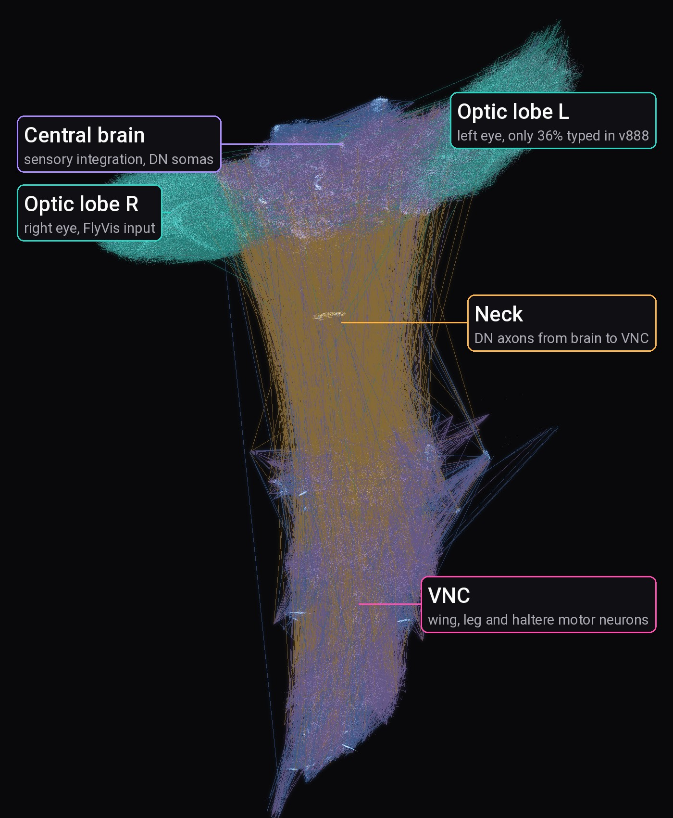
STEPS 4–5: THE FLY BRAIN
HOW IT WORKS
175,401
18.6 M
neurons in the fly brain and nerve cord
synapses, the contacts between neurons
1.53 M
863
neuron-to-neuron connections we use
flight neurons drawn in full 3D shape
optic lobes: 105,646
VNC: 26,769
central brain: 42,620
DN / AN: 3,165
Lines: 60,000 real connections from BANC, drawn as straight lines between neurons.
VNC: ventral nerve cord, the fly's spinal cord
DN / AN: neurons linking brain and nerve cord, down / up
Optic lobes: the visual part of the brain
Notes:
Official BANC v888 (Bates et al. 2026, public Lee Lab bucket). Dots are somas from the position column; lines are real edges from the v888 edge list, sampled with probability proportional to synapse count and coloured by the presynaptic class. The amber bundle through the neck is descending neurons. Lines are straight for drawing only — real axons take other paths.

Slide 7
STEP 6: THE FLIGHT NEURONS
HOW IT WORKS
DN flight power
235
brain neurons that set wing power
DN flight steering
140
brain neurons that steer
MN wing power
24
drive the big muscles that beat the wings
MN wing steering
24
drive small steering muscles at the wing base
MN wing tension
12
keep the wing tight
Haltere afferents
428
rotation sensors, here fed by the drone gyroscope
Halteres: tiny club-shaped hind wings that sense body rotation, a natural gyroscope
Labels: all groups come from official BANC annotations
Notes:
All groups come from official BANC v888 annotation columns (super_cluster, cell_function, body_part_sensory). We never guess cell-type names.

Slide 8
STEP 6: WHERE THE BRAIN KNOWS THE TARGET
HOW IT WORKS
99%
of scenes where single flight neurons tell left from right correctly
68%
if you average the muscle neurons: left and right cancel out
Accuracy: how often we can tell which side the target is on (50% = guessing)
Notes:
Ridge regression angle ~ activity, target from −90° to +90° at 3 distances, validated on the distance left out of training (scripts/check_side_decoding.py). A finding about the connectome: direction is carried by individual descending neurons and is lost if you average motor neurons.

Slide 9
STEP 7: THE DECODER LEARNS TO READ
HOW IT WORKS
1
Teacher
BANC stays frozen
a simple pilot that knows where the target is
The fly brain itself never changes. We only learn how to read its flight neurons.
2
Taking turns
the teacher flies less and less, then not at all
3
Learning
2 laptops working together
the readout copies what the teacher would do
One computer hands out worlds, two laptop graphics cards fly them in parallel. Every 50 flights we test and keep the best version.
4
Repeat
updated after every batch of flights
Imitation learning: the model flies, the teacher says what it should have done
Notes:
Hard moments: big angle to the target (> 20°), height error > 0.3 m, fast rotation (> 1 rad/s). Most frames are 'target straight ahead, do nothing', so the hard ones are weighted up. Workers send XᵀX and Xᵀy, enough to compute the regression on the master.

Slide 10
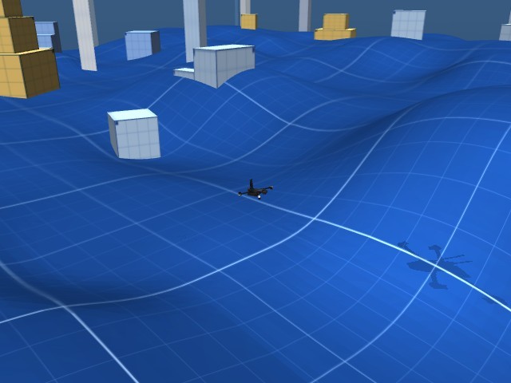
STEP 8: THE DRONE AND ITS WORLD
HOW IT WORKS
A Skydio X2 drone with two eyes on its nose
Random worlds with hills, blocks, a target mast and wind
MuJoCo: free physics simulator used in robotics
Episode: one flight from start until target, crash or time limit

Slide 11
WHO STEERS WHAT: GPS FAR, FLY BRAIN NEAR
HOW IT WORKS
far from the target: heading from GPS + compass
last 4 m: heading from BANC
drone
smooth hand-over: up close GPS is not precise enough
target
WHERE TO TURN
STAYING LEVEL AND AT HEIGHT
BANC only
BANC + drone sensors
Only fly neurons decide the direction. Drone sensors are not allowed to help.
The fly brain never sees the drone's height or speed, so the sensors help here.
GPS: satellite position, here with a wandering 2.5 m error
Heading: the direction the nose points
Our choice: fly brain = where to go, sensors = stay stable
Notes:
Our assumption, said out loud: BANC is perception and direction, the drone's sensors do stabilisation, much like a fly whose wings have their own fast reflexes. GPS only brings the drone into view of the target; inside 4 m the heading is decided by the connectome.

Slide 12
RESULT 1: TURNING TO THE TARGET
RESULTS
2.65°
average miss after turning, without the teacher (25.1° before training)
1,000
training flights
Hovering drone, target to the side. Only fly neurons choose the turn.
Miss: angle between the drone's nose and the target; 0° = pointing straight at it
Notes:
Target at ±30° and ±60°, model flying alone. Bars: before vs after training.

Slide 13
RESULT 2: HOVER, TURN, GUST
RESULTS
Hover
1.7°
heading error while hovering
Target +60°
7°
error after the turn settles (6 s)
Target −60°
21°
turns, weaker on the left (the left-eye gap)
Real fly vision and the full fly brain, flying the simulated drone.
Gust
35° to 1.5°
pushed off course, back on course in 3.9 s
Heading error: angle between the nose and the target
Gust: a simulated sudden wind push
Heading: where the nose points
Notes:
fly_banc.py --local --decoder data/decoders/planB_dn.npz --thrust hold. Thrust is held by the simulator; the connectome decides the heading and, through the halteres, damps the rotation after the gust.

Slide 14
RESULT 3: FLIGHT IN NEW WORLDS
RESULTS
5 / 6
new worlds where the drone reached the target
18.2 m to 2.1 m
closest the drone got to the target, before vs after training
Start about 20 m away, 40 s to get there, imperfect sensors.
training flights done before each test; red: best weights, kept
Test worlds: 6 fixed worlds the model never trained on
Closest distance: how near the drone got to the target, averaged over the 6 worlds
Notes:
Validation every 50 episodes on the same 6 worlds (seeds 101–106). Before training the drone did not even get going (0/6, 18.2 m). The best checkpoint reaches 5 of 6 targets; the final one 4 of 6. Run it: python -m sim.run_env --banc data/decoders/world_distributed_best.npz --beacon-scale 4 --vision-range 4 --sensors real --motor-tau 0.04

Slide 15
WHAT DOES NOT WORK YET
HONESTY
Lift from the fly brain
too weak: the drone slowly sinks, so the simulator holds the height
Averaged muscle neurons
do not turn the drone; the direction is only in single flight neurons
Vision range
the fly brain steers only the last 4 m; farther away GPS does
Left eye
fewer labelled neurons in the data, so the left eye reaches ~3× fewer
Simulation only
no real drone flown yet; sensors and wind are simulated
Lift: propeller power that keeps the drone in the air
Notes:
We would rather show the limits than hide them. Each of these is a concrete next step.

Slide 16
FROM BANC VS. OUR ASSUMPTIONS
HONESTY
from BANC v888
our assumptions
every neuron and every connection
how strong each connection is
which neurons excite or calm down
which neurons are for flight
the 3D shape of each neuron
the equation for neuron activity
how vision is plugged into the brain
how flight neurons become drone commands
the gyroscope feeds only turning
GPS far away, fly brain in the last 4 m
No made-up wiring anywhere: every connection is real BANC data.
BANC: the public map of a whole fly brain and nerve cord (Bates et al. 2026)

Slide 17
WHY IT MATTERS: WHO GAINS
NEXT
Neuroscientists
Drone & robot builders
Put real wiring in a body: which neurons matter?
Heading from a plain camera and a biological circuit
Found: single flight neurons know where the target is (99%)
Direction: small vision-guided drones
Students & educators
Anyone
Watch a real brain work: 3D explorer and live BANC panel
Open data and code, runs on a laptop GPU
Connectomics you can see
2.6 ms per frame for the full connectome
DN: descending neuron, carries commands from the brain down to the body
GPU: graphics card, updates all neurons in parallel
ms: millisecond
Notes:
Who is this for? Neuroscientists get a closed-loop test bench: the connectome has to produce behaviour, and we can ask which neurons matter. Robot builders get a working example of insect-style visual homing; this is a direction, not a product. Students get something they can see. Everything is open and runs on a gaming laptop.

Slide 18
FROM DEMO TO USERS
NEXT
TODAY
NEXT
LATER
Simulation
Real hardware
Applications
Full BANC v888 steers the heading
X2 drone in MuJoCo with noisy sensors
Target reached in 5 of 6 new worlds
Two cameras on a real micro-drone
Connectome on an onboard GPU
Same decoder, same calibration
Search & rescue: home in on a beacon
Inspection where GPS is poor
Low-power neuromorphic chips
DEMONSTRATED
PLANNED
POTENTIAL
MuJoCo: physics simulator widely used in robotics research
Neuromorphic chip: a brain-like chip that uses very little power
Notes:
Be clear about what is shown and what is a direction. Today: simulation only, but with noisy sensors, wind and motor lag. Next step is hardware. The applications column is potential, not something we tested.

Slide 19
HOW WE SPLIT THE WORK
NEXT
PERSON 1
PERSON 2
PERSON 3
The eyes
The brain
Body and world
Takes the two drone camera images, turns them into what a fly eye sees and passes that signal into the matching neurons of the fly brain.
Runs the whole fly connectome on a graphics card, listens to the flight neurons and translates them into drone commands.
Builds the drone, its sensors, wind and random worlds in a physics simulator, flies the commands and renders the next camera image.
gives: activity of visual neurons
gives: thrust, roll, pitch, yaw
gives: the next camera image
12-hour hackathon. We first agreed what each part hands to the next, then everyone built and tested their part on their own.
Physics simulator: MuJoCo, computes how the drone moves and what its cameras see
Graphics card (GPU): updates all 175,401 neurons in parallel
Notes:
Each person owned one part of the loop and one hand-over: eyes give the brain neuron activity, the brain gives the body four numbers, the body gives the eyes a new image. In the code: visual_pipeline/, banc_control/, sim/; linked by a small message protocol (ZMQ) and shared BANC v888 neuron IDs.

Slide 20
TRY IT YOURSELF
NEXT
Explore the brain
3D view of every neuron and the flight neurons
cd explorer; npm run dev
Watch it fly
the drone flies, the fly brain lights up next to it
python -m sim.run_env --banc data/decoders/world_distributed_best.npz --beacon-scale 4 --vision-range 4 --sensors real --motor-tau 0.04
Record a demo
save a video of drone, eyes and brain
python scripts/fly_banc.py --local --decoder data/decoders/planB_dn.npz --thrust hold --brain --video demo.mp4
Setup: pip install -e .[all] python scripts/download_banc.py flyvis download-pretrained python scripts/doctor.py

Slide 21
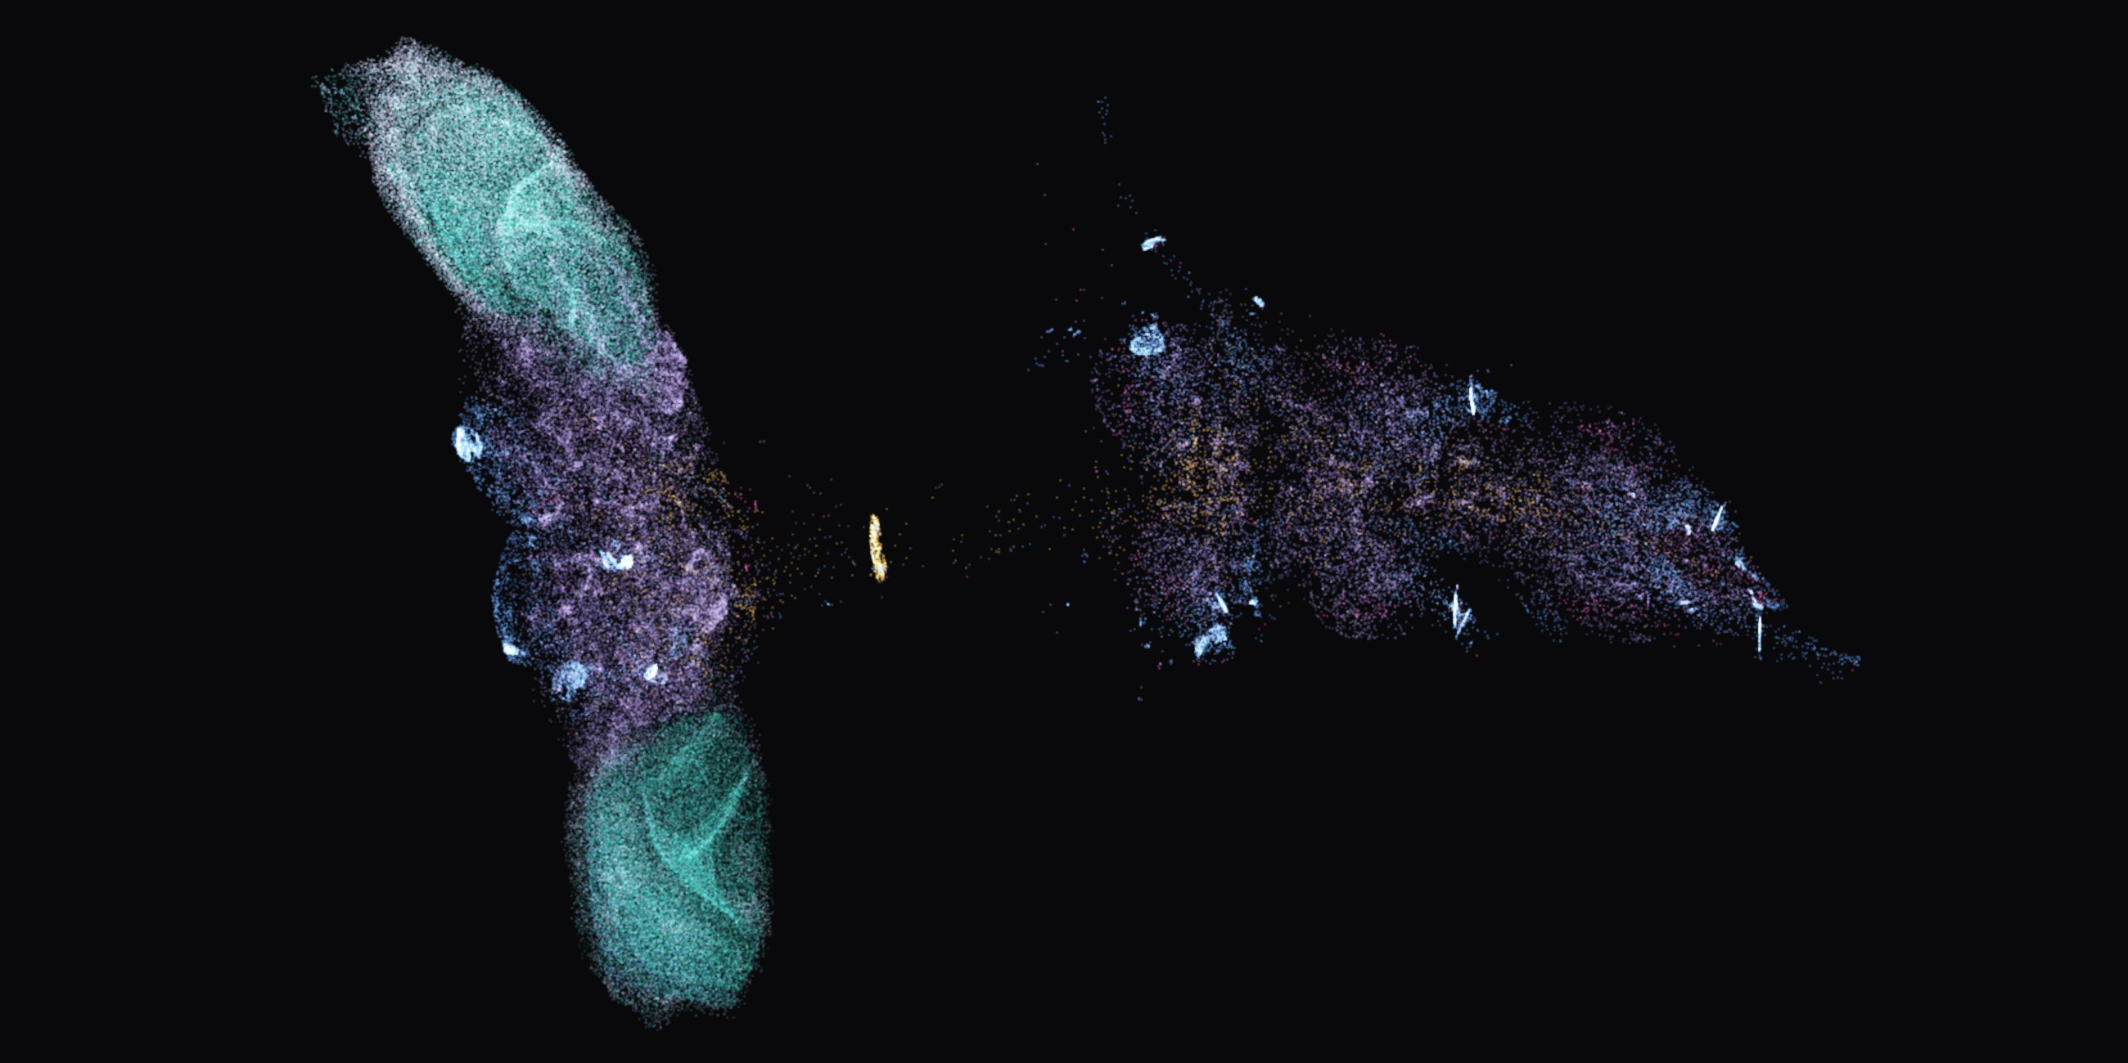
NEUROFLY HACKYEAH
THANK YOU
A real fly brain chose the heading.
Live demo: BANC panel in flight.
GITHUB.COM/FALCONDEVX/NEUROFLY

Slide 22
DETAILS: THE BRAIN EQUATION
APPENDIX
τ dr / dt = − r + tanh( relu( g W r + I ) )
Excite or calm down
computed in steps of dt = 5 ms, 4 steps per camera frame
ACh: excites the next neuron
GABA: calms it down
W
how strongly each neuron talks to each other one: synapse counts from BANC, plus or minus
glutamate: calms it down
τ, g
how fast neurons react (20 ms) and overall strength (0.9)
histamine: calms it down
I
what comes in: vision from the eyes and rotation from the drone gyroscope
The connections come from BANC. The equation and the plus / minus signs are our own choice.
GPU
the whole brain is updated in 2.6 ms on a laptop graphics card
r: how active each neuron is, from 0 to 1
relu, tanh: keep activity between 0 and 1
ACh, GABA: chemicals a neuron releases to signal the next one

Slide 23
DETAILS: CALIBRATION
APPENDIX
1
2
3
4
Rest
Scale
Turn direction
Gyro strength
look at an empty scene to learn the calm level
show the target left and right to set the volume
spin the scene and watch which way the fly turns
set how much rotation the brain feels
without it any light gave full power
vision changes the signal by only ~1 %
left and right taken from behaviour
too strong and the drone just spun
Takes about 6 s at start-up, automatically, with no hand tuning.
Optomotor reflex: flies turn with a rotating scene to keep their view steady
Notes:
Real FlyVis + MuJoCo scenes change motor-neuron activity by only about 1% of the resting level, so the readout has to be calibrated against the network's own rest state. Without the haltere gain step the gyroscope input dominated: raw yaw ~6000 per 1 rad/s.

Slide 24
DETAILS: THE FLY'S GYROSCOPE
APPENDIX
TURNING AND TILTING
TURNING ONLY
6–11 rad/s
0.03 rad/s
after a push the drone spins faster and faster
after the same push: the fly brain stops the spin
In BANC the fly's rotation sensors mostly control turning, hardly tilting. So we give them only the turning speed, and the simulator keeps the drone level. Target 29° to the side: off by only 1° after 5 s (without these sensors it keeps swinging between 26° and 33°).
Kick: a sudden push that spins the drone
rad/s: rotation speed, 1 rad/s ≈ 57°/s
Yaw rate: how fast the drone turns left or right

Slide 25
DETAILS: THE LEFT-EYE GAP
APPENDIX
LEFT EYE
RIGHT EYE
36%
80%
of visual neurons are labelled
of visual neurons are labelled
5,535
16,927
neurons the left eye can reach
neurons the right eye can reach
Vision can only reach labelled neurons, so the left eye reaches ~3× fewer. Boosting it did not change the result, and single flight neurons still tell left from right.
Labelled: the neuron's type is known, for example a motion detector

Slide 26
DETAILS: IMPERFECT SENSORS
APPENDIX
Gyroscope
Rangefinder
measures rotation, with noise and slow drift
height above ground, sometimes misses
Optical flow
Barometer
speed from a camera looking down
height from air pressure, drifts slowly
GPS + compass
Motors
position off by about 2.5 m, arrives late
need time to speed up, like real ones
The drone only gets these imperfect readings, never the true values.
Drift: an error that slowly grows over time
Why: a model trained on perfect data breaks in the real world
Notes:
A model trained on perfect values leans on them instead of on BANC and breaks in real conditions. So the simulator adds noise, drift, dropouts and delay to every sensor, and the final world training ran with these real sensors.

Slide 27
DETAILS: THE TEACHER STEPS BACK
APPENDIX
138 / 150
training flights flown by the model alone that reached the target
3 / 300
times the drone flipped over in all training flights
teacher share: 0.84 0.50 0.17 0.00 0.00 0.00
training flights, 50 per bar; red: the model flies alone
Target reached: the drone touches the target within 40 s
Teacher share: how much of the time the teacher flies
Notes:
300 episodes: 194 on RTX 4060, 106 on RTX 3070 Ti. As the teacher's share β drops to zero, the success rate per 50 episodes stays at 88–96%.

Slide 28
DETAILS: SPEED
APPENDIX
9×
faster on the graphics card, with the same results
0.3 ms
for one update of all 1.53 M connections
time to update the whole fly brain once per camera image, on a laptop
Fast enough to keep up with the camera in real time.
ms: millisecond, a thousandth of a second

