Slide 1
NEUROFLY

Slide 2
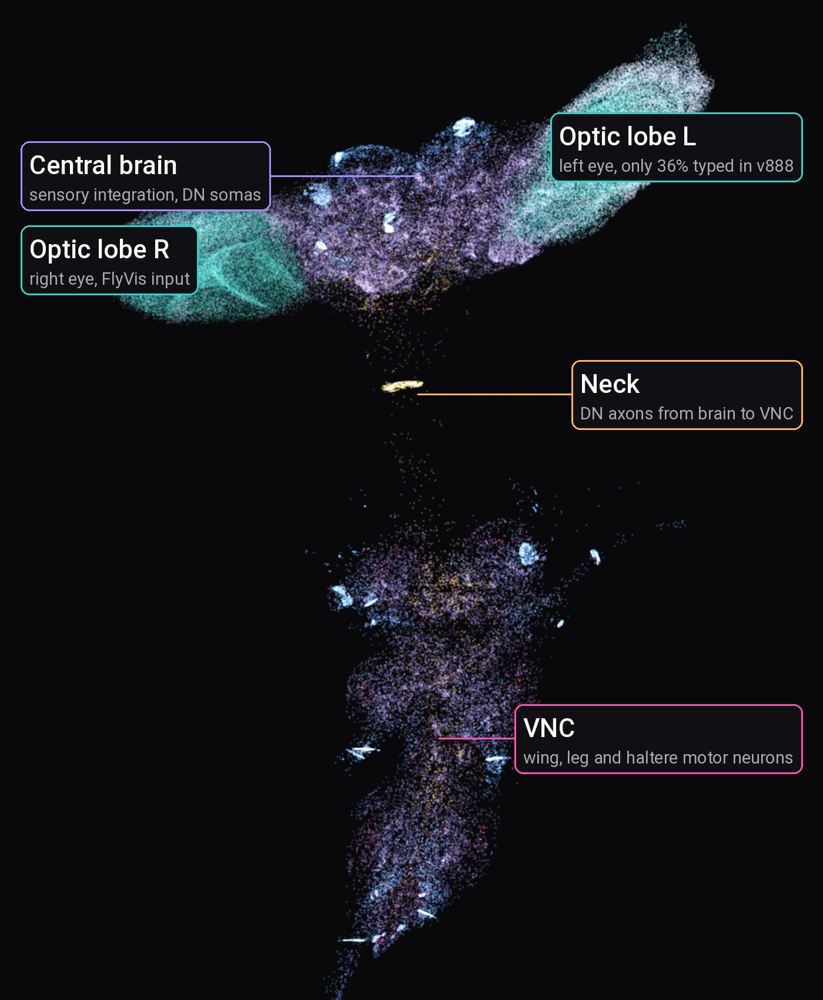
MEASURED, NOT TRAINED
IDEA
TYPICAL AI
Random weights, learned from millions of examples. Nobody can say what one weight means.
NEUROFLY
The real wiring of a fruit fly, measured synapse by synapse. Tuned by evolution, every neuron has a name.
18.6 M
0
real synapses in the controller
invented connections or weights
Connectome: the complete wiring diagram of a nervous system
Right: the whole BANC connectome, 175,401 neurons at their real positions
Notes:
Hook: AI usually means random weights trained on huge data. We do the opposite: the network is the real fly connectome, mapped synapse by synapse. We run it as the brain of a drone in a closed loop. The brain itself is never trained; we only learn how to read its flight neurons.

Slide 3
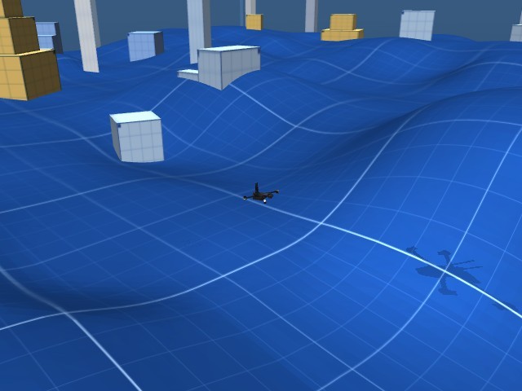
USE CASE: THE LAST METRES
IDEA
A rescue drone homes in on a beacon among rubble or trees, where GPS drifts by metres. GPS brings it close. The last 4 m are steered by the fly brain, from a plain camera.
far: GPS
near: fly brain
2.5 m
100%
GPS error in our simulation
of the final heading comes from fly neurons
Simulated world: hills, blocks, wind, a target mast
Beacon: the target the drone must reach, here a dark mast
Heading: the direction the nose points
Status: shown in simulation, not yet on a real drone
Notes:
Concrete use case: the final approach, where GPS is not precise enough. Far away a GPS pilot flies; inside 4 m the turn command comes only from BANC flight neurons. Drone sensors keep it level and at height. Today this runs in MuJoCo; the hardware step is on slide 9.

Slide 4
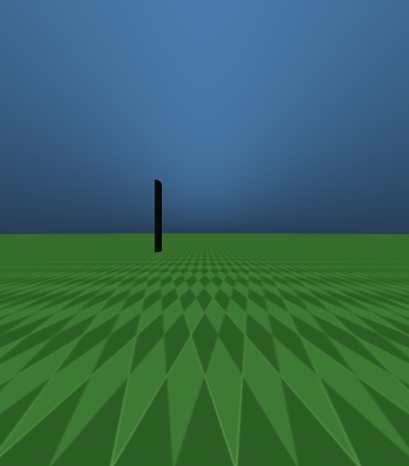
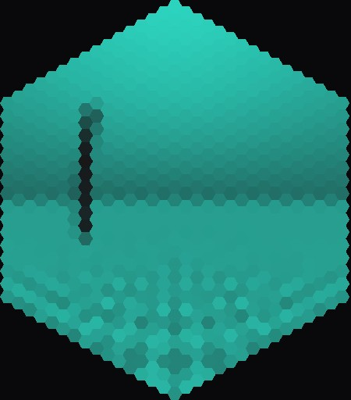
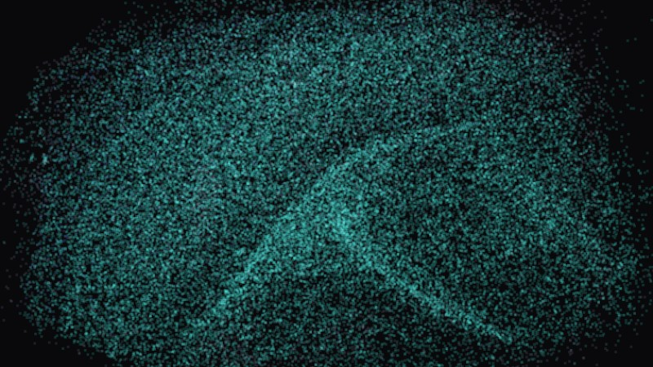
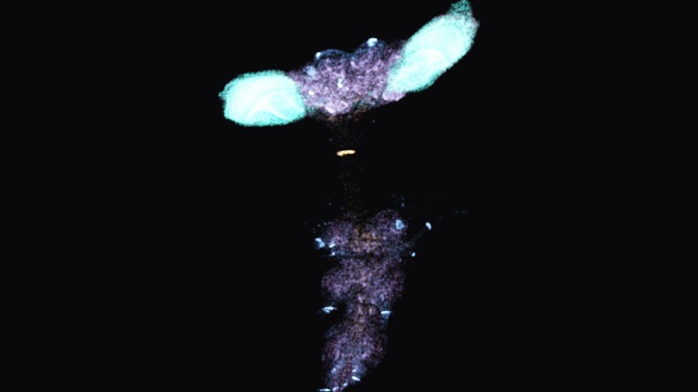
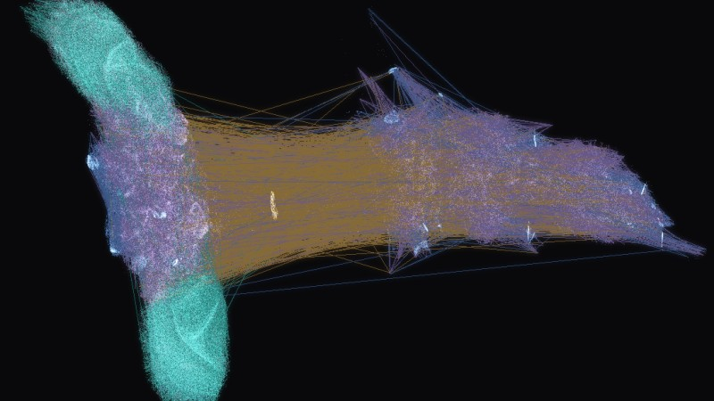
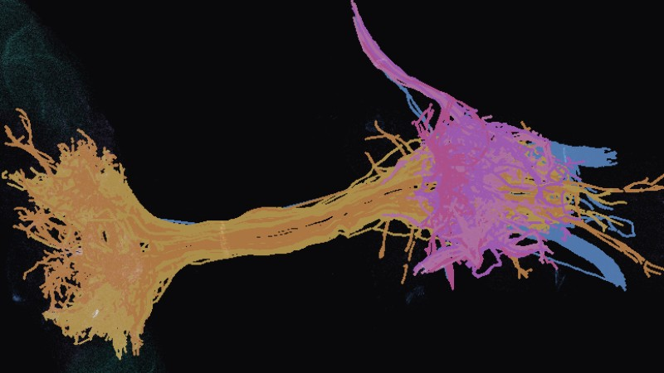
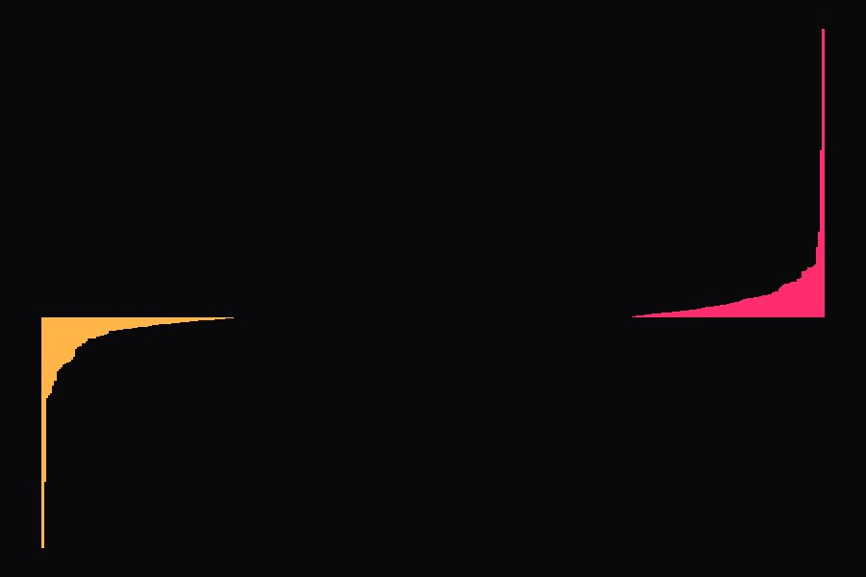
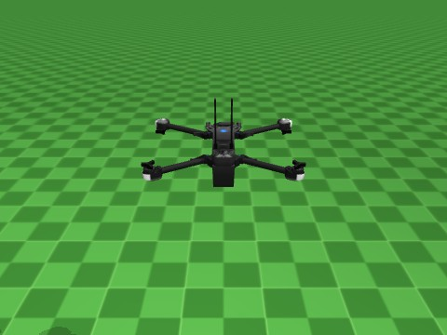
HOW IT WORKS: ONE LOOP, 8 STEPS
HOW IT WORKS
TRAINED NET
1 Camera
2 Retina
3 FlyVis
4 Into the brain
2 eyes, 157° view each
721 facets per eye
fly vision model
22,462 neurons get input
REAL CONNECTOME
REAL CONNECTOME
IMITATION LEARNING
5 Fly brain
6 Flight neurons
7 Decoder
8 Drone
175,401 neurons on GPU
commands to the wings
turns them into 4 numbers
moves, then back to 1
Red tag: where AI works in the loop
FlyVis: published model of the fly eye and visual brain
Speed: 2.6 ms per frame for the whole connectome on a laptop GPU
Notes:
Every camera frame goes once around the loop. Three AI parts: FlyVis (a trained network of the fly visual system), the BANC connectome itself (a biological neural network, simulated as a rate model on the GPU) and the decoder, learned by imitation (DAgger) and trained on 2 laptop GPUs at once.

Slide 5
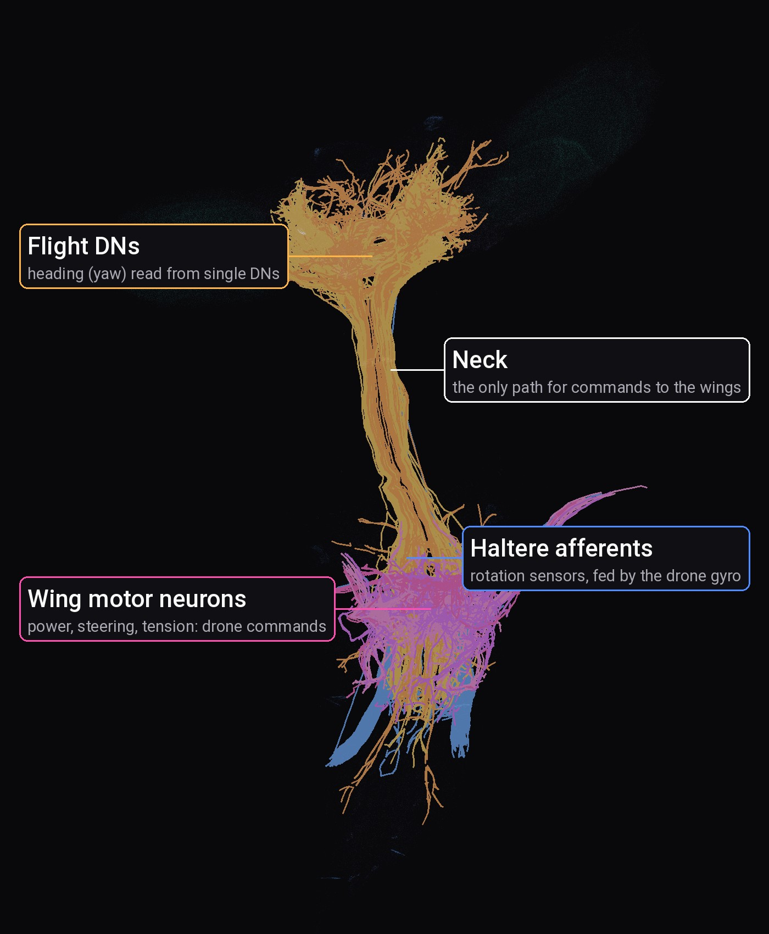
THE BRAIN: REAL, NOT INVENTED
HOW IT WORKS
175,401
1.53 M
neurons in the fly brain and nerve cord
neuron-to-neuron connections we use
375
60
428
flight neurons from the brain
wing muscle neurons
haltere neurons, the fly's gyroscope
Every group comes from official BANC labels. We never guess a neuron's name or add a connection.
Left: 863 flight neurons in full 3D shape, from BANC skeletons
Haltere: tiny hind wing that senses rotation
Notes:
Official BANC v888 (Bates et al. 2026, public Lee Lab bucket, DOI 10.7910/DVN/7WTH1N). Groups from super_cluster, cell_function and body_part_sensory columns. Edges with at least 5 synapses, sign from the predicted neurotransmitter.

Slide 6
SINGLE NEURONS KNOW THE TARGET
RESULTS
99%
of scenes where single flight neurons tell left from right correctly
68%
if you average the muscle neurons: left and right cancel out
So we read the brain neuron by neuron.
Accuracy: how often we can tell which side the target is on (50% = guessing)
Notes:
Ridge regression angle ~ activity, target from −90° to +90° at 3 distances, validated on the distance left out (scripts/check_side_decoding.py). Direction lives in individual descending neurons and is lost when averaged.

Slide 7
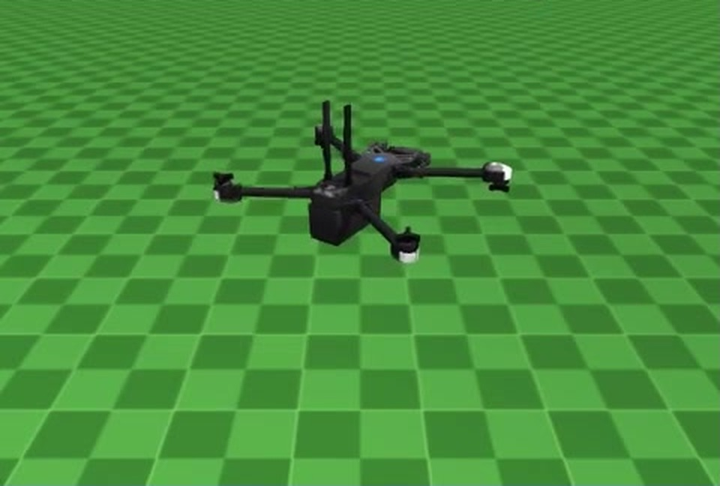
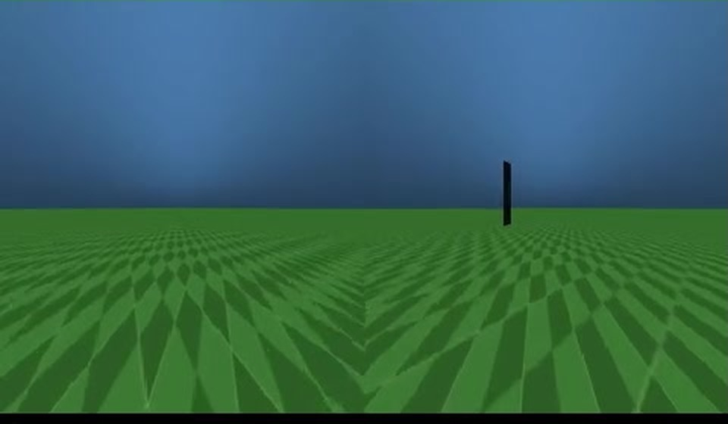
RESULTS: IT LEARNS TO FLY TO THE TARGET
RESULTS
25.1° to 2.65°
average heading miss, before vs after 1,000 training flights
138 / 150
flights reached the target with no teacher at all (92%)
18.2 m to 2.1 m
closest approach in 6 new worlds never seen in training
35° to 1.5°
pushed off course by a gust, back on course in 3.9 s
Heading miss: angle between the nose and the target, 0° = straight at it
Bottom right: what the drone's two eyes see, the target is the dark mast
Notes:
Real FlyVis + full BANC v888 in MuJoCo. Heading: 1,000 flights on 2 GPUs (planB_distributed). Worlds: 300 episodes with noisy sensors and wind; the last 150 with the teacher fully switched off reached the target 138 times. New worlds: seeds 101–106, best checkpoint 5 of 6 reached. Gust: planB_dn decoder, thrust held by the simulator.

Slide 8
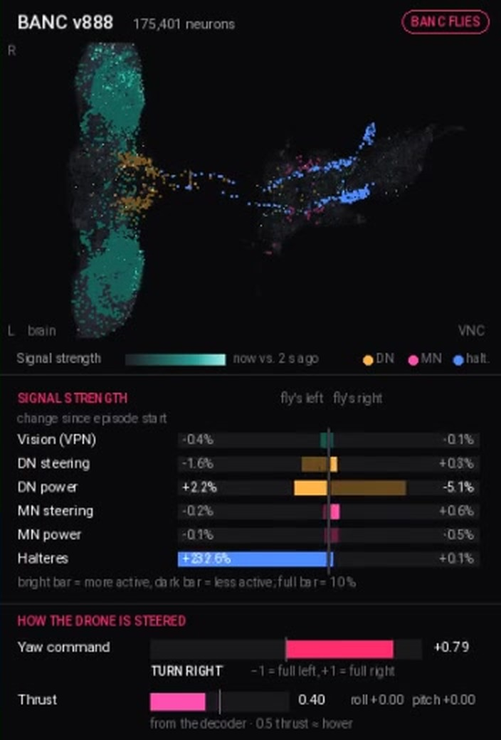
YOU STAY IN CONTROL
RESULTS
1
See who steers
Live share of the heading from the fly brain vs GPS, plus the final command.
2
See why it turns
Each flight neuron's vote for left or right, from the real decoder weights.
3
Take over any time
Sensors keep the drone level, GPS takes over far away, a pilot can fly by keyboard while the brain only watches.
4
Check every neuron
3D explorer: every neuron, its class and its real synaptic partners from BANC.
Left: live BANC panel in flight, a brain you can watch
Not a black box: every command traces back from pixel to neuron to wing
Notes:
How users verify outputs and stay in control: the live panel (sim/brain_panel.py) shows signal strength in vision, DN, MN and haltere groups, who decides the heading (BANC vs GPS) and the votes of individual neurons. python -m sim.viewer --brain lets a person fly with WASD while the network only observes. The Next.js explorer shows every neuron with its top synaptic partners from the real edge list.

Slide 9
HONEST LIMITS AND NEXT STEPS
HONESTY
WHAT DOES NOT WORK YET
TODAY
demonstrated
Lift
fly-brain thrust too weak, the simulator holds height
Full BANC steers a simulated drone in random worlds
Left eye
fewer labelled neurons in BANC, ~3× less input
NEXT
planned
Two cameras on a micro-drone, connectome on an onboard GPU
Obstacles
the fly brain does not avoid blocks yet
Hardware
simulation only, no real drone flown
LATER
potential
Search and rescue homing, low-power neuromorphic chips
From BANC: neurons, synapses, excite or inhibit, neuron groups, 3D shapes
Our assumptions: the neuron activity equation, how vision enters, how flight neurons become drone commands
Notes:
We would rather show the limits than hide them. Each is a concrete next step. The split between what is BANC data and what is our modelling choice is stated on every result.

Slide 10
EVOLUTION WROTE THE WEIGHTS.
WE GAVE THEM WINGS.
TEAM THE ROOOK
BUILT ON, WITH THANKS
The eyes
camera, fly retina, FlyVis, input to BANC
BANC v888 connectome
Bates et al. 2026, doi 10.7910/DVN/7WTH1N
FlyVis, FlyGym, MuJoCo, Skydio X2 model
open models and simulator (MuJoCo Menagerie)
Claude Code
AI assistant for code, docs and slides
The brain
full connectome on GPU, decoders, training
Body and world
drone, sensors, wind, random worlds
Dawid Wypych Mateusz Nowaczek Krzysztof Mazur
Built during HackYeah: the whole loop, controller, decoders and training, drone simulator, live panel, 3D explorer.
GITHUB.COM/FALCONDEVX/NEUROFLY
Notes:
Close: evolution wrote the weights, we gave them wings. Team roles follow the three parts of the loop. Disclosure as required: BANC data, FlyVis, FlyGym, MuJoCo and the X2 model are open resources; Claude Code was used as a coding assistant. Everything else was built during HackYeah.

