Slide 1
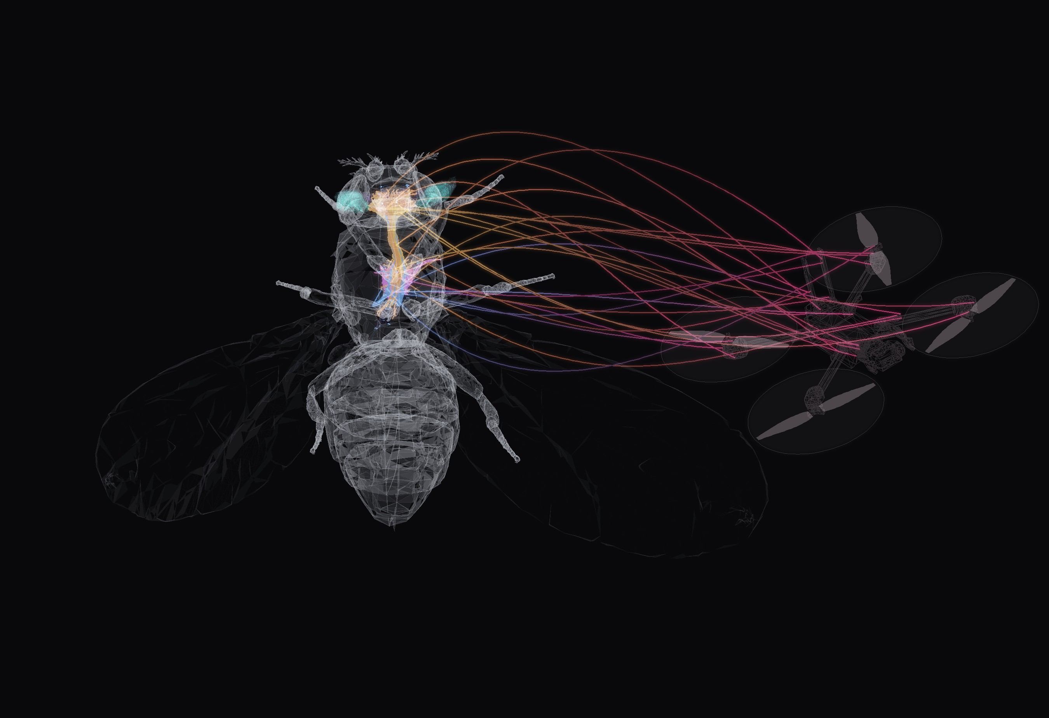

BANC V888 CONNECTOME
NEUROFLY
The brain of a fruit fly which
pilots a drone
FULL BANC V888 CONNECTOME 175,401 NEURONS CLOSED LOOP IN MUJOCO
Notes:
NeuroFly: the drone camera image goes through a model of the fly eye (FlyVis), then through the real Drosophila connectome (BANC v888, brain + ventral nerve cord), and flight-neuron activity steers the drone in simulation. Render: semi-transparent NeuroMechFly body (FlyGym) with the BANC connectome inside — body alignment is illustrative — next to the X2 drone from MuJoCo. The threads from flight neurons to the drone are an illustration of the loop, not data.

Slide 2
WHAT NEUROFLY DOES AND WHY
IDEA
A drone sees through two cameras. A fly-eye model passes the image into the real wiring of a fruit fly's brain, and the fly's own flight neurons decide where the drone turns.
OUR PREMISES
WHY
OUR RULE NO. 1
Only the real connectome: no invented neurons or connections
Test if a mapped brain can really drive a body
The connectome makes the key decision
100%
The brain is never trained; we only learn to read its flight neurons
See which neurons carry the decision
of the heading near the target comes from fly neurons
The fly brain chooses where to turn; drone sensors only keep it level
A path to small drones guided by vision
Connectome: the complete wiring diagram of a nervous system, every neuron and synapse
Flight neurons: neurons that carry flight commands from the brain to the wings
Notes:
What it does: camera image, fly eye model (FlyVis), the real fruit fly connectome (BANC v888, 175,401 neurons), the fly's flight neurons, the drone. Premises: only the official connectome, never trained, only a small linear readout is learned, and the most important decision, where to turn, is made by the fly's own descending neurons; drone sensors get zero weight on heading by construction. Why: a closed-loop test of whether a mapped brain can drive a body, which neurons carry the decision, and a direction for small vision-guided drones. An early synthetic network was thrown away.

Slide 3
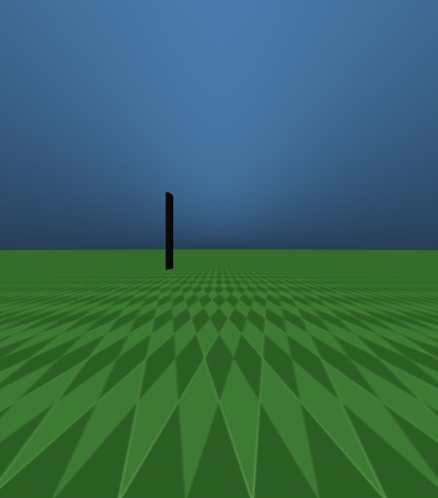
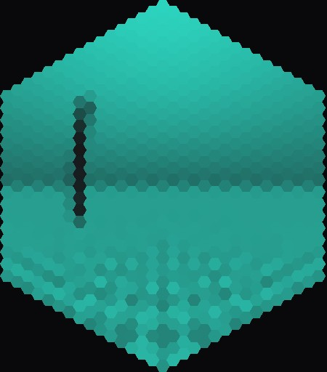
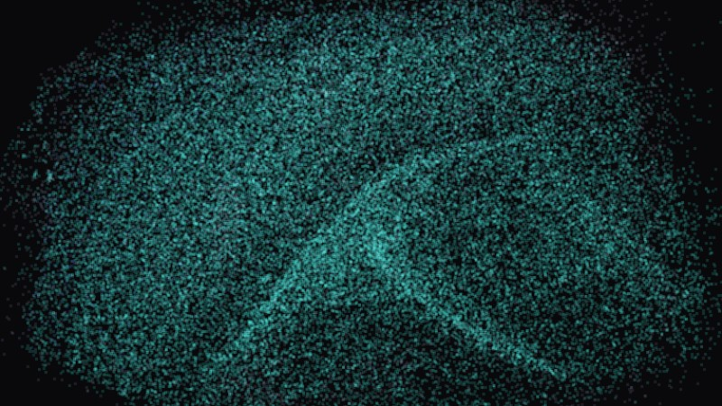
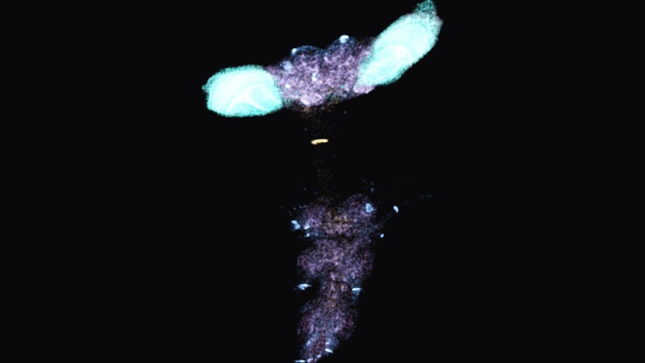
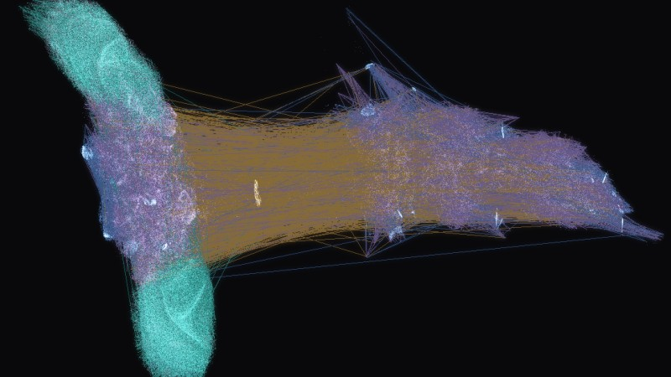
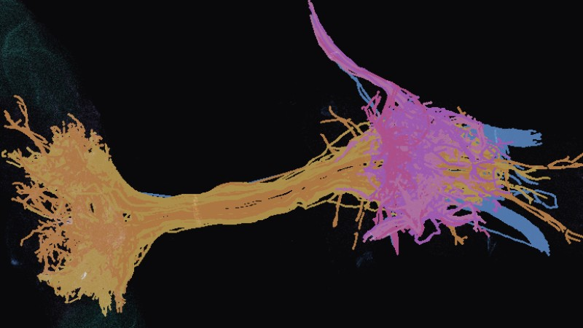
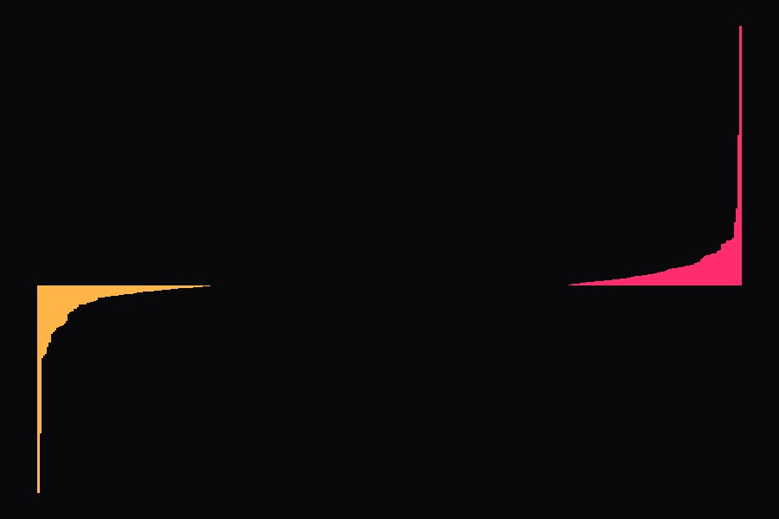
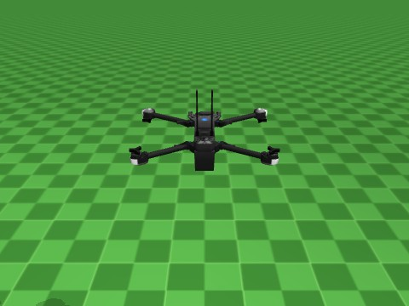
HOW IT WORKS: ONE LOOP, 8 STEPS
IDEA
1 Camera
2 Retina
3 FlyVis
4 Into the brain
2 eyes, 157° view each
721 facets per eye
fly vision model
22,462 neurons get input
5 Fly brain
6 Flight neurons
7 Decoder
8 Drone
175,401 neurons
the brain's flight commands
turns them into 4 numbers
moves, then back to 1
FlyVis: a published model of how the fly eye and visual brain process an image
Flight neurons: neurons that carry flight commands from the brain to the wings
Thrust, roll, pitch, yaw: total power, tilt sideways, nose up or down, turn
Notes:
Every camera frame goes once around this loop, steps 1 to 8. Steps 1–4 happen before the connectome; 5–8 are the connectome, the flight-neuron readout, the decoder and the drone. One frame (FlyVis + 4 BANC substeps on the GPU) takes ~15–20 ms. There is no hand-coded heading controller near the target: the direction is read out from descending-neuron (DN) activity in BANC. Decoder thumbnail: the real yaw weights of the best world decoder, sorted.

Slide 4
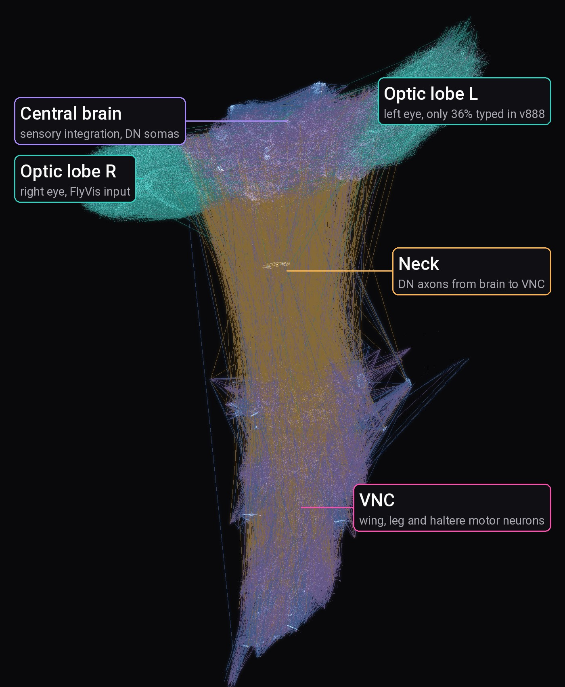
STEPS 4–5: THE FLY BRAIN
HOW IT WORKS
175,401
18.6 M
neurons in the fly brain and nerve cord
synapses, the contacts between neurons
1.53 M
863
neuron-to-neuron connections we use
flight neurons drawn in full 3D shape
optic lobes: 105,646
VNC: 26,769
central brain: 42,620
DN / AN: 3,165
Lines: 60,000 real connections from BANC, drawn as straight lines between neurons.
VNC: ventral nerve cord, the fly's spinal cord
DN / AN: neurons linking brain and nerve cord, down / up
Optic lobes: the visual part of the brain
Notes:
Official BANC v888 (Bates et al. 2026, public Lee Lab bucket). Dots are somas from the position column; lines are real edges from the v888 edge list, sampled with probability proportional to synapse count and coloured by the presynaptic class. The amber bundle through the neck is descending neurons. Lines are straight for drawing only — real axons take other paths.

Slide 5
STEP 6: WHERE THE BRAIN KNOWS THE TARGET
HOW IT WORKS
99%
of scenes where single flight neurons tell left from right correctly
68%
if you average the muscle neurons: left and right cancel out
Accuracy: how often we can tell which side the target is on (50% = guessing)
Notes:
Ridge regression angle ~ activity, target from −90° to +90° at 3 distances, validated on the distance left out of training (scripts/check_side_decoding.py). A finding about the connectome: direction is carried by individual descending neurons and is lost if you average motor neurons.

Slide 6
WHO STEERS WHAT: GPS FAR, FLY BRAIN NEAR
HOW IT WORKS
far from the target: heading from GPS + compass
last 4 m: heading from BANC
drone
smooth hand-over: up close GPS is not precise enough
target
WHERE TO TURN
STAYING LEVEL AND AT HEIGHT
BANC only
BANC + drone sensors
Only fly neurons decide the direction. Drone sensors are not allowed to help.
The fly brain never sees the drone's height or speed, so the sensors help here.
GPS: satellite position, here with a wandering 2.5 m error
Heading: the direction the nose points
Our choice: fly brain = where to go, sensors = stay stable
Notes:
Our assumption, said out loud: BANC is perception and direction, the drone's sensors do stabilisation, much like a fly whose wings have their own fast reflexes. GPS only brings the drone into view of the target; inside 4 m the heading is decided by the connectome.

Slide 7
RESULT: HOVER, TURN, GUST
RESULTS
Hover
1.7°
heading error while hovering
Target +60°
7°
error after the turn settles (6 s)
Target −60°
21°
turns, a bit weaker on the left
Real fly vision and the full fly brain, flying the simulated drone.
Gust
35° to 1.5°
pushed off course, back on course in 3.9 s
Heading error: angle between the nose and the target
Gust: a simulated sudden wind push
Heading: where the nose points
Notes:
fly_banc.py --local --decoder data/decoders/planB_dn.npz --thrust hold. Thrust is held by the simulator; the connectome decides the heading and, through the halteres, damps the rotation after the gust.

Slide 8
RESULT: FLIGHT IN NEW WORLDS
RESULTS
5 / 6
new worlds where the drone reached the target
18.2 m to 2.1 m
closest the drone got to the target, before vs after training
Start about 20 m away, 40 s to get there, imperfect sensors.
training flights done before each test; red: best weights, kept
Test worlds: 6 fixed worlds the model never trained on
Closest distance: how near the drone got to the target, averaged over the 6 worlds
Notes:
Validation every 50 episodes on the same 6 worlds (seeds 101–106). Before training the drone did not even get going (0/6, 18.2 m). The best checkpoint reaches 5 of 6 targets; the final one 4 of 6. Run it: python -m sim.run_env --banc data/decoders/world_distributed_best.npz --beacon-scale 4 --vision-range 4 --sensors real --motor-tau 0.04

Slide 9
WHY IT MATTERS: WHO GAINS
NEXT
Neuroscientists
Drone & robot builders
Put real wiring in a body: which neurons matter?
Heading from a plain camera and a biological circuit
Found: single flight neurons know where the target is (99%)
Direction: small vision-guided drones
Students & educators
Anyone
Watch a real brain work: 3D explorer and live BANC panel
Open data and code, runs on a laptop GPU
Connectomics you can see
2.6 ms per frame for the full connectome
DN: descending neuron, carries commands from the brain down to the body
GPU: graphics card, updates all neurons in parallel
ms: millisecond
Notes:
Who is this for? Neuroscientists get a closed-loop test bench: the connectome has to produce behaviour, and we can ask which neurons matter. Robot builders get a working example of insect-style visual homing; this is a direction, not a product. Students get something they can see. Everything is open and runs on a gaming laptop.

Slide 10
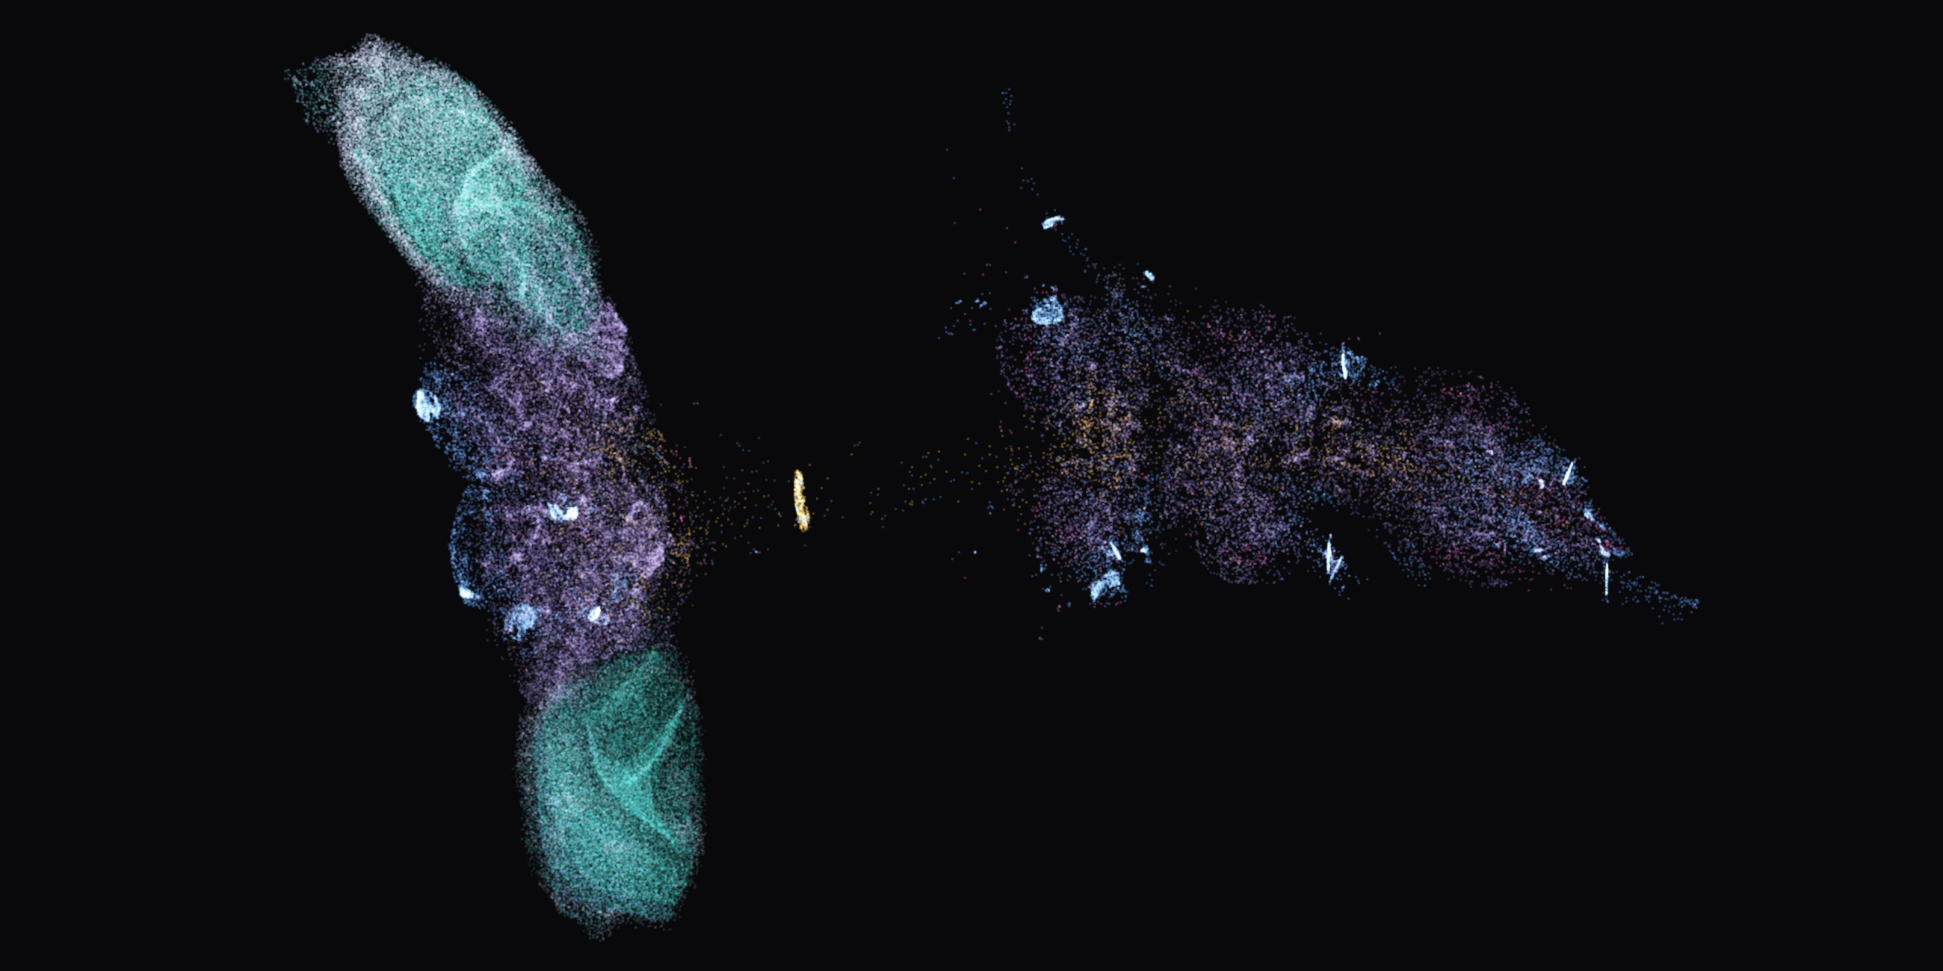
NEUROFLY HACKYEAH
THANK YOU
A real fly brain chose the heading.
Live demo: BANC panel in flight.
TEAM
THE ROOOK
Dawid Wypych Mateusz Nowaczek Krzysztof Mazur
GITHUB.COM/FALCONDEVX/NEUROFLY

