Slide 1

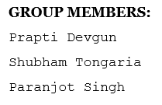
STUDENT FEEDBACK SYSTEM
2
+
2
+

Slide 2
Table of contents
Introduction
Aim of the Project
Resources Required
Literature Survey
System Analysis and Design
Conclusion
References

Slide 3
INTRODUCTION
Student Feedback System for college students have been developed which aims to rate and analyse the college faculty’s performance.
This type of Student Feedback system reduces the work of physically examining the feedback pages of each and every student.
The system also reduces the burden of efforts and burden of keeping and maintaining the records on a manual base, it requires a lot of space and safety to keep up such records.
Also the students feedbacks can be tempered for wrong reasons in case of paper based feedbacks wherein the SFS will always ensure safety of feedbacks privacy.

Slide 4
AIM OF THE PROJECT
The aim of the project is to reduce the time for getting feedback data and provide a depth analysis about the performance. The system so developed helps in making the decision processes and the selection processes much more effective.
Proposed system is used to reduce confusion at the time of processing feedback average.

Slide 5
RESOURCES REQUIRED
XAMPP server
Front end:
HTML : Page layout has been designed in HTML.
CSS : CSS has been used for the designing part.
Back end:
PHP : Backend logic has been implemented in PHP.
MySQL and Apache server have been used as database for the project.

Slide 6
LITERATURE SURVEY
The existing manual system (using pen and paper) would take a lot of time for analyzing the performance of the faculty.
The proposed system is an interface between the faculties and students. This is a web based system where the database is very important. In the proposed system we have designed a student login form. Student will login in their student login form with a proper id and password.After this the page with different subjects is displayed, where the subject is located and as per the selection done by the student, the student is directed towards the main feedback form where the student gives their feedback and submit it.

Slide 7
System analysis and design
MODULES :
Admin: Admin can access the database and make changes in the database.
Student: A student can get logged in by entering his/her login ID and password.
The Curriculum Feedback System has been developed on the concept of 3-tier Architecture. The three levels are a user interface, the web server and the database server.

Slide 8
Tier-I: User Interfaces
The interfaces have been developed for the student user. Figure-1 shows the login interface for student. Student after logging into the system can select from thirteen subjects as shown in Figure-2 and can provide the feedback against the nine questions through the interface as shown in Figure-3 and consequently the admin can check the results as shown in Figure-4 in the phpMyAdmin. All the interfaces have been developed in Html and for styling and scripting, JavaScript and CSS have been extensively used.

Slide 9
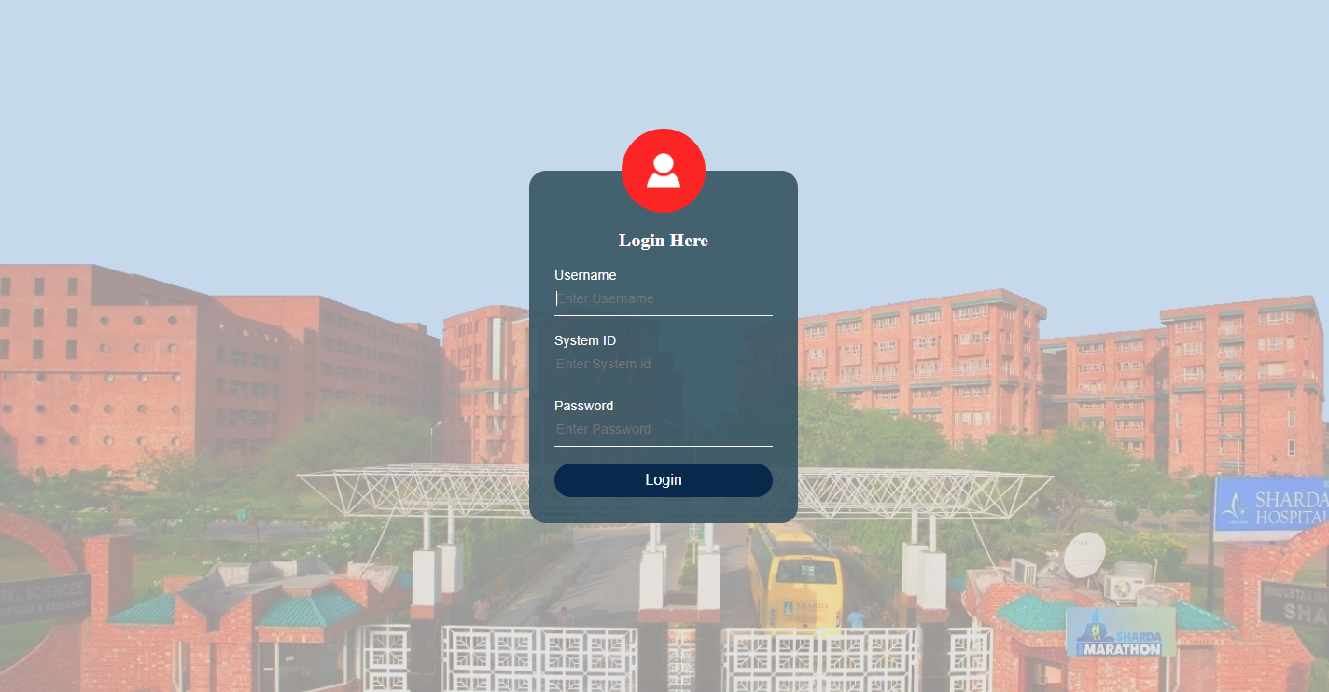
Figure 1

Slide 10
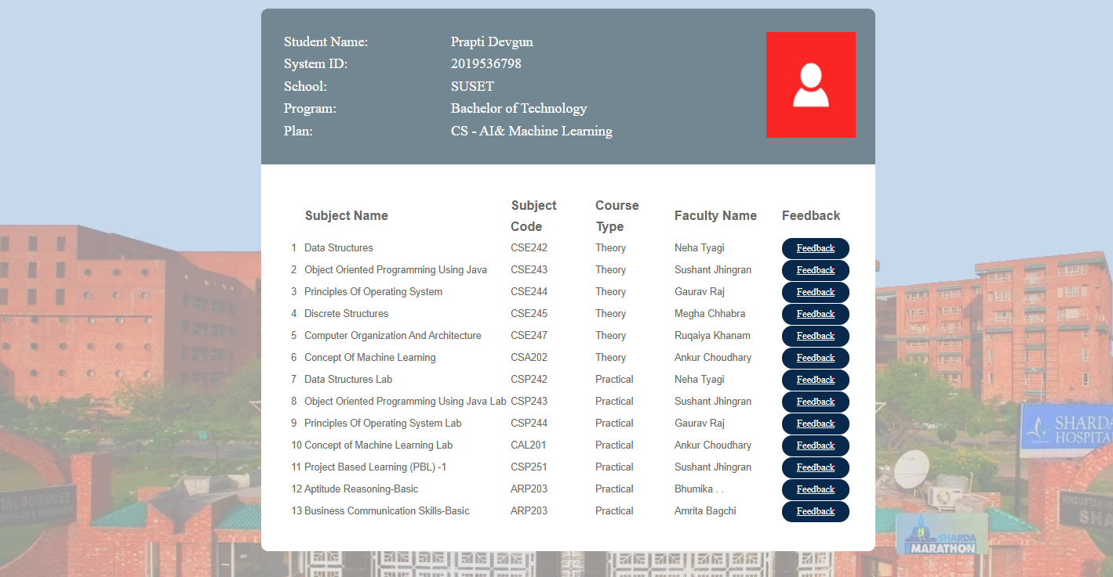
Figure 2

Slide 11
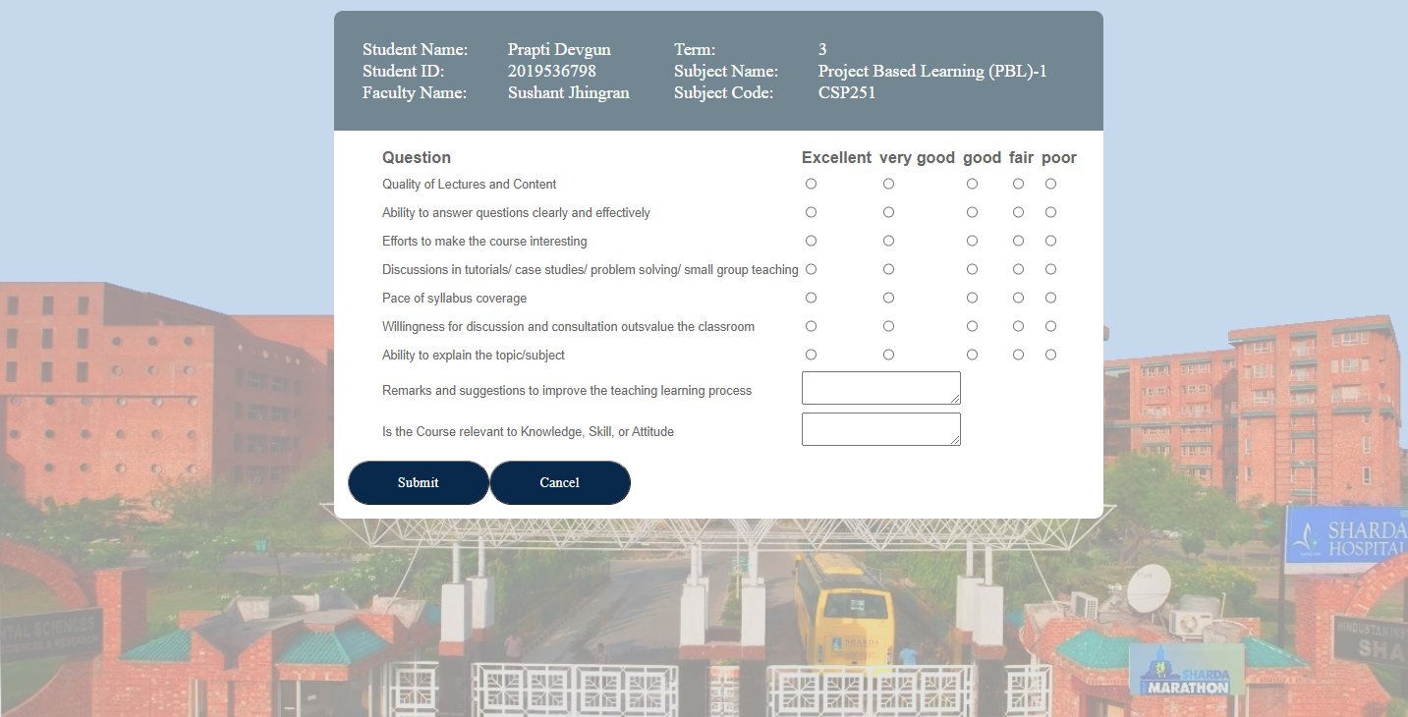
FIGURE 3

Slide 12
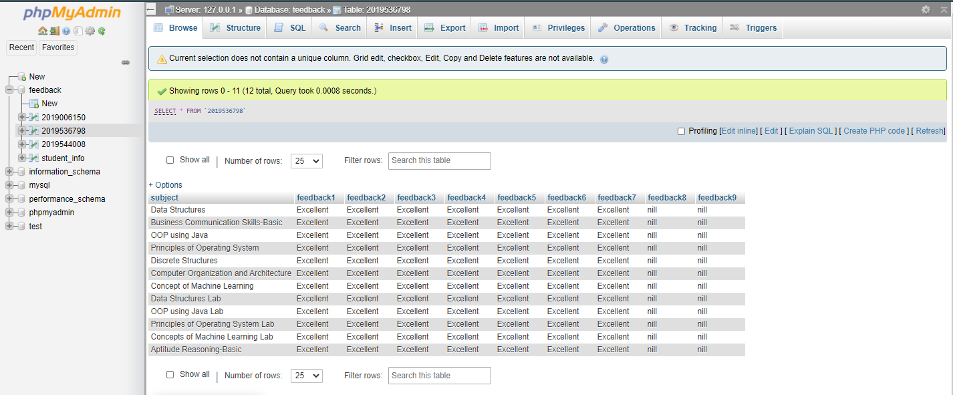
FIGURE 4

Slide 13
Tier-II: Web Server (Scripting)
The entire data handling at the server has been done through PHP. There are various handlers that have been developed for the successful implementation. MySQL queries are embedded in php for communication with the database server.
Login: The login handler checks the authentication of the users and the passwords have been stored in the database.
User Count Handler: Every time a student gives a feedback, the user count is updated to get the information regarding the number of users who have given feedback.
Data Insertion Handler: This handler is used to insert the feedback data in the database.
Data generation Handler: This handler is used to analyses the data submitted by the users.

Slide 14
Tier-III: Database
For database development, the relational model of database has been used in the feedback system and same has been developed in MySQL.
The various Entities used in the model are:
a) Courses (for storing the information about the various subjects being taught in the University)
b) Rating, the entity used to store the actual rating points for each question in the questionnaire.
c) User-account, the entity used to store the log in details.

Slide 15
CONCLUSION
The aim of the study was to improve the quality of teaching by introducing students’ feedback as a teachers’ evaluation. Students’ feedback is an effective tool for teachers’ evaluation resulting in faculty development. In a short duration the factors and processes that contribute to an effective feedback system, paying particular attention to how the system affects early career teachers.

Slide 16
REFERENCES
https://www.w3schools.com/sql/default.asp (W3school Database management System, MySQL).
Schon, D. (1983) The Reflective Practitioner. London: Temple Smith.
Elliott, J. (1993c) Introduction. In J. Elliott (Ed.) Reconstructing Teacher Education (pp. 1-12). London: Falmer Press.

Slide 17
THANK YOU
2
+
2
+

