Slide 1
Lending Club Case Study - EDA
- Ramkumar Raman

Slide 2

Data Sourcing and Data Cleaning

Slide 3
Code for Data Sourcing and Data cleaning
#importing the required libraries
import pandas as pd
import matplotlib.pyplot as plt
import seaborn as sns
import warnings
#To ignore warnings
warnings.filterwarnings('ignore')
#Data Sourcing
#reading the dataset in low memory set to false because data contains mixed data types
df= pd.read_csv("D:\\loan.csv", low_memory=False)
#Data Cleaning
#Including the columns which I planned to use which is having NA values
df['emp_length'].fillna("0 years", inplace=True)
#Dropping the columns having NA values
cleaned_df= df.dropna(axis=1)
#Standardizing the Annual Income data to 2 decimal values
cleaned_df['annual_inc']=cleaned_df['annual_inc'].round(2)
#Removing Outliers
Q1 = cleaned_df['annual_inc'].quantile(0.10)
Q3 = cleaned_df['annual_inc'].quantile(0.95)
IQR = Q3 - Q1
threshold = 1.5
cleaned_df_no_outliers = cleaned_df[~((cleaned_df['annual_inc'] < (Q1 - threshold * IQR)) | (cleaned_df['annual_inc'] > (Q3 + threshold * IQR)))]
cleaned_df_no_outliers['int_rate'] = cleaned_df_no_outliers['int_rate'].str.rstrip('%').astype(float)

Slide 4
UNIVARTIATE ANALYSIS

Slide 5
Before starting the analysis, Here I have listed the variables took into account for analysis. Columns for EDA (not as in the file)
Term
Interest Rate
Grade
SubGrade
Employment Length
Home Ownership
Annual Income
Verification Status
Address State
Purpose
Open Account
Total Account
Loan Status
Funded Amount
Funded Amount Investors
Loan Amount

Slide 6
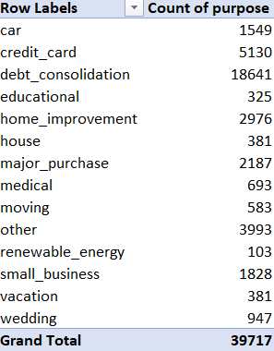
Analysis on Purpose - An Unordered Categorical Variable
As we can see below, the main reason for borrowing the money is for debt_consolidation and the least for making their energy consumption as renewable_energy

Slide 7
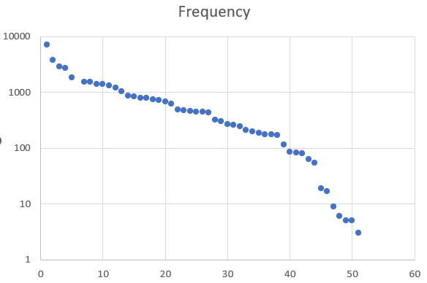
Analysis on Address State - An Unordered Categorical Variable
Here I have plotted a Scatter Plot for the Address State variable in terms of Rank (x-axis) and Frequency (y-axis). As per the Power Law Distribution, The Plot obeys it and there is no anomaly detected in the pattern

Slide 8
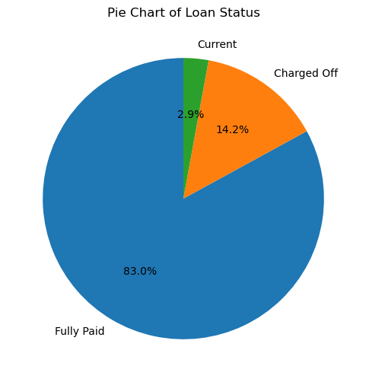
Code and Results for Univariate analysis
#Univariate Analysis
#Analysis on Loan Status
plt.figure(figsize=(6, 6))
loan_status_counts = df['loan_status'].value_counts()
plt.pie(loan_status_counts, labels=loan_status_counts.index, autopct='%1.1f%%', startangle=90)
plt.title('Pie Chart of Loan Status')
plt.show()
As we can see, Most of the borrowers paid the loan and some of them are currently paying the loan.

Slide 9

Code and Results for Univariate analysis
#Univariate Analysis
#Analysis on Annual Income - A Quantitative Variable (After removing the outliers)
mean_income = cleaned_df_no_outliers['annual_inc'].mean().round(2)
print("Mean Income - ",mean_income)
median_income = cleaned_df_no_outliers['annual_inc'].median()
print("Median Income - ",median_income)
From the above extracted data, we can see that the people having around 55 k to 70 k annual income likely to get a loan. I have removed the outliers using Interquartile difference already.

Slide 10
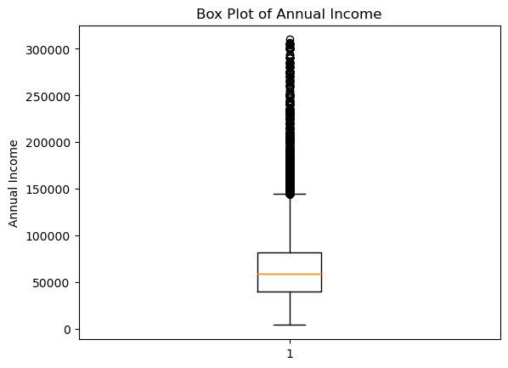
Code and Results for Univariate analysis
#Univariate Analysis
#Summary Metrics
#Box Plot on Annual Income
plt.boxplot(cleaned_df_no_outliers['annual_inc'])
plt.title('Box Plot of Annual Income')
plt.ylabel('Annual Income')
plt.show()
The above BoxPlot shows the spread of Annual Income and we can see most of the borrowers are around 40k to 70k

Slide 11
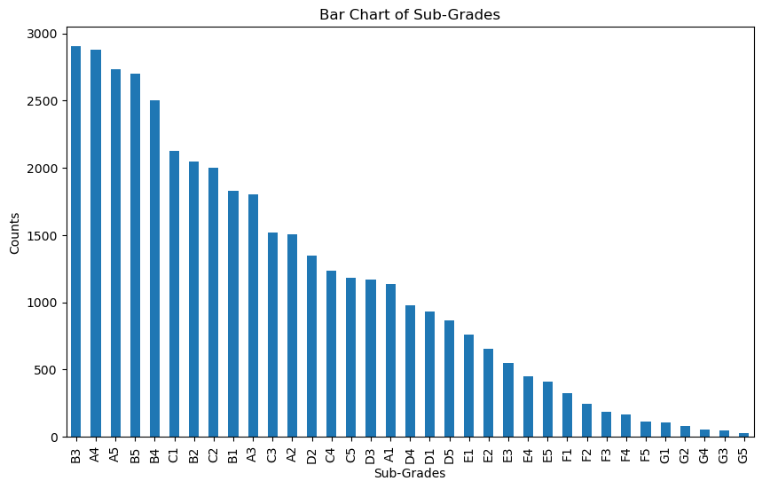
Code and Results for Univariate analysis
#Univariate Analysis
#Bar Chart on Sub Grades
SubGrade_Counts= cleaned_df_no_outliers['sub_grade'].value_counts()
plt.figure(figsize=(10, 6))
SubGrade_Counts.plot(kind='bar')
plt.xlabel('Sub-Grades')
plt.ylabel('Counts')
plt.title('Bar Chart of Sub-Grades')
plt.show()
As we can see, Most borrowers falls under sub grade of 'B3' and 'A4' and G5 sub grade has the least borrowers.

Slide 12
Segmented Univariate Analysis

Slide 13
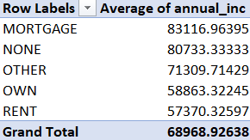
Analysis on Annual Income across House Ownership
From below results we can see that the average annual income of people who got mortgage property is more than that of who lives for rent.

Slide 14
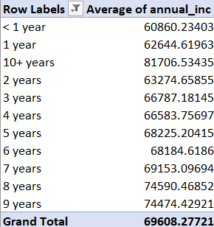
Analysis on Annual Income across Employee Experience
In below image, We can see as the experience increases , the annual income increases.

Slide 15
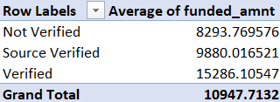

Analysis on Funded amount across Verification
The image shows that the Verified users are more likely to get more loan amount than the others.
Analysis on Loan Amount across Terms
As we can see here, The more the term duration, more the loan amount

Slide 16
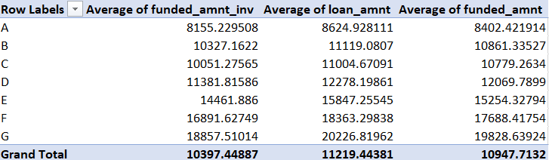
Analysis on Loan Amount, Funded Amount and Funded Amount Investors across Grades
As we can see, The amounts are in the increasing order according to the grades from A to G but I can see a slight anomaly on Grade B and C.

Slide 17
Bivariate Analysis

Slide 18
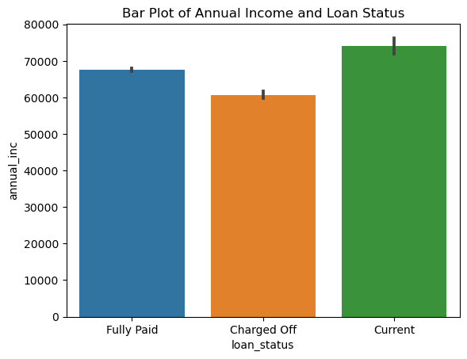
Code and Results for Bivariate analysis
#Bivariate Analysis on Loan Status and Annual Income
sns.barplot(x='loan_status',y='annual_inc',data=cleaned_df_no_outliers)
plt.title('Bar Plot of Annual Income and Loan Status')
plt.show()
By comparing the annual incomes,the borrowers who has more annual income likely to repay the loan fully.

Slide 19
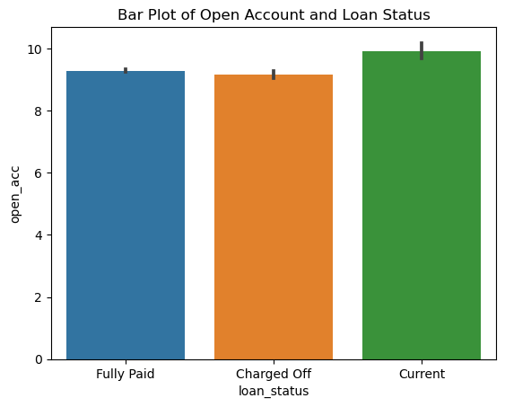
Code and Results for Bivariate analysis
#Bivariate Analysis on Loan Status and Open Account
sns.barplot(x='loan_status',y='open_acc',data=cleaned_df_no_outliers)
plt.title('Bar Plot of Open Account and Loan Status')
plt.show()
By comparing, The borrowers who fully paid the loan and defaulted has most likely the same number of open credit lines.

Slide 20

Code and Results for Bivariate analysis
#Bivariate Analysis on Loan Status and Total Account
sns.barplot(x='loan_status',y='total_acc',data=cleaned_df_no_outliers)
plt.title('Bar Plot of Total Account and Loan Status')
plt.show()
By comparing, The borrowers who fully paid the loan has slightly having more total credit lines than Defaulters.

Slide 21
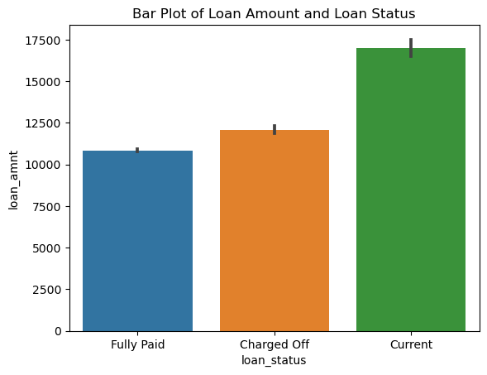
Code and Results for Bivariate analysis
#Bivariate Analysis on Loan Status and Loan Amount
sns.barplot(x='loan_status',y='loan_amnt',data=cleaned_df_no_outliers)
plt.title('Bar Plot of Loan Amount and Loan Status')
plt.show()
By comparing, The fully paid borrowers likely to ask for less loan amount than the Defaulters.

Slide 22
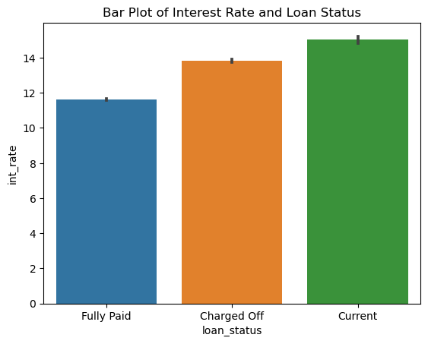
Code and Results for Bivariate analysis
#Bivariate Analysis on Loan Status and Interest Rate
sns.barplot(x='loan_status',y='int_rate',data=cleaned_df_no_outliers)
plt.title('Bar Plot of Interest Rate and Loan Status')
plt.show()
By comparing, With Less Interest rates, the loan is more likely to be paid.

Slide 23
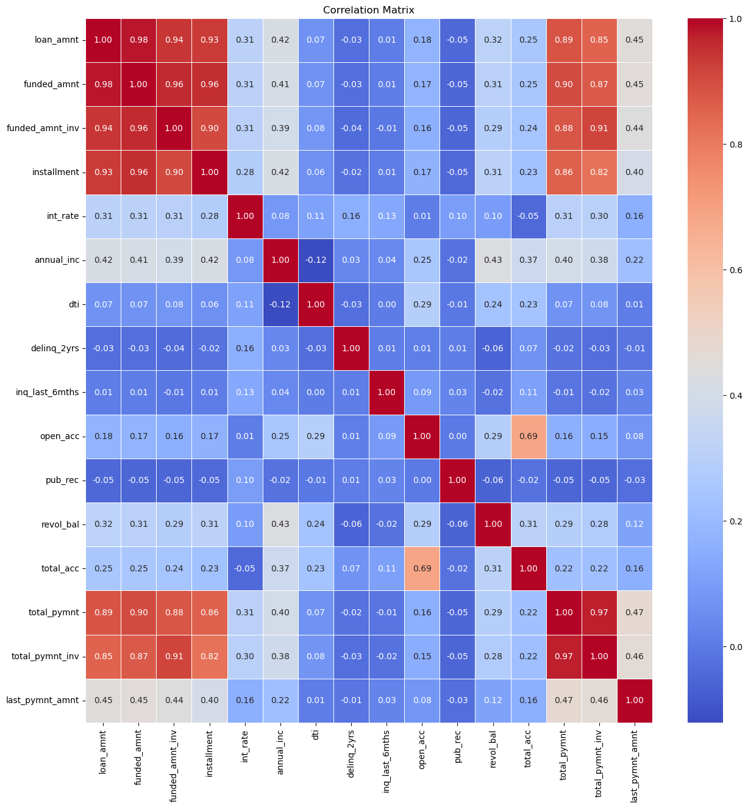
Code and Results for Bivariate analysis
#Bivariate Analysis
#Finding Correlations
loan_correlation = cleaned_df_no_outliers[['loan_amnt','funded_amnt','funded_amnt_inv','installment','int_rate’,'annual_inc','dti','delinq_2yrs','inq_last_6mths','open_acc','pub_rec','revol_bal','total_acc', 'total_pymnt','total_pymnt_inv','last_pymnt_amnt']]
correlation = loan_correlation.corr()
plt.figure(figsize=(15,15))
sns.heatmap(correlation, annot = True, cmap='coolwarm', fmt='.2f', linewidths=0.5)
plt.title("Correlation Matrix")
plt.show()
Here the loan amount is most correlated with the funded amount i.e., as the loan amount increases/decreases, the funded amount will increase/decrease. The DTI and the annual income are less correlated i.e., as the annual income increases, the DTI decreases and vice versa.

Slide 24
Derived Metrics

Slide 25
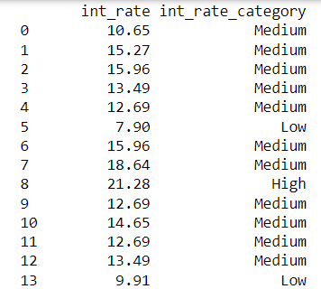
Code and Results for Derived Metrics
#Adding a new Business driven column
bins = [5, 10, 20, 25]
labels = ['Low', 'Medium', 'High']
cleaned_df_no_outliers['int_rate_category'] = pd.cut(cleaned_df_no_outliers['int_rate'], bins=bins, labels=labels, right=False)
print(cleaned_df_no_outliers[['int_rate', 'int_rate_category']].to_string())

