Slide 1


FALCONS · EE308FZ 软件工程 · 作业四
SPORTS
BUDDY
界面原型设计汇报
Interface Prototype Design · Sports Buddy
约得到 · 约得好 · 约得准
Falcons（第12组）· 12 屏交互原型（墨刀）
Notes:
【约1分钟】大家好，我们是 Falcons 小组，项目是 Sports Buddy（Sports Buddy）。这次汇报作业四：界面原型设计。内容依次是：原型概览、设计理念与过程、12 屏界面、业务规则与需求对应、验证结果、遇到的难点，最后是团队分工、协作与感受。

Slide 2

Prototype at a glance
12
5
108
21
interactive screens
SRS modules covered
real-browser checks
end-to-end steps
login to review
M1–M5
plus 188 Node checks
login → review
Tool and demo
Design tool: MoDao (墨刀), a specialised prototyping tool
Live demo: the 12 screens are embedded as interactive HTML pages, so the flow can be opened and clicked through during the defence
Links: modao.cc/proto/Ebn0JeMtntbdoIJ4M1YfJ · source: assignment4/prototype
Goal: an interactive prototype covering the full user journey, from login to review
Notes:
【约1分钟】先看整体：12 屏可点击的交互原型，覆盖 SRS 的 M1–M5 五个模块；用 108 项真实浏览器检查、188 项 Node 检查和 21 步端到端流程做了验证。工具是墨刀，答辩时可以直接打开链接演示。

Slide 3
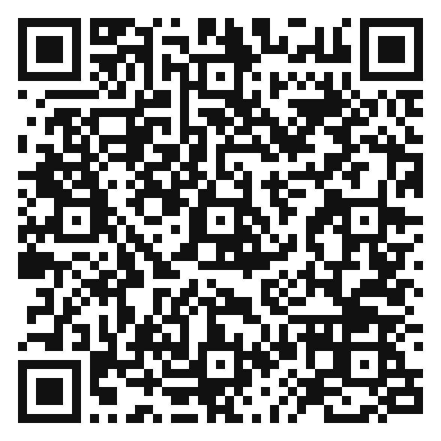
Live demo: try the prototype
Interactive prototype (MoDao)
Scan the QR code with a phone, or click the link below to open the 12-screen prototype in device view.
Prototype
modao.cc/proto/Ebn0JeMtntbdoIJ4M1YfJ
Project repository (GitHub)
github.com/Falcons-FZU-MU-SE-GROUP12/SportsBuddy
Suggested demo path
Login → Discovery → Activity list → Detail → Sign up → Check-in → Review
Scan to open the prototype
Notes:
【约1分钟，现场演示】这一页放了墨刀原型的二维码和链接，点击链接或扫码即可打开 12 屏交互原型；GitHub 是项目仓库。建议演示路径：登录→找局→活动列表→详情→报名→签到→评价。

Slide 4
Design concepts: buddy up easily, well, precisely
Easily
Well
Precisely
约得到
约得好
约得准
Design concept
Design concept
Design concept
One-sentence search returns ranked activities, so finding a game takes seconds.
Check-in, mutual reviews and a credit score make reliable people stand out and reduce no-shows.
Matching weighs sport, campus / time, skill level, distance and organizer reliability, and explains why.
Where to see it
Where to see it
Where to see it
P-02 Discovery Home · P-03 Activity List
P-07 Check-in · P-08 Manage · P-12 Review
P-02 Discovery Home (match reasons)
The prototype follows the product vision: “buddy up, easily, well and precisely”
Notes:
【约1分钟】原型围绕产品愿景展开：约得到（一句话找局，几秒钟找到活动）、约得好（签到、互评、信用分，减少爽约）、约得准（综合项目、校区/时间、水平、距离和发起人靠谱度匹配，并解释为什么匹配）。

Slide 5
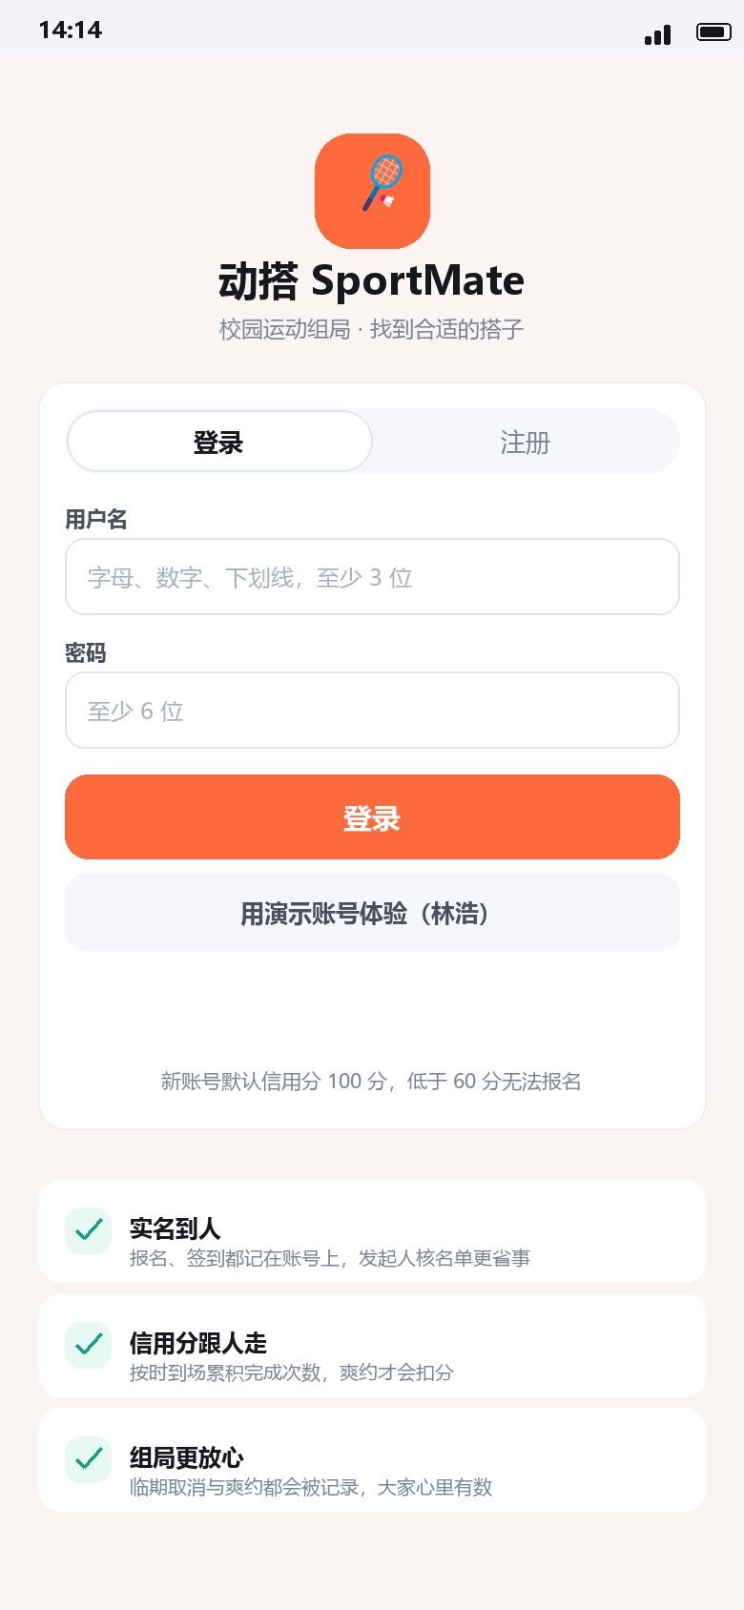
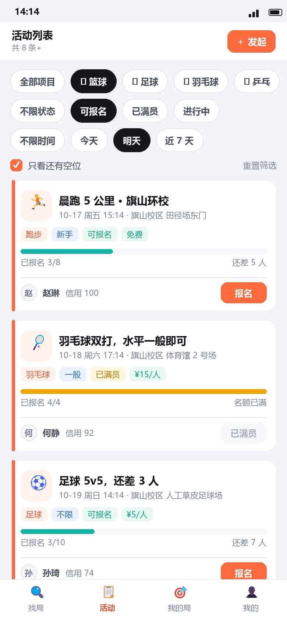



Visual design principles
Mobile-first
A 390 × 844 phone frame is the main canvas; the layout also adapts to 320, 768 and 1280 px with no horizontal overflow.
Warm, energetic palette
Orange is the action colour, dark text sits on a light background, and the hierarchy stays clear.
Low cognitive load
One primary action per screen, clear status (full / joined / checked in) and explicit feedback after every action.
P-01 Login / Register
P-03 Activity List
Notes:
【约1分钟】视觉上三条原则：移动优先（390×844 画布，并适配 320/768/1280 宽度）；暖色、有活力的配色（橙色作为行动色）；低认知负担（每屏一个主操作、状态清晰、每次操作都有反馈）。右边是登录页和活动列表的实际截图。

Slide 6
Design process: six steps
1
Requirement mapping
2
Information architecture
3
Screen production
The 12 screens were derived from the SRS (M1–M5) and the 41 use cases.
Login → discovery → list → detail → create → check-in → manage → my activities → me → profile → reviews.
Each screen was built by its owner, then reviewed against the requirement it serves.
4
Interaction wiring
5
Business-rule states
6
Review and regression
Buttons, tabs, forms, modals and page transitions were linked into one continuous flow.
Full capacity, credit below 60, late cancellation, check-in code / location and permissions became visible states.
The testing group walked through the flow against the SRS; defects were fixed and re-verified.
Notes:
【约1.5分钟】设计过程六步：需求映射（由 SRS 的 M1–M5 和 41 个用例得到 12 屏）；信息架构；分屏制作并对照需求评审；交互串联成连续流程；加入业务规则状态；最后由测试组按 SRS 走查，缺陷修复后再次验证。

Slide 7
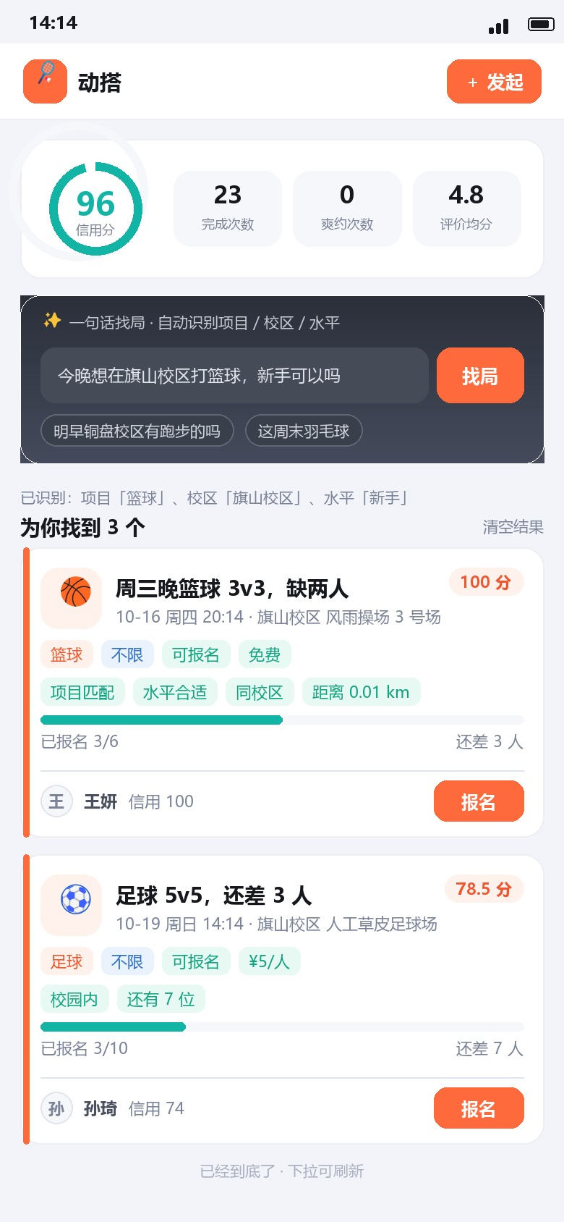
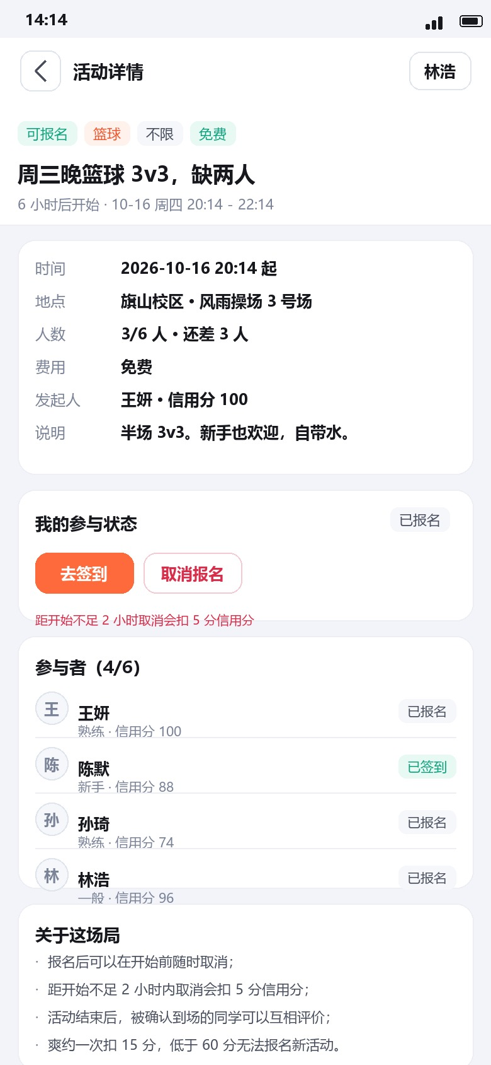
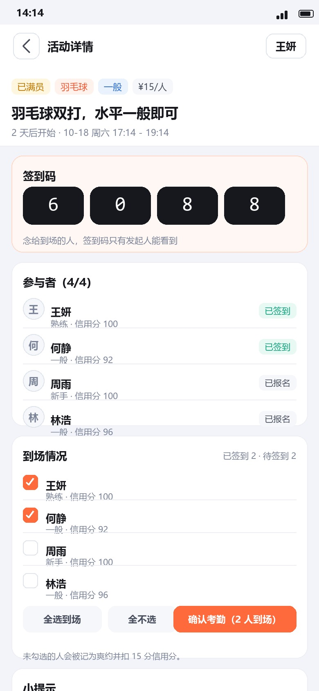
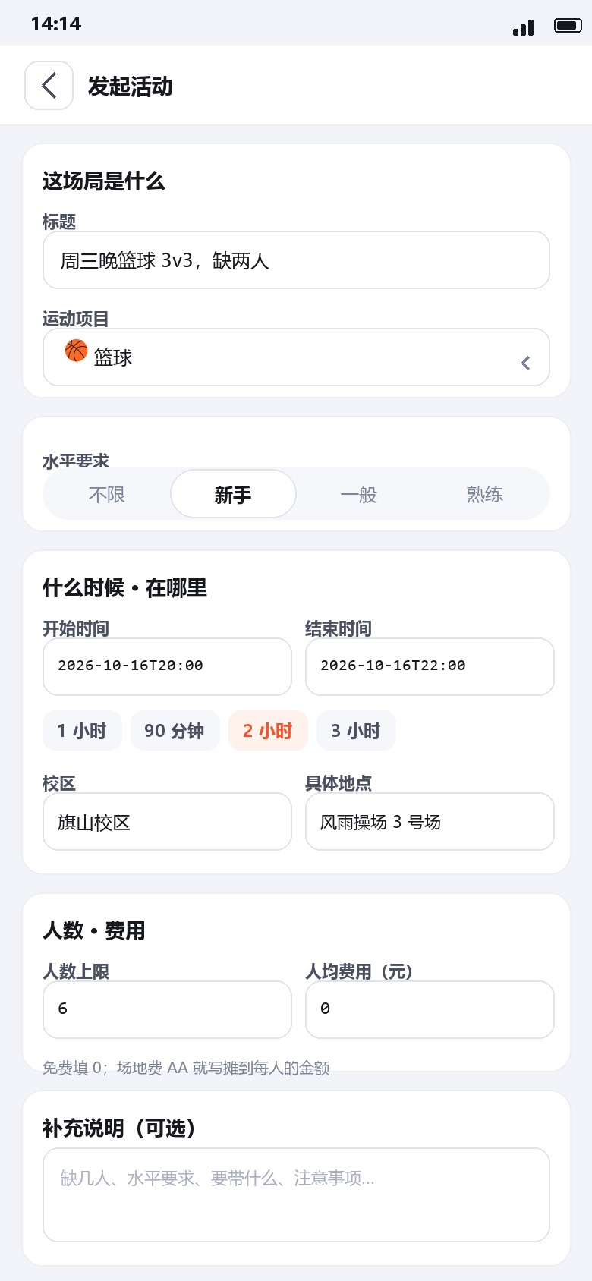
Interface overview (1/2): from login to creating a game
P-01 Login / Register
P-02 Discovery Home
P-03 Activity List
P-04 Activity Detail (participant)
P-05 Activity Detail (organizer)
P-06 Create Activity
Entry, demo account
One-sentence search, recommendations
Filters: sport, time, level, campus
Join, see participants, status
Manage, see sign-ups
Time, place, headcount, level
Main flow: Login → Discovery → Activity list → Detail → Sign up → Check-in → Review
Notes:
【约1分钟】12 屏分两页介绍。第一页：登录注册、找局首页（一句话找局和推荐）、活动列表（按项目、时间、水平、校区筛选）、活动详情（参与者视角和发起人视角）、发起活动。主流程：登录→找局→列表→详情→报名→签到→评价。

Slide 8
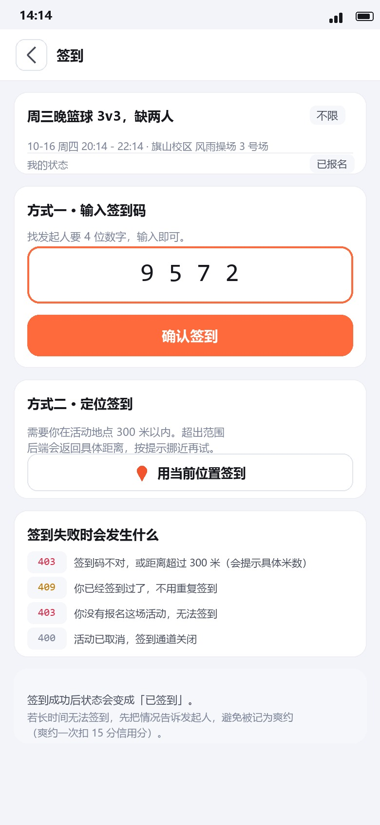
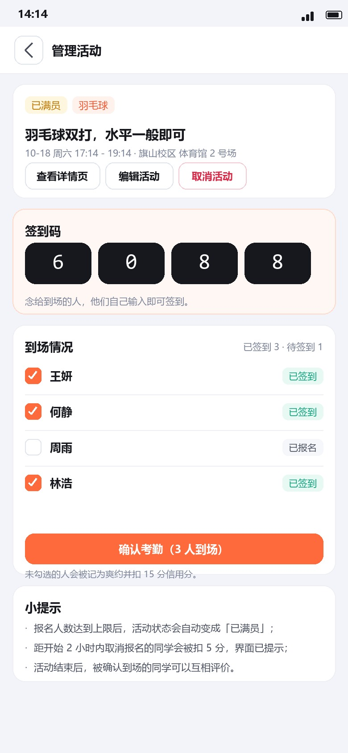
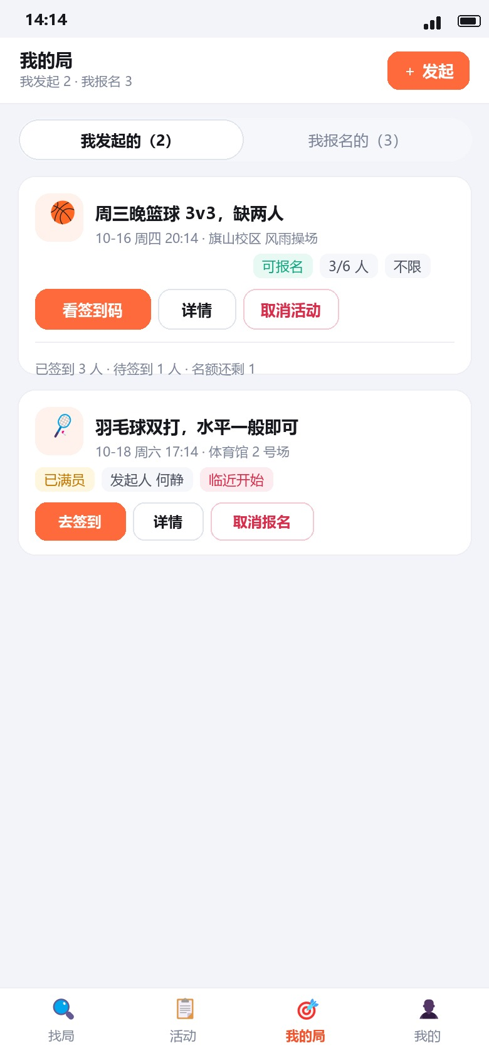
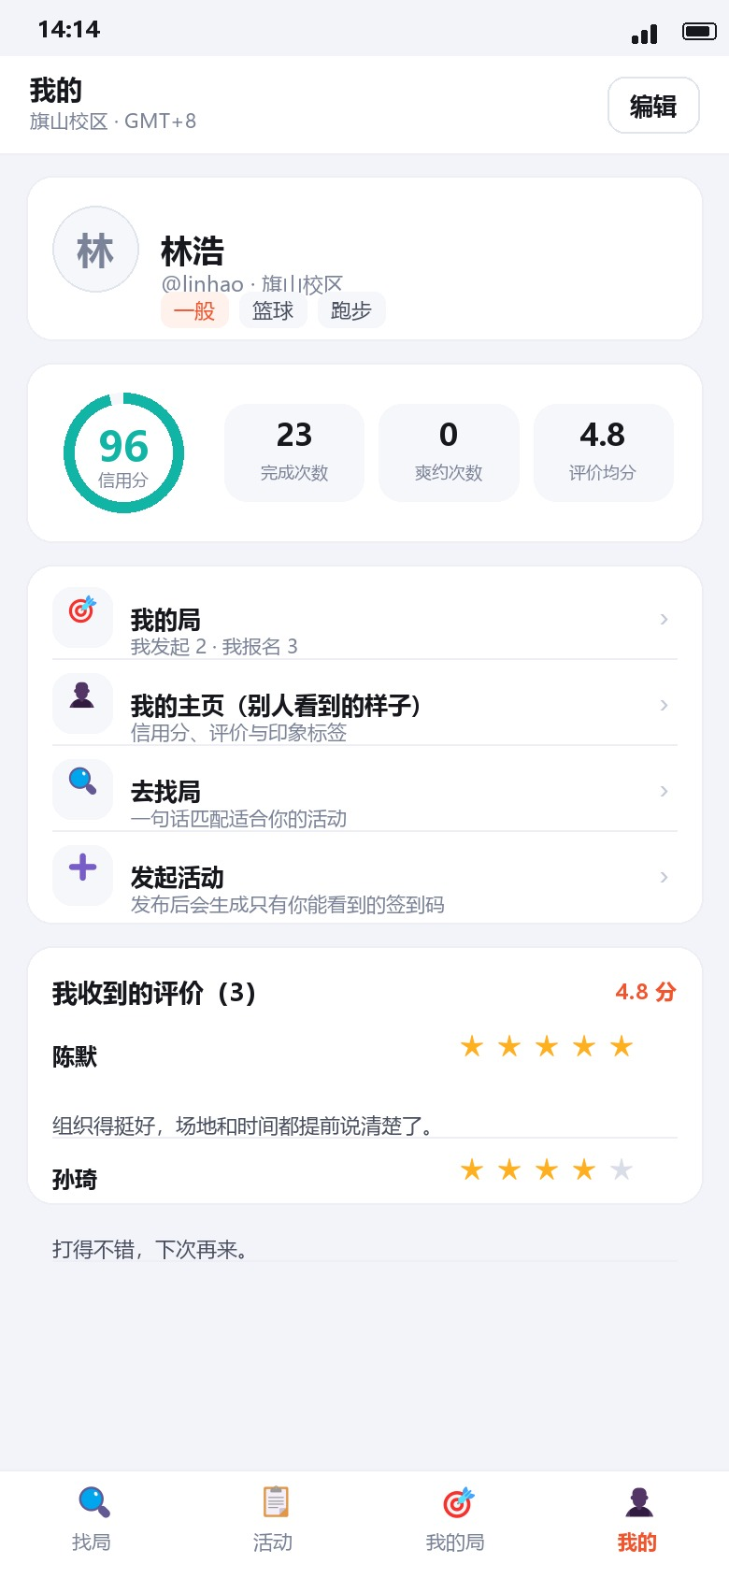
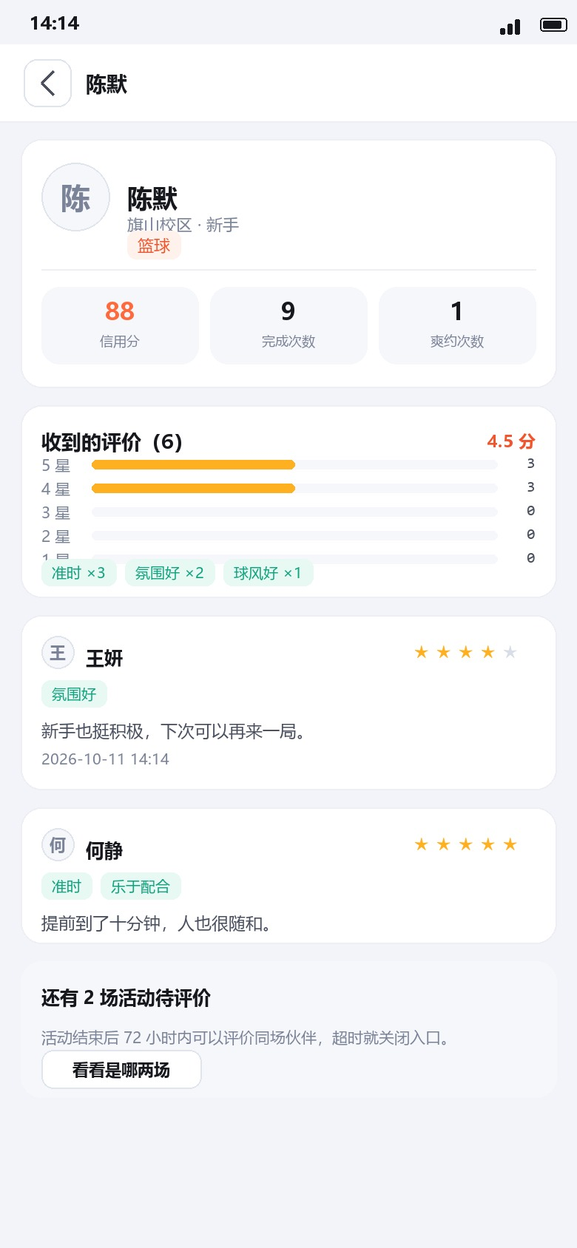
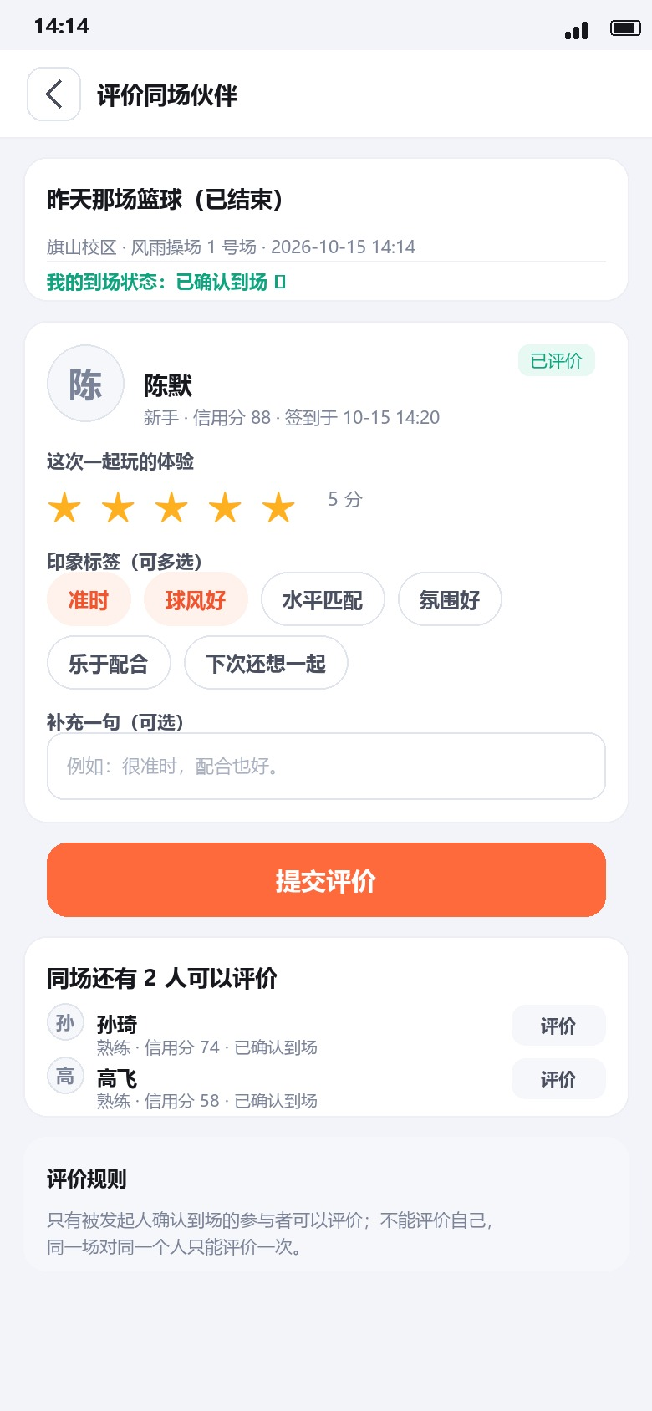
Interface overview (2/2): check-in, profile and reviews
P-07 Check-in
P-08 Manage Activity
P-09 My Activities
P-10 Me
P-11 Profile (other user)
P-12 Review Partners
Code or location (within 300 m)
Attendance, cancellation
Organized / joined
Profile, credit score, settings
Credit and reviews
Stars and impression tags
Together the 12 screens cover the whole journey, from login to review
Notes:
【约1分钟】第二页：签到（签到码或 300 米内定位）、管理活动（考勤和取消）、我的局、我的（信用分和资料）、他人主页、评价同场伙伴（星级和印象标签）。12 屏合起来覆盖从登录到评价的完整旅程。

Slide 9
Business rules made visible
Rules shown as states
Capacity: status turns “Full” automatically
Credit < 60: cannot join new activities
Late cancel: less than 2 h before start: −5 pts
No-show: unticked at attendance: −15 pts
Check-in: 4-digit code, or location within 300 m
Permissions: only the organizer sees the check-in code
P-04 Detail
P-07 Check-in
P-08 Manage
join / cancel rules
code or location
attendance
Notes:
【约1分钟】业务规则在原型里都做成了可见状态：名额满自动变“已满员”；信用分低于 60 不能报名；开始前不足 2 小时取消扣 5 分；考勤时未勾选记爽约扣 15 分；签到支持 4 位签到码或 300 米内定位；签到码只有发起人能看到。

Slide 10
Requirements alignment: M1–M5 to screens
M1
User & authentication
P-01
P-10
M2
Activity publishing
P-06
P-05
M3
Matching & discovery
P-02
P-03
M4
Sign-up & participation
P-04
P-07
P-08
P-09
M5
Reliability & credit
P-04
P-11
P-12
All five SRS modules map to at least one screen
Notes:
【约45秒】需求与界面的对应：M1 用户与认证对应 P-01、P-10；M2 活动发布对应 P-06、P-05；M3 匹配与发现对应 P-02、P-03；M4 报名与参与对应 P-04、P-07、P-08、P-09；M5 靠谱度与信用对应 P-04、P-11、P-12。

Slide 11
Results and verification
188
Node checks
108
real-browser checks
21
end-to-end steps
automated regression suite
titles, rendering, undefined / NaN, overflow, console errors
login → discover → sign up → check in → review
✓
All 12 screens reachable and clickable
✓
Main flow works end to end
✓
Business-rule states visible
✓
Responsive at 320 / 768 / 1280 px, no horizontal overflow
✓
Consistent colour, typography and components
✓
Real-browser verification and end-to-end flow passed
✓
Non-posed team discussion photo
✓
Public prototype link (MoDao)
Notes:
【约1分钟】结果与验证：自动化回归套件 188 项 Node 检查、108 项真实浏览器检查（通过 DevTools Protocol 和无头 Edge，覆盖标题、渲染、undefined/NaN、溢出和控制台错误），以及 21 步端到端用户旅程。下面是原型检查清单，全部已打勾。

Slide 12
Difficulties and solutions (1/2)
1
Layout collapsed: CSS class mismatch
2
Mobile top bar covered the screens
3
Floating button on every screen
Difficulty CSS used .proto-screen but the HTML used screen, so display: none never applied and all 12 screens rendered at once.
Fix Traced the selector mismatch and unified the class name to .screen.
Lesson Verify the rendered layout, not just the source; keep one naming convention.
Difficulty The phone media query came before the base .proto-chrome rule and was overridden; the bar took about 130 px at 390 px.
Fix Moved the media query to the end of the stylesheet.
Lesson Cascade order matters; test responsive rules at real device widths.
Difficulty The floating action button used position: fixed, so it hovered over all 12 screens.
Fix Scoped it under .screen.is-active so only the active screen shows it.
Lesson Scope global positioning when several screens share one page.
All three layout issues were solved and re-verified in the rendered prototype
Notes:
【约1.5分钟】难点一到三都是前端排版类问题，已全部解决：CSS 类名不一致导致 12 屏同时显示，统一为 .screen；手机端顶栏的媒体查询顺序写反被覆盖，调整到样式表末尾；悬浮按钮用了 position: fixed，浮在所有页面上，改为限定在当前激活的屏。收获：要验证真实渲染结果，注意 CSS 层叠顺序，全局定位要限定范围。

Slide 13
Difficulties and solutions (2/2) and gains
4 Feedback messages and route parameters lost
5 Class diagram overflowed on small screens
Difficulty The router cleared messages before rendering, the login token was not persisted (401) and route parameters were dropped (/activities/NaN).
Fix Added a flashPending flag, stored the token on login and fixed route parsing to pass activityId / userId.
Lesson State that survives navigation needs an explicit lifecycle.
Difficulty The page overflowed by 12 px at 390 px because a grid column had a 360 px minimum.
Fix Switched to minmax(min(360px, 100%), 1fr) and regenerated; SVG diff was zero.
Lesson Test layout at the narrowest supported width.
Gains
Automated regression
End-to-end journey test
Root-cause thinking
188 Node checks and 108 real-browser checks (DevTools Protocol, headless Edge).
21 steps: login → discover → sign up → check in → review.
Fix causes, not symptoms; keep prototype, web app and share package generated from one source.
Notes:
【约1.5分钟】难点四：提示消息被路由提前清空、登录令牌没有持久化导致 401、路由参数丢失导致请求 /activities/NaN；用 flashPending 标记、登录时写入存储、修正路由解析解决。难点五：类图页在 390px 下横向溢出 12px，因为网格列最小宽度 360px，改用 minmax(min(360px,100%),1fr)。收获：自动化回归、端到端测试、从根因解决问题。

Slide 14
Team plan and progress
✓
✓
✓
✓
●
Preparation
Screen production
Consistency & review
Publication
Report & submission
10/26 – 10/27
10/27 – 10/28
10/28 – 10/29
10/29 – 10/31
10/31 – 11/01
Project set-up, screen ownership, flow map
12 interactive screens, business-rule states
Unified style, defect list, fixes
Public prototype link, testing report
Blog, PPT, final submission
Next steps before the defence
Finalise the presentation
Confirm the public MoDao link opens and navigates correctly
1
2
A one-week cycle; specific dates follow the course arrangement.
Notes:
【约1分钟】作业四按一周周期推进：准备、画面制作、视觉统一与评审、发布、汇报提交。目前处于最后阶段。答辩前还要完成两件事：定稿 PPT、确认公开的墨刀链接能正常打开和跳转。（团队讨论照片已补充，见后面一页。）日期以课程安排为准。

Slide 15
Roles and workload: 13 members, about 7.7% each
13
Project Mgmt
1
Product Req.
2
Frontend
4
Huang Zhiyuan (Team Lead)
Zhang Zile · Ye Yifan
Lin Zijun · Li Zhenhao · Li Haoze · He Jinghao
members · 1 team lead
Schedule, coordination, blog, integration, submission
Prototype set-up, P-01–P-06, flow map, interaction details
P-07–P-12, visual consistency, PPT layout
6
functional groups
Backend
4
Algorithm
1
Testing
1
7.7%
Zhang Jingtian · Yu Chenghao · Zhang Xinyu · Xu Boyu
Cai Yaohua
Wang Shaojie
Estimated share per member, 100% in total; adjusted by performance assessment
Business-rule states: capacity, credit, cancel penalty, check-in, permissions
Matching and reliability display, LLM research
Walkthrough, defect list, acceptance
Notes:
【约1.5分钟】13 人分六组。产品组负责原型结构和 P-01 到 P-06 以及流程图；前端组负责 P-07 到 P-12、视觉统一和 PPT 排版；后端组提供业务规则状态（名额、信用分、取消扣分、签到、权限）；算法组负责匹配与靠谱度展示；测试组负责走查、缺陷清单和验收；项目管理负责进度、整合和提交。每人按 1/13 估计约 7.7%，最终由绩效考核调整。逐人明细见博客第 2 章。

Slide 16




Team collaboration
Repository and folders
Work log
All deliverables live in the shared GitHub repository under fixed folders: assignment4/prototype, slides, evidence and testing.
Every change is recorded in WORKLOG.md (date, member, type, files, summary, assignment), so contributions are traceable.
Task allocation and communication
Review and integration
Each screen and document has one owner and one reviewer; the lead tracks the critical path; daily coordination in the team chat.
The testing group walked through the prototype against the SRS; owners fixed and re-verified each defect; the share package was regenerated from one source.
Workload shares start as an equal estimate, then are adjusted by the team performance assessment
Notes:
【约1分钟】协作方式：成果统一放在 GitHub 仓库固定目录；用 WORKLOG.md 记录每次改动，贡献可追溯；每个页面和文档一位负责人、一位评审；测试组按 SRS 走查并出缺陷清单，负责人修复后复验，最终的分享包由同一份源文件重新生成。

Slide 17
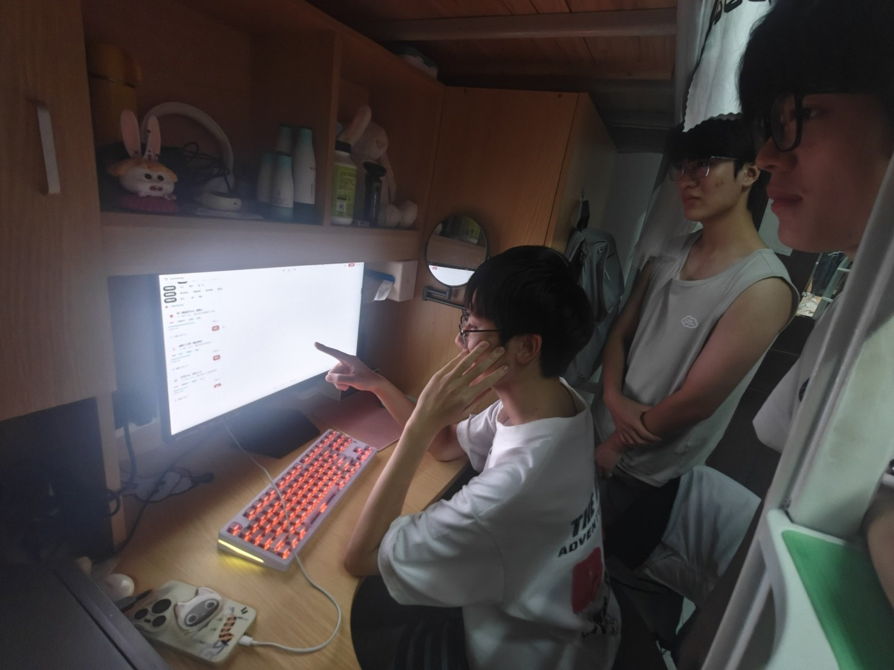
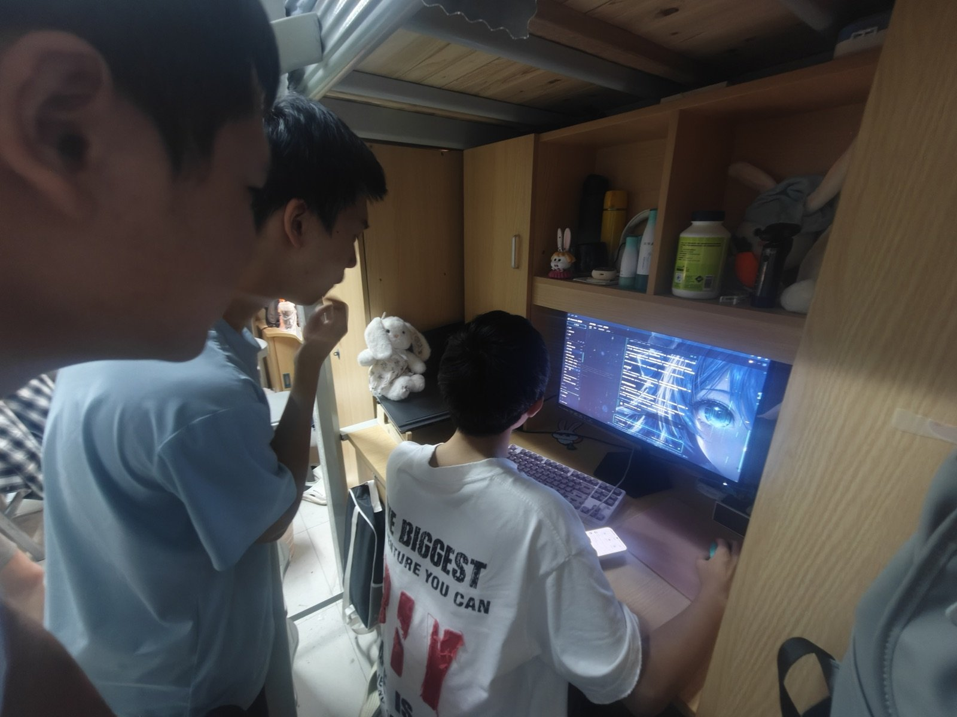
Team photo: reviewing the prototype together
Figure 15. Non-posed photo of the team discussing the prototype.
Figure 16. The team reviewing the prototype flow together.
Notes:
【约30秒】这是团队讨论原型的非摆拍照片：大家围在电脑前对照原型流程逐项走查，边看边讨论、边提出修改。

Slide 18
Team feelings
“Clear scope and a working prototype beat a perfect plan: when problems appeared, we discussed them openly, fixed the root cause and re-verified the result.”
“Whenever we face challenges, we communicate and discuss them together, each doing our part and collaborating seamlessly.”
Huang Zhiyuan
Zhang Zile
Project Management (Team Lead)
Product Requirements
“From choosing Modao for prototyping to setting up the overall framework, everything feels efficient and gives me a lot of confidence for development.”
“This team has shown me the power of teamwork. We split tasks clearly, and we always pull together to get through every difficulty.”
Yu Chenghao
Wang Shaojie
Backend Development
Testing
Clear division of labour, GitHub work-log tracking and a test-driven review loop
Notes:
【约1分钟】团队感受，这里选了四位成员的原话。总体评价：分工清晰、用 GitHub 工作日志透明追踪进度、以测试驱动的评审闭环；沟通直接，互相主动帮助。团队合影（非摆拍的讨论照片）答辩前补充。

Slide 19
谢谢大家
Q & A
Sports Buddy · 约得到，约得好，约得准
墨刀交互原型 · 源码：github.com/Falcons-FZU-MU-SE-GROUP12/SportsBuddy
Notes:
【答疑】预留提问时间。可能被问到：为什么选墨刀；业务规则（信用分、签到距离）的取值依据；匹配如何给出解释；原型与真实前端的关系。

