Slide 1


FALCONS · EE308FZ 软件工程 · 作业三
SPORTS
BUDDY
需求分析汇报 Requirements Analysis
校园运动搭子平台 · Sports Buddy
约得到 · 约得好 · 约得准
Falcons（第12组）· SRS V3.1
Notes:
【约1分钟】大家好，我们是 Falcons 小组，项目是 Sports Buddy。这次汇报围绕作业三的需求分析，依次讲：为什么做、做了什么（含领域类图）、团队计划与分工，最后是难点与下一步。

Slide 2



Want to exercise on campus? Hard to find the right partner
Scattered invitations
Poor fit
Last-minute no-shows
Group-chat posts quickly disappear under newer messages, so finding people is down to luck.
Partners differ in time, location or skill level, so a game can feel awkward or not happen at all.
When someone drops out late, the activity is short of players and everyone else's time is wasted.
Target users: university students · First make one campus truly usable
Note: background research currently uses simulated data; real interviews / surveys will be added before the design is frozen.
Notes:
【约1.5分钟】背景是一个很常见的校园问题：想运动，却找不到人。三个痛点：邀约散落在群聊里；时间地点水平对不上；临时爽约。需要如实说明：目前的调研数据是模拟数据，真实访谈列为设计冻结前的待办。

Slide 3
Why we build it: buddy up easily, well, precisely
Easily
Well
Precisely
约得到
约得好
约得准
Problem solved
Problem solved
Problem solved
Wanting to exercise but no one to go with
Frequent no-shows and skill mismatch
Tedious filtering, unsure whom to join
How we do it
How we do it
How we do it
Create, browse and join activities, turning “want to exercise” into “actually exercising”
Check-in + mutual reviews + credit score, so reliable people stand out
One-line search + smart matching: activities that fit your time, skill and campus
Make one campus truly usable first, then expand to more universities, clubs and communities
Notes:
【约1分钟】项目价值用三句话概括：约得到、约得好、约得准。约得到靠发起/报名；约得好靠签到、互评和信用分；约得准靠一句话找局和智能匹配。策略是先做透一所校园。

Slide 4
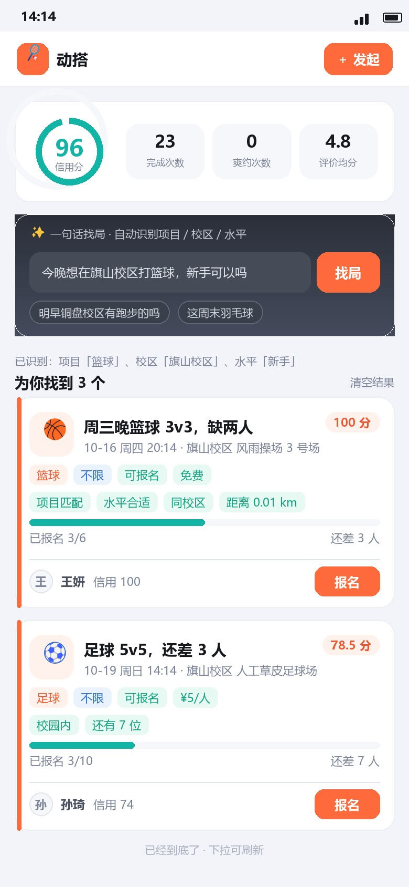
Target users and a typical scenario
Target users: university students
Organizer: posts activities, checks the list, confirms attendance Participant: finds, joins, checks in, reviews
Scenario: find a game with one sentence
1
Type one sentence
“Basketball at Qishan campus tonight — beginners OK?”
2
Conditions recognized automatically
Sport: basketball · Campus: Qishan · Level: beginner
3
Get matches and sign up
3 activities found, ranked by match score, one tap to join
P-02 Discovery Home
Notes:
【约1分钟】用户是高校学生，有发起人和参与者两种角色。典型场景：用户输入一句话，系统自动识别项目、校区和水平，返回按匹配分排序的活动，直接报名。右侧是对应的 P-02 找局首页原型。

Slide 5
Deliverables: SRS upgraded from V2.2 to V3.1
48
41
12
15
requirements
user scenarios
prototype screens
domain classes
M1–M5, with priorities
full usage flow covered
from login to review
19 APIs · 20 relations
Core activity flow
Create
Sign up
Check in
Review
Credit score · Matching
New this time: domain class diagram · 12 prototype screens · requirement–use case–acceptance traceability
Notes:
【约1分钟】本次把 SRS 从 V2.2 完善到 V3.1，新增了领域类图、12 屏高保真原型和功能与验收的对应关系。数字：48 条功能需求（M1–M5）、41 个用户场景、12 屏原型、15 个领域类。完整 SRS 不放进 PPT，只讲重点。

Slide 6
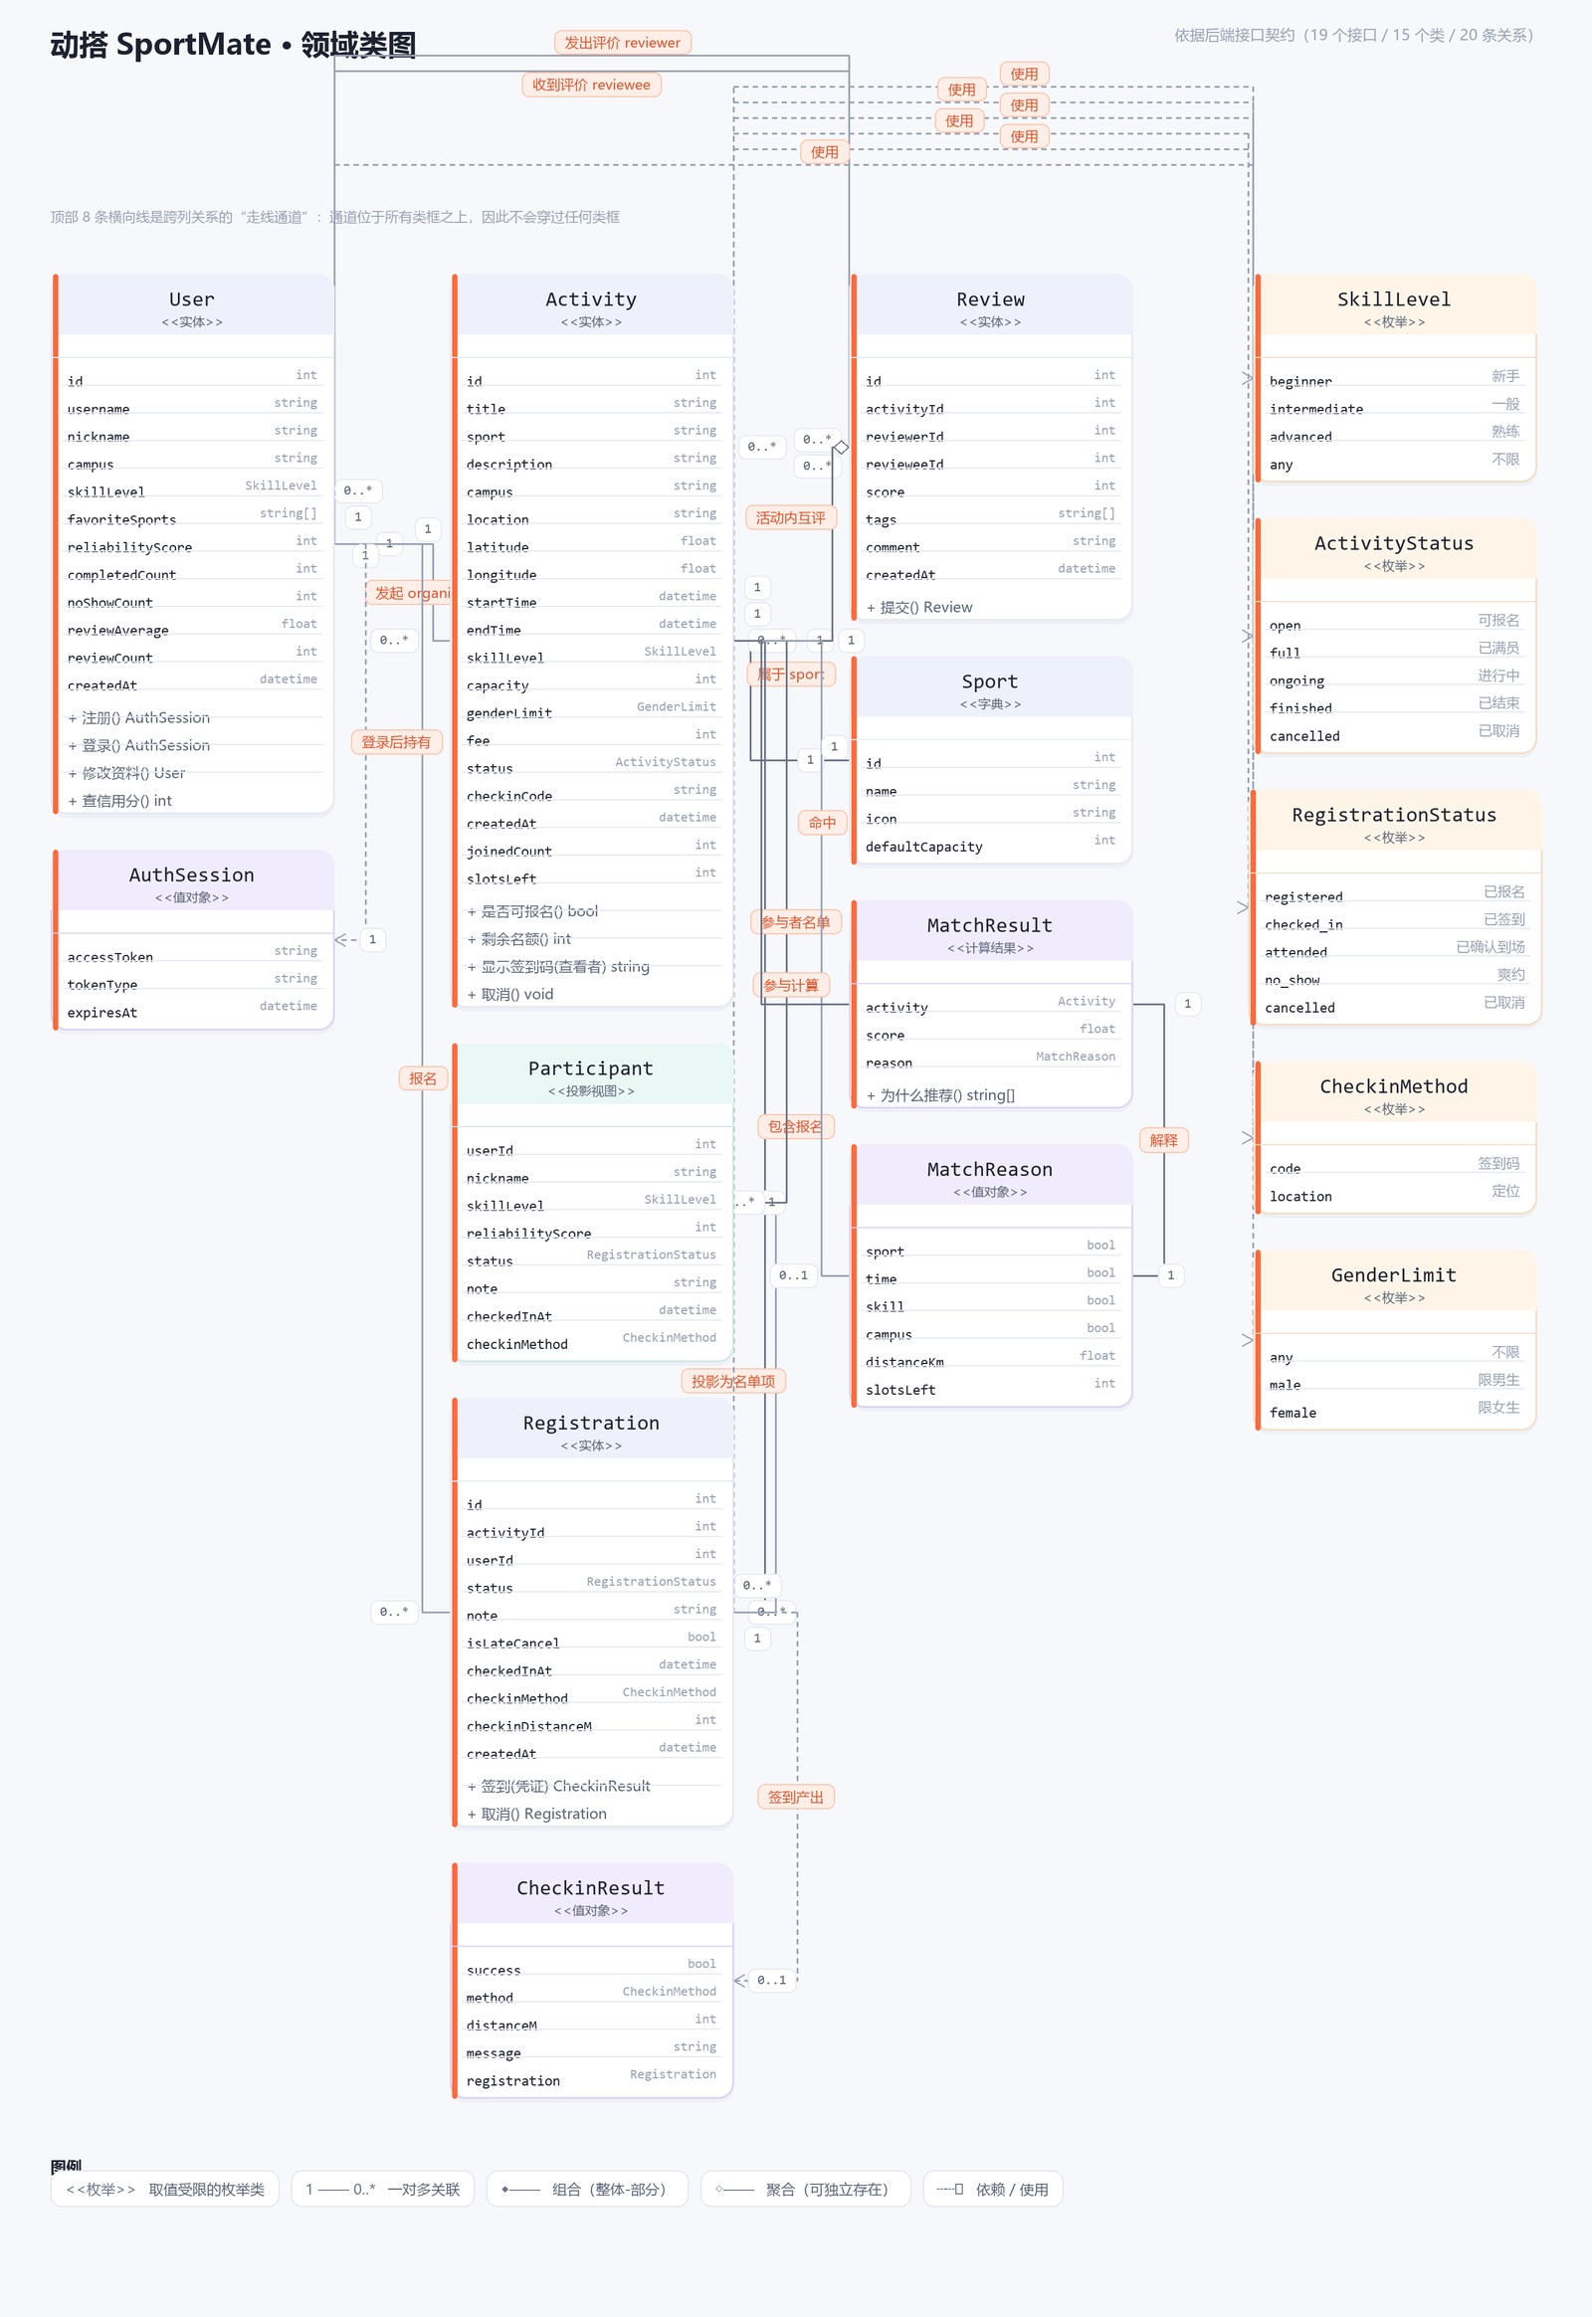
Domain class diagram: 15 classes, 20 relations
15
classes
20
relations
19
APIs
Entities
User · Activity · Registration · Review · Sport
Value objects / projections
AuthSession · Participant · CheckinResult · MatchReason
Computed result
MatchResult (score + reason)
Enumerations
SkillLevel · ActivityStatus · RegistrationStatus · CheckinMethod · GenderLimit
Notes:
【约1.5分钟，重点页】这是领域类图。共 15 个类、20 条关系，依据后端 19 个接口契约绘制。四类元素：实体（用户、活动、报名、评价、运动项目）；值对象和投影（登录会话、参与者名单项、签到结果、匹配理由）；计算结果 MatchResult；以及五个枚举。下一页放大讲核心部分。

Slide 7
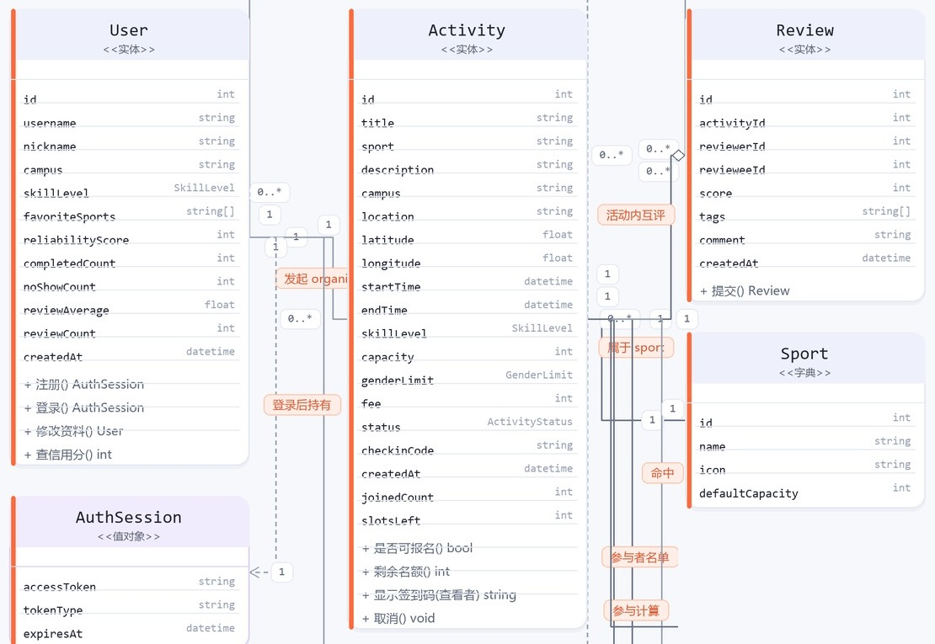
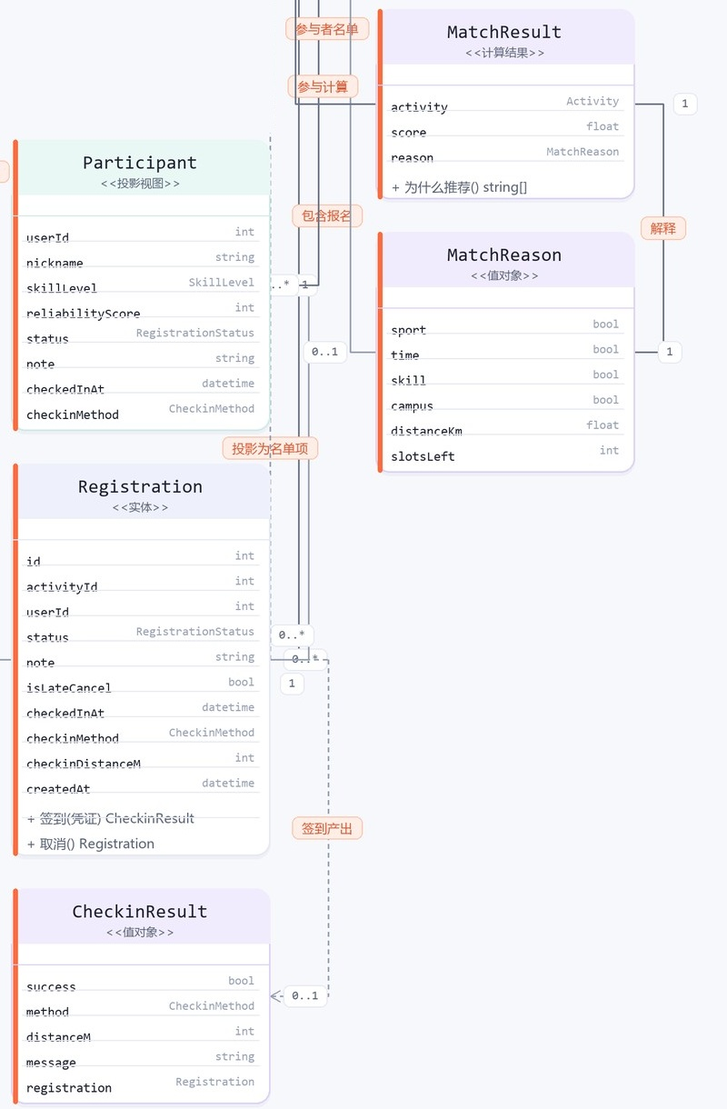
Reading the diagram: core entities, check-in and matching
① Core entities User, Activity, Review and Sport are linked by organize / in-activity review / belongs-to; User stores credit score, no-shows and review stats
② Check-in & matching Registration produces CheckinResult; MatchResult carries MatchReason
Notes:
【约1.5分钟】左图是核心实体：User 发起并报名 Activity，参与者在活动内互评产生 Review，Sport 是运动项目字典；User 上有信用分、完成次数、爽约次数等统计字段。右图是签到与匹配：报名记录 Registration 通过签到产生 CheckinResult；Participant 是名单投影；MatchResult 携带 MatchReason，用来解释为什么推荐这个局。

Slide 8
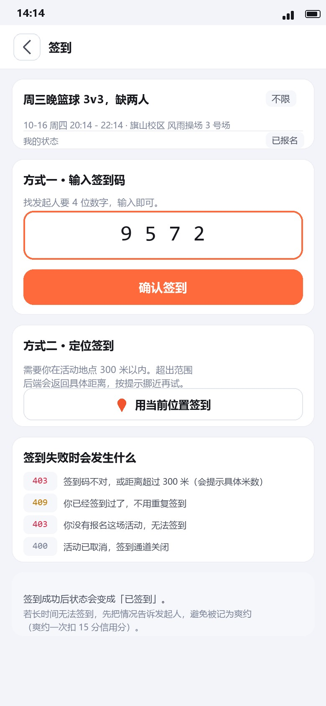
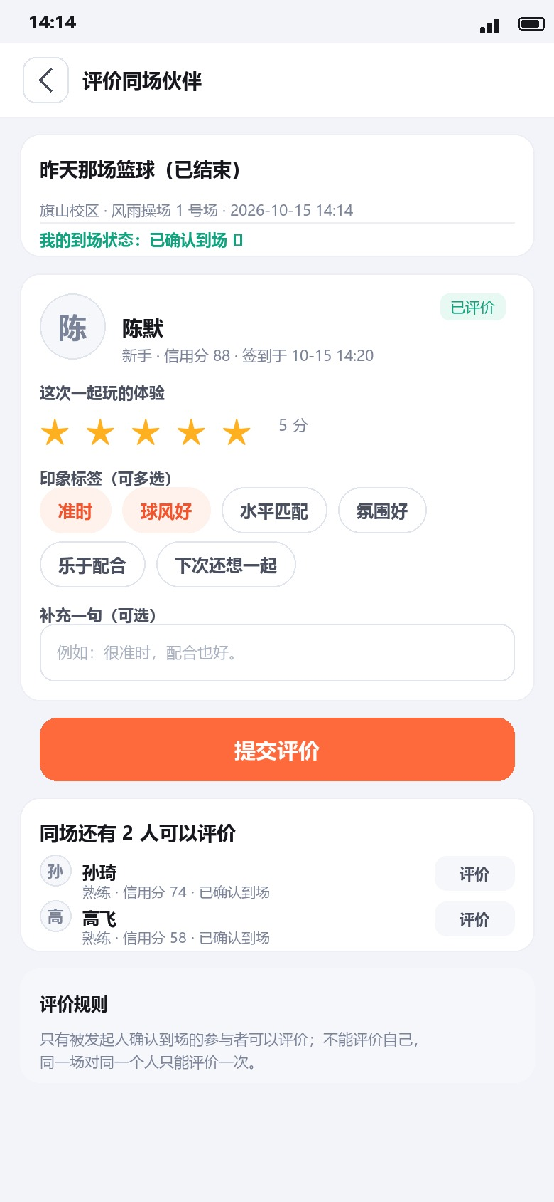
Prototype highlights: discover, check in, review
12 screens, full user journey
P-01 Login & Register
P-02 Discovery Home
P-03 Activity List
P-04 Activity Detail (Participant)
P-05 Activity Detail (Organizer)
P-06 Create Activity
P-07 Check-in
P-08 Manage Activity
P-09 My Activities
P-10 Me
P-11 Profile (Other User)
P-12 Review Partners
P-02 Discovery Home
P-07 Check-in
P-12 Review Partners
One-line search
Code or location
Stars + impression tags
Notes:
【约1分钟】12 屏原型覆盖登录、找局、详情、发起、签到、管理、评价、个人主页。这里挑三屏：P-02 一句话找局，P-07 签到（签到码或定位二选一），P-12 评价同场伙伴（星级和印象标签）。其余屏见博客和仓库。

Slide 9
Features and acceptance: rules built into the screens
100 pts
−15 pts
−5 pts
< 60 pts
Default credit score
Per no-show
Cancel < 2 h before start
Cannot join new activities
Feature
Prototype
Acceptance points
Sign up
P-04 Activity Detail
Status turns “Full” automatically at capacity; below 60 pts cannot join; cancel before start, late cancel loses points
Check in
P-07 Check-in
4-digit code or location (within 300 m); clear messages for duplicate, unregistered or cancelled cases
Attendance
P-08 Manage Activity
Organizer ticks who attended; unticked people are marked no-show and lose 15 pts
Review
P-12 Review Partners
Only confirmed attendees; no self-review; one review per person per activity; within 72 h after the activity
Rules shown in the prototypes; the full requirement–use case–acceptance traceability matrix is in SRS Chapter 7.
Notes:
【约1.5分钟】这一页说明需求怎么落到界面和验收。信用分规则：新账号 100 分，爽约扣 15，距开始不足 2 小时取消扣 5，低于 60 分不能报名。报名、签到、考勤、评价四个环节各有对应原型和可检查的验收点，完整追溯矩阵在 SRS 第 7 章。

Slide 10
Team plan and progress
✓
●
2
3
4
5
0 Team & Topic
1 Requirements
2 Design
3 Development
4 Testing
5 Wrap-up
By Oct 11
Oct 12–18
Oct 19–25
Oct 26–Nov 1
Nov 2–8
Nov 9–15
Team blog, topic PPT, requirements V2.2
SRS V3.1, class diagram, prototypes
Prototype, architecture and API docs
Weekly runnable versions and iteration reviews
Test report, feedback from 30–50 students
Final version and demo
Assignment 3 progress (one week)
Consolidation
Writing
Review
Presentation
Week 1
Week 1
Week 1
Week 1
Review V2.2, split chapter tasks
Scenarios, class diagram, prototypes, features, acceptance
Cross-review, unify terms and figures, release V3.1
PPT, blog, file upload
Done
Done
Done
In progress
Notes:
【约1.5分钟】上方是六阶段总路线（具体日期以课程安排为准），目前处于第 1 阶段需求分析的收尾。下方是作业三一周的执行情况：需求梳理、文档撰写、评审整合都已完成，SRS V3.1 已出；当前在做汇报 PPT、博客和文件上传。

Slide 11
Roles and workload: 13 members, about 7.7% each
13
Project Mgmt
1
Product Req.
2
Frontend
4
Huang Zhiyuan (Team Lead)
Zhang Zile · Ye Yifan
Lin Zijun · Li Zhenhao · Li Haoze · He Jinghao
members · 1 team lead
Schedule, risk tracking, blog, final integration
User research and scenarios, SRS writing
Interface prototypes, UI consistency, interaction notes
6
functional groups
Backend
4
Algorithm
1
Testing
1
7.7%
Zhang Jingtian · Yu Chenghao · Zhang Xinyu · Xu Boyu
Cai Yaohua
Wang Shaojie
Estimated share per member, 100% in total; final share adjusted by performance assessment
Class diagram, function descriptions, acceptance criteria, Word formatting
Matching / reliability modelling, class-diagram support
Acceptance criteria, SRS consistency check
Notes:
【约1.5分钟】团队共 13 人，分六个小组。本次作业各小组分工如图：项目管理负责进度和整合；产品需求负责场景与 SRS；前端做界面原型；后端做类图、功能描述和验收标准；算法负责匹配与靠谱度建模；测试负责验收标准和一致性检查。每人工作量按 1/13 估计，约 7.7%，最终由绩效考核调整。逐人明细见博客第 1 章。

Slide 12




Collaboration: one owner, one reviewer
Task allocation
Progress sync
The lead splits the SRS into chapters mapped to the six groups; every task has one owner and one reviewer.
A short online meeting each week; finished items are marked on the task board, blockers raised at once; the lead tracks the critical path.
Document collaboration
Review & integration
Word is the single source of truth and the PDF is exported from it; deliverables live in fixed folders of the shared repository.
Each chapter is reviewed by someone outside its author group; the tester runs a checklist; the lead unifies names and figure numbers.
Workload shares start as an equal estimate, then are adjusted by the team performance assessment
Notes:
【约1分钟】协作上坚持“一人负责、一人评审”。四件事：任务分配、每周进度同步、文档协作（Word 为唯一源）、评审整合（跨组评审加测试清单，组长终审）。占比先平均估计，再由绩效考核调整。

Slide 13
Challenges and solutions
Challenge
Solution
Previous SRS had no class diagram or prototypes
Added a domain class diagram and 12 high-fidelity screens, linked back to requirements
Background research used simulated data
Clearly marked in the document; real interviews / surveys listed to validate before design freeze
Large document, many figures, Word and PDF may drift
Word as single source, PDF exported from it; figure numbers and captions managed in one place
Inconsistent product name (an early temporary name)
Unified as Sports Buddy across SRS, slides and blog
Chapters written by different members are hard to merge
Fixed a chapter template and glossary first, then cross-review and merge by the product group
Notes:
【约1分钟】五个难点：旧版缺类图和原型，已补齐；调研数据是模拟的，已标注并列为待验证；文档图多，靠 Word 单一来源；产品名统一为 Sports Buddy；多人写作靠模板加交叉评审。

Slide 14
Next steps
1
Validate needs
2
Design phase
3
Build & test
Before design freeze
Oct 19 – Nov 1
Nov 2 – Dec 13
Run real user interviews and surveys
Replace simulated research data
Revise the SRS from feedback
Finalize prototypes
Architecture and API documents
Keep class diagram and API contract consistent
Build and review runnable versions
Trial with 30–50 students
Deliver test report and feedback
Goal: make one campus truly usable, then expand to more universities, clubs and communities
Notes:
【约45秒】下一步：先验证需求（补真实访谈和问卷），再进入设计阶段（10月19日起），然后开发与测试，并邀请 30–50 名学生试用。日期以课程安排为准。

Slide 15
谢谢大家
Q & A
Sports Buddy · 约得到，约得好，约得准
SRS V3.1 · 领域类图 · 12 屏原型 · 源码：github.com/Falcons-FZU-MU-SE-GROUP12/SportsBuddy
Notes:
【答疑】预留提问时间。可能被问到的点：信用分规则的取值依据、匹配分如何计算、调研数据为何是模拟数据及后续验证计划。

