Slide 1
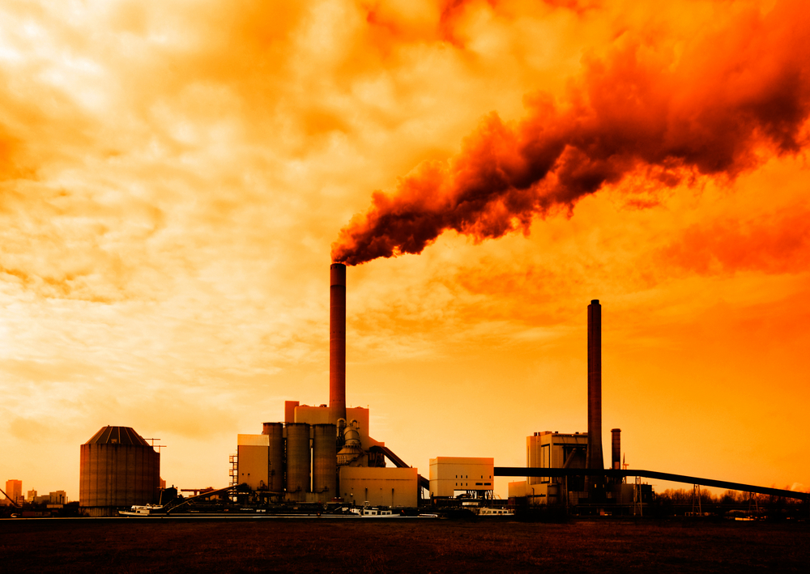
BACK
GLOBAL WARMING
This Photo by Unknown Author is licensed under CC BY

Slide 2
GLOBAL WARMING:
BACK
INTRODUCTION:
Climate change refers to significant, long-term changes in the global climate.
The global climate is the connected system of sun, earth and oceans, wind, rain and snow, forests, deserts and savannas, and everything people do, too. The climate of a place, say New York, can be described as its rainfall, changing temperatures during the year and so on.
But the global climate is more than the “average” of the climates of specific places.
It is this systemic connectedness that makes global climate change so important and so complicated.

Slide 3
GLOBAL WARMING
BACK

Slide 4
BACK
SIDE CHECK:
SIDE 1
SIDE 2
SIDE 3
LINK : https://www.google.com/
1
2
3

