Slide 1
Visual Studio 2015 and Azure Resource Manager
Or the presentation known as Azure Resource Manager Templates: DSC for the Microsoft Cloud
cloudsatatl.murphymoments.com

Slide 2





Thank Our Sponsors
Platinum Sponsors

Slide 3



Thank Our Sponsors
Platinum Sponsors

Slide 4



Thank Our Sponsors
Gold Sponsors

Slide 5
Who Am I
Started coding and scripting in 1999.
C, C++, BASH
Started in IT in 2000 while co-oping in college.
Korn Shell and PERL on AIX
Written Production solutions in PERL, KSH,BASH, VB Script, and of course PowerShell
Been working in IT Operations/Engineering for last 10+ years
Started with PowerShell v1 in 2009.
Written several modules
Working on several Azure projects, deployments of both PaaS and IaaS solutions

Slide 6
Level Set
How many have worked with …
Cloud base services
Azure
Desired State Configuration
Chef, Puppet, CloudFormation, or other
PowerShell in the Cloud

Slide 7
Cloud Computing Models
On-Premises
( Private Cloud )
Infrastructure
( as a Service )
Platform
( as a Service )
Software
( as a Service )
You Manage
Data & Access
Data & Access
You Manage
Data & Access
Data & Access
You Provision & Manage
You Provision & Manage
Applications
Applications
Applications
Applications
Provisioned & Managed by Vendor
Runtime
Runtime
Runtime
Provisioned & Managed by Vendor
Runtime
Operating System
Operating System
Operating System
Operating System
Virtual Machine
Virtual Machine
Virtual Machine
Virtual Machine
Physical Fabric Managed by Vendor
Compute
You Provision Cloud Services
Compute
Compute
Compute
Networking
Networking
Networking
Networking
Storage
Storage
Storage
Storage
Host
Develop
Consume

Slide 8
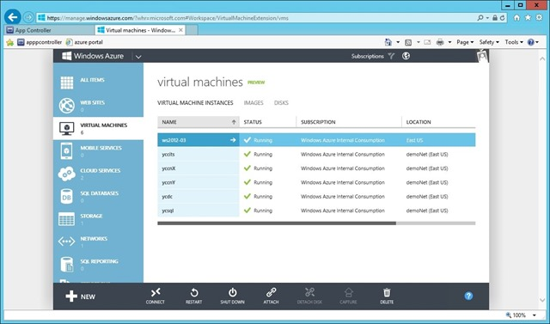
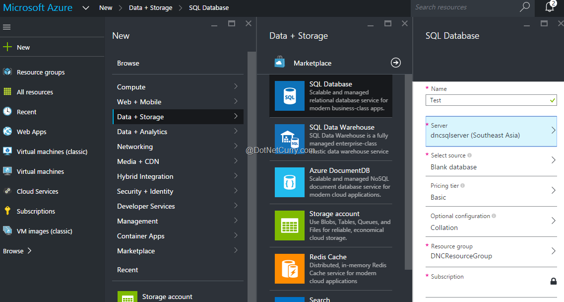
What is Azure Resource Manager
Azure Service Manager aka “Old Portal”
Azure Resource Manager aka “New Portal”
Everything is a resource
Declarative
Idempotent
Multi-Region
Multi-Service

Slide 9
Resource Groups
Acts as a “container”
Can cross regions
Can contain multiple services
A resource cannot exist in multiple groups
Resources in a Resource Group follow the same life cycle

Slide 10
ARM Templates
JSON formatted file
4 parts
Parameters
Variables
Resources
Outputs
Declarative description of the resource group
Functions
concat
uri
resourceId
subscription

Slide 11
Samples and Demo

Slide 12
Credits and Additional information
Deploying, Organizing and Securing Applications with the Azure Resource Manager, BRK4453; Ryan Jones, Ignite 2015
Azure QuickStart Templates
MSDN Azure Resource Manager Documentation.
Project NAMI
World Class ARM Templates Considerations and Proven Practices

Slide 13
http://recruiting.acuitynext.ninja/
Web Developer: Front-End and Back-End
DevDBA
DevOps/Cloud Engineer
QA
Security Enigneer

Slide 14

Continue the conversation…
See website for more info and directions
https://cloudsaturdayatlanta.com/
Slides, demo material, available at: http://cloudsatatl.murphymoments.com

