Slide 1
Azure Resource Manager Templates DSC for the Microsoft Cloud
Will Murphy
atlts.murphymoments.com

Slide 2
Who Am I
Started coding and scripting in 1999.
C, C++, BASH
Started in IT in 2000 while co-oping in college.
Korn Shell and PERL on AIX
Written Production solutions in PERL, KSH,BASH, VB Script, and of course PowerShell
Been working in IT Operations/Engineering for last 10+ years
Started with PowerShell v1 in 2009.
Written several modules
Working on several Azure projects, deployments of both PaaS and IaaS solutions

Slide 3
Level Set
How many have worked with …
Cloud base services
Azure
Desired State Configuration
Chef, Puppet, or other
PowerShell in the Cloud

Slide 4
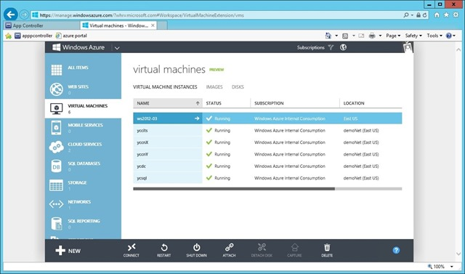
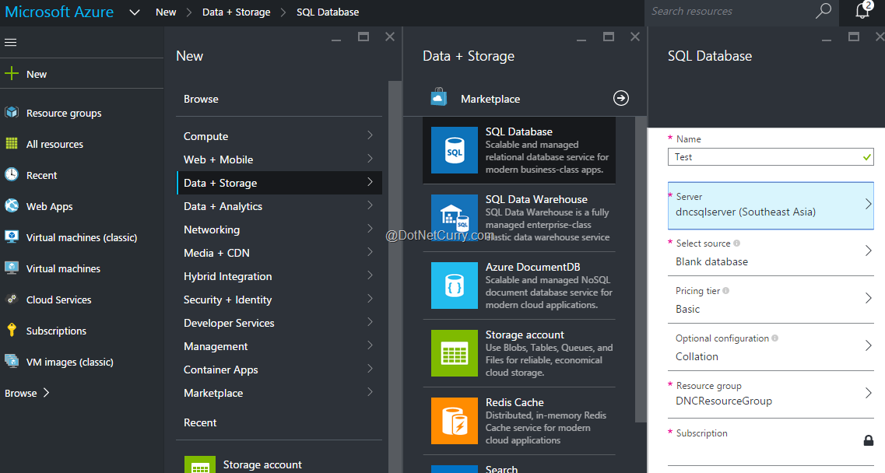
What is Azure Resource Manager
Azure Service Manager aka “Old Portal”
Azure Resource Manager aka “New Portal”
Everything is a resource
Declarative
Idempotent
Multi-Region
Multi-Service

Slide 5
Resource Groups
Acts as a “container”
Can cross regions
Can contain multiple services
A resource cannot exist in multiple groups
Resources in a Resource Group follow the same life cycle

Slide 6
ARM Templates
JSON formatted file
4 parts
Parameters
Variables
Resources
Outputs
Declarative description of the resource group
Functions
concat
uri
resourceId
subscription

Slide 7
Samples and Demo

Slide 8
Credits and Additional information
Deploying, Organizing and Securing Applications with the Azure Resource Manager, BRK4453; Ryan Jones, Ignite 2015
Azure QuickStart Templates
MSDN Azure Resource Manager Documentation.
Project NAMI
World Class ARM Templates Considerations and Proven Practices

Slide 9
http://recruiting.acuitynext.ninja/
Web Developer: Front-End and Back-End
DevDBA
DevOps/Cloud Engineer
QA
Security Enigneer

Slide 10
Slide Deck, Templates, and scripts…
atlts.murphymoments.com

