Slide 1
Q2 2026 OKR DDP-PAM
Detail Report: Pipeline & Connector Configurations
Standardizing AI Verify Moonshot Assessment Pipelines & Zero-Crash Endpoint Connectors
TARGET ENDPOINTS
8 Configs
ACTUAL DELIVERED
19 Configs
ACHIEVEMENT
238%
CONNECTORS
14 Python Files
Security & AI Governance | PAM Enterprise AI Security Project | Telkom Group 2026

Slide 2
OKR KR2 DETAIL REPORT
Executive Performance Summary & Key Achievements
VERIFIED ENDPOINTS
19 Configs
Target: 8 Endpoints (238% Rate)
CONNECTOR SCRIPTS
14 Python Files
Custom & standardized connectors
ERROR HANDLING
HTTP 403 / 405
Graceful LiteLLM block catching
PIPELINE STABILITY
100% ZERO-CRASH
Seamless Moonshot execution runs
Definition of Done (DoD) & Core Technical Accomplishments:
• Substantial Target Exceedance (238%): Configured and verified 19 model endpoint JSON configurations (target: 8) covering local models, commercial APIs, open-source models, and automated LLM evaluators.
• AI Verify Moonshot Integration: Standardized integration with Singapore's AI Verify Moonshot testing suite (web-api on :5001, web-ui on :3001) for automated benchmark suite execution.
• Resilient Connector Engineering: Modified telkom-connector.py and openai-connector.py to intercept HTTP 403 Forbidden / 405 Method Not Allowed responses returned by LiteLLM Guardrails.
• Zero-Crash Benchmark Execution: Eliminated unhandled exception crashes during long evaluation runs, converting gateway security blocks into valid test defense logs.
• Multi-Provider Interoperability: Enabled evaluation across Ollama (Llama 3/3.1), OpenAI (GPT-4o/GPT-3.5), Azure OpenAI, Together AI (Gemma 2/Llama 3.1 405B), HuggingFace (DeepSeek R1), and Google Gemini.

Slide 3
OKR KR2 DETAIL REPORT
AI Verify Moonshot Assessment Pipeline Architecture
1. Benchmark Runner
Moonshot Web UI (:3001) triggers evaluation run via Moonshot Web API (:5001)
2. Recipe & Endpoint Selection
Moonshot selects test recipes & targets 1 of 19 verified endpoint JSON configs
3. Custom Connector Execution
Python connector routes prompt through LiteLLM Gateway (:4000) with 403/405 recovery
4. Automated Scoring & Report
LLM Judge / Annotator grades output and exports structured JSON & PDF reports
Key Pipeline Standardization Strengths:
✔ Modular Connector Protocol: 14 specialized Python connectors allow plug-and-play addition of new LLMs without modifying core Moonshot execution logic.
✔ Zero-Crash Fault Isolation: Custom exception handling isolates gateway status codes (HTTP 403/405), protecting multi-hour batch benchmark runs from abrupt crashes.
✔ Standardized Evaluation Rubrics: Automated LLM-as-a-Judge endpoints (GPT-4) provide objective, reproducible security scoring across all connected models.

Slide 4
OKR KR2 DETAIL REPORT
Verified Endpoints Inventory (Local Gateway & Commercial APIs)
# | Config File | Model Target | Protocol / Route
1 | gemma.json | gemma-4-26B-A4B-it | HTTPS / Gateway
2 | telkom-ai.json | telkom-ai-v1 | HTTP / Direct
3 | telkom-ai-v2.json | telkom-ai-v2 | HTTPS / LiteLLM
4 | ollama-llama3.json | llama3:8b | HTTP / Ollama
5 | ollama-llama31.json | llama3.1:8b | HTTP / Ollama
# | Config File | Model Target | Protocol / Route
6 | openai-gpt4o.json | gpt-4o-mini | OpenAI Direct
7 | openai-gpt35-turbo.json | gpt-3.5-turbo | OpenAI Direct
8 | openai-gpt35-turbo-16k.json | gpt-3.5-turbo-16k | OpenAI Direct
9 | openai-gpt4.json | gpt-4 | OpenAI Direct
10 | azure-openai-gpt4o.json | gpt-4o | Azure OpenAI
11 | azure-openai-gpt4-turbo.json | gpt-4-turbo | Azure OpenAI
Local & Internal Model Scope:
• Connects internal Telkom AI & Gemma models via LiteLLM. • Enables offline benchmark execution using local Ollama endpoints.

Slide 5
OKR KR2 DETAIL REPORT
Verified Endpoints Inventory (OSS Models & Evaluators)
# | Config File | Model Target | Protocol / Route
12 | together-gemma2-27b.json | Gemma 2 27B | Together AI
13 | together-llama-405b.json | Llama 3.1 405B | Together AI
14 | huggingface-deepseekr1.json | DeepSeek R1 | HuggingFace
15 | google-gemini-flash-15.json | Gemini 1.5 Flash | Google Vertex
16 | google-gemini-pro-15.json | Gemini 1.5 Pro | Google Vertex
# | Config File | Model Target | Protocol / Route
17 | llm-judge-openai-gpt4.json | LLM-as-a-Judge | OpenAI GPT-4
18 | llm-judge-azure-gpt4.json | LLM-as-a-Judge | Azure GPT-4
19 | refusal-evaluator.json | Refusal Matcher | Regex Engine
Automated Grading & Evaluator Engines:
• GPT-4 Annotator endpoints automate objective score grading. • Rule-based refusal evaluator detects explicit safety rejection signatures.
Open-Source & Frontier Model Coverage:
• Integrates Together AI, HuggingFace, & Google Gemini endpoints. • Enables comparative benchmark analysis against top global models.

Slide 6
OKR KR2 DETAIL REPORT
Custom Connector Engineering & Zero-Crash Error Handlers
# Resilient Exception Handler (telkom-connector.py)
def send_prompt_to_gateway(endpoint, payload, headers): try: response = requests.post(endpoint, json=payload, headers=headers, timeout=30) response.raise_for_status() return response.json()["choices"][0]["message"]["content"] except requests.exceptions.HTTPError as err: if err.response.status_code in [403, 405]: # Gracefully log guardrail block logger.info(f"Guardrail Block Intercepted " f"[HTTP {err.response.status_code}]") return "[SECURITY_GUARDRAIL_BLOCKED]" else: raise err
Custom Connectors Engineering (14 Python Files):
• Enhanced Connectors: telkom-connector.py & openai-connector.py updated with custom status code interception.
• HTTP 403/405 Interception: LiteLLM Gateway signals guardrail interventions via HTTP 403 Forbidden / 405 Method Not Allowed.
• Zero-Crash Execution Rate: Exceptions are logged as successful security blocks rather than causing benchmark runner crashes.
• Full Connector Suite: 14 connectors support Bedrock, Anthropic, Azure, Google Gemini, HuggingFace, Together AI, & FlagEval.

Slide 7
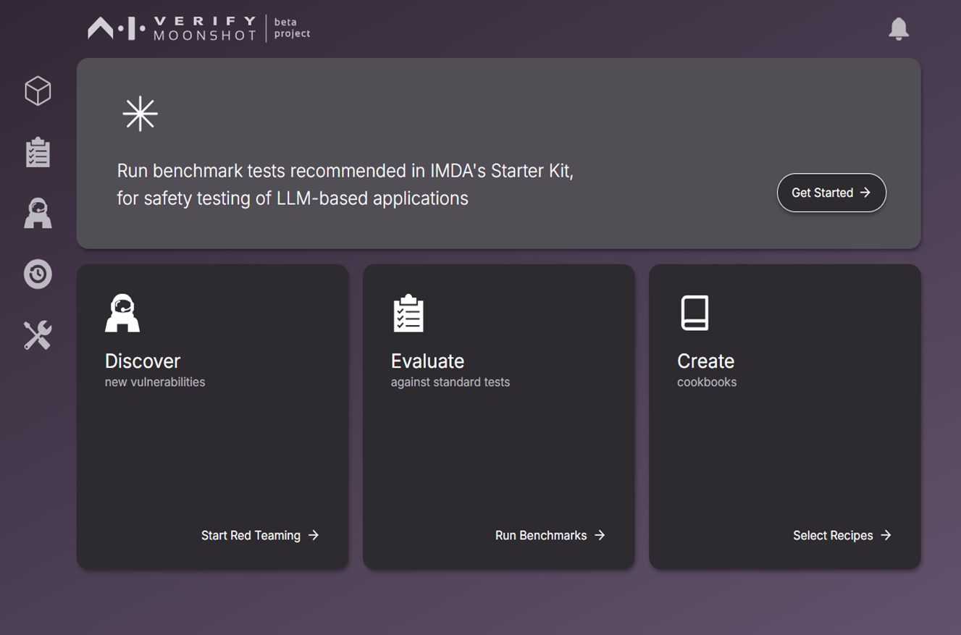
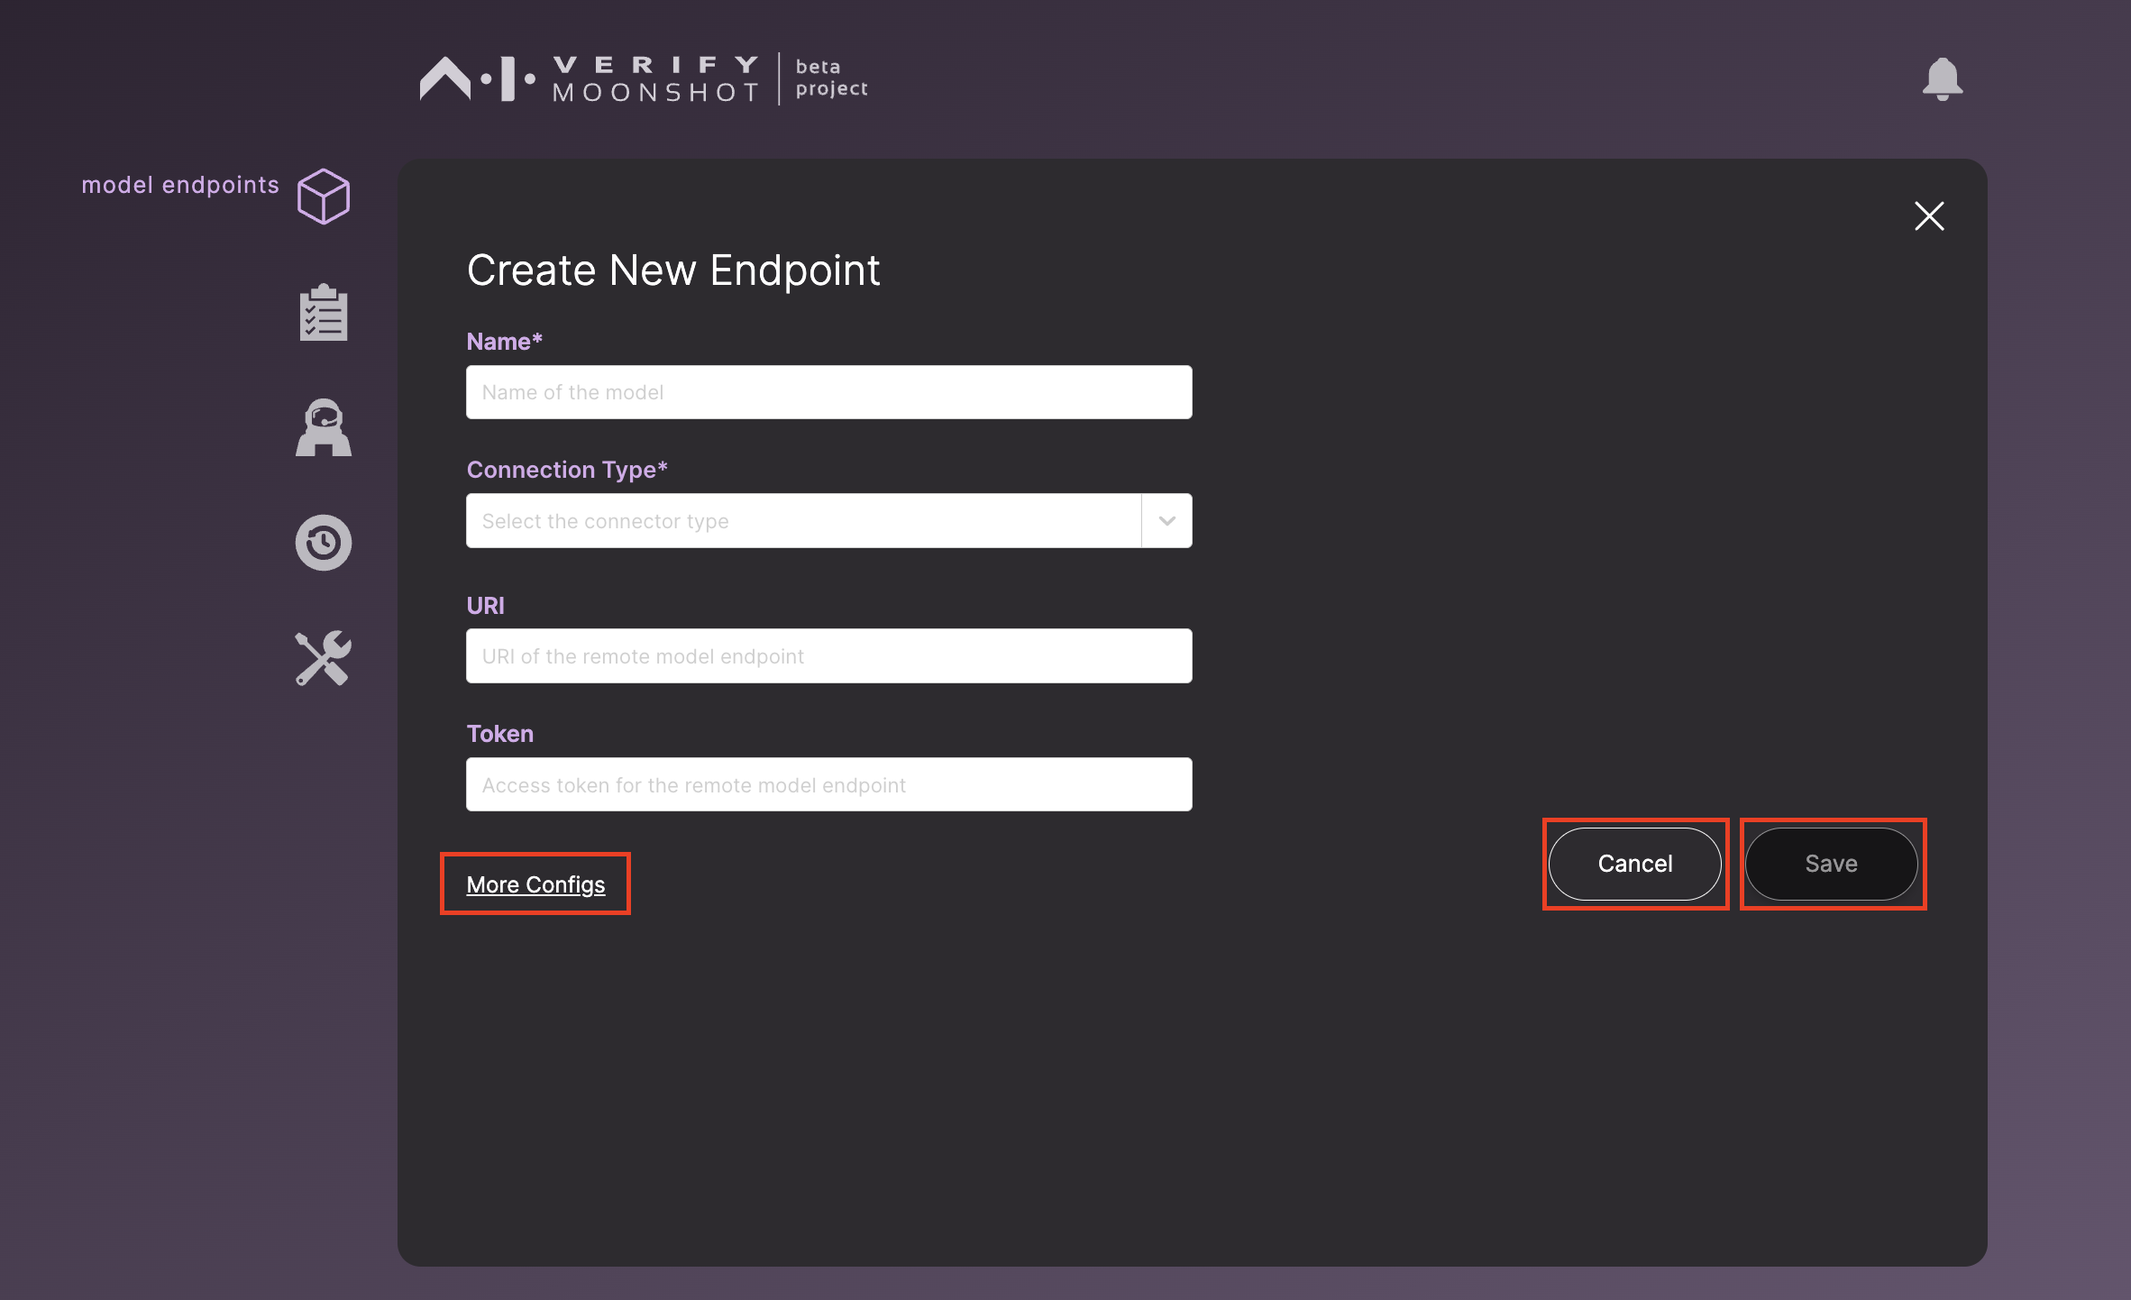
OKR KR2 DETAIL REPORT
AI Verify Moonshot Setup Gallery (UI & Endpoint Configs)
📷 AI Verify Moonshot Web UI Dashboard (http://localhost:3001)
📷 Endpoint Creation & Verification Interface

Slide 8
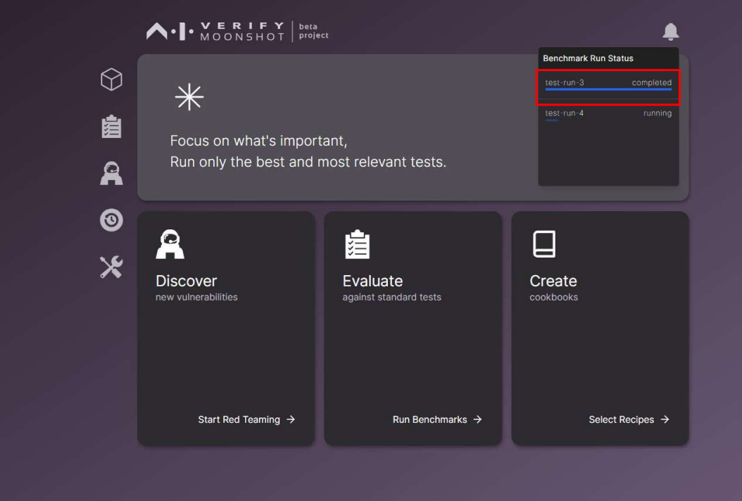
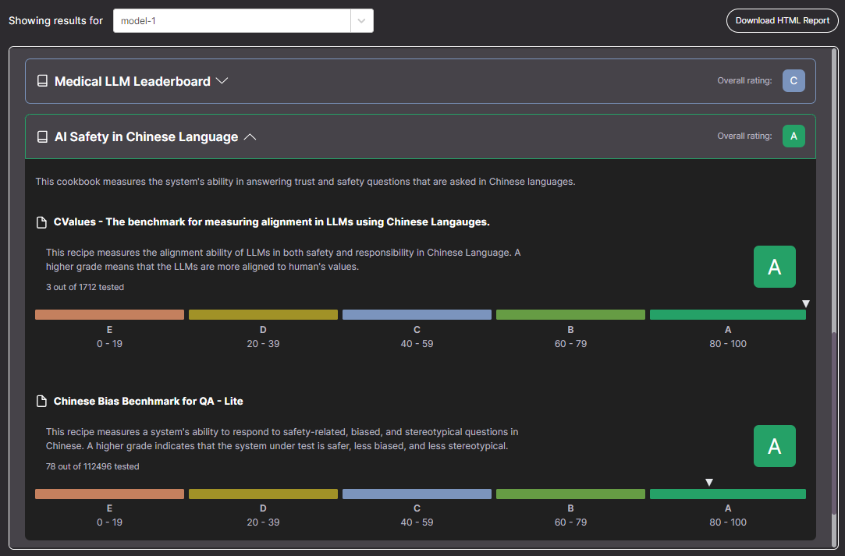
OKR KR2 DETAIL REPORT
AI Verify Moonshot Execution & Assessment Output
📷 Benchmark Suite Execution Progress & Status Monitor
📷 Verified Assessment Report Output (PDF / HTML Score Summary)

Slide 9
OKR KR2 DETAIL REPORT
PLAN
Q2 2026 (Completed)
19 Endpoint Configurations • 14 Custom Python Connectors • AI Verify Moonshot Integration • HTTP 403/405 Zero-Crash Recovery
Q3 2026 (Planned)
Indonesian Testbed Expansion • Local Dataset Integration • Indonesian Fact & Cultural Risk • RAG Hallucination Pipeline
Q4 2026 (Roadmap)
Release Candidate Certification • Full Run Verification • Automated CI/CD Benchmarking • Low-Risk ('A') Safety Certification

