Slide 1
VETO
The Commit Gate for Autonomous Analytics
The first autonomous data analyst you can let run unsupervised — because an adversarial agent with veto power stands between every conclusion it reaches and every action it takes.
Microsoft Agents League · Reasoning Agents Track · Built on Microsoft Foundry

Slide 2
THE PROBLEM IT KILLS
Enterprises don't fear dumb agents.
They fear confident, wrong agents with execution rights.
1
2
3
An agent acts
Someone ships it
Trust collapses
It pushes a flawed conclusion to a dashboard or a Teams channel — autonomously, with no human in the loop.
A wrong automated insight becomes a real decision: a budget cut, a defunded team, a treatment choice.
That single fear is the #1 blocker to deploying autonomous analytics at all.
LLMs are structurally unreliable at statistical inference — they hallucinate rigor. So we never ask them to do inference.

Slide 3
THE CORE IDEA
Separate generation from verification. Put a commit gate between them.
PROPOSE
VERIFY
GATE
An LLM Analyst reads the data and commits to an action with a victim — "cut Region B." Fast, decisive, naive.
An Adversary runs a deterministic statistical battery — scipy / statsmodels. Verdicts are computed, not claimed.
Pure-Python code holds the only execution keys. Nothing runs without a signed commit it can independently verify.
The authority comes from scipy — not from a second model agreeing with the first.

Slide 4
ARCHITECTURE
Agents propose and critique. Only deterministic code holds the keys.
ANALYST
proposes (queued)
COMMIT GATE
verdict
ADVERSARY
LLM agent on
Microsoft Foundry
deterministic
Python state machine
LLM agent on
Microsoft Foundry
veto + required controls → self-correct
runs battery
ANTI-HALLUCINATION
STATISTICAL BATTERY
gate cross-checks the verdict
against raw battery output
scipy · statsmodels
confounding · power · FDR · shift
EXECUTOR — signed commits only
Teams Adaptive Card · reversal chart · append-only audit log (every veto, reason, rerun)

Slide 5
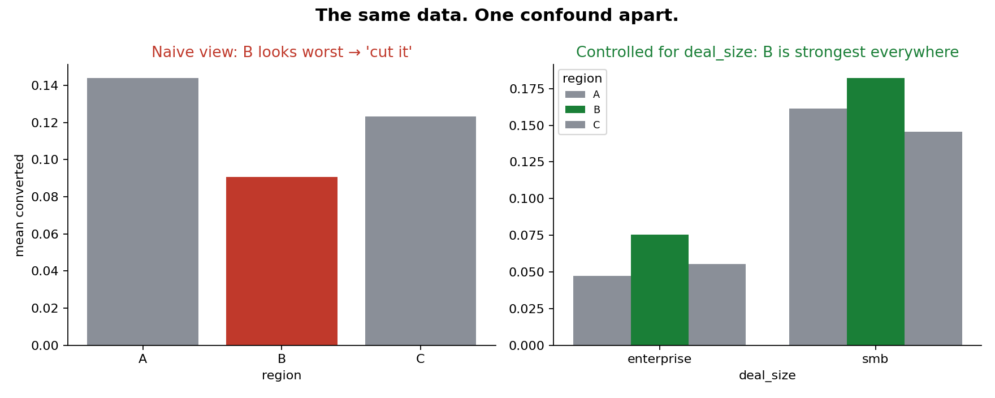
THE GUT-PUNCH
The same data. One confound apart.
NAIVE Region B looks worst. "Cut it." CONTROLLED Once you account for deal size, B is the strongest region in every segment.
Approved as-is, this would have defunded the best team in the company.
The battery fires the confounding check — sign reversal, naive −0.043 → controlled +0.025 (p = 0.002) — and vetoes the commit.

Slide 6
WHY IT'S NOT A ONE-TRICK DEMO
Different data. Different traps. Same gate.
Confounding
Statistical power
Multiplicity
Simpson's reversal
Underpowered "trend"
p-hacking bait
Stratified OLS: the effect flips sign once you control for the covariate.
Achieved power 0.27, bootstrap CI crosses zero — the gap isn't real.
20-metric scan; the lone nominal hit dies under Benjamini-Hochberg FDR.
headline_sales.csv
trap_power.csv
trap_multiplicity.csv
The seeded dataset generators ship in the repo — generate your own and try to sneak one past the gate.

Slide 7
WHY THIS IS HARD — AND MICROSOFT-NATIVE
Built so the model can fail and it doesn't matter.
The gate is code, not an agent
Anti-hallucination cross-check
A deterministic state machine holds the only execution keys. The Adversary reports; the gate decides.
The verdict must cite a battery run id; the gate independently holds the raw output and overrides any mismatch.
Fails closed
Foundry + Agent Framework
Three veto cycles without convergence → escalates to a human with the full audit trail. Never silent execution.
Both agents run live on Microsoft Foundry via the Microsoft Agent Framework. Offline reference brains prove the gate is model-agnostic.

Slide 8
The difference between an AI demo
and a system you'd let run unsupervised.
VETO · The Commit Gate for Autonomous Analytics
Propose → Veto → Self-correct → Deliver
Microsoft Agents League · Reasoning Agents Track · Microsoft Foundry

