Slide 1
Rockbuster Stealth LLC
Falguni Chaudhari
July 23, 2022

Slide 2
Table of Contents
Introduction
Which movies contributed the most/least to revenue gain?
What was the average rental duration for all videos?
Which countries are Rockbuster customers based in? Do sales figures vary between geographic region?
Where are customers with a high lifetime value based?
Questions

Slide 3
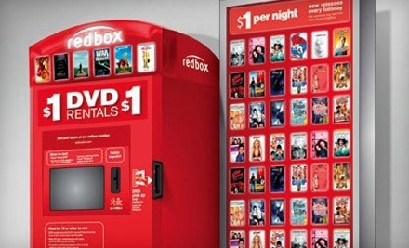
Introduction
Rockbuster Stealth LLC is a traditional movie rental company that used to have stores around the world
Facing stiff competition from streaming services such as Netflix and Amazon Prime, the Rockbuster Stealth management team is planning to use its existing movie licenses to launch an online video rental service in order to stay competitive

Slide 4
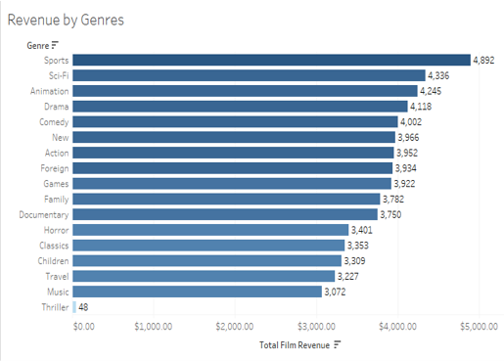
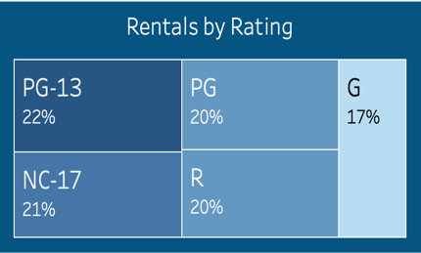
Which movies contributed the most/least to revenue gain?
Most popular genre: Sports
Least popular genre: Thriller
Most popular rating: PG-13
Least popular rating: G

Slide 5

What was the average rental duration for all videos?
Average rental duration?
4.985 days
Minimum rental duration?
3 days
Maximum rental duration?
7 days

Slide 6
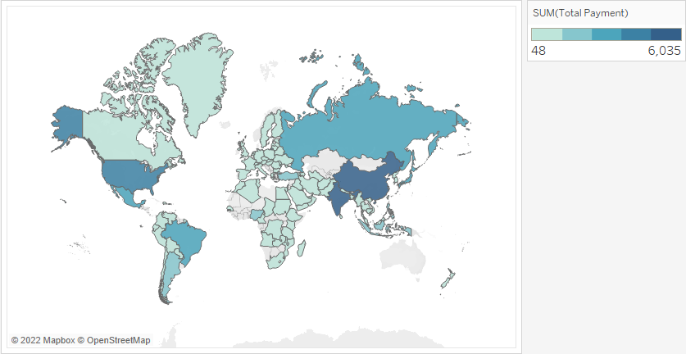
Which countries are Rockbuster customers based in? Do sales figures vary between geographic region?
Countries shaded darker blue represent more revenue generated from that country
India, China, and the United States generate the most revenue

Slide 7
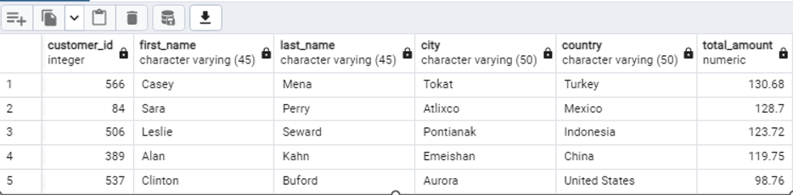
Where are customers with a high lifetime value based?
Our Top 5 customers in terms of revenue are based in:
Tokat, Turkey
Atlixco, Mexico
Pontianak, Indonesia
Emeishan, China
Aurora, United States

Slide 8
SUMMARY
Based on the Database received, we revealed the followings:
1.Average rental cost, Average rental duration and Average replacement cost:
Average rental cost for a film is $2.98 and the replacement cost for a film is $19.98. The average rental duration is 5 days.
2.Most Rental count & Gain the most revenues based on Movie’s Genre:
Movie’s genre type SPORTS was the most rental count (1,081) and it gains the most revenue in the world ($4,892).
3.Top 5 countries ROCKBUSTER customers based in:
India, China, United States, Japan and Mexico were the top 5 countries ROCBUSTER customers based in.

Slide 9
SUMMARY
4. Top 3 customers who had the high estimate lifetime value:
Casey Mena in Tokat, Turkey ($130.68); Sara Perry in Atlixco, Mexico ($128.70) & Leslie Seward in Pontianak, Indonesia ($123.72) were the top 3 customers who had the highest lifetime value.
5.Top 5 countries ROCKBUSTER gained the highest Revenues and Lowest Revenues:
India, China, United States, Japan and Mexico gained the highest revenues in the world. American Samoa, Lithuania, Saint Vincent and the Grenadines, Tonga and Afghanistan gained the lowest revenue.
6.Genre type animation was the second best rental count but not in revenues:
Genre type Animation was the second best rental count (1,065) but the revenue gained from Animation was behind Sci-Fi.

Slide 10
Recommendation
1. Investment to where ROCBUSTER customers based in:
ROCBUSTER could market their online movies to where their customers most based in, especially in India, China, United States, Japan and Mexico.
2. Keep the customer who had the higher lifetime value:
ROCKBUSTER could develop lower subscription fees in the business to keep their customer who had the higher lifetime value.
3. Continue investment in movie Genre Sports :
ROCKBUSTER could invest on movie type in SPORTS, making it as online movie for renting.

Slide 11
Recommendation
4. Further investigation on movie genre Animation and Sci-fi:
ROCBUSTER could carry out a further investigation on movie genre Animation to find out why the revenue is lower than SCI-FI.
5. Further investigation to the Lowest Revenues Countries:
ROCKBUSTER could carry out a further investigation to the lowest revenues countries to find out why the revenues were low. It might be due to infrastructure, rental rate, late rental return or anything else.

Slide 12
Next Step
We would recommend the following steps:
1. Collect yearly rental database from ROCKBUSTER:
Collect annual rental database from ROCKBUSTER, also should understand the customer behavior in renting the movies.
2. Further investigation to the lowest Revenues Countries:
Further investigation to the lowest revenues countries to find out why the revenues were low. It might be due to infrastructure, rental rate, late rental return etc. Local reviews could be conducted in these countries.
3. Further investigation on Movie Genre Animation and Sci-fi:
Further investigation on movie’s genre Animation & Sci-Fi, to understand why the revenue for Animation is lower than Sci-Fi.

Slide 13

Questions?
Link to Tableau: Rockbuster | Tableau Public

