Slide 1
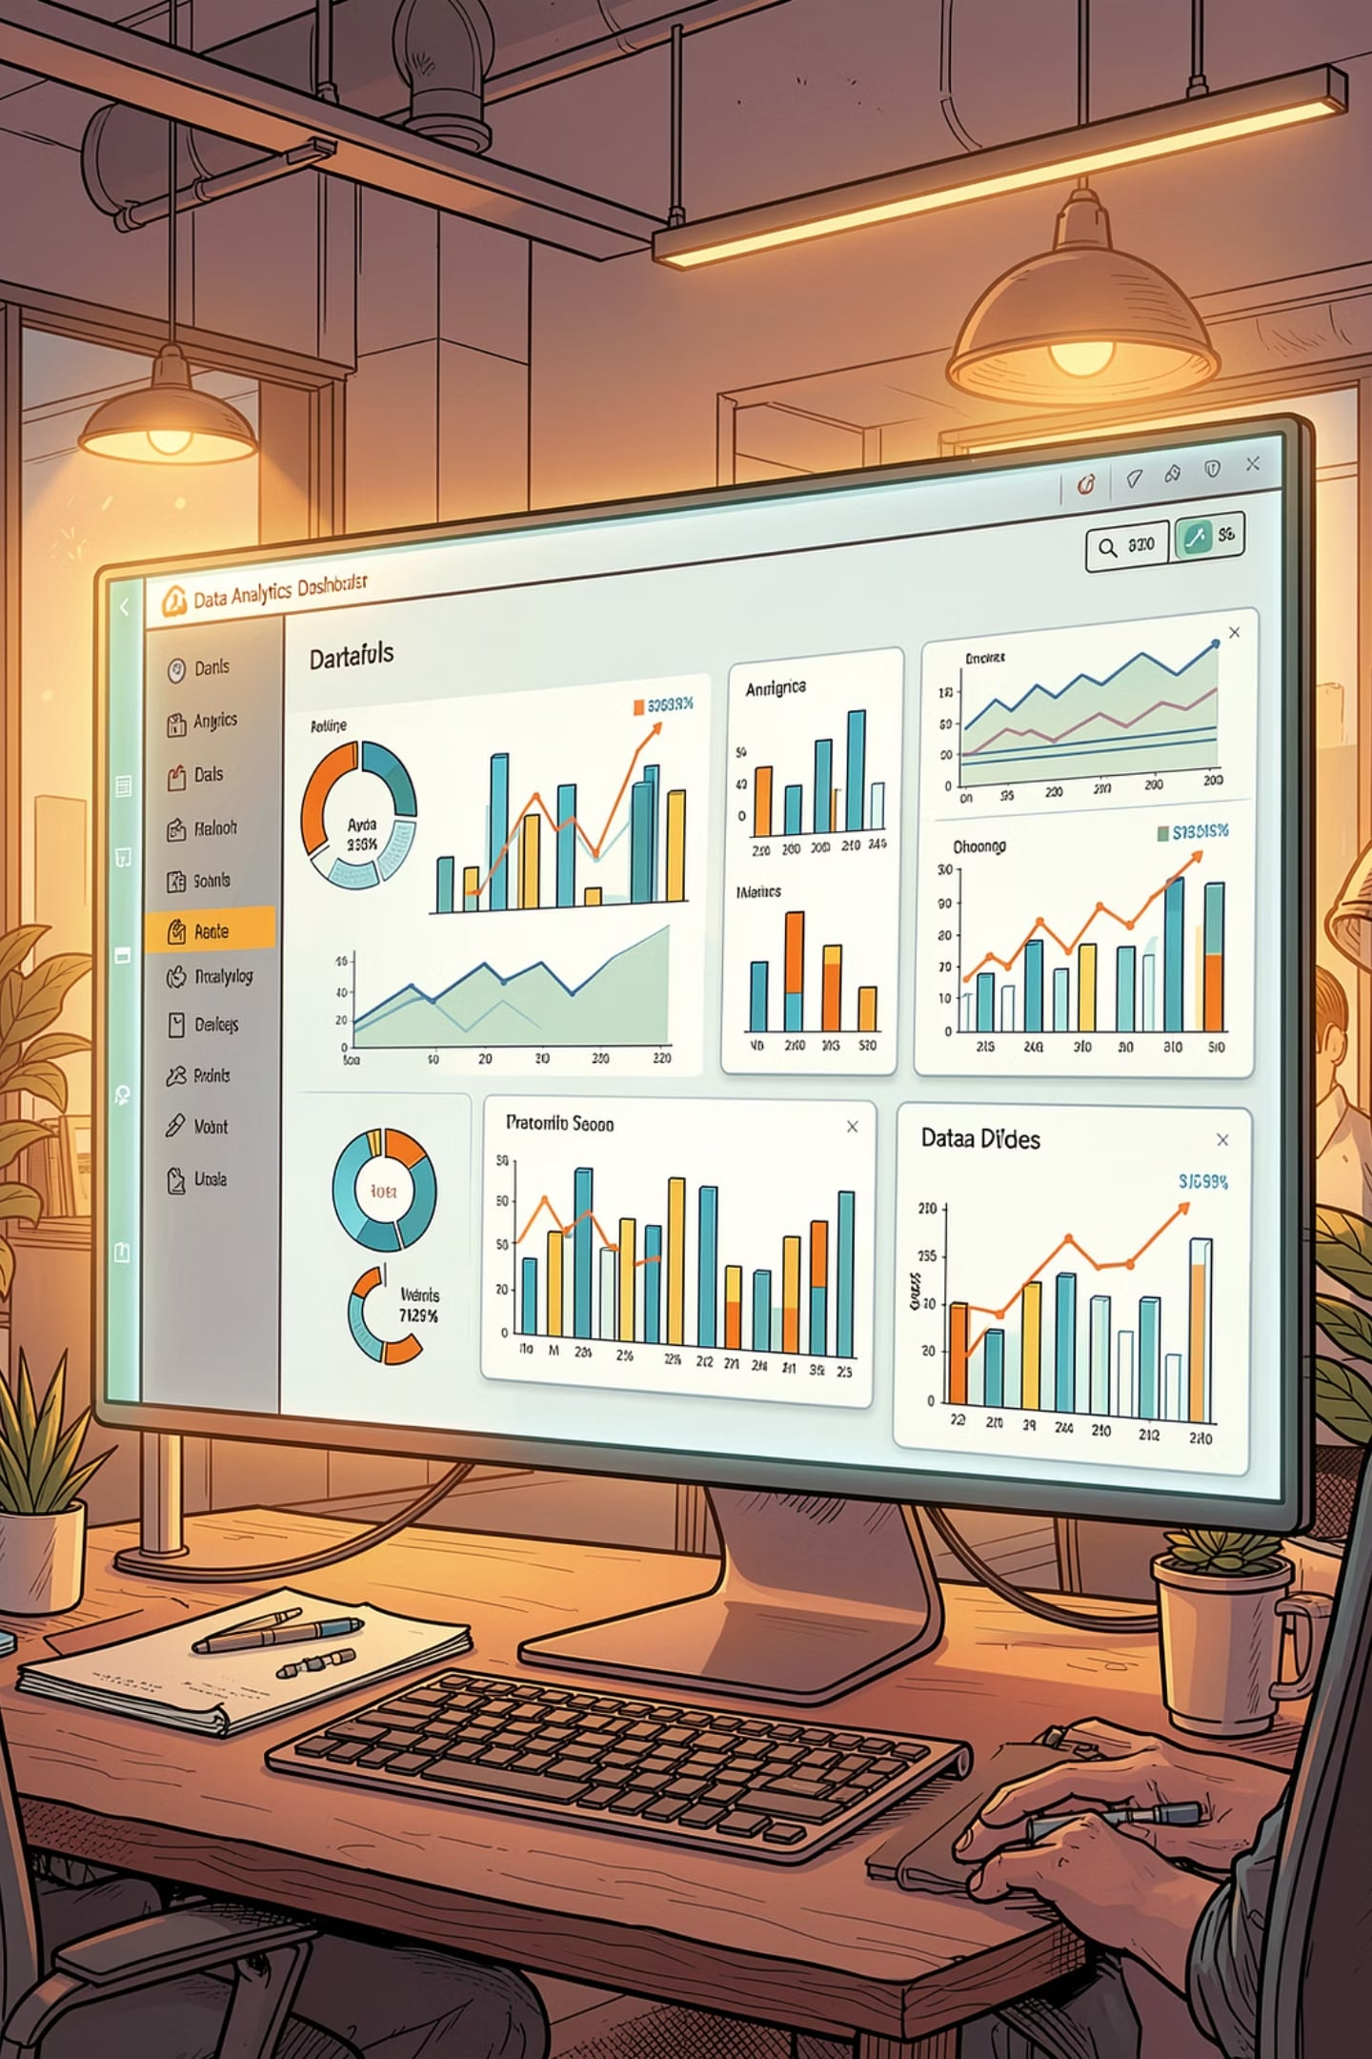
Customer Shopping Behavior Analysis
An interactive data analytics project using SQL, Python, and Power BI to uncover customer purchasing patterns and business performance insights.

Slide 2

Dataset at a Glance
3,900 Rows
Key Features
18 columns covering demographics, purchases, and shopping behavior
Age, Gender, Location, Category, Purchase Amount, Season, Review Rating, Subscription Status, Shipping Type, Discount & Promo Code usage
37 Missing Values
Only in the Review Rating column — imputed during cleaning

Slide 3


Exploratory Data Analysis in Python
Load & Explore
Data loaded via pandas; df.info() and .describe() used for initial exploration
Clean & Standardize
Renamed columns to snake_case; imputed missing review ratings; dropped redundant promo_code_used
Feature Engineering
Created age group bins; connected cleaned dataframe to PostgreSQL for SQL analysis

Slide 4
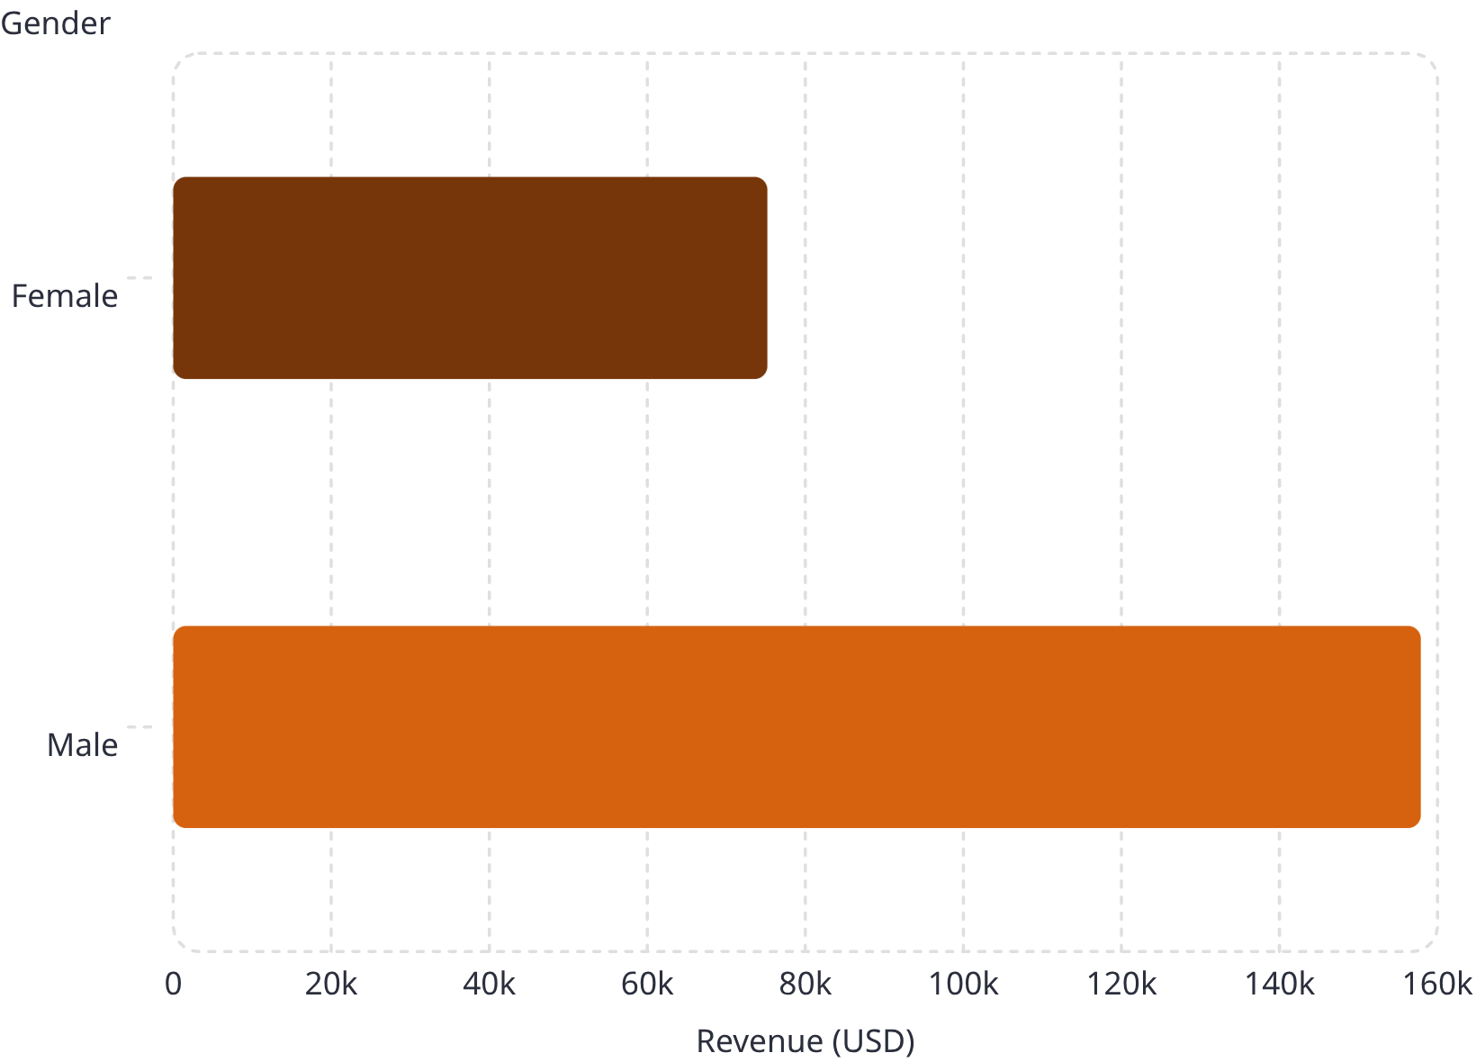

Revenue by Gender
Key Insight
Male customers generated $157,890 in total revenue — more than double the $75,191 from female customers.
This gap suggests an opportunity to better understand and engage female shoppers.

Slide 5
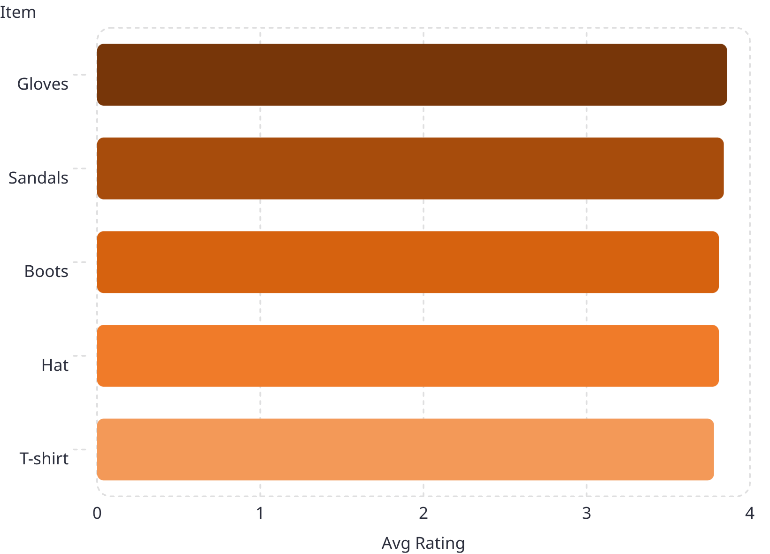
High Spenders & Top-Rated Products
High-Spending Discount Users
Top 5 Products by Rating
Customers who used discounts but still spent above the average purchase amount. Top spenders include IDs 9 ($97), 35 ($91), and 4 ($90).

Slide 6
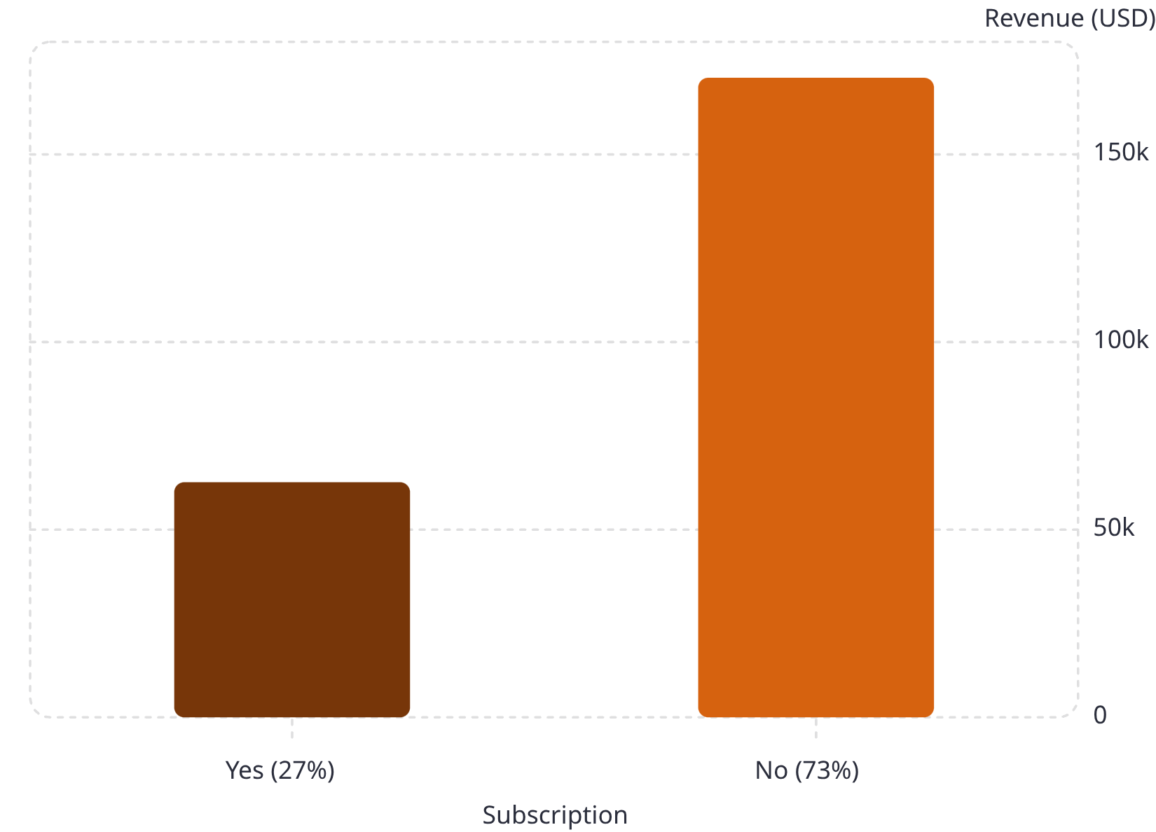
Shipping Type & Subscription Revenue
Avg Purchase by Shipping Type
Revenue by Subscription Status
Standard shipping averaged $58.46 per transaction. Express and other types were also analyzed for comparison.
Non-subscribers drive 73% of customers and $170K revenue, but subscribers show strong engagement with 1,053 customers.

Slide 7
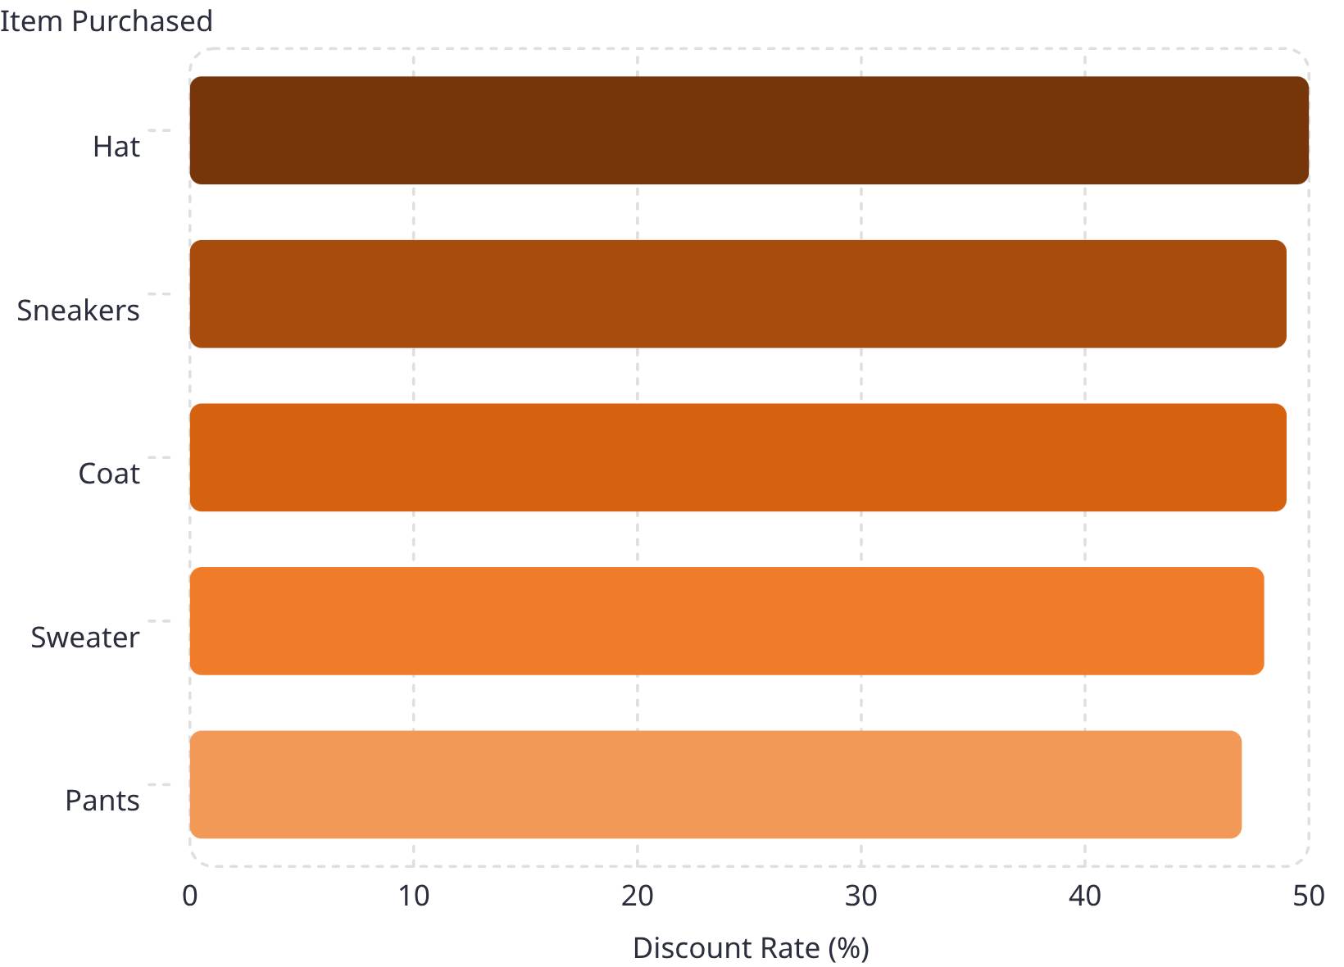
Discount Rates by Product
Discount Strategy Insight
Hats receive the highest discount rate at 50%, while Pants are discounted at 47%. Outerwear and footwear items consistently see discounts near 49%.
High discount rates on popular items may erode margins — a key area for policy review.

Slide 8

Customer Segmentation
3,116
701
Loyal Customers
Returning
The dominant segment — frequent repeat buyers
Occasional shoppers with purchase history
83
New Customers
First-time buyers — growth opportunity

Slide 9
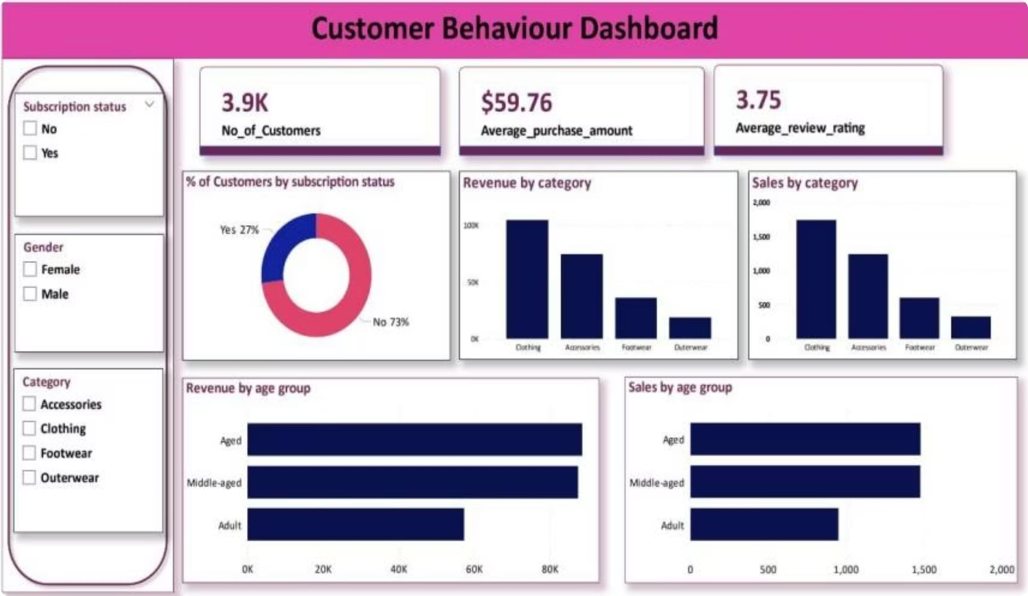
Power BI Dashboard Overview
Dashboard Highlights
3.9K Customers
Avg purchase: $59.76 · Avg rating: 3.75
Revenue by Category
Clothing leads at ~$200K; Accessories $100K; Footwear $50K; Outerwear $25K
Revenue by Age Group
Aged & Middle-aged each ~$80K; Adult ~$60K

Slide 10
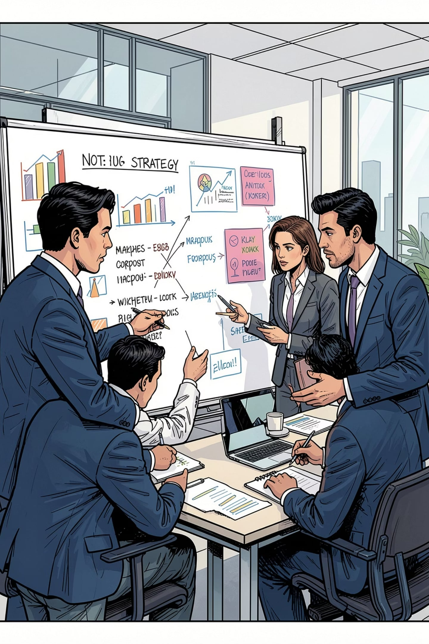



Business Recommendations
Boost Subscriptions
Reward Loyalty
Offer exclusive benefits to convert non-subscribers and grow the 27% subscriber base
Incentivize returning customers to advance into the Loyal segment (currently 3,116)
Refine Discount Policy
Balance sales boosts with margin control — discount rates reach up to 50% on some items

