Slide 1

IPL Data Analysis
By Shivam Khandelwal

Slide 2
Introduction to Project
IPL team formation: Competitive bids, BCCI’s guidelines & rules.
Shape a Winning Strategy for IPL 2024.
Hunting top cricket talents: Firms competes.
Need of Data Analyst Guiding IPL 2024 Victory Through Insights.
Balancing Players Strengths & BCCI’s Guidelines.

Slide 3
Problem Statement
Building a winning IPL team by picking Players smartly from the dataset.
Challenges faced:
Diverse player metrics
Strategically Composing the team
BCCI Guidelines
Budget Constraints

Slide 4

Our Approach
Understand the Approach from the below flowchart.
Data Loading
Data Cleaning & pre-processing
Data Exploration & Statistics
Feature Engineering
Data Grouping
Visualisation and Analysis
Linear Regression Trend Visualisation
Team Composition

Slide 5
Data Loading
IPL Dataset
Batting
2016 - 2022
Bowling
2016 – 2022
Row: 1005
Column: 15
Row: 615
Column:14

Slide 6
Data Cleaning & Pre - processing
Load data in list of dictionaries
All data in string
Filter out players with less than 6 occurrences
In 'Avg’ , replace '-' with '0', strip whitespace
Removing * (symbol) from 'HS' (High Score) values
Dropping the 'POS' key from each dataset and 'BBI' from ‘all_bowling_data’
convert data types to int or float as needed

Slide 7
Data Exploration & Statistics
Criteria | Mat | Inns | NO | Runs | HS | Avg | BF | SR | 100 | 50 | 4s | 6s | Year
mean | 11.69 | 9.17 | 2.10 | 205.13 | 47.90 | 24.17 | 151.29 | 123.69 | 0.06 | 1.17 | 17.94 | 8.55 | 2019.03
median | 13.00 | 10.00 | 2.00 | 172.00 | 47.50 | 23.09 | 130.00 | 128.55 | 0.00 | 0.00 | 13.00 | 6.00 | 2019.00
min | 1.00 | 1.00 | 0.00 | 0.00 | 0.00 | 0.00 | 1.00 | 0.00 | 0.00 | 0.00 | 0.00 | 0.00 | 2016.00
max | 17.00 | 17.00 | 10.00 | 973.00 | 129.00 | 101.00 | 640.00 | 300.00 | 4.00 | 9.00 | 88.00 | 52.00 | 2022.00
count | 376.00 | 376.00 | 376.00 | 376.00 | 376.00 | 376.00 | 376.00 | 376.00 | 376.00 | 376.00 | 376.00 | 376.00 | 376.00

Slide 8
Feature Engineering
Runs per Innings added as column in batting data.
All Rounder data not available, so created it.
Overall Score (Bat or Bowl Score per year) added as column in both data.

Slide 9
Data Grouping
Aggregated data player wise for selected metrics.
Found top players per average metric.
Created a list of rankings of player from each data each average metric.

Slide 10
Visualisation and Analysis
Average Performance Ranking Graph over 7 Years.
Historical Performance Graph of each top Player of all metrics.

Slide 11
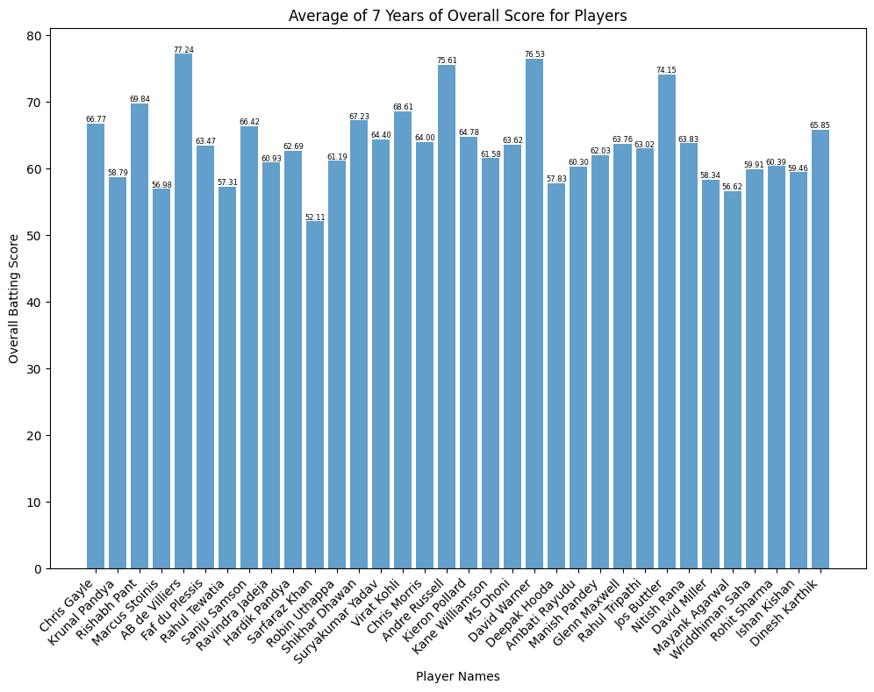
Visualisation and Analysis

Slide 12
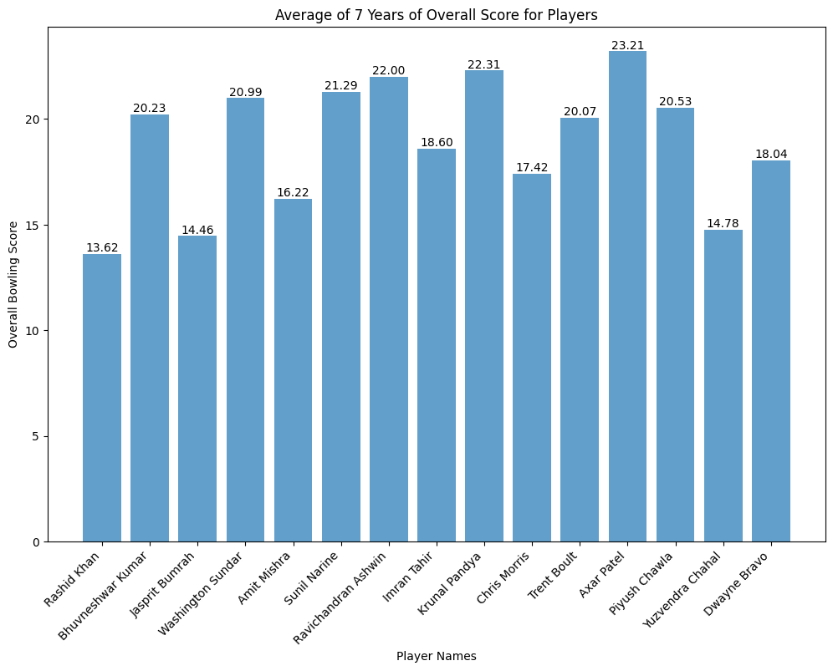
Visualisation and Analysis

Slide 13
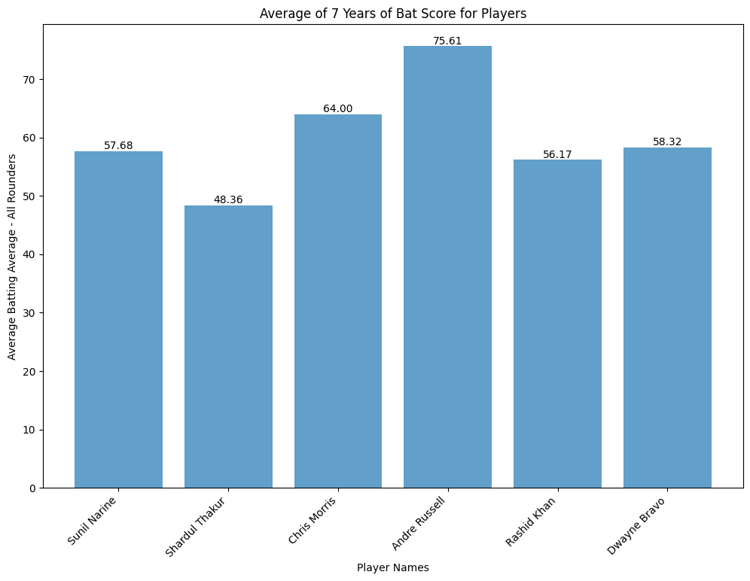
Visualisation and Analysis

Slide 14
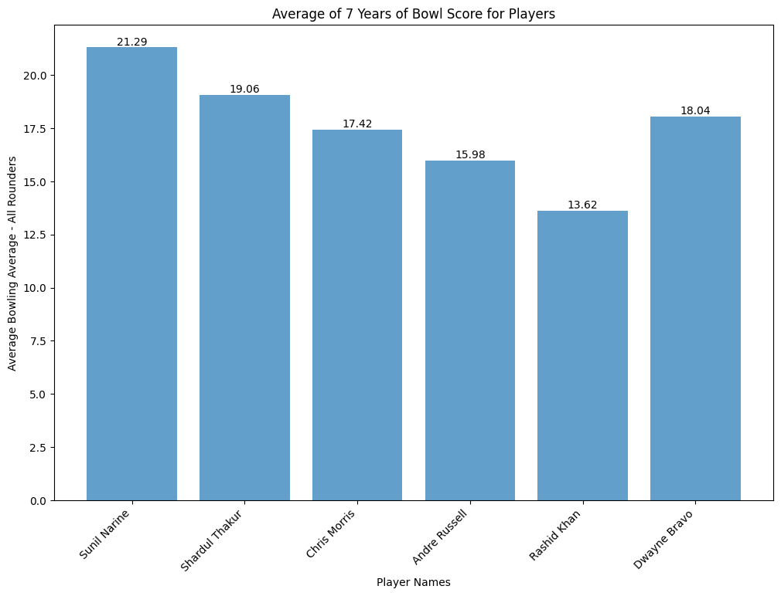
Visualisation and Analysis

Slide 15
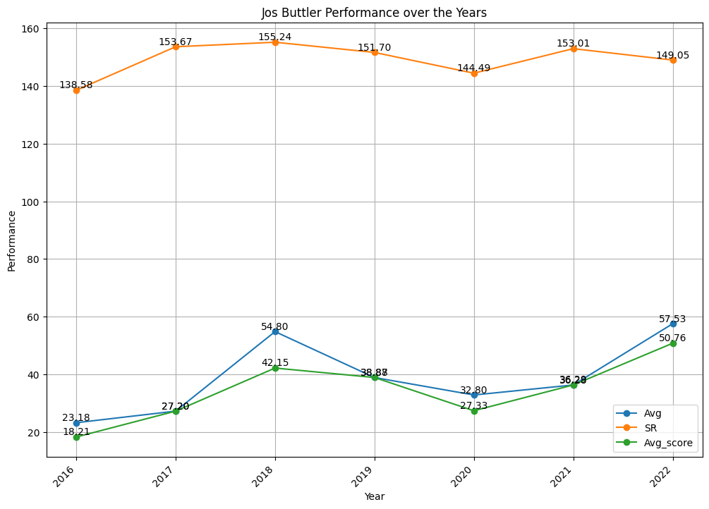
Visualisation and Analysis

Slide 16
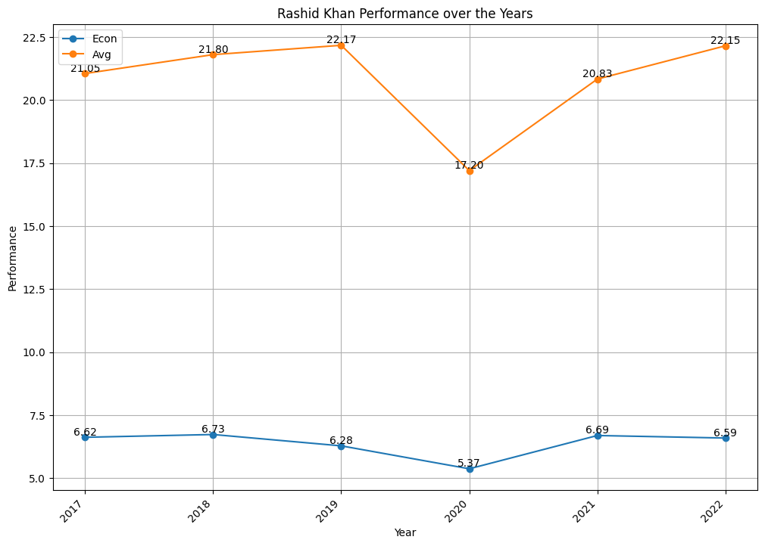
Visualisation and Analysis

Slide 17
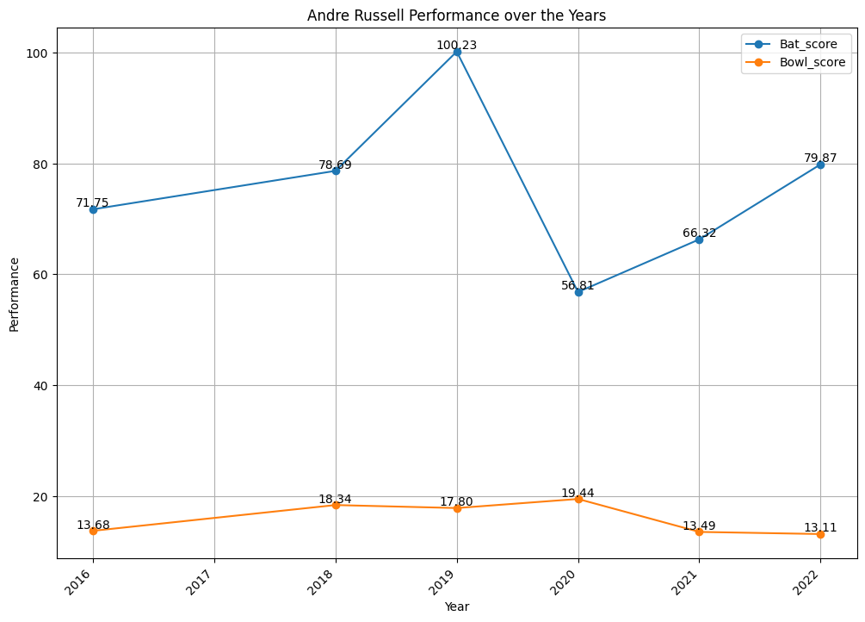
Visualisation and Analysis

Slide 18
Linear Regression Trend Visualisation
Trend of each player of each metric over 7 years.
Trend of each player of overall score over 7 years.

Slide 19
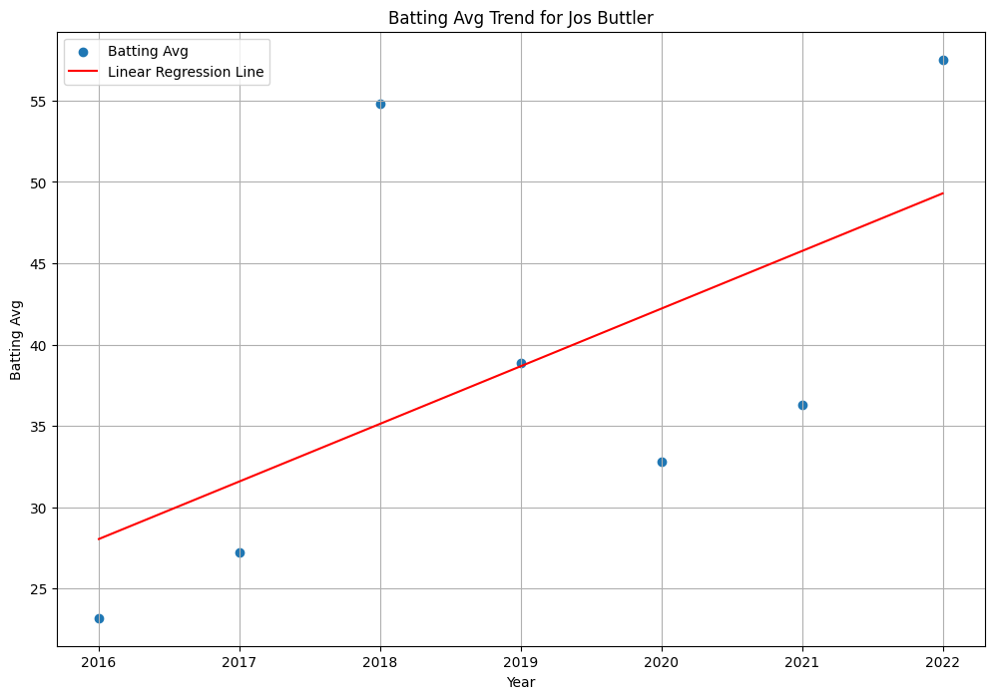
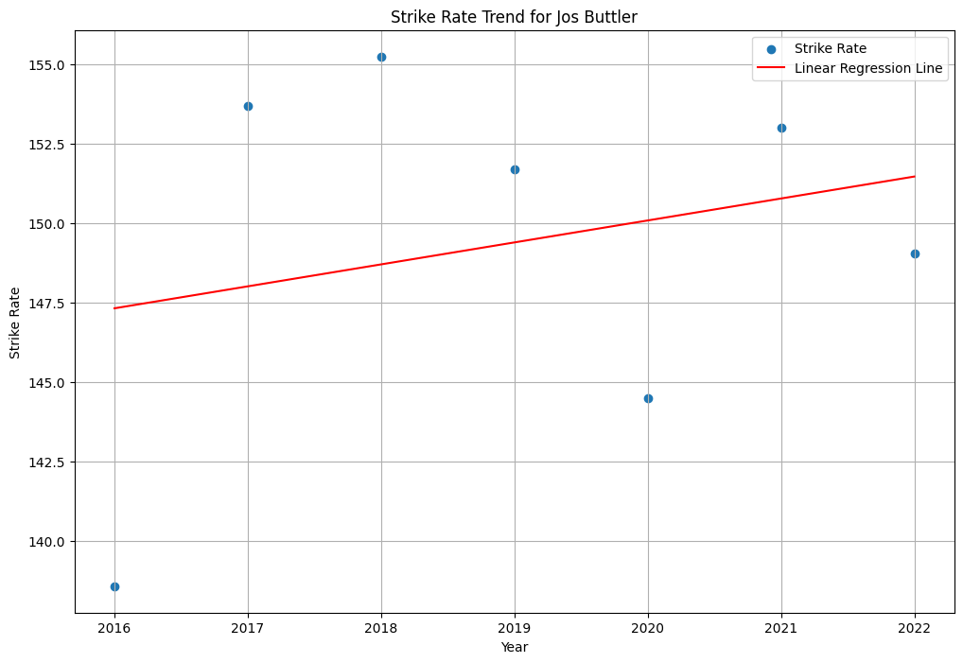
Linear Regression Trend Visualisation

Slide 20
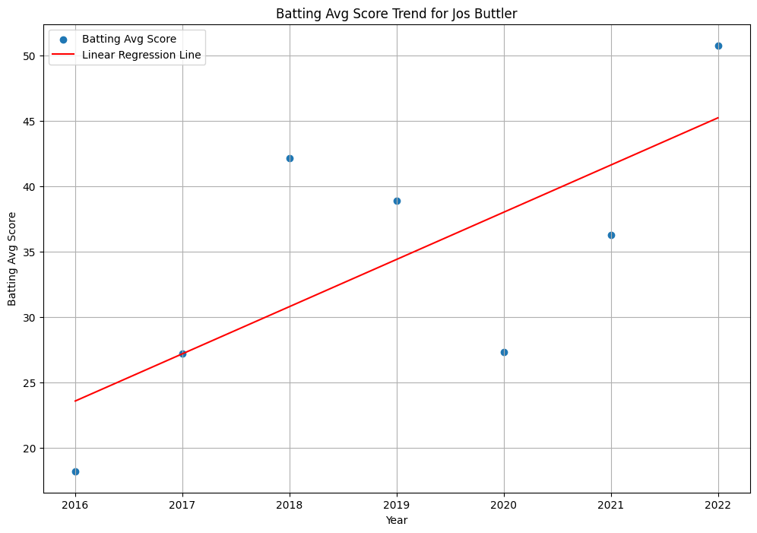
Linear Regression Trend Visualisation

Slide 21
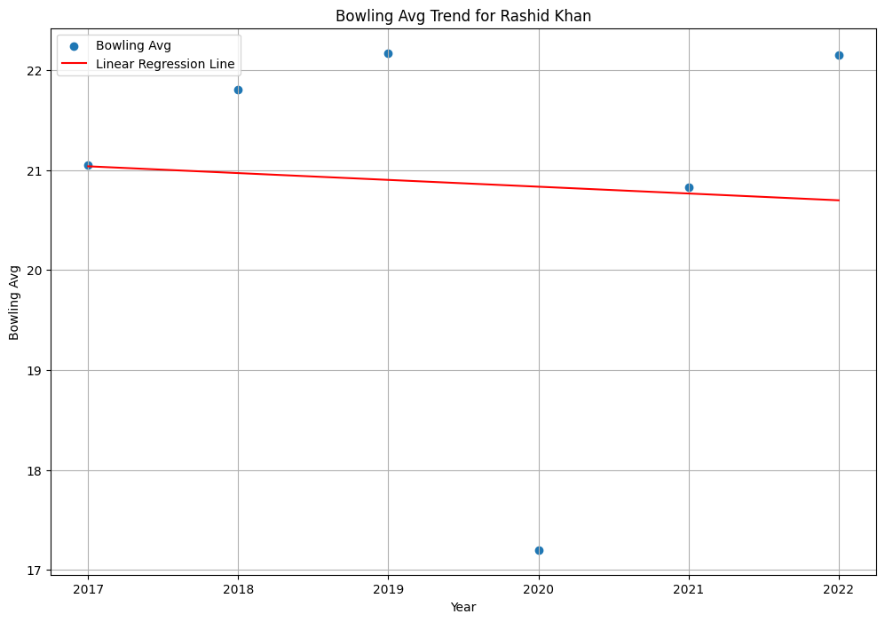
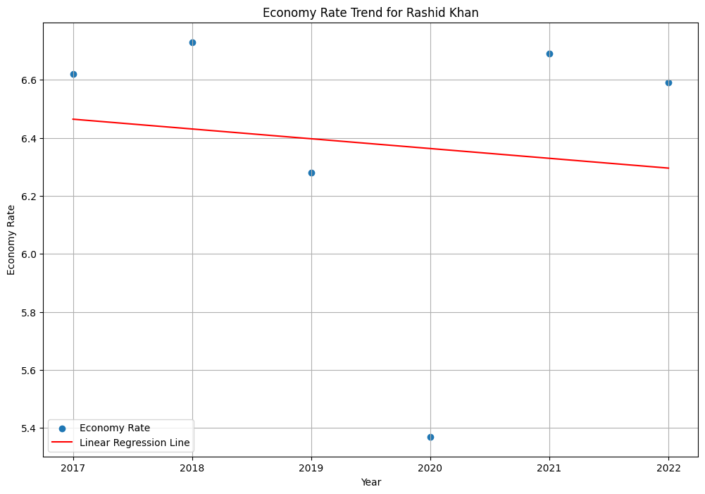
Linear Regression Trend Visualisation

Slide 22
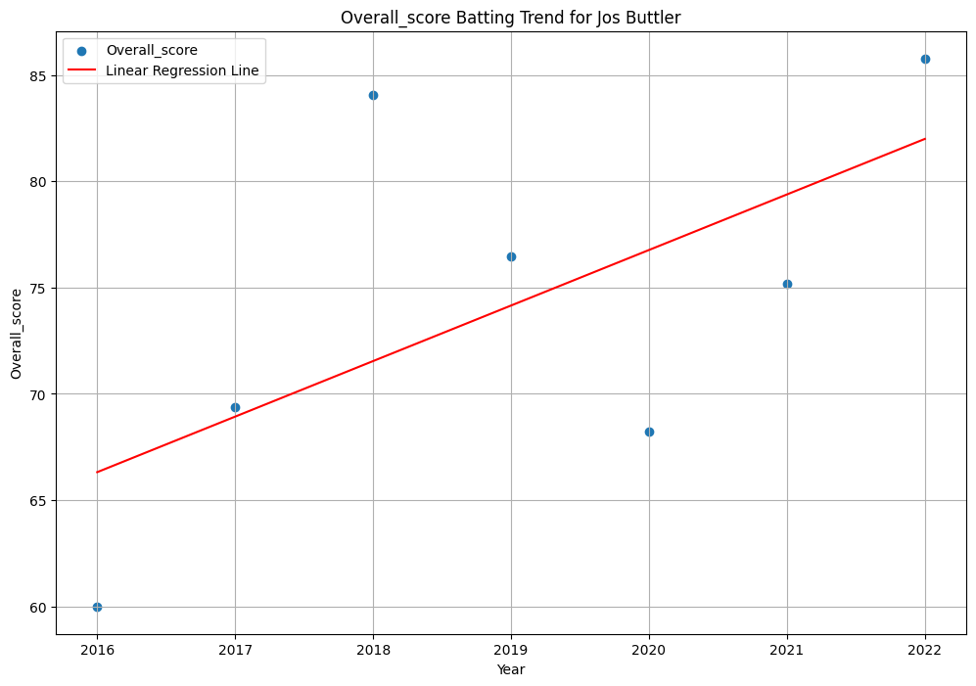
Linear Regression Trend Visualisation

Slide 23
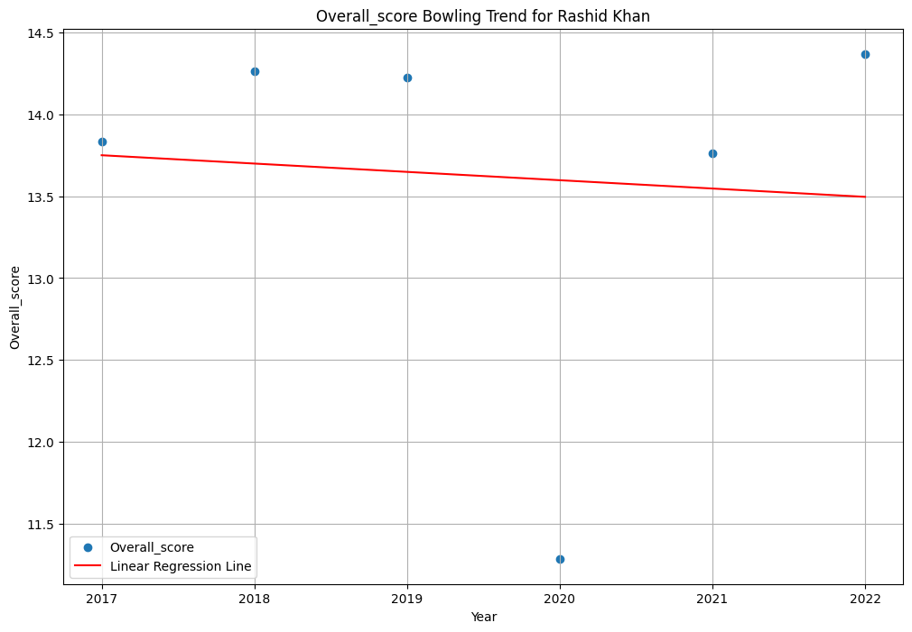
Linear Regression Trend Visualisation

Slide 24
Team Composition
Extracted the name of Players with Positive Trends from each category.
Getting the top 10 Batsmen, 4 Bowlers, 5 All Rounders
Batsmen:
Jos Buttler
Rishabh Pant
Chris Gayle
Sanju Samson
Shikhar Dhawan
Bowlers:
Imran Tahir
Bhuvneshwar Kumar
Dinesh Karthik
Kieron Pollard
Suryakumar Yadav
Nitish Rana
Piyush Chawla
Washington Sundar
All Rounders:
Andre Russell
Chris Morris
Jasprit Bumrah
Yuzvendra Chahal
Rashid Khan

Slide 25
Future scope
As per situation better players can be suggested.
Other analysis may be given as required, e.g. top players based on runs, etc.

Slide 26
Assumptions
Medium Budget
Taking players whose record is of more than or equal to 6 years.
Analysis is based on average scores of players.
Some BCCI guidelines were neglected.

Slide 27
Referral
kaggle.com
Google Stats
iplt20.com

Slide 28
Conclusion
In conclusion, this IPL data analysis identifies high-performing players for IPL 2024, offering valuable insights for team formation and strategy.

