Slide 1
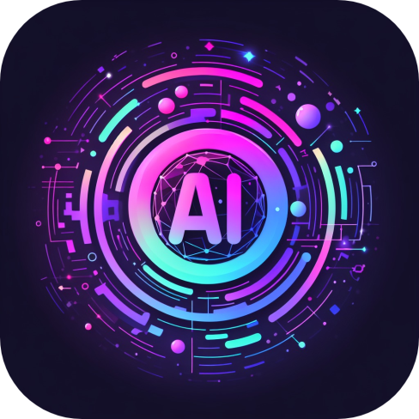
AIverse
Team Members
Dhruva Sharma – 160721733008
Fareeha Ali – 160721733015

Slide 2
ABSTRACT
AIverse: Your Ideal Companion for Everyday Efficiency!
Unlock the Power of AI with our cutting-edge Android app, which was carefully developed in Android Studio using Kotlin.
Our mission? To revolutionize daily tasks by offering a variety of AI tools and resources at your fingertips. But wait, there's more! We curate a universe of AI tools covering education, videos, literature, and beyond. Our easy-to-use interface ensures a seamless experience, making complex tasks as simple as a click.
Why us? While open-source solutions exist, our app goes the extra mile. Along with flexibility, we hand-pick effective free AI tools. Furthermore, we also provide the features and limitations associated with each AI tool so you can choose the one that best suits your requirements.

Slide 3
EXISTING IDEA
There are few websites that provide various AI tools like
TopAiTools.in
Zapier.com
Insidr.ai
But the problem is not all of them specify if tools are free or not and if they are free then what are their limitations.
PROPOSED IDEA
AIverse provides
Free AI tools based on categories.
All the AI tools provided in the app are tried-and-tested to ensure best choices.
These is also a list of features and limitations of each AI tool.
Users can make selection as per their needs.

Slide 4


ARCHITECTURE
Web Server
App
Home Page
Category Page
AI Tool
Link
Web Browser
User

Slide 5
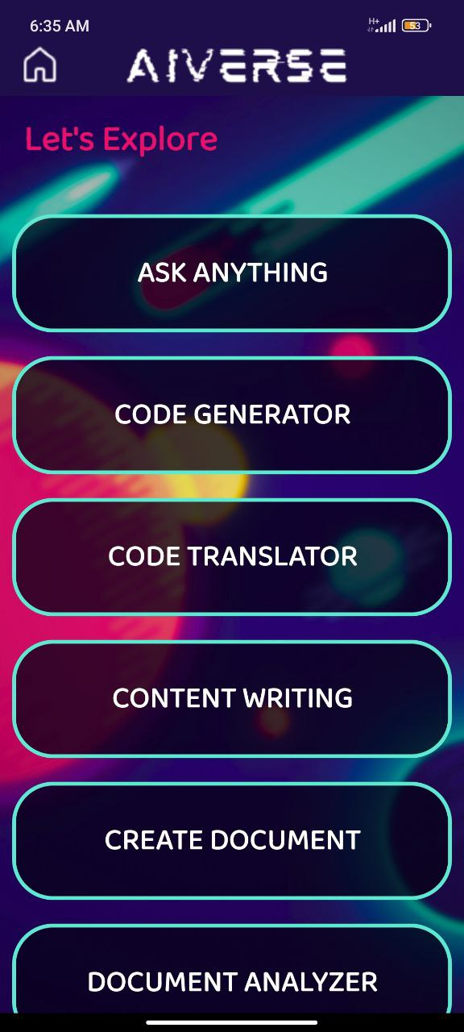
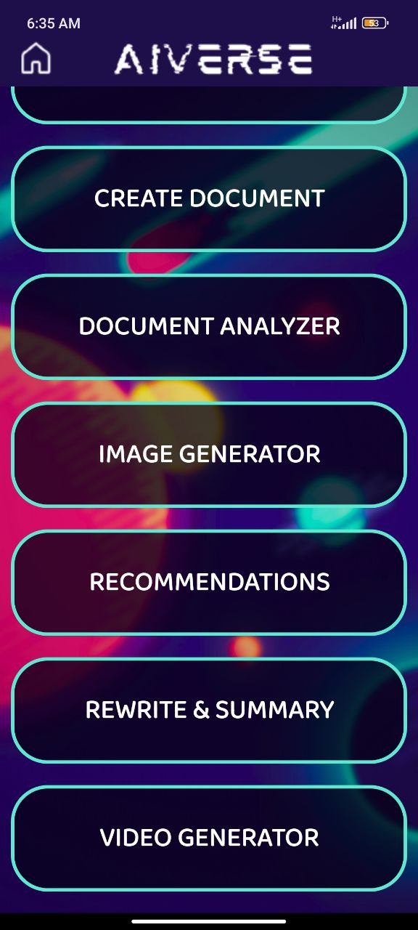
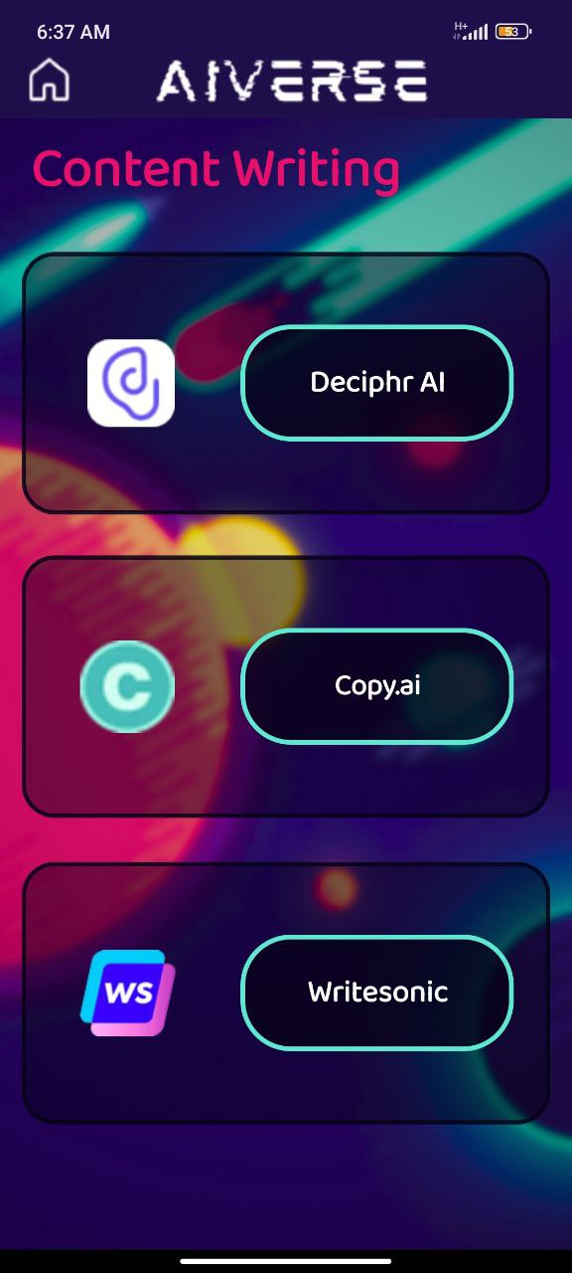
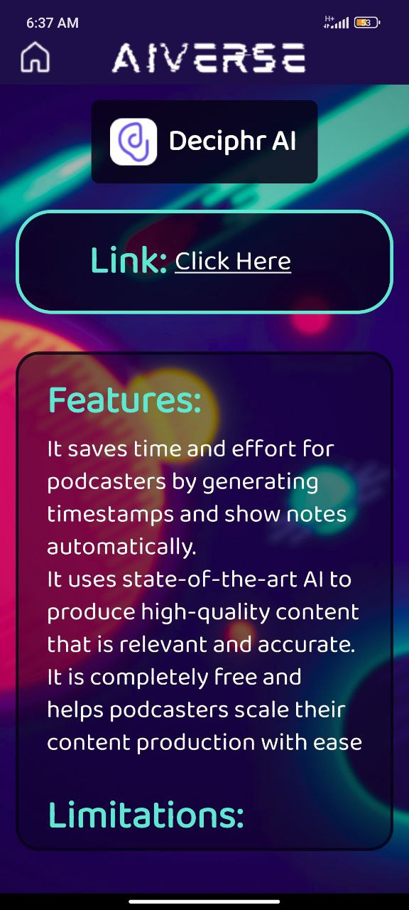
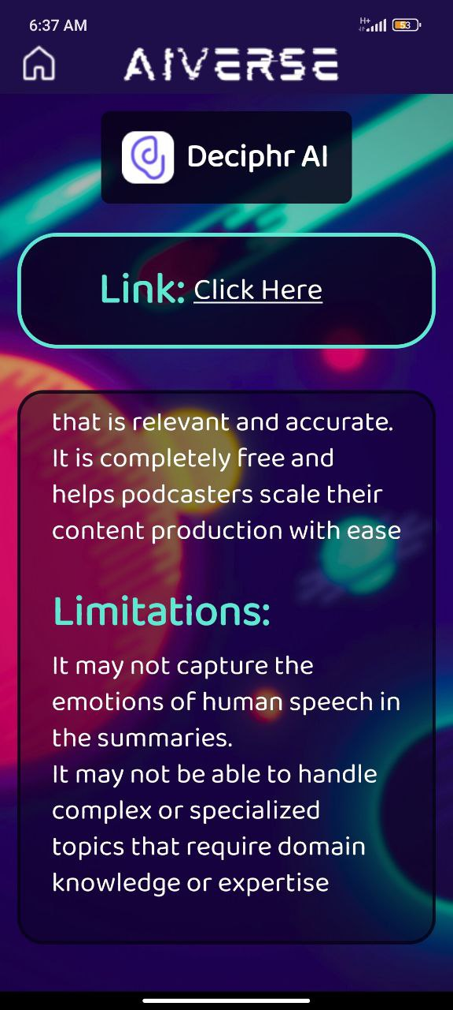
SCREENSHOTS

Slide 6
HOME PAGE
Contains:
10 categories
Scroll View

Slide 7
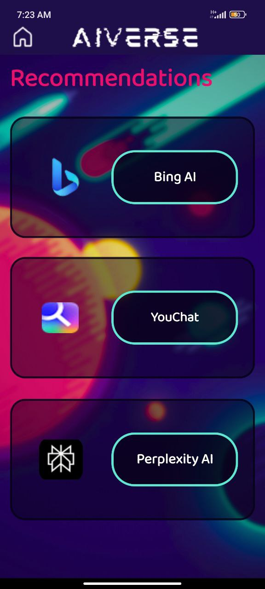
CATEGORY PAGE SAMPLES
Contains:
3 AI Tools
(per page)

Slide 8
AI TOOLS PAGE
Contains:
Link of AI Tool
Features and Limitations (Scroll View)

Slide 9
CONCLUSION
In conclusion, AIverse not only stands as a promising application with a robust technological foundation and a user-centric approach but also distinguishes itself in the crowded landscape of AI resources. While various open-source platforms offer an array of links and information about AI tools, AIverse takes a step further by curating and integrating the most efficient free AI tools into a seamless app-based experience. The commitment to regular updates ensures that users have access to the latest and most relevant AI tools, custom-tailored to simplify tasks at their fingertips.

