Slide 1
Model-View Design Pattern
A Lecture for KMP’s COMP 401 Class
Aaron Smith
November 14, 2019
Adapted from Ketan Mayer-Patel’s Lecture Slides

Slide 2
COMP 401 Big Picture
First Half: Object Oriented Programming
Second Half: Design Patterns
Interfaces
Inheritance
Classes
Polymorphism
Iterator
Factory
Model-View
Observer

Slide 3
What are design patterns?
Design patterns are techniques
for organizing your code
that are often used in the real world

Slide 4


What are design patterns?
Writing code without design patterns
Writing code with design patterns

Slide 5
Design Patterns
Iterator
Model-View
Factory
Decorator
Singleton
And more…
Model-View-Controller
Observer / Observable

Slide 6
Review: AWT/Swing
What is AWT/Swing?
AWT/Swing are built-in Java libraries for making user interfaces (UIs)
AWT/Swing consists of about
200 classes (!) which implement various UI components
Do I have to remember 200+ classes?
Swing: https://docs.oracle.com/javase/7/docs/api/javax/swing/package-summary.html
AWT: https://docs.oracle.com/javase/7/docs/api/java/awt/package-summary.html
Notes:
Continuation of color widget lecture

Slide 7
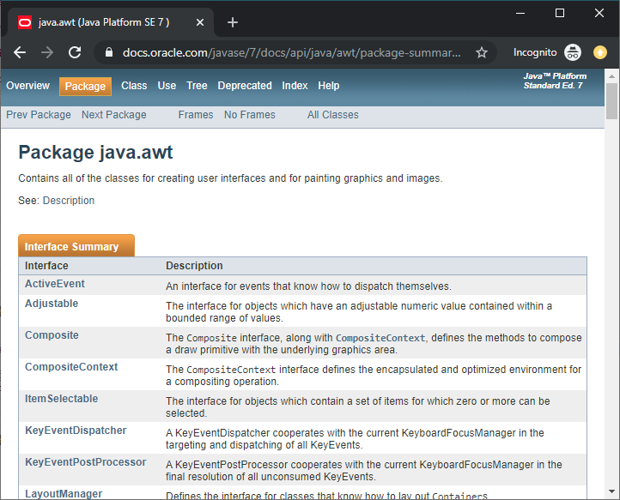
AWT Documentation
Lists AWT’s interfaces and classes
Provides descriptions of each
More details accessible by clicking the links

Slide 8
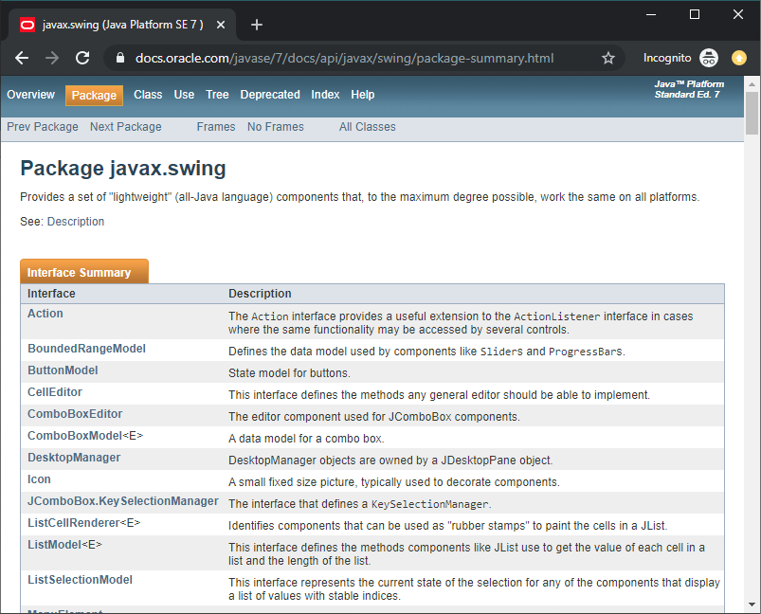
Swing Documentation
Java’s Swing documentation page is similar

Slide 9
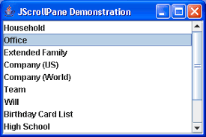
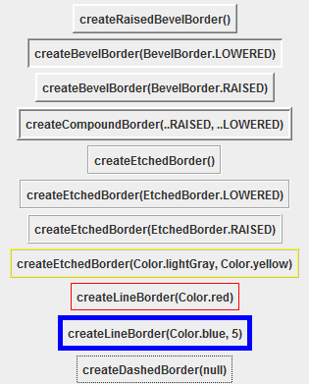
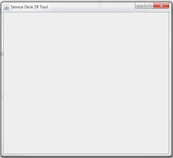
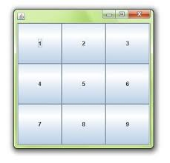
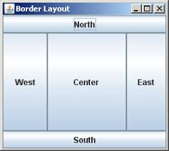
Review: Java AWT/Swing concepts
JScrollPane
JPanel
add()
setLayout()
revalidate()
removeAll()
BorderFactory
BorderLayout
GridLayout

Slide 10
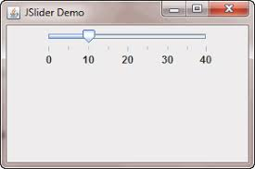
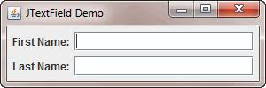
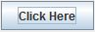
Review: Java AWT/Swing concepts
JSlider
getValue()
JButton
addActionListener()
setActionCommand()
JLabel
JTextField
getText()

Slide 11
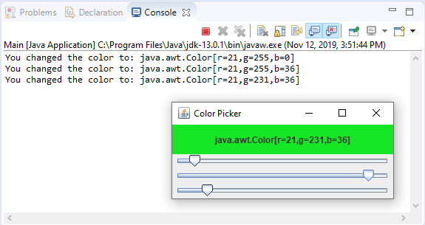
Review: ColorChooser Widget
Featuring:
Java’s AWT/Swing API

Slide 12
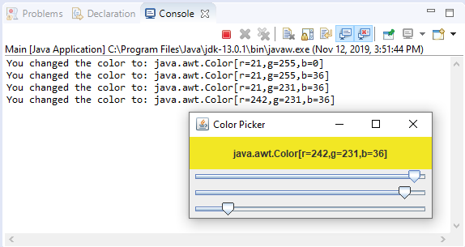
Review: ColorChooser Widget
The observer design pattern is very common in user interface development
Featuring:
Java’s AWT/Swing API
Observer design pattern
2. A method in your code is executed
1. User changes slider

Slide 13
This class is a JPanel UI Component
It listens for keyboard events and slider changes
public class ColorChooser extends JPanel implements ChangeListener, KeyListener {
Color color;
JSlider red_slider;
JSlider green_slider;
JSlider blue_slider;
JLabel color_label;
List<ChangeListener> change_listeners;
public ColorChooser(Color init_color) {
// ...
}
// ...
}
Instance Variables
Job: Store object state
Constructor
Job: Set initial values for instance variables
Current color (Color)
UI components (JSlider, JLabel)
Observers (List<ChangeListeners>)

Slide 14
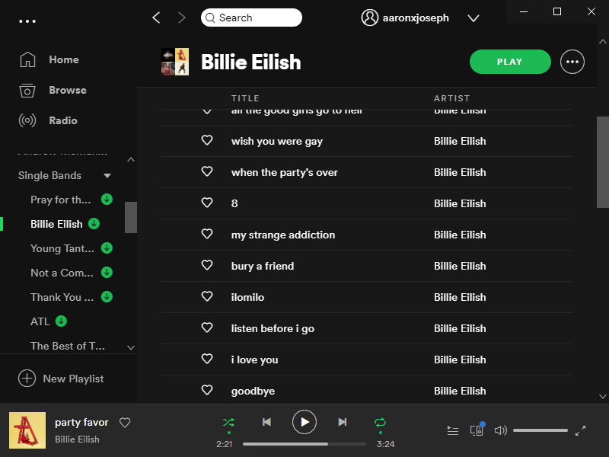
Q: How can we improve this design?
Imagine a more complicated widget…
…like a song playlist (think of Spotify)
Separation of concerns:
state vs presentation

Slide 15
Model-View Design Pattern
Widget
…and this represents
how the state is presented
User Interface
Application Data
This represents
the state of the system…
Data Manipulation

Slide 16
Model-View Design Pattern
Widget
Application Data
User Interface
Data Manipulation
Application Data
Data Manipulation

Slide 17
Model-View Design Pattern
Notify when
the underlying data
is changed
Model
View
Application Data
User Interface
Notify when the user interacts with the
UI components
Data Manipulation
This is the observer design pattern

Slide 18
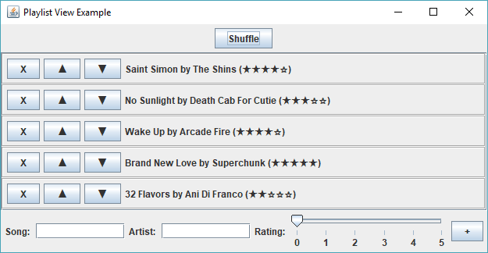
Today’s MV Example: Song Playlist
class PlaylistView
JPanel button_panel
JPanel list_panel
class SongListingWidget
class AddSongWidget

Slide 19
Q: What should the model be for this app?
In other words,
what data state is presented by this view?
A: A list of songs
(List<Song>)
Each song contains:
A title (String)
An artist (String)
A rating (int)

Slide 20
Unicode Characters
★ Unicode character U+2605 ("\u2605")
☆ Unicode character U+2606 ("\u2606")
▲ Unicode character U+25b2 ("\u25b2")
▼ Unicode character U+25bc ("\u25bc")
Q: How do we display the rating stars and the arrows?
A: With Unicode glyphs!

Slide 21
Version 1:
The Model
Playlist.java
Song.java

Slide 22
The model exposes methods to the data
Model
The purpose of the model is to…
Store the data
Provide methods for data access and manipulation
Application Data
Data Manipulation

Slide 23
The model exposes methods to the data
Playlist
public int getSize()
View
public Song[] getSongs()
Song
public void addSong(Song s)
public void removeSong(Song s)
title
public Song getSong(int index)
artist
public void shuffle()
rating
public void moveSong(int start, int end)

Slide 24
PlaylistView Structure
class PlaylistView
JPanel button_panel
JPanel list_panel
class AddSongWidget
class SongListingWidget
class SongListingWidget
class SongListingWidget
class SongListingWidget

Slide 25
Version 2:
The View
PlaylistView.java
Main.java

Slide 26
SongListingWidget Structure
class SongListingWidget
JPanel button_panel
JLabel slabel
class SongListingWidget
class SongListingWidget
JButton up_button

Slide 27
AddSongWidget Structure
class AddSongWidget
JButton add_song_button
JLabel
class SongListingWidget
JSlider rating_slider
JTextField song_field

Slide 28
Version 3:
More View Pieces
AddSongWidget.java
SongListingWidget.java

Slide 29
Observer Data Flow
Model
View
public void update(Observable arg0, Object arg1)
public void shuffle()
public void removeSong(Song s)
public void moveSong(int start, int end)
public void addSong(Song s)

Slide 30
Version 4:
Connecting View and Model
Playlist.java
PlaylistView.java

Slide 31
Limitations of Model-View Design
Problem: Sometimes, user events require a more sophisticated response than updating raw Model data
Example: How would a song title and artist name autocomplete feature be implemented?
Solution: Make a Controller class to mediate between the View and Model

