Slide 1

NLA Promotional Campaign Impact Analysis
Loyalty Program Membership & Flight Activity
Benjamin McKenzie
December 2025

Slide 2




Executive Summary
06_retention_comparison.png
1
Campaign generated 830 net new members with 3x higher flight activities than standard enrollees.
971
Gross Enrollments
830
Net New Members
+54%
Growth vs Baseline
Gross Impact: 971 members enrolled during promotional period (Feb-Apr 2018)
Net Impact: 830 net new members after accounting for 141 cancellations
Member Quality: Campaign members fly 2.6X more per month than standard enrollees
5

Slide 3

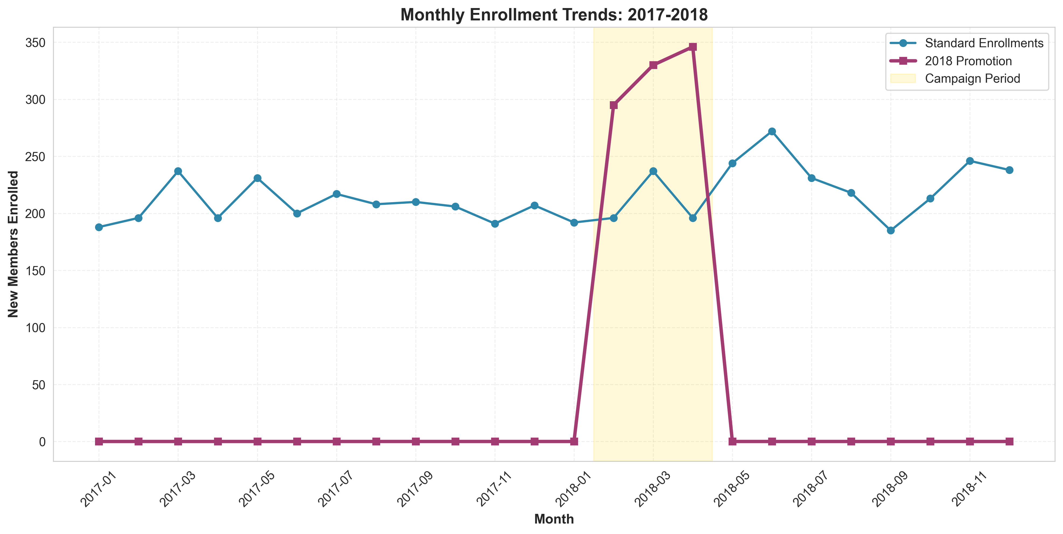
Gross Impact: 971 New Members
February – April 2018
Net Growth vs Baseline: +32%
Monthly breakdown:
- February: 295
- March: 330
- April: 346
Enrollment returned to slightly above baseline level post-campaign

Slide 4
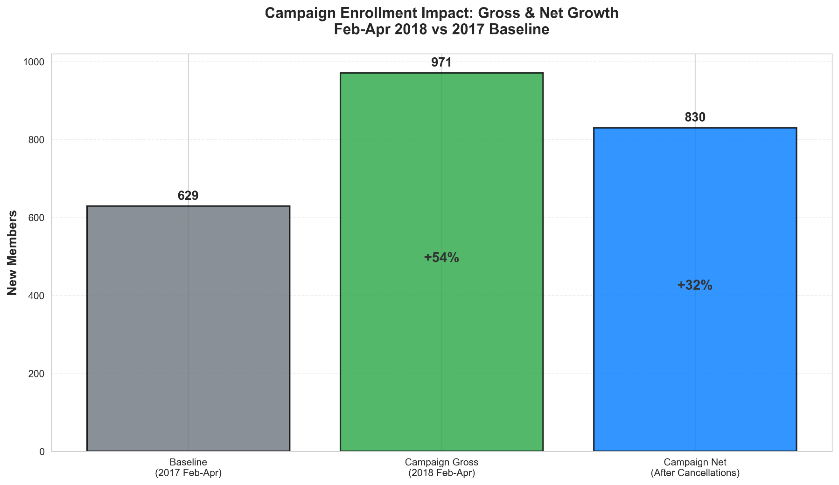
Net Impact: 830 New Members Post-Campaign
After Cancellations
Gross Enrollments: 971 members
Cancellations: 141 members
Net Growth: 830 members
Baseline (2017 Feb-Apr): 629 members

Slide 5
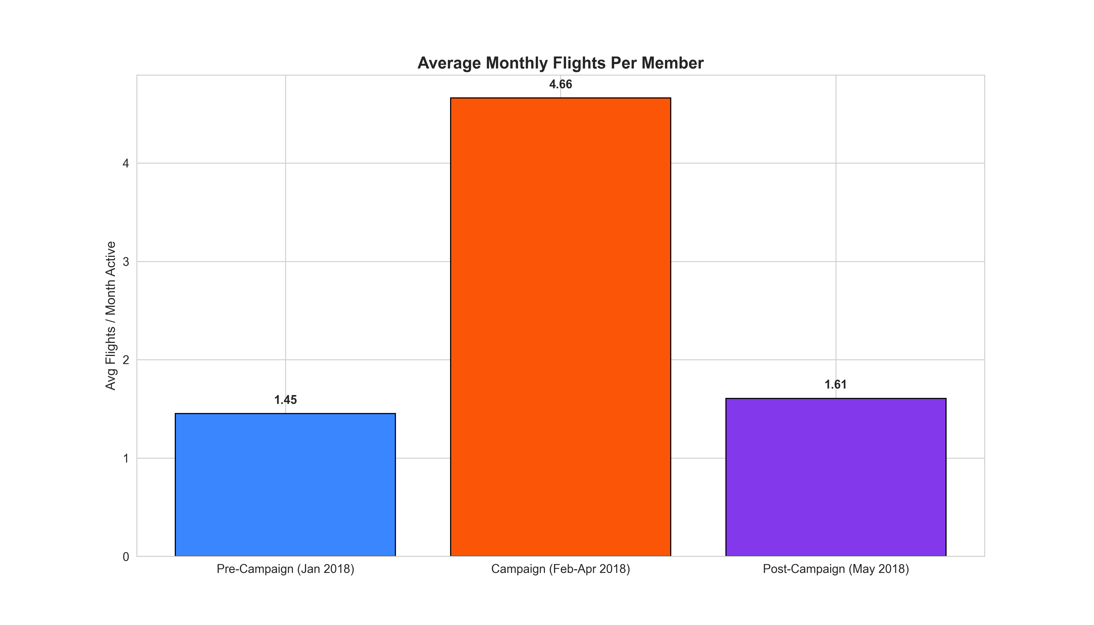
Campaign Attracted Frequent Flyers
Members who enrolled during the campaign flew 3x more than standard enrollees
Net Growth vs Baseline: +32%
Utilization: 924 of 971 members took at least one flight
High engagement: 79% flew 31+ times (3-4 flights per month)
2.6× more flights monthly than pre-campaign standard members

Slide 6
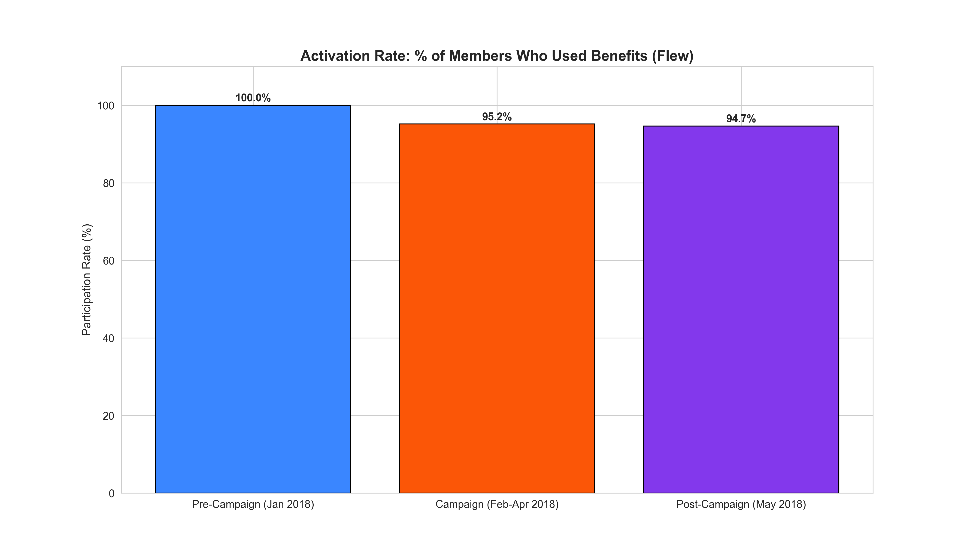
Campaign Value & Impact
95.2%
95.2% of enrollees flew at least once
$7.8M
Customer Lifetime Value
103M
Loyalty Points Accumulated

Slide 7
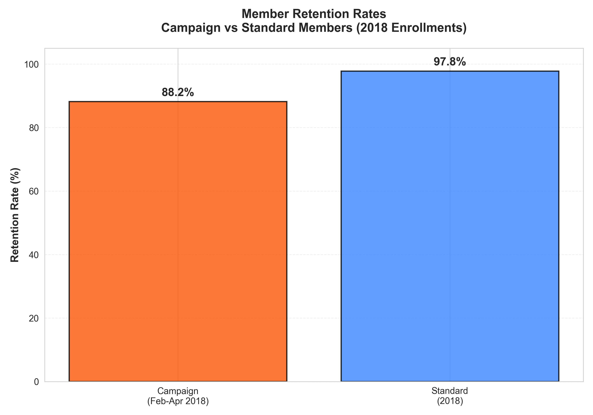
Member Quality - Retention
Retention Rate
88.2%
For Campaign Members - 9.6% lower
97.8%
Standard Members

Slide 8
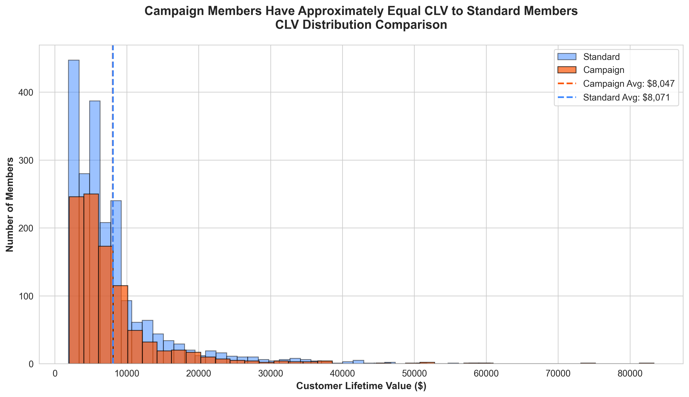
Member Quality – Customer Value
CLV Distribution Comparison
Campaign members: $8,047 average CLV
Standard members: $8,007 average CLV
Distributions are nearly identical
Campaign attracted comparable-value customers

Slide 9
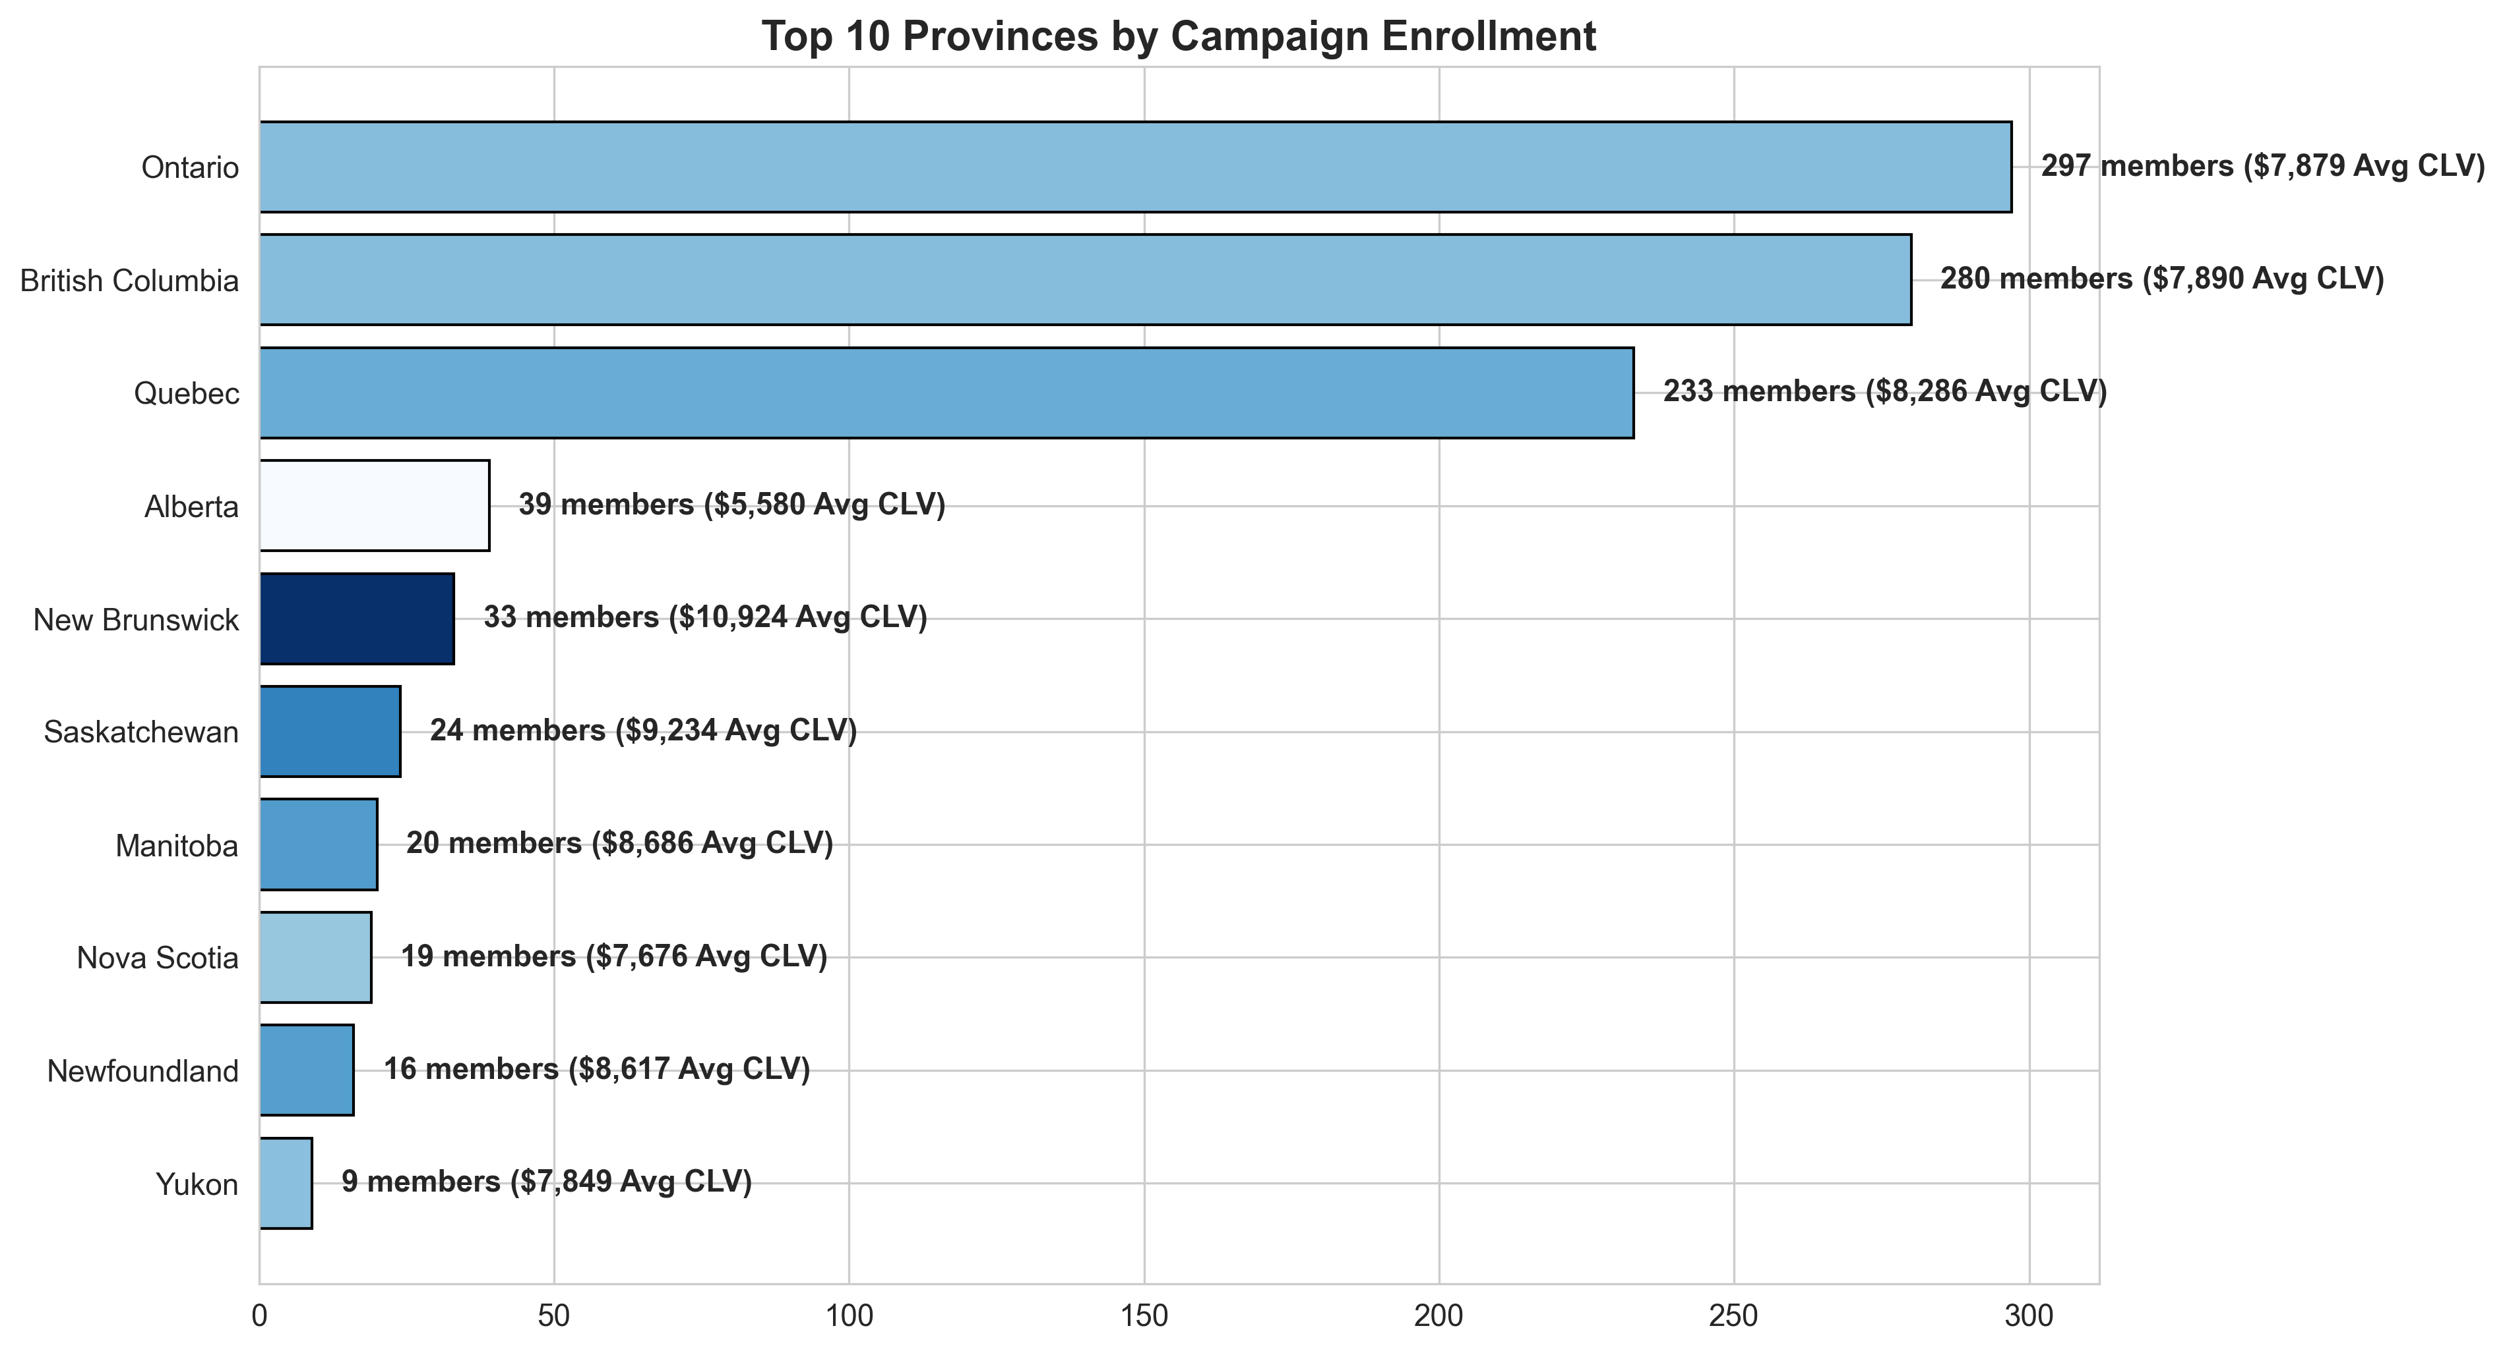
Geographic Distribution
Top Markets by Campaign Enrollment

Slide 10

Campaign Summary
GROSS IMPACT
NET IMPACT
971 Members
+54% vs baseline
830 Members
+32% vs baseline
FLIGHT ACTIVITY
MEMBER QUALITY
95.2%
Campaign enrollees flew 1 or more times
2.6× More
Flights vs Standard

