Slide 1
GWU Data Science Capstone · Fall 2026 · Group 4
Do Sparse Autoencoders Preserve What a Language Model Uses?
SAE faithfulness beyond reconstruction error · GPT-2 Small and Gemma-2-2B
Simbarashe Simbanegavi · Aditi Shukla · Dhruv Rai
Final presentation · November 2026
Notes:
Storyboard slide 1. The study evaluates SAE faithfulness beyond reconstruction error. Check the course line and date before presenting.

Slide 2
Why Reconstruction Alone May Not Be Enough
MOTIVATION
Research question To what extent do SAEs faithfully preserve the information and behaviour of language models beyond simply reconstructing activations well?
Activation x
residual stream, layer L
Encoder
Sparse code z
few active latents (L0 ≈ 128)
Decoder
Reconstruction x̂
Model continues
x̂ spliced back in
MSE / EV checks
only that x̂ ≈ x
Information?
Is truth / persona information still readable from x̂?
Behaviour?
Does the model still predict the same next token?
Causal effect?
Does x̂ still carry the effect of an intervention?
Takeaway A reconstruction can look numerically good while changing information, behaviour, or causal effects.
Notes:
Storyboard slide 2 (merges old slides 1–2). The schematic is the SAE splice used throughout: encode, sparse code, decode, and let the frozen model continue from x̂.

Slide 3
One Study, Four Levels of Faithfulness
FRAMEWORK AND SCOPE
4 Causal
Does x̂ carry the intervention effect?
Patching share T_rec / T_full
3 Behaviour
Does the spliced model predict the same tokens?
ΔCE, KL vs random-error control
2 Information
Can a reader still decode truth / persona?
Frozen, re-trained, MLP probes; PCA reference
1 Reconstruction
Does x̂ match x?
EV, NMSE, cosine, L0
Models
GPT-2 Small (all 12 layers) · Gemma-2-2B (layers 5, 12, 19)
SAEs
In-house ReLU, TopK, JumpReLU (L0 ≈ 128, 3 seeds) · public Gemma Scope · public res-jb
Data
OpenWebText · Geometry of Truth · RepE-LM · The Pile
Takeaway Faithfulness is multidimensional and must be measured at several levels. Every result carries its evidence label.
Notes:
Storyboard slide 3 (merges old slides 3–4). Rules: compare SAEs only at matched L0 (±10 %); evaluation probes are fitted on original activations only; test splits touched once by a pre-registered pass. Labels: TEST / CONFIRMED TEST (held-out, pre-registered), VALIDATION, EXPLORATORY, PRE-REGISTERED ONLY. Steering is a separate category and appears only in backup.

Slide 4
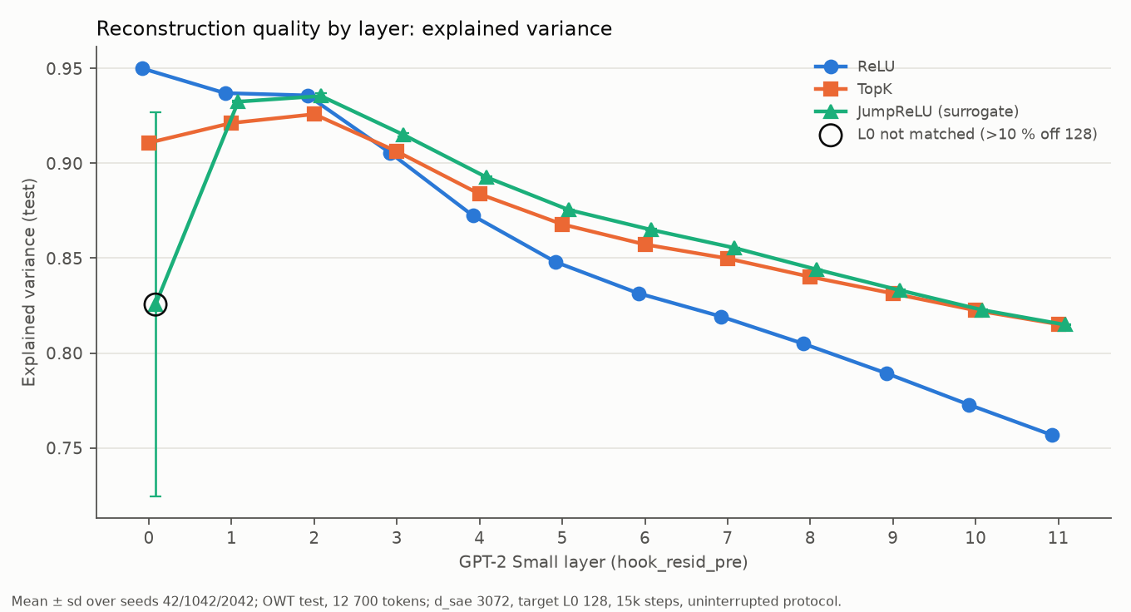
RQ1 — How Well Do SAEs Reconstruct GPT-2 Activations?
RQ1 · RECONSTRUCTION · GPT-2 · OPENWEBTEXT
TEST
Best architecture at matched L0
Layers | Leader (paired by seed)
0 | not ranked (L0 missed)
1 | ReLU
2 | ReLU ≈ JumpReLU
3–9 | JumpReLU
10–11 | JumpReLU ≈ TopK
108 SAEs: 12 layers × 3 architectures × 3 seeds. EV falls from 0.95 to 0.76 (ReLU, layer 0 → 11).
Takeaway Reconstruction quality varies strongly by layer and architecture; no single architecture wins everywhere.
Source: results/openwebtext/reconstruction_evaluation/uninterrupted_protocol/; layer_comparison/sparsity_matched_cells.csv (sae-research @ d5521c4)
Notes:
Storyboard slide 4 (merges old 5–6; architecture detail in backup B1). EXPERIMENT_RESULTS_SUMMARY §1 (TEST, 3 seeds, 12,700 OWT test tokens). Layer-0 JumpReLU seed 42 is unmatched (L0 73.6) and excluded from rankings; it causes the wide error bar.

Slide 5
Before Measuring Information, We Fixed the Persona Benchmark
RQ2 · BENCHMARK · GPT-2 · RepE → RepE-LM
VALIDATION
Original RepE honesty prompts
' untruthful' is 3 tokens longer than ' honest'
0.80
AUROC from prompt length alone
→ earlier RepE results relabelled HISTORICAL (D23)
RepE-LM: equal-length, one-token persona swap
506 statements × 20 variants
0.50
every shortcut AUROC (gate K2)
behavioural effect 2× synonym null (K7)
Takeaway The equal-length RepE-LM task removes a shortcut that could otherwise distort information-faithfulness claims.
Source: results/repe/repe_lm_gates/; docs/RESEARCH_DECISIONS.md D23 (sae-research @ d5521c4)
Notes:
Storyboard slide 5 (old 7). EXPERIMENT_RESULTS_SUMMARY §13 (M1 gates on TRAIN; validation descriptive). Layer-0 probe on the old prompts reached 0.83. GoT numerical statements have a similar shortcut (second number alone AUROC 0.84); only GoT cities/neg_cities are used for truth.

Slide 6
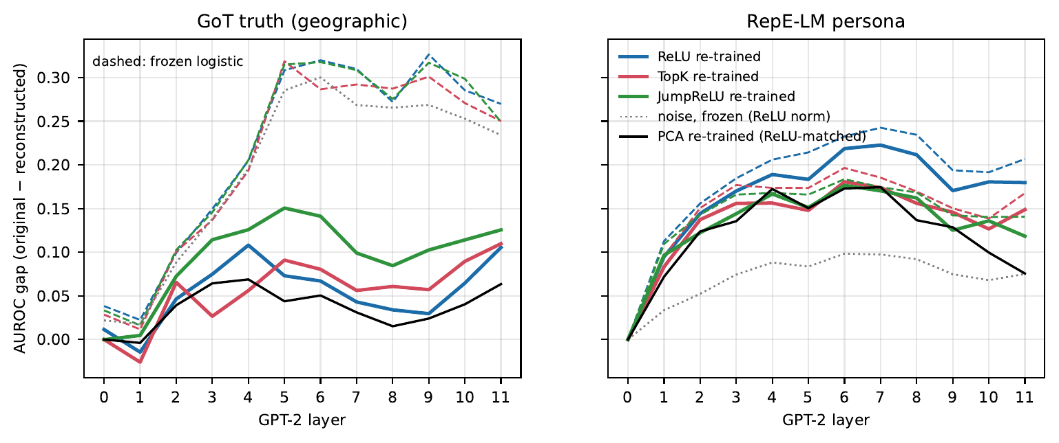
RQ2 — Does the Reconstruction Preserve Information?
RQ2 · INFORMATION · GPT-2 · GoT + RepE-LM
VALIDATION
Frozen reader: GoT gap ≈ 0.28, mostly readout fragility
Re-trained reader: GoT 0.07–0.12; persona 0.14–0.18 (real loss)
Nonlinear (MLP): GoT 0.04–0.07; persona 0.18–0.23
vs PCA: SAE better in 0 cells; worse in 52/81 (GoT), 59/99 (persona)
Takeaway Good reconstruction does not guarantee preserved task information; PCA can match or outperform the SAE representation.
Source: results/shared/m2_four_level_faithfulness/ (108 SAEs + 36 PCA; gaps = AUROC original − reconstructed, ↓; sae-research @ d5521c4)
Notes:
Storyboard slide 6 (old 8). EXPERIMENT_RESULTS_SUMMARY §14. Re-trained logistic gaps GoT ReLU/TopK/JumpReLU 0.066/0.075/0.118; persona 0.179/0.147/0.143. MLP: GoT 0.049/0.037/0.066; persona 0.232/0.190/0.177. No cell labelled 'Preserved'. M2 supersedes the frozen-probe-only reading.

Slide 7
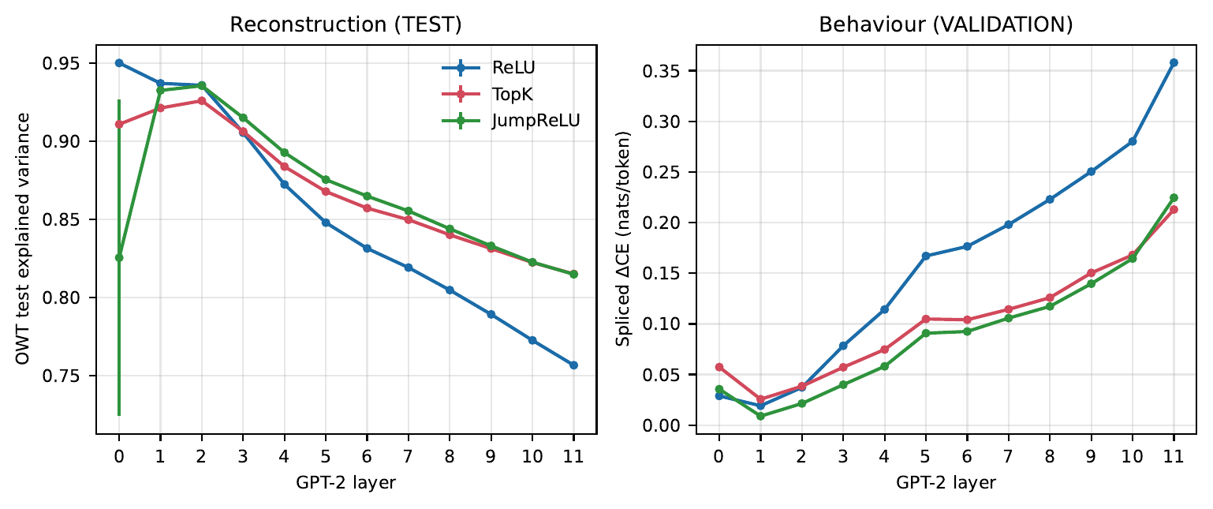
RQ3 — Reconstruction Error Predicts Behaviour Better Than Truth Loss
RQ3 · BEHAVIOUR · GPT-2 · OWT + GoT
VALIDATION
Within-layer regressions (M0, 107 SAEs)
Link (within layer) | p (Holm) | Verdict
OWT NMSE → splice ΔCE | 0.0008 | Supported
OWT NMSE → GoT truth gap | 0.044 | Fragile
GoT error → GoT truth gap | 1.00 | Not supported
GoT error → splice ΔCE | 1.00 | Not supported
Left panel TEST, right panel VALIDATION.
Splice damage vs a random error of the same norm: 0.76–2.89× per run.
'Fragile': the truth link disappears without architecture fixed effects (architecture = 99.8 % of within-layer NMSE variance).
Takeaway Within a layer, reconstruction error robustly predicts splice damage, but not task-truth loss.
Source: results/shared/m0_within_layer_reanalysis/; results/*/spliced_evaluation/ (sae-research @ d5521c4)
Notes:
Storyboard slide 7 (old 9 plus the behaviour panel of old 5). EXPERIMENT_RESULTS_SUMMARY §4 and §12. β [95 % CI]: NMSE→ΔCE 0.165 [0.134, 0.265]; NMSE→GoT gap 0.268 [0.056, 0.477]; GoT error→GoT gap 0.005 [−0.059, 0.080]; GoT error→ΔCE −0.012 [−0.060, 0.028]. Freedman–Lane within-layer permutation (5000).

Slide 8
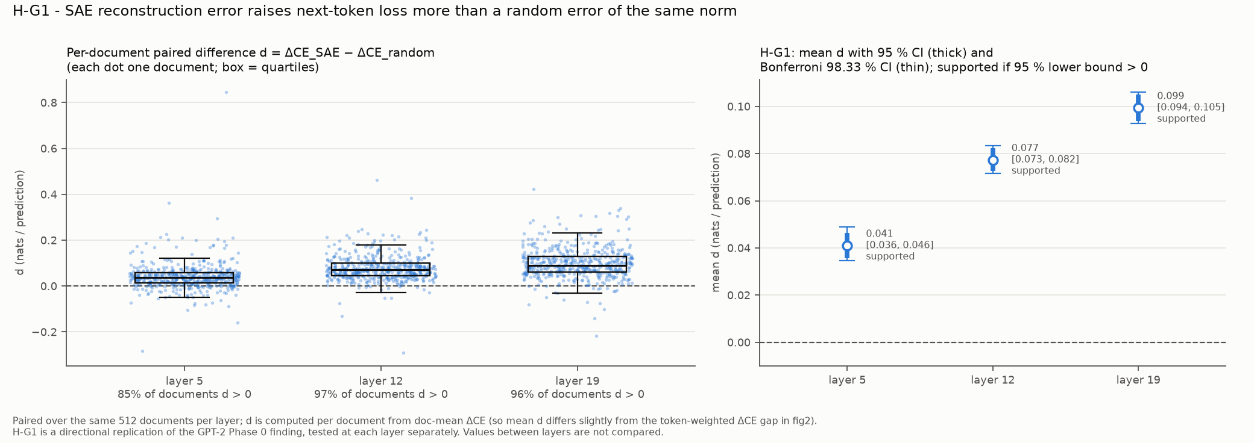
Gemma-2-2B Replicates the Behavioural Concern
RQ3 · BEHAVIOUR · GEMMA-2-2B · THE PILE
VALIDATION
Layer (Gemma Scope 16k) | ΔCE SAE | ΔCE random | SAE / random | mean d [95 % CI] | H-G1
5 (L0 68) | 0.071 | 0.029 | 2.48× | 0.041 [0.036, 0.046] | supported
12 (L0 82) | 0.115 | 0.039 | 2.97× | 0.077 [0.073, 0.082] | supported
19 (L0 73) | 0.177 | 0.080 | 2.22× | 0.099 [0.094, 0.105] | supported
Takeaway At layers 5, 12 and 19, Gemma Scope SAE reconstruction error causes more next-token damage than norm-matched random error. The experiment does not identify the mechanism.
Source: results/gemma2_pile/gemma_scope_splicing/ (512 Pile docs, paired document bootstrap; simba-gemma-m6-results @ 4fd2706; run code 13eaeca)
Notes:
Storyboard slide 8 (merges old 10–11). M6 README §2. Required wording: SAE-splice reconstruction error produced greater next-token behavioural damage than the norm-matched random-error control at all three preregistered layers; this experiment does not identify the mechanism responsible. Bonferroni 98.33 % CIs: L5 [0.0345, 0.0489], L12 [0.0715, 0.0832], L19 [0.0928, 0.1062]; all supported. EV 0.813 / 0.770 / 0.789; loss recovered 0.992 / 0.988 / 0.980. Gates V1–V5 pass. Layers have different SAEs and L0, so they are not ranked; no GPT-2 vs Gemma numerical ranking is made. Limitation: bf16 logit floor (H4a smoke KL 0.00083).

Slide 9
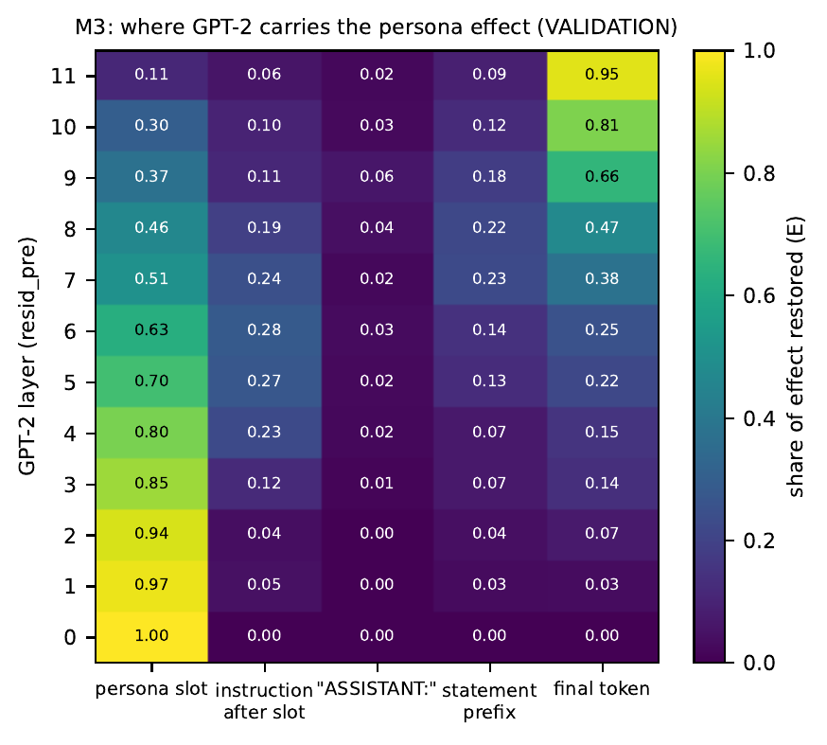
RQ4 — Where Does GPT-2 Carry the Persona Effect?
RQ4 · CAUSAL · GPT-2 · RepE-LM
VALIDATION
Patch the original activation from the persona prompt into the swapped prompt, one site at a time (no SAE yet).
Persona slot: 0.97 of the effect at L1 → 0.11 at L11
Final token: 0.03 at L1 → 0.95 at L11
Handover at layers 7–8
Sites chosen on TRAIN, confirmed on VALIDATION: L1 slot, L8 final, L11 final
Takeaway The causal effect moves from the persona slot in early layers toward the final token in later layers.
Source: results/repe/causal_site_sweep/ (baseline KL(p_H‖p_U) = 0.033 nats; sae-research @ d5521c4)
Notes:
Storyboard slide 9 (old 12). EXPERIMENT_RESULTS_SUMMARY §15. 50/65 cells pass; synonym control R_S ≈ 0.5 R_A at every site.

Slide 10
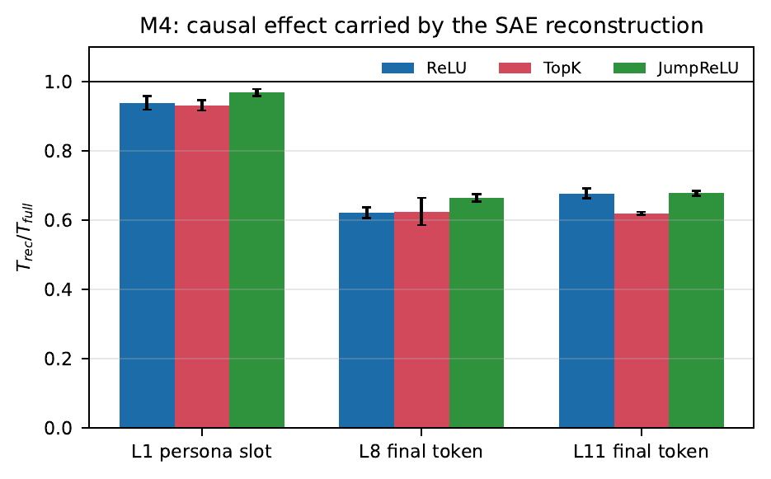
SAE Reconstructions Preserve Most — But Not All — Causal Effect
RQ4 · CAUSAL · GPT-2 · RepE-LM
VALIDATION
How compact is the causal signal? (L8 final token, R5)
Basis | k = 1 | k = 4 | k = 64
Learned direction (DAS) | 0.64 | 0.91 | 1.29
PCA | 0.36 | 0.52 | 0.83
SAE top-k features | 0.04–0.05 | 0.10–0.16 | 0.34–0.48
Random directions | 0.00 | 0.01 | 0.11
Share of the persona effect T_k / T_full. A value above 1 overshoots the effect.
Takeaway Reconstruction preserves about 93–97 % at the early site but only about 62–68 % at later sites; it is not fully causally faithful.
Source: results/repe/sae_patch_decomposition/ (M4); results/repe/r5_causal_subspace_skyline/ (R5, descriptive) (sae-research @ d5521c4)
Notes:
Storyboard slide 10 (old 13). EXPERIMENT_RESULTS_SUMMARY §16 and §22. T_full: L1 slot 0.0435, L8 final 0.0220, L11 final 0.0430 nats. 64 SAE features carry 47–74 % of T_rec and beat matched random sets (p = 0.005).

Slide 11
RQ5 — Truth-Focused Fine-Tuning Did Not Reliably Solve the Problem
RQ5 · IMPROVEMENT · GPT-2 FINE-TUNING
VALIDATION
Approach | Truth gap, frozen reader | Truth gap, re-trained reader | Causal share (E3, L8) | Verdict
Truth-aware fine-tune (L6) | Gain was circular (probe = teacher); independent MLP probe: worse in 6/6 | — | — | INVALID / not supported
Method A (L6) | Lower MLP gap 9/9 seeds, not by > 2 sd | — | — | NOT MET
Method A (IMP-L, L3/8/9) | Preliminary gain 4/9 cells; GoT error −61 to −85 % | 0/9: all CIs span 0 | No improvement 3/3 | Not robust
Output-KL (IMP-L, L3/8/9) | 0/9 gains; 2 regressions at L3 | — | TopK none; ReLU/JumpReLU fail L0 guard | Behaviour only
Persona (RLM-RP): Method A no improvement in 12/12 cells. Caught and reported: our own truth-aware 'improvement' was an evaluation leak.
Takeaway Frozen-probe improvements did not translate into robust re-trained-reader or causal improvements.
Source: geometry_of_truth/{truth_aware_pilot,method_a_layer6,multilayer_finetune}/; repe/e3_finetuned_causal_preservation/; docs/2026-11-07_truth_aware_finetuning_audit.md
Notes:
Storyboard slide 11 (merges old 14–16). EXPERIMENT_RESULTS_SUMMARY §7, §17, §18, §19; results_registry 'Pilots' and 'Superseded or invalid'. IMP-L criteria: T_method_a 4/9; B_kl 5/9 (4/9 not creditable, L0 +5 to +8 %); T_kl 0/9. E3 T_rec/T_full base→Method A: ReLU 0.621→0.622, TopK 0.625→0.615, JumpReLU 0.665→0.669; no regressions. Also VALIDATION: E2E-inspired (behaviour gain TopK only), KL-weight ablation INCONCLUSIVE; R1/R2 honesty work is HISTORICAL (length-confounded task).

Slide 12
What Worked: More Data and Wider SAEs
RQ5 · IMPROVEMENT · GPT-2 · OWT TEST
CONFIRMED TEST
Takeaway Scaling cut NMSE 40–69 % and splice damage 53–75 % at matched L0 on TEST; information preservation did not automatically follow.
Source: results/shared/m5_confirmatory_test/comparisons.csv (C1, single pre-registered run, 3 seeds; every L0 within 1 % of 128; sae-research @ d5521c4)
Notes:
Storyboard slide 12 (old 17). EXPERIMENT_RESULTS_SUMMARY §20 and §24. Chart values are the C1 TopK means; the charts are native and editable. Across C1–C3: NMSE −31 to −74 %, ΔCE −35 to −79 %. GoT re-fit and SAE − PCA gaps: no improvement in any comparison on TEST. Validation only: causal T_rec/T_full 0.62 → 0.73 at L8.

Slide 13
Behaviour-Targeted Training Helps Behaviour — With Trade-offs
RQ5 · IMPROVEMENT · GPT-2 LAYERS 8, 11
MIXED
−16 to −17 %
splice ΔCE vs MSE-trained control
+2 %
reconstruction NMSE (slightly worse)
0.69 → 0.67
causal share T_rec / T_full at L11: a regression
CONFIRMED TEST
CONFIRMED TEST
VALIDATION
Information gaps: no improvement (VALIDATION). Fixed L0; EV cost −0.002.
Takeaway Optimising downstream behaviour improves behavioural metrics without corresponding information or causal gains.
Source: results/openwebtext/r4_kl_finetune/ (VALIDATION, 3 seeds paired); results/shared/m5_confirmatory_test/ K1 (TEST)
Notes:
Storyboard slide 13 (old 18). EXPERIMENT_RESULTS_SUMMARY §21 and §24. Validation ΔCE: L8 0.0601 → 0.0493 (−17.9 %), L11 0.0997 → 0.0814 (−18.4 %). T_rec/T_full L8 0.720 → 0.710 (no improvement), L11 0.694 → 0.671 (regression).

Slide 14
The Main Conclusions Hold for an External Public SAE
GENERALISATION · GPT-2 · PUBLIC res-jb SAEs
VALIDATION
Hypothesis (pre-registered) | GoT cities | RepE-LM persona
H1 Frozen-probe loss is mostly readout fragility | Holds (L8, L10, L11) | Does not hold: the loss is real
H2 Loss survives a re-fitted reader | Holds at L10, L11 | Holds at all layers
H3 SAE never beats PCA of the same size | Holds | Holds
H4 Partial causal preservation | — | Holds at L8 (0.56), L11 (0.61)
res-jb: public GPT-2 residual SAEs trained on 300M tokens. An external reference, not our improvement.
Takeaway The headline pattern is not limited to the team's own training recipe.
Source: results/shared/e2_public_sae_reference/hypotheses.csv (descriptive; layers 8, 10 pre-registered, 1, 11 extension; sae-research @ d5521c4)
Notes:
Storyboard slide 14 (old 19). EXPERIMENT_RESULTS_SUMMARY §23. H2 GoT at L8 misses (CI low −0.001). H4 does not hold at L1 (0.979, i.e. near-full preservation).

Slide 15
Integrated Answer: Faithfulness Is Not One Number
SYNTHESIS
MIXED
Evidence | Reconstruction | Information | Behaviour | Causal
GPT-2 baseline SAEs | EV 0.76–0.95; layer-dependent winner [TEST] | Persona loss real; SAE never beats PCA [VAL] | Error predicts ΔCE; 0.76–2.89× random [VAL] | Keeps 0.62–0.97 of effect [VAL]
GPT-2 scaled SAEs (R2) | NMSE −40 to −69 % [CONFIRMED TEST] | No GoT re-fit or SAE−PCA gain [CONFIRMED TEST] | ΔCE −53 to −75 % [CONFIRMED TEST] | 0.62 → 0.73 at L8 [VAL]
GPT-2 fine-tuning (Method A, output-KL) | GoT error −61 to −85 % (Method A) [VAL] | No re-trained-reader gain [VAL] | Output-KL ΔCE −16 to −17 % [CONFIRMED TEST] | No gain; L11 regression (R4) [VAL]
Gemma-2-2B (Gemma Scope) | EV 0.77–0.81 [VAL] | Not tested | SAE error > random at 3/3 layers [VAL] | Not tested
External res-jb | — | Persona loss real; never beats PCA [VAL] | — | Partial: 0.56–0.61 [VAL]
Takeaway Reconstruction quality is necessary evidence, but insufficient by itself to establish SAE faithfulness.
Notes:
Storyboard slide 15 (old 20). Colours: green = improvement / good preservation; amber = partial or layer-dependent; red = loss, no gain or regression; grey = not tested. GPT-2 and Gemma rows use different protocols, models and SAEs and are not ranked against each other. Gemma 'SAE error > random' = H-G1 supported at layers 5, 12, 19 (ratio 2.2–3.0×).

Slide 16
Limitations and Ongoing Work
SCOPE
Scope
Most claims are GPT-2 Small. Gemma: one public SAE per layer, behaviour only.
Sparsity
L0 matched on OWT; task-prompt L0 differs by architecture.
PRE-REGISTERED ONLY
R3 Gemma Scope width × L0 ladder
Does a wider or denser Gemma SAE reduce splice damage? 54 SAEs at layers 5, 12, 19. Not yet run; ≈ 21 GPU-hours planned on Kaggle T4. Optional: the core study does not depend on it.
Also pre-registered, not run: SAE-in-the-loop and PCA-matched causal tests on GPT-2.
Statistics
3 seeds; most findings VALIDATION; one confirmatory TEST pass (M5).
Measurement
Finite probe families; Gemma bf16 logit floor (KL ≈ 0.0008), not corrected.
Takeaway R3 is PRE-REGISTERED ONLY and optional. GPT-2 and Gemma numbers are not ranked against each other where protocols differ.
Notes:
Storyboard slide 16 (merges old 21–22). R3 status checked 2026-11-14 after git fetch: only README.md (pre-registration + Amendment 1) and literature_comparison.md exist on simba-gemma-m6-results @ 4fd2706; no script, outputs or results. Other limitations: GoT layer-6 test scored twice for fine-tunes, so it can no longer select among them. SIL / PCA-CM pre-registrations live on sae-research (PR #27).

Slide 17
Conclusion — Measure Faithfulness by Category, Not by MSE Alone
Reconstruction
More data and wider SAEs cut error and next-token damage on a held-out test.
Information
Persona information is lost, an equal-size PCA does as well, and fine-tuning did not fix it.
Causal
Reconstructions carry 62–97 % of the persona effect; fine-tuning did not raise it.
Thank you · Questions?
Notes:
Storyboard slide 17 (old 23). Core takeaway: better reconstruction does not automatically mean a more faithful SAE; reconstruction, information, behaviour and causal preservation behave differently and must be evaluated separately.

Slide 18
Backup B1: Architecture Detail Across GPT-2 Layers
BACKUP · RECONSTRUCTION · GPT-2
TEST
Layer | ReLU EV | TopK EV | JumpReLU EV | ReLU L0 | TopK L0 | JumpReLU L0
0 | 0.950 | 0.911 | 0.826* | 135.1 | 125.3 | 110.3*
1 | 0.937 | 0.921 | 0.933 | 132.2 | 128.0 | 129.3
2 | 0.936 | 0.926 | 0.935 | 131.9 | 128.0 | 129.0
3 | 0.905 | 0.906 | 0.915 | 131.7 | 128.0 | 129.1
4 | 0.872 | 0.884 | 0.893 | 131.1 | 128.0 | 129.1
5 | 0.848 | 0.868 | 0.875 | 130.8 | 128.0 | 129.0
6 | 0.832 | 0.857 | 0.865 | 131.0 | 128.0 | 129.1
7 | 0.819 | 0.850 | 0.855 | 131.4 | 128.0 | 129.9
8 | 0.805 | 0.840 | 0.844 | 131.9 | 128.0 | 130.3
9 | 0.789 | 0.831 | 0.833 | 132.4 | 128.0 | 131.0
10 | 0.773 | 0.822 | 0.823 | 132.7 | 128.0 | 131.6
11 | 0.757 | 0.815 | 0.815 | 133.2 | 128.0 | 132.1
±10 %
L0 tolerance for any architecture comparison
4–7 %
extra latents ReLU uses vs TopK; L0 adjustment changes no ranking except two near-ties
Unmatched
L0 on task prompts: GoT TopK 128, ReLU 8–110, JumpReLU 12–92
OWT test, mean of 3 seeds. * Includes unmatched seed 42 (L0 73.6); excluded from rankings.
Takeaway JumpReLU leads at layers 3–9 on OWT, ReLU at layer 1; task-prompt L0 is not matched, so rankings stay within OWT.
Source: results/openwebtext/reconstruction_evaluation/uninterrupted_protocol/all_layers_summary.csv; results/shared/m0_within_layer_reanalysis/
Notes:
Backup B1 (expanded old 6). EXPERIMENT_RESULTS_SUMMARY §1 (TEST) and §12 (M0, VALIDATION). Layer-0 JumpReLU sd 0.101 because of the unmatched seed; without it EV 0.884, L0 ≈ 128.6. architecture_summary.csv is INVALID and is not used.

Slide 19
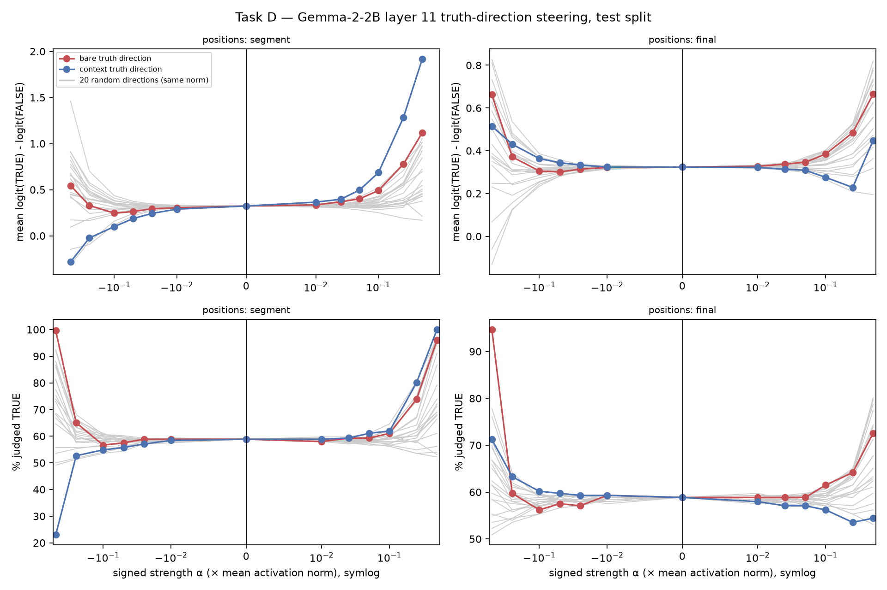
Backup B2: Gemma-2-2B Truth-Direction Steering
BACKUP · STEERING · NO SAE
EXPLORATORY
Layer-11 truth direction added at increasing strength; grouped GoT splits.
Each strength is compared with 20 random directions of the same norm; the registry notes a bias shift.
No SAE in the forward pass, so this is not evidence about SAE faithfulness.
Takeaway Exploratory only: steering a raw direction is a separate category from SAE faithfulness.
Source: results/gemma/steering_sweep_layer11/ (HISTORICAL since D23, appendix only; sae-research @ d5521c4)
Notes:
Backup B2 (old 24). results_registry.md: 'Gemma-2-2B truth steering (appendix only, D23)'. Use only if asked.

Slide 20
Backup B3: Reproducibility and Provenance
BACKUP
Item | Where
GPT-2 results, docs, registry | branch sae-research @ d5521c4 (PR #27)
Gemma M6 results and figures | branch simba-gemma-m6-results @ 4fd2706 (PR #28); run code 13eaeca
M6 integrity | SHA-256 of every output in run_info.json; gates V1–V5 pass; 85 tests passed
Pre-registration | results/*/README.md and preregistration.json before any run
Citable results | docs/results_registry.md (AUTHORITATIVE / VALID / SUPERSEDED / INVALID)
Evidence labels | TEST · CONFIRMED TEST · VALIDATION · EXPLORATORY · PRE-REGISTERED ONLY
Slide figures | presentation/assets/SOURCES.md (branch, commit, path, hash)
Takeaway Every number in the talk traces to a committed result file; speaker notes give the source for each slide.
Notes:
Backup B3 (old 25). Commit hashes as of 2026-11-14. Update after PR integration if necessary.

