Slide 1
Geometry of Truth
SAE Baseline Results
GPT-2 Small layer-8 residual stream → pretrained sparse autoencoder → TRUE vs FALSE feature differences
Headline result
Feature 14114 is the strongest TRUE-associated candidate; Feature 4133 is the strongest FALSE-associated candidate.
1,496 statements
748 TRUE / 748 FALSE
24,576 SAE features
SVG + CSV committed

Slide 2
Baseline pipeline
Goal: turn each labeled city–country statement into SAE feature activations and compare TRUE vs FALSE groups.
Geometry
statements
GPT-2
Small
Layer 8
residual
SAE
encode
Feature
matrix
TRUE vs FALSE
stats
Implementation details
What this baseline can and cannot prove
• Hook used: blocks.8.hook_resid_pre
• Representation: last non-padding token
• SAE release: gpt2-small-res-jb
• Output: 24,576-dimensional sparse vector per statement
It identifies candidate features whose activations differ between TRUE and FALSE examples. It does not yet prove causal truth representation.

Slide 3
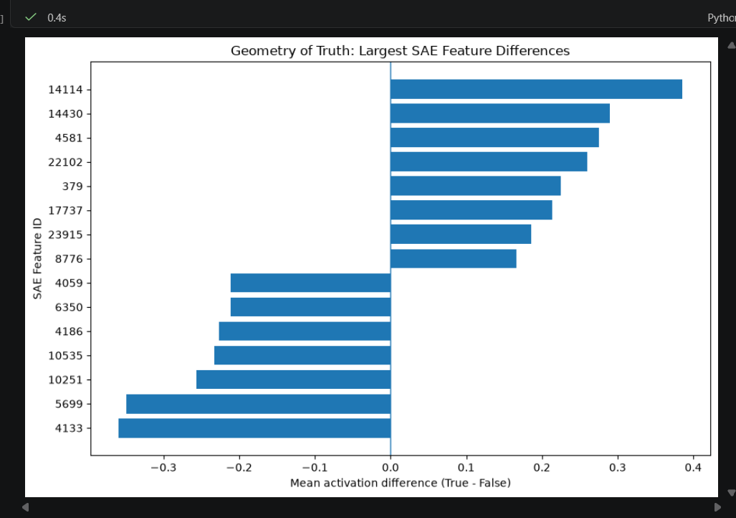
Largest SAE feature differences
Mean activation difference is computed as TRUE mean minus FALSE mean.
Read the chart
Right side: stronger activation for TRUE statements
Left side: stronger activation for FALSE statements
More distance from zero = stronger baseline separation
TRUE candidate
Feature 14114 • +0.385
FALSE candidate
Feature 4133 • −0.359

Slide 4
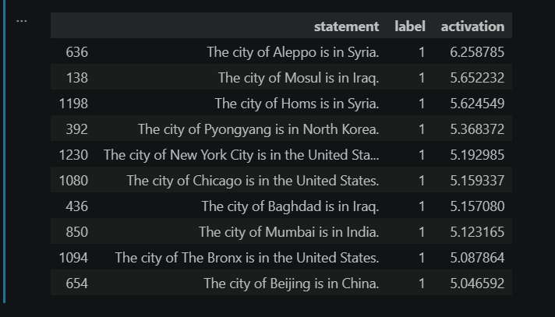
Feature 14114: strongest TRUE-associated candidate
Top activations were all TRUE city–country statements in the inspection table.
What the inspection shows
The highest activating examples include true statements such as Aleppo–Syria, Mosul–Iraq, Baghdad–Iraq, Mumbai–India, and Beijing–China.
Interpretation
Feature 14114 is a good candidate for follow-up because it preferentially activates on true examples in this dataset.
Caution
This may reflect familiar factual co-occurrence rather than abstract truthfulness. Causal tests are still needed.

Slide 5
Conclusion and next steps
Baseline is now in review and ready to become the foundation for steering and AWS work.
Baseline result
Next workflow
Some pretrained SAE features show systematic activation differences between TRUE and FALSE Geometry of Truth statements.
PR review
by teammate
Key candidates
• 14114: strongest TRUE-associated candidate
• 4133: strongest FALSE-associated candidate
• Results are associative, not yet causal
Merge to main
after approval
Causal tests
with fixed top-p
Artifacts committed
Notebook • feature statistics CSV • baseline SVG figure
AWS run
for scale-up
.

