Slide 1

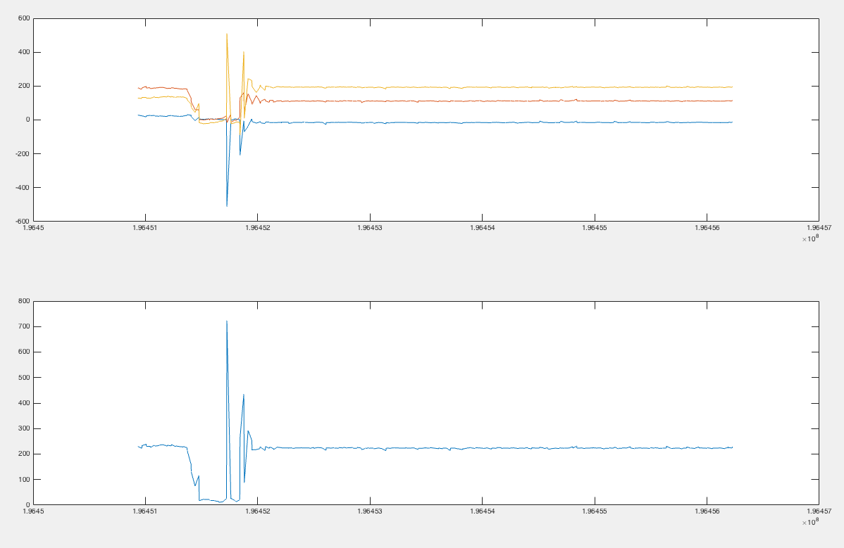
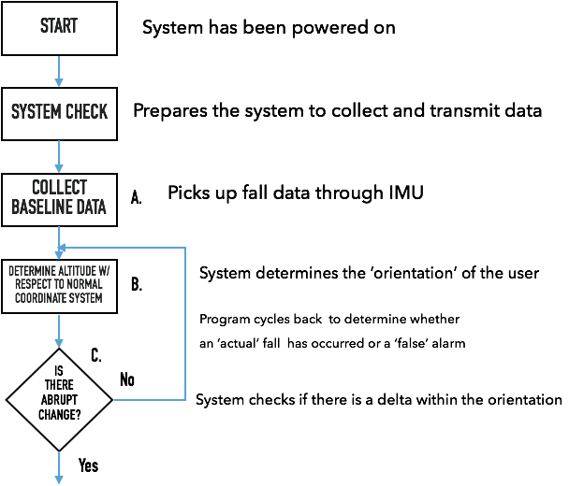
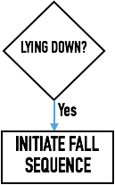

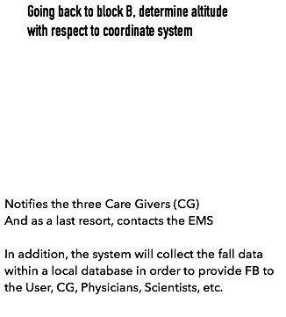
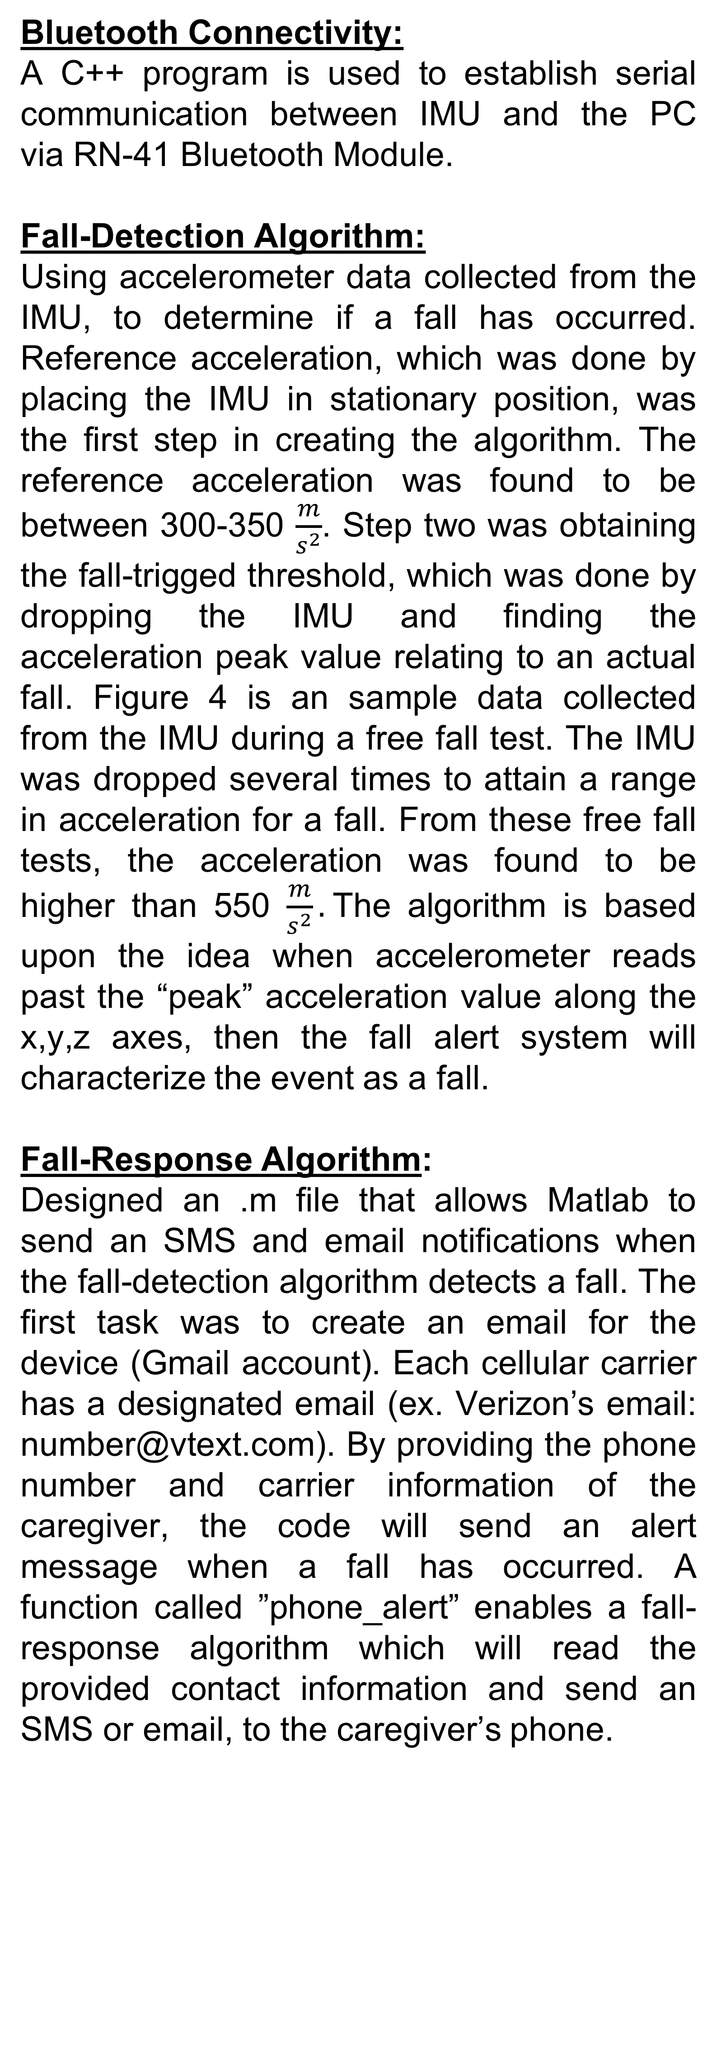
Self-Activating Fall Alert
Maisha Talukder, Michael McGrath, William Kelly
Advisors: Dr. Mohammad Imitiaz, Dr. Jing Wang, Dr. In Soo Ahn
Department of Electrical and Computer Engineering
Objectives
Parts List
Design Approach
Testing:
A self-activating fall alarm can shorten the rescue response time and duration of treatment.
This project aims to develop a wearable prototype.
The fall alarm device is designed to be “invisible” to the user (as part of clothing or jewelry), dependable, user-friendly, self-activating, and provides post biometric data analysis.
With this low-power, wireless device, medical doctors can access a person who may have a tendency of fall to prescribe some fall prevention exercise and appropriate advice.
9 degrees of freedom- Razor Inertial Measurement Unit (IMU)
Three axis-accelerometer, -magnetometer, and –gyroscope
On-board Atmega328 microcontroller
Sparkfun RN-41 Bluetooth Mate Gold
JST connector cables
Lithium Ion Battery - 400 mAh
LiPo Charger – Single Cell 3.7-7V input
Bluetooth Connectivity:
A C++ program is used to establish serial communication between IMU and the PC via RN-41 Bluetooth Module.
Fall-Detection Algorithm:
Using accelerometer data collected from the IMU, to determine if a fall has occurred. Reference acceleration, which was done by placing the IMU in stationary position, was the first step in creating the algorithm. The reference acceleration was found to be between 300-350 $\frac{m}{s^{2}}$. Step two was obtaining the fall-trigged threshold, which was done by dropping the IMU and finding the acceleration peak value relating to an actual fall. Figure 4 is an sample data collected from the IMU during a free fall test. The IMU was dropped several times to attain a range in acceleration for a fall. From these free fall tests, the acceleration was found to be higher than 550 $\frac{m}{s^{2}}.$The algorithm is based upon the idea when accelerometer reads past the “peak” acceleration value along the x,y,z axes, then the fall alert system will characterize the event as a fall.
Fall-Response Algorithm:
Designed an .m file that allows Matlab to send an SMS and email notifications when the fall-detection algorithm detects a fall. The first task was to create an email for the device (Gmail account). Each cellular carrier has a designated email (ex. Verizon’s email: number@vtext.com). By providing the phone number and carrier information of the caregiver, the code will send an alert message when a fall has occurred. A function called ”phone_alert” enables a fall-response algorithm which will read the provided contact information and send an SMS or email, to the caregiver’s phone.
Holding the enclosed IMU at waist level, the group measured the range of connectivity of the Bluetooth.
The device was found to still be connected over a 100 feet of open air range.
Difference scenarios of false-positives were tested, such as sitting down, laying down to resemble going to bed, etc. were executed. The algorithm did not detect these motions as falls.
Bluetooth
Mate Gold
GND <--> GND
9DoF Razor
IMU
3.3V <--> 3.3V
TXO <--> RXI
RXI <--> TXO
Significance
3.3V
LiPo Charger
JST connector
LiPo Battery (400mah)
Every 11 seconds an elderly person is treated in a hospital due to a fall, and every 19 minutes an elderly dies from a falling incident
According to the Center for Disease Control and Prevention, 1 out of 5 falls results in a serious injury such as broken bones, like wrist, arm, ankle, hip fractures, or head injuries [1].
The elderly population (those aged 65 and older) has increased from 35.9 million to 44.7 million (24.7% increase) between 2003 and 2013.
About 28% (12.5 million) of noninstitutionalized older people live alone (8.8 million women, 3.8 million men), and almost half of older women (46%) age 75+ live alone [2].
The product is targeted primarily to these elderly who are living independently, to give them assurance in case of an emergency they will receive aid in a concise manner.
Figure 2. System Schematic
System Overview
Figure 4. Freefall Acceleration Plot
Conclusion
Continuation of the self-activating fall alert
system will include development in:
Fall-detection algorithm to completely eliminate false-positives
Effectively allocate biometric data for future research
Increased battery life and range of Bluetooth connectivity
Utilizing a Raspberry Pi as a ’home base’ station in replacement of a computer
Incorporating user’s location through GPS
System designed to be attached around a user’s waist
References
Figure 3. System Flow Chart
[1] "Important Facts about Falls." Centers for Disease Control and Prevention. Centers for Disease Control and Prevention, 10 Feb. 2017. Web. 07 Apr. 2017
[2] "Administration on Aging (AoA)." AoA. N.p., n.d. Web. 07 Apr. 2017.

