Slide 2
Concept
A small, wheeled vehicle that can be wirelessly controlled from a PC via an Xbox 360 Controller
Features an IR Rangefinder mounted on a hobby servo that scans the area in front of the vehicle and records distance information
Wirelessly sends distance data back to the PC to be displayed as a 2-D map

Slide 3
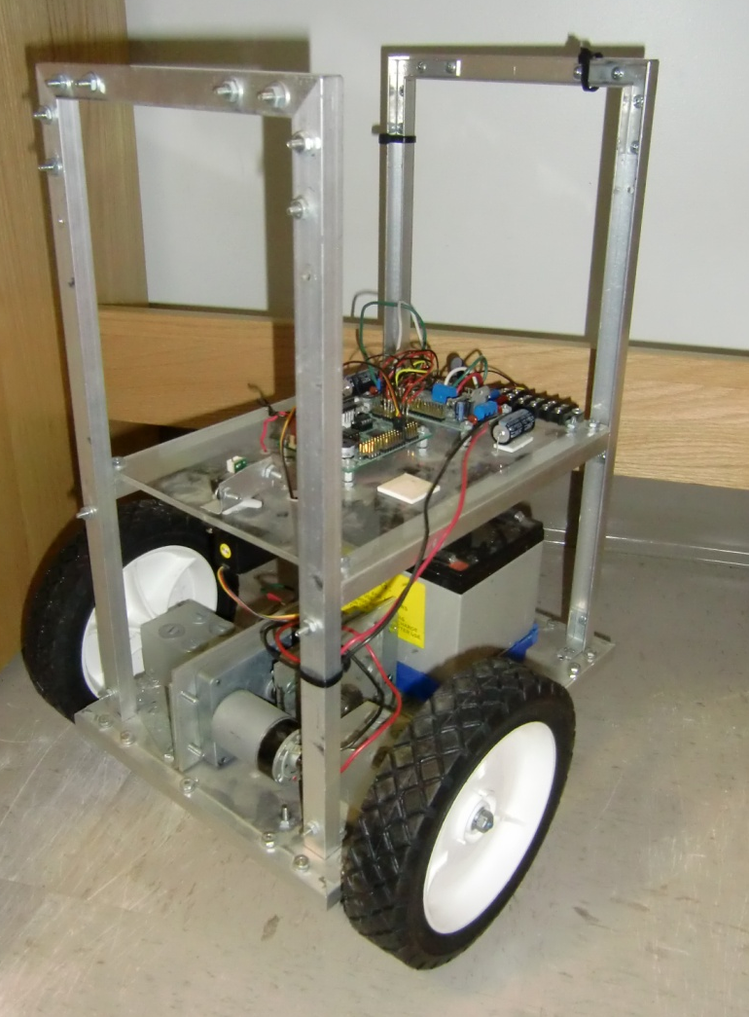
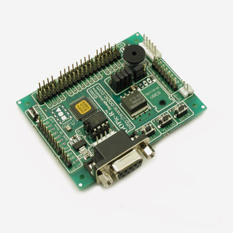
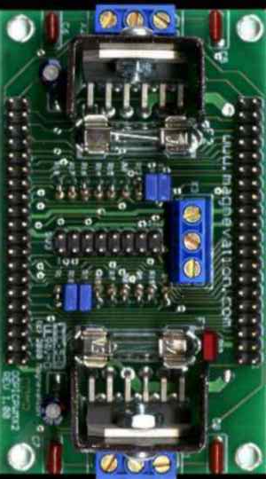
Platform
A vehicle with two independent drive wheels and a caster. Features:
Independent gear motors for propulsion and steering
A 12v, 12 Ah lead acid battery for power.
An OOPic R Microcontroller for motor, servo, and IR Rangefinder control
A Magnevation Dual H-Bridge motor controller to drive the gear motors

Slide 4
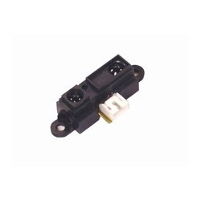
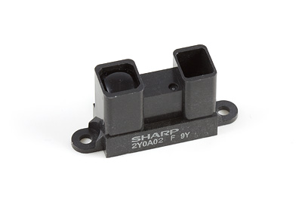
IR Rangefinders
2 Sharp GP2D12 and 1 Sharp 2Y0A02 Rangefinders available
GP2D12 has a range of 10 to 80 cm
2Y0A02 has a range of 20 to 150 cm

Slide 5
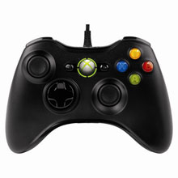
Control
The user will control the vehicle using a PC program written in Java. The primary input device will be a wired xbox 360 controller
The program will display a 2-D, top-down map of any objects or walls in front
of the vehicle

