Slide 1
Vertex Cover Analysis:
Brute Force vs. Greedy vs. 2-Approximation
Kailyn Culpepper, Mitchell Korody, Anthony Pfaff

Slide 2
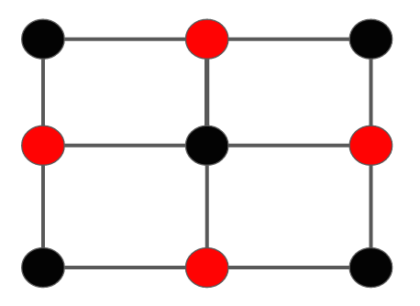
What is Vertex Cover?
A set of vertices including at least one endpoint of every edge
Minimum Vertex Cover = smallest possible set

Slide 3
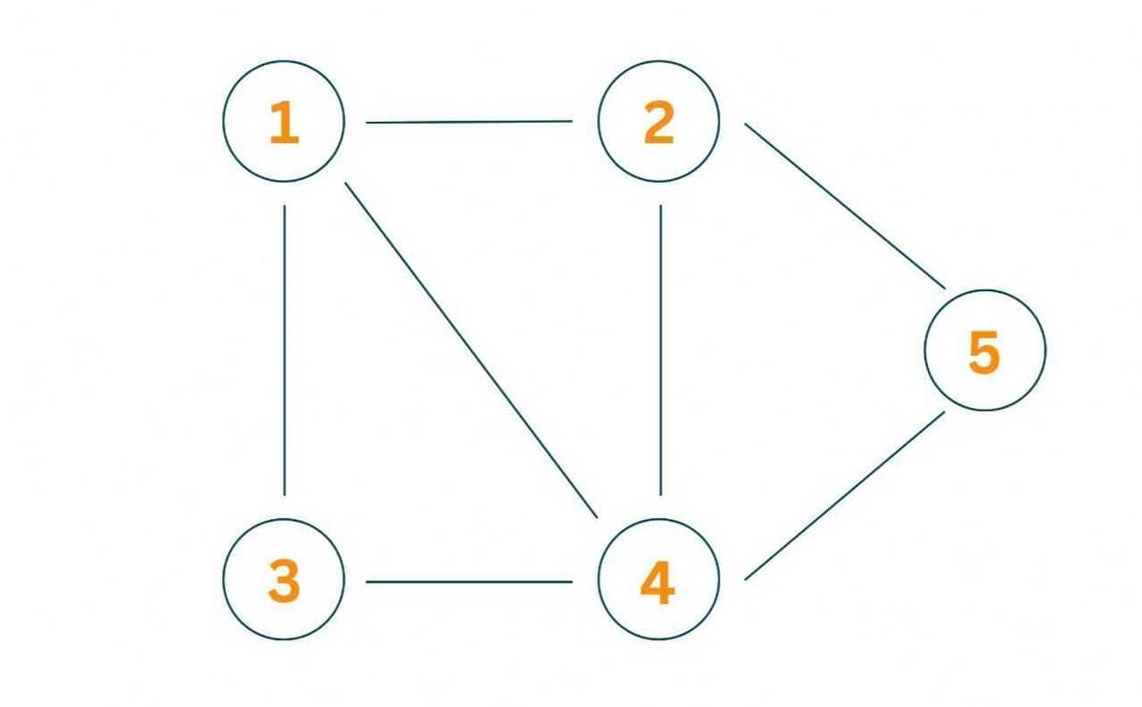
Algorithms Analyzed
Brute Force
Greedy Approximation
2-Approximation (matching)

Slide 4
Research Questions
How do the algorithms compare in solution quality and runtime?
How does increasing graph size impact runtime for each algorithm?
Clear performance differences
Demonstrates optimization trade-offs
Fits course concepts

Slide 5
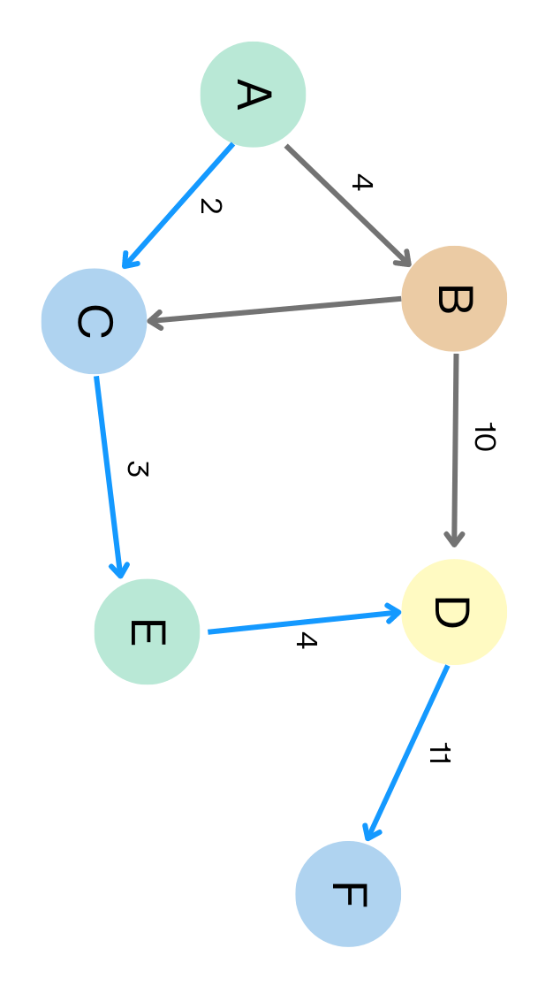
Methods & Implementation
Implemented in C++
User input
Graph type: random, complete, cycle, path
Number of vertices
Edge probability
Outputs
Vertex cover size
Selected vertices
Execution time (ms)
Basic Operations
Percent Optimal

Slide 6
Testing Setup
Vertex counts tested: 5, 10, 15, 20, 25
System used:
Intel i9-12900KF (3.20 GHz)
32 GB DDR5 RAM
Notes:
Brute Force becomes extremely slow past ~25 vertices
One test per algorithm for each vertex count
Only tested random graphs

Slide 7
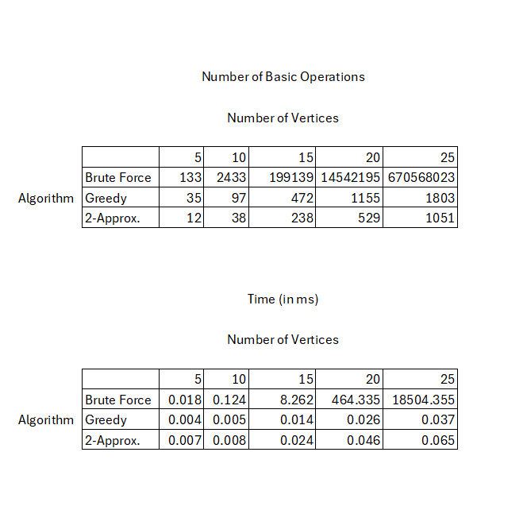
Results Overview
Brute Force: Always optimal, extremely slow
Greedy: Good balance of speed + accuracy
2-Approximation: Fastest, least optimal
Brute Force: 18.5 seconds, 100% optimal
Greedy: 0.037 ms, 93.8% optimal
2-Approx: 0.009 ms, 62.5% optimal

Slide 8
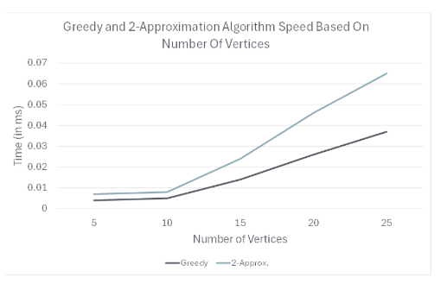
Runtime Comparison
Brute Force grows exponentially
Greedy increases moderately
2-Approximation stays relativly consistent
(Brute Force excluded due to scale)

Slide 9
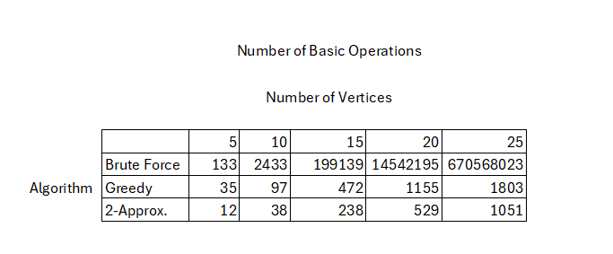
Basic Operations
Brute Force operations increase exponentially with graph size
Greedy shows moderate growth as vertices increase
2-Approximation consistently performs the fewest operations
Clear trade-off between accuracy (Brute Force) and efficiency (2-Approx)

Slide 10
Limitations and Future Work
Limitations:
Could not test higher vertex counts
Limited time and computing resources
Future Work:
Test more vertex cover algorithms
Explore additional graph types
Compare random vs. real-world graph data

Slide 11
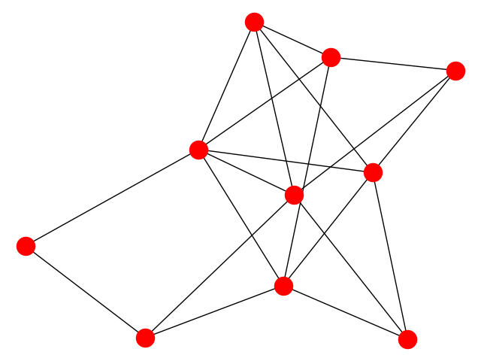
Tools Used
Zybooks
In-class PowerPoints
Stack Overflow
Claude (brainstorming & debugging)

