Slide 1
B37VB2
C Programming for Engineers
Unit 1d: Introduction to Borland C

Slide 2
AIMS
In this unit, we will be considering the following topics:
  How to use the Borland C++ programming environment installed in EM252 and EM181 to create and run C programs.

Slide 3
Getting Started - Running Borland C++
To use the Borland package, first log on to one of the PCs in 2.52.
The Borland 5 program resides in the “Start -> All Programs -> HW programs -> Borland -> Borland C++” menu.
If you cannot find it, ask for help immediately

Slide 4
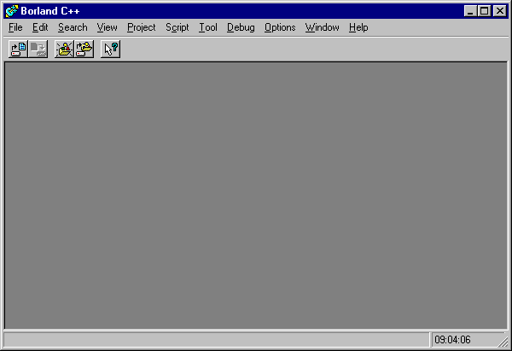
Using the Borland C++ package
The following window will appear on your desktop:

Slide 5
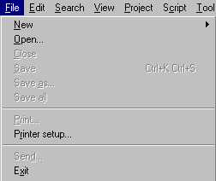

Opening a new "project"
Borland C++ stores all information about a program in a "project file".
  To create a new project file, click on File in the menu bar.
  Select New on the drop down menu and select Project.

Slide 6
The Borland C++ "project"
The "project" is a feature of Borland C++ that is used to organise all the different files required by a single program.
  We shall see later, that it is possible to split one C program over a number of different files.
  The idea of a project is entirely to do with the package that we are using, and has nothing to do with the C programming language.
  Project files are terminated in the file extension ".ide", which stands for Integrated Development Environment.

Slide 7
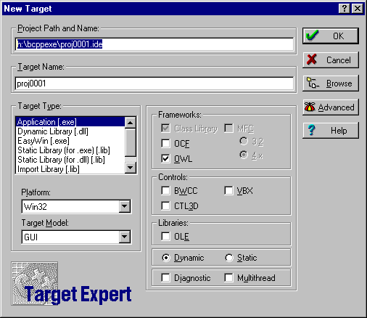
Creating a project
A dialogue window will appear, as shown below:
1
3
2
There are 3
points to note:

Slide 8
Creating a project
  The project path and name
  A path is the directory where the project file is stored. The default path is "h:\bcppexe\" where h: is your "root" directory and bcppexe is the directory containing the Borland C++ files. You can type in the name of a new directory (e.g. "h:\cprogs\" ) if you prefer. Borland C++ will create this directory.
  The package will provide a default project name (e.g. proj0001.ide). You may provide your own name (e.g. "hello.ide" ).
1
NOTE: All directory and file names used in Borland C++
should obey the DOS naming convention :-
use only letters, digits, and the underscore character "_"
and no more than 8 characters per directory/file name.

Slide 9
Creating a project
  The "Target Type"
  This is another feature that is specific to the package Borland C++ and not the C programming language. All of the programs that we shall write will have the " EasyWin [.exe] " target type.
  Compiling C on the C++ Borland compiler
  As indicated by its name, Borland C++ is actually a C++ compiler. C++ is a programming language that was developed from C. To make the package pretend that it is actually a C compiler, we need to select the Advanced option button.
  This will pop up a new dialogue box. Simply click on the "tick box" named ".c Node" and select OK.
2
3

Slide 10
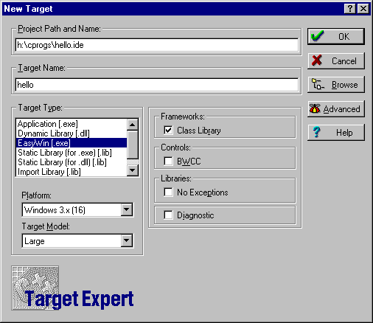
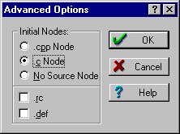
Selecting the options
4
select
OK
enter path
and name
1
3
click
Advanced
select
EasyWin
2
3a
select
.c node

Slide 11
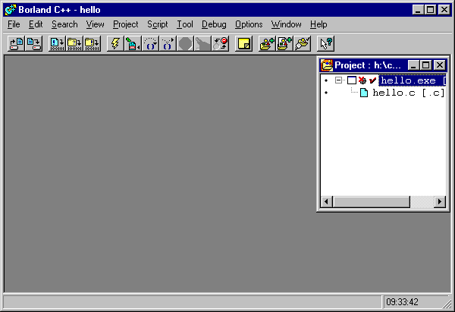
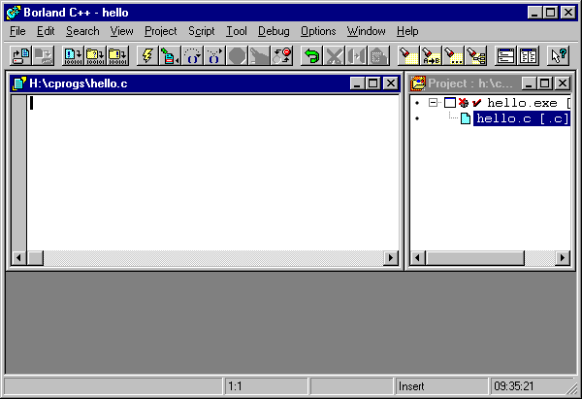
Editing the program
You will be presented with a project window, containing icons for the files hello.c and hello.exe.
editor window
appears
2
1
click
hello.c

Slide 12
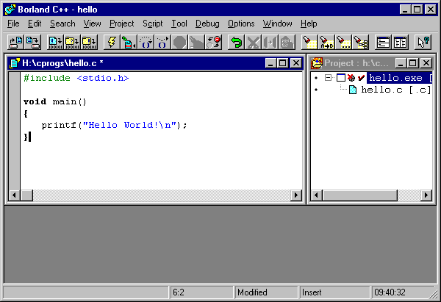
Entering the program
When the editor window appears, simply type in the text of your program.

Slide 13
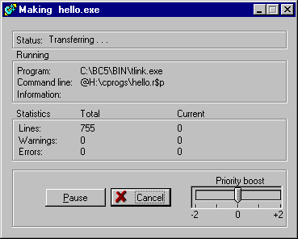
Compiling and Running
To compile and run your program, click on the “lightning” icon:
  A window appears indicating that the program is being compiled and linked.
click

Slide 14
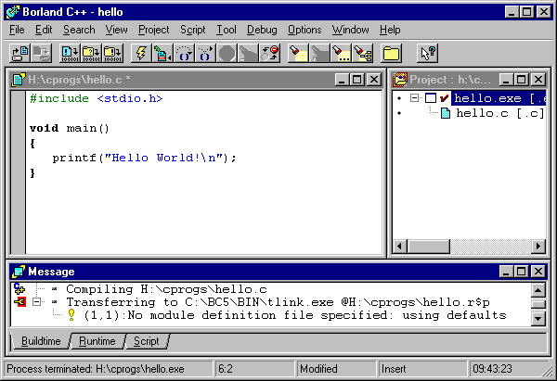
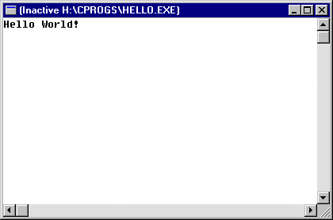
Program execution
If there are no errors, a window will appear displaying any output, and allowing data input.
To quit window
click here.
Program input
and output takes
place in window.
Any errors are
displayed in
this window.

Slide 15
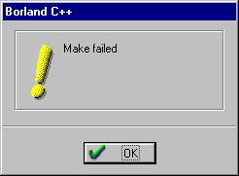
Error reporting
If there is a problem with your code, a warning box will appear:

Slide 16
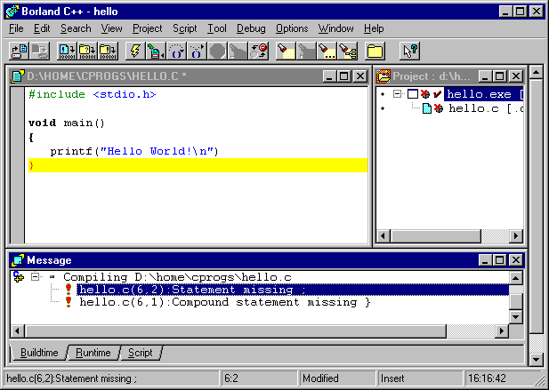
Locating errors
If your program has an error, a message will appear in the bottom window:
Any errors are
displayed in
this window.
Clicking on the
error message will
take you to the line.

Slide 17
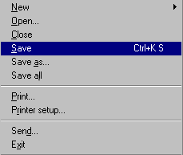
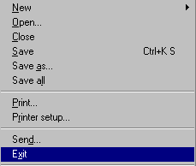
Saving and quitting
Once you have entered and run a program, you can save it and quit the package.
To save
project
click Save
To exit
package
click Exit

Slide 18
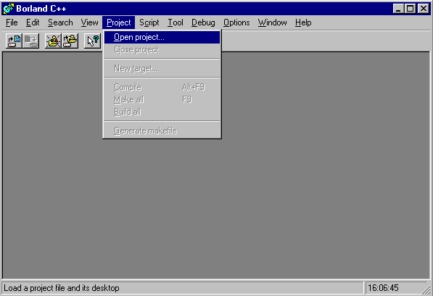
Opening an existing project
To open an existing project, start Borland C++ as before and select Open project under the Project menu item.

Slide 19
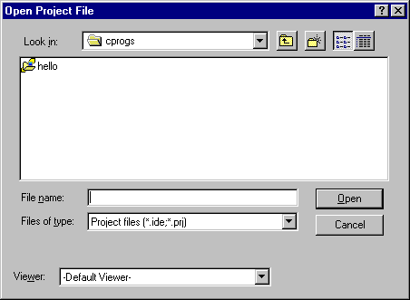

Opening an existing project
A dialogue box will appear as shown below:
  The project will appear in the main window as before.
Select directory
here.
Double click on
project icon.

