Slide 1
B37VB2
C Programming for Engineers
Unit 1e: Introduction to Visual C++ 6.0

Slide 2
AIMS
In this unit, we will be considering the following topics:
  How to use the Microsoft Visual C++ 6.0 programming environment to create and run C programs.

Slide 3
Getting Started - Running Visual C++ 6.0
To use the VC++6.0 package, first log on to one of the PCs.
The VC++6.0 program resides in the “Start -> All Programs -> Microsoft Visual C++ 6.0 -> Microsoft Visual C++ 6.0 ” menu.
If you cannot find it, ask for help immediately

Slide 4
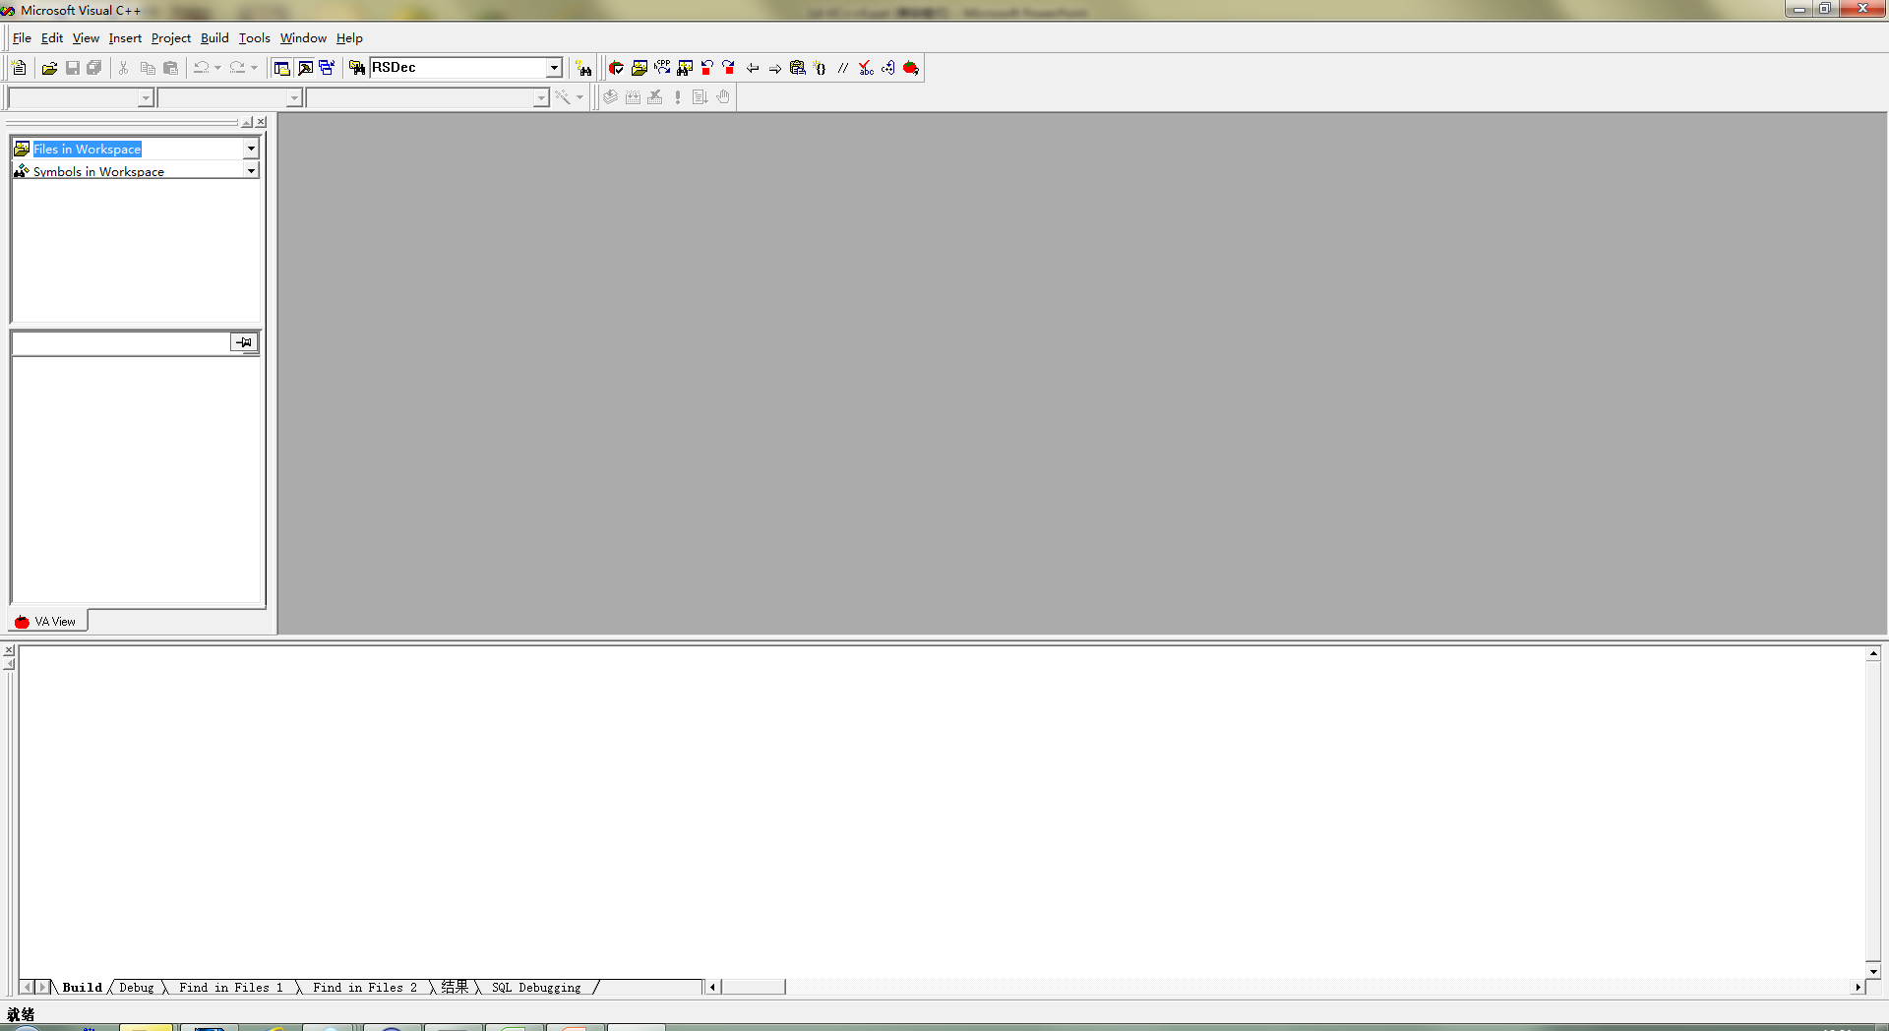
Using the Borland C++ package
The following window will appear on your desktop:

Slide 5
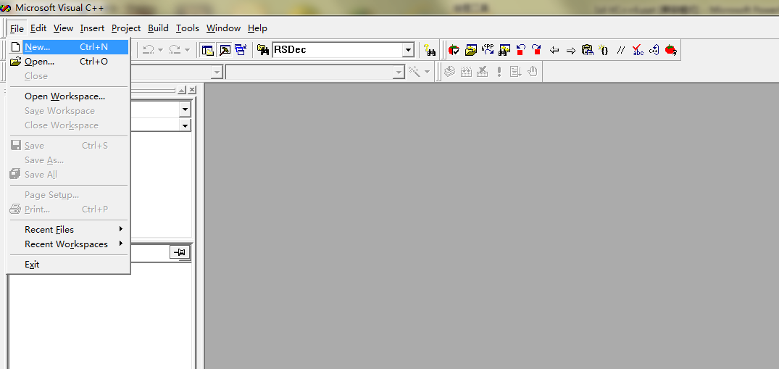
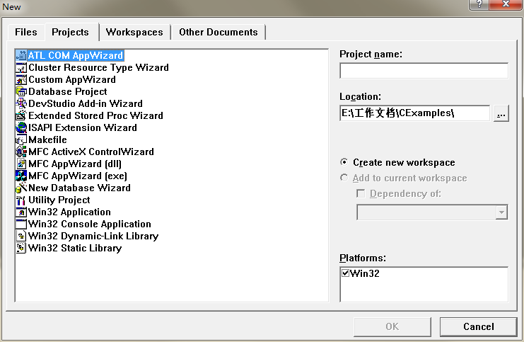
Opening a new "project"
VC++6.0 stores all information about a program in a "project file".
  To create a new project file, click on File in the menu bar.
  Select New on the drop down menu and select Projects Label on the pop up menu.

Slide 6
The VC++6.0 "project"
The "project" is a feature of VC++ 6.0 that is used to organise all the different files required by a single program.
  We shall see later, that it is possible to split one C program over a number of different files.
  The idea of a project is entirely to do with the package that we are using, and has nothing to do with the C programming language.
  When you create a “project” you will also create a “workspace” . Workspace files are terminated in the file extension “.dsw“. You can create a number of projects in one workspace.

Slide 7
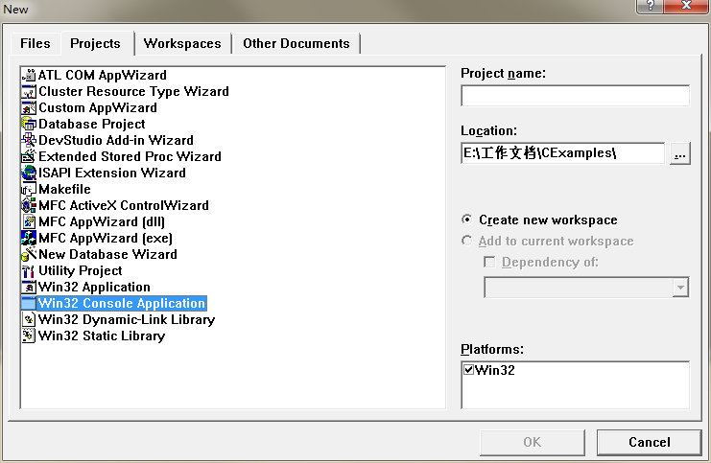
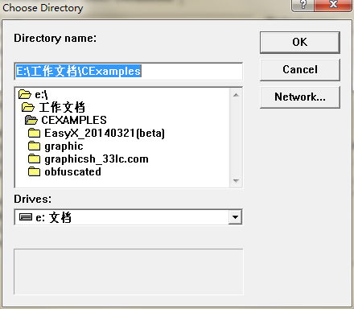
Creating a project
A dialogue window will appear, as shown below:
2
1
There are 2
points to note:

Slide 8
Creating a project
  The “Project Type"
  All of the programs that we shall write will have the " Win32 Console Application" project type.
  The project path and name
  A path is the directory where the project file is stored. The default path is “F:\B37VB\" where F: is your "root" directory and B37VBis the directory containing the VC++ 6.0 C source files. You can type in the name of a new directory (e.g. “F:\mine\" ) if you prefer. VC++ 6.0 will create this directory.
  The package won’t provide a default project name (Unlike the VS2012). You may provide your own name (e.g. “ProjectOne" ).
1
2
NOTE: All directory and file names used in VC++ 6.0
should obey the Windows naming convention :-
use only letters, digits, and the underscore character "_" .

Slide 9
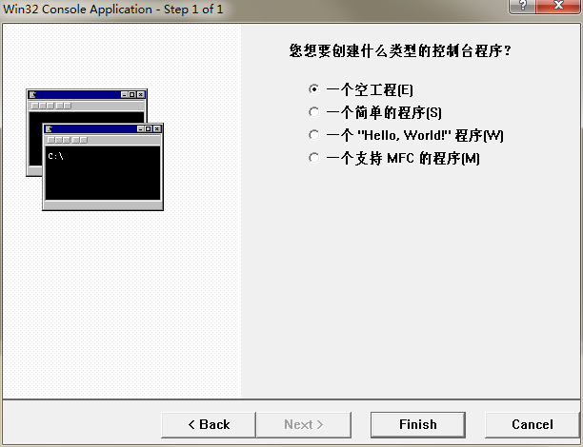
Project type
You may select “an empty project” on the pop up menu.

Slide 10
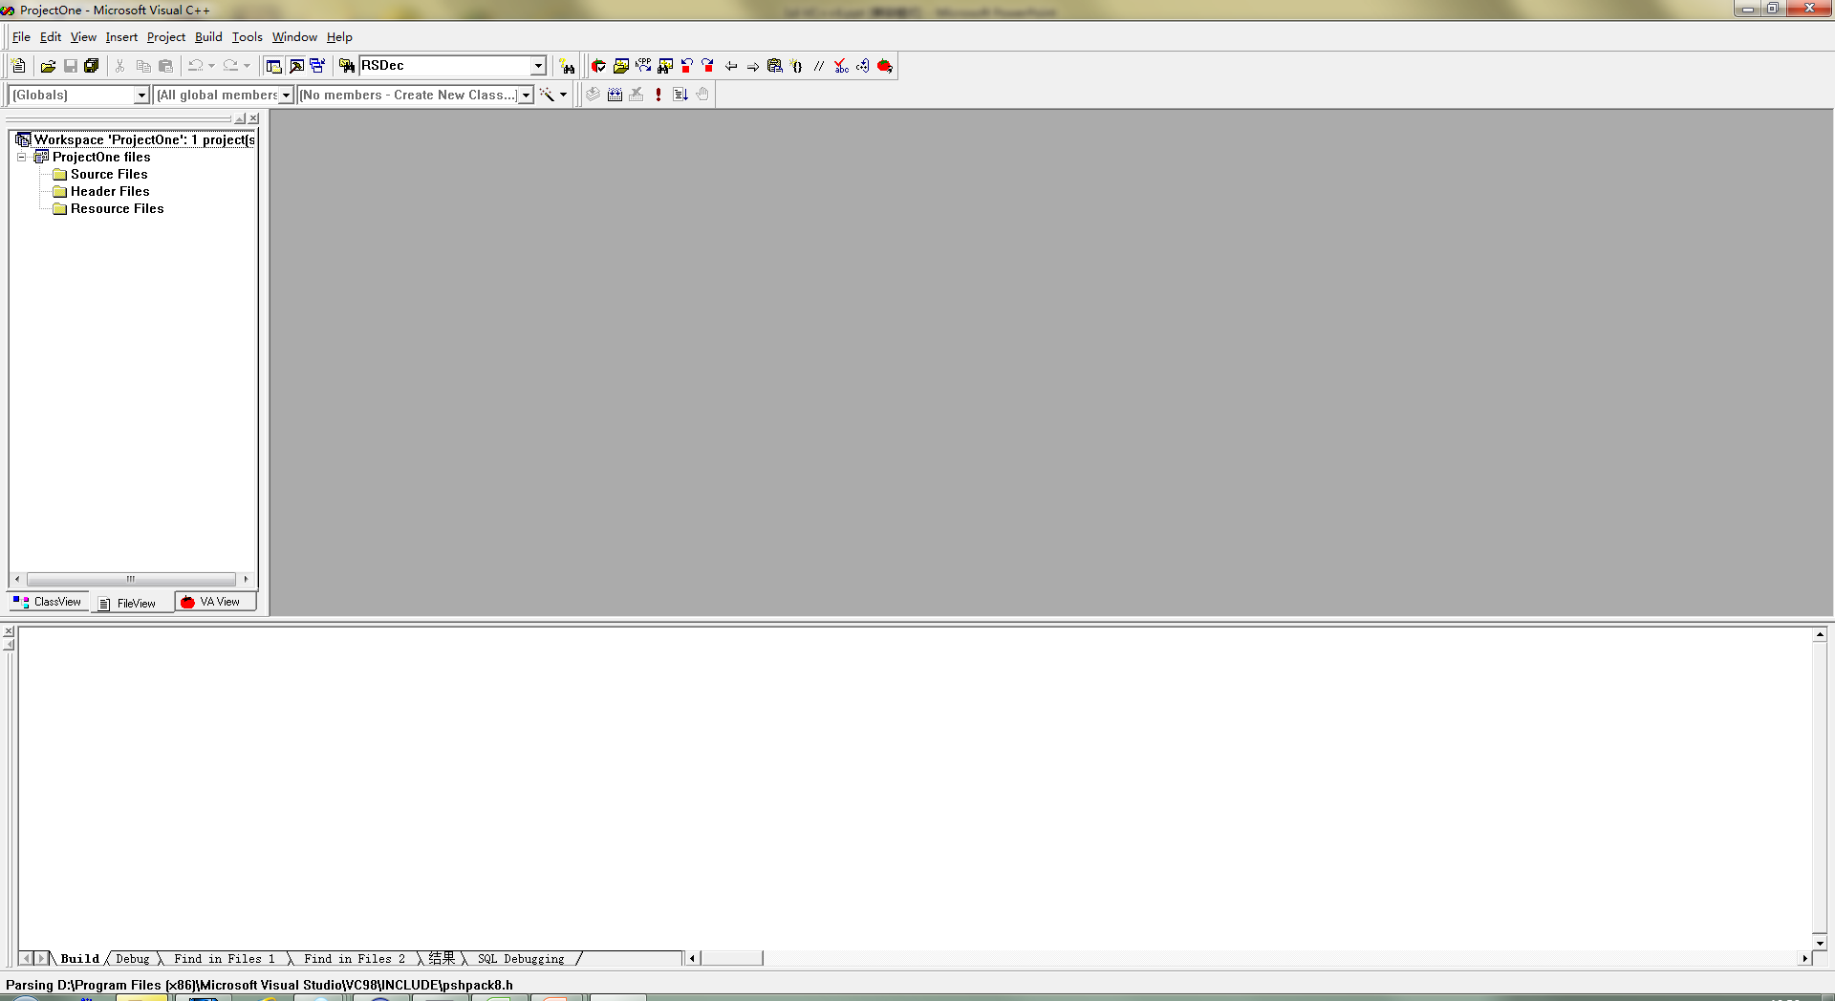
The view of a created project
4
Tools window
Edit window
1
3
Workspace
Output window
2

Slide 11
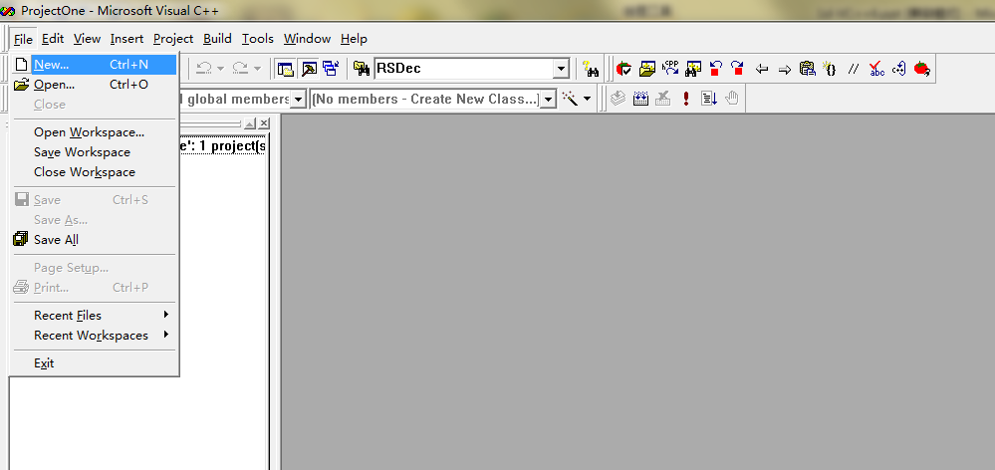
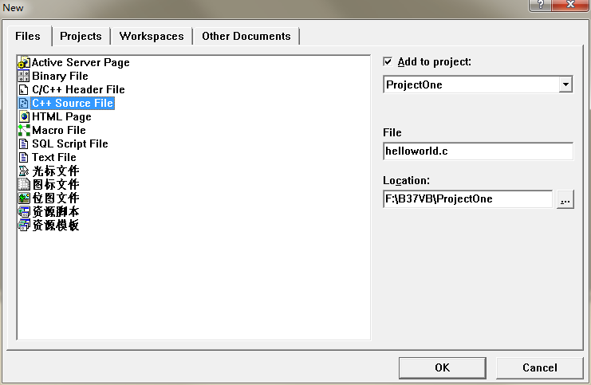
Add a new source file
Choose the “New” on the drop down list of “File” menu.
Choose “C++ Source File” on the “Files” Label.
Files Label
2
Name with suffix
“.c”
1
3
File->New

Slide 12
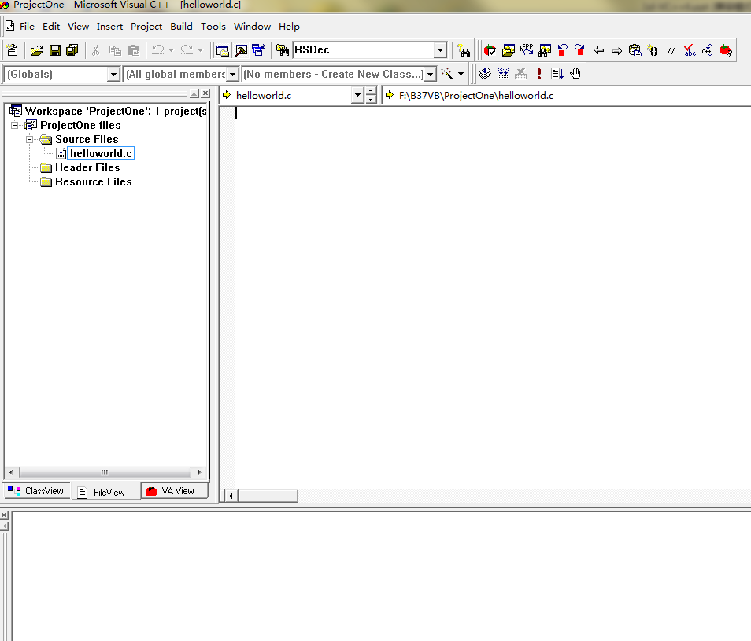
Editing the program
You will be presented with a project window, containing icons for the files helloworld.c.
editor window
appears
2
click
helloworld.c
1

Slide 13
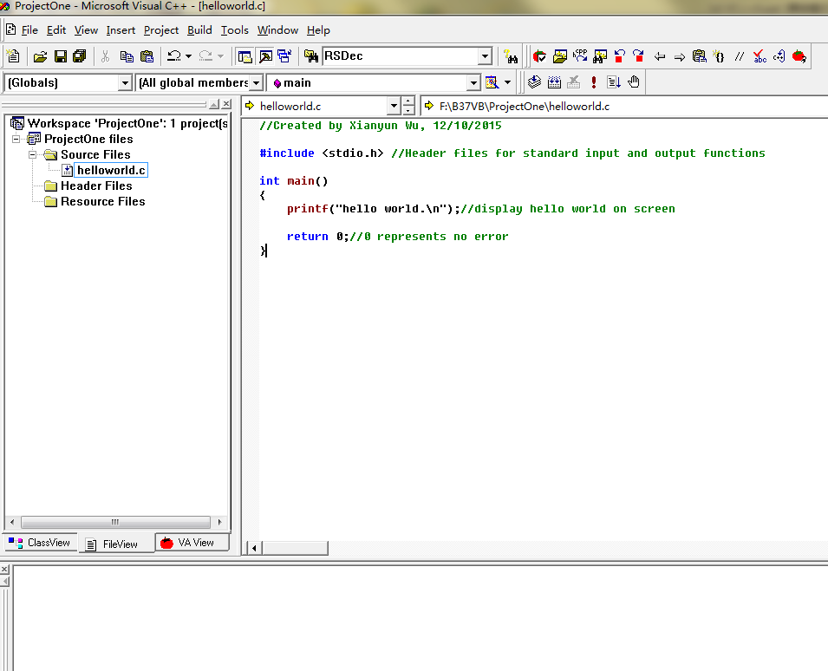
Entering the program
When the editor window appears, simply type in the text of your program.
Edit here
1

Slide 14
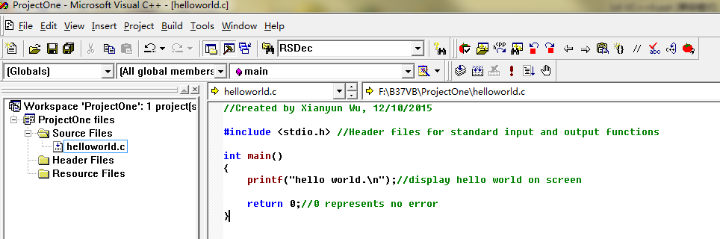
Compiling and Running
To compile and run your program, click on the “Compile” icon:
  The output window display information and indicating that the program is being compiled and linked.
click

Slide 15
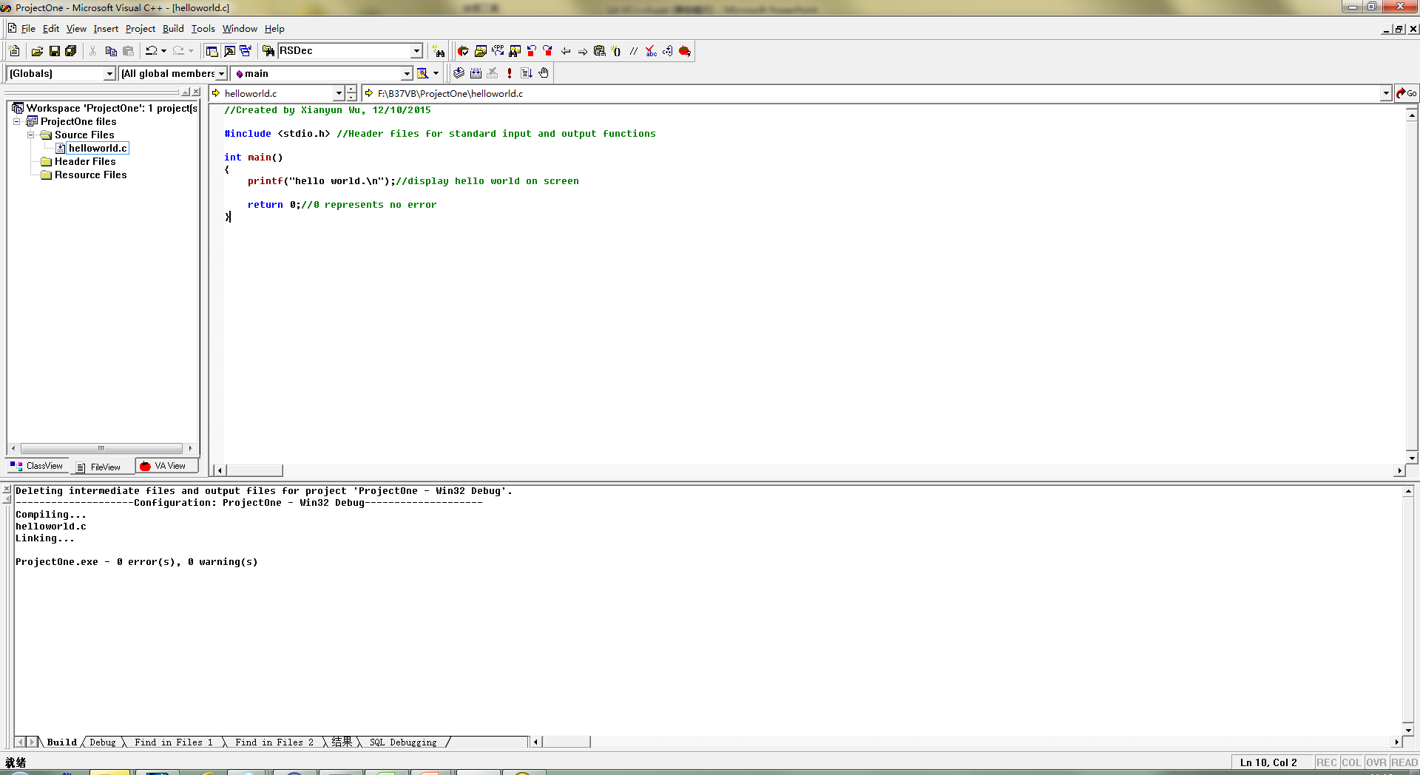
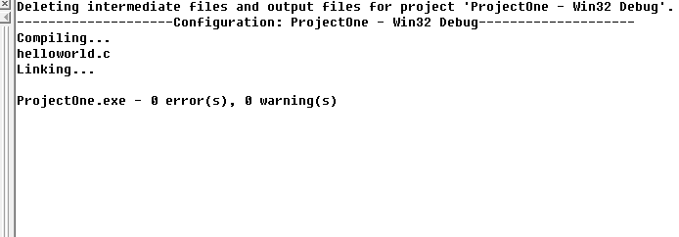
Program compile and link
If there are no compile errors, output window will displaying compile and link information.
Program input
and output takes
place in window.
Any errors and warinings are displayed in this window.

Slide 16
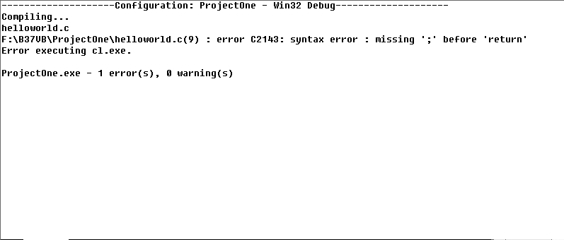
Error reporting and locating
If there is a problem with your code, error and warning informatio will display in output window:
The error is located in line 9.
The error code is C2143.
Detail information
Double click the
error message will
take you to the line.

Slide 17
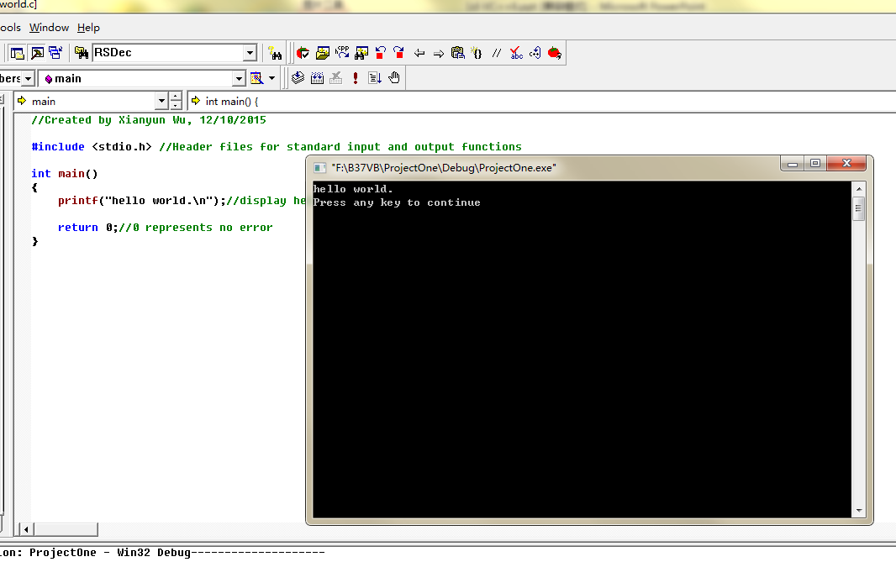
Program execution
If there are no errors, a terminal window will appear displaying any output, and allowing data input.
Click the icon here
Program input
and output takes
place in window.

Slide 18
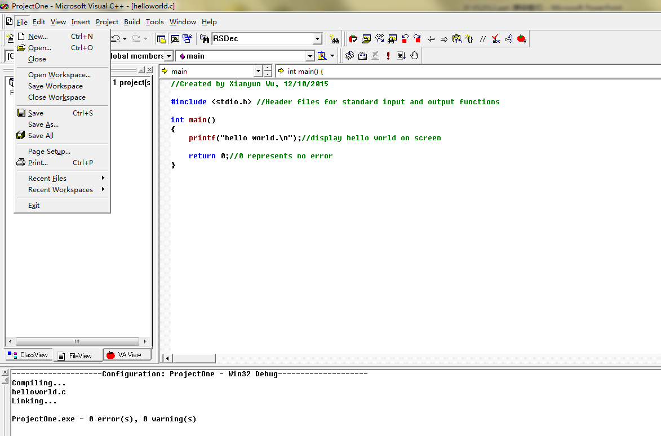
Saving and quitting
Once you have entered and run a program, you can save it and quit the package.
To save
project
click Save
Open existing workspace
click Open Workspace
To exit
package
click Exit

Slide 19
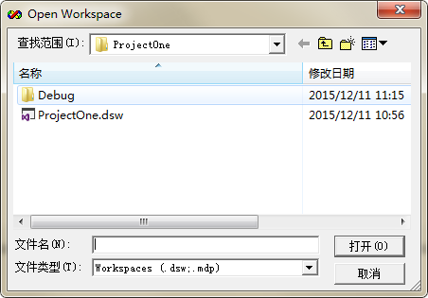
Opening an existing workspace
To open an existing workspace, start VC++ 6.0 as before and select Open Workspace under the File menu item.
Choose the existing
workspace and click
Select directory
here.
Double click or click
the open button

Slide 20
Homework
What’s the difference between C project and C++ project?
What other project types can you created in VC++ 6.0?
How to debug a program if your code has a bug?

