Slide 1
B37VB2
C Programming for Engineers
Unit 1f: Introduction to Xcode on MAC

Slide 2
AIMS
In this unit, we will be considering the following topics:
  How to use the Xcode programming environment on MAC system to create and run C programs.

Slide 3
Getting Started – Running Xcode
To use the Xcode package, first log on to one of the PCs.
Click the Xcode application icon.
If you cannot find it, ask for help immediately

Slide 4
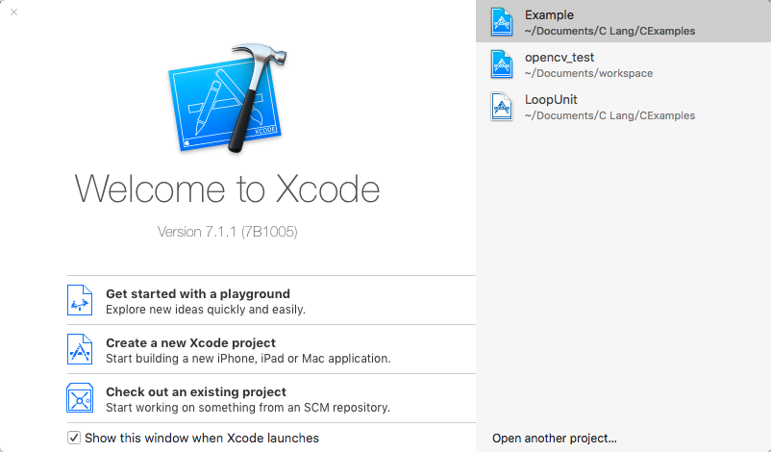
Using the Xcode
The following window will appear on your desktop:

Slide 5
Opening a new "project"
Xcode stores all information about a program in a "project file".
  To create a new project file, select Create a new Xcode Project.

Slide 6
The Xcode "project"
The “project” is a feature Xcode that is used to organize all the different files required by a single program.
  We shall see later, that it is possible to split one C program over a number of different files.
  The idea of a project is entirely to do with the package that we are using, and has nothing to do with the C programming language.

Slide 7
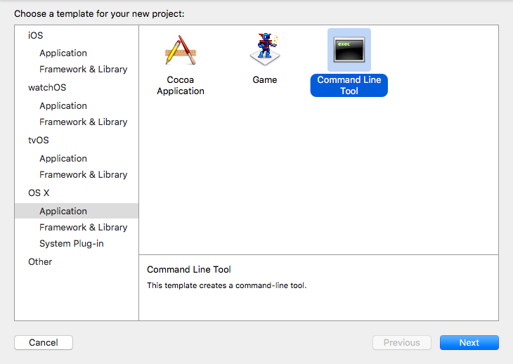
Creating a project
A dialogue window will appear, as shown below:

Slide 8
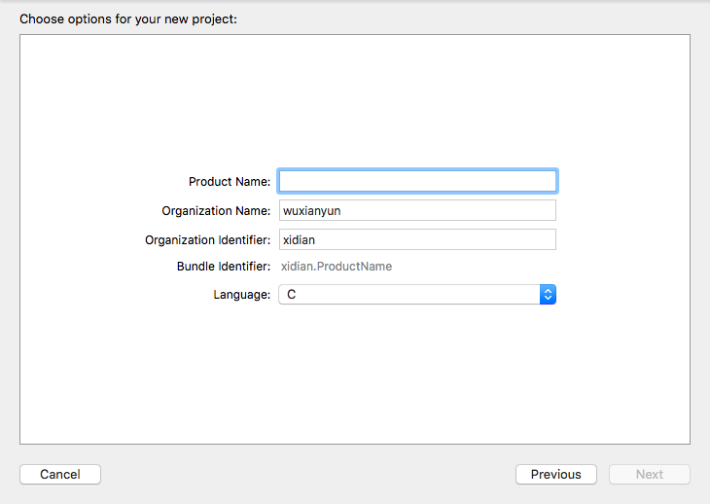
Name your project and Select C

Slide 9
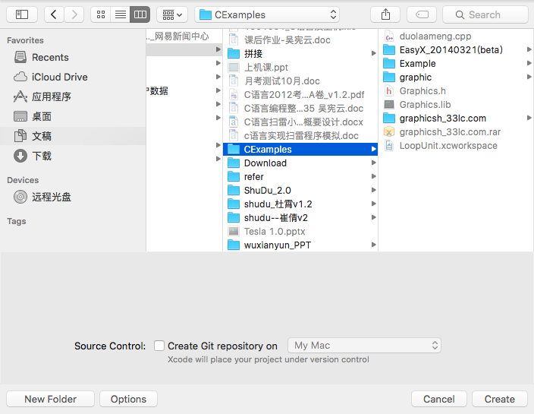
Choose project directory

Slide 10
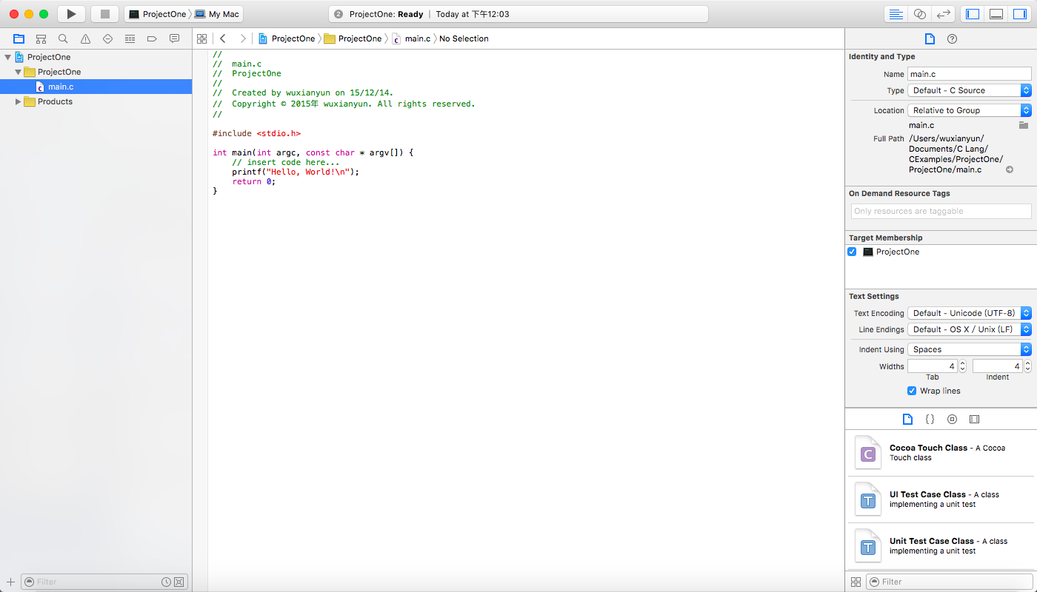
Edit Window

Slide 11
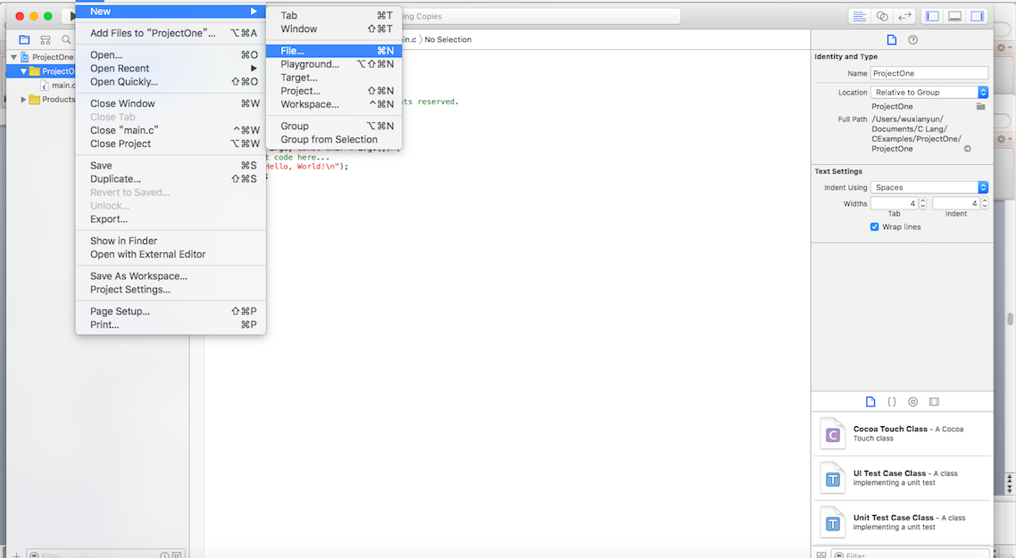
Add new file

Slide 12
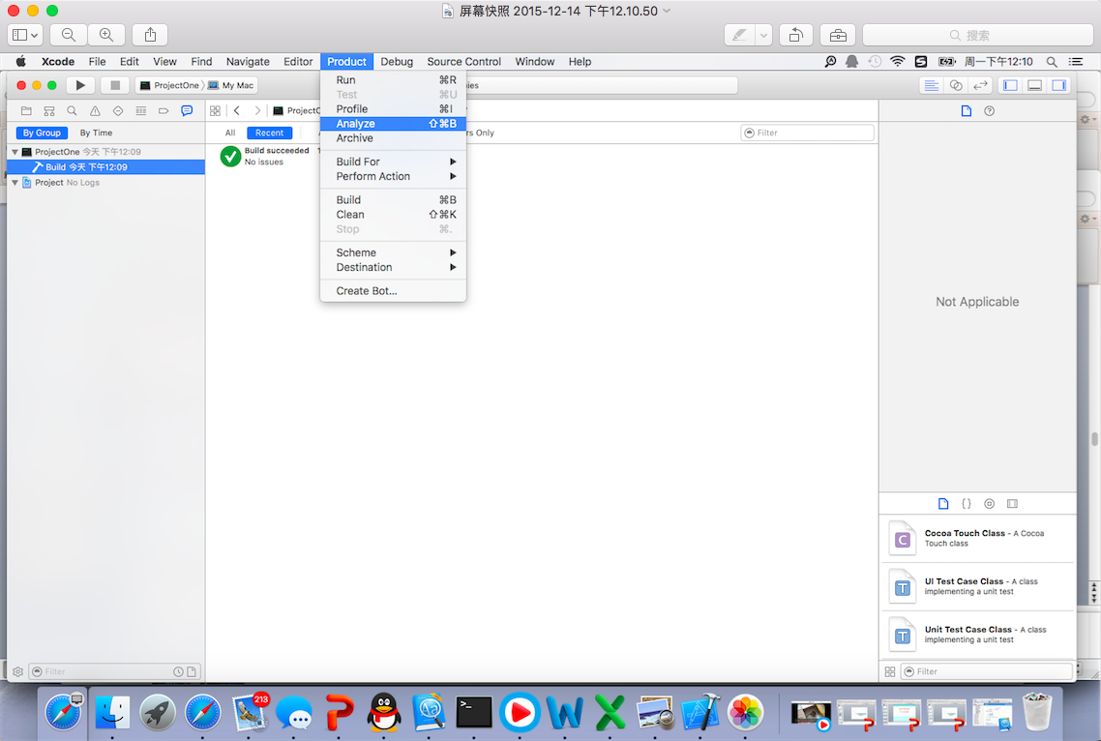
Build & run your product

Slide 13
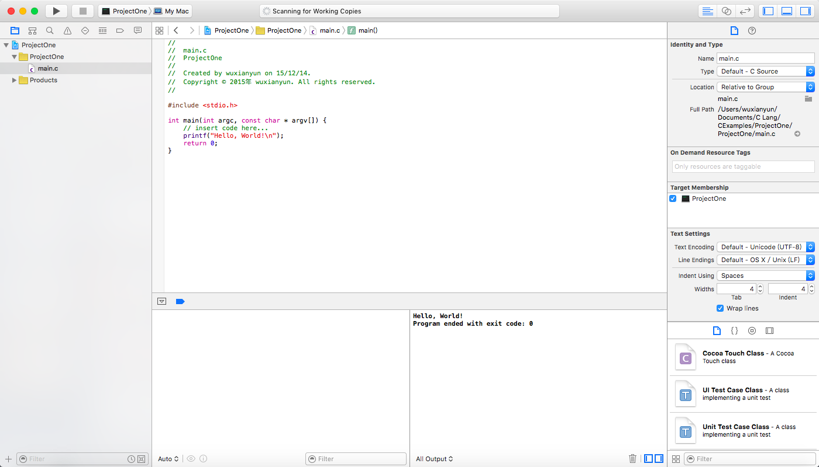
Program execution
If there are no errors, the output window will display build success.
Any errors are
displayed in
this window
Source file list in
this window
Editing window
Input & output in this window

Slide 14
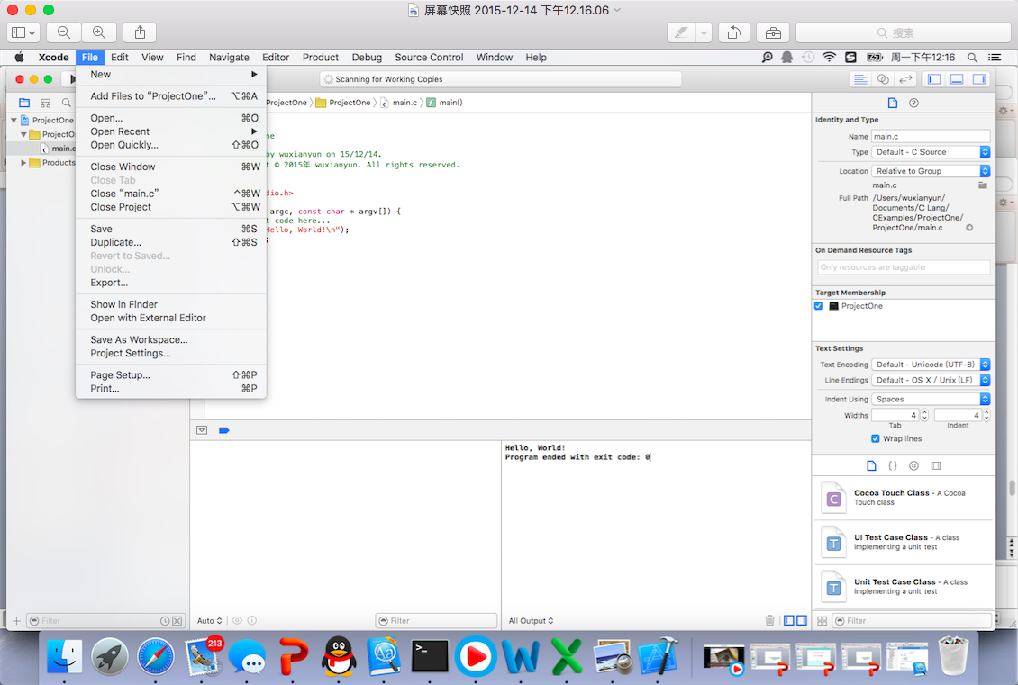
Saving and quitting
Once you have entered and run a program, you can save it and quit the package.
To exit
package
click Quit Xcode
To save
project
click Save

Slide 15
Homework
What’s the difference between C project and C++ project?
What other project types can you created in Xcode?
How to debug a program if your code has a bug?

