Slide 1


COMP2x0/VR220 Portfolio Development/ Worksheet Support Week 5: Portfolios & Personal Branding

Slide 2
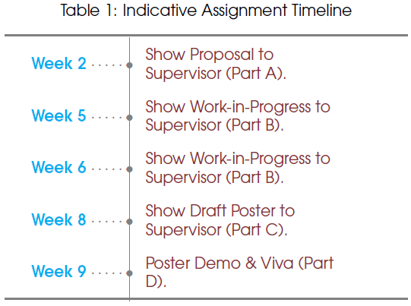
Timeline

Slide 3
Portfolio Purpose
Showcase your talents!
To demonstrate to a prospective employer or client:
Who you are
What you can do
Where you want to go
Why they should hire you
Your story
Evidence your skills through applicaton
Your goals

Slide 4
Activity: Portfolio Examples
Feel free to add more!
Take a look at the example portfolios on the Padlet
Leave comments/attach posts to note:
What impression does the site give of the person?
Does it focus on any particular specialisms?
What information have they included?
What do you think of how the information is presented?
Review “50 of the Best Personal Website and Portfolio Examples” to see further examples with commentary

Slide 5
Discussion: What makes an impression?

Slide 6
Personal Branding
“Personal branding is the conscious and intentional effort to create and influence public perception of an individual by positioning them as an authority in their industry, elevating their credibility, and differentiating themselves from the competition, to ultimately advance their career, increase their circle of influence, and have a larger impact.
“The process of personal branding involves finding your uniqueness, building a reputation on the things you want to be known for, and then allowing yourself to be known for them.”
https://en.wikipedia.org/wiki/Personal_branding

Slide 7
Personal Value Proposition
Convey not only what you do, but the value you bring by doing it.
“Executives set value propositions for their products — the target market segments, the benefits they provide, and their prices. It’s why a target customer should buy the product.
“But value propositions go beyond just products. Your personal value proposition (PVP) is at the heart of your career strategy. It’s the foundation for everything in a job search and career progression — targeting potential employers, attracting the help of others, and explaining why you’re the one to pick. It’s why to hire you, not someone else.”
https://hbr.org/2011/11/a-value-proposition-for-your-c

Slide 8
Discussion: How to Find your Brand/PVP
Notes:
What should it be based on?
What you want (to do/be)
What you’re good at (strengths and accomplishments)
Provide evidence
What you enjoy

Slide 9
Asynchronous Task: Personal Brand
Read how to Use a Personal Value Proposition to Land Your Next Job
Decide how you’d like to present yourself online:
Identify your strengths/USPs
Write an elevator pitch (or PVP) for yourself.
Use it to “introduce yourself” on this week’s Teams channel.
Collect examples of your work that support your brand.
Next week: we’ll look at how to design a website to present your portfolio

Slide 10
Further Reading
Ultimate Guide to Creating a Programmer Portfolio
Jobs in Games: how to build a portfolio for programmers
8 Bits of Advice for your Programmer Portfolio
10 Golden Rules of Personal Branding

