Slide 1


COMP2x0/VR220 Portfolio Development/ Worksheet Support Week 8: Posters Peer Review

Slide 2
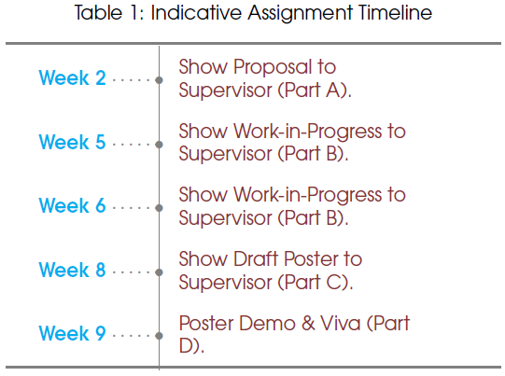
Timeline

Slide 3
Poster Sessions: On-Campus Opt-In
https://forms.office.com/Pages/ResponsePage.aspx?id=s-4LVT1qRkahEfidAXd5Lu3RGRzgzCNJr7AfAhuHTVZURjE2RDE0RENJTFdONlJFUTZWVlNZR1daWi4u

Slide 4
Portfolio Roadmap
Week | Topic
5 | Defining yourself: what is your USP?
7 | Portfolio design and structure
8 | Posters peer review
9 | Talking about your work
10 | Talking about yourself
11 | Online presence: CV/LinkedIn?
12 | Portfolio peer reviews?

Slide 5
Poster requirements
System components, patterns, data structures…
At least one UML diagram (COMP2x0)
Describe your artefact
Illustrate the architecture of your artefact
Justify key development choices and design decisions
Don’t forget your name and project title!
Format: Portrait A3 PDF document
Analyse merits and flaws

Slide 6
Poster layout
TITLE
NAME
WHAT IS THE PROBLEM
WHY IS IT AN ISSUE
Style/layout: simple, clear, readable – concentrate on key details and favour images over text.
More info/guidelines: https://www.makesigns.com/tutorials
WHAT IS THE SOLUTION
USE-CASES
CLASS HIERARCHY
STATE MACHINE
FLOW CHART
PSEUDO CODE
SCREEN CAPS
WHAT WORKED WELL
WHAT IS THE SCOPE FOR IMPROVEMENT(S)

Slide 7
Poster marks allocation
COMP2x0
Threshold: 30%
Description of architecture: 10%
UML diagram: 10%
Appropriateness of artefact design: 15%
Context for practice-based research: 10%
Defence of argument: 10%
Appropriateness of practice-based research methods: 10%
Academic conventions: 5%
VR220
Threshold: 15%
Explanations and discussions of technical elements of the project: 10%
Description of project objectives and their justification: 10%
Reflection on the artefact: 15%

