Slide 1


COMP2x0/VR220 Portfolio Development/ Worksheet Support Week 5:

Slide 2
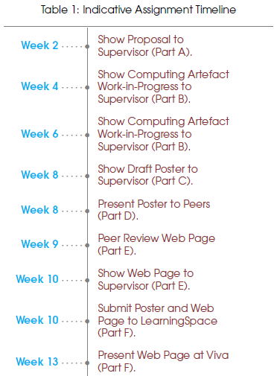
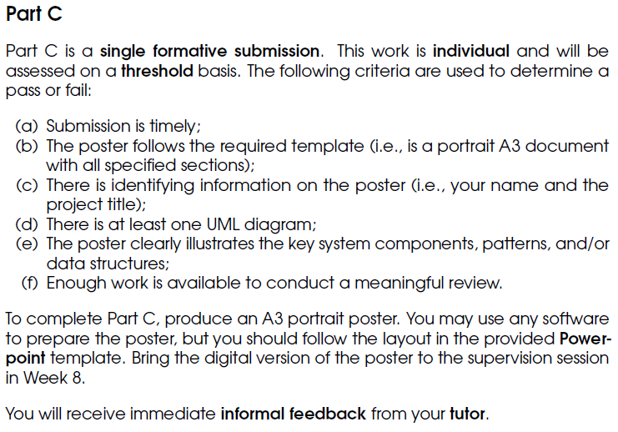
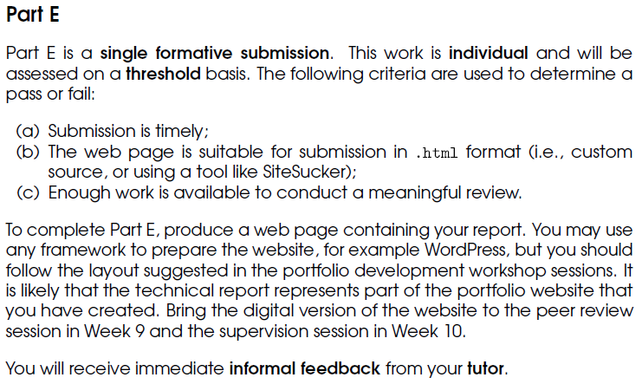
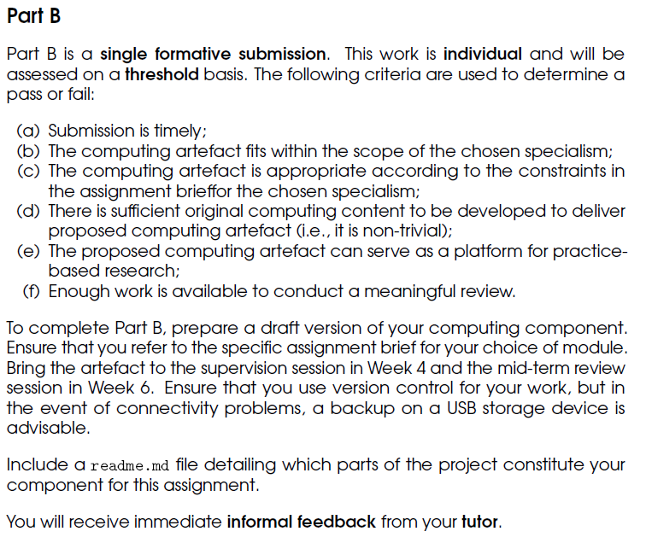
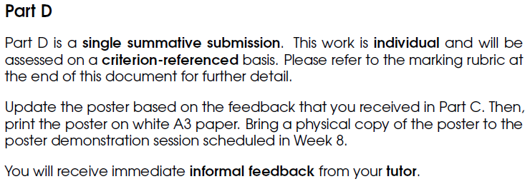
Timeline

Slide 3
What does a portfolio look like?
Purpose: to show a prospective employer
who you are, and
what you can do.
Structure: should contain at least the following sections:
About – who are you/where you are now/where you’d like to be
Projects – what you’ve done, including how and why
Include pictures, videos, descriptions, demos – and possibly reasoned arguments…
Contact – details for getting in touch with you (email/contact form – NB beware spammers)
Links to your profiles on LinkedIn and GitHub
More info/examples: https://www.springboard.com/blog/programmer-portfolio/ https://opmjobs.com/programmer-portfolio/ https://collegeinfogeek.com/personal-website-examples/#student-website-examples

Slide 4
Suggested activities
Top recommendation – spend at least some time investigating web platforms (e.g. Wordpress, GitHub pages, Wix, Weebly…) to determine:
How easy is it to use/get the look you want? Try setting up a basic page with some text and images.
How easy is it to download an html copy that works offline? (Test this out!)
Investigate 3rd party tools if need be, e.g. SiteSucker (MacOS), WebCopy (Windows)
Also recommended –
Start writing about the research you’ve done and your argument.
Start drafting your poster – e.g. make notes on content for each section; create/start creating your UML diagram.
If you need to – continue work on your artefact.

Slide 5
Suggested activities
Top recommendation – start creating your portfolio outline using your chosen web platform.
Also recommended –
Look up the date/time of your poster presentation.
Start/continue writing about the research you’ve done and your argument.
If you need to – continue work on your artefact.
Find these slides online at:
https://github.com/Falmouth-Games-Academy/COMP2x0-workshop-slides

Slide 6
Suggested activities
Top recommendation – spend at least some time investigating web platforms (e.g. Wordpress, GitHub pages, Wix, Weebly…) to determine:
How easy is it to use/get the look you want? Try setting up a basic page with some text and images.
How easy is it to download an html copy that works offline? (Test this out!)
Investigate 3rd party tools if need be, e.g. SiteSucker (MacOS), WebCopy (Windows)
Also recommended –
Start writing about the research you’ve done and your argument.
Start drafting your poster – e.g. make notes on content for each section; create/start creating your UML diagram.
If you need to – continue work on your artefact.

