Slide 1


COMP2x0/VR220 Portfolio Development/ Worksheet Support Week 7: Designing your Portfolio

Slide 2
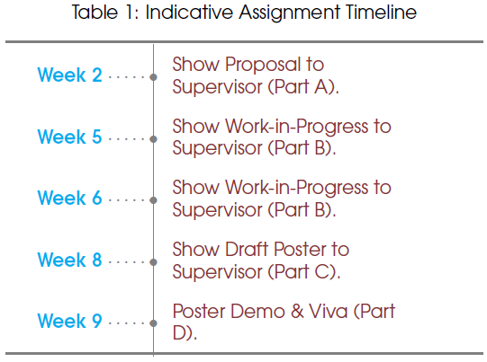
Timeline

Slide 3
Portfolio Roadmap
Week | Topic
5 | Defining yourself: what is your USP?
7 | Portfolio design and structure
8 | Talking about your work
9 | Talking about yourself
10 | Draft portfolio peer reviews?
11 | Portfolio design iteration?
12 | Portfolio peer reviews?

Slide 4
Portfolio Design: Essential Information
A portfolio should contain at least the following sections:
About – who are you/where you are now/where you’d like to be
Projects – what you’ve done, including how and why
Include pictures, videos, descriptions, demos – and possibly reasoned arguments…
Contact – details for getting in touch with you (email/contact form – NB beware spammers)
Links to your profiles on LinkedIn and GitHub
Your story

Slide 5
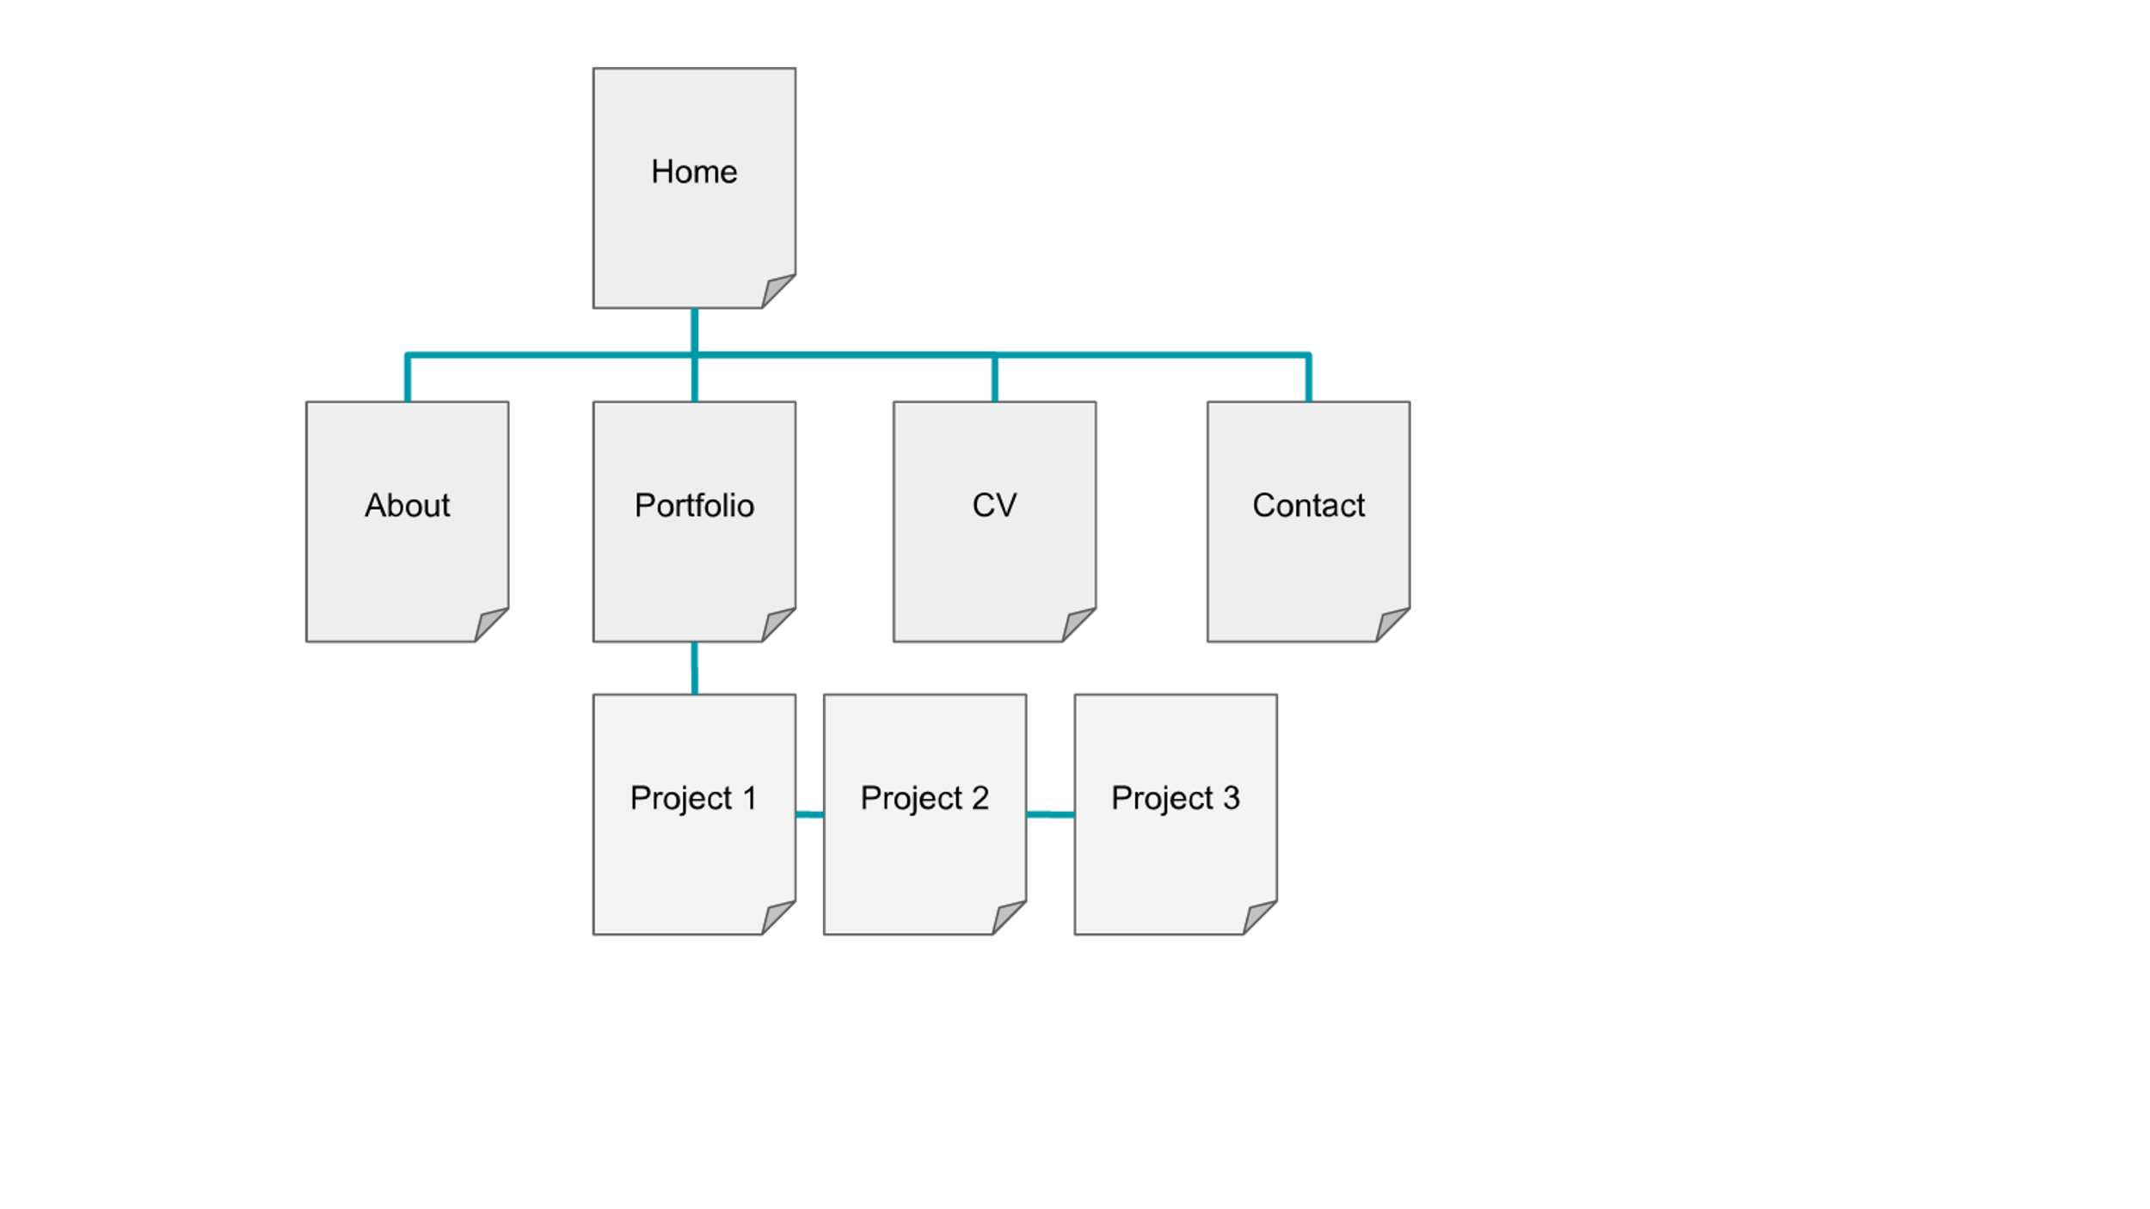
Portfolio Structure

Slide 6
Visual Impact
“46.1% of people say a website's design is the number one criterion for discerning the credibility of the company”.
Recruiters are busy people – make a good, fast, first impression!
Use visual perception techniques to make an impact, e.g.:
Visual hierarchy to show importance and relationship of information; “guide them on a journey that ultimately culminates in a conversion”.
Structure content in an F-shape
Condense text as much as possible
Include adequate white space and use contrast
Notes:
What features of the examples we looked at before made an impression?

Slide 7
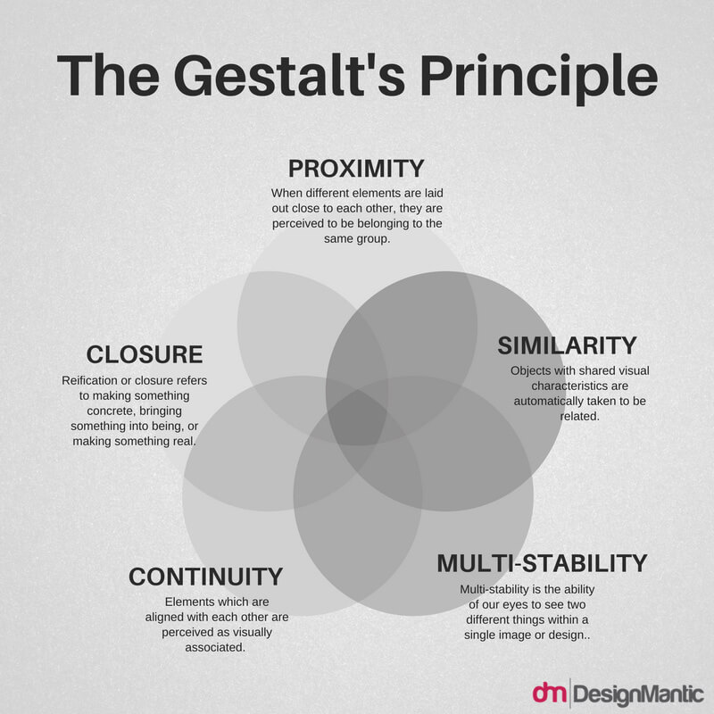
Gestalt Theory
“Attempts to describe how people tend to organize visual elements into groups or unified wholes when certain principles are applied.”

Slide 8
Activity: Portfolio Home Page
Revisit the example portfolios on the Padlet
Decide which elements you’d like to include on your home page
Draft an outline design for your home page, including:
Your elevator pitch (from week 5)
Any featured demos
Menu placement etc.
Share your designs in the chat!

Slide 9
Discussion: What’s on your Home Page?
Notes:
What have you included, where have you put it and why?

Slide 10
Portfolio Platform
GitHub pages: create a web page straight from your repo using Markdown or HTML
Wordpress: has a large selection of (customisable) themes
Wix: has customisable portfolio templates
Weebly: drag and drop content using themes
DIY HTML (etc.): only recommended if you’re familiar with running a website/arranging hosting etc.

Slide 11
Asynchronous Task: Finding a Platform
Investigate one or two of the suggested platforms (or any others you know of):
Create a basic skeleton site with your home page outline and placeholders for other sections
Share a link to your test site on the Teams channel for this week, with comments on how easy it was to set up
Next week: we’ll compare notes on the pros and cons of the platforms

Slide 12
Further Reading
Visual impact:
What You Need to Know About Visual Perception and Website Design
How to create visual impact online
Home page principles
Tips on portfolio building:
How to Build a Coding Portfolio (has links to GitHub pages tutorials)
Building a Kickass Portfolio (describes the process of reviewing and redesigning one of the examples).

